Slide 1
Doctors without borders
Student names redacted

Slide 2
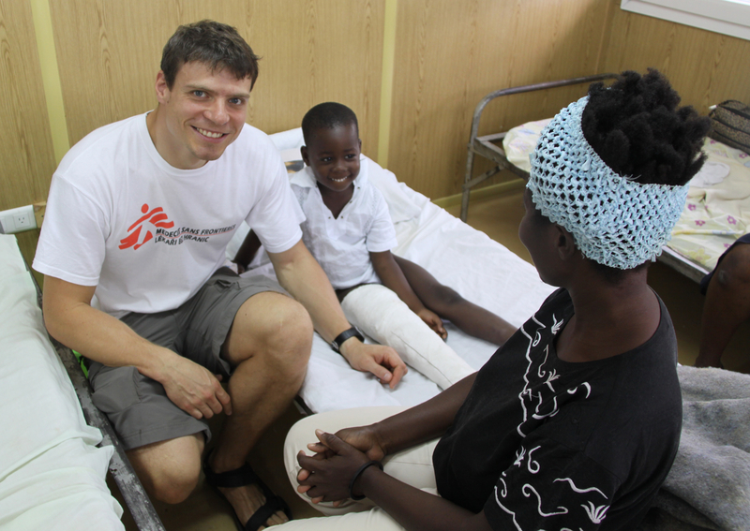
Introduction
Czech doctor Tomáš Šebek on mission

Slide 3
What?

Slide 4
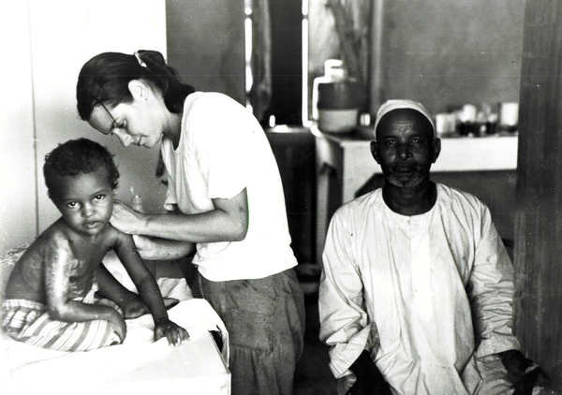
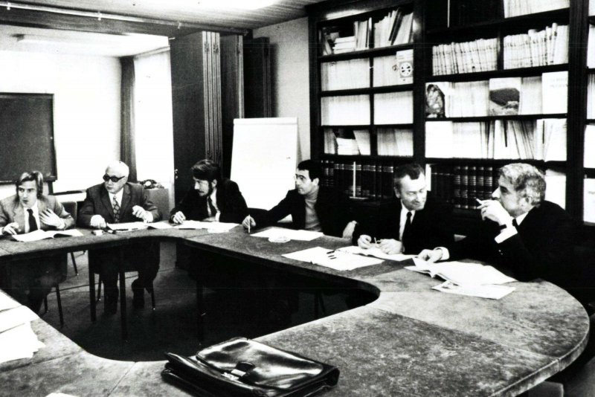
History
1971
French doctors and journalists
Nigerian civil war
1. mission – Nicaragua, earthquake
CR – 2006 – volunteers, money, info

Slide 5
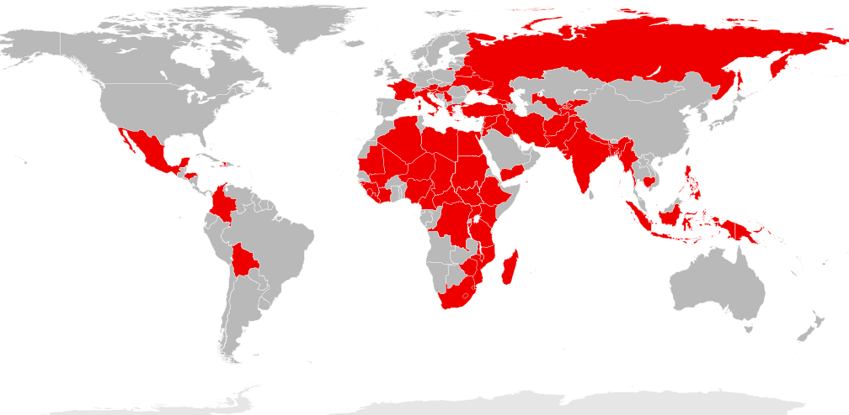
Where?
main office- Geneva, Switzerland.
70 coutries
70+
countries

Slide 6
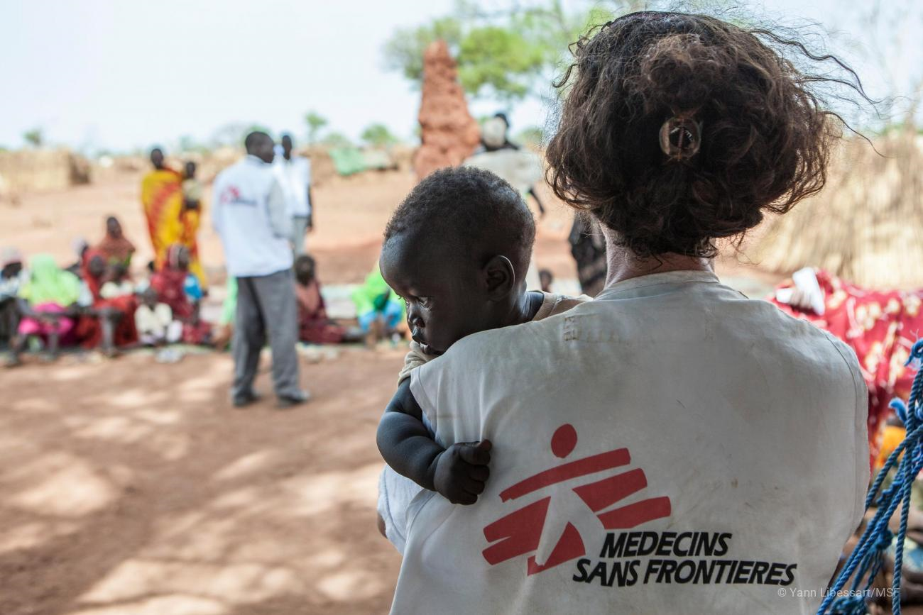
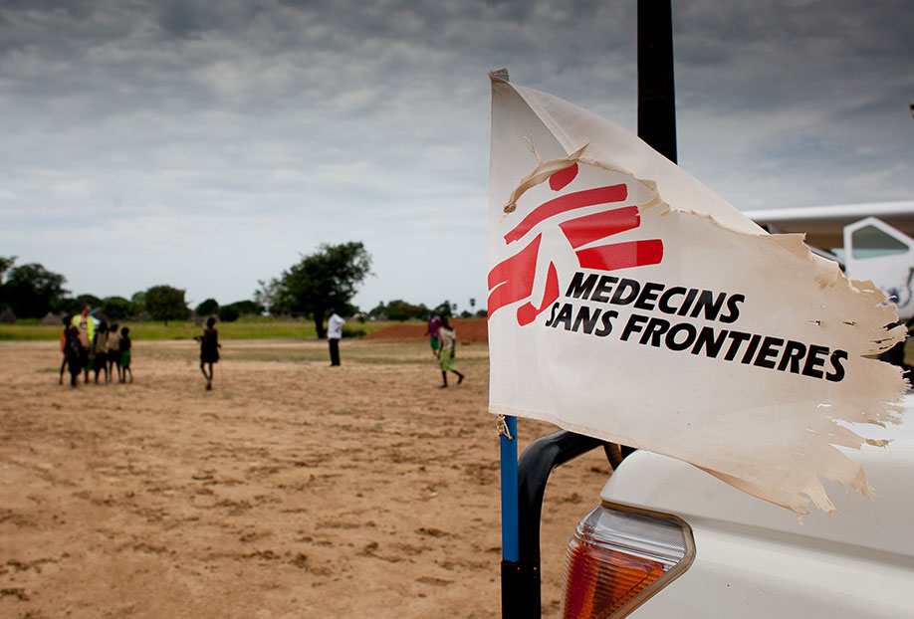
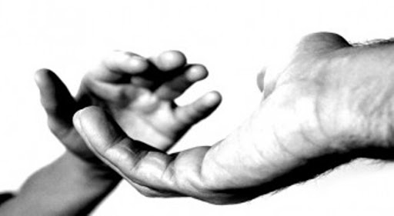
Values
Neutrality
Independency
Impartiality

Slide 7
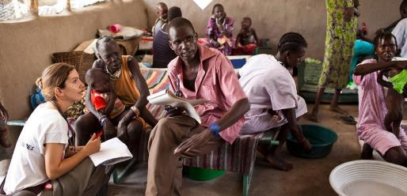
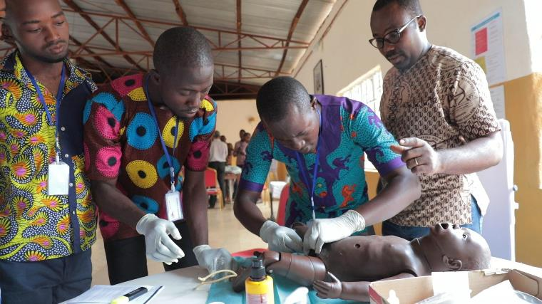
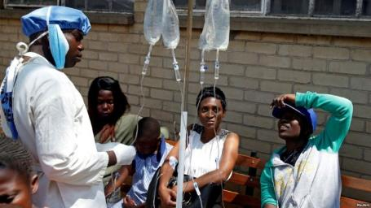
Who?
Doctors, nurses and other medical
professionals, logistical experts,
water and sanitation engineers
and administrators
Nobel Peace prize- 1999
2 600 international co-workers
35 000 local employees

Slide 8
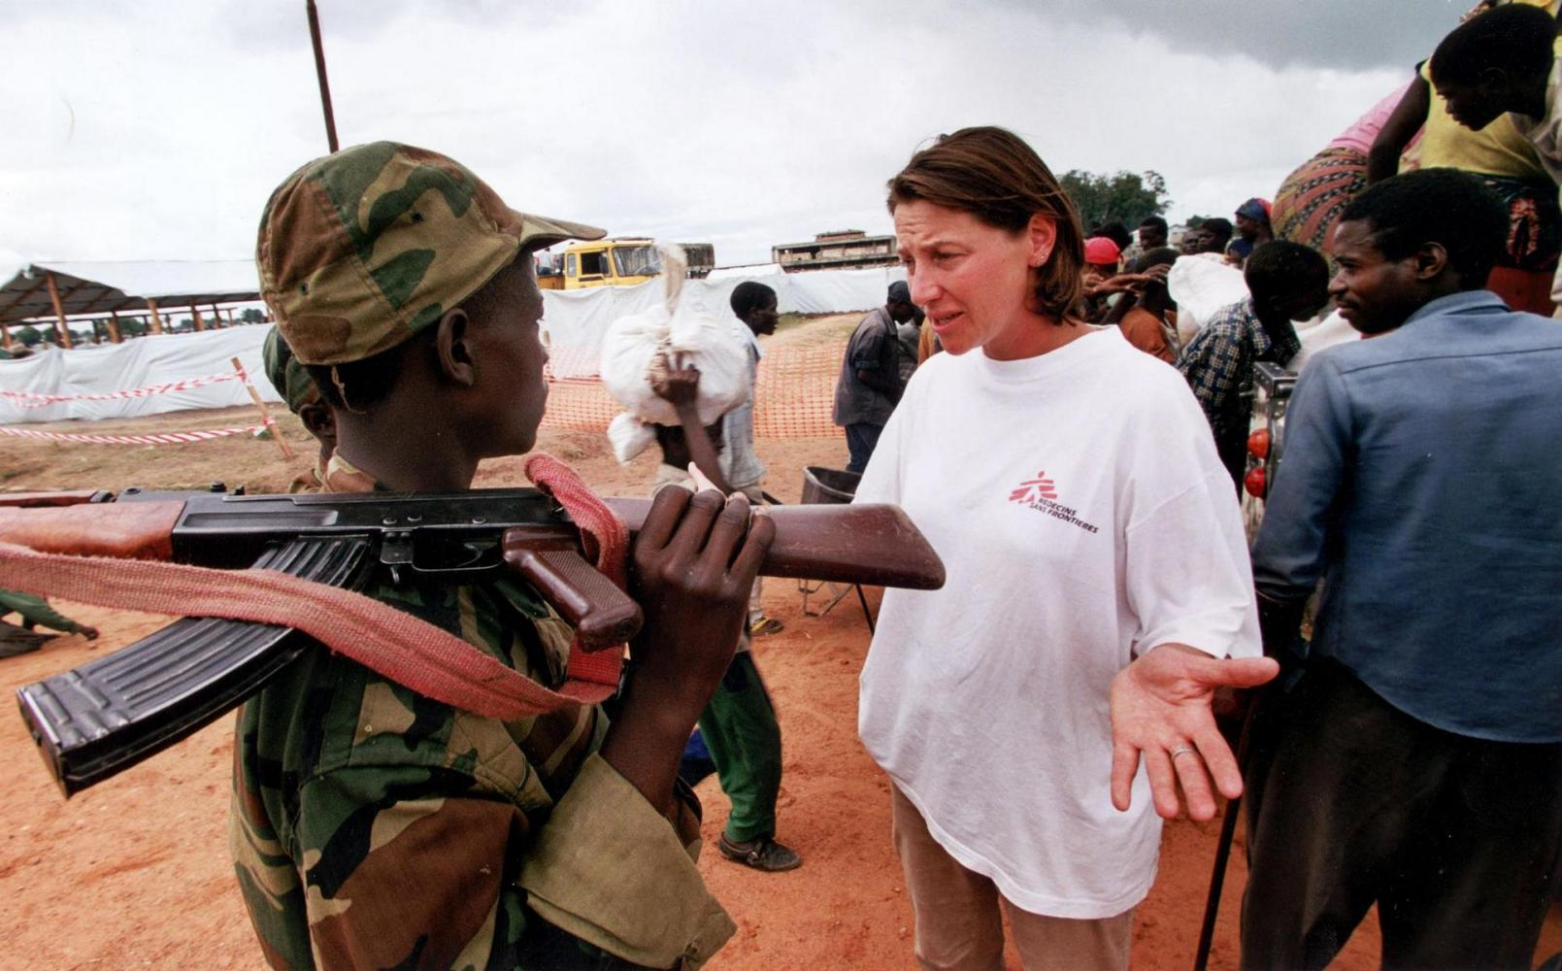
Targets
Deal
Treat
Inform
Bear witness

Slide 9
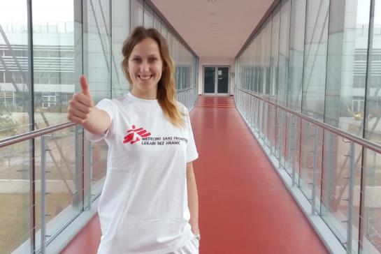
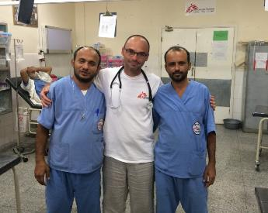
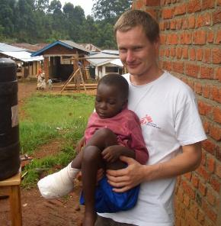
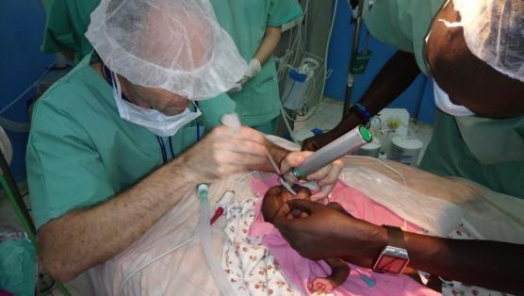
People
Adela Foltýnová
Anesthesiologist
in University hospital
Brno
3 missions-
2x Afghanistan, Iraq
Dušan Mach
Anesthesiologist
in Hospital in Nové
Město na Moravě
4 missions-
Kenya, 2x Yemen,
South Sudan
Jan Trachta
Pediatric surgeon
in University hospital
Motol Prague
10 missions-
3x DR Congo, Haiti,
South Sudan, Syria,
Yemen, Liberia,
Ivory Coast,
Central African republic

Slide 10
Topics
Conflicts and War
Illneses and Epidemic
Natural disasters
Gravidity and labours
Availability of medicaments
Refugees
Psychologist help
Sexual violence
Water and sanitation

Slide 11
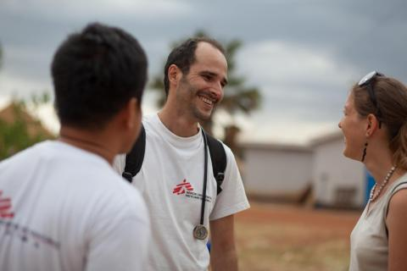
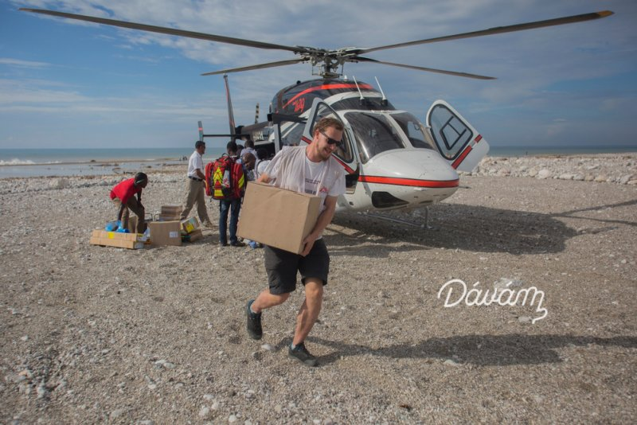
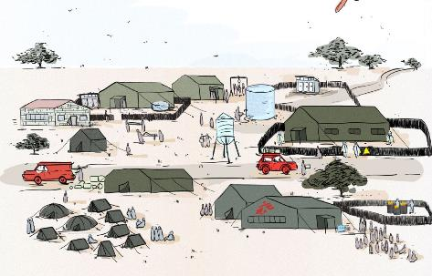
Conclusion
How can we help?
DONATION
Fund-raising campaign
Bitcoin
Standing payment order
PROJECT MISSING MAPS
VIRTUAL HOSPITAL WITHOUT BORDERS
OFFER THINGS OR SERVICE
Would YOU be a doctor without borders ?
title
2 years prax
knowledge of tropical medicine
English ☺

Slide 12
Thanks for your attention!

Slide 13
Sources
https://en.wikipedia.org/wiki/Médecins_Sans_Frontières
https://cs.wikipedia.org/wiki/Lékaři_bez_hranic
https://www.lekari-bez-hranic.cz/kdo-jsme
https://www.msf.org/
https://www.youtube.com/watch?v=LLPvzieC7rw&feature=youtu.be&fbclid=IwAR3uVt2eA9oKM-_gyPJw0-UeiUF7IwDQrTZFNk9LTIho6sBp8udNRDSkiKQ
https://www.doctorswithoutborders.org/
https://www.nemocnice-bez-hranic.cz/

