Slide 1
Research Methodology and Statistics
In Sports Sciences

Slide 2
Research Methodology and Statistics
Research Methodology
Examples of theory
Science (Benešová, 1999) - is a systematic, critical and methodological pursuit of true and common knowledge in a defined area of reality
Science (Ferjenčík, 2000) - is a comprehensive system of information obtained by a scientific method. Science provides guidelines for examination (methods) and an explanation of collected information (scientific theory)
Theory (Zháněl, 2014) - The primary goal of science is , i.e.an attempt to find general explanations of natural phenomena (via science research)
(Dovalil et al., 2012)

Slide 3
Research Methodology and Statistics
Research Methodology
Sport science – Kinesiology, Kinanthropology, Sportwissenschaft - is multidisciplinary science about human (voluntary) movement
Paradigm - a fundamental concept of a certain scientific discipline, which is considered to be exemplary. Defines proper procedures and methods, according to which rules and conventions
Methodology vs methods (Gabriel, 2011)– method is a research tool (interwiew in qualitatice study) and methodology is the justification for using this method.
Methodology – the summary and study of methods, or the science of methods.
Method – a tool or process for monitoring, researching, learning, exploring and achieving certain goals.
Methodical guidelines – specific instructions for carrying out specific activities.

Slide 4
Research Methodology and Statistics
Type of Research
Types of different research (Hendl, 2016)
Methodological study, Case study, Comparison, Correlation-predictive study, Experiment, Quasi-experiment, Evaluation, Development studies, Trend analysis, attitudes, Status, Exploration, Historical study, Modelling, Proposal and demonstration, systematic review, Meta-analysis, Theoretical studies, Analytical, Qualitative study
Types of different research (Mishra and Alok, 2017)
Descriptive vs. analytical research
Applied vs. fundamental research
Conceptual vs. empirical research
Other types of research
one-time research vs. longitudinal research
field-setting research vs. laboratory research vs. model research
clinical vs. diagnostic research
case-study methods vs. exhaustively approaches
exploratory vs. formalized research
The objective of exploratory research (creation of hypotheses rather than their testing) vs. formalized research (specific hypotheses are tested)
conclusion-oriented and decision-oriented research

Slide 5
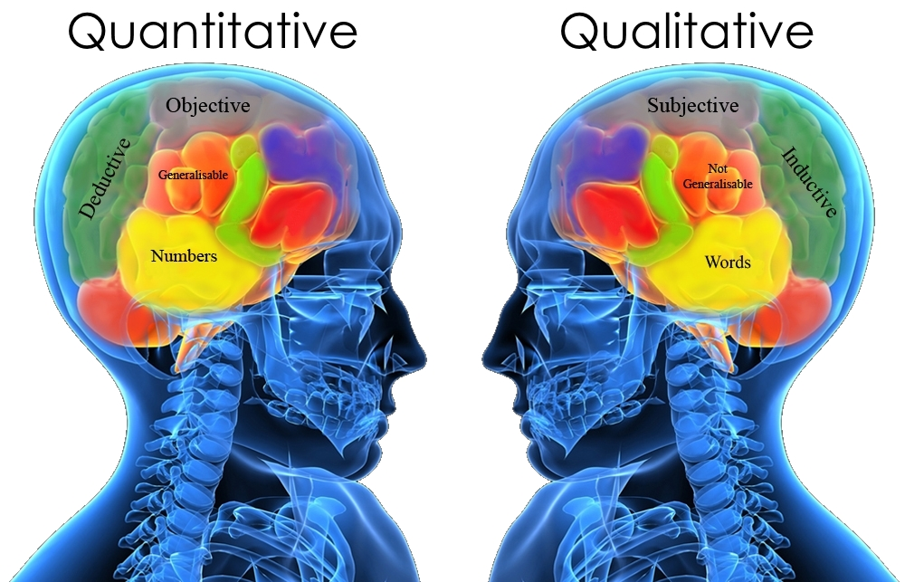
Research Methodology and Statistics
Type of Research
Qualitative research
Quantitative research

Slide 6
Research Methodology and Statistics
Type of Research
Qualitative research - According of Švaříček & Šeďová et al. (2007) it is a process of examining phenomena and problems in an authentic environment in order to obtain a comprehensive picture of these phenomena based on deep data and a specific relationship between a researcher and a research participant. The aim of a qualitative research is to uncover and represent how people understand, experience and create social reality. It focuses on how individuals and/or groups view, understand and interpret the World (Zháněl, 2014), via non-numerical data.
Quantitative research - is the process of collecting and analyzing numerical data. It can be used to find patterns and averages, make predictions, test causal relationships, and generalize results to wider populations (Bhandari, 2021).
A common mistake: when it is relatively simple to transforming words (eg answers in a questionnaire) into numbers (occurrence) these are quantitative data
Mixed research
Hendl (2005) then talks about a combination of quantitative and qualitative methods in a single research activity when speaking of a mixed research strategy, in which the results obtained by the two strategies complement each other

Slide 7
Research Methodology and Statistics
Type of Qualitative Research
Type of Quantitative Research
Phenomenological method – how participant experiences, feel have opinion about a specific event or activity. It utilizes in-depth interviews, observation or survey to gather information
Grounded theory - tries to explain why a course of action evolved the way it did. Need large subject number to developer theoretical model based on existing data (DNA – genetic model)
Case study - in-depth look at one test subject (opposite of grounded theory). Various data are compiled to create a bigger conclusion
Focus groups - group of individuals who are asked questions about their opinions and attitudes towards certain fenomen
Ethnographic research - subjects are experiencing a culture that is unfamiliar to them
Descriptive research - seeks to describe the current status of an identified variable. The researcher does not usually begin with an hypothesis, but is likely to develop one after collecting data
Correlation research - aim is to determine the extent of a relationship between two or more variables using statistical data. This type of research will recognize trends and patterns in data
Causal-Comparative/Quasi-Experimental - establish cause-effect relationships among the variables. The researcher does not randomly assign groups
Experimental Research - establish the cause-effect relationship. Subjects are randomly assigned to experimental

Slide 8
Research Methodology and Statistics
Research Ethics
Most commen problems are
Plagiarism (or wrong used of citations)
Non-disclosure acknowledgement
Data collection/analysis/interpretation
Disclosure of interest; using third-party materiál
Plagiarism - It is a simple matter to follow the clear guidelines in citation that will prevent you being accused of passing off other people’s work as your own (Williman, 2011)

Slide 9
Research Methodology and Statistics
Research Ethics
Helsinki Declaration
General Principles
The health of my patient will be my first consideration
Physician must promote and safeguard the health, well-being and rights of patients
… never take precedence over the rights and interests of individual research subjects
researcher protect the life, health, dignity, integrity, right to self-determination, privacy, and confidentiality of personal information of research subjects
…
Adopted by the 18th The World Medical Association (WMA) General Assembly, Helsinki, Finland, June 1964
Statement of ethical principles for medical research involving human subjects, including research on identifiable human material and data

Slide 10
Research Methodology and Statistics
The Research Hypotheses
Hypotheses are statements that relate to the existence of the relationship between variables or prediction of defined variables using other variables (Zháněl, 2014)
Without hypothesis the research in unfoucussed
Hypothesis is necesarry link between theory and investigation
Sources of hypothesis
Theory and studies (literature research)
Observation (from own practice / experience)
Intuition (less then theory and observation)
Culture (behavior or beliefs of social, ethnic or age group)
New trend (possible future experience)

Slide 11
Research Methodology and Statistics
The Research Hypotheses
Types of research hypotheses
Working hypothesis – not very specific, they can be easily modified, used with insufficient data; example: Chocolates before training ensures maximum performance
Descriptive hypothesis – variable can be situation, event, organization, person, group, object
Relation hypothesis (describes relationship – positive, negative or casual – between two variables) example: Children from higher incomes families spend more times at leisure physical activities
Formalised hypothesis (cause and effect relationship between independent and dependent variable) example: If families have higher incomes, than they spend more money on leisure physical activities
Null hypothesis (H₀) – predicts that there is no relationship between two variables;
Alternative hypothesis (H_{a}/H₁) – the opposite statement than H₀. For acceptance of H_{a}, H₀ must be rejected first.
Directional (left or right tailed test) – hypothesis in which we can predict effect (positive/negative) of one variable on others. Example: Girls are more flexible than boys
Non-directional (two tailed test) – hypothesis in which we cannot predict effect, but stat a relationship between variables (we do not know what kind of difference); example: there will be a difference in the performance of experimental and control groups
(Zháněl, 2014; Cauvery et al., 2010)

Slide 12
Research Methodology and Statistics
The Research Hypotheses
Rejecting the null hypothesis
 |  | Actual Value (reality)
 |  | Positive | Negative
Conclusion from hypothesis test | Positive | Positive Positive == TRUE Positive (Power, 1 – β) | Negative Positive == FALSE Positive, Type I Error (α)
 | Negative | Positive Negative == FALSE Negative Type II Error (β) | Negative Negative == TRUE Negative

Slide 13
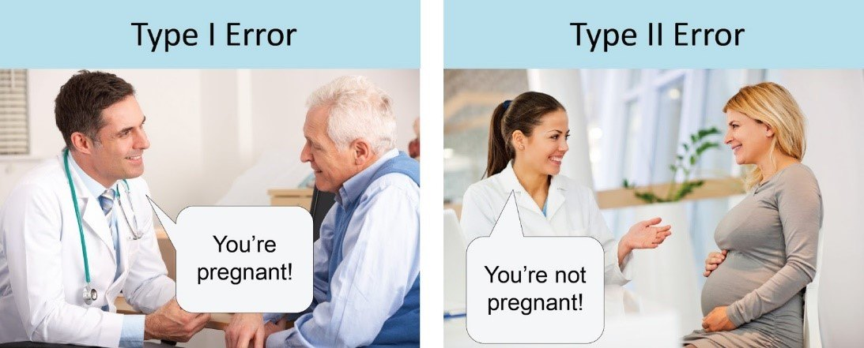
Research Methodology and Statistics
The Research Hypotheses
Rejecting the null hypothesis
 |  | Actual Value (reality)
 |  | Positive | Negative
Conclusion from hypothesis test | Positive | Positive Positive == TRUE Positive | Negative Positive == FALSE Positive, Type I Error (α)
 | Negative | Positive Negative == FALSE Negative Type II Error (β) | Negative Negative == TRUE Negative
Correct
Correct

Slide 14
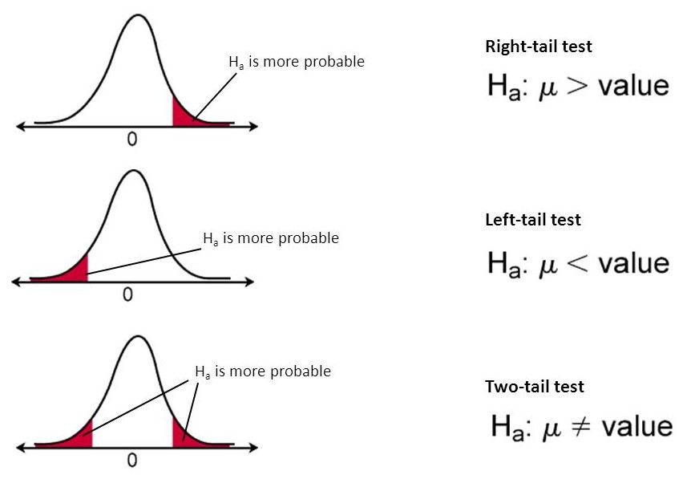
Research Methodology and Statistics
The Research Hypotheses
Rejecting the null hypothesis

Slide 15
Research Methodology and Statistics
Sampling
The study of the total population is not possible and it is impracticable.
The practical limitation cost, time, and other factors which are usually operative in the situation, stand in the way of studying the total population
Sampling is the process of selecting a few (a sample) from a bigger group (the sampling population) to become the basis for estimating or predicting the prevalence of an unknown piece of information, situation, or outcome regarding the bigger group
Basically we have two types of sample:
Random sample
Non-random sample
(Singh, 2006; Kumar, 2011)

Slide 16
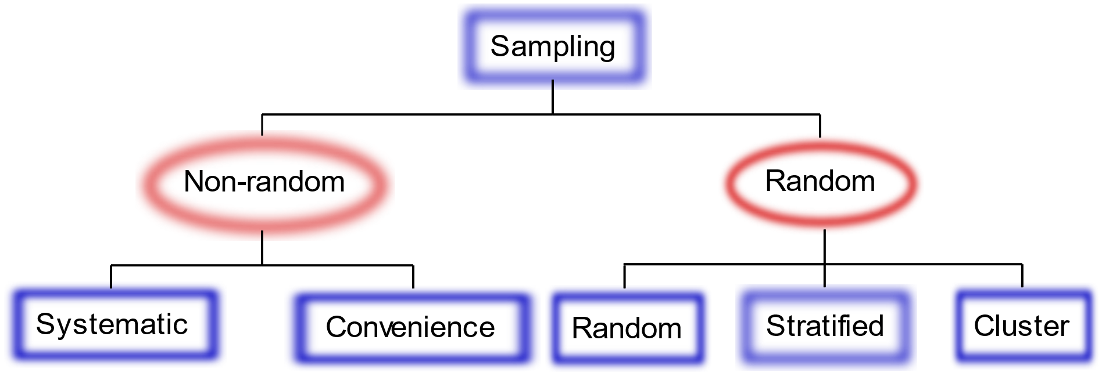
Research Methodology and Statistics
Sampling
Population
Research Population
Random Sample
Non-random Sameple

Slide 17
Research Methodology and Statistics
Statistical Analysis
Statistical analysis is the science of collecting data and uncovering patterns and trends
note: you cannot only accept H₀ (only reject or fail to reject), after rejecting H₀, we can add „we can accept H_{a}

Slide 18
Research Methodology and Statistics
Characteristics of a Good Test
Reliability, Validity, Objectivity and Usability
Reliability is consistency, dependence or trust
measurement reliability is the consistency with which a test yields the same result in measuring whatever it does measure
Example 1: If after first test mean score is 80, and after one week we used same test on same sample and the mean score is:
80 = test provided stable and dependent results
102 = test results are not consistent
Example 2: how two different teachers will evaluate the same test results
Types of reliability testing methods:
Test-retest method (the same test over time)
Interrater method (the same test conducted by different people)
Parallel forms method (different version of a test which are designed to be equivalent)
Split-half method (same test divides into two equivalent values)
Internal consistency method (correlation between multiple items in a test that are intended to measure the same construct)
Methods of determining reliability
Intraclass Correlation Coefficient (ICC) - defines a measure's ability to discriminate among subjects
Standard Error of Measurement (SEM) - quantifies error in the same units as the original measurement
(Gronlund and Linn, 1995; Ebel and Frisbie, 1991)

Slide 19
Research Methodology and Statistics
Characteristics of a Good Test
Reliability, Validity, Objectivity and Usability
It means to what extent the test measures that, what the test maker intends to measure
means truthfulness of a test
Validity do not have different types. It is a unitary concept, based on various types of evidence
Both Reliable and Valid
Reliable but not Valid
Neither reliable or valid
Not Reliable but Valid
Tato fotka od autora Neznámý autor s licencí CC BY-SA-NC
Tato fotka od autora Neznámý autor s licencí CC BY-SA-NC
Tato fotka od autora Neznámý autor s licencí CC BY-SA-NC
Tato fotka od autora Neznámý autor s licencí CC BY-SA-NC
Tato fotka od autora Neznámý autor s licencí CC BY-SA-NC

Slide 20
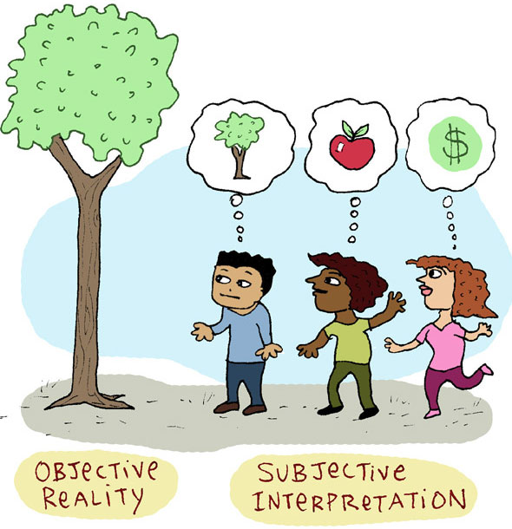
Research Methodology and Statistics
Characteristics of a Good Test
Reliability, Validity, Objectivity and Usability
The extent to which the instrument is free from personal error (personal bias), that is subjectivity on the part of the scorer (Good, 1973)
a test is considered objective when it makes for the elimination of the scorer’s personal opinion and bias judgement
It affects both validity and reliability of test scores

Slide 21
Research Methodology and Statistics
Characteristics of a Good Test
Reliability, Validity, Objectivity and Usability
The test must have practical value from time, economy, and administration point of view
Practical considerations cannot be neglected

Slide 22
Research Methodology and Statistics
Variable Types and Scaling
Research Variables
The most common types of variable
Independent variable (IV) - is a singular characteristic that the other variables in your experiment cannot change, but IV can change other variables
Age (eating or exercise habits are not changing your biological age, but you will not lift same weight as senior)
Dependent variable (DV) - relies on and can be changed by other components, IV can influence DV, DV can’t influence IV. Researchers goals are determine what makes the dependent variable change and how.
A grade on exam (it depends on factors as how much your slept or how long you studied, but your test does not affect the time you spent studying)
Control (controlling) variables - are constant and do not change during a study, they have no effect on other variables.
If we are investigating how much your slept (IV) effect a grade on exam (DV), we need to control time spent learning, the same level of students and more
Research variables are things you measure, manipulate and control in statistics and research
Person, place, thing, idea, …
Other variables: Intervening (mediator) variables, Moderating (moderator) variables, Extraneous variables, Quantitative (numerical) variables, Qualitative (categorical) variables, Composite variables

Slide 23
Research Methodology and Statistics
Variable Types and Scaling
Levels of Measurement
Quantitative data
or
Parametric data
or
Scale
is a classification that describes the nature of information within the values assigned to variables (Stevens, 1936)
nominal, ordinal, and interval/ratio
Named variables
Named
+
Orderd variables
Named
+
Orderd variables
+ Proportionate interval between variables
Named
+
Orderd variables
+
Proportionate interval between variables
+
Absolute zero
Ratio
Interval
Ordinal
Qualitative data
or
Nonparametric data
Nominal

Slide 24
Research Methodology and Statistics
Variable Types and Scaling
Levels of Measurement
Levels of Measurement (Scale of Measure) are Nominal, Ordinal, Interval, Ratio
Types of variables
Qualitative variable (categorical, words)
Division according to the possibility of arrangement
Division according to number of categories
Quantitative variables (numerical, numbers)
Discrete variable
Nominal variable (cannot by order)
Ordinal variable (can by order)
Dichotomous (2 variant)
Multiples (> 2 variant)
Continous variable
(Litschmannová, 2011)

Slide 25
Research Methodology and Statistics
Variable Types and Scaling
Levels of Measurement
Levels of Measurement (Scale of Measure) are Nominal, Ordinal, Interval, Ratio
Nominal
Qualitative
Dichotomis
Ordinal
Categorical
Interval
Discrete
Multiples
Quantitative
Ratio
Continous
(Řezanková et al., 2017)

Slide 26
Research Methodology and Statistics
Descriptive Statistic
Measures of Distribution or Frequency
Measures of Central Tendency
Measures of Dispersion or Variation
Measures of Position

Slide 27
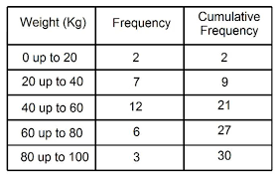
Research Methodology and Statistics
Descriptive Statistic
Measures of Distribution or Frequency
a graph or data set organized to show the frequency of occurrence of each possible outcome of a repeatable event observed many times
compare one part of the distribution to another part of the distribution
Count, Percent, Frequency

Slide 28
Research Methodology and Statistics
Descriptive Statistic
Measures of Distribution or Frequency
a graph or data set organized to show the frequency of occurrence of each possible outcome of a repeatable event observed many times
compare one part of the distribution to another part of the distribution
Count, Percent, Frequency

Slide 29
Research Methodology and Statistics
Descriptive Statistic
Measures of Central Tendency
is defined as the number used to represent the center or middle of a set of data values
Mean, Median, Mode

Slide 30
Research Methodology and Statistics
Descriptive Statistic
Measures of Central Tendency
Positive kurtosis or Leptokurtic
Normal kustosis or Mesokurtic
Negative kurtosis or platykurtic
Right or Positive skew
Left or Negative skew

Slide 31
Research Methodology and Statistics
Descriptive Statistic
Measures of Dispersion or Variation
how far apart data points lie from each other and from the center of a distribution (mean±SD)
Range, IQR, Standard Deviation, Variance
Range (R) = x_{Max} - x_{min}
Interquartile range (IQR) = Q₃ - Q₁
Standard deviation (SD, s) is the average amount of variability in your dataset
s = sample standart diviation
σ = population standard deviation
Variance (s²) is the average of squared deviations from the mean
To get variance, square the standard deviation (s)
s² = sample variance
σ² = population variance

Slide 32
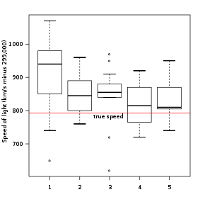
Research Methodology and Statistics
Descriptive Statistic
Measures of Dispersion or Variation

Slide 33
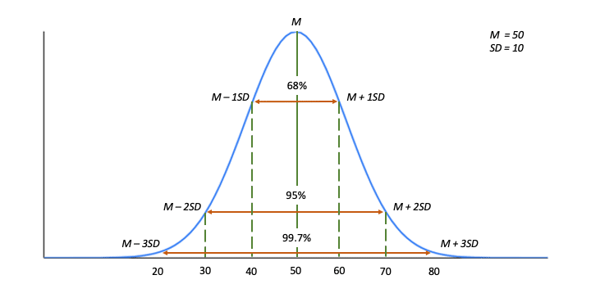
Research Methodology and Statistics
Descriptive Statistic
Measures of Dispersion or Variation

Slide 34
Research Methodology and Statistics
Descriptive Statistic
Measures of Position
Determines the position of a single value in relation to other values in a sample or a population data set.
Quantiles (Percentile, Decile, Quartile), Outliers, standard scores
Percentile (P_{i})= divide a rank-ordered data set (from the smallest to the largest) into 100 equal parts
Decile - divide a rank-ordered data set into ten equal parts
Quartiles (Q_{i}) - divide a rank-ordered data set into four equal parts
Q₁ = P₂₅, Q₂ = P₅₀ = median
Standard scores: raw scores that, for ease of interpretation, are converted to a common scale of measurement, or z distribution
z-Score indicates how many standard deviations an element is from the mean
t-score enables you to take an individual score and transform it into a standardized form, which helps you to compare scores.

Slide 35
Research Methodology and Statistics
Inferential or Analytical Statistic
Inferential statistics takes data from a sample and makes inferences about the larger population from which the sample was drawn
the goal of inferential statistics is to draw conclusions from a sample and generalize them to a population

Slide 36
Research Methodology and Statistics
Inferential or Analytical Statistic
Hypothesis (or Predictions) Testing
Comparison tests
t-test, ANOVA, Mann-Whitney U test, Wilcoxon test, Kruskal-Wallis H test
Correlation tests
Pearson’s r, Spearman’s rho, Chi square test
Regression tests
Simple linear regression, Multiple linear regression, …

Slide 37
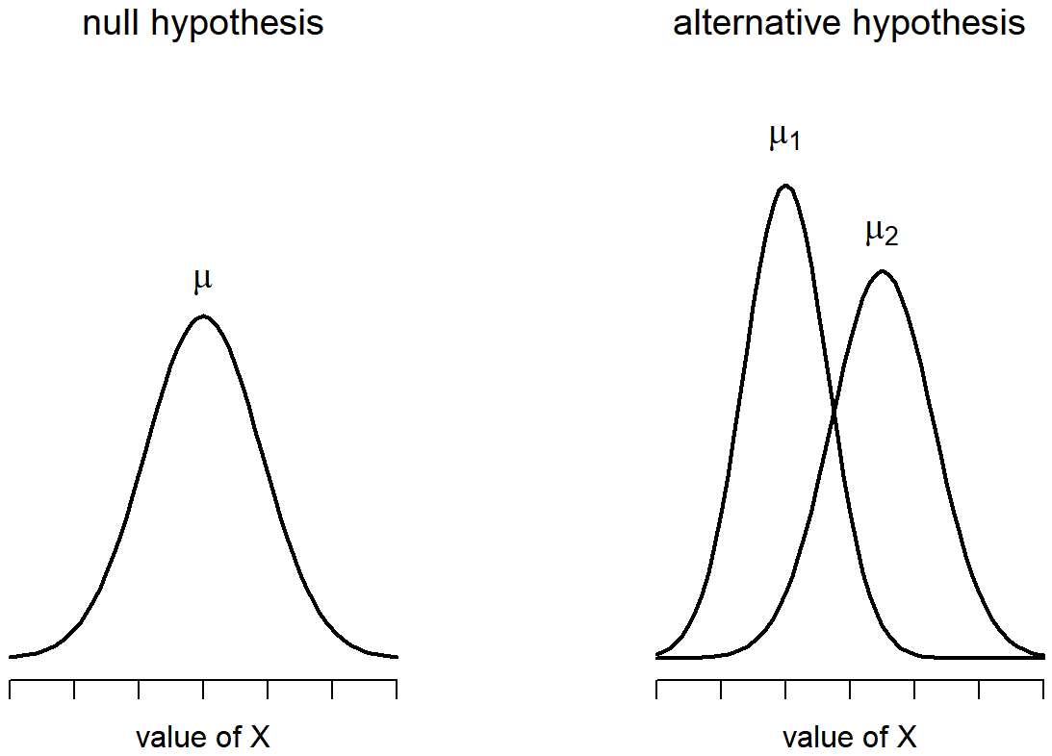
Research Methodology and Statistics
Inferential or Analytical Statistic
Hypothesis (or Predictions) Testing
Comparasion tests
t-test, ANOVA, Mann-Whitney U test, Wilcoxon test, Kruskal-Wallis H test
Correlation tests
Pearson’s r, Spearman’s rho, Chi square test
Regression tests
Simple linear regression, Multiple linear regression, …
For Choosing adequate Comparasion test You need to know:
Which test answer the research question (Validity)
Scales of measurement
Nominal, Ordinal, Interval, Ratio data
Binary, Multiple, Discrete Continuous data
Binary, Nominal, Ordinal, Discrete, Continuous data
Parametric or nonparametric data
using the normal distribution test (just for quantitative data)
Paired (repeated measurements) or independent (unpaired) sample

Slide 38
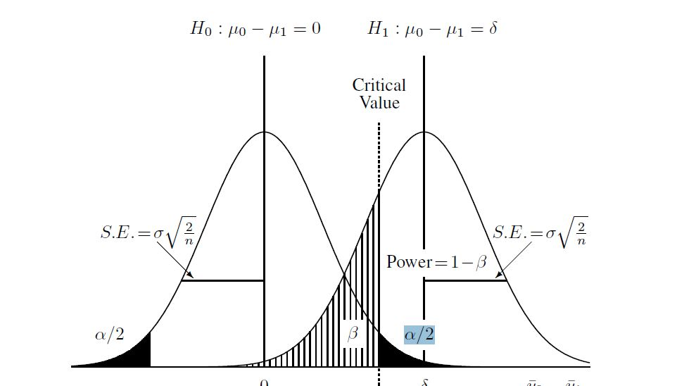
Research Methodology and Statistics
Inferential or Analytical Statistic
Hypothesis (or Predictions) Testing
Comparasion tests
t-test, ANOVA, Mann-Whitney U test, Wilcoxon test, Kruskal-Wallis H test
Correlation tests
Pearson’s r, Spearman’s rho, Chi square test
Regression tests
Simple linear regression, Multiple linear regression, …
Example of Comparison Tests
Suitable tests for nominal data
odds ratio test,
Suitable tests for ordinal data
Chi-square test (goodness of fit, homogeneity and independence)
Suitable tests for interval and Ratio data (Scale data)
t-test (one sample, two independent/paired sample; for one or two sample)
ANOVA test (also for repeated measurements; for three or more sample)

Slide 39
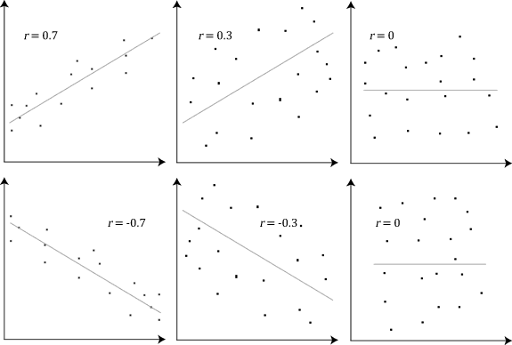
Research Methodology and Statistics
Inferential or Analytical Statistic
Hypothesis (or Predictions) Testing
Comparasion tests
t-test, ANOVA, Mann-Whitney U test, Wilcoxon test, Kruskal-Wallis H test
Correlation tests
Pearson’s r, Spearman’s rho, Chi square test
Regression tests
Simple linear regression, Multiple linear regression, …
Pearson’s r
parametric, quantitative data
Spearman’s rho
nonparametric, quantitative which are handled like qualitative data
Chi-square test (χ²)
qualitative data
Dimension reduction techniques
Factor analysis (use when you assume association if you want to understand the latent factors)
Principal Component Analysis (seeks to identify, to predict using the factors, PCA)

Slide 40
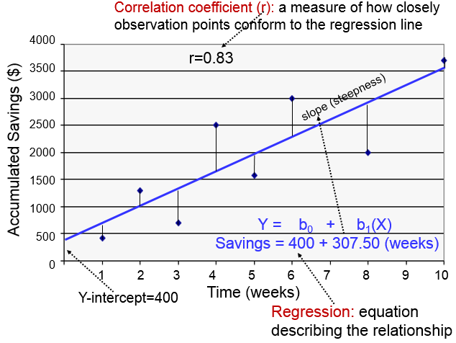
Research Methodology and Statistics
Inferential or Analytical Statistic
Hypothesis (or Predictions) Testing
Comparasion tests
t-test, ANOVA, Mann-Whitney U test, Wilcoxon test, Kruskal-Wallis H test
Correlation tests
Pearson’s r, Spearman’s rho, Chi square test
Regression tests
Simple linear regression, Multiple linear regression, …
Simple linear regression (1 metric IV; 1 metric DV)
Multiple linear regression (2+ metric IV; metric DV)
Logistic regression (1 any IV; 1 binary variable)

Slide 41
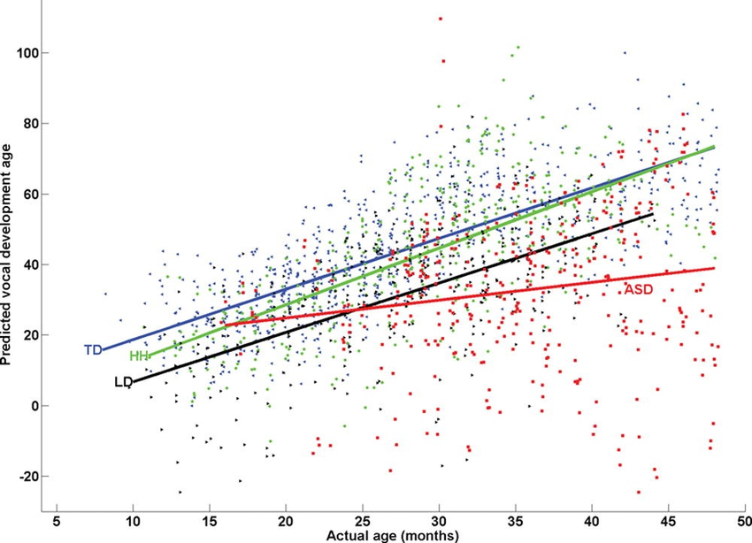
Research Methodology and Statistics
Inferential or Analytical Statistic
Hypothesis (or Predictions) Testing
Comparasion tests
t-test, ANOVA, Mann-Whitney U test, Wilcoxon test, Kruskal-Wallis H test
Correlation tests
Pearson’s r, Spearman’s rho, Chi square test
Regression tests
Simple linear regression, Multiple linear regression, …
Simple linear regression (1 metric IV; 1 metric DV)
Multiple linear regression (2+ metric IVs; metric DV)
Logistic regression (1 any IV; 1 binary variable)

Slide 42
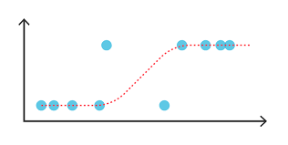
Research Methodology and Statistics
Inferential or Analytical Statistic
Hypothesis (or Predictions) Testing
Comparasion tests
t-test, ANOVA, Mann-Whitney U test, Wilcoxon test, Kruskal-Wallis H test
Correlation tests
Pearson’s r, Spearman’s rho, Chi square test
Regression tests
Simple linear regression, Multiple linear regression, …
Simple linear regression (1 metric IV; 1 metric DV)
Multiple linear regression (2+ metric IVs; metric DV)
Logistic regression (1 any IV; 1 binary variable)
Win/pass
Loss/fail
Serves speed / test points

Slide 43
Research Methodology and Statistics
The Effect size
Is a quantitative measure of the magnitude of the experimental effect
Is considered an essential complement of the statistical significance test, because it allows to know the relevance of the difference and discerning between the statistical significance of a test and its practical importance.
The effect size allows to make comparisons between the statistical significant differences from groups with a very different number of items, and studying groups from different scientific works (meta-analysis)
Effect size hepl undestend the magnitude of differences found (statistical signifikance examines whether the findings are likely to be due to chance)
Most common effect size tests
Cohen‘s d (Effect size index d)
Appropriate to campared two means (t-test)
Small (d = 0.2; 58%*), Medium (d = 0.5; 69%*), Large (d = 0.8; 79%)
Pearson correlation (r)
Confidence interval (CI)
is a range of values that you can be (95%) certain contains the true mean of the population.
there are variants of 90 % CI, 95% CI, 99% CI
Cohen‘s d [95% CI] = d [lower bound; higher bound] = 0.9 [0.12; 1.52]
Odds ratio test (OR)
For 2x2 table, (AD) / (BC)
Example for OR (95% CI): 2.1 (2.0 to 2.2)
Others Effect size tests
Epsilon-squared (ε²), Cohen‘s ω (ω), Eta-squared (η²), Cramer‘s V (V), Effect size Phi (ϕ), Relative risk or risk ratio (RR), Coefficient of determination (r²), Common Language Effect Size (CLES), ...
*Procentige of control group below the mean of experimental group

