Slide 1
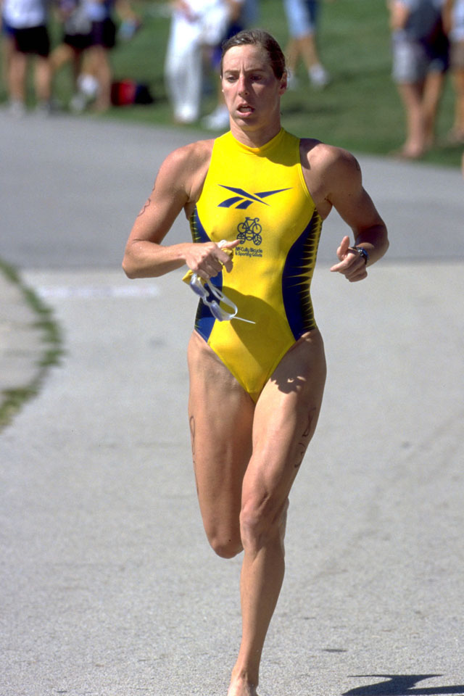
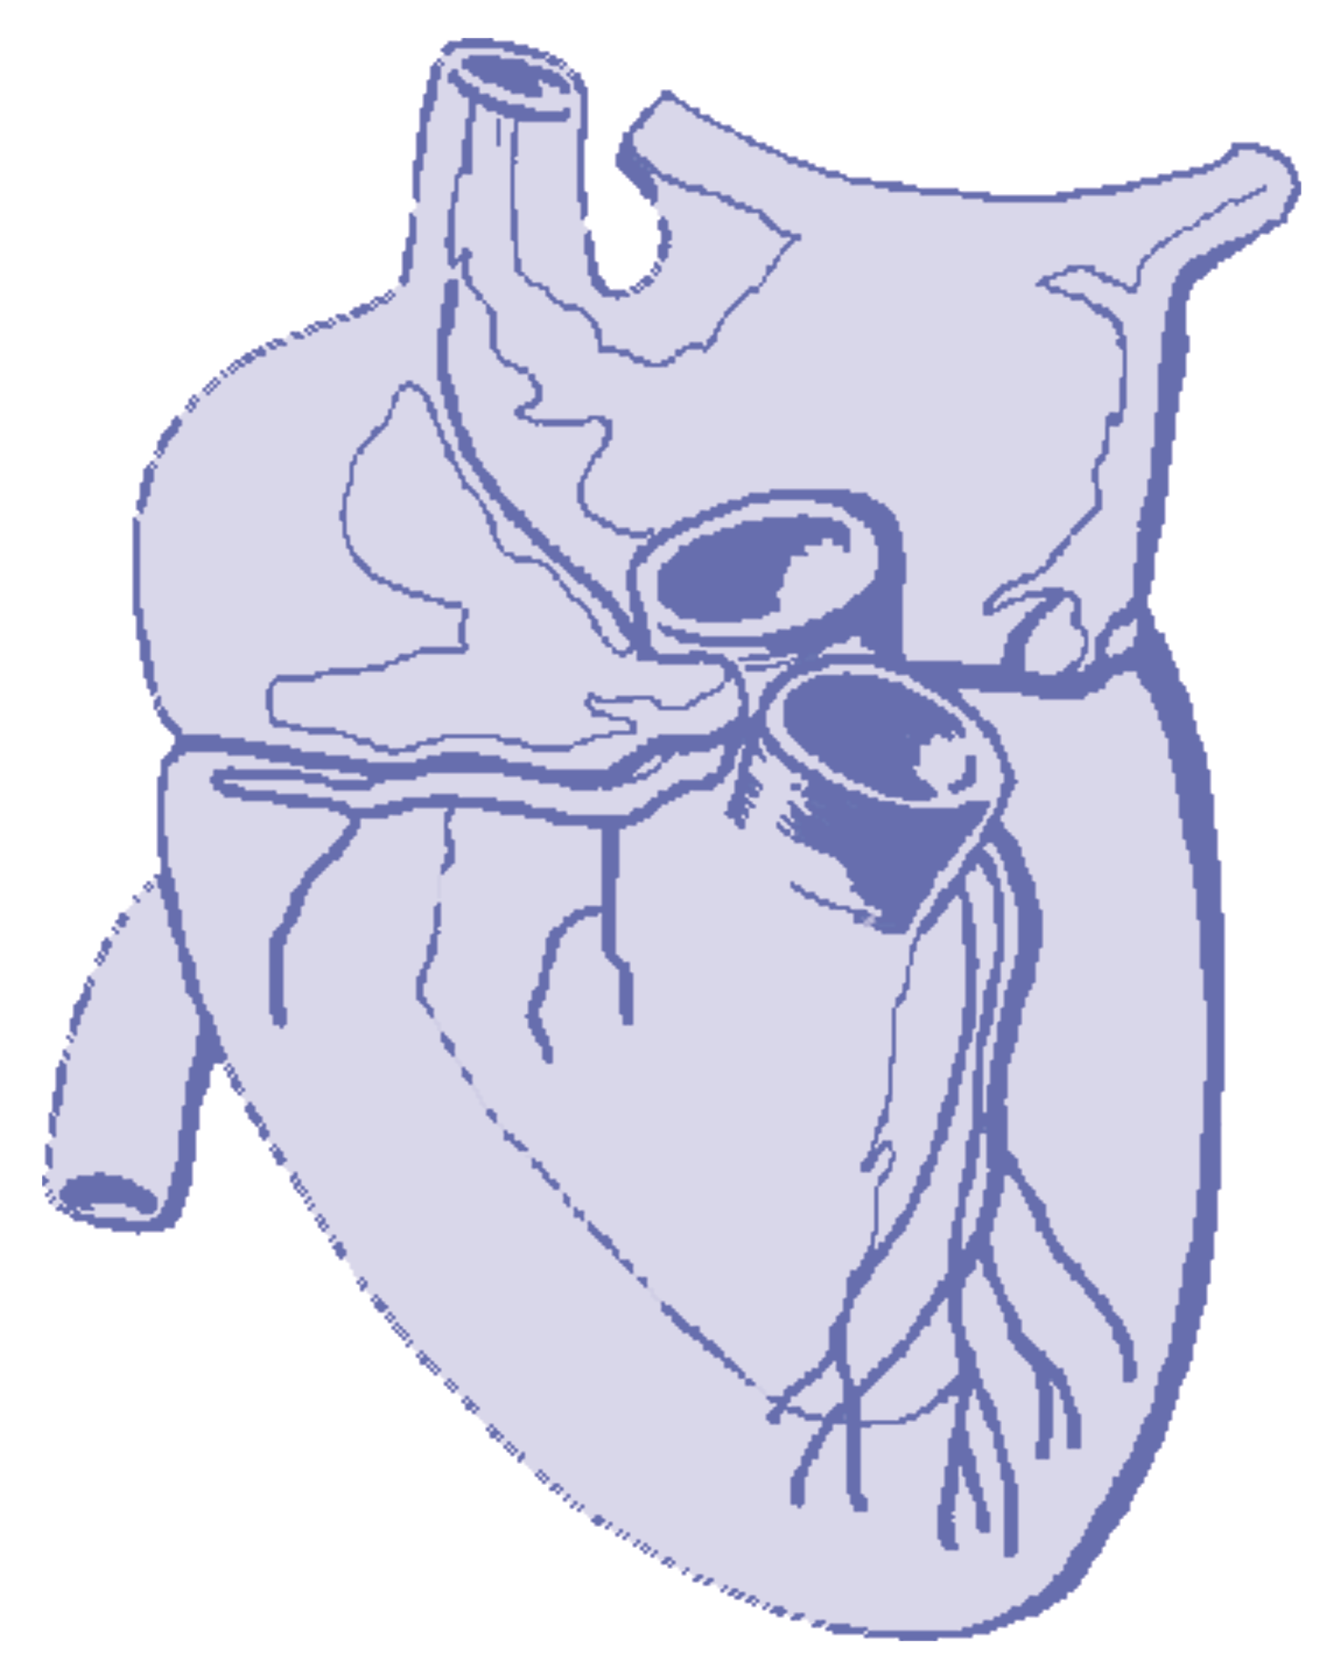
C H A P T E R 7
CARDIOVASCULAR CONTROL DURING EXERCISE

Slide 2

Major Cardiovascular Functions
w Delivery (e.g., oxygen and nutrients)
w Removal (e.g., carbon dioxide and waste products)
w Transportation (e.g., hormones)
w Maintenance (e.g., body temperature, pH)
w Prevention (e.g., infection—immune function)

Slide 3
Cardiovascular System
w A pump (the heart)
w A system of channels (the blood vessels)
w A fluid medium (blood)

Slide 4
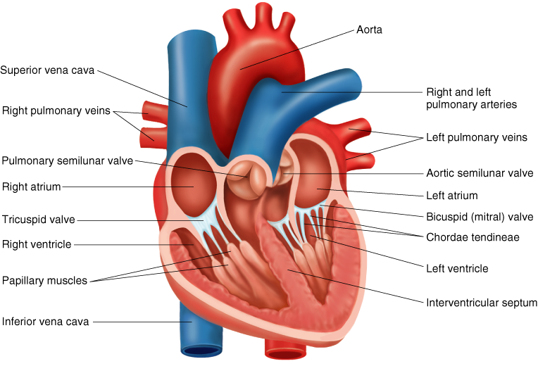
HEART

Slide 5
Myocardium—Cardiac Muscle
w Thickness varies directly with stress placed on
chamber walls.
w Left ventricle is the most powerful of chambers
and thus, the largest.
w With vigorous exercise, the left ventricle size
increases.

Slide 6
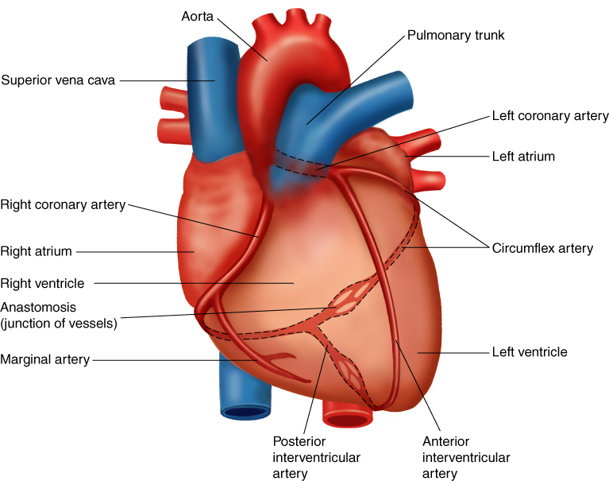
CORONARY CIRCULATION

Slide 7
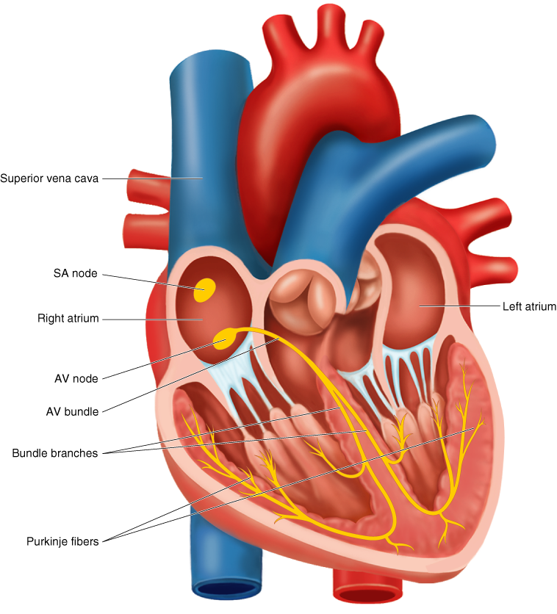
INTRINSIC CONDUCTION SYSTEM

Slide 8

Cardiac Conduction System
w Sinoatrial (SA) node—pacemaker (60–80
beats/min intrinsic heart rate)
w Atrioventricular (AV) node—built-in delay of 0.13 s
w AV bundle (bundle of His)
wPurkinje fibers—6 times faster transmission

Slide 9
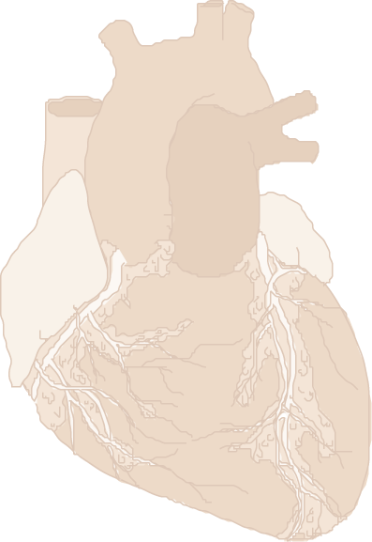
Extrinsic Control of the Heart
w Parasympathetic nervous system acts through
the vagus nerve to decrease heart rate and force
of contraction (predominates at rest—vagal tone).
w Sympathetic nervous system is stimulated by stress
to increase heart rate and force of contraction.
w Epinephrine and norepinephrine—released due to sympathetic stimulation—increase heart rate.

Slide 10
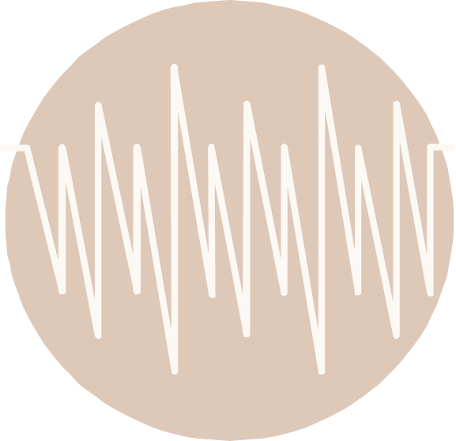
Did You Know…?
Resting heart rates in adults tend to be between
60 and 85 beats/min. However, extended
endurance training can lower resting heart rate to
35 beats/min or less. This lower heart rate is
thought to be due to decreased intrinsic heart rate
and increased parasympathetic stimulation.

Slide 11
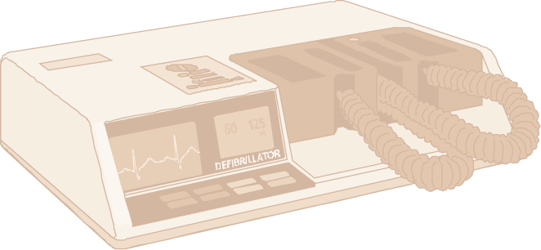
Main Cardiac Arrhythmias
Bradycardia—resting heart rate below 60 beats/min
Tachycardia—resting heart rate above 100 beats/min

Slide 12
Electrocardiogram (ECG)
w Printout shows the heart's electrical activity
and can be used to monitor cardiac changes
w The P wave—atrial depolarization
w The QRS complex—ventricular depolarization and
atrial repolarization
w The T wave—ventricular repolarization

Slide 13
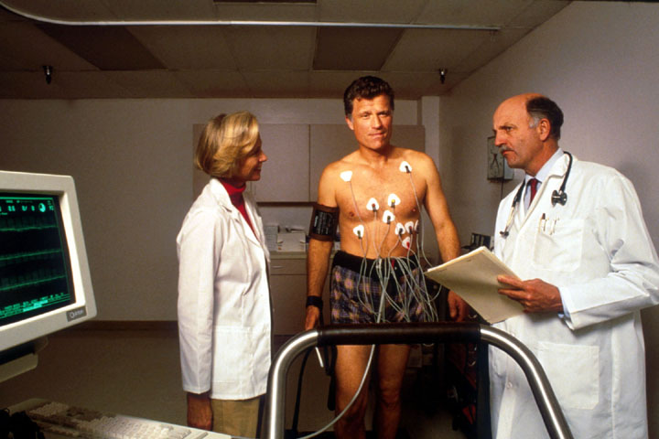
TAKING AN EXERCISE ECG

Slide 14
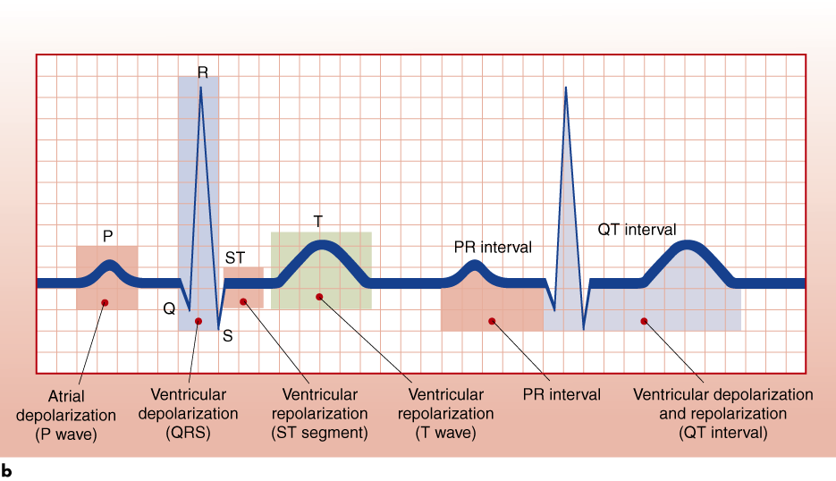
PHASES OF A RESTING ECG

Slide 15
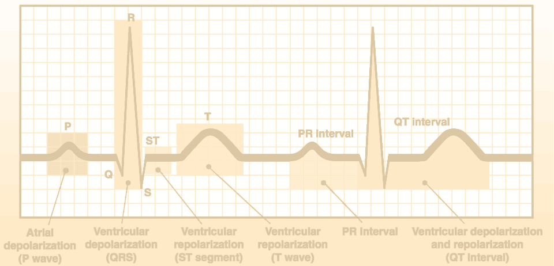
Cardiac Cycle
w Events that occur between two consecutive
heartbeats (systole to systole)
w Diastole—relaxation phase during which the chambers fill with blood (T wave to QRS)—62% of cycle duration
Systole—contraction phase during which the chambers expel blood (QRS to T wave)—38% of cycle duration

Slide 16
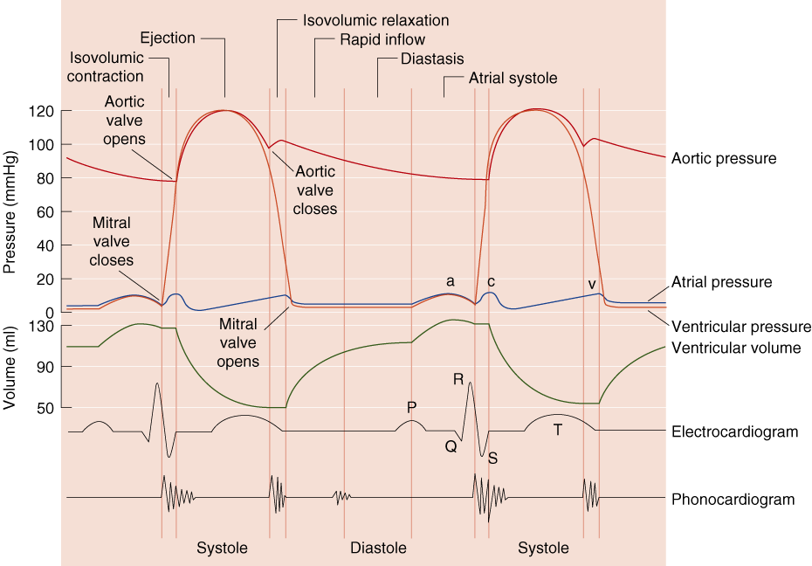
WIGGERS DIAGRAM

Slide 17
Stroke Volume and Cardiac
Output
Stroke Volume (SV)
w Volume of blood pumped per contraction
w End-diastolic volume (EDV)—volume of blood
in ventricle before contraction
w End-systolic volume (ESV)—volume of blood
in ventricle after contraction
w SV = EDV – ESV
.
Cardiac Output (Q)
w Total volume of blood pumped by the ventricle
per minute
.
w Q = HR × SV

Slide 18
Ejection Fraction (EF)
w Proportion of blood pumped out of the left
ventricle each beat
w EF = SV/EDV
w Averages 60% at rest

Slide 19
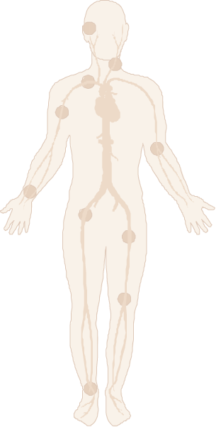
Vascular System
w Arteries
w Arterioles
w Capillaries
w Venules
w Veins

Slide 20
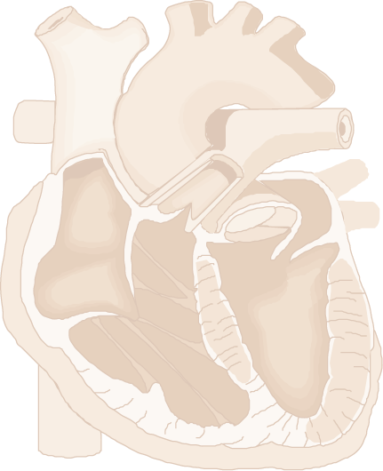
Did You Know…?
Arteries always carry blood away from the heart; veins always carry blood back to the heart with the help of breathing, the muscle pump, and valves. Pulmonary “veins” carry oxygenated blood from the lungs to the heart and pulmonary “arteries” carry blood with lower oxygen levels to the lungs for oxygenation.

Slide 21
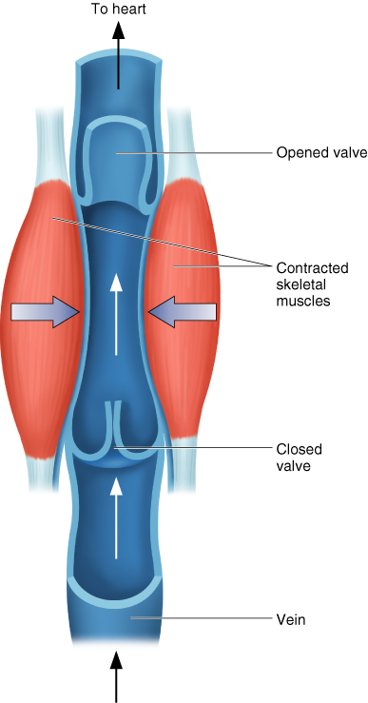
MUSCLE PUMP

Slide 22
Blood Distribution
w Matched to overall metabolic demands
w Autoregulation—arterioles within organs or tissues dilate or constrict in response to the local chemical environment
w Extrinsic neural control—sympathetic nerves within walls of vessels are stimulated causing vessels to constrict
w Determined by the balance between mean arterial pressure and total peripheral resistance

Slide 23
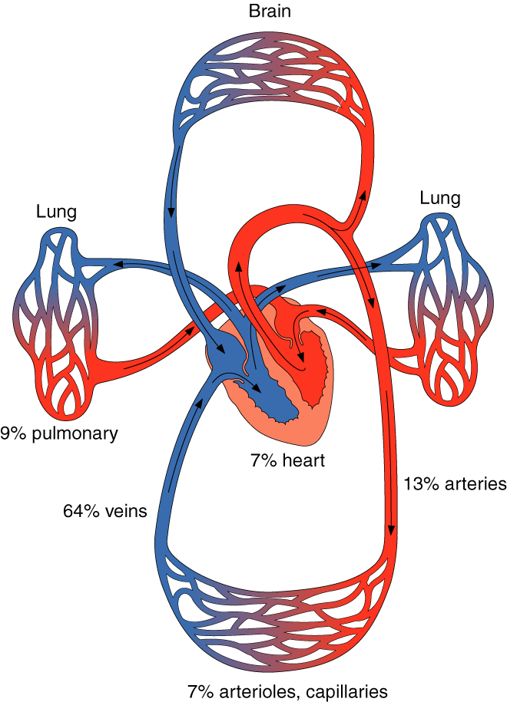
BLOOD DISTRIBUTION AT REST

Slide 24
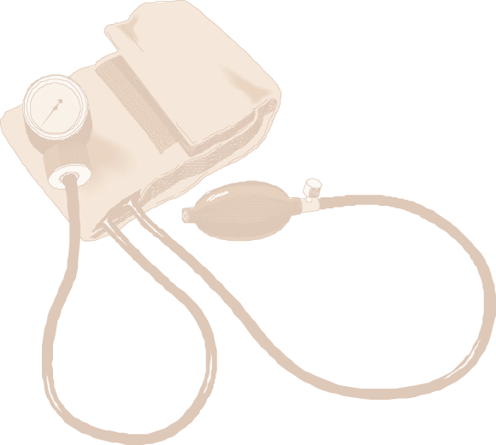
Blood Pressure
w Systolic blood pressure (SBP) is the highest pressure and diastolic blood pressure (DBP) is the lowest pressure
w Blood vessel constriction increases blood pressure; dilation reduces blood pressure

Slide 25

Cardiovascular Response to Acute
Exercise
Heart rate (HR) increases as exercise intensity
increases up to maximal heart rate.
Stroke volume (SV) increases up to 40% to 60% VO₂max in untrained individuals and up to maximal levels in trained individuals.
Increases in HR and SV during exercise cause cardiac output (Q) to increase.
w Blood flow and blood pressure change.

Slide 26
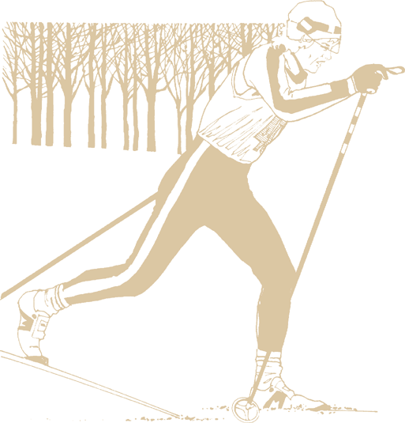
Maximum Heart Rate
w The highest heart rate value one can achieve in an all-out effort to the point of exhaustion
w Remains constant day to day and changes slightly from year to year
Can be estimated: HRmax = 220 – age in years or
HRmax = 208 – (0.7 × age)

Slide 27
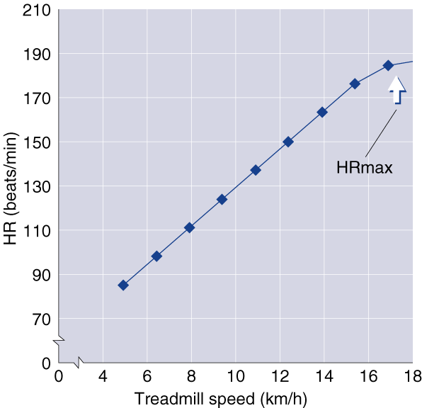
HEART RATE AND INTENSITY

Slide 28
Heart rate detection
Auscultation at the heart apex
ECG record (R–R distance)
Pulse palpation
Photometric, piezoelectric or electric devices

Slide 29
Heart rate (HR) changes
Average rest HR is 72 bpm
The HR is higher in children
The HR is higher during exercise, stress or fever
During exercise the HR increases as much as twice
After exercise the HR drops back to rest state within 3 minutes
In trained individuals the rest HR reoccurs faster

Slide 30
HR during exercise
Initial increase of HR (mental preparation)
Work state HR (followed by steady-state HR – corresponds to the load intensity)
Subsequent HR (after the load, decrease to rest
HR)

Slide 31
Pulse
During systolic ejection a flexible wall of aorta expands.
During diastole the wall of aorta contracts and empowers the bloodstream.
The expansion and contraction of the arterial walls transmit throughout the body (from centre to peripheries).
This wave-like transmission is called a pulse. It could be palpated close to body surface.

Slide 32
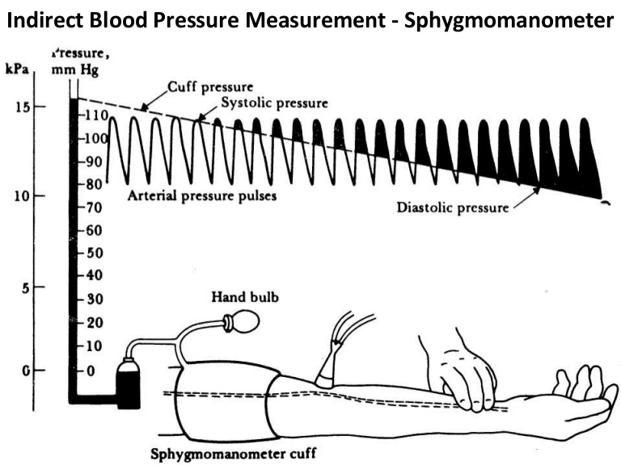
https://images.app.goo.gl/VYzmuEJJ6AKfYtHh8

