Slide 1
Fitness assessment in older adults
Faculty of Sport Studies
This study material is for study purposes only and is protected by copyright

Slide 2
Physical activity in older adults
Goals
  Maintaining self-sufficiency
  Maintaining or improving the quality of life
  Slowing down aging processes and their manifestations

Slide 3
PHYSICAL FITNESS IN OLDER ADULT
  the ability to perform activities of daily living (ADL) and instrumental activities of daily living (IADL) safely and without becoming unduly fatigued.
    Activities of daily living (ADL) are basic tasks that must be accomplished every day for an individual to thrive (personal hygiene, continence management, dressing, feeding, ambulating - the extent of a person’s ability to change from one position to the other and to walk independently.
    Instrumental activities of daily living (IADL) are somewhat more complex but nevertheless also reflect on a person’s ability to live independently and thrive (transportation and shopping, preparing meals, managing a person’s household, managing medications, communicating with others, managing finances)

Slide 4
Components of Physical Fitness
Cardiorespiratory endurance
Musculoskeletal fitness
Body weight and body composition
Flexibility
Balance

Slide 5
Cardiorespiratory endurance
  ability to the heart, lungs, and circulatory system to supply oxygen and nutrients efficiently to work muscles.
  Assessment
    To measure the maximum oxygen consumption (V02max),
    or the rate of oxygen utilization of the muscles during aerobic exercise, in order to assess cardiorespiratory endurance and functional aerobic capacity. Physical fitness evaluations should include a test of cardiorespiratory function during rest and exercise. Graded exercise tests (GXTs) are used for this purpose.
    6-minute walking test (easy to use in practice)
    2-minute step test

Slide 6
The 6 minute walk test - 6MWD
6 Minute Walk Test Distance Conversion Table
Standard estimates from 6MWD (feet walked) to METs
Based on ACSM metabolic prediction equation formula for horizontal walking.*
Distance Distance MPH Meters
in feet in meters ∙min-1 VO2(ml∙kg-1∙min-1) METs
500 152 .94 25 6.04 1.73
510 155 .96 26 6.09 1.74
520 159 .98 26 6.14 1.75
530 162 1.00 27 6.19 1.77
540 165 1.02 27 6.24 1.78
550 168 1.04 28 6.29 1.80
560 171 1.06 28 6.35 1.81
570 174 1.08 29 6.39 1.83
580 177 1.10 29 6.45 1.84
590 180 1.11 30 6.50 1.86
600 183 1.13 30 6.55 1.87
610 186 1.15 31 6.59 1.89
620 189 1.17 32 6.65 1.90
630 192 1.19 32 6.70 1.91
640 195 1.21 33 6.75 1.93
650 198 1.23 33 6.80 1.94
The 6MWD is a sub-maximal exercise test used to assess aerobic capacity and endurance. The distance covered over a time of 6 minutes is used as the outcome by which to compare changes in performance capacity.

Slide 7
Musculoskeletal fitness
  to the ability of the skeletal and muscular systems to perform work. This requires muscular strength, muscular endurance, and bone strength. Muscular strength is the maximal force or tension level that can be produced by a muscle group; muscular endurance is the ability of a muscle to maintain submaximal force levels for extended periods; bone strength is directly related to the risk of bone fracture and is a function of the mineral content and density of the bone tissue. Resistance training is one of the most effective ways to improve the strength of muscles and bones and to develop muscular endurance.

Slide 8
Musculoskeletal fitness assessment
The measurable variables are mass, strength and physical performance.
Variables Measurement techniques
Muscle mass Dual energy X-ray absorptiometry (DXA)
                Bioimpedance analysis (BIA)
Muscle strength Handgrip strength
                Arm Curl
                Knee flexion/extension
Physical performance Usual gait speed
        Chair stand
                Foot up and go

Slide 9
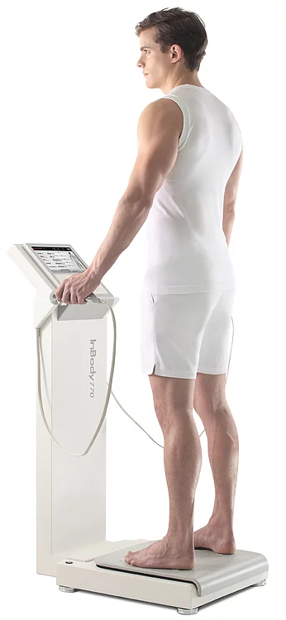
Muscle mass assessment
A wide range of techniques can be used to assess muscle mass. Cost, availability and ease of use can determine whether the techniques are better suited to clinical practice or are more useful for research.
Dual energy X-ray absorptiometry (DXA) is one of the methods for research and also clinical use to distinguish fat, bone mineral and lean tissues. This whole-body scan exposes the patient to minimal radiation. The main drawback is that the equipment is not portable, which may preclude its use in largescale epidemiological studies.
Bioimpedance analysis (BIA) estimates the volume of fat and lean body mass. The test itself is inexpensive, easy to use, readily reproducible and appropriate for both ambulatory and bedridden patients.

Slide 10
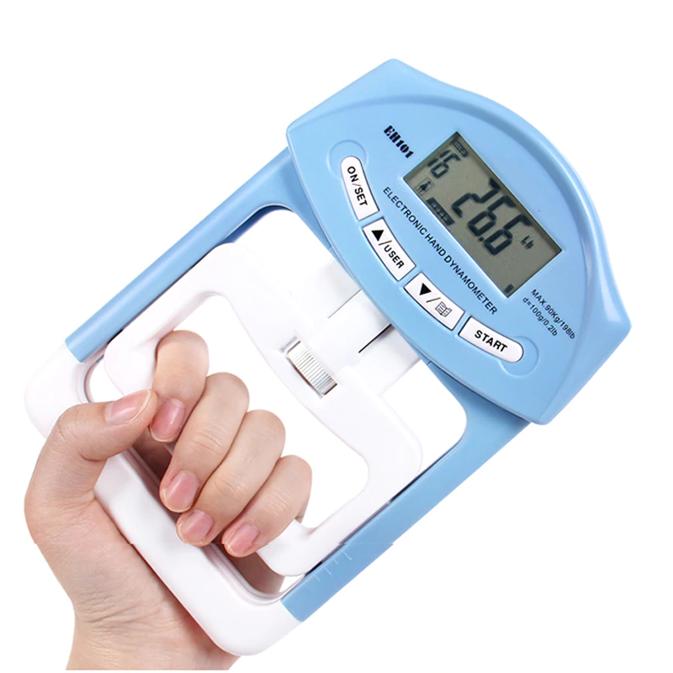
Muscle strength assessment
Hand grip strength test
Physical status according to the result given by the dynamometer (in kg)
Age Male Female
normal strong weak normal strong weak
Isometric hand grip strength is strongly related with lower extremity muscle power, knee extension torque and calf cross-sectional muscle area. Low handgrip strength is a clinical marker of poor mobility and a better predictor of clinical outcomes than low muscle mass. In practice, there is also a linear relationship between baseline handgrip strength and incident disability for activities of daily living (ADL).

Slide 11
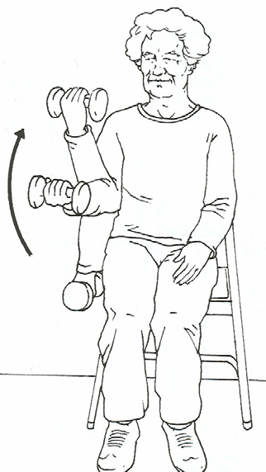
Muscle strength assessment
Senior fitness test – Arm Curl - To assess upper-body strenght
  Number of biceps curls that can be completed in 30 seconds
  holding and hand weight of 5 pounds (2.27 kg) for women;
  8 pounds (3.63 kg) for men
  # curls in 30 seconds
  Age Men Women
  60 – 64 19 17
  65 – 69 18 17
  70 – 74 17 16
  75 – 79 16 15
  80 – 84 15 14
  85 – 89 13 13
  90 + 11 11

Slide 12
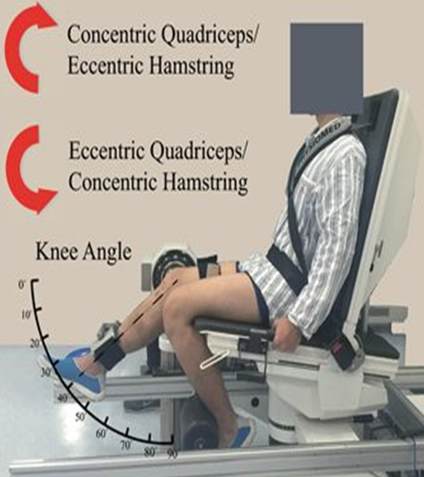
Muscle strength assessment
Isokinetic dynamometry
  Knee flexion/extension
Strength is about the magnitude of force generation, whereas power is about work rate (work done per unit time). In healthy older people, power is lost faster than strength. Both are important, but power is a better
predictor of certain functional activities.
Strength can be measured isometrically or isokinetically, the latter being a closer reflection of muscle function in everyday activity.
It is usually measured as the force applied to the ankle, with the subject seated in an adjustable straight-back chair, the lower leg unsupported and the knee flexed to 90°. Modern, commercial isokinetic dynamometers allow both isometric and isokinetic measurements of strength as concentric torque at various angular velocities. Measurement is feasible in frail older people.

Slide 13
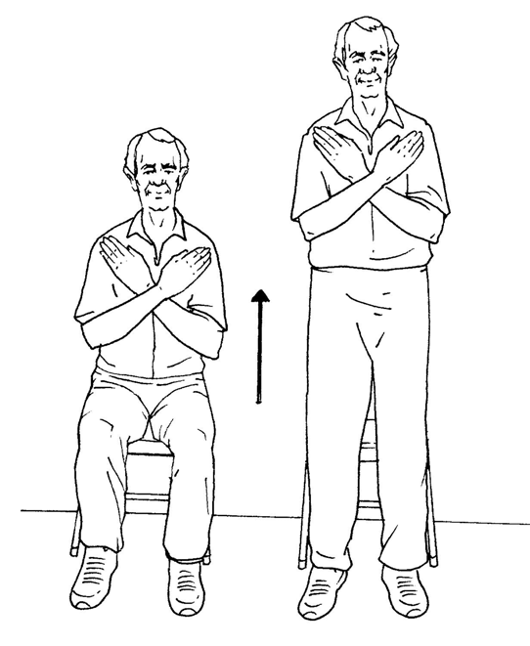
Physical performance assessment
Senior fitness test – Chair stand – To assess lower-body strenght
  Number of full stands that can be completed in 30 seconds with arms folded across chest
# stands in 30 seconds
Age Men Women
60 – 64 17 15
65 – 69 15 15
70 – 74 15 14
75 – 79 14 13
80 – 84 13 12
85 – 89 11 11
90 + 9 9

Slide 14
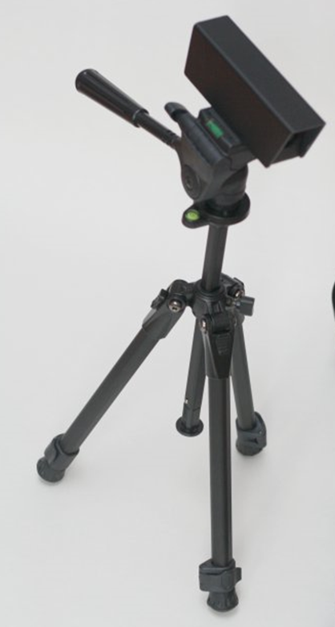
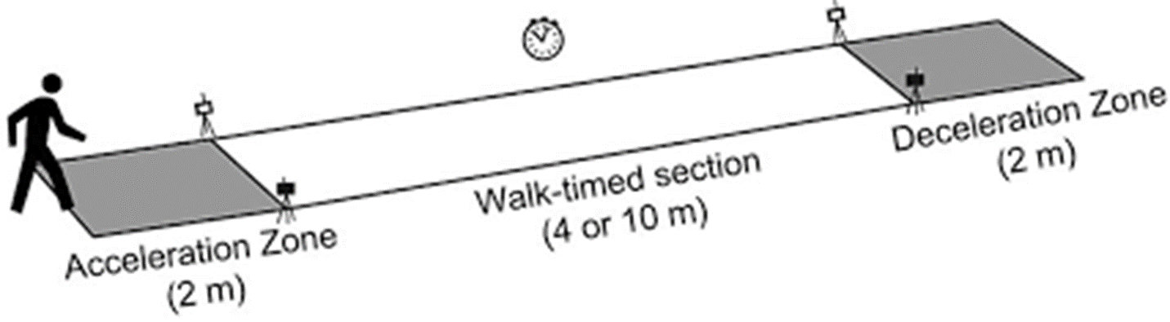
Physical performance assessment
Timed 10-Meter Walk Test
Normal comfortable speed or
maximum speed trials

Slide 15
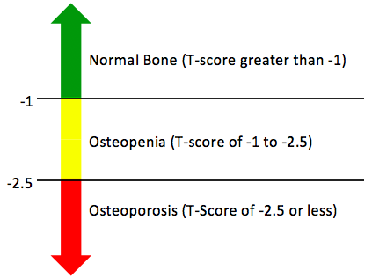
Bone strenght assessment
A bone density test uses X-rays to measure how many grams of calcium and other bone minerals are packed into a segment of bone. The bones that are most commonly tested are in the spine, hip and sometimes the forearm.
DEXA scores are reported as "T-scores" and "Z-scores." The T-score is a comparison of a person's bone density with that of a healthy 30-year-old of the same sex. The Z-score is a comparison of a person's bone density with that of an average person of the same age and sex.

Slide 16
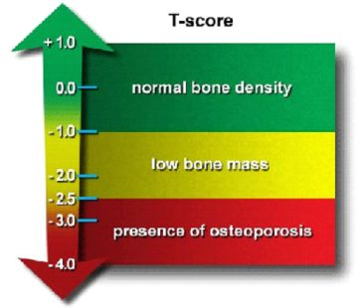
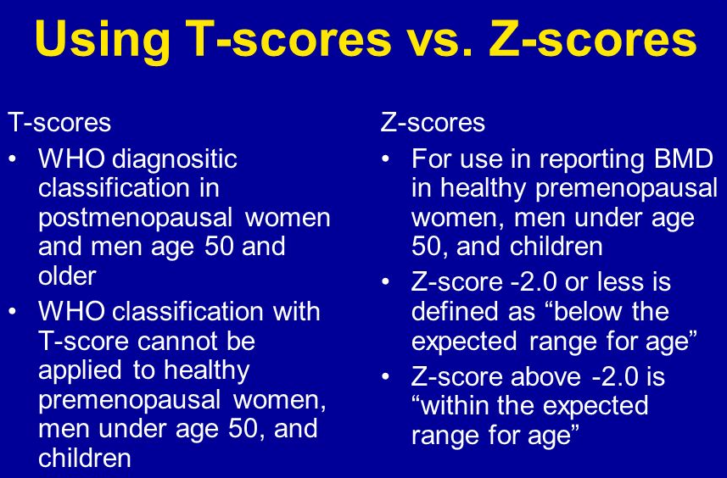
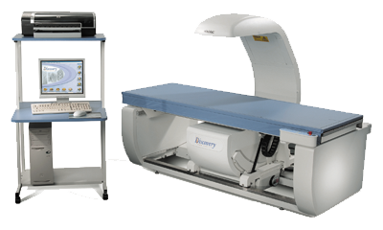
Bone Densitometry (DXA)

Slide 17
Body weight and body composition
  Body weight refers to the size or mass of the individual.
  Body composition refers to body weight in terms of the absolute and relative amounts of muscle, bone, and fat tissues.
  Aerobic exercise and resistance training are effective in altering body weight and composition.
Assessment
  Dual energy X-ray absorptiometry (DXA)
  Bioimpedance analysis (BIA) - InBody

Slide 18
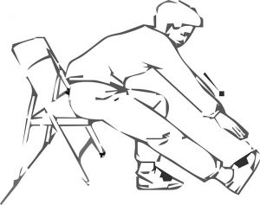
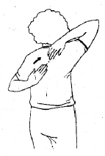
Flexibility
  the ability to move a joint or series of joints fluidly through the complete range of motion. Flexibility is limited by factors such as bony structure of the joint and the size and strength of muscles, ligaments, and other connective tissues.
  Assessment
  Senior fitness test (SFT) – Chair sit – and – reach test
  SFT – Back scratch test

Slide 19
balance
  the ability to keep the body's center of gravity within the base of support when maintaining a static position, performing voluntary movements, or reacting to external disturbances.
  Functional balance refers to the ability to perform daily movement tasks requiring balance such as picking up an object from the floor dressing, and turning to look at something behind you.
Assessment
  Static balance
    Posturography
    The One-Legged Stance Test
  Dynamic balance
    The 3m backwards walk test
    Foot up and go test
    Reach test
There are inconsistencies in the terminology used - postural stability, postural control, postural responses, postural sway, postural balance, balance, balance ability, balance control, balance performance, dynamics of standing balance, and so on. We work with the following terminology - static balance and dynamic balance.

Slide 20
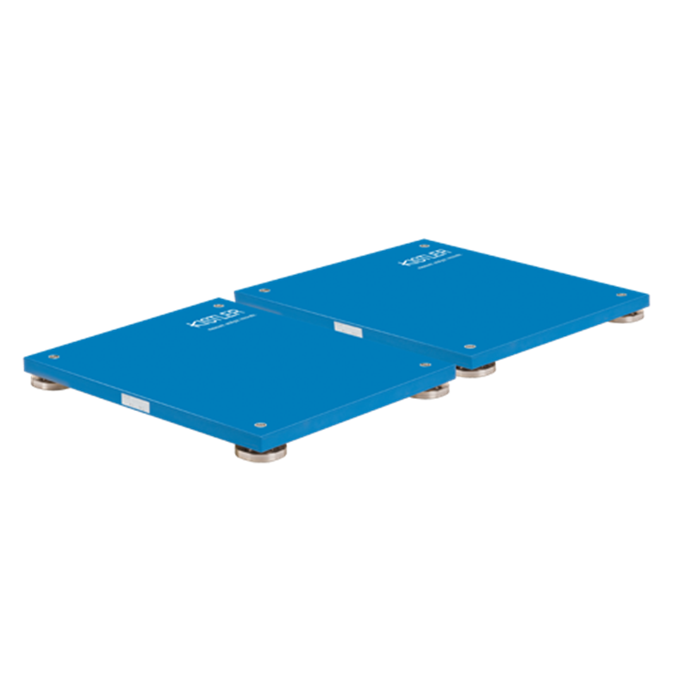
Static Balance - force plates
Posturography is the technique used to quantify postural control in upright stance in either static or dynamic conditions.
The trials were performed under both eyes closed (EC) and eyes open (EO) conditions in double leg stance and narrow. Most researchers conducted between 2 and 5 repetitions of postural sway recordings.
The possible effect of fatigue, especially in a population of balance impaired or otherwise pathologically affected elderly subjects, has to be considered when increasing the trial number or duration.
In studies was found higher overall reliability values under eyes closed conditions compared to open eyes.
Changing from a narrow- to a broad-based stance invokes a change in balance strategy from ankle to hip to the trunk and in the degree of control by stiffness.
The most common COP variable reported is the total sway path length, sway area, medial-lateral sway length, anterior-posterior sway length, and velocity.
Even though it has been shown that COP measures differ between age groups, these measures' reliability is not influenced by gender.
Resistance exercise interventions did not significantly change any of the variables in either eye open or closed conditions.

Slide 21
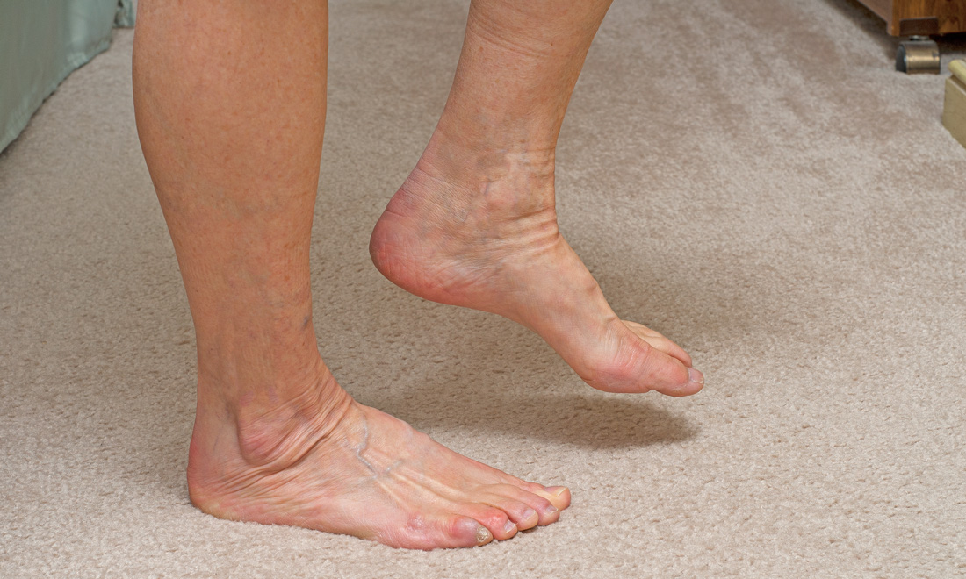
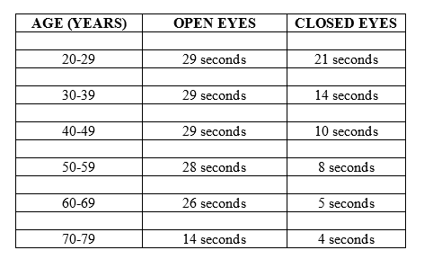
    The One-Legged Stance Test
    measures postural stability (i.e., balance) and is more difficult to perform due to the narrow base of support required to do the test. ... The patient is then instructed to close his eyes and maintain balance for up to 30 seconds.
Simple Balance Test

Slide 22
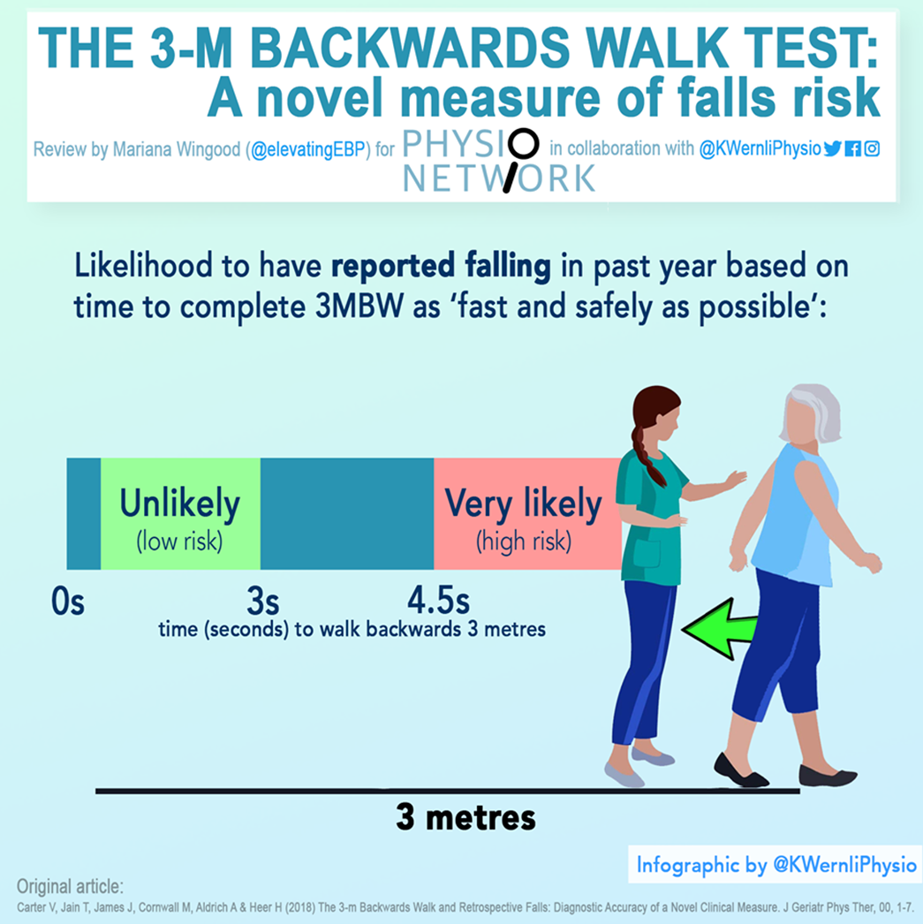
Dynamic balance ability – assessment
The 3-m backwards walk test
... Several measures of fall risk have been previously developed and include forward walking, turning, and stepping motions.
… recent research has demonstrated that backwards walking is more sensitive at identifying age-related changes in mobility and balance compared with forward walking…

Slide 23
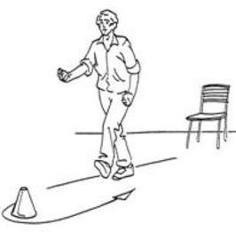
Dynamic balance ability assessment
Senior fitness test – 8 – Foot up and go
  Number of seconds required to get up from a seated position, walk 8 feet (2.44m), turn and return to seated position
  Seconds to complete task
  Age Men Women
  60 – 64 4.8 5.0
  65 – 69 5.1 5.3
  70 – 74 5.5 5.6
  75 – 79 5.9 6.0
  80 – 84 6.4 6.5
  85 – 89 7.1 7.1
  90 + 8.0 8.0

Slide 24
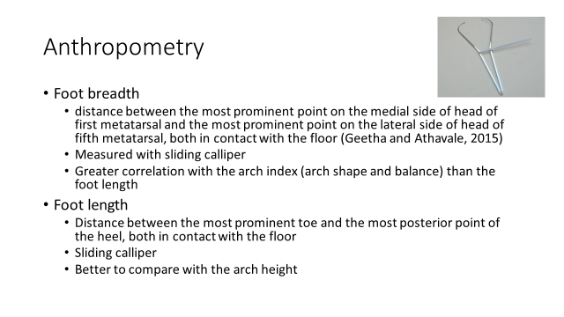
As we know, balance can be influenced by more variables (visual system, proprioception, foot breadth, foot length, Hallux valgus angle, Arch foot, height, Waist-to-hip ratio, navicular drop, cerebellum dysfunction).

Slide 25
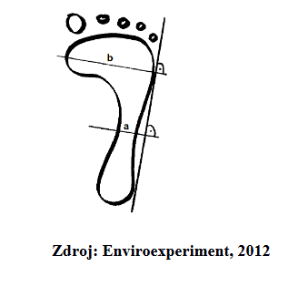
Hallux valgus angle
  angle between the longitudinal axes of the proximal phalanx of the great toe and the first metatarsal bone (Seki et al., 2020)
  Measured with goniometer
  Up to 10-15° considered normal
  Influenced by the anatomical alignment of the joint, heredity, hypermobility, shoes, …
  High correlation with the COP total area with eyes closed in the elderly
Arch index (Chippaux-Šmiřák method)
  Lateral tangent line of the footprint, then perpendicular line
  at the widest point (b) and the narrowest point (a)
  Length a (mm) divided by length b (mm) times 100
  AI up to 45% considered as normal arched foot

Slide 26
Height
  Strongest relationship with total area of COP (eyes opened)
Waist-to-hip ratio
  Waist: midway between the iliac crest and the lower rib margin by using an insertion tape
  Hip: widest circumference over the buttocks and below the iliac crest
  Waist measurement divided by hip measurement
  Men 60-69: less then 0,91 – low risk, women 60-69: less then 0,76 – low risk
  Higher WHR correlates with increased mortality risk

Slide 27
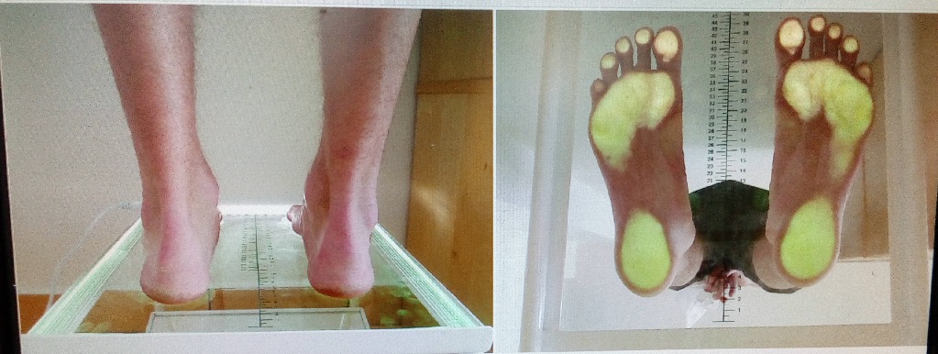
Podocam
Device showing arch shape (footprint)
To assess foot type

Slide 28
Navicular drop test
Assessing the sagittal plane excursion of the navicular bone during loading
Locating the navicular tuberosity on the non-weight-bearing foot
Then the subject is asked to assume 50% weight bearing on the foot and the sagittal plane excursion of navicular bone is measured by a ruler
Sagittal displacement of the navicular tuberosity may reflect excessive subtalar joint pronation (due to insufficient support of the MLA from ligaments and muscle tendons)
Reliable means of measurement of foot pronation
Excessive amount of navicular drop has been reported to be associated with knee joint pathology
6-9 mm displacement considered normal, less than 6 mm hypomobility, more than 9 mm hypermobility

Slide 29
Cerebellum exams
to exclude cerebellum dysfunction and to eliminate any dysfunction of both visual and proprioceptive system for maintaining balance
finger-nose test (for each hand)
diadochokinesis test (bringing an upper limb into opposite positions of pronation and supination)
elimination of nystagmus
Romberg´s test (feet together eyes opened – Romberg I; feet together eyes closed – Romberg II)

Slide 30
Fitness assessment in older adults
Step 1
to take into account the health condition in older adult
Step 2
to choose test (reliability, validity)
Step 3
to hold the methodology of test
Step 4
evaluate the results correctly and to apply
Notes:
Uveďte všechny kroky použité při provádění experimentu.
Jednotlivé kroky očíslujte.

Slide 31
References used in presentation
American College of Sports Medicine, Chodzko-Zajko, W. J., Proctor, D. N., Fiatarone Singh, M. A., Minson, C. T., Nigg, C. R., … Skinner, J. S. (2009). American College of Sports Medicine position stand. Exercise and physical activity for older adults. Medicine and Science in Sports and Exercise, 41(7), 1510–1530. https://doi.org/10.1249/MSS.0b013e3181a0c95c
Baechle TR, Earle RW, Wathan D. (2008). Resistance Training. In Essentials of Strength Training and Conditioning (3.). Champaign, IL: Human Kinetics.
Carter, V., Jain, T., James, J., Cornwall, M., Aldrich, A., & de Heer, H. D. (2019). The 3-m Backwards Walk and Retrospective Falls: Diagnostic Accuracy of a Novel Clinical Measure. Journal of Geriatric Physical Therapy, 42(4), 249–255. https://doi.org/10.1519/JPT.0000000000000149
Cruz-Jentoft, A. J., Baeyens, J. P., Bauer, J. M., Boirie, Y., Cederholm, T., Landi, F., … European Working Group on Sarcopenia in Older People. (2010). Sarcopenia: European consensus on definition and diagnosis: Report of the European Working Group on Sarcopenia in Older People. Age and Ageing, 39(4), 412–423. https://doi.org/10.1093/ageing/afq034
Debra J. Rose. (2019). Physical Activity Instruction of Older Adults. Human Kinetics, Inc.
Du Pasquier, R. A., Blanc, Y., Sinnreich, M., Landis, T., Burkhard, P., & Vingerhoets, F. J. G. (2003). The effect of aging on postural stability: A cross sectional and longitudinal study. Neurophysiologie Clinique/Clinical Neurophysiology, 33(5), 213–218. https://doi.org/10.1016/j.neucli.2003.09.001

Slide 32
References used in presentation
Fragala, M. S., Cadore, E. L., Dorgo, S., Izquierdo, M., Kraemer, W. J., Peterson, M. D., & Ryan, E. D. (2019). Resistance Training for Older Adults: Position Statement From the National Strength and Conditioning Association. The Journal of Strength & Conditioning Research, 33(8), 2019–2052. https://doi.org/10.1519/JSC.0000000000003230
Granacher, U., Muehlbauer, T., Zahner, L., Gollhofer, A., & Kressig, R. W. (2011). Comparison of traditional and recent approaches in the promotion of balance and strength in older adults. Sports Medicine (Auckland, N.Z.), 41(5), 377–400. https://doi.org/10.2165/11539920-000000000-00000
Low, D. C., Walsh, G. S., & Arkesteijn, M. (2017). Effectiveness of Exercise Interventions to Improve Postural Control in Older Adults: A Systematic Review and Meta-Analyses of Centre of Pressure Measurements. Sports Medicine (Auckland, N.z.), 47(1), 101–112. https://doi.org/10.1007/s40279-016-0559-0
Roberta E. Rikli, & C. Jessie Jones. (2001). Senior Fitness Test Manual. Human Kinetics, Inc.
Rogind, H., Lykkegaard, J. J., Bliddal, H., & Danneskiold-Samsoe, B. (2003). Postural sway in normal subjects aged 20-70 years. Clinical Physiology and Functional Imaging, 23(3), 171–176. https://doi.org/10.1046/j.1475-097X.2003.00492.x
Ruhe, A., Fejer, R., & Walker, B. (2010). The test–retest reliability of centre of pressure measures in bipedal static task conditions – A systematic review of the literature. Gait & Posture, 32(4), 436–445. https://doi.org/10.1016/j.gaitpost.2010.09.012
Vivian H. Heyward. (2010). Advanced Fitness Assessment and Exercise Prescription. Human Kinetics, Inc.

