Slide 1
bp4036 Selected topics in Sport Science
Management in sport

Slide 2
Join the website
Mentimeter.com
90762335

Slide 3
Outline
Theoretical part
  Management in a sports organisation
  Basic strategies
  Way to the appropriate strategy
Practical examples
  Club Brugge
  Feyenoord Rotterdam
  Ferencváros Budapest – video
Discussion

Slide 4

https://fb.watch/8uF9EDZSQS/

Slide 5
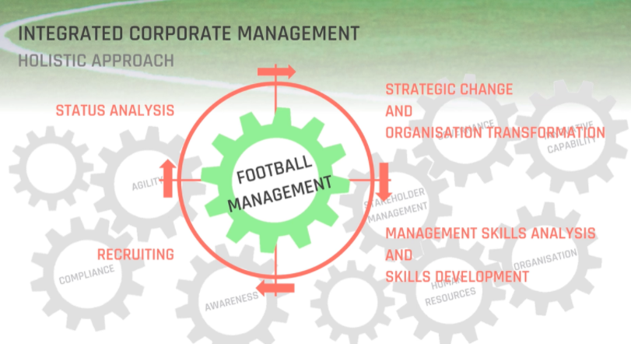

Slide 6
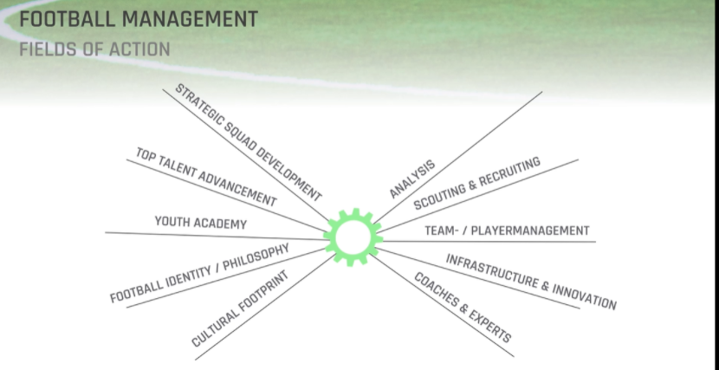

Slide 7


Slide 8
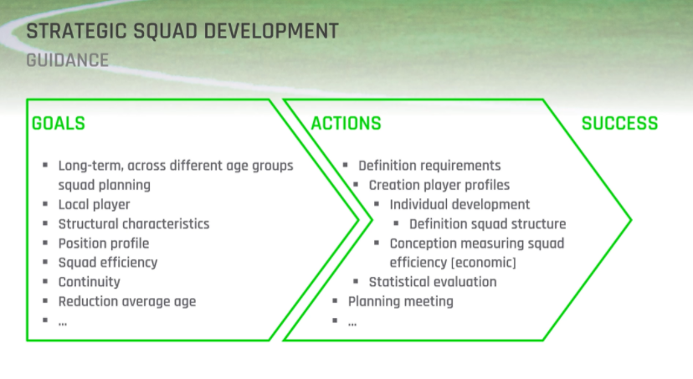

Slide 9
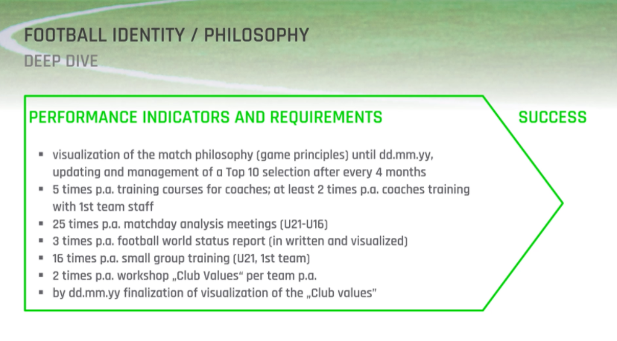

Slide 10
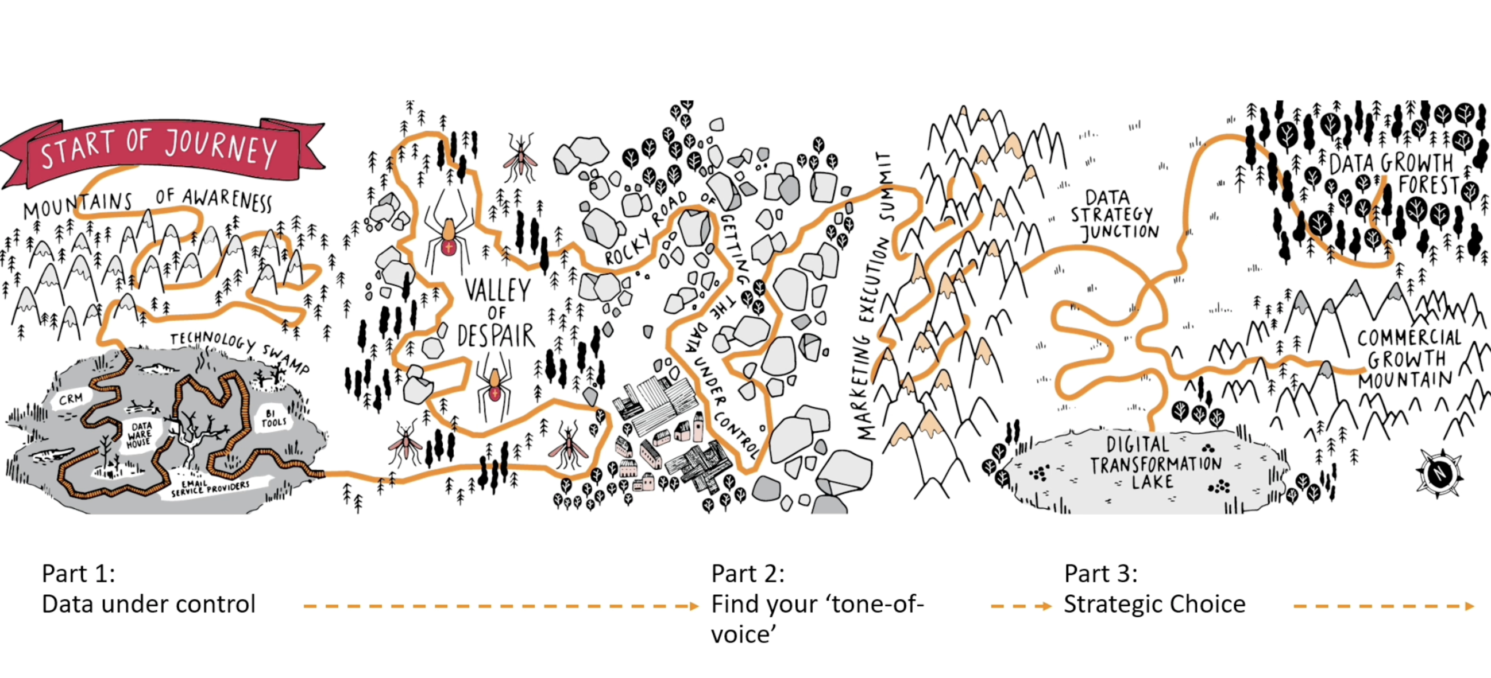

Slide 11
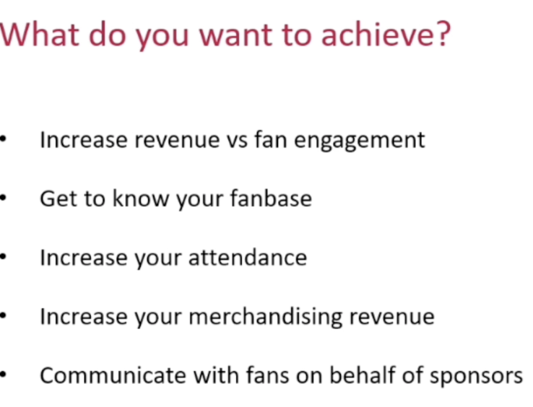

Slide 12
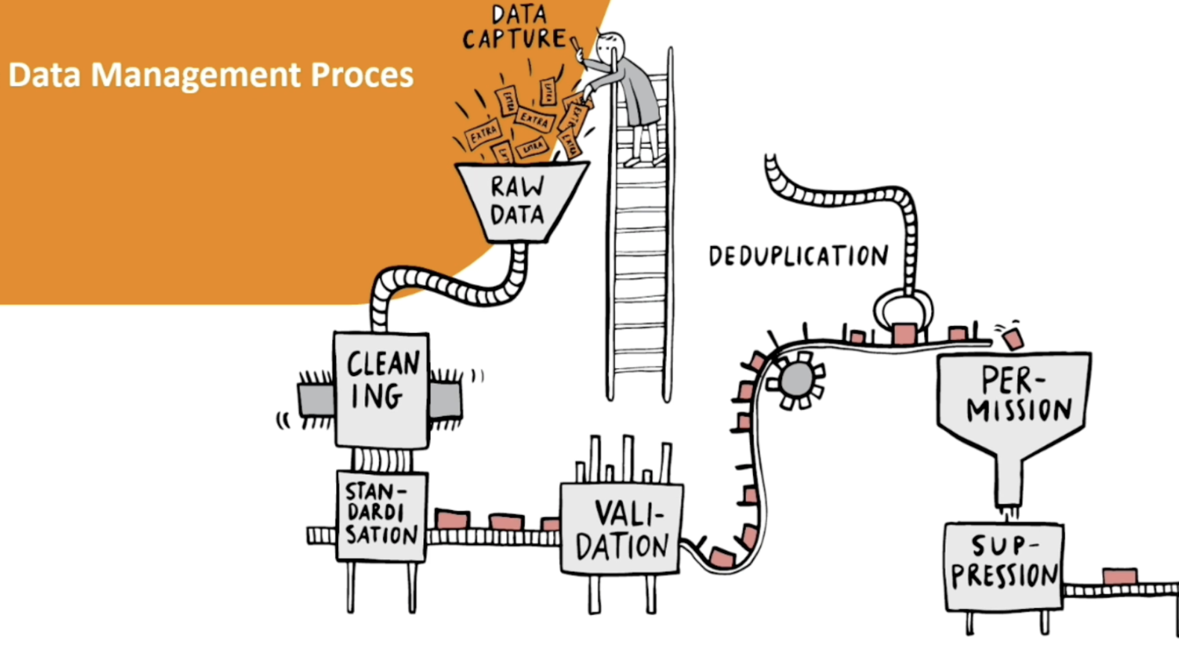

Slide 13
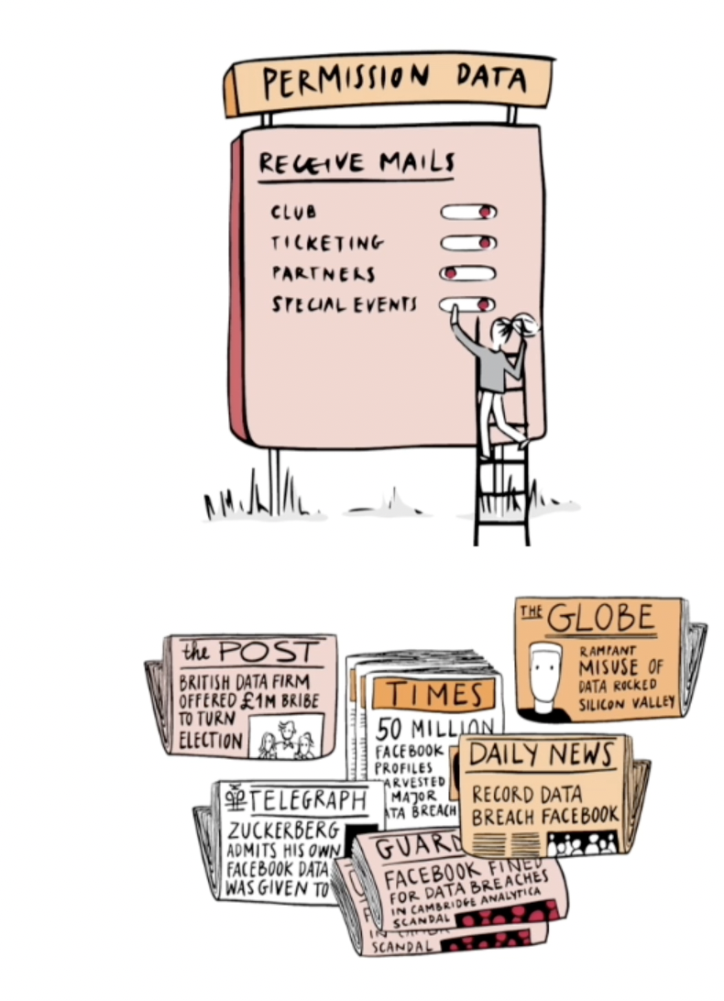
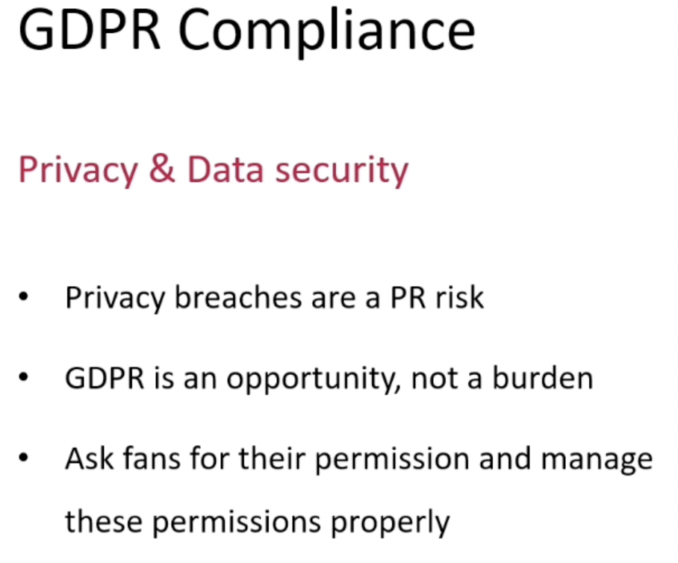

Slide 14
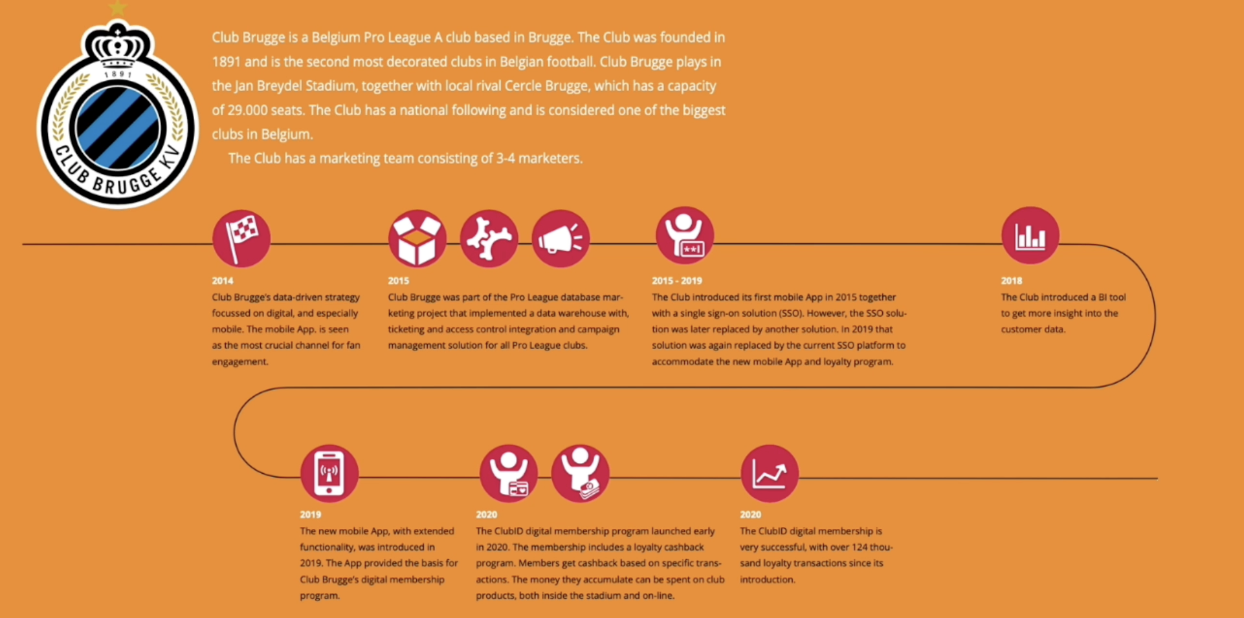

Slide 15
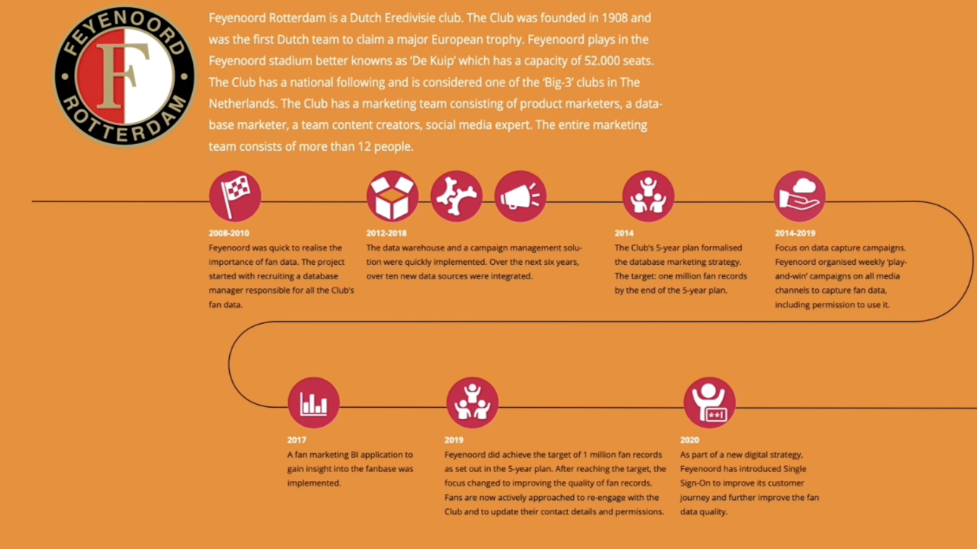

Slide 16
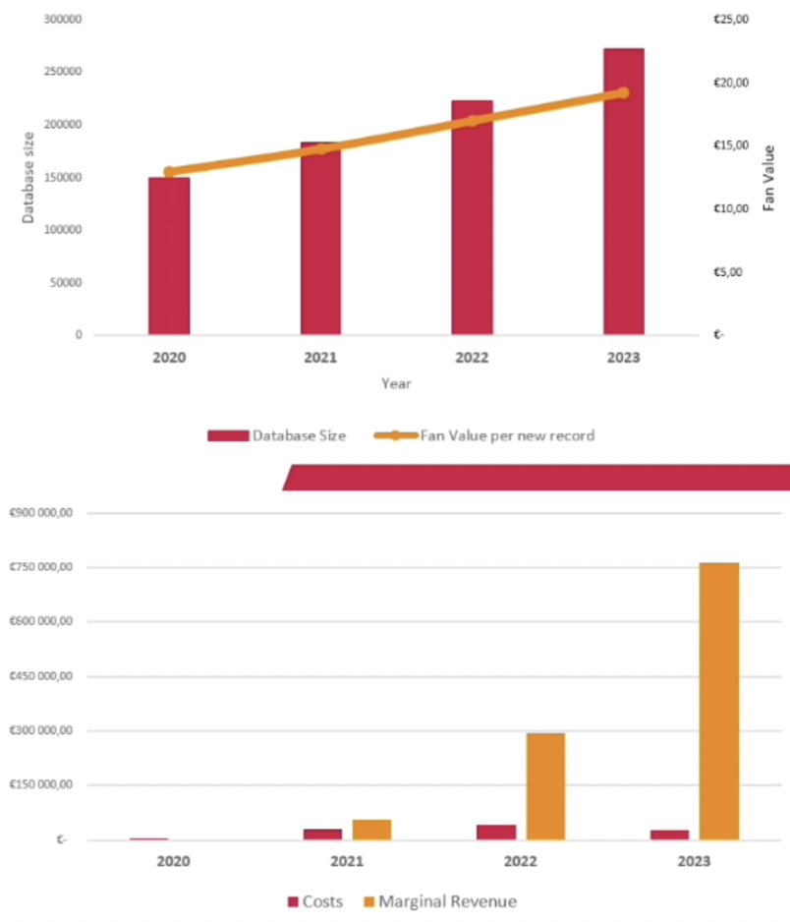

Slide 17
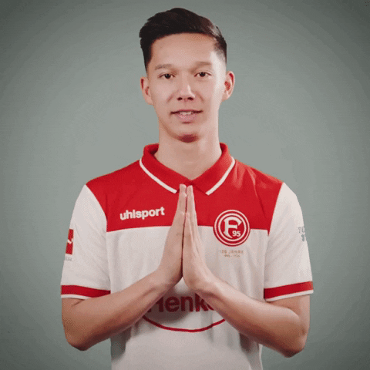
Thank you for your attention

