Slide 1
Cardiovascular system
Cardiovascular control during exercise

Slide 2
Major cardiovascular functions
Delivery (e.g., oxygen and nutrients)
Removal (e.g., carbon dioxide, lactate, other waste products)
Transportation (e.g., hormones)
Maintenance (e.g., body temperature, pH)
Prevention (e.g., infection—immune function)

Slide 3
Cardiovascular system
A pump – the heart
A system of channels – the blood vessels
A fluid medium - blood

Slide 4
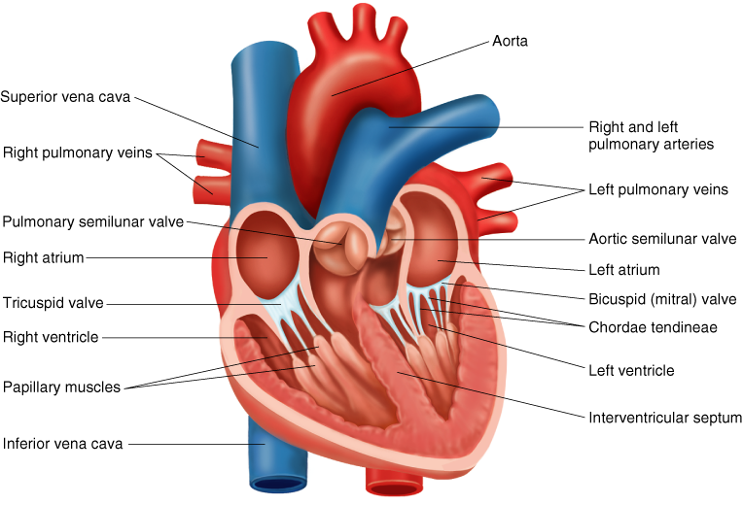
Heart anatomy
Notes:
https://www.gettyimages.com/detail/illustration/anatomy-of-heart-interior-frontal-section-royalty-free-illustration/188057943

Slide 5
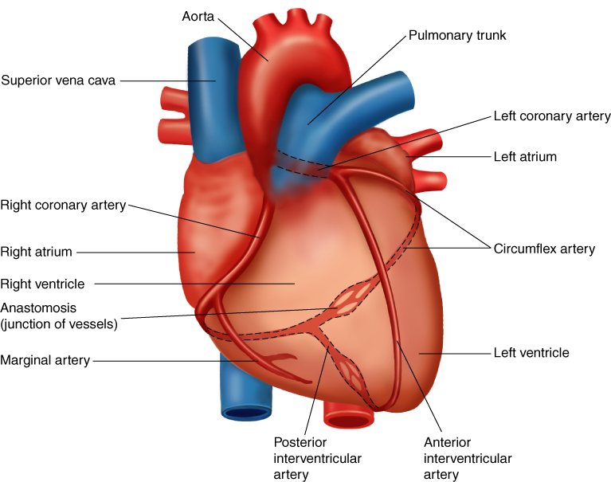
Heart anatomy

Slide 6
Key points
The two atria receive blood into the heart; the two ventricles send blood from the heart to the rest of the body.
The left ventricle has a thicker myocardium due to hypertrophy resulting from the resistance against which it must contract.

Slide 7
Heart Rate
Resting heart rates in adults tend to be between 60 and 85 beats/min. However, extended endurance training can lower resting heart rate to 35 beats/min or less. This lower heart rate is thought to be due to decreased intrinsic heart rate and increased parasympathetic stimulation.
What is the average resting heart rate frequency?

Slide 8
Heart Rate
Resting heart rates in adults tend to be between 60 and 80 beats/min. However, extended endurance training can lower resting heart rate to 40 beats/min or less. This lower heart rate is thought to be due to decreased intrinsic heart rate and increased parasympathetic stimulation.

Slide 9
Cardiac Arrhythmias
BRADYCARDIA – Resting heart rate below 60 beats/min
TACHYCARDIA – Resting heart rate above 100 beats/min
PREMATURE VENTRICULAR CONTRACTIONS (PVCs) – feels like skipped or extra beats
VENTRICULAR TACHYCARDIA – three or more consecutive PVCs that can lead to ventricular fibrillation in which contraction of the ventricular tissue is uncoordinated

Slide 10
Cardiac cycle
The event that occurs between two consecutive heartbeats (systole to systole)
Diastole—relaxation phase during which the chambers fill with blood - 62% of cycle duration
Systole—contraction phase during which the chambers expel blood - 38% of cycle duration
Notes:
https://en.wikipedia.org/wiki/Cardiac_cycle#/media/File:2027_Phases_of_the_Cardiac_Cycle.jpg

Slide 12
Stroke Volume and Cardiac Output
Stroke volume (SV) is volume of blood pumped per contraction
Average 50-100 ml
End-Diastolic Volume (EDV) – blood volume in a ventricle before contraction
End-Systolic Volume (ESV) – blood volume in a ventricle after contraction
SV = EDV – ESV
Cardiac output (Q) is the total volume of blood pumped by the ventricles per minute

Slide 13
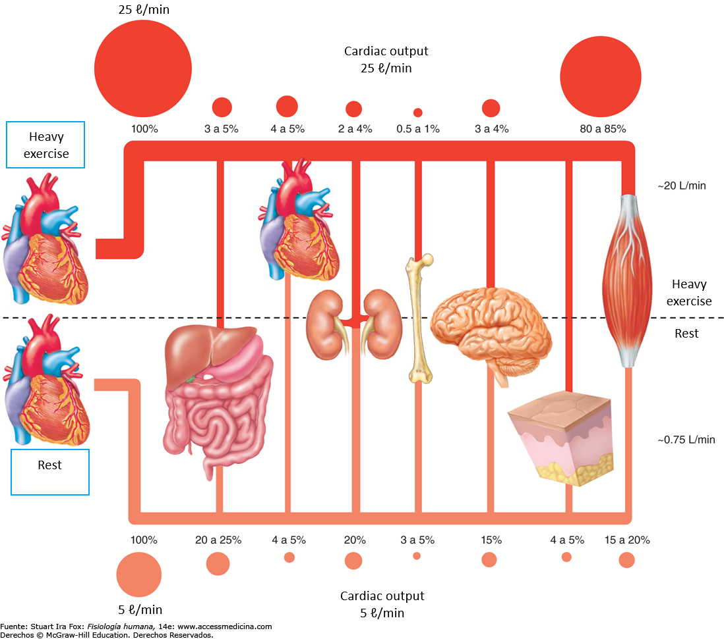
Blood distribution
Notes:
https://www.ncbi.nlm.nih.gov/pmc/articles/PMC4551211/
https://physoc.onlinelibrary.wiley.com/doi/10.1113/JP270593

Slide 14
Blood pressure
Systolic blood pressure (SBP) is the highest pressure and diastolic blood pressure (DBP) is the lowest pressure
Mean arterial pressure (MAP)—average pressure exerted by the blood as it travels through arteries
MAP = DBP + [0.333 ´ (SBP – DBP)]
Rest Blood Pressure is about 120/80
Hypertension: BP = more than 140/90
Hypotension: BP = less than 90/60
Notes:
https://medical.andonline.com/systolic-vs-diastolic-blood-pressure/

Slide 15
Parameters affected by training
Heart size
Stroke Volume
Heart rate
Cardiac output
Blood flow
Blood pressure
Blood volume

Slide 16
Cardiovascular Response to Acute Exercise
Heart rate (HR) increases as exercise intensity increases up to maximal heart rate
Stroke volume (SV) increases up to 40% to 60% VO₂max in untrained individuals and up to maximal levels in trained individuals.
Increases in HR and SV during exercise cause cardiac output (Q) to increase
Blood flow and blood press
All result in allowing the body to efficiently meet the increased demands placed on it

Slide 17
Resting and Maximum Heart Rate
RHR
Averages 60 to 80 beats/min; can range from 28 to above 100 beats/min
Tends to decrease with age and with increased cardiovascular fitness
Is affected by environmental conditions such as altitude and temperature
HRmax
The highest heart rate value one can achieve in an all-out effort to the point of exhaustion
Remains constant day to day and changes slightly from year to year
Can be estimated:
HRmax = 220 – age in years or
HRmax = 208 – (0.7 x age)
Notes:
https://www.mayoclinic.org/healthy-lifestyle/fitness/in-depth/exercise-intensity/art-20046887#:~:text=Subtract%20your%20age%20from%20220,minute%20for%20the%20average%20adult.

Slide 18
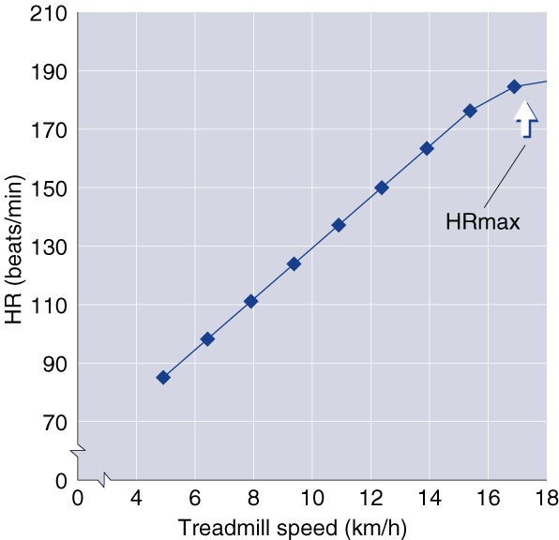
Heart Rate and Intensity
Notes:
https://www.mayoclinic.org/healthy-lifestyle/fitness/in-depth/exercise-intensity/art-20046887#:~:text=Subtract%20your%20age%20from%20220,minute%20for%20the%20average%20adult.

Slide 19
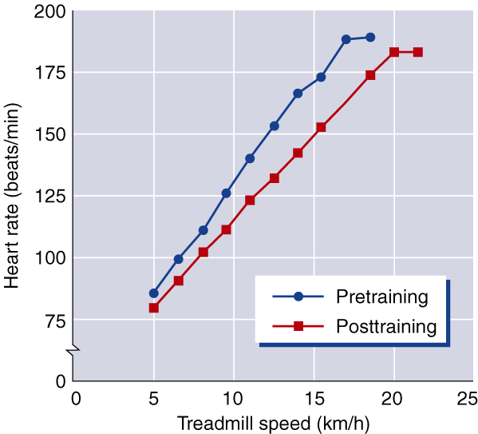
Heart Rate and Training
Notes:
https://www.mayoclinic.org/healthy-lifestyle/fitness/in-depth/exercise-intensity/art-20046887#:~:text=Subtract%20your%20age%20from%20220,minute%20for%20the%20average%20adult.

Slide 20
Resting Heart Rate
Decreases with endurance training likely due to more blood returning to heart and changes in autonomic control
Sedentary individuals can decrease RHR by 1 beat/min per week during initial training, but several recent studies have shown small changes of less than 3 beats/min with up to 20 wk of training
Highly trained endurance athletes may have resting heart rates of 30 to 40 beats/min
Notes:
https://www.mayoclinic.org/healthy-lifestyle/fitness/in-depth/exercise-intensity/art-20046887#:~:text=Subtract%20your%20age%20from%20220,minute%20for%20the%20average%20adult.

Slide 21
Heart Rate During Exercise
SUBMAXIMAL
Decreases proportionately with the amount of training completed
May decrease by 10 to 30 beats/min after 6 months of moderate training at any given rate of work, with the decrease being greater at higher rates of work
MAXIMAL
Remains unchanged or decreases slightly
A decrease might allow for optimal stroke volume to maximize cardiac output
Notes:
https://www.mayoclinic.org/healthy-lifestyle/fitness/in-depth/exercise-intensity/art-20046887#:~:text=Subtract%20your%20age%20from%20220,minute%20for%20the%20average%20adult.

Slide 22
Heart Rate Recovery Period
The time after exercise that it takes your heart to return to its resting rate
With training, heart rate returns to resting level more quickly after exercise
Has been used as an index of cardiorespiratory fitness
Conditions such as altitude or heat can affect it
Should not be used to compare individuals to one another

Slide 23
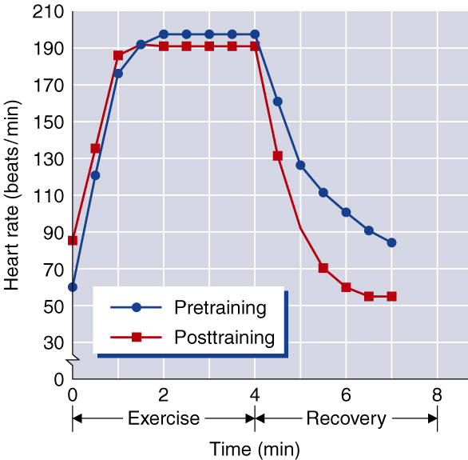
Heart Rate Recovery Period and Training

Slide 24
Stroke Volume
Determinant of cardiorespiratory endurance capacity at maximal rates of work
Increases with increasing rates of work up to intensities of 40% to 60% of max or higher
May continue to increase up through maximal exercise intensity, generally in highly trained athletes
Magnitude of changes in SV depends on position of body during exercise

Slide 25
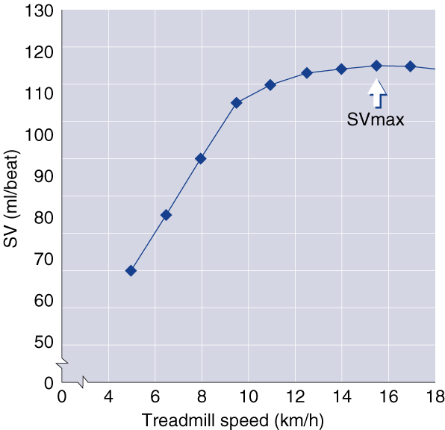
Stroke Volume and Intensity

Slide 26
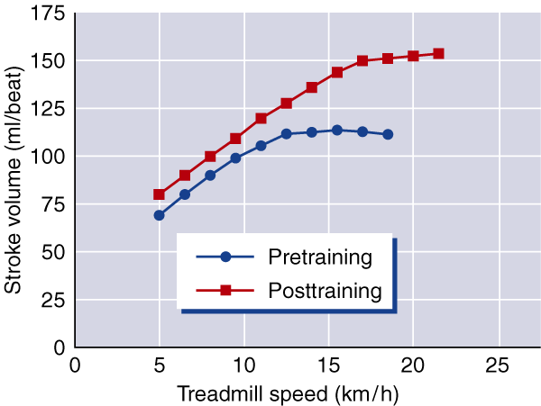
Stroke Volume and Training
Stroke Volumes (SV) for Different States of Training
Subjects SVrest (ml) SVmax (ml)
Untrained 50-70 80-110
Trained 70-90 110-150
Highly trained 90-110 150-220

Slide 27
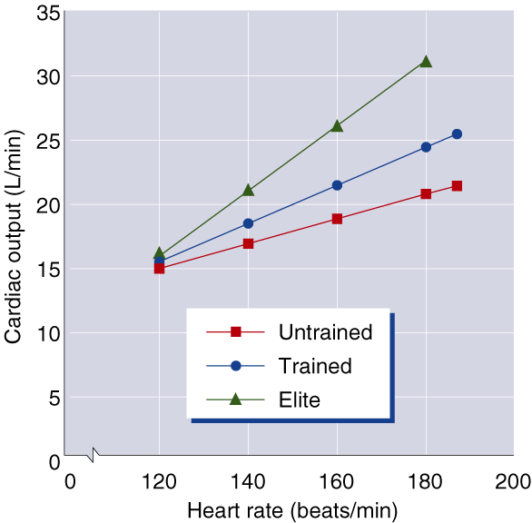
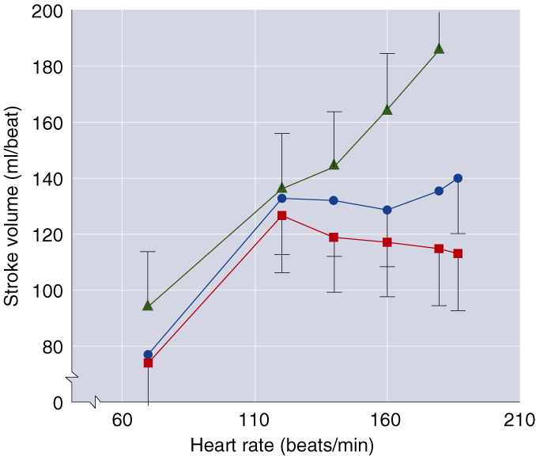
Changes in Q and SV with Increasing Rates of Work

Slide 28
Cardiac Output
Resting value is approximately 5.0 L/min.
Increases directly with increasing exercise intensity to maximal values of between 20 to 40 L/min
The magnitude of increase varies with body size and endurance conditioning.
When exercise intensity exceeds 40% to 60%, further increases in Q are more a result of increases in HR than SV since SV tends to plateau at higher work rates.

Slide 29
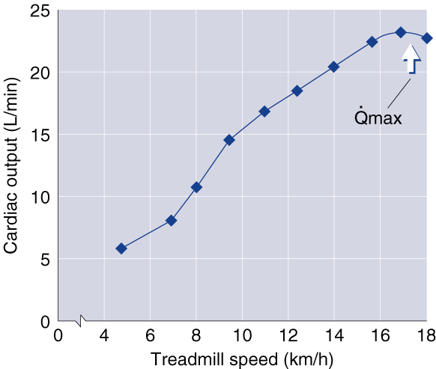
Cardiac Output and Intensity

Slide 30
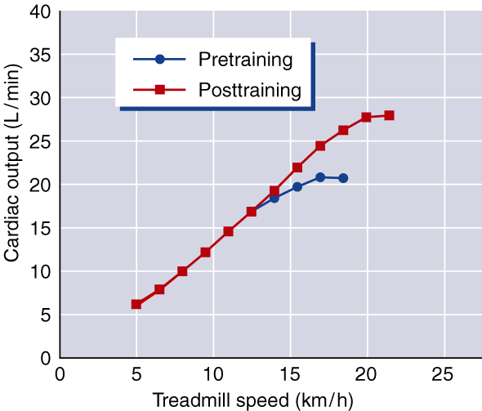
Cardiac Output and Training

Slide 31
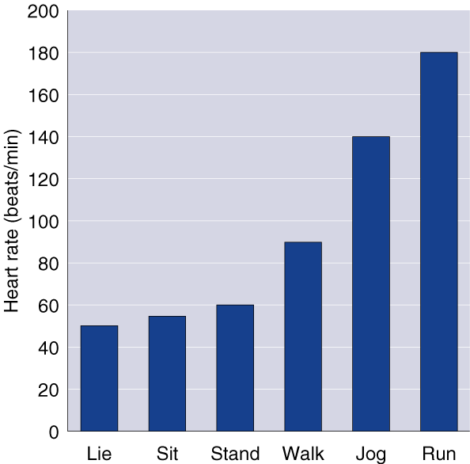
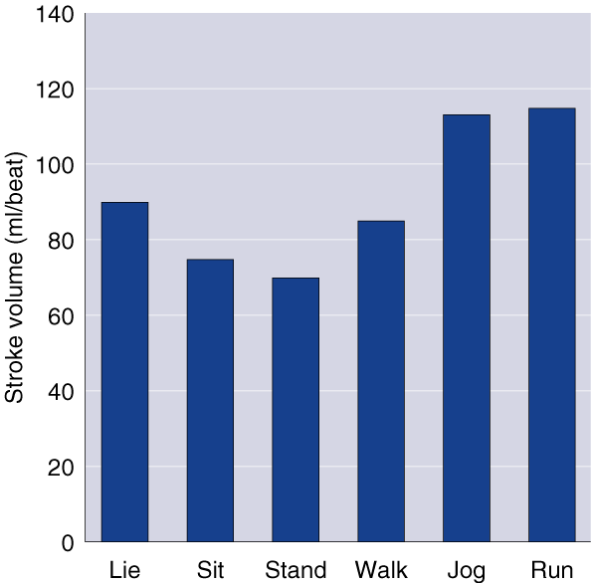
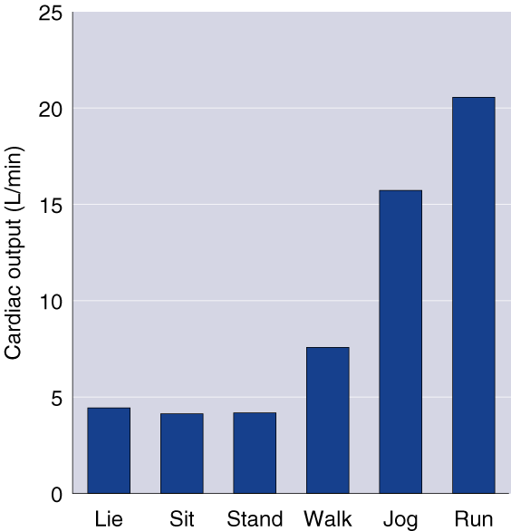
Changes in HR, SV, and Q with Changes in Position and Exercise Intensity

Slide 32
Blood Pressure
Cardiovascular Endurance Exercise
Systolic BP increases in direct proportion to increased exercise intensity
Diastolic BP changes little if any during endurance exercise, regardless of intensity
Resistance Exercise
Exaggerates BP responses to as high as 480/350 mmHg

Slide 33
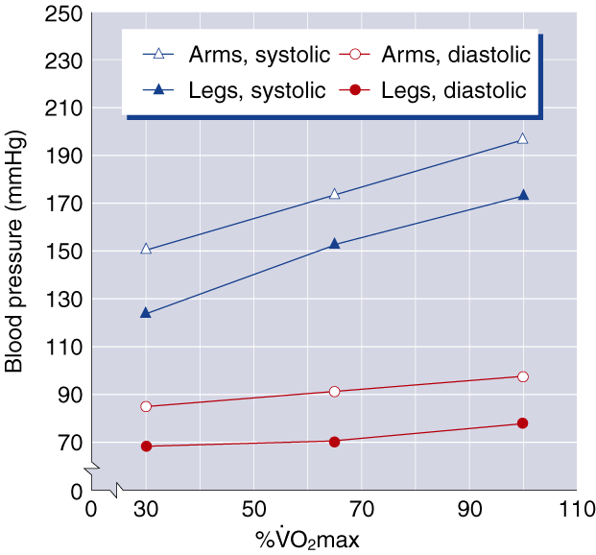
Blood Pressure Responses

Slide 34
Cardiovascular Adaptations to Training
Left ventricle size and wall thickness increase
Resting, submaximal, and maximal stroke volume increases
Maximal heart rate stays the same or decreases
Cardiac output is better distributed to active muscles and maximal cardiac output increases
Blood volume increases, as does red cell volume, but to a lesser extent
Resting blood pressure does not change or decreases slightly, while blood pressure during submaximal exercise decreases

Slide 35
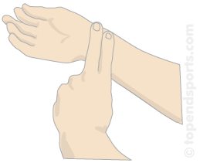
Heart rate measurements

Slide 36
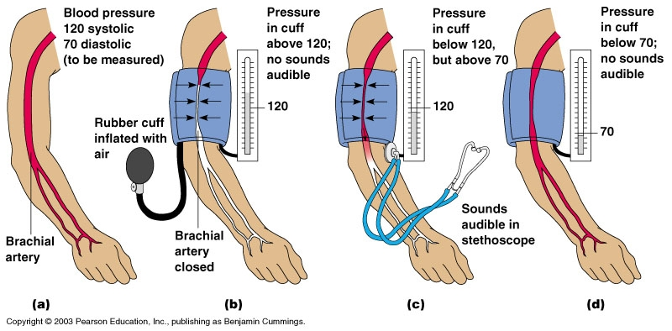
Blood pressure measurements

Slide 37
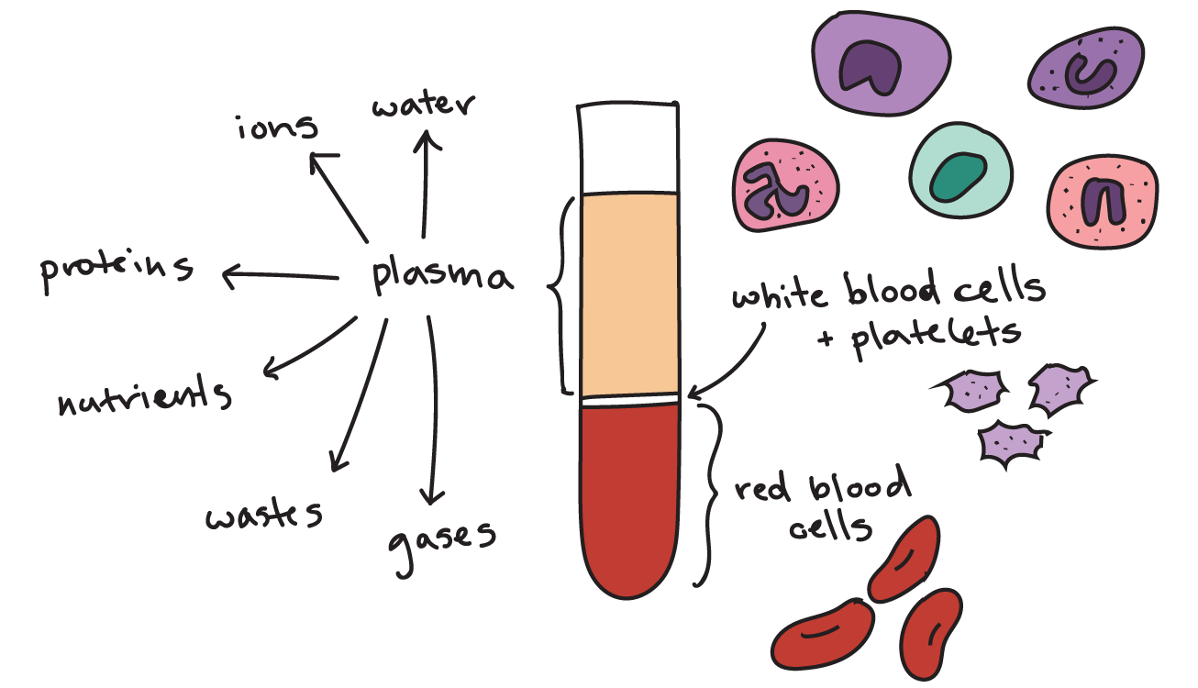
Blood
Connective tissue (the only fluid tissue in the body)
Accounts for approx. 7% of body weight
An adult individual has approx. 5liters of blood
Blood composition
Plasma (55%)
91% water
8% proteins – albumin, globulin (transportation)
1% other molecules
Formed elements (45%)
99% red blood cells (erythrocytes) – carry oxygen
<1% white blood cells (leukocytes) – protect from pathogens
Platelets (<1%)
Blood placed in a centrifuge
* Erythrocytes and platelets do not possess all the typical organelles and they can not divide – they are replaced by stem cells in the bone marrow
Notes:
https://www.khanacademy.org/science/biology/human-biology/circulatory-pulmonary/a/components-of-the-blood
https://www.youtube.com/watch?v=yj7bfZKlIp8&t=182s&ab_channel=ProfessorDaveExplains

Slide 38
Blood hematocrit, viscosity
$$∗Hematocrit=\frac{Formed elements}{Total blood volume}$$
Blood viscosity = thickness of the blood
The more viscous, the more resistant to flow
Higher hematocrits result in higher blood viscosity
Notes:
https://www.khanacademy.org/science/biology/human-biology/circulatory-pulmonary/a/components-of-the-blood

Slide 39
Blood functions
Delivers oxygen to tissues
Delivers nutrients such glucose, amino acids or fatty acids – dissolved in blood or attached to carrier proteins
Transports waste products – CO2, Urea, Lactic acid
Transports hormones
Protects from pathogens (Immunological functions) – white blood cells, Antibodies
Regulates temperature
Buffers and balances acid base homeostasis
Coagulation (to stop bleeding)

Slide 40
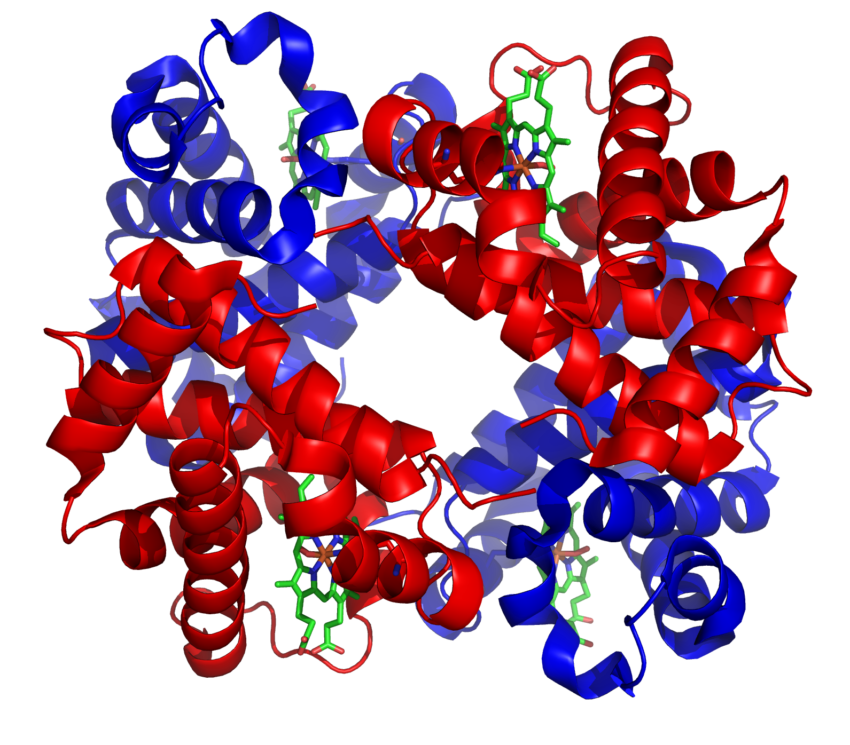
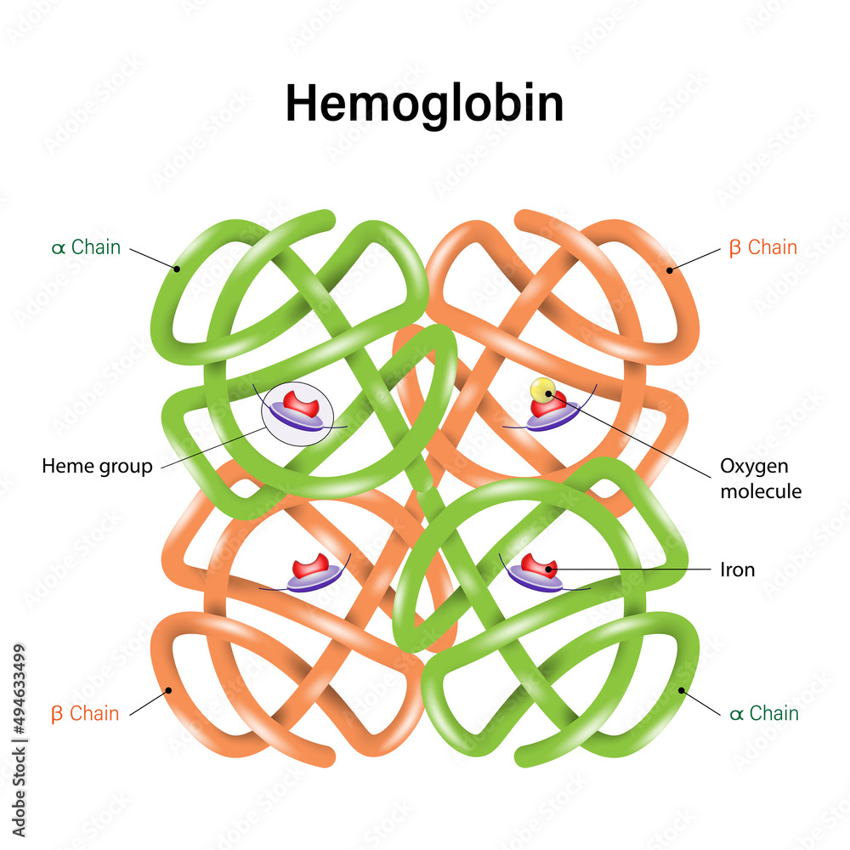
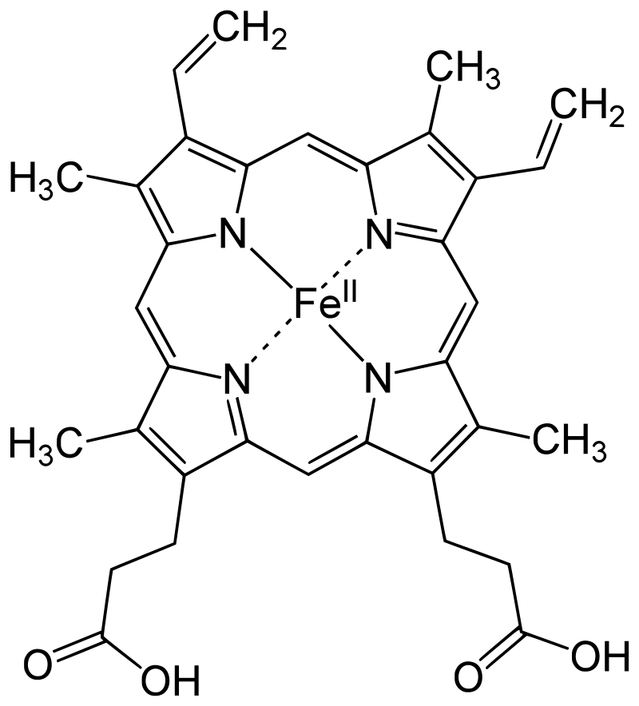
Hemoglobin (Hb)
Hb comprises 4 globin subunits – two α and two β units
Each globin is attached to a heme b group with an iron atom at the center
Each heme b group can carry one oxygen molecule attached to the iron atom
Hb is present in two forms (influenced by partial pressures and pH)
Relaxed (R)
Tense (T)
Different absorption spectra - used for oxygen levels measurements
Heme b group
Notes:
Various factors such as low pH, high CO₂ and high 2,3 BPG at the level of the tissues favor the taut form, which has low oxygen affinity and releases oxygen in the tissues. Conversely, a high pH, low CO₂, or low 2,3 BPG favors the relaxed form, which can better bind oxygen.^{[54]} The partial pressure of the system also affects O₂ affinity where, at high partial pressures of oxygen (such as those present in the alveoli), the relaxed (high affinity, R) state is favoured. Inversely, at low partial pressures (such as those present in respiring tissues), the (low affinity, T) tense state is favoured.^{[55]} Additionally, the binding of oxygen to the iron(II) heme pulls the iron into the plane of the porphyrin ring, causing a slight conformational shift. The shift encourages oxygen to bind to the three remaining heme units within hemoglobin (thus, oxygen binding is cooperative).

Slide 41
Hemoglobin (Hb)
Approx. 250 million Hemoglobin molecules per one red blood cell!
100 ml of blood contains ~14-18 g of Hb in men and ~12-14 in women (1 g of Hb combines with 1.34 ml of oxygen)
There are ~20.1 ml of O₂ per 100 ml of arterial blood (15 g of Hb x 1.34 ml of O₂/g of Hb) in men and ~17.4 ml of O₂ per 100 ml of arterial blood (13 g x 1.34) in women
Low iron leads to iron-deficiency anemia, reducing the body’s capacity to transport oxygen—this is more of a problem in women than men
Heme b group
Notes:
Various factors such as low pH, high CO₂ and high 2,3 BPG at the level of the tissues favor the taut form, which has low oxygen affinity and releases oxygen in the tissues. Conversely, a high pH, low CO₂, or low 2,3 BPG favors the relaxed form, which can better bind oxygen.^{[54]} The partial pressure of the system also affects O₂ affinity where, at high partial pressures of oxygen (such as those present in the alveoli), the relaxed (high affinity, R) state is favoured. Inversely, at low partial pressures (such as those present in respiring tissues), the (low affinity, T) tense state is favoured.^{[55]} Additionally, the binding of oxygen to the iron(II) heme pulls the iron into the plane of the porphyrin ring, causing a slight conformational shift. The shift encourages oxygen to bind to the three remaining heme units within hemoglobin (thus, oxygen binding is cooperative).

Slide 42
Blood KEY POINTS
Blood and lymph transport materials to and from body tissues
Blood is about 55% to 60% plasma and 40% to 45% formed elements (white and red blood cells and blood platelets)
Oxygen travels through the body by binding to hemoglobin in red blood cells
An increase in blood viscosity results in resistance to flow

Slide 43
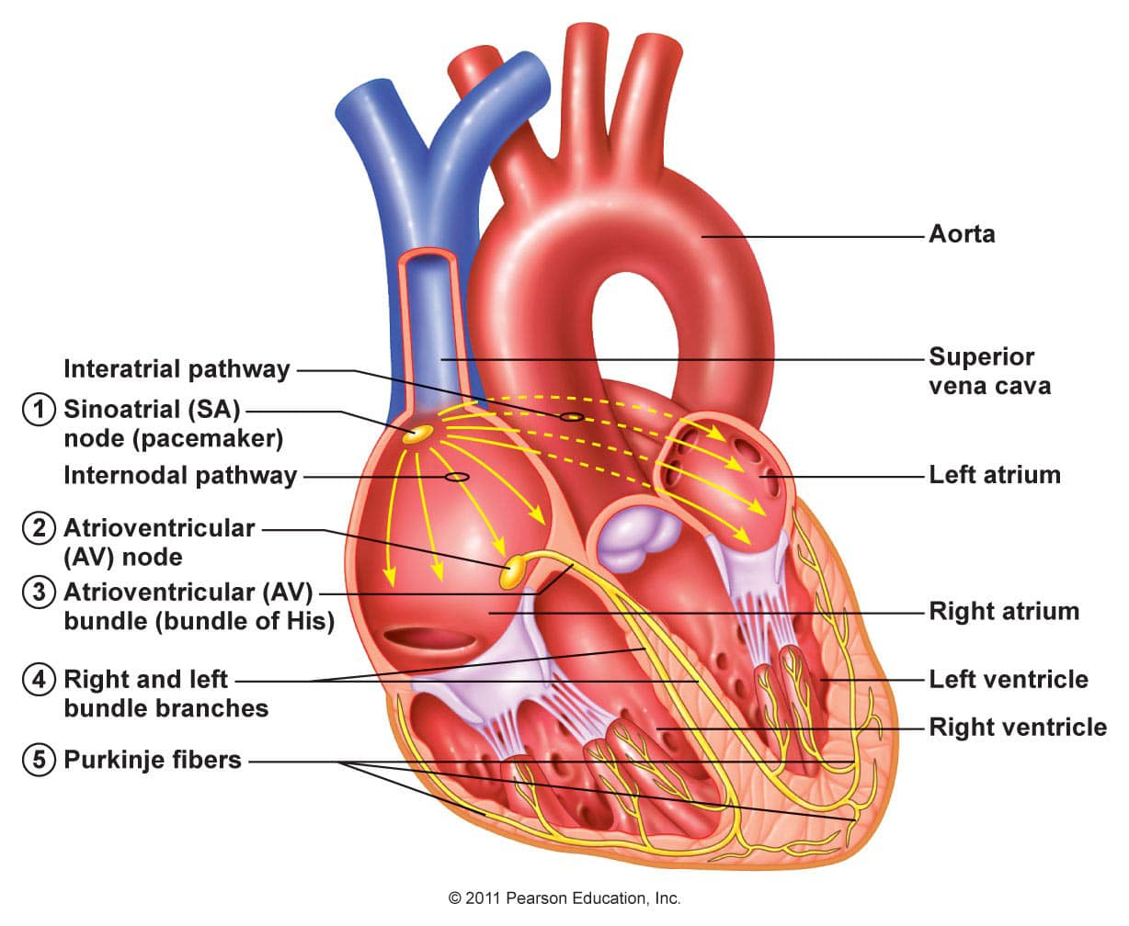
Intrinsic Conduction System
Cells of Intrinsic conduction system (ICS) generate their own electrical impulses
Sinoatrial node (SA node) - the pacemaker – it generates electrical impulses the fastest and sets the rhythm for the rest of ICS
Atrioventricular node (AV node)
AV bundle
Bundle branches
Purkinje fibers (subendocardial conducting network) – contractions of the ventricles
Notes:
https://www.facebook.com/photo/?fbid=497597494434803&set=pcb.497598781101341

Slide 44
Intrinsic Conduction System
Cells of Intrinsic conduction system (ICS) generate their own electrical impulses
Sinoatrial node (SA node) - the pacemaker – it generates electrical impulses the fastest and sets the rhythm for the rest of ICS; heavily controlled
Atrioventricular node (AV node)
AV bundle
Bundle branches
Purkinje fibers (subendocardial conducting network) – contractions of the ventricles
Notes:
https://www.facebook.com/photo/?fbid=497597494434803&set=pcb.497598781101341
https://www.youtube.com/watch?v=sysTSvey4Ow&ab_channel=AnatomyHero
https://www.frontiersin.org/articles/10.3389/fphys.2020.00170/full

Slide 45
Intrinsic Conduction System

Slide 46
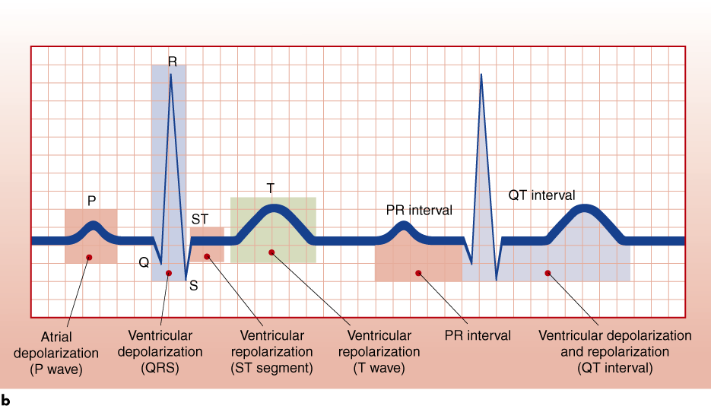
Electrocardiogram (ECG)
Printout shows the heart's electrical activity – can be used to monitor cardiac changes
The P wave – atrial depolarization
The QRS complex – ventricular depolarization and atrial repolarization
ST segment – plateau of action potential, ventricles pump blood
The T wave – ventricular repolarization (diastole)
Notes:
https://www.youtube.com/watch?v=RYZ4daFwMa8&ab_channel=AlilaMedicalMedia
https://www.youtube.com/watch?v=v7Q9BrNfIpQ&ab_channel=AlilaMedicalMedia
Q – depolarization of the interventricular septum
R – depolarization of the main mass of the ventricles
S – depolarization at the base of the heart

Slide 47
KEY POINTS – Cardiovascular system
The pacemaker of the heart is the SA node; it establishes heart rate and coordinates conduction
The autonomic nervous system or the endocrine system can alter heart rate and contraction strength
An ECG records the heart's electrical function and can be used to detect cardiac disorders

Slide 48
Vascular system
Arteries
Arterioles
Capillaries
Venules
Veins
Carry blood away from the heart
Carry blood back to the heart
Pulmonary VEINS carry oxygenated blood from the lungs to the heart
Pulmonary ARTERIES carry blood with lower oxygen levels to the lungs

Slide 49
Vascular system
Arteries
Arterioles
Capillaries
Venules
Veins

Slide 50
Vascular system
Arteries
Arterioles
Capillaries
Venules
Veins

Slide 51
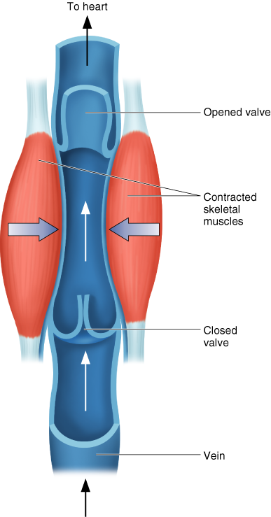
Vascular system
Arteries
Arterioles
Capillaries
Venules
Veins

Slide 52
Vascular system
Arteries
Arterioles
Capillaries
Venules
Veins

Slide 53
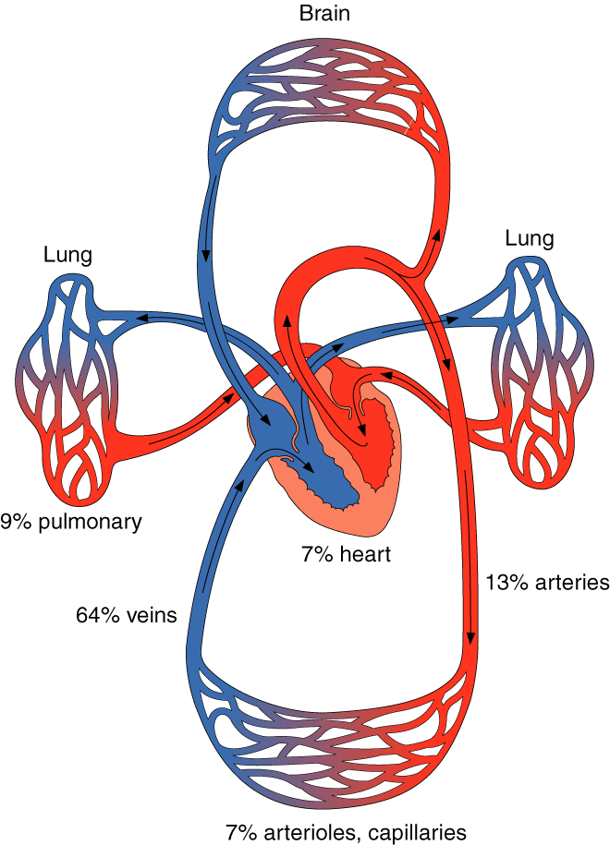
Blood distribution
Matched to overall metabolic demands
Autoregulation—arterioles within organs or tissues dilate or constrict in response to the local chemical environment
Extrinsic neural control—sympathetic nerves within walls of vessels are stimulated causing vessels to constrict
Determined by the balance between mean arterial pressure and total peripheral resistance

Slide 54
Blood Flow Increases with Training
Increased capillarization of trained muscles (higher capillary-to-fiber ratio)
Greater opening of existing capillaries in trained muscles
More effective blood redistribution—blood goes where it is needed
Blood volume increases

Slide 55
Blood Volume and Training
Endurance training, especially intense training, increases blood volume
Blood volume increases due primarily to an increase in plasma volume (increases in ADH, aldosterone, and plasma proteins cause more fluid to be retained in the blood)
Red blood cell volume increases, but increase in plasma volume is higher; thus, hematocrit decreases
Blood viscosity decreases, thus improving circulation and enhancing oxygen delivery
Changes in plasma volume are highly correlated with changes in SV and VO₂max.

Slide 56
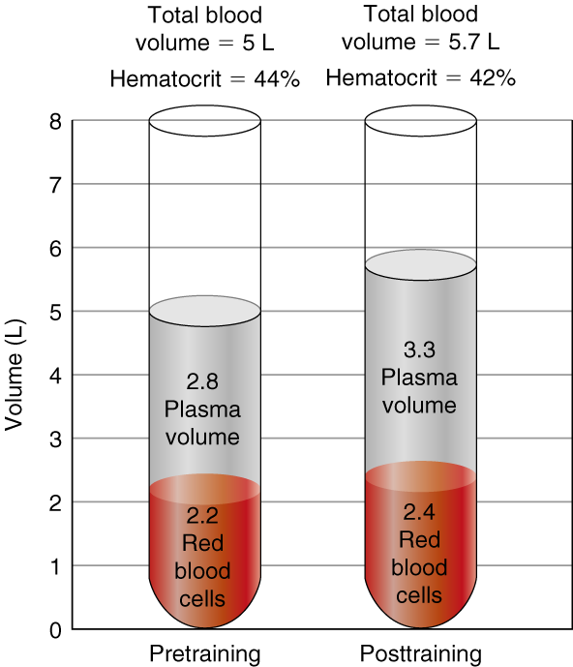
Blood and Plasma Volume and Training

Slide 57
Cardiovascular Adaptations to Training
Left ventricle size and wall thickness increase
Resting, submaximal, and maximal stroke volume increases
Maximal heart rate stays the same or decreases
Cardiac output is better distributed to active muscles and maximal cardiac output increases
Blood volume increases, as does red cell volume, but to a lesser extent
Resting blood pressure does not change or decreases slightly, while blood pressure during submaximal exercise decreases

Slide 58
Respiratory system
Respiratory regulation during exercise

Slide 59
Respiration
Respiration - delivery of oxygen to and removal of carbon dioxide from the tissue
External respiration—ventilation and exchange of gases in the lung
Pulmonary ventilation – movement of air into and out of the lungs—inspiration and expiration
Pulmonary diffusion – exchange of oxygen and carbon dioxide between the lungs and blood
Internal respiration—exchange of gases at the tissue level (between blood and tissues)

Slide 60
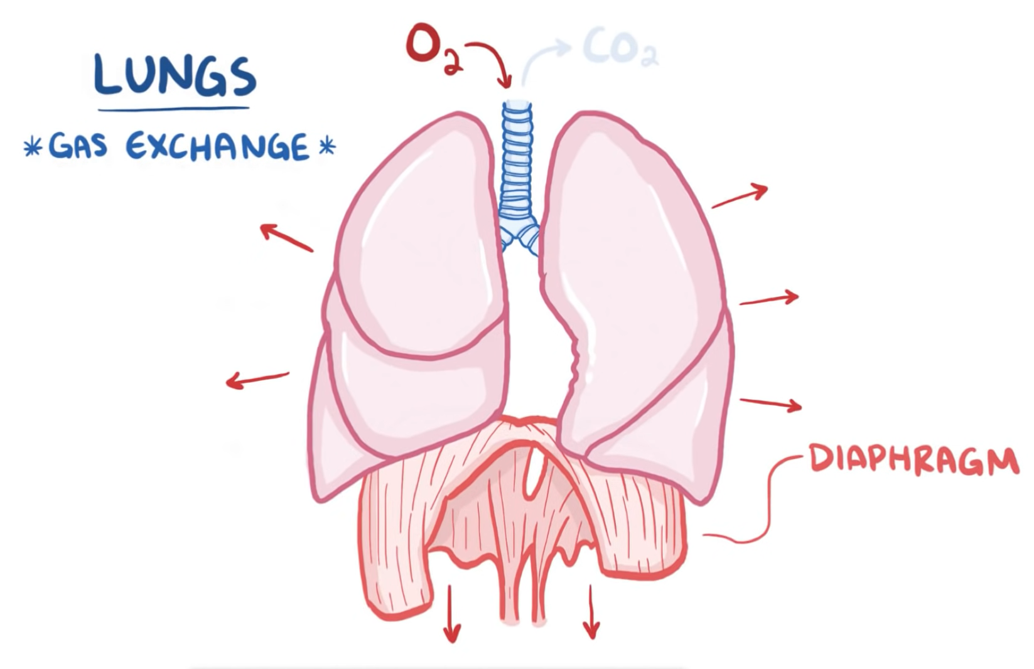
External respiration
Rest
Inspiration
Expiration
The diaphragm contracts to pull downwards and chest muscles contract to pull open the chest
The diaphragm and the chest muscles relax allowing the lungs to spring back to normal relaxed size – this pushes the air out
Notes:
What muscles help us with breathing?
Hypotonic environment

Slide 61
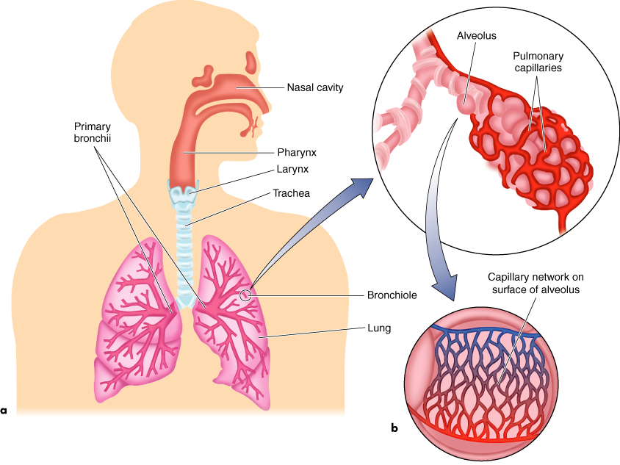
Pulmonary ventilation
Nasal cavity – lined by cells that release mucus
Mucus – sticky and salty, contains lysozymes
Nasal hair covered in mucus catch large particles, dust, pollen etc.
Paranasal sinuses – help the air to circulate to get warm and moist
Air flow
Notes:
As you breathe in the air goes to the nasal cavity
Filled with mucus
Lysozymes – help fight bacteria

Slide 62
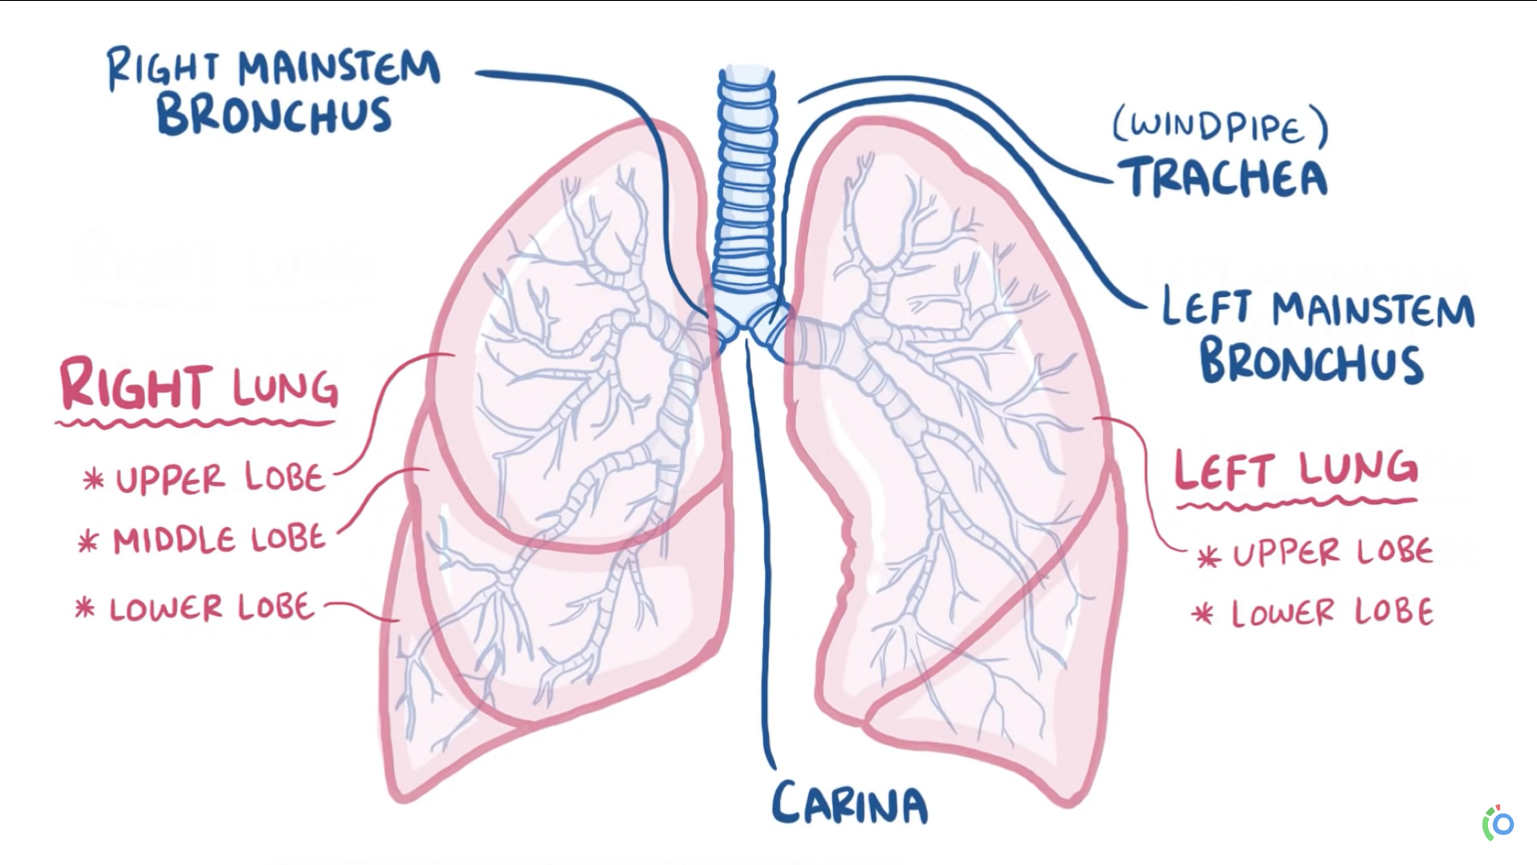
Pulmonary ventilation
Lungs' lobes
Trachea and the first three generations of bronchi use cartilage rings for support
Then the bronchi narrow down to bronchioles
No cartilage
15-20 generations
Notes:
The air goes into your lungs
Branch out
https://www.youtube.com/watch?v=0fVoz4V75_E&ab_channel=Osmosis

Slide 63
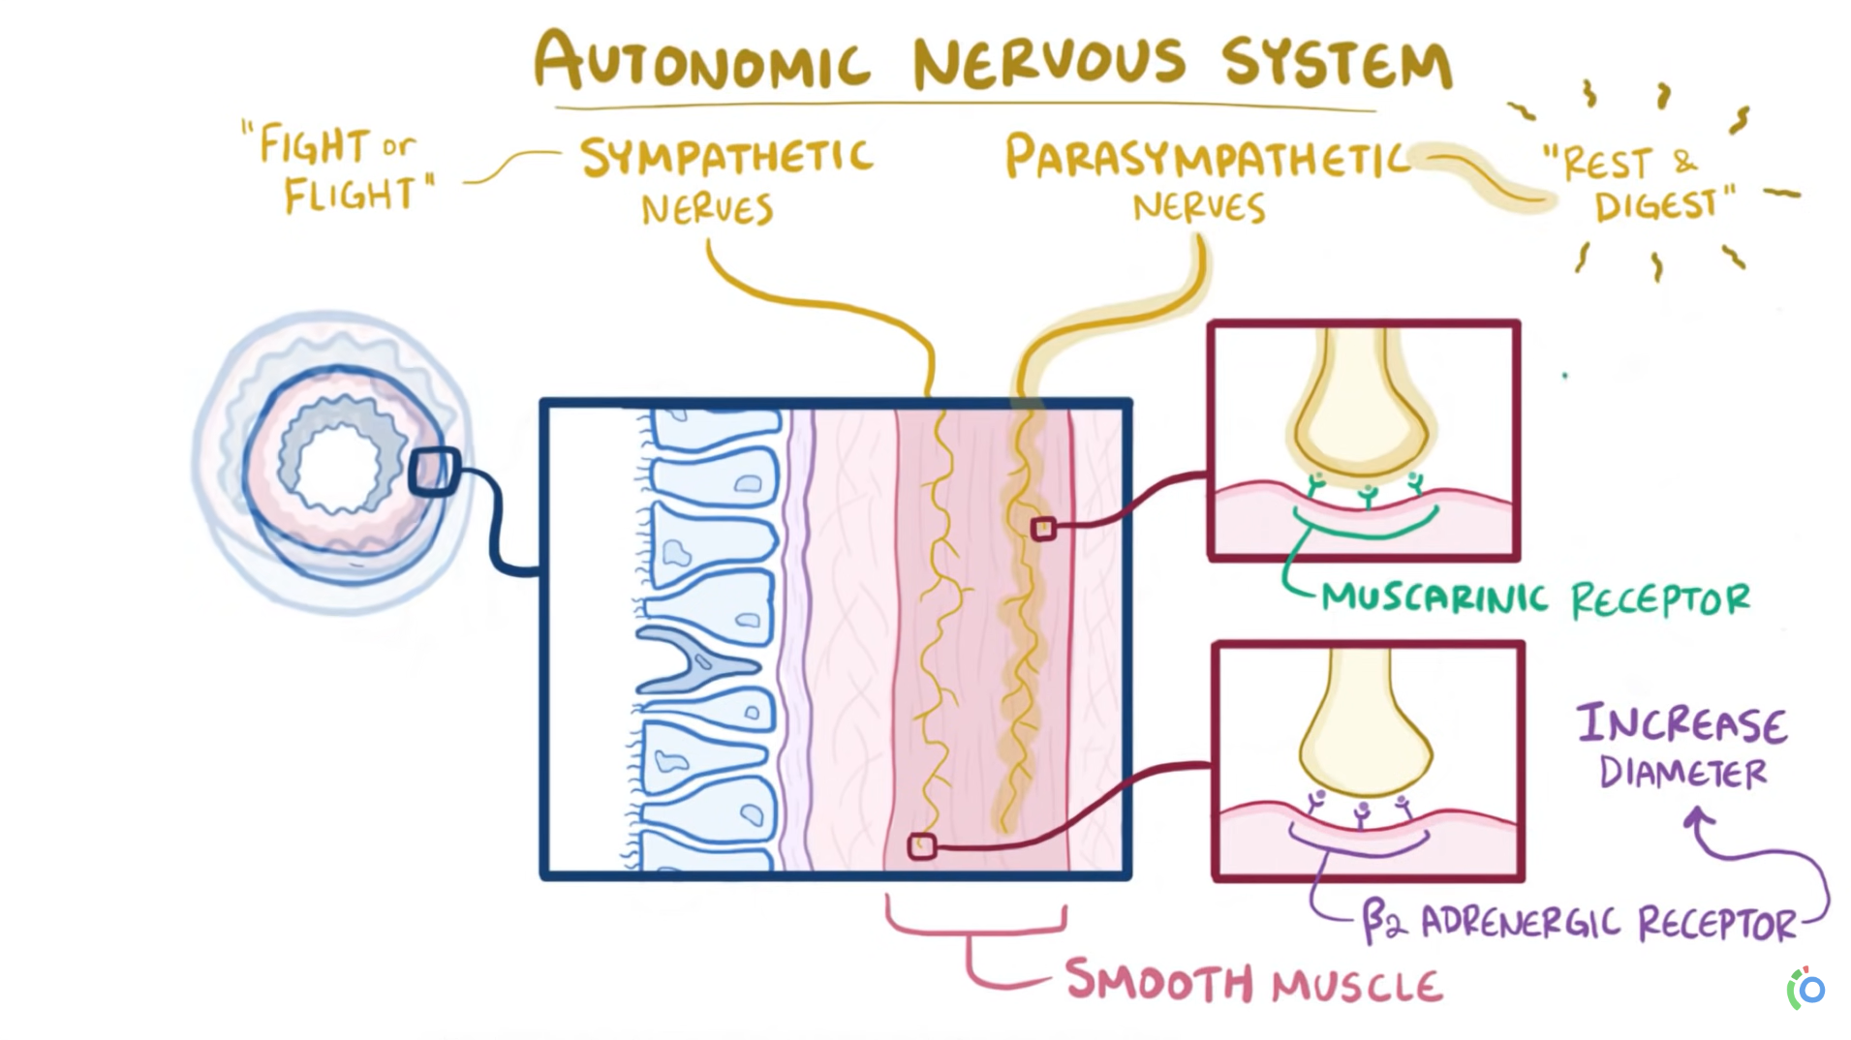
Respiration
Notes:
https://www.youtube.com/watch?v=0fVoz4V75_E&ab_channel=Osmosis

Slide 64
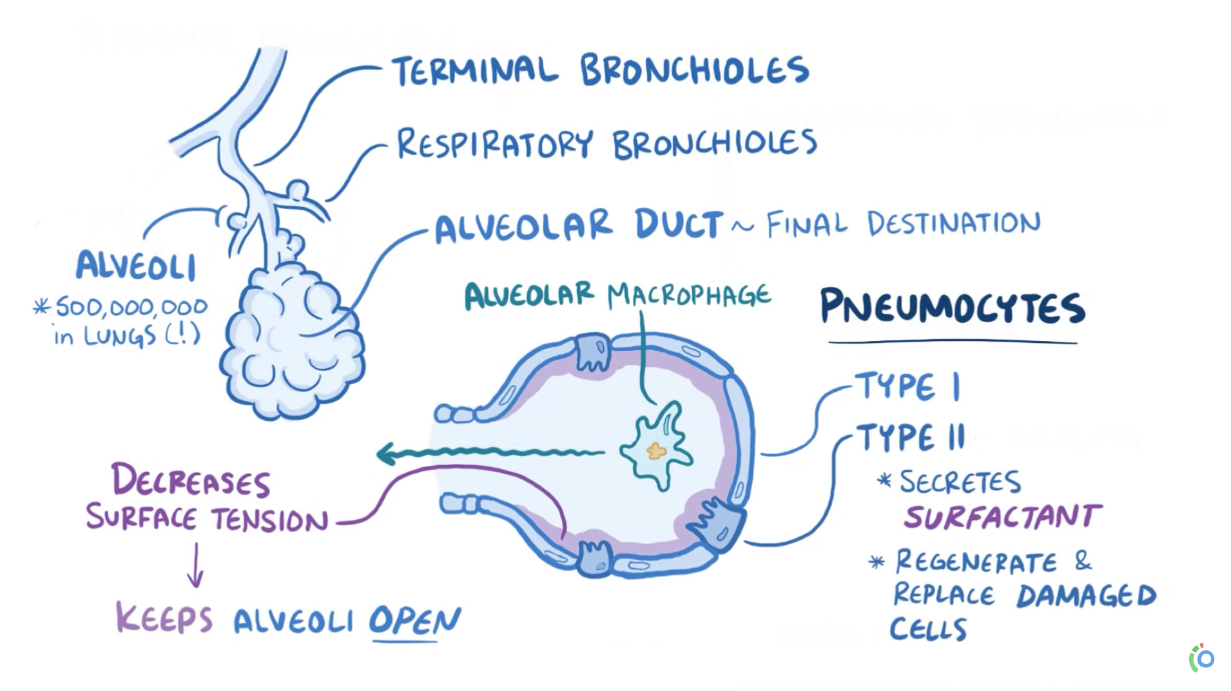
Pulmonary ventilation
Terminal bronchioles
Respiratory bronchioles
Alveoli – about 500 000 000 in the lungs
Alveolar duct – the destination of the inhaled air
Pneumocytes
Type I
Type II - surfactant
Notes:
https://www.youtube.com/watch?v=0fVoz4V75_E&ab_channel=Osmosis

Slide 65
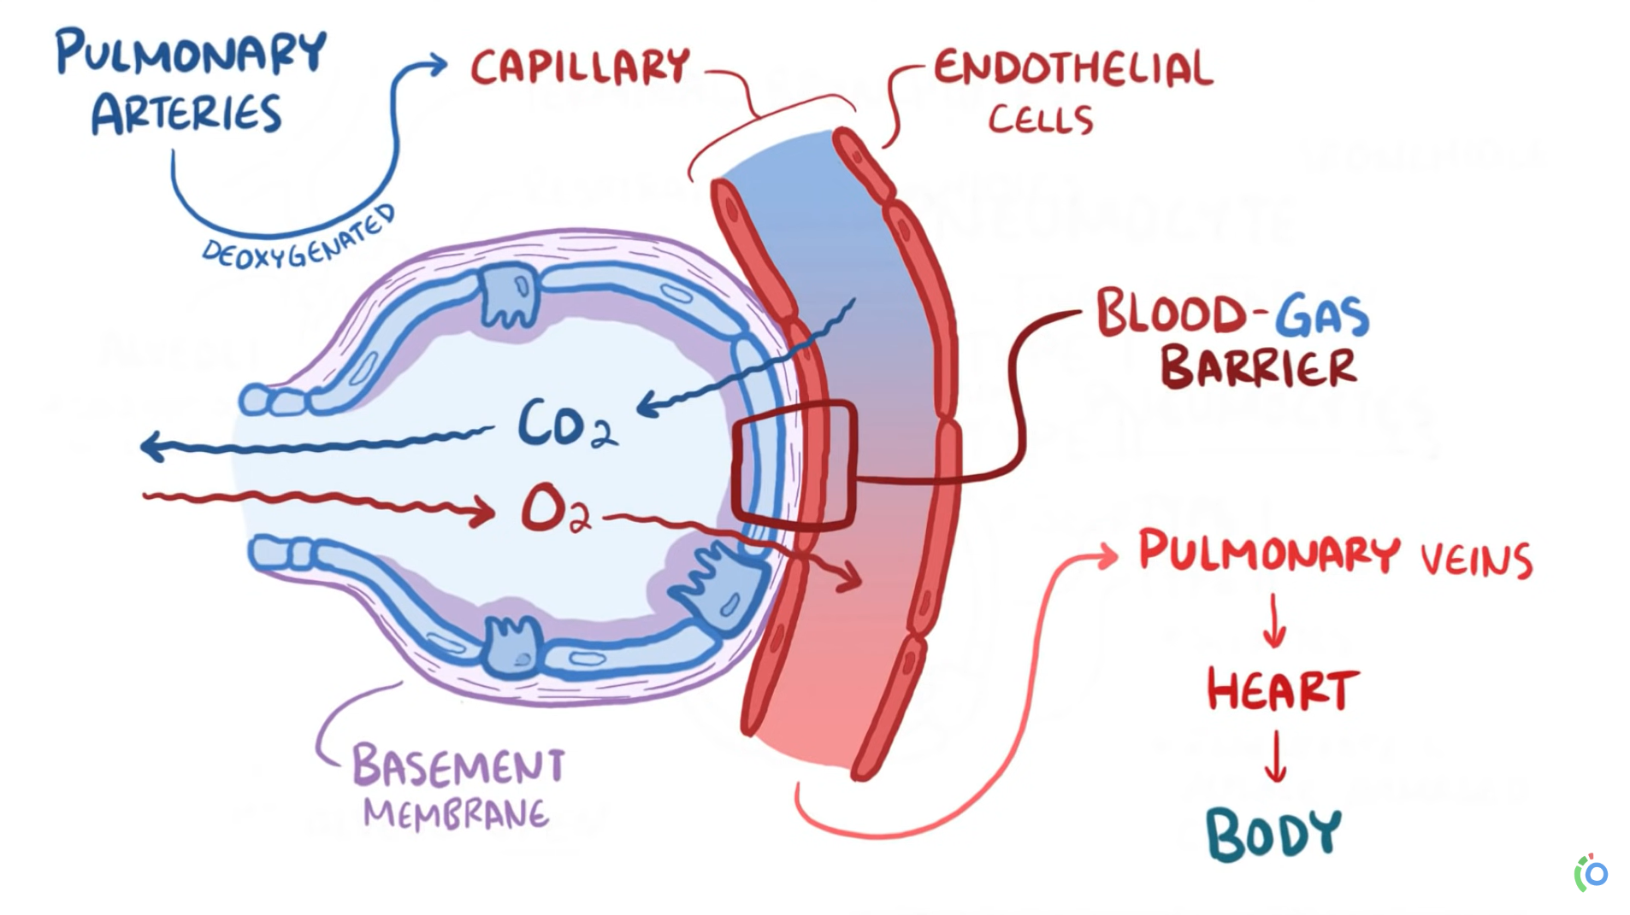
Pulmonary diffusion
BLOOD-GAS barrier: pneumocytes, endothelial cells and basement membrane (proteins)
Deoxygenated blood arrives via pulmonary arteries
Replenishes blood's oxygen supply that has been depleted for oxidative energy production
Carbon dioxide is removed and breathed out
Oxygenated blood via pulmonary veins – to the heart – to the body
Notes:
What happens in the Alveoli?
Deoxygenated blood comes and meets the alveoli – gases can exchange
DIFFUSION – partial pressure helps diffusion
https://www.youtube.com/watch?v=0fVoz4V75_E&ab_channel=Osmosis

Slide 66
Did you know?
Differences in the partial pressures of gases in the alveoli and in the blood create a pressure gradient across the respiratory membrane. This difference in pressures leads to diffusion of gases across the respiratory membrane. The greater the pressure gradient, the more rapidly oxygen diffuses across it.
Notes:
https://www.youtube.com/watch?v=0fVoz4V75_E&ab_channel=Osmosis

Slide 67
Gases – partial pressure and exchange
PV=nRT
Atmospheric air is a mixture of gases – each with its own partial pressure contributes to the total atmospheric pressure
Alveolar air differs from atmospheric air
The gas exchange occurs between the alveolar air and the blood in capillaries by diffusion – the flow down their concentration gradient or partial pressure gradient
The composition of alveolar air is closely monitored
Gas exchange depends on:
The magnitude of partial pressure gradient (influenced also by altitude)
Solubility (nitrogen is plentiful in the air but does not diffuse into the blood)
Thickness of the pulmonary membrane
Notes:
Nitrogen, carbon dioxide, oxygen…
Https://www.youtube.com/watch?v=6qnSsV2syUE&ab_channel=AlilaMedicalMedia

Slide 68
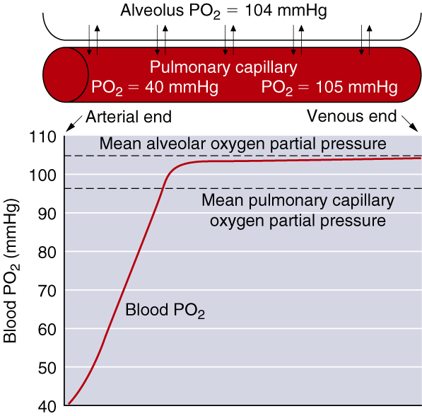
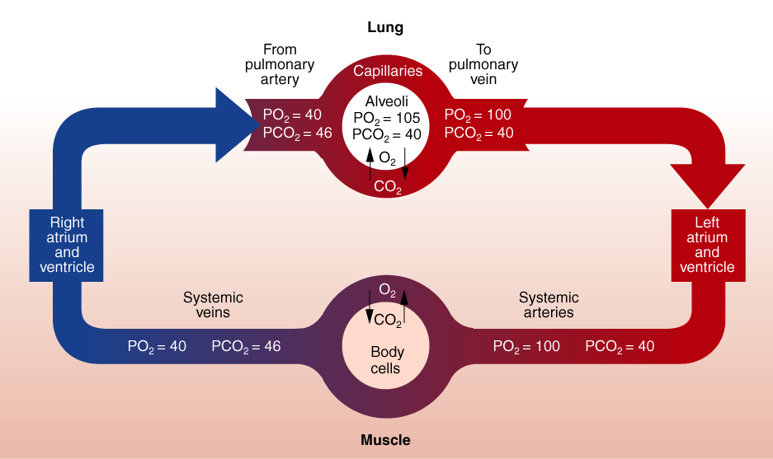
PO₂ AND PCO₂ IN BLOOD

Slide 69
Partial Pressures of Respiratory Gases at Sea Level
Partial pressure (mmHg)
% in Dry Alveolar Arterial Venous Diffusion Gas dry air air air blood blood gradient
Total 100.00 760.0 760 760 706 0
H₂O 0.00 0.0 47 47 47 0
O₂ 20.93 159.1 105 100 40 60
CO₂ 0.03 0.2 40 40 46 6
N₂ 79.04 600.7 568 573 573 0

Slide 70
KEY POINTS – Pulmonary diffusion
Pulmonary diffusion is the process by which gases are exchanged across the respiratory membrane in the alveoli to the blood and vice versa
The amount of gas exchange depends on the partial pressure of each gas, its solubility, and temperature
Gases diffuse along a pressure gradient, moving from an area of higher pressure to lower pressure
Oxygen diffusion capacity increases as you move from rest to exercise
The pressure gradient for CO2 exchange is less than for O2 exchange, but carbon dioxide’s diffusion coefficient is 20 times greater than that of oxygen’s, so CO2 crosses the membrane easily
Notes:
https://www.youtube.com/watch?v=6qnSsV2syUE&ab_channel=AlilaMedicalMedia

Slide 71
Oxygen Transport
Hemoglobin concentration largely determines the oxygen-carrying capacity of blood (>98% of oxygen transported)
Increased H+ (acidity) and temperature of a muscle allows more oxygen to be unloaded there
Training affects oxygen transport in muscle

Slide 72
Carbon Dioxide Transport
Dissolved in blood plasma (7% to 10%)
As bicarbonate ions resulting from the dissociation of carbonic acid (60% to 70%)
Bound to hemoglobin (carbaminohemoglobin) (20% to 33%)

Slide 73
Factors of Oxygen Uptake and Delivery
Oxygen content of blood
Amount of blood flow
Local conditions within the muscle

Slide 74
KEY POINTS – External an Internal Respiration
Oxygen is largely transported in the blood bound to hemoglobin and small amounts are transported dissolved in the blood plasma
Hemoglobin saturation decreases when PO2 or pH decreases, or if temperature increases. These factors increase oxygen unloading in a tissue that needs it
Hemoglobin is usually 98% saturated with oxygen which is higher than what our bodies require, so the blood's oxygen-carrying capacity seldom limits performance
Carbon dioxide is transported in the blood as bicarbonate ion, in blood plasma or bound to hemoglobin
The difference in the oxygen content of arterial and mixed venous blood—reflects the amount of oxygen taken up by the tissues
Carbon dioxide exchange at the tissues is similar to oxygen exchange except that it leaves the muscles and enters the blood to be transported to the lungs for clearance

Slide 75
Breathing frequency (BF)
Breathing frequency is the number of breaths taken within a set amount of minute:
BF rest = 16 (breaths per minute) (10 in endurance)
BF (light exercise) = 20-30
BF (moderate exercise) = 30-40
BF (heavy exercise) = 50-60

Slide 76
Tidal volume (VT)
Tidal volume (l) is the amount of air inspired or expired during normal quiet respiration.
V_{T} rest = 0,5 l (1 l in endurance)
V_{T} (light exercise) = 1-1,5 l
V_{T} (moderate exercise) = 1,5-2 l
V_{T} (heavy exercise) = 2-3 l

Slide 77
Pulmonary ventilation
Ventilation (VE) is the product of tidal volume (TV) and breathing frequency (f):
V_{E} rest = 8 l
V_{E} (light exercise) = 40 l
V_{E} (moderate exercise) = 80 l
V_{E} (heavy exercise) = 120l (180l in endurance)

Slide 78
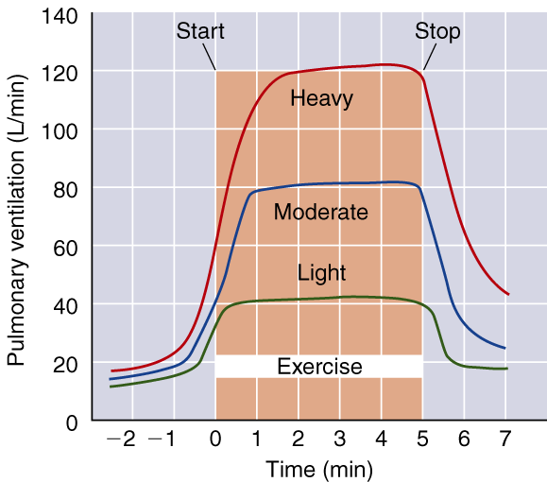
Ventilatory Response to Exercise

Slide 79
Breathing Terminology
Dyspnea = shortness of breath
Hypervetilation = increase in ventilation that exceeds the metabolic need for oxygen. Voluntary hyperventilation, as is often done before underwater swimming, reduces the ventilatory drive by increasing blood pH

Slide 80
Ventilatory Equivalent for Oxygen
The ratio between V_{E} and VO₂ in a given time frame
Indicates breathing economy
At rest—V_{E}/VO₂ = 23 to 28 L of air breathed per L VO₂ per minute
At max exercise—V_{E}/VO₂ = 30 L of air per L VO₂ per minute
Generally V_{E}/VO₂ remains relatively constant over a wide range of exercise levels

Slide 81
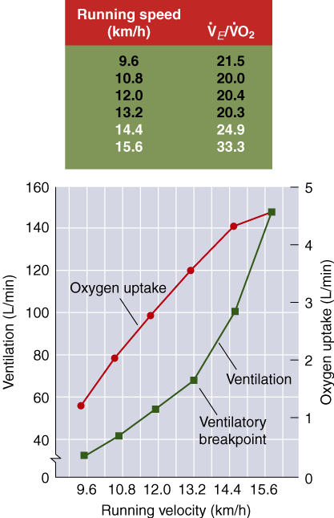
Ventilatory Breakpoint
The point during intense exercise at which ventilation increases disproportionately to the oxygen consumption
When work rate exceeds 55% to 70% VO₂max, oxygen delivery can no longer match the energy requirements so energy must be derived from anaerobic glycolysis
Anaerobic glycolysis increases lactate levels, which increase CO₂ levels (buffering), triggering a respiratory response and increased ventilation

Slide 82
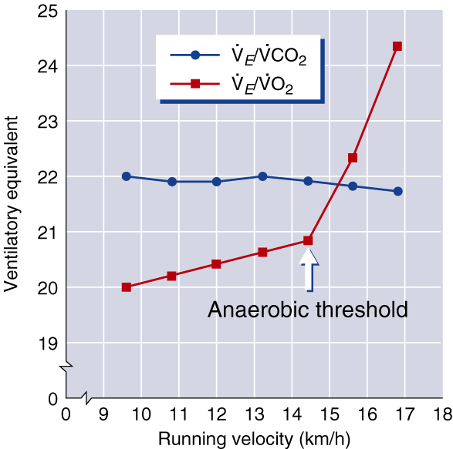
Anaerobic Threshold
The point during intense exercise at which metabolism becomes increasingly more anaerobic
Reflects the lactate threshold under most conditions, though the relationship is not always exact
An increase in V_{E}/VO₂ without an concomitant increase in the ventilatory equivalent for carbon dioxide (V_{E}/VCO₂)

Slide 83
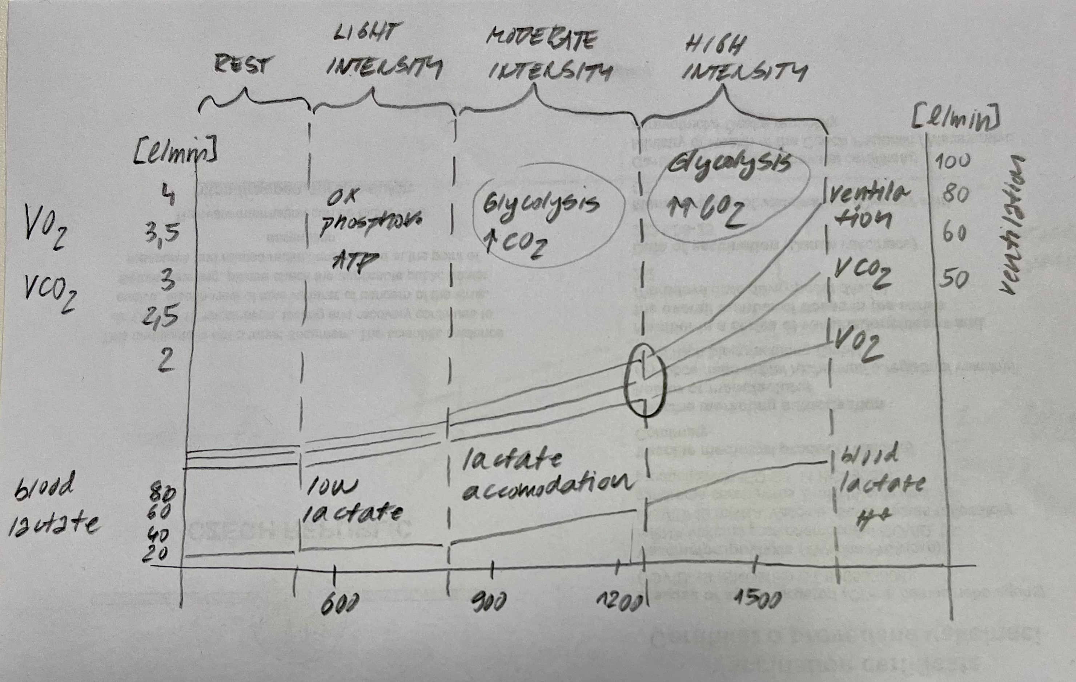
Anaerobic Threshold

Slide 84
Pulmonary Ventilation
The respiratory centres in the brain stem set the rate and depth of breathing
Chemoreceptors respond to increases in CO2 and H+ concentrations or to decreases in blood oxygen levels by increasing respiration
Ventilation increases at the initiation of exercise due to inspiratory stimulation from muscle activity. As exercise progresses, increase in muscle temperature and chemical changes in the arterial blood further increase ventilation

Slide 85
Pulmonary Ventilation
During mild, steady-state exercise, ventilation parallels oxygen uptake
The ventilatory breakpoint is the point at which ventilation increases disproportionately to the increase in oxygen consumption
Anaerobic threshold is identified as the point at which V_{E}/VO₂ shows a sudden increase, while V_{E}/VCO₂ stays stable. It generally reflects lactate threshold

Slide 86
Respiratory Limitations to Performance
Respiratory muscles may use up to 11% of total oxygen consumed during heavy exercise and seem to be more resistant to fatigue during long-term activity than muscles of the extremities
Pulmonary ventilation is usually not a limiting factor for performance, even during maximal effort, though it can limit performance in highly trained people
Airway resistance and gas diffusion usually do not limit performance in normal healthy individuals, but abnormal or obstructive respiratory disorders can limit performance

Slide 87
KEY POINTS – Respiratory Adaptations to Training
Pulmonary ventilation increases during maximal effort after training; you can improve performance by training the inspiratory muscles
Pulmonary diffusion increases at maximal work rates
The a-vO2 diff increases with training due to more oxygen being extracted by tissues
The respiratory system is seldom a limiter of endurance performance
All the major adaptations of the respiratory system to training are most apparent during maximal exercise

Slide 88
VO₂ Adaptations to Training
Oxygen consumption (VO₂) is
unaltered or slightly increased at rest
unaltered or slighted decreased at submaximal rates of work
increased at maximal exertion (VO₂max—increases range from 0% to 93%)

Slide 89
Factors Affecting VO₂max
Level of conditioning—the greater the level of conditioning the lower the response to training
Heredity—accounts for slightly less than 50% of the variation as well as an individual’s response to training
Age—decreases with age are associated with decreases in activity levels as well as decreases in physiological function
Sex—lower in women than men (20% to 25% lower in untrained women; 10% lower in highly trained women)
Specificity of training—the closer training is to the sport to be performed, the greater the improvement and performance in that sport

Slide 90
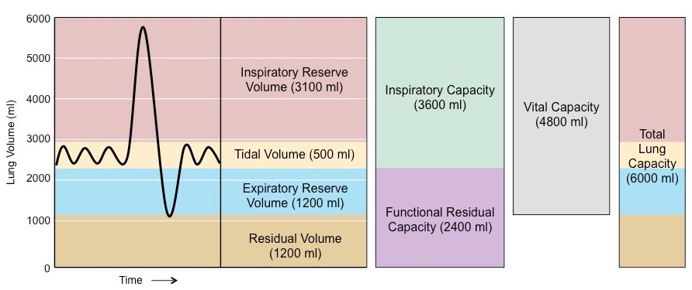
Vital Capacity
Vital capacity is the maximum amount of air that can be forcefully expired after a maximum inspiration
VC females = 3-4 l
VC males = 4-5.5 l
From the pulmonary function test the vital capacity testing is the most frequently used. It could be performed „slowly“ (VC) and/or as fast and forced as possible (forced vital capacity, FVC)

Slide 91
Vital Capacity
Calcultae your predicted value of the vital capacity:
Males:
Predict. VC (ml) = [27.63 – (0.112 x age (yrs)] x height (cm)
Females:
Predict. VC (ml) = [21.78 – (0.101 x age (yrs)] x height (cm)
Compare your measured values with the predicted values and express them as a percentage of the predicted values

Slide 92
Vital Capacity
Calcultae your predicted value of the vital capacity:
Males:
Predict. VC (ml) = [27.63 – (0.112 x age (yrs)] x height (cm)
Females:
Predict. VC (ml) = [21.78 – (0.101 x age (yrs)] x height (cm)
Compare your measured values with the predicted values and express them as a percentage of the predicted values

Slide 93
BTPS
All the pulmonary volumes should be standardiesd, i.e. converted from actual conditions (ATPS) to the BTPS conditions (Body Temperature and atmospheric Pressure completly Saturated with water vapour at body temperature).
BTPS for Czech Republic is 1.09

Slide 94
Thank You!

