Slide 1
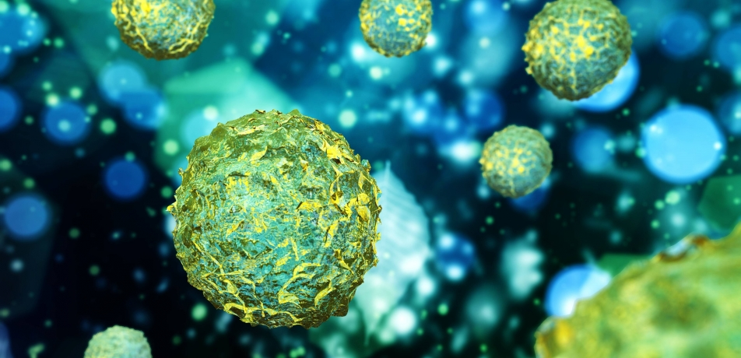
Stem cells
Student names redacted
Notes:
Can you imagine you, as a doctor, to be able to create a brand new, perfectly healthy organ? You would not need to wait for a donor or create organs using artificial materials which can often cause more harm than good.

Slide 2
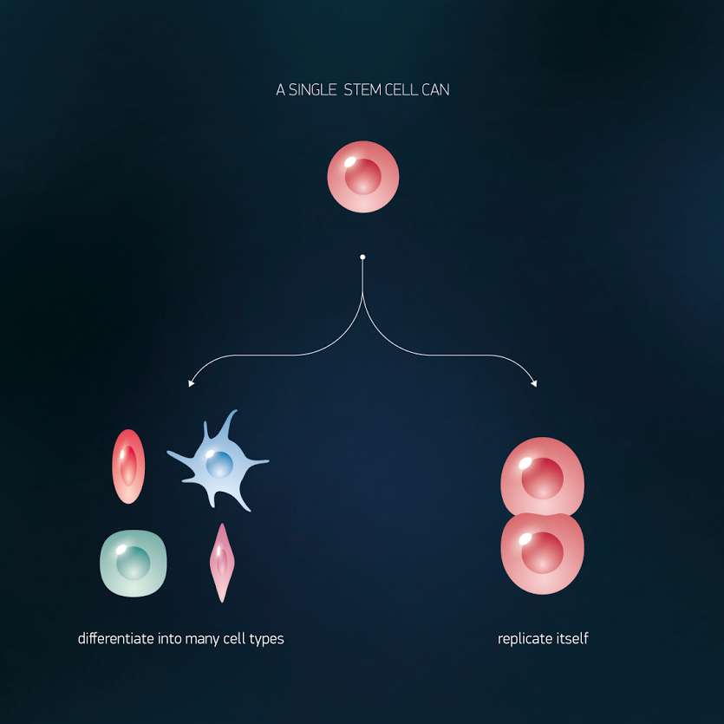
What are stem cells?
Undifferentiated cells
Ability to:
DIVIDE
DIFFERENTIATE
Notes:
Stem cells are undifferentiated cells with the ability to divide and evolve into a different cell types – they have ability to differentiate. They are undergoing multiple mitotic divisions, thus regenerating themselves. Daughter cells are often able to differentiate into more than one cell type. After a transplant, they are able to incorporate into their original tissue. In vivo, they are contributing to the formation of differentiated cellular populations.

Slide 3
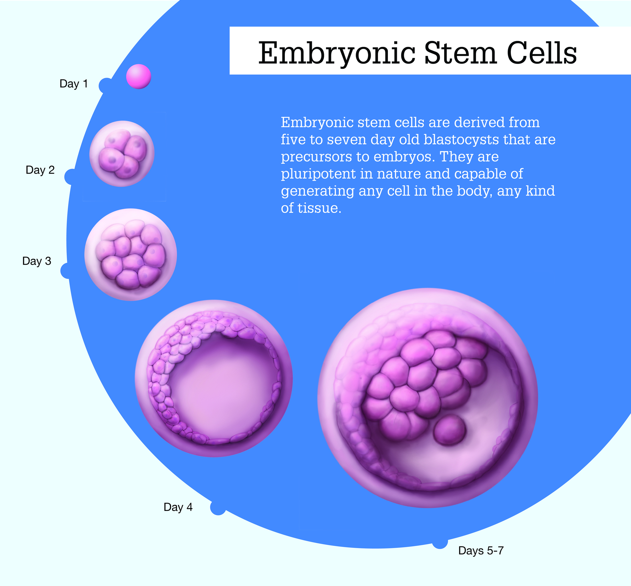
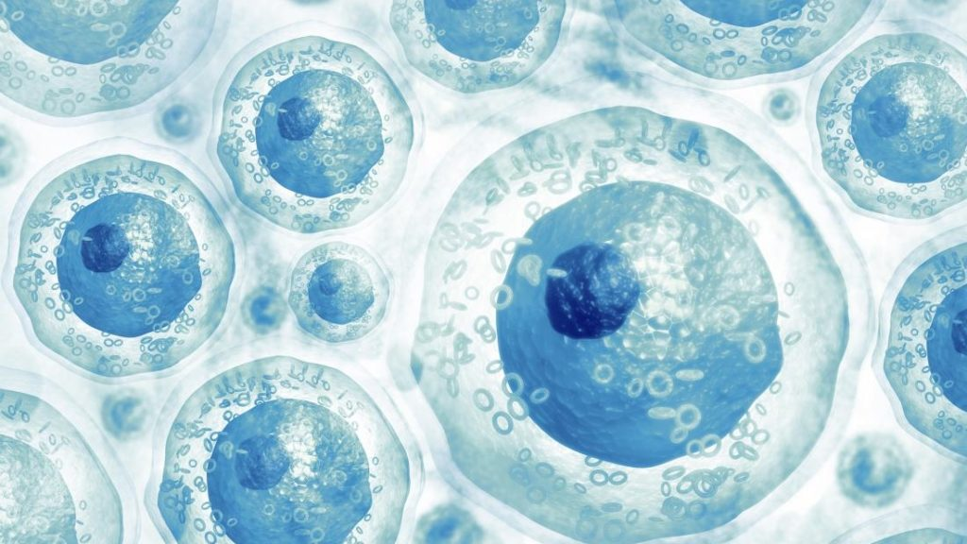
Types of stem cells
Embryonic stem cells – blastocyst >> pluripotent cells
Adult stem cells >> multipotent
Notes:
We distinguish between two stem cell types – an embryonic cell found in a blastocyst and adult stem cells. The embryonic cells in blastocyst are undergoing differentiation into tissues of the developing human body. They may develop into any tissue found in the body, excluding umbilical cord or placenta – they are called pluripotent cells. The adult stem cells are found in different tissues, they are part of repairing mechanisms as they substitute dead cells. They are not able to transform into any tissue, just into the one they are part of, being called multipotent stem cells.

Slide 4
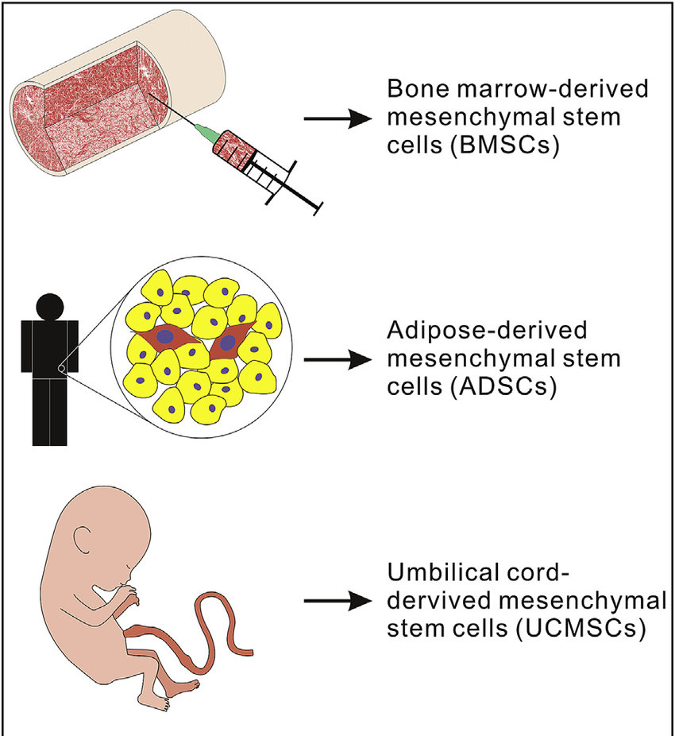
Sources of stem cells
A bone marrow
An adipose tissue
Blood
Umbilical cord
Amniotic sac
Skin
Notes:
There are 3 main sources of stem cells in the human body – a bone marrow (typically from femur or hip bone), an adipose tissue and blood. Other, less common sources are blood from the umbilical cord shortly after the delivery of a baby, stored for the baby, tissue from an amniotic sac in the placenta or a basal layer of the skin.

Slide 5
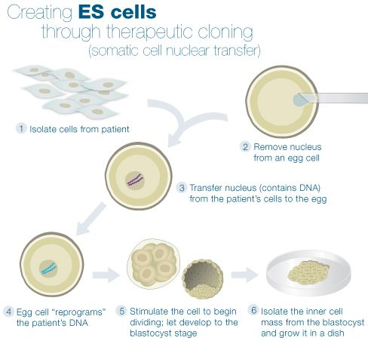
How can we get stem cells?
Therapeutic cloning
Notes:
There are a lot of ways how the stem cells may be useful in the clinical medicine. The therapeutic cloning starts with taking a sample of cells from the patient. The next step is putting them into an egg cell of a woman without the nucleus while embryo and later the blastocyst are formed. The stem cells are taken out of the blastocyst and are being cultivated. The differentiation may be controlled using chemical signals as cells are naturally reacting to these. This method is not used in the Czech Republic, but it is allowed in the South Korea or the Great Britain.

Slide 6
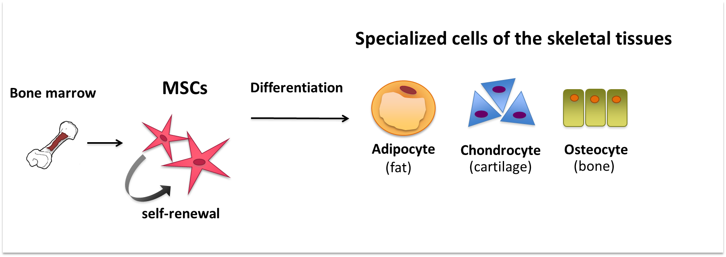
The mesenchymal stem cells
Notes:
The mesenchymal stem cells are obtained by isolation from the desired tissue. Then the intercellular bonds are destroyed and cells are put into the cultivating containers where they are being cultivated while other differentiated cells are washed away.

Slide 7
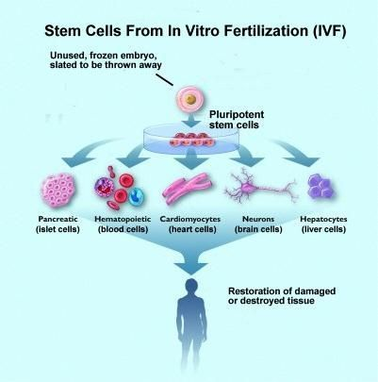
Notes:
Another way to obtain stem cells is using an embryo that was meant to be destroyed after in vitro fertilization. Some experiments are allowed in the Czech Republic.

Slide 8
Induced pluripotent stem cells
Notes:
The induced pluripotent stem cells are cells that were originally adult stem cells, but scientists are able to transform them into totipotent stem cells in undifferentiated status. They use a vector – virus, into which a particular gene is put which induces the transformation of the cell. These cells are similar to the ones found in embryo.

Slide 9
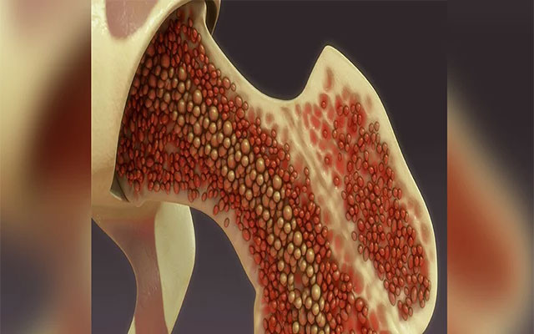
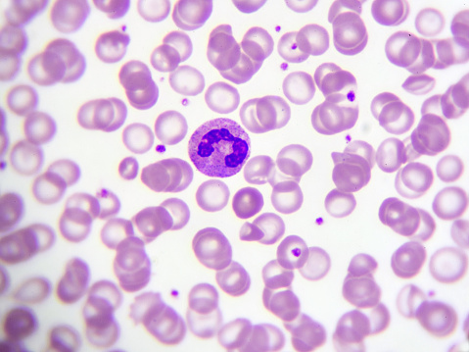
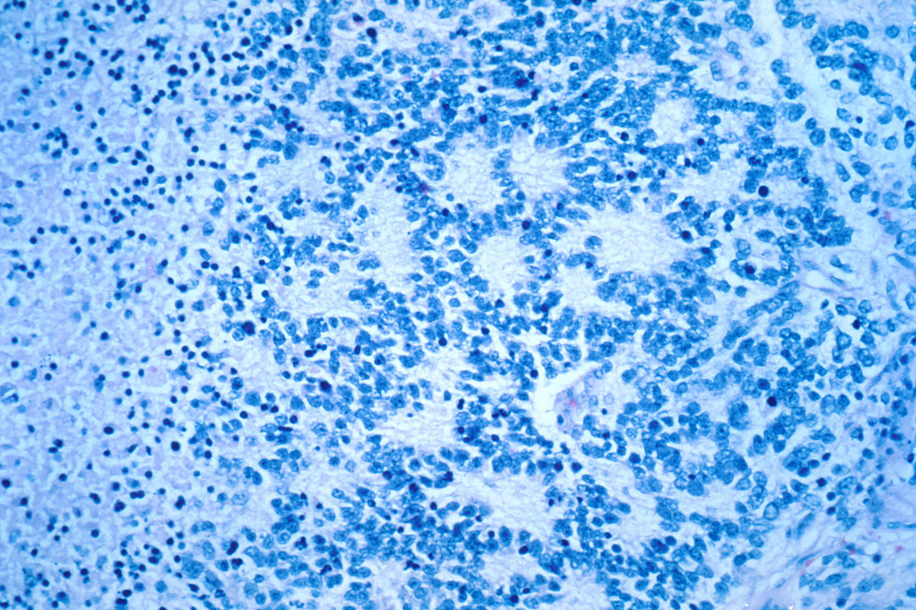
How can we use stem cells?
Lymphoproliferative diseases
Cancer of a bone marrow
Neuroblastoma
Notes:
In a common therapy, we may use stem cells to treat lymphoproliferative diseases, which are cancerous diseases of lymphocytes, or inborn immunodeficient diseases. Also tissue from a pig may be used, however, not to replace damaged tissue, but to hold back its death and help to regenerate.
Transplantation of a stem cell is recommended for a patient suffering from acute lymphoblastic leukaemia, cancer of a bone marrow or neuroblastoma.

Slide 10
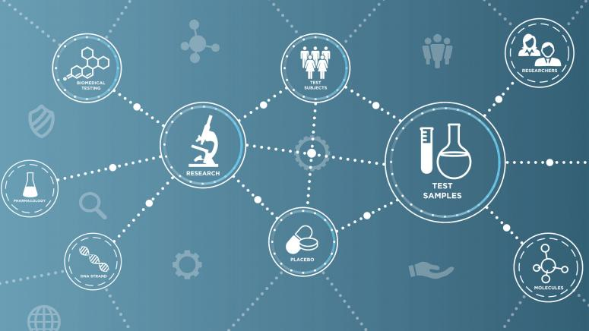
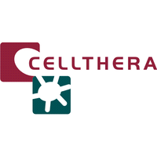
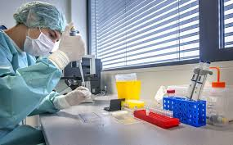
Cellthera Clinic Clinical trials
Notes:
Some centres, such as Cellthera Clinic, are offering cell therapies for patients suffering from heart conditions, brain diseases, diseases of blood vessels, liver, lungs, gastrointestinal tract or urinary system.
There are clinical trials testing therapies of diabetes mellitus one, treatment of cerebral palsy, sclerosis multiplex or amyotrophic lateral sclerosis.

Slide 12
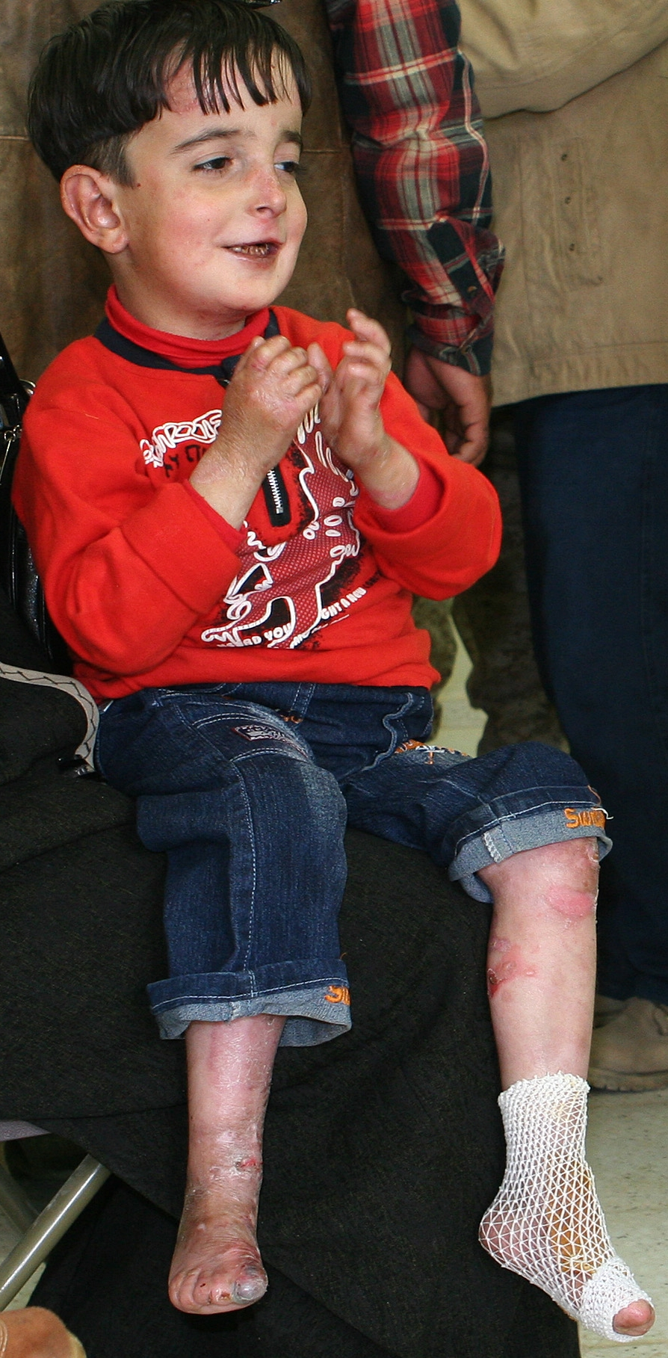
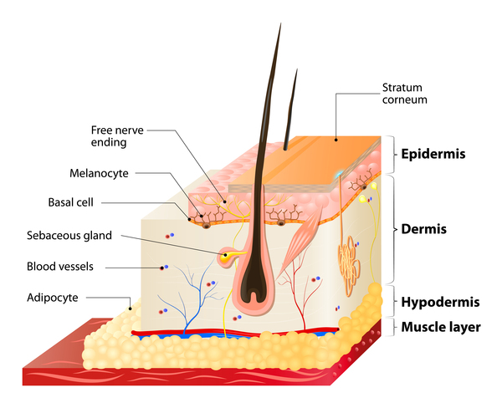
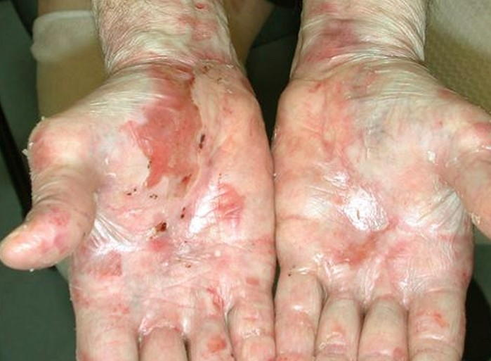
Stem cells in action…
Junctional epidermolysis bullosa
Junctional epidermolysis bullosa

Slide 13
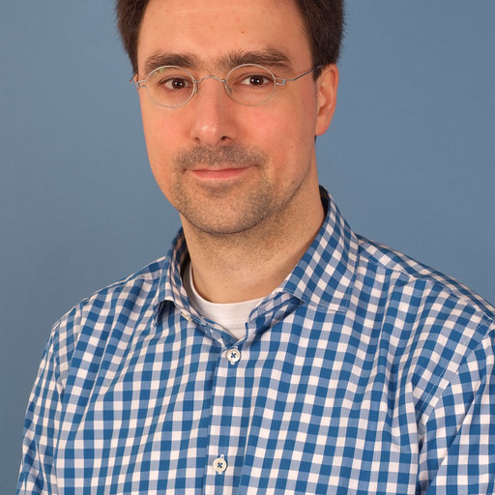
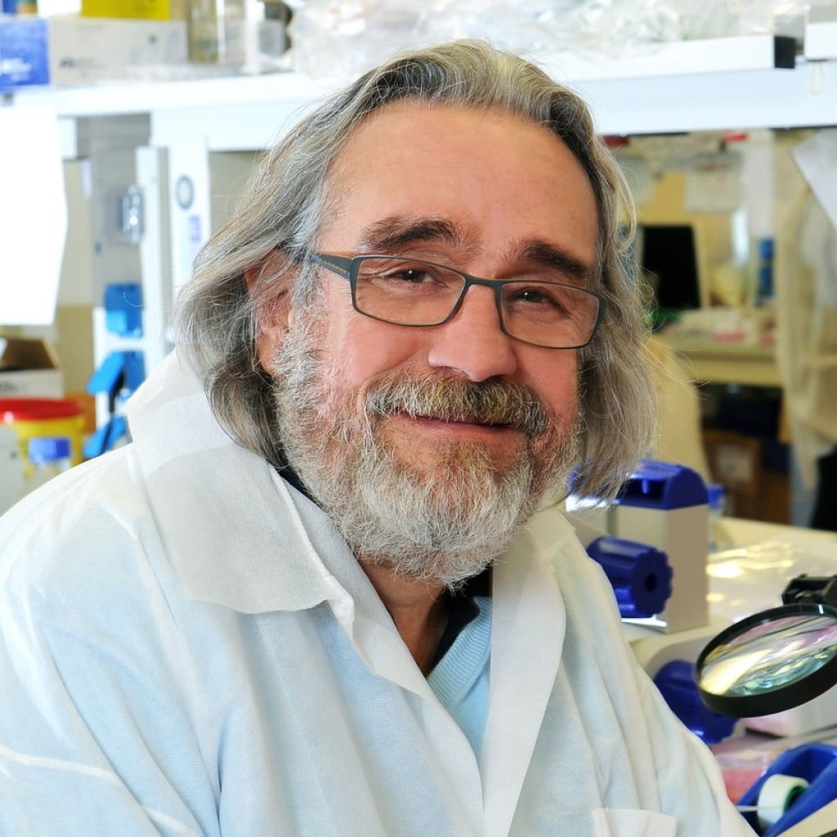
Heroes…
Professor Dr Tobias Hirsch
Dr Tobias Rothoeft
Prof. Michele De Luca

Slide 14
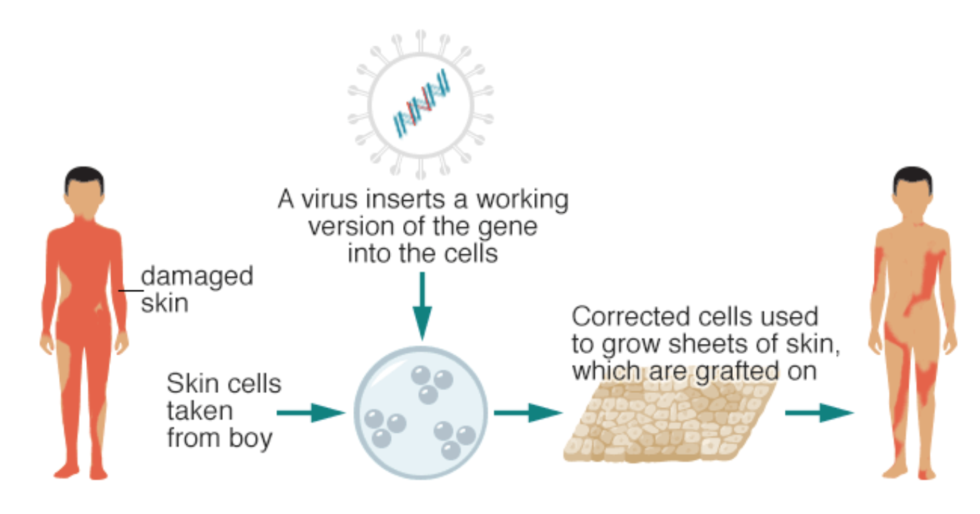
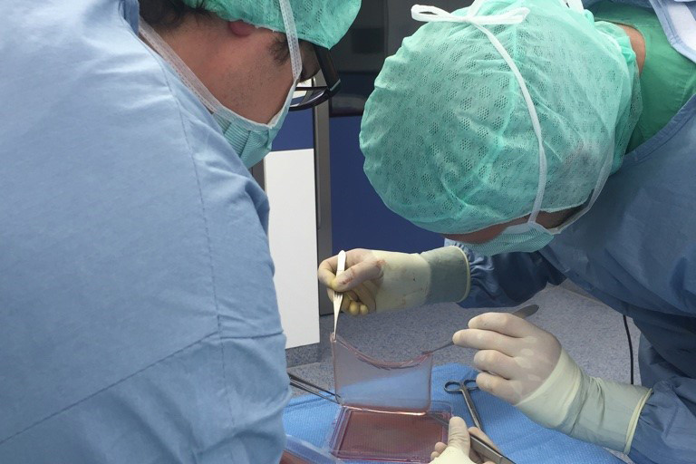
Hard working…

Slide 15
And happy ending
The new skin will last his whole life.

Slide 16
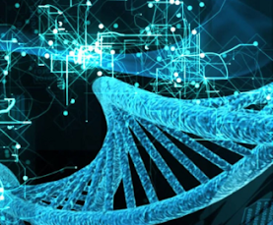
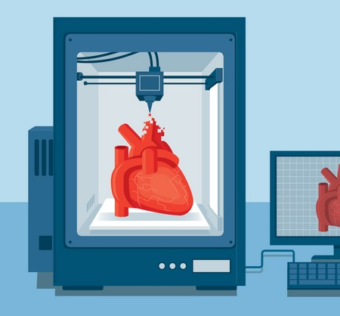
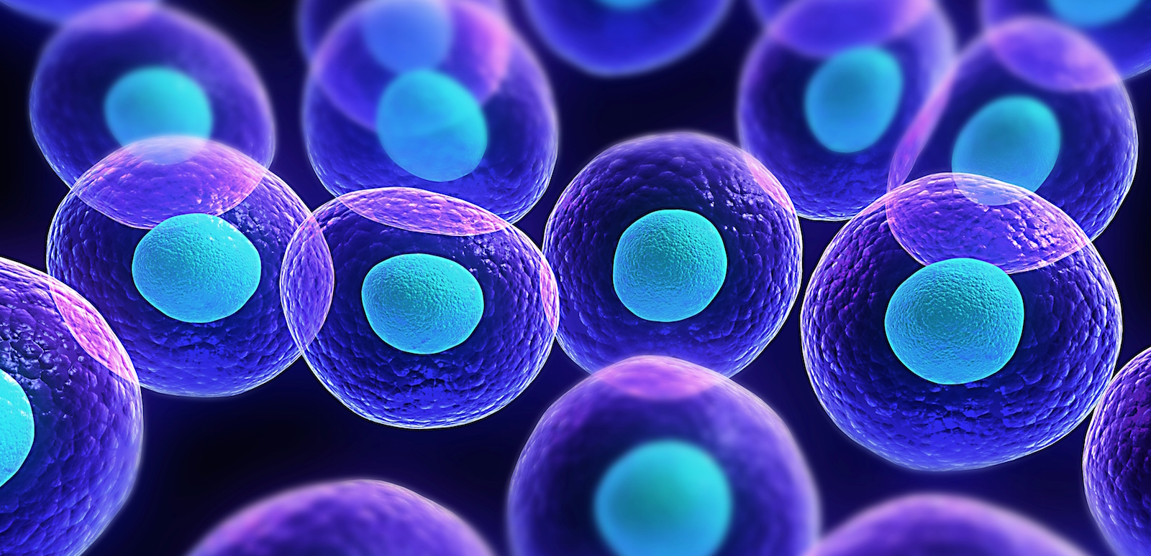
Let’s take a look back at what we’ve spoken about…
Ability to divide
Ability to create more than one specific tissue
Stem cells:
Embryonic
Adult

Slide 17
Thank you for your attention

