Slide 1
Making a difference: adapting psychosocial interventions for people with Intellectual Disabilities

Slide 2

Structure for today’s talk
Do diagnoses take account of the experience and context of people’s lives?
Life experience and the nature of mental health and inter-personal problems
Some implications for psychological therapy and CBT in particular
How do people with intellectual disabilities view therapy?
Concluding thoughts
Notes:
By and large – in relation to psychological therapies – my talk relates to work with people who have moderate to mild intellectual disabilities in particular. Although I will touch on other points.

Slide 3
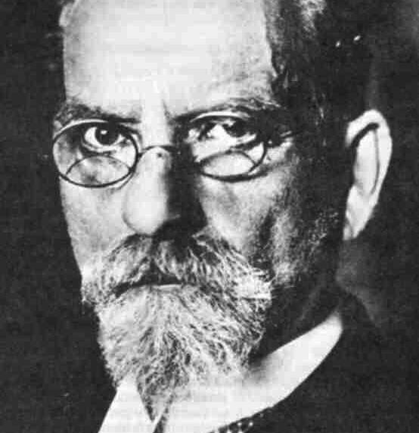
Phenomenology (Edmund Husserl)
People’s lived experience
How people negotiate their lives as actors in the world
Notes:
Talk today will focus on those with mild to moderate intellectual disabilities. Edmund Husserl

Slide 4
DSM-5
Diagnostic and Statistical Manual of Mental Disorders
APA
ICD-11
International Statistical Classification of Diseases and Related Health Problems
WHO
Notes:
DSM 5 caused quite a stir in the UK – concerns that pathologise aspects of everyday life. Mental behavioural and neurological disorders.
Also ICD -11 has recently been produced, with a section on problem behaviours. Love child – very positive aspect of this is that diagnostic criteria have helped to produce epidemiological evidence about the high prevalence of mental health problems experienced by people with intellectual disabilities.

Slide 5

Controversy
Classification of behaviour and experience in relation to functional psychiatric diagnoses:
Time for a paradigm shift
Notes:
BPS are one of the bodies who have argued that there are problems with diagnostic systems like DSM 5 and ICD 11 and have argued for a paradigm shift.

Slide 6
Criticisms included…
Marginalising knowledge from lived experience: Service users often emphasise the primary significance of practical, material, interpersonal and social aspects of their experiences, which only constitute subsidiary or ‘trigger’ factors in the current system of classification (Beresford, 2013).
Perhaps linked to phenomenology:
How people experience and negotiate their social worlds.
Notes:
Amongst their criticisms is the following statement

Slide 7
Relevance for people with intellectual disabilities
Can we assume that depression or psychosis mean the same for someone with a mild or a more severe intellectual disability?
What about behaviour problems? Surely easier to assume that we can look across classes of behavioural difficulties presented by different individuals?
Notes:
When we rely on self report of so many symptoms of diagnoses like depression – how can we assume that depression or psychosis is the same for someone with a mild or profound disability? Perhaps it should be easier with a more clearly operationally defined behaviour like aggression? However, even here we have challenges because the same actions are can occur for quite different reasons.

Slide 8
Aggression?
Reactive vs Instrumental
Intent to cause harm vs defensive / escape
Notes:
Two types of aggression: Reactive (show picture of Louis Suarez) and instrumental, where people use aggression as a means of achieving goals?
Another theoretical distinction is between proactive offensive acts of aggression and defensive acts / linked to escape. How might this differ between those who are able to empathise with or predict the reactions of others with those who lack the ability to act with intent.

Slide 9
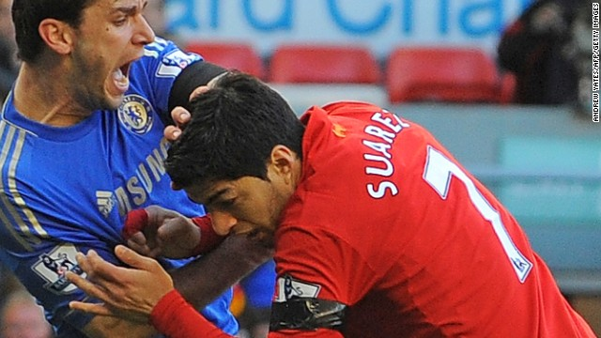
Is there a risk we miss something if we don’t properly check on people’s own experience?

Slide 10


Slide 11
Phenomenology
Life experience and the nature of mental health and inter-personal problems
Is there something distinct about people’s experience / development that we should take into account?
Notes:
I do recognise the importance of diagnosis – without that couldn’t do the vital epidemiological. We have heard persuasively from people like Eric Emerson about how people with intellectual disabilities’ are particularly vulnerable to the impact of deprivation – with higher rates of reported psychopathology than other people who experience these environmental / developmental challenges – a corrosive effect. But what about the content of people’s difficulties?

Slide 12
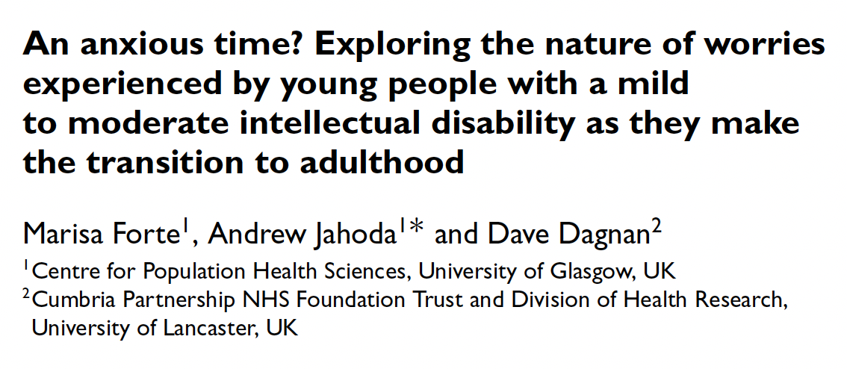
Young people’s worries.
Young people with intellectual disabilities (26) and group of typically developing young people (26), aged 16-21.
Groups matched for gender and socio-economic status.
Participants asked about twelve broad areas of worry, taken from themes highlighted in previous research with adolescents.
Visual stimuli used to illustrate the different kinds of worry. After talking about the worries evoked by the stimuli, participants were asked to rank their main four worries.
Notes:
Also opportunity for ‘other’ worries to be raised. They posted each of their worries – had to be able to give an example. Then they were asked to pick out their top 4 worries and then to rank them.

Slide 13
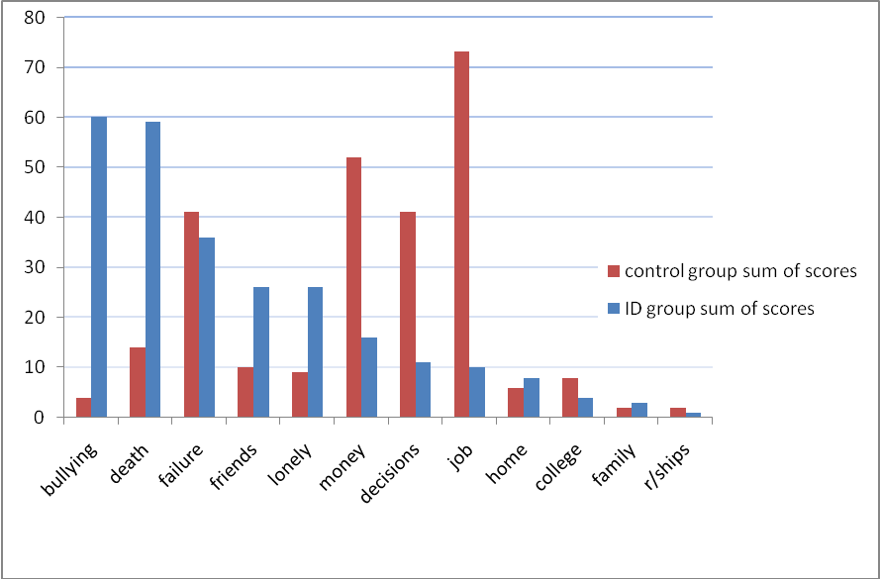

Slide 14
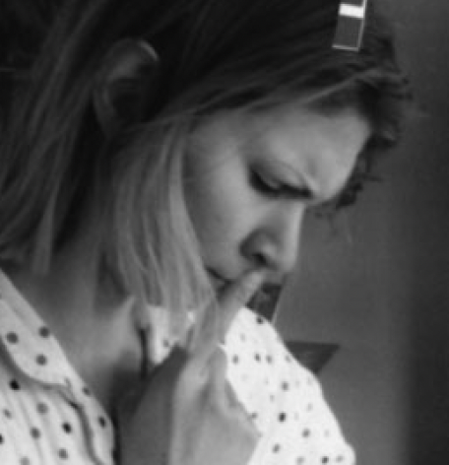
Different kinds of worry.
The two groups generated different kinds of worry.
The only overlap was in terms of failure, and even then the nature of the two groups’ worries in this regard were rather different.
While the non-disabled group talked about specific failures and their implications (driving test, school exam), those with intellectual disablities talked about a general sense of incompetence.
I feel like a failure all the time, it’s just like the useless thing again in a way, because I can’t get college right, I can’t get friends right…I want to join clubs but it’s like friends, are they going to judge me for how I am so it’s the same kind of roller coaster up here and down there, will I fail?
Notes:
Even the one area of overlap was spoken about differently by those with an intellectual disability.

Slide 15
Group differences
Young people with intellectual disabilities:
ruminated more about their worries [t(34.95)=2.34,p=0.025].
were significantly more distressed by their worries [t(50)=4.96,p<0.001].
had significantly higher self-report anxiety scores between groups [t(50)=2.247,p=0.029].
had significantly lower self-efficacy scores than the typically developing young people [t(50)=2.79,p=0.008].

Slide 16
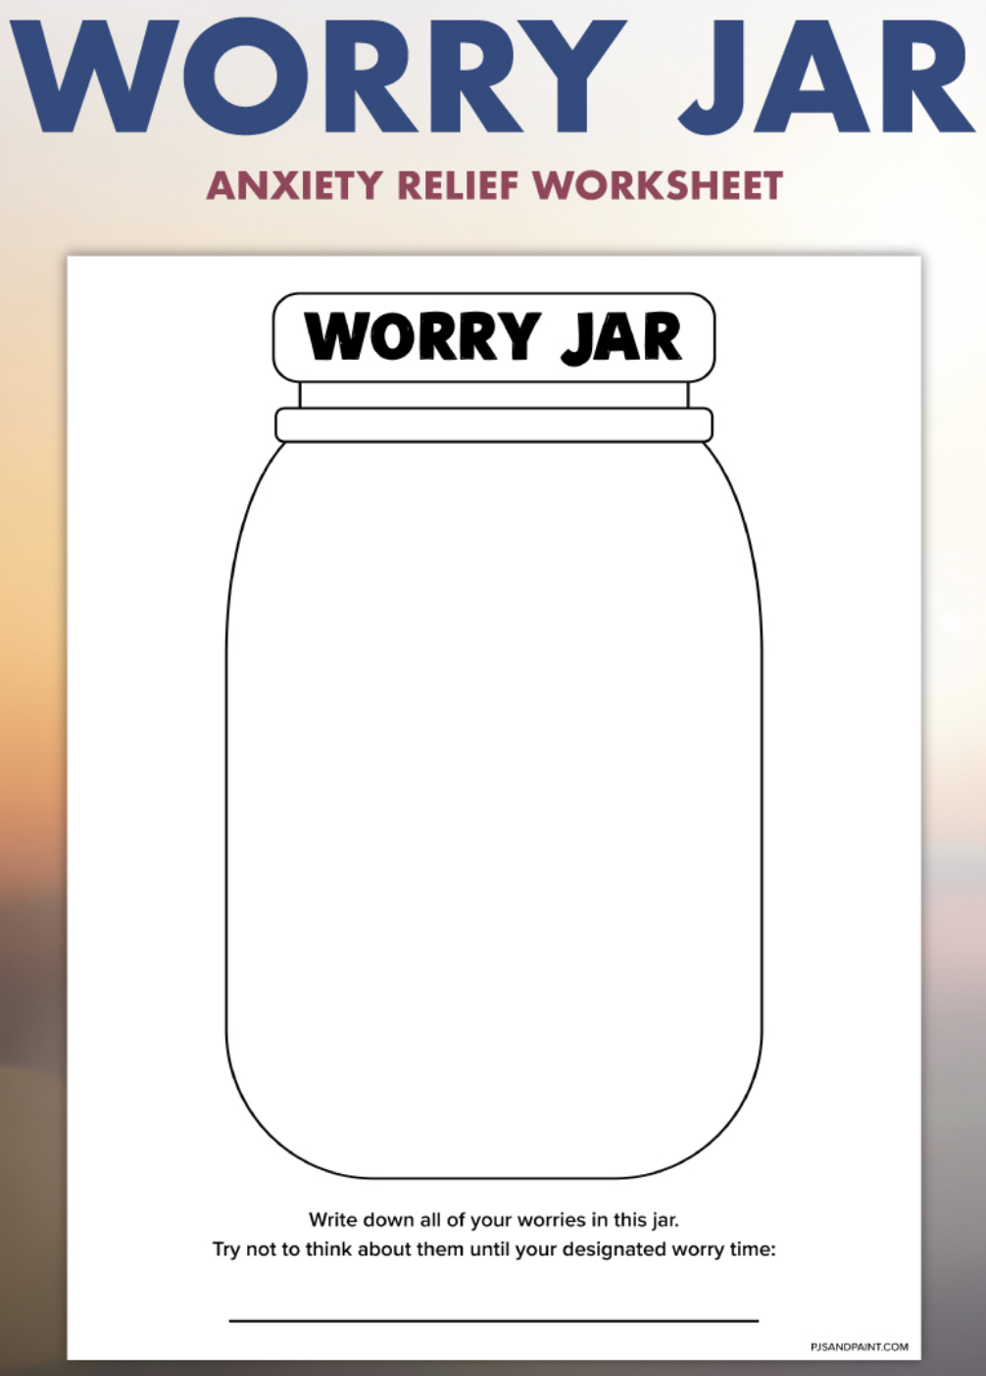
What does this tell us?
People’s worries seem to reflect a history of dealing with adversity and their particular social circumstances.
We do not know if such worries increase vulnerability to future mental health problems, but the higher levels of distress and rumination might be negative signs.
Perhaps we look for major life events with people who have intellectual disabilities and sometimes overlook the corrosive effects of more mundane experience.
Notes:
Could be adaptive in certain ways – or may be a precursor to future problems

Slide 17
Phenomenology
The emotional challenges of negotiating everyday life.
Notes:
Not static - an active negotiation with the world. Begin to think also about the possibility that people don’t necessarily have a disease process that they have or don’t have but that problems have a developmental history and occur in particular social circumstances – perhaps arising when people lack the ability to deal with particular challenges in their lives.

Slide 18
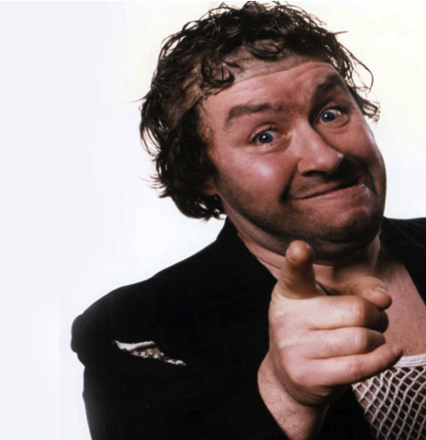
Frequent inter-personal aggression
Who are you looking at?
Notes:
This is a friendly comedy character form my home town of Glasgow, adopting a classic and rather challenging ‘what are you looking at?’ pose. He’s the man who lives at the margins of society and is sensitive to other people putting him down and does a remarkable job of maintaining his dignity in the face of all odds. Revolving doors or remitting problems...

Slide 19
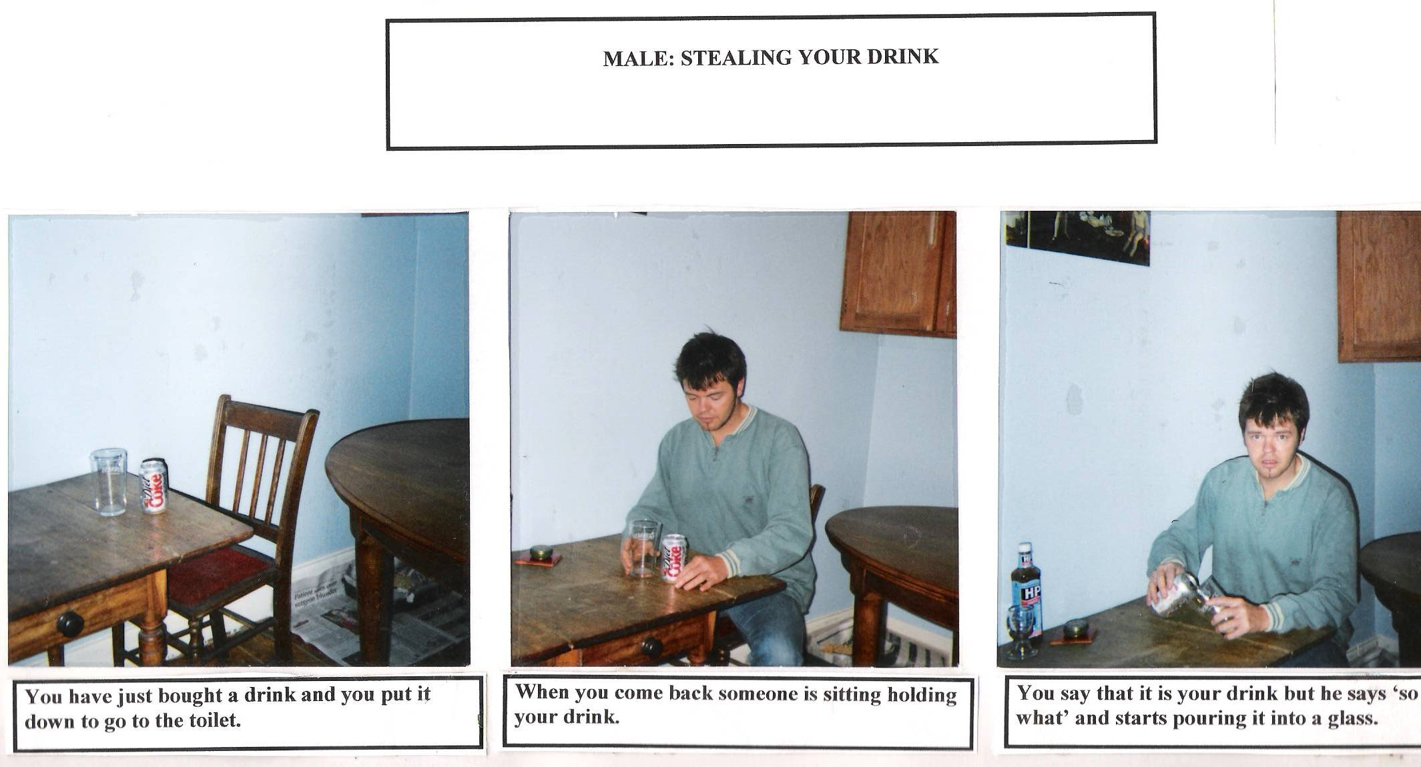
Submission and aggressiveness.
In this study we looked at how people with significant problems of aggression (18) view both aggressive and submissive behaviour, as compared to nonaggressive peers (18).
We wanted to find out what the participants thought the outcomes of behaving both aggressively and submissively in situations of potential conflict might be.
Presented with vignettes and asked to imagine themselves as the protagonists in the stories where they faced potential conflict and responded i) aggressively, and ii) submissively

Slide 20
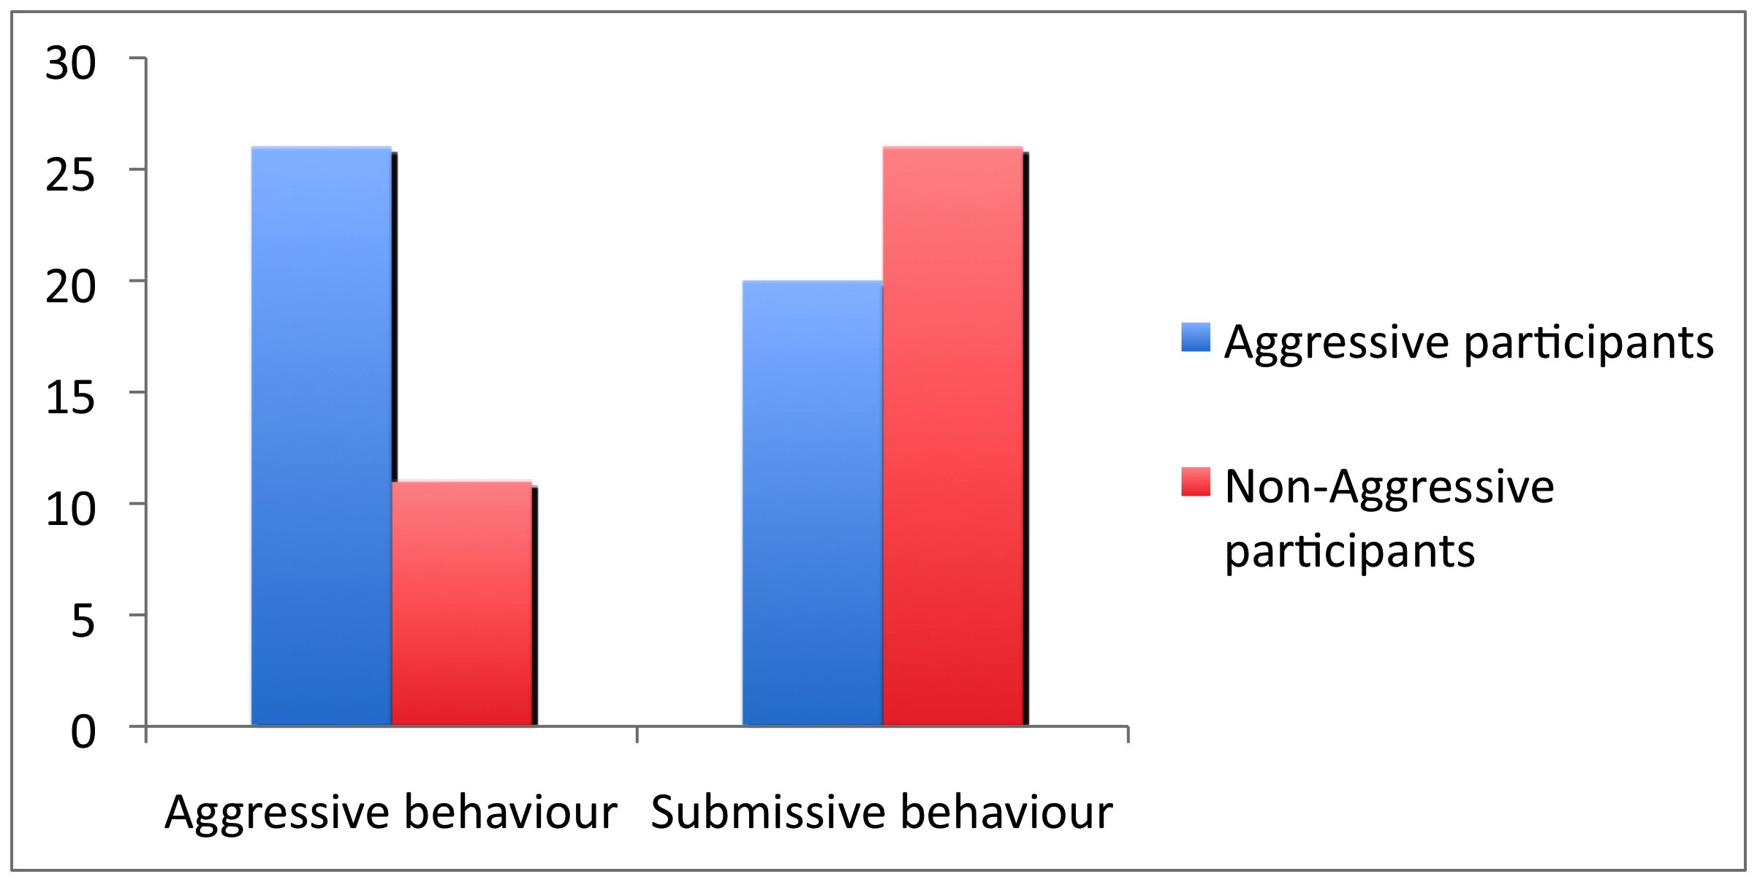
Participants’ positive views of aggressive and submissive behaviour.

Slide 21
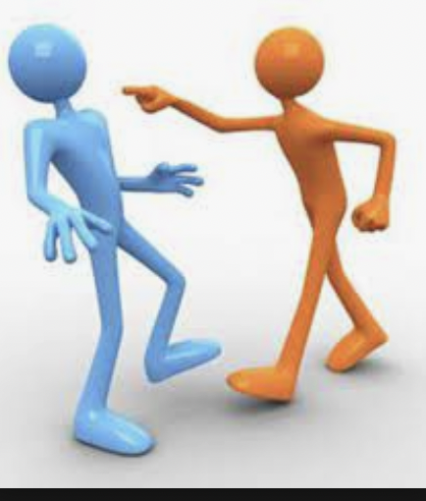
Inter-personal aggression in context
The participants who had problems with frequent inter-personal aggression were more likely to endorse aggressive responses to potential conflict and to find submissive responses intolerable
How people view themselves in relation to others helps to determine their reactions.
Whether or not emotional regulation or other particular social cognitive deficits play a part in people’s aggressiveness, the difficulties are enacted in a social context.

Slide 22
Links to therapy
What about psycho-social therapies?

Slide 23
Cognitive Behavioural Therapy – an example
Not just about adapting the technique to make it more accessible also about the content
It means asking the right questions. For example, acknowledging the potential impact of stigma or social exclusion and perhaps acknowledging difficulties relating to someone’s disability
It means not challenging people’s views that are based in reality
It may mean working with people’s sense of self
Notes:
Elephant in the room – a real strength of the work of John Taylor and Ray Novaco. Not about a misrepresentation of the world but its impact on self – or both. Need to know the right questions to ask – or how to open up areas for discussion

Slide 24
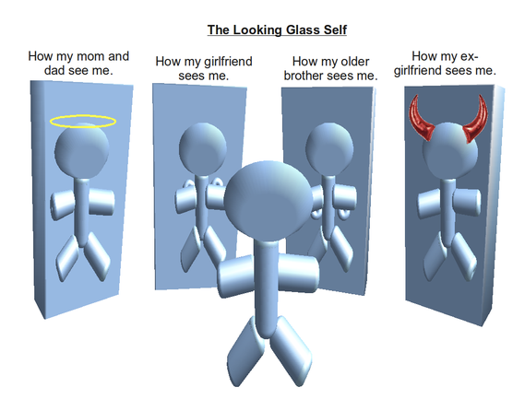
Involve significant others in therapy
Why?
People lack power to generalise therapeutic achievements into their everyday lives
A reflected self – not just thinking and behaving in ways that cause less distress but also how seen and treated by others
Notes:
Whether it’s possible or not also depends on the underpinning support and wider service framework.Use the example of Karen – the power to change others’

Slide 25
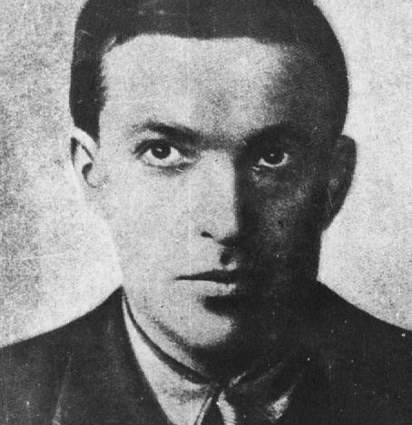
Zone of proximal development: learning in collaboration.
Vygotsky’s concept of the ‘zone of proximal development’ has been used to describe how to work effectively with people who have psychosis
Not too difficult to easy
The idea that the therapist is trying to provide scaffolding to help the person achieve change that would otherwise be beyond their reach is helpful

Slide 26
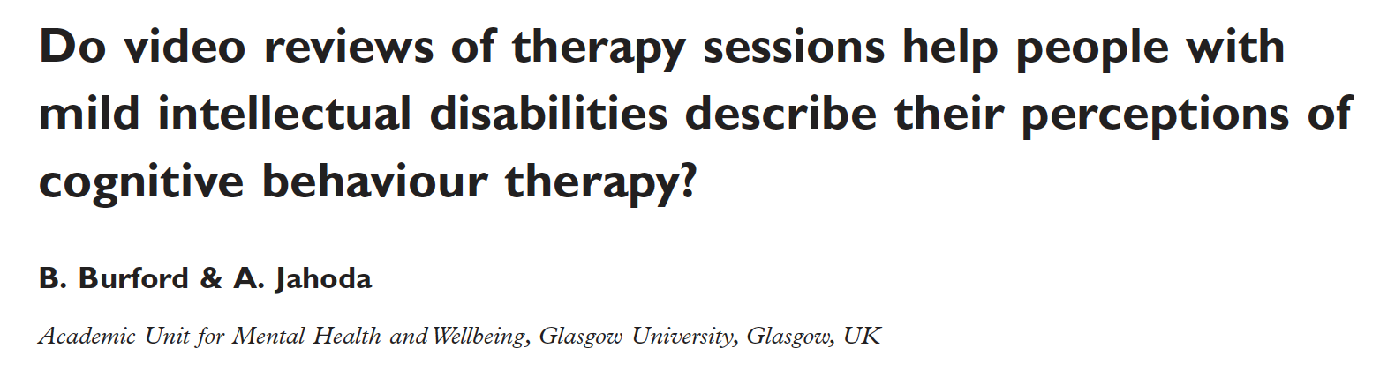
A Video Review Study
What do people with intellectual disabilities make of therapeutic interventions?

Slide 27
Participants who took part in a video review of CBT sessions they had taken part in
18 clients took part (9 women and 9 men).
Participants referred to clinical psychologists with a range of emotional problems: anger, anxiety and depression.

Slide 28
Video review study - a qualitative approach.
Video review method.
Part of a larger process study, Jahoda et al., (2009).
6 experienced therapists (Clinical Psychologists).
Individual formulation driven approach. Fidelity checks carried out by CBT expert.
Aims
To look at clients own experiences of CBT sessions.
Pilot the video review method with this client group.
Notes:
A number of different methods but here will talk about a video review method. Part of a larger study looking at process issues. Many different strands of process research. Here we are considering the the clients own unique perspective on therapy. A few different methods were used to explore this and I will focus on a video review method developed by Bronwen Burford.

Slide 29
Method and Analysis
Video Review Method devised by Bronwen Burford (2003).
Clients view tapes of therapy sessions and comment on what they see.
Important that clients were NOT confined by specific questions set by the researcher.
No ‘right or wrong’ response.
Analysis
Data analysed using Thematic Analysis
Notes:
Can tag the video as often as wish or not at all.
Useful for clients who have difficulty expressing broader views of therapy. Focus on one session.

Slide 30
Why bother? Because….
Two main strands to the findings.
1. Supportive aspects of therapy
2. Changes linked with a CBT approach.
Valuing a positive therapeutic relationship.
Feeling supported and understood.
Valuing the chance to talk about feelings.
Working together on problems. CBT approach leads to better understanding of problems and better coping skills.
Positive impact on self identity and self efficacy.
Notes:
Focus on the first of these.

Slide 31
FINDINGS. What clients say about CBT (1)
“I’ve never ever told anybody else, I wanted to talk about that. I feel really, really glad with (T). It felt really good, I trust (T).
“ I enjoy the sessions with (T), they’re good. And I felt that (T) understands how I feel. More or less that I’ve got feelings.”
(T is the therapist)
A positive therapeutic alliance.
Trust
Empathy

Slide 32
What clients say about CBT (3).
“Never heard myself say that before. Never done in my life. I’ve always hurt people and caused grief. I’m seeing a different me”
“When I was watching myself I was thinking is there anything wrong with me or not? People say there is and I say there’s not. But when you see that I don’t know what to think.”
Learning about myself.
Views of self.

Slide 33
What clients say about CBT (2).
“T’s good to talk to and that’s helpful. I come here to get a bit of help.”.
“…..It’s kind of helped me cope with life. Because before (T), before I came here I’d actually nobody to talk to really.”
Talking about problems is helpful.
Enjoy talking
Having someone to talk to.

Slide 34
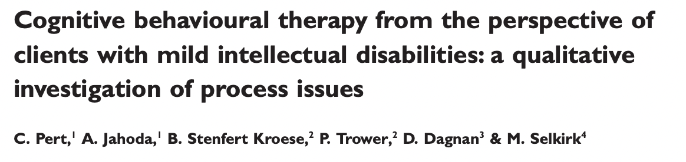
BUT: Change can be seen as fragile
Change might not last.
‘I just don’t want to stop seeing (therapist) because it’ll take some time to get to see her again…’
Notes:
A complimentary interview study with the participants

Slide 35
Making a real difference
A tension
Private space Life in context
Notes:
A tension – but ways of negotiating this

Slide 36
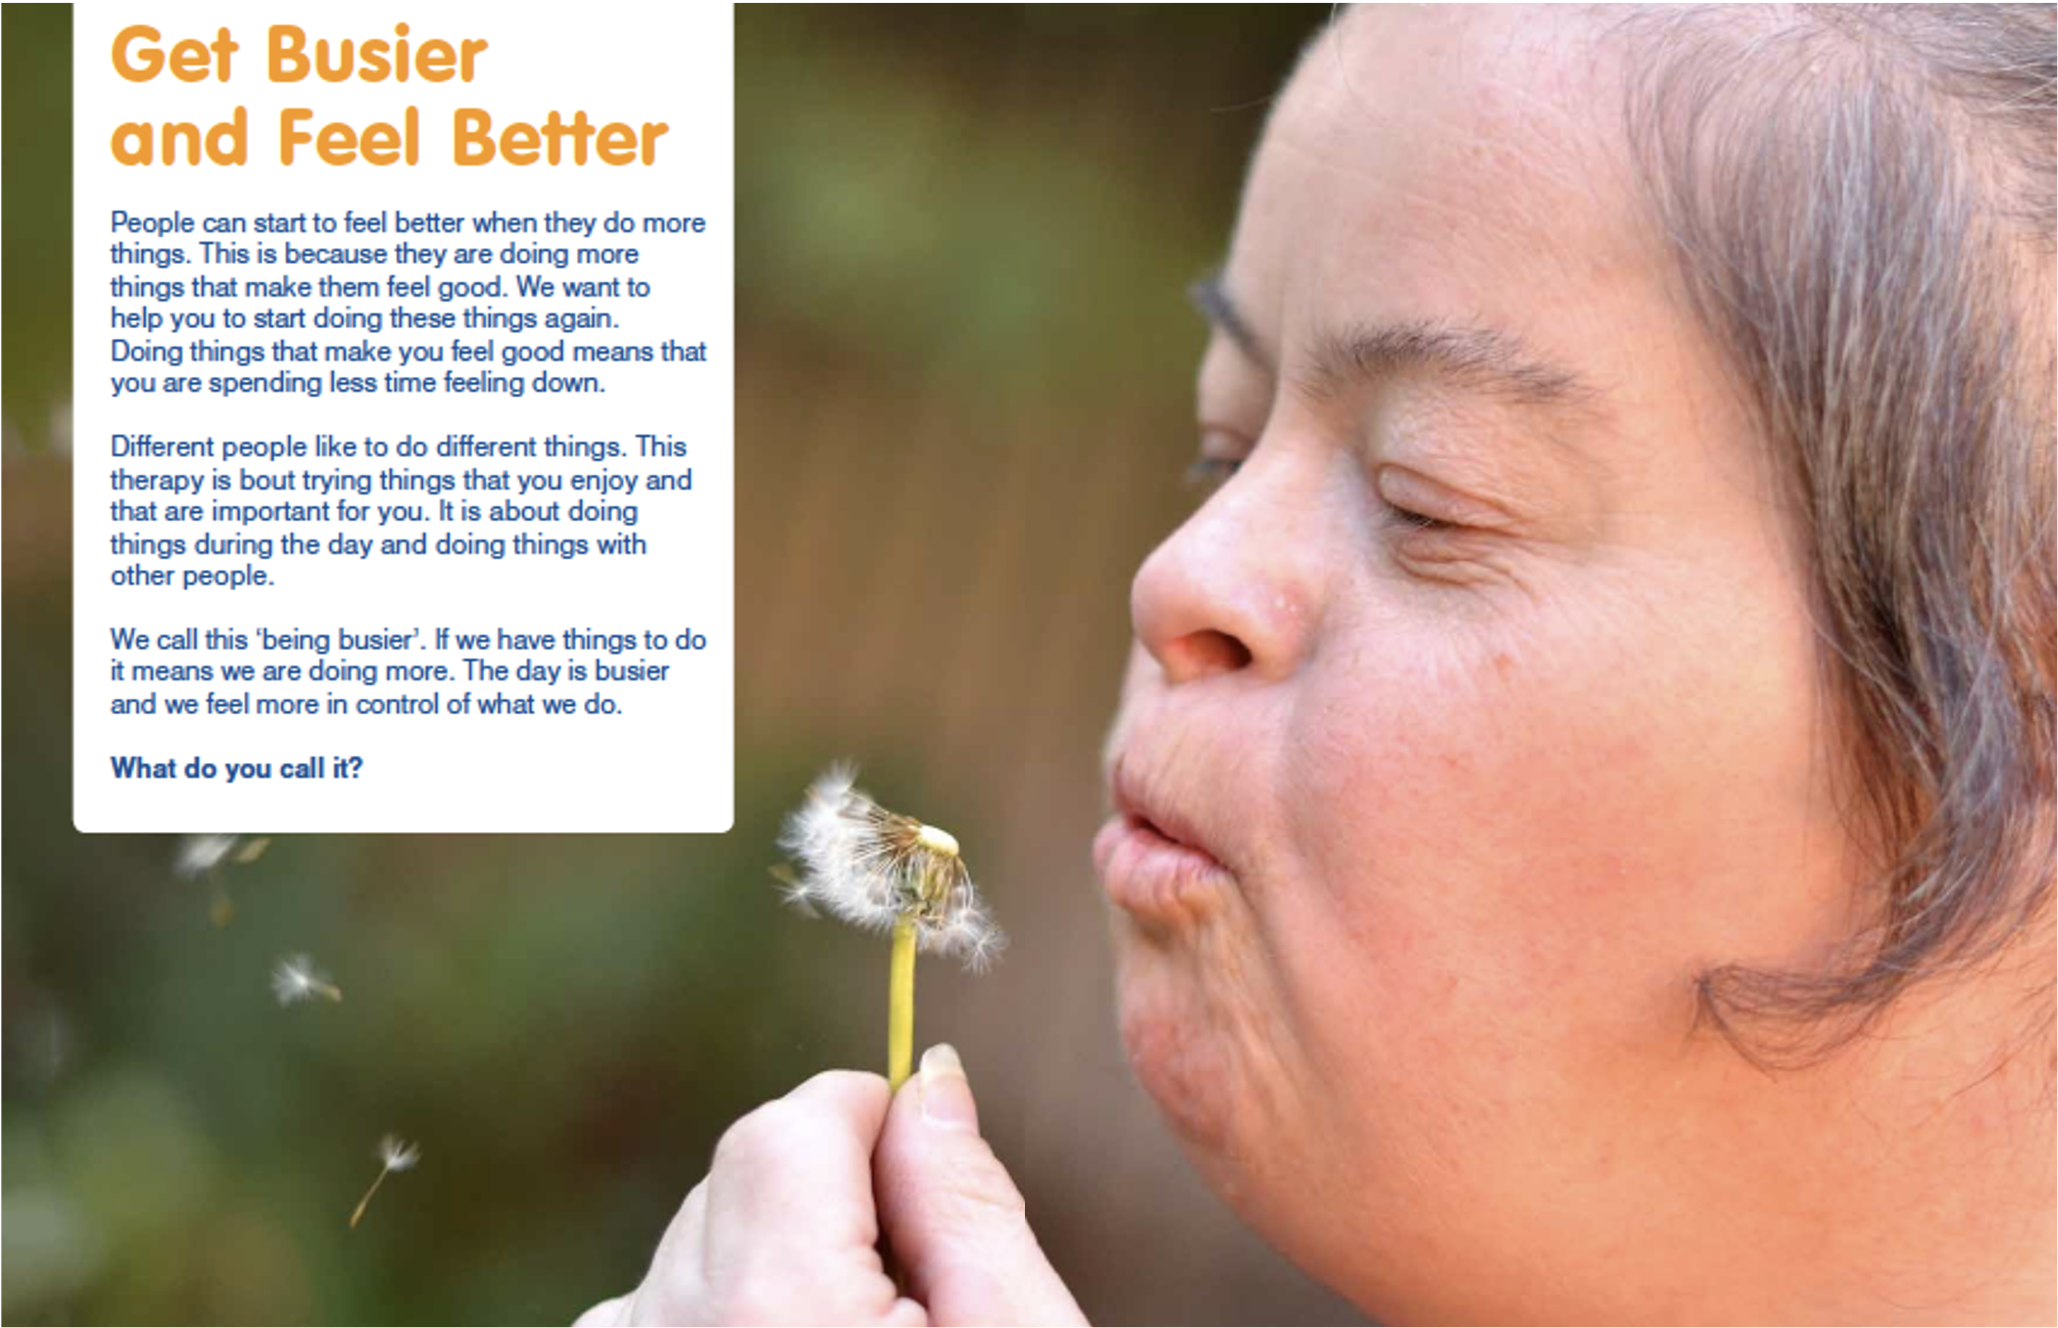
CBT and real life change
Behavioural activation for depression
Increasing purposeful and meaningful activity, overcoming withdrawal and bringing people in contact with more reinforcing aspects of life
Key adaptations: the involvement of a significant other and the attempt to make it the beginning of a new pattern of life rather than an endpoint

Slide 37
Concluding thoughts
Ensure psychosocial interventions remain just that
About working with the whole person in the context of their lives – not a disease entity separate from the person
Aim to achieve change that makes a real difference to people’s lives
Health promotion as well as dealing with mental ill health building on people’s strengths

Slide 38
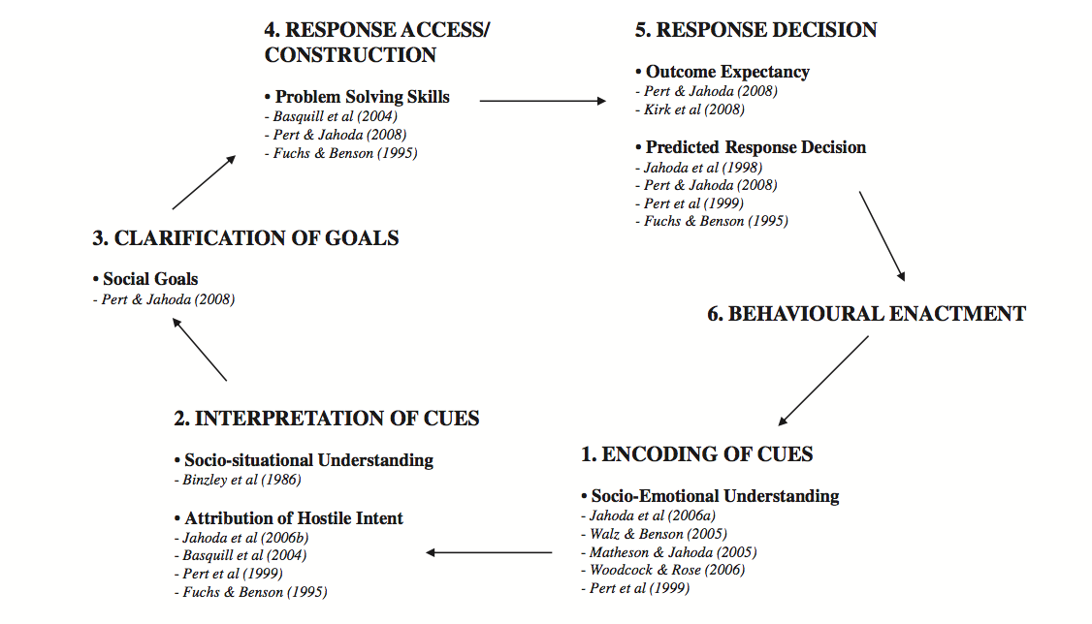
Concluding thoughts
Adapting interventions:
Still a tendency to fall back on cognitive deficit models, rather than considering cognitive content.
BUT NOT NECESSARILY ONE THING OR ANOTHER
We still need to consider how people’s intellectual difficulties might interact with their emotional experience.

Slide 39
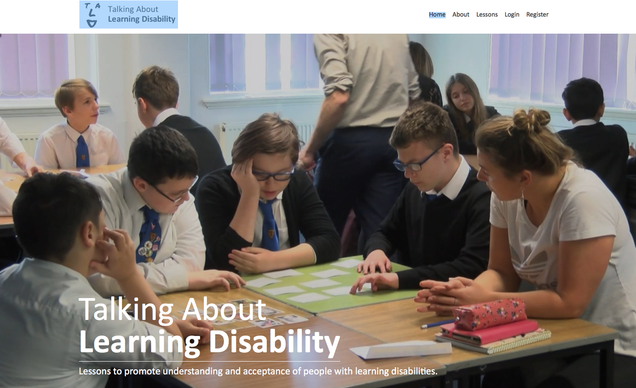
Concluding thoughts
Research on underlying psycho-social factors that contribute to emotional distress or make change difficult
An engagement with research on process of therapeutic change and also on maintaining change
Notes:
The content and nature of their experience can still be key to a change process that is motivating and meaningful for the individual.
Link to earlier ideas – worry – talk about and acknowledge particular worries ( such as death, no one to talk about sexual matters with), experience of stigma. Working with context an example etc – dealing with anxiety or depression – may be about working with the context of life –
Proactive and preventative work – health promotion – rather than picking up problems after. Understanding the developmental trajectory of children and young people and factors that help promote resilience – link to Eric’s talk.

Slide 40
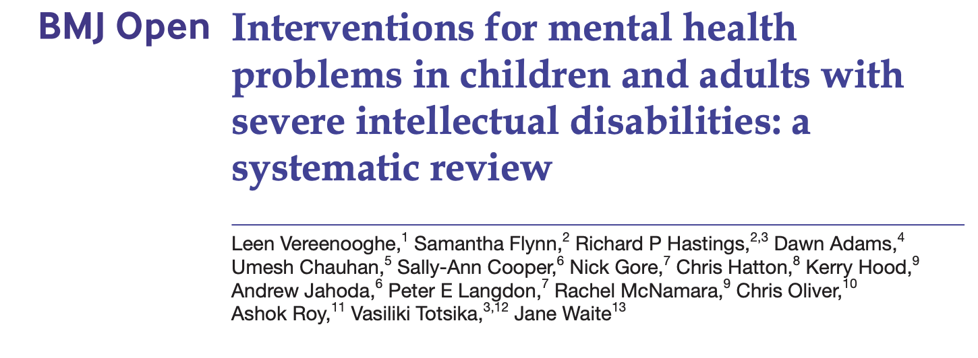
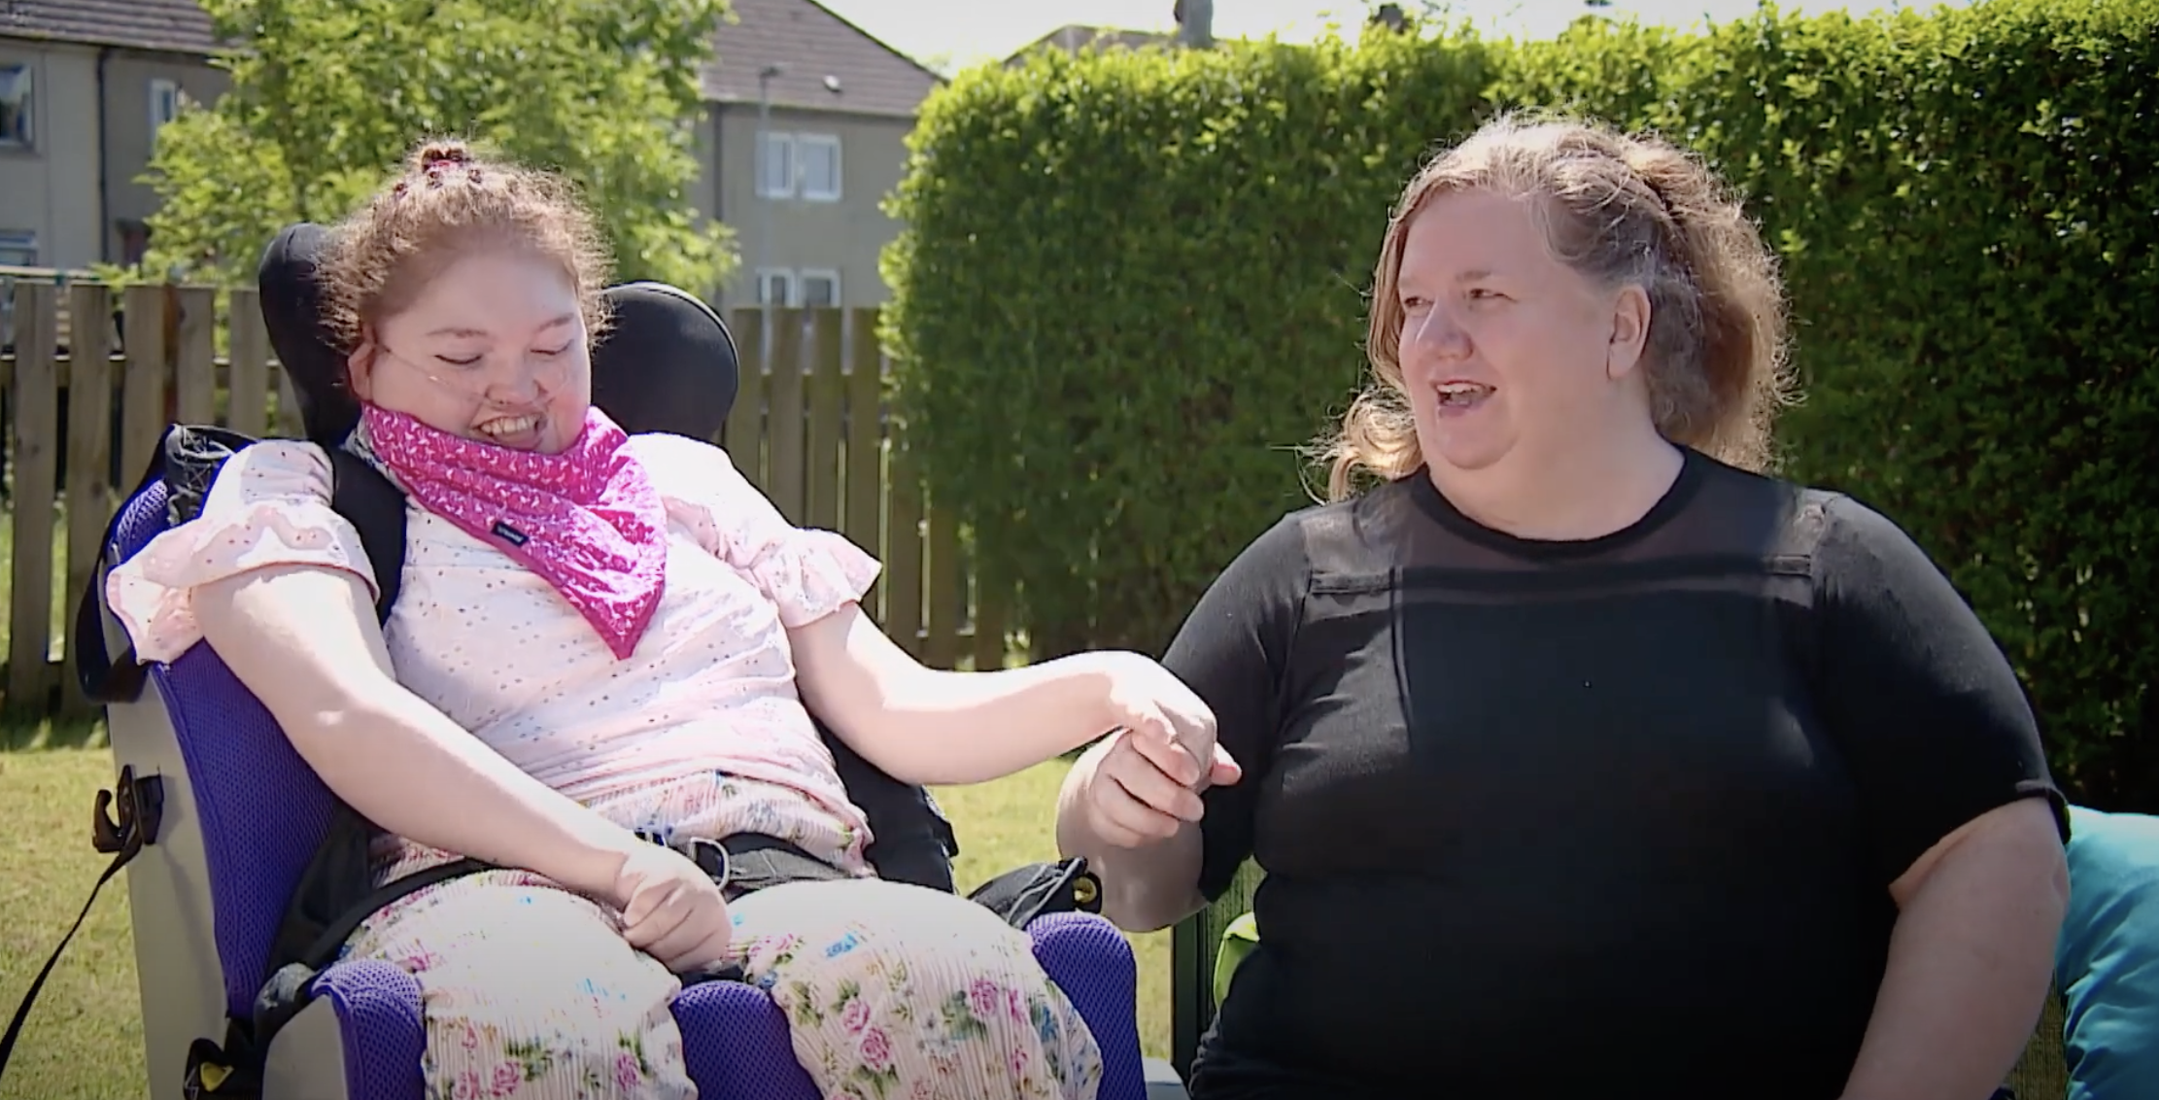
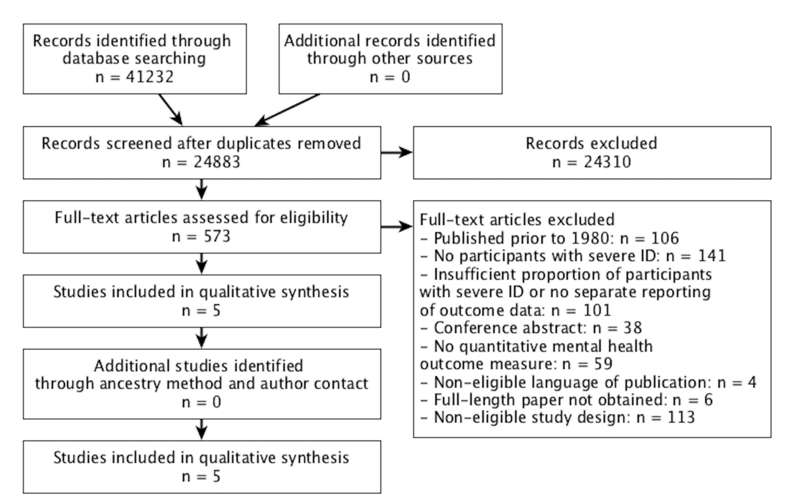
Not everyone is included…
Notes:
Small single case studies.

Slide 41

Thank you!

