Slide 1

Data Mining Statistical Methods
C&RT trees and Neural networks
Martin Sebera
Faculty of Sports Studies, Masaryk University

Slide 2
Orcid: 0000-0003-3750-1549
Scopus Author ID: 36165218300
ResearcherID: M-9818-2018
https://www.muni.cz/en/people/55084-martin-sebera

Slide 3
CONTENT
Standards statistical methods
  Disadvantages, limitations ☹
Datamining methods – classification, regression
  Benefits ☺
  C&RT trees, MLP Neural networks
Examples

Slide 4
Short list of frequently used methods
Basic statistical characteristics (mean, median, standard deviation, …)
t-test and ANOVA (analysis of variance)
Correlation analysis and Factor analysis
Linear regression and Test chí2
assumptions: normality of data, homogenity of variances
(→ parametric vs. nonparametric methods)
nominal, ordinal, categorical variables cannot be combined in model

Slide 5
Classification and regression
Classification - the process of classifying patterns into given classes based on the features of the classified object
Regression - the process of interleaving function data

Slide 6
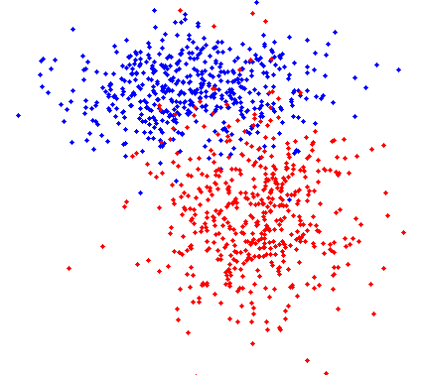
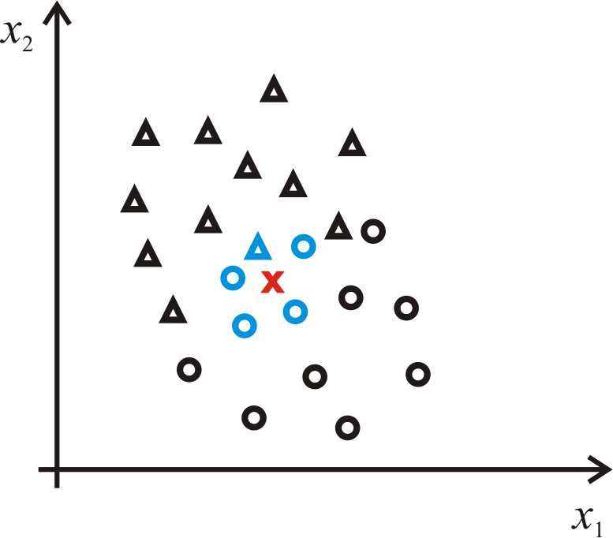
Classification
E.g. linear classifier, k-NN (k-nearest neighbors) classifier, trees, neural networks, ...

Slide 7
Regression (approximation)

Slide 8
Classification and regression tools
Tools that are used for regression can almost always be used for classification.
Not all classification tools are usable for regression.
Artificial neural networks (MLP, RBF,...)
Trees and their variants
Genetic and evolutionary techniques
Classical discriminant methods - k-nearest neighbors, Bayesian classifier, Support-vector machine (SVM), ...

Slide 9
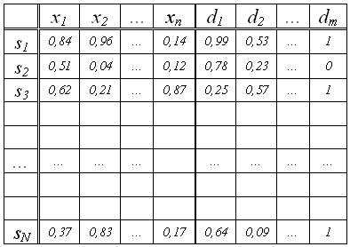
Data preparation
Editing data to the standard dataset format

Slide 10
Data preprocessing
Filtering - most often noise (sliding averaging, median filter - impulse noise removal)
Completion of missing data - only in an emergency, it is supplemented on the basis of the average resp. frequency
Normalization - the goal is to unify the numerical ranges of values

Slide 11
Data preparation
Dividing data into training, validation and testing set
Training set - known output → classifier learning
Validation set - known output, but we will not provide it to the classifier (comparison of the classification result with the real output) → validation
Test set - known output, we measure the success of the classifier
Most often the distribution of available data (patterns) in the ratio 2 : 1 : 1

Slide 12
Classification and regression trees
Principle: Gradual hierarchical dividing of data space into subgroups so that in the leaves of the created tree there are (homogeneous) groups of data belonging (in case of classification) to one class.
  Based on the gradual division of the symptom space (similar to searching in the botanical key).
  Classify an object into the corresponding class based on flags
  Simple, fast
  Easy visualization → good interpretation of results
  More resistant to outliers and missing values.

Slide 13
Classification accuracy
We can influence the accuracy of the classification and thus the structure of the tree:
misclassification cost matrix
a priori probabilities of representation of individual classes (priors)
proportional representation of patterns of individual classes in the data (case weights, count variable)
change of one parameter affects the others (different expressions of the same)

Slide 14
Classification accuracy
ROC curve (Receiver Operating Characteristics) - area under the plotted curve - quality of the classification
graphical plot that illustrates the diagnostic ability of a binary classifier system as its discrimination threshold is varied.
Sensitivity = TP / (TP + FN), Specificity = TN / (FP + TN),
Positive predictive value = TP / (TP + FP),
Negative predictive value = TN / (FN + TN),
Efficiency = (TP + TN) / (TP + TN + FP + FN)
TP – true positive, TN – true negative, FP – false positive, FN – false negative

Slide 15
Classification trees (Nonparametric method)
Samples are classified linearly and hierarchically into a finite (small) predetermined number of classes.
Sequence of decisions.
The root contains the entire data file.
Two (binary tree) or more branches grow from each node. Each sheet represents one of the groups.
The creation: choose a variable that divides the data into the most homogeneous subgroups possible.

Slide 16
Classification trees (Nonparametric method)
Stopping the growth of the tree. There are ways to:
  further subdivision is not statistically significant
  the size of the error in the subnodes (growth stops when the percentage success of the incorrect classification exceeds the specified value)
  number of samples in the end node
  number of terminal nodes

Slide 17
C&RT
C&RT is a binary tree build by splitting node into two child nodes repeatedly.
Each root node represents a single input variable (x) and a split point on that variable (assuming the variable is numeric).
The leaf nodes of the tree contain an output variable (y) which is used to make a prediction.

Slide 18
Example 1
Kratochvíl, J., Plch, L., Sebera, M., & Koritáková, E. (2020). Evaluation of untrustworthy journals: Transition from formal criteria to a complex view. Learned Publishing, 33(3), 308–322.
https://doi-org.ezproxy.muni.cz/10.1002/leap.1299

Slide 19
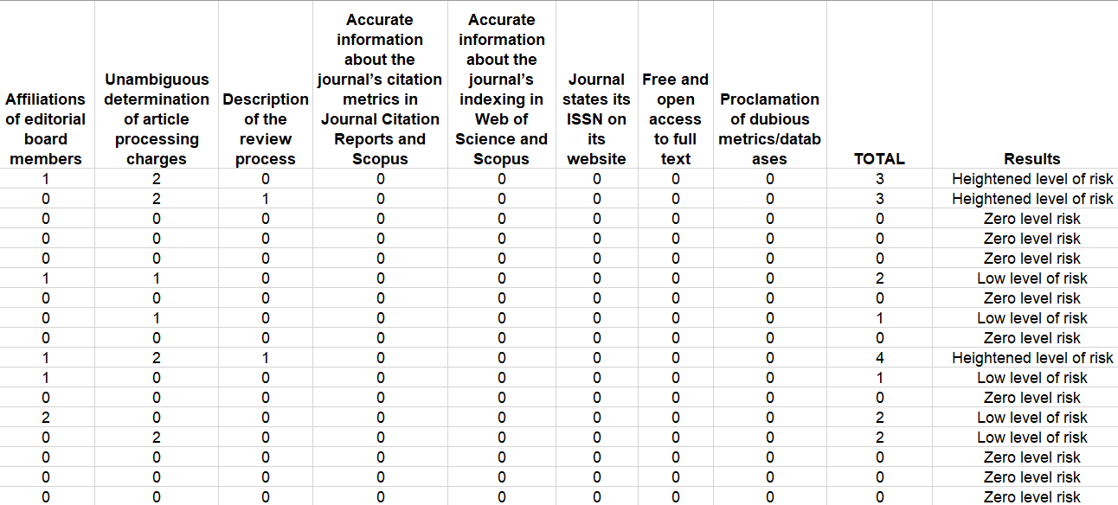

Slide 20
Predatory journals: criteria
Unambiguous determination of article processing charges
Affiliation of editorial board members
Journal ISSN on its website
Review Time
Description of Peer-Review
Proclamation of indexing WoS/Scopus/ERIH/Medline
Accessibility of full texts
Publisher
An evaluation of 259 biomedical journals
using the list of 8 criteria
The most common reason for failure to comply was:
  sufficient editorial information and
  declaration of article processing charges.

Slide 21
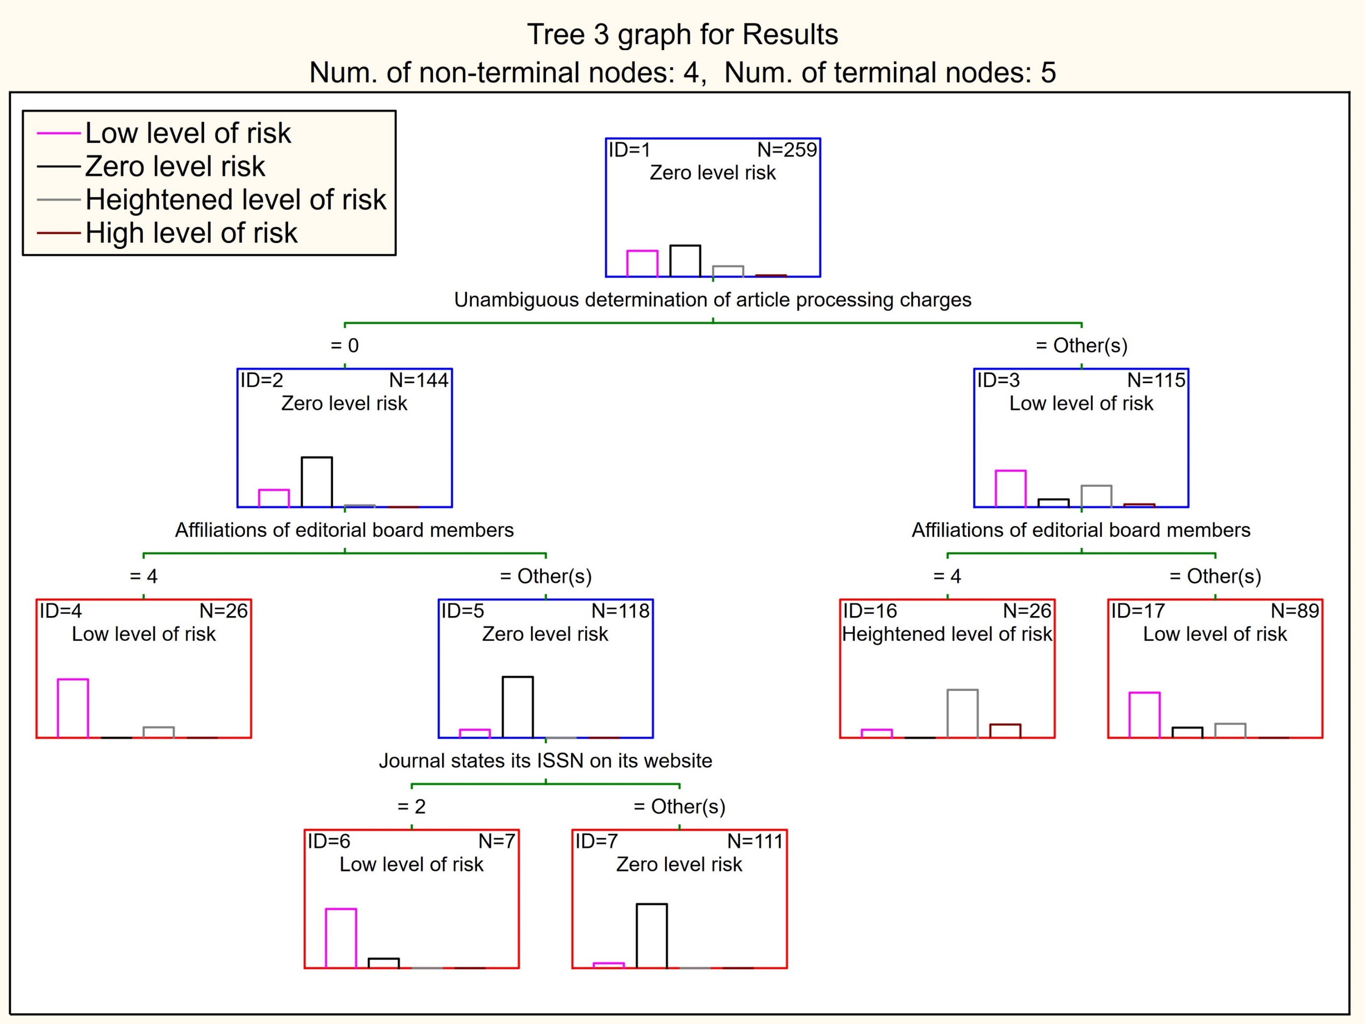

Slide 22
EXAMPLE 2
Vít M., Reguli Z., Sebera M., Cihounková J., & Bugala M. (2016). Predictors of children´s successful defence against adult attacker. Archives of Budo. (12), p. 141-150.
The paper is based on the presumption that the probability of successful defence of a child against an adult attacker is influenced by diversity of variables with different predictive values.

Slide 23
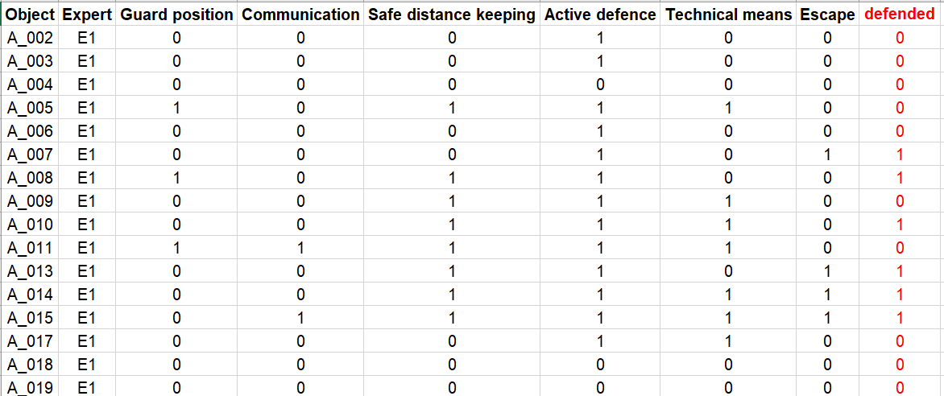
288 defense situations were evaluated by 6 self-defense experts in 6 criteria.

Slide 24
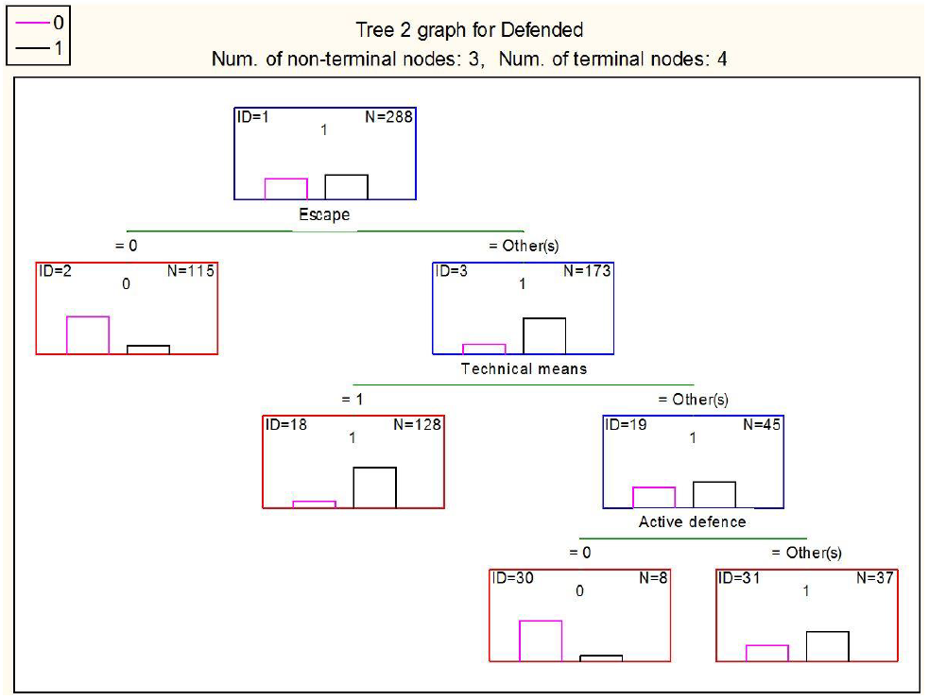
The best predictors: Active defence, Escape and Technical means
Communication and Safe distance keeping varied in the fifth position.
Guard position was found the weakest predictor.

Slide 25
Neural network (NN)
A tool for nonlinear modeling.
Many inputs generate an output that is a nonlinear function of the weighted sum of these inputs.
The weights assigned to each of the inputs are obtained on the basis of a learning process, where the generated outputs are compared with the so-called target outputs.
The obtained deviations between the known values and the obtained outputs serve as feedback for the adjustment of the weights.

Slide 26
Neural network
NN is a method in artificial intelligence
NN teaches computers to process data in a way that is inspired by the human brain.
It is a type of machine learning process, called deep learning, that uses interconnected nodes or neurons in a layered structure that resembles the human brain.
In other words, it is a very complex regression, where I have one dependent and many independent

Slide 27
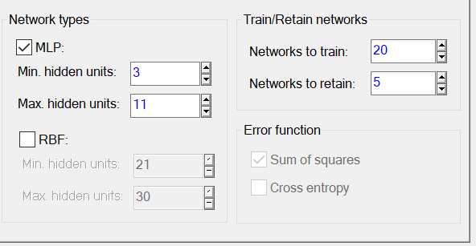
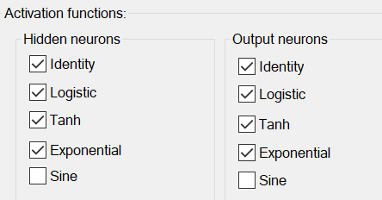
Neural network - MLP
Multilayer Perceptron (MLP): class of feed-forward neural networks
3 types of layers - the input layer, output layer and hidden layer
Activation Functions: defines how the weighted sum of the input is transformed into an output from a node or nodes in a layer of the network

Slide 28
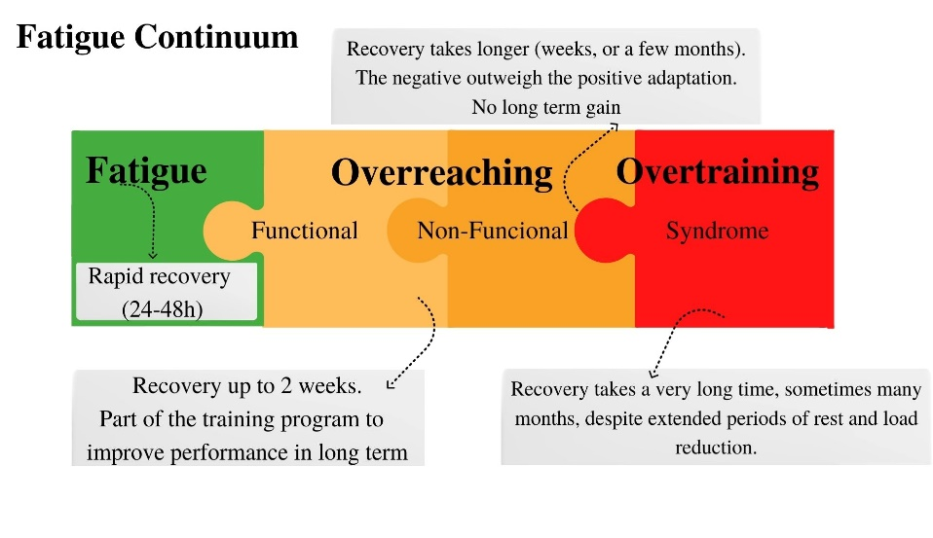
EXAMPLE 3 - Bernaciková M., Kumstát M., Buresová I., Kapounková K.,Struhár I., Sebera M. & Paludo, A. C. (2022). Diagnosing and preventing chronic fatigue in Czech youth athletes: mobile application
Frontiers in Physiology, section Exercise Physiology. In press

Slide 29
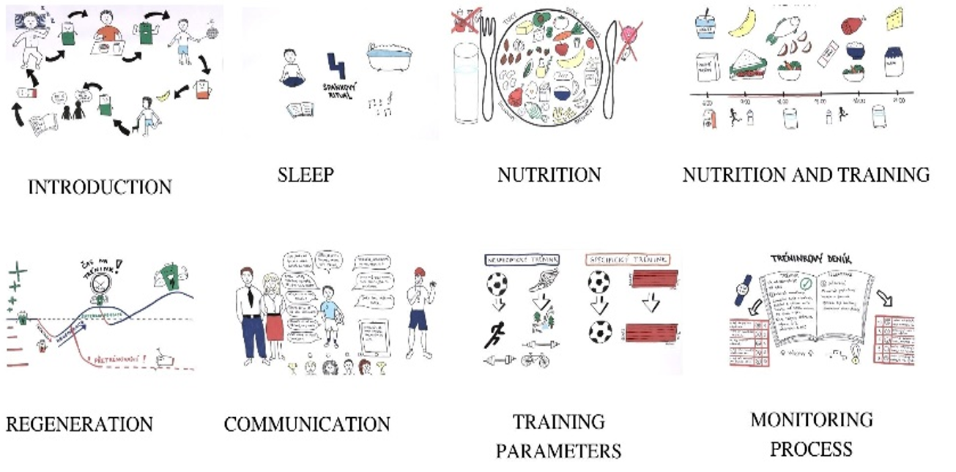

Slide 30
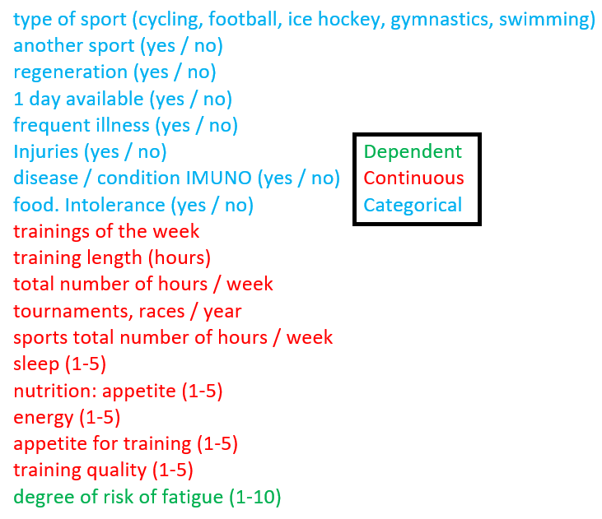
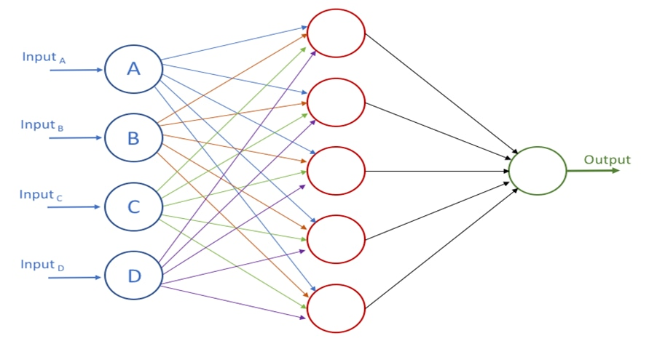
Bernaciková M., Kumstát M., Buresová I., Kapounková K.,Struhár I., Sebera M. & Paludo, A. C. Diagnosing and preventing chronic fatigue in Czech youth athletes: mobile application
MLP 30-11-1

Slide 31
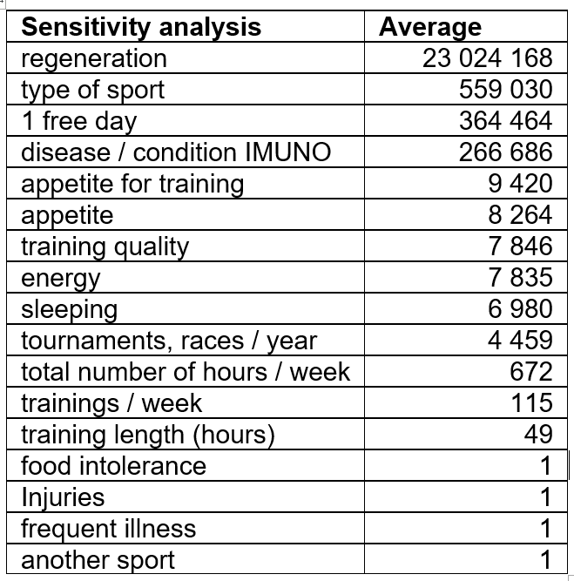
Bernaciková M., Kumstát M., Buresová I., Kapounková K.,Struhár I., Sebera M. & Paludo, A. C. Diagnosing and preventing chronic fatigue in Czech youth athletes: mobile application
MLP 30-11-1

Slide 32
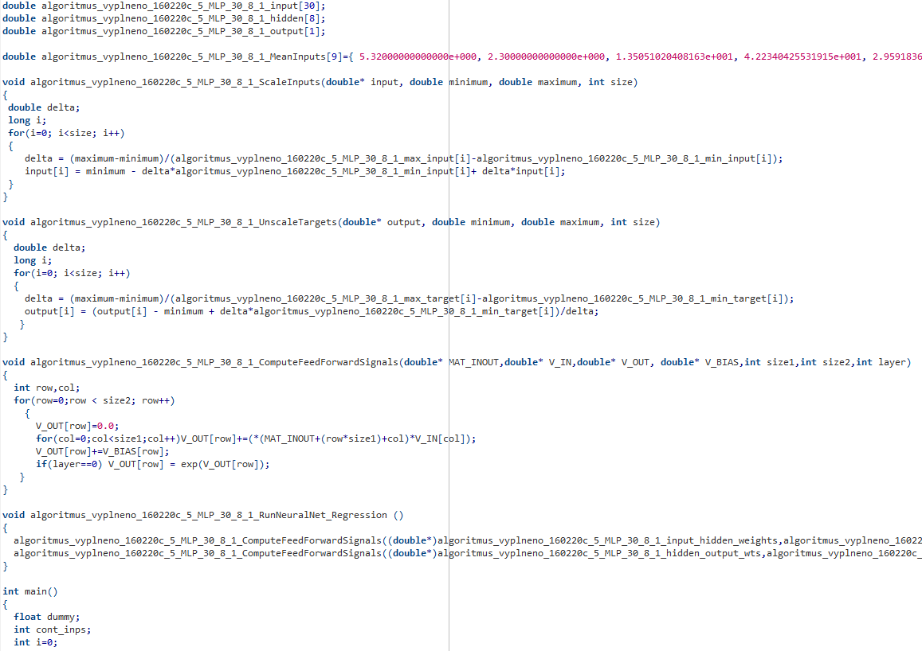

Slide 33
Software
STATISTICA
  TIBCO Software Inc. (2020). Data Science Workbench, version 14. http://tibco.com.
SPSS 28
  IBM SPSS Statistics, 28.0.0.0 (190)
I have to learn „R“
  language and environment for statistical calculations, https://www.r-project.org/

Slide 34
Sources
Kratochvíl, J., Plch, L., Sebera, M., & Koritáková, E. (2020). Evaluation of untrustworthy journals: Transition from formal criteria to a complex view. Learned Publishing, 33(3), 308–322. https://doi-org.ezproxy.muni.cz/10.1002/leap.1299
Vít M., Reguli Z., Sebera M., Cihounková J., & Bugala M. (2016). Predictors of children´s successful defence against adult attacker. Archives of Budo. (12), p. 141-150.
Bernaciková M., Kumstát M., Buresová I., Kapounková K.,Struhár I., Sebera M. & Paludo, A. C. (2022). Diagnosing and preventing chronic fatigue in Czech youth athletes: mobile application. Frontiers in Physiology, section Exercise Physiology. In press.

Slide 35
Conclusion
Everything here are statistical games ☺
Remember the most important and difficult thing of all statistical calculations is:
factual interpretation of the results !

Slide 36
Hvala na pažnji
Thank you for your attention

