Slide 1
Introduction to Regression
(linear, logistic, multivariate, nonlinear) and a message at the end
Martin Sebera
Magdeburg, January 2024

Slide 2
Content
I. Linear regression
II. Logistic regression
III. Multivariate Regression
IV. Nonlinear regression - Neural net

Slide 3
What it is regression?
statistical method that helps us understand the relationship between variables.
exploring how one variable affects another.
In a sports setting, we can use linear regression to predict outcomes or analyze performances. Let's demonstrate this with three examples:

Slide 4
History of regression
The term regression comes from the works of anthropologist and meteorologist Francis Galton, which he presented to the public between 1877 and 1885.
The question of heredity and specifically the relationship between the height of fathers and their first-born sons.
The "return tendency" of the next generation towards the mean was called regression by Galton (he originally called this phenomenon reversion, which he later changed to regression = a step back).
Although the current concept of regression analysis has little in common with Galton's original intention, the idea of accessing empirical data has remained, and the term regression has become so accepted that it is still used today

Slide 5
Correlation
Correlation - the mutual relationship between two variables.
If there is a correlation between two variables, it is likely that they depend on each other, but this does not mean that one of them must be the cause and the other the effect. The correlation alone does not allow to decide.

Slide 6
Procedure
Model design, where we choose the appropriate shape of the regression function. If the theoretical model is not known, we analyze the point diagram and the graph of conditional averages.
Estimation of regression parameters and tests of their significance.
Regression diagnostics, when we perform residual analysis and identification of influential points.
Assessment of model quality. The result is either the acceptance of the proposed model or the design of another model.

Slide 7
Regression procedure
Working with regression models is actually much more difficult.
It is necessary to test many assumptions (normality, homogeneity of variances, multicollinearity), choose an appropriate method (method of least squares, maximum likelihood), test residuals, analyze the quality of the model (residual variance, index of determination, Akaike information criterion, ROC curve, Gain graph), etc. .
The following examples are more emotive, which are intended to show the possibilities of regression.

Slide 8
I. Linear regression
Linear regression analysis is used to predict the value of a variable based on the value of another variable. The variable you want to predict is called the dependent variable. The variable you are using to predict the other variable's value is called the independent variable.
It mathematically models the unknown or dependent variable and the known or independent variable as a linear equation.

Slide 9
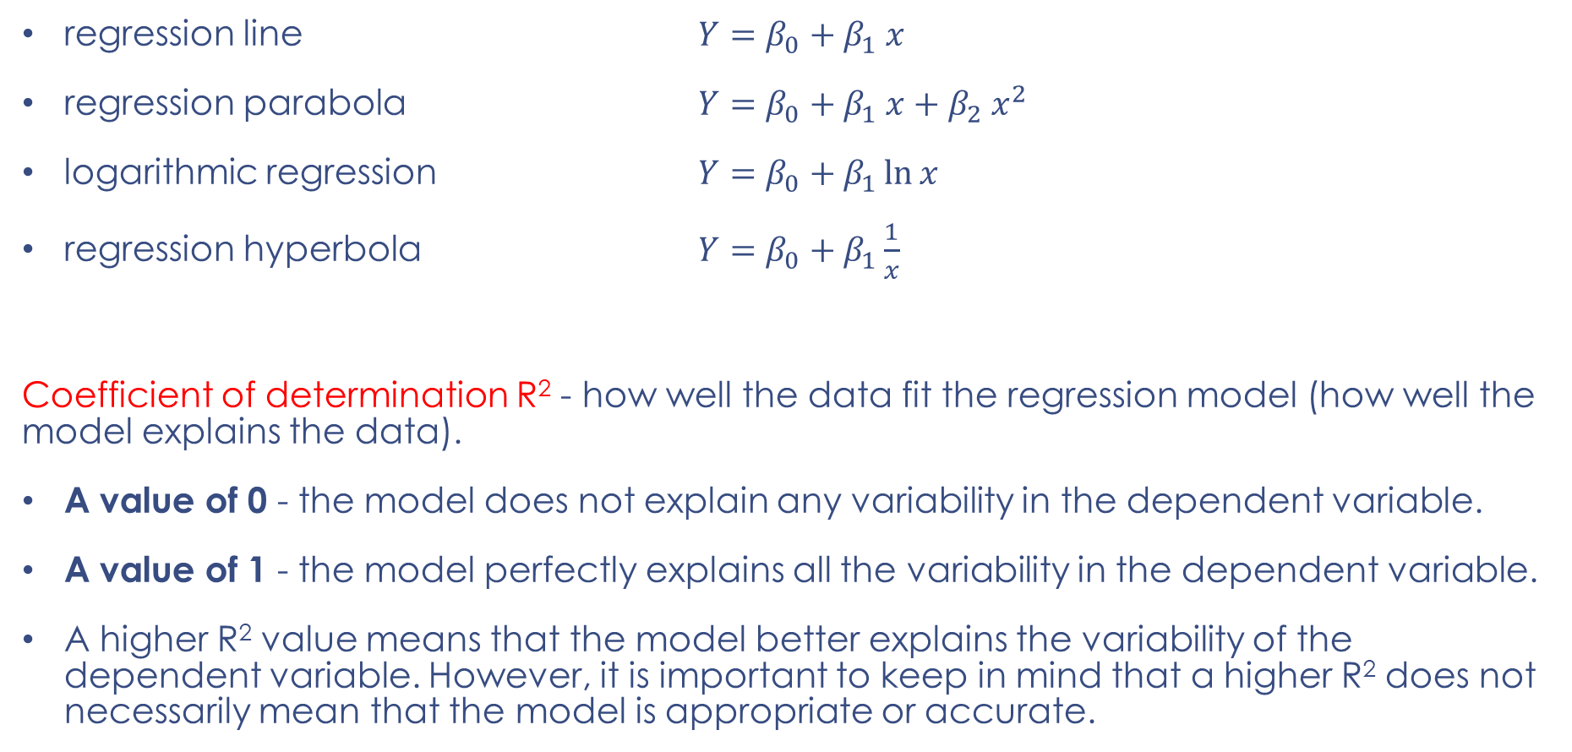
The most frequently used functions
regression line $Y=β_{0}+β_{1} x$
regression parabola $Y=β_{0}+β_{1} x+β_{2} x^{2}$
logarithmic regression $Y=β_{0}+β_{1}\ln{x}$
regression hyperbola $Y=β_{0}+β_{1}\frac{1}{x}$
Coefficient of determination R² - how well the data fit the regression model (how well the model explains the data).
A value of 0 - the model does not explain any variability in the dependent variable.
A value of 1 - the model perfectly explains all the variability in the dependent variable.
A higher R² value means that the model better explains the variability of the dependent variable. However, it is important to keep in mind that a higher R² does not necessarily mean that the model is appropriate or accurate.

Slide 10
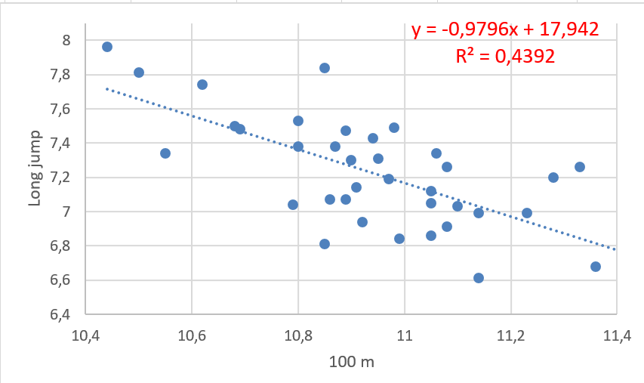
Example 1
dependence of performance in the long jump on performance in the 100 m run
LJ = -0,98 * 100m + 17,94
Geometrically speaking,
the coefficient of the
independent variable
is the tangent of the
angle the line makes
with the x-axis.
arctg(-0,9796) = -45°

Slide 11
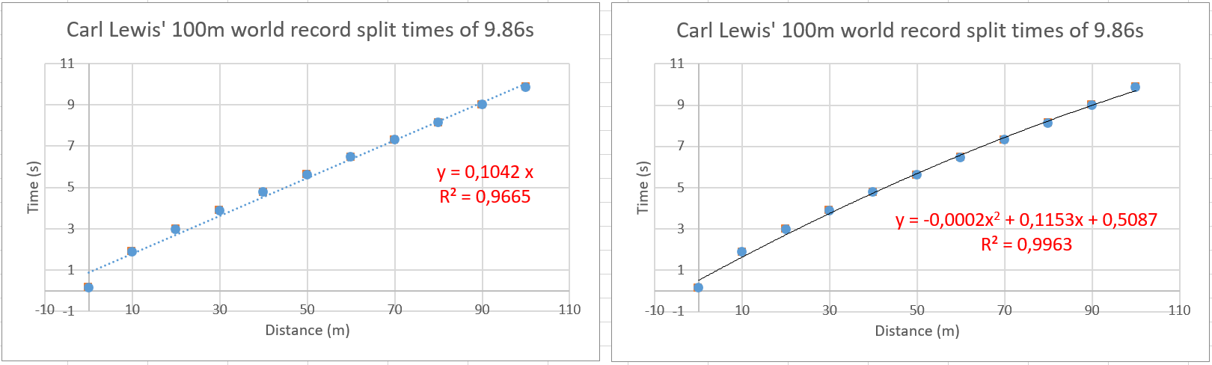
Example 2
Linear and quadratic linear regression models.
Quadratic regression has a slightly higher quality (both models are very accurate, because R² → 1). The quadratic model takes into account "fatigue" - the decrease in speed during the sprint

Slide 12
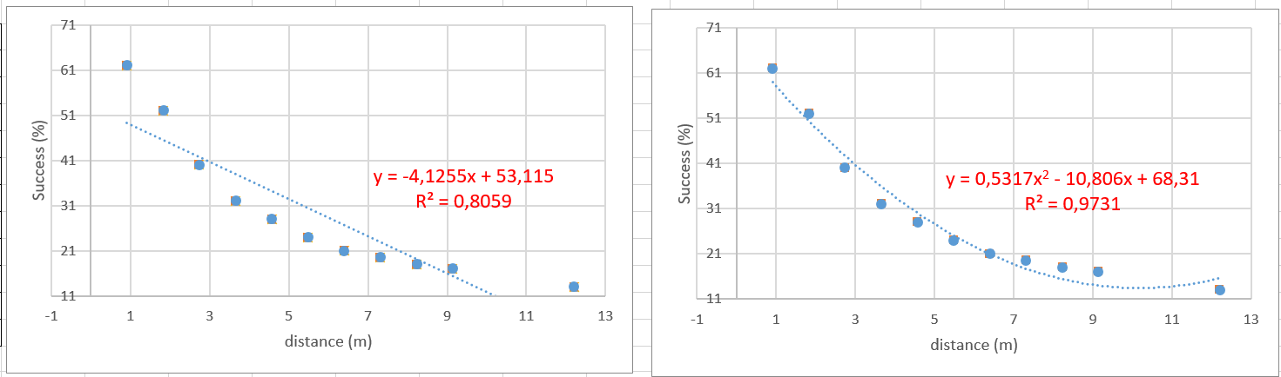
Example 3 - Shooting success in basketball
foot | m | %
3 | 0,9 | 62
6 | 1,8 | 52
9 | 2,7 | 40
12 | 3,7 | 32
15 | 4,6 | 28
18 | 5,5 | 24
21 | 6,4 | 21
24 | 7,3 | 20
27 | 8,2 | 18
30 | 9,1 | 17
40 | 12 | 13
If the horizontal distance of the basketball player
from the basket increases, the percentage of shooting
success decreases with this distance

Slide 13
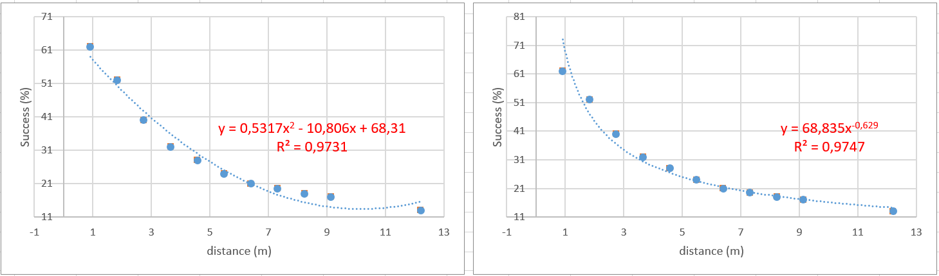
Example 3 - Shooting success in basketball
foot | m | %
3 | 0,9 | 62
6 | 1,8 | 52
9 | 2,7 | 40
12 | 3,7 | 32
15 | 4,6 | 28
18 | 5,5 | 24
21 | 6,4 | 21
24 | 7,3 | 20
27 | 8,2 | 18
30 | 9,1 | 17
40 | 12 | 13
However, the best regression model will be a power
model. Why? See how the curve would behave
with further distance…

Slide 14
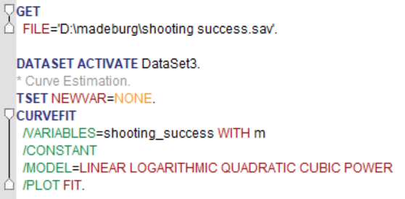
Example 3 - Shooting success in basketball in SPSS
The chosen type of regression function must first of all respect the logical and objective connections of the phenomena and their regularities
SPSS → Analyze → Regression → Curve estimation

Slide 15
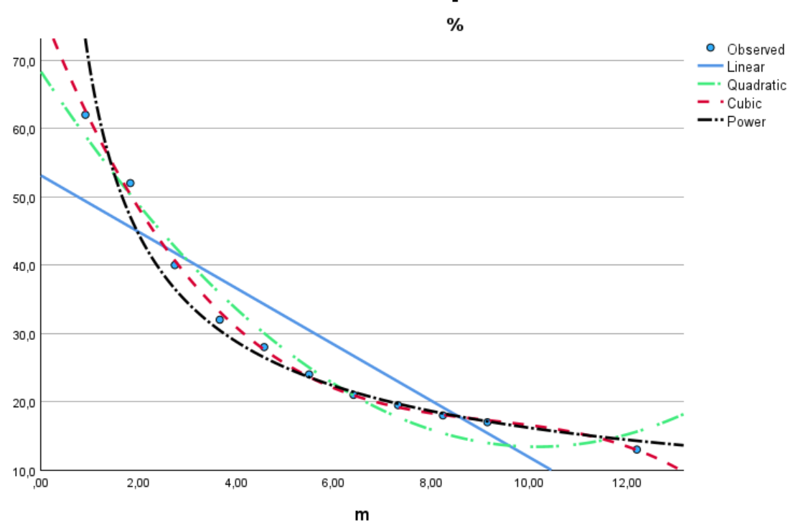
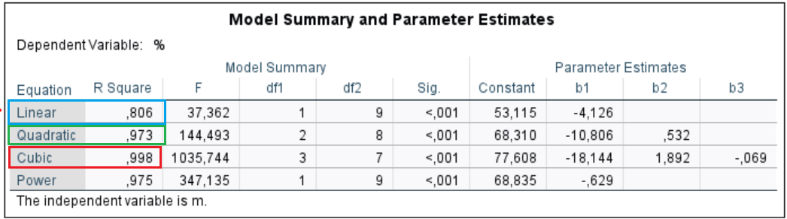

Slide 16
Example 4 – height, weight
We take the measures of people in the class and try to estimate the shape of the regression curve

Slide 17
II. Logistic regression
Logistic regression is a statistical method used to analyze data where the dependent variable is categorical, usually binary (ie has two possible values, such as yes/no, success/failure, 0/1).
The main goal of logistic regression is to model the probability that a given input sample belongs to one of two categories.
Example:
  Pollard, R., & Reep, C. (1997). Measuring the Effectiveness of Playing Strategies at Soccer. Journal of the Royal Statistical Society. Series D (The Statistician), 46(4), 541–550.

Slide 18
Logistic regression - example
Pollard and Reep (1997) used logistic regression to investigate the effectiveness of different strategies in soccer and their effect on the probability of scoring a goal. They wanted to discover how certain characteristics of the situation affect the probability of a goal being scored. As the basic event (dependent variable), they chose a situation that ended with a shot on goal. There were 489 of these events. They also identified the characteristics of the situations that could affect the outcome of the event. They chose as predictors:
distance from the goal in meters (DIST);
the angle (ANGLE) to the nearest goal post;
measure of how many touches the player had with the ball before shooting: one (TOUCH = 0), more than one (TOUCH = 1);
distance measure of the closest opponent: less than one meter (TIGHTNESS = 0), more than one meter (TIGHTNESS = 1);
origin of ball acquisition: from play (GAIN = 0), free kick or throw from the sideline (GAIN = 1).

Slide 19
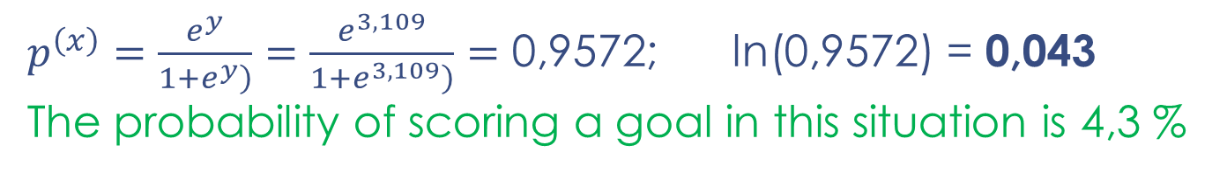
Logistic regression - example
The available information made it possible to complete these variables for all 489 events. Head shots and kick shots were analyzed in particular. For 410 kick shots, the regression equation was found:
Ln(goal chance) = 1.245 - 0.219 DIST - 1.578 ANGLE + 0.947 TIGHTNESS - 1.069 GAIN
This formula allows you to calculate the probability of scoring a goal in different situations.
For example, let's assume a kick from 15 meters (DIST=15) directly in front of the goal (ANGLE=0) with an opponent less than one meter away (TIGHTNESS=0) when the player got to the ball after a free kick (GAIN=0). The value of Ln(goal chance) = y = 3.109. The probability is calculated according to the formula
$p^{\left(x\right)}=\frac{e^{y}}{\left.1+e^{y}\right)}=\frac{e^{3,109}}{\left.1+e^{3,109}\right)}=\text{0,9}\text{572}$; ln(0,9572) = 0,043
The probability of scoring a goal in this situation is 4,3 %

Slide 20
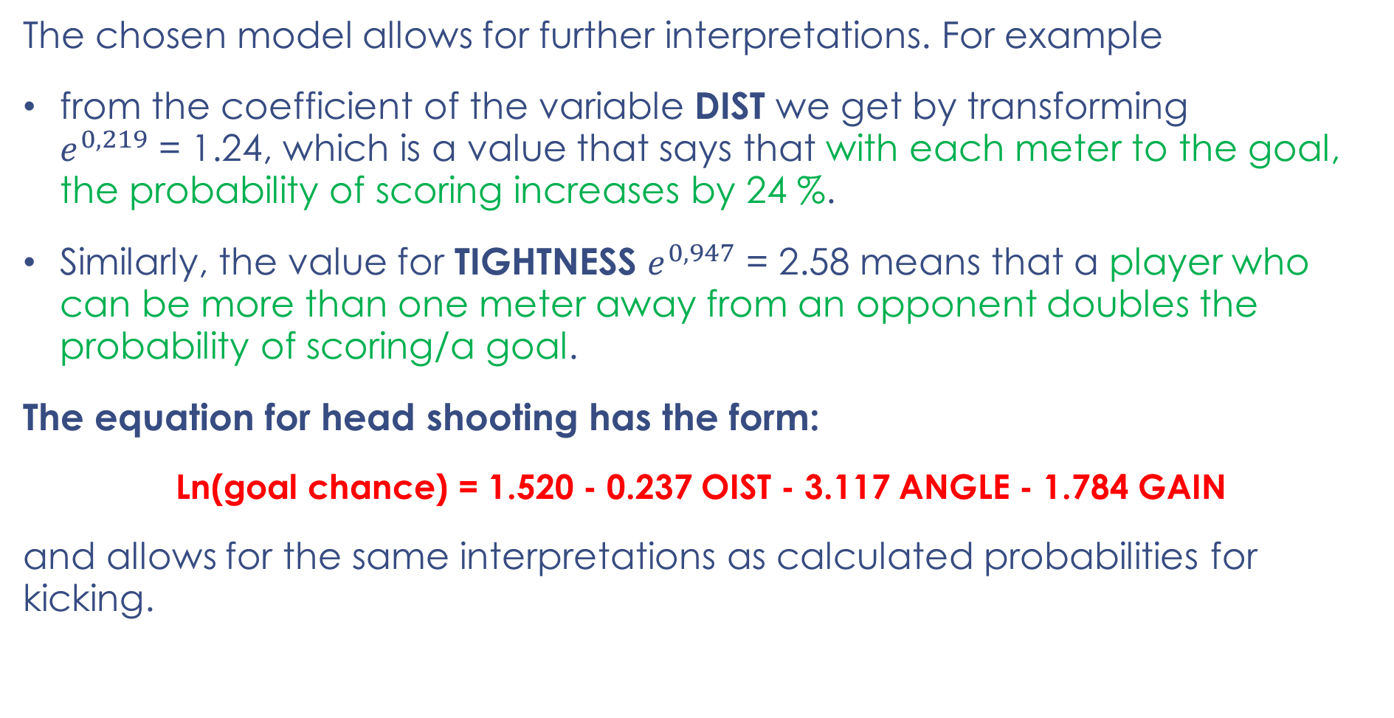
Logistic regression - example
The chosen model allows for further interpretations. For example
from the coefficient of the variable DIST we get by transforming
$e^{0,219}$ = 1.24, which is a value that says that with each meter to the goal, the probability of scoring increases by 24 %.
Similarly, the value for TIGHTNESS $e^{0,947}$ = 2.58 means that a player who can be more than one meter away from an opponent doubles the probability of scoring/a goal.
The equation for head shooting has the form:
Ln(goal chance) = 1.520 - 0.237 OIST - 3.117 ANGLE - 1.784 GAIN
and allows for the same interpretations as calculated probabilities for kicking.
Pollard, R., & Reep, C. (1997). Measuring the Effectiveness of Playing Strategies at Soccer. Journal of the Royal Statistical Society., 46(4), 541–550.

Slide 21
III. Multivariate Regression
Multivariate Regression is a method used to measure the degree at which more than one independent variable (predictors) and more than one dependent variable (responses), are linearly related.

Slide 22
Multivariate Regression - example
For twenty selected households, data on quarterly expenditure on food and beverages (y), quarterly household income (x1), number of children (x2), average age of earning household members (x3) and number of household members (x4) were obtained.
Decide which variables contribute significantly to explaining the variability in quarterly spending values.
Try to guess which independent variables what will they be?

Slide 23
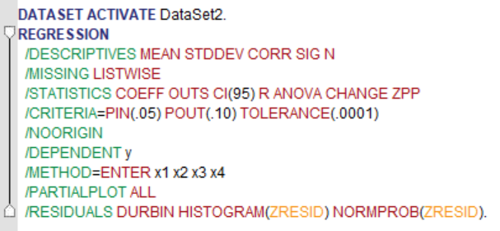
Multivariate Regression - example
x₁ | x₂ | x₃ | x₄ | y
11172 | 0 | 55 | 1 | 3464
8868 | 0 | 21 | 1 | 1982
17414 | 0 | 49 | 1 | 3228
10730 | 0 | 22 | 1 | 3034
24110 | 0 | 62,5 | 2 | 10146
38530 | 0 | 57 | 2 | 8202
22902 | 0 | 54,5 | 2 | 9332
25448 | 0 | 57,5 | 2 | 7096
20326 | 0 | 28 | 2 | 6248
39186 | 1 | 38,5 | 3 | 13816
28758 | 1 | 45,5 | 3 | 10328
33658 | 1 | 28,5 | 3 | 4786
24272 | 1 | 36 | 3 | 9710
30386 | 2 | 35 | 4 | 10778
31750 | 2 | 30,5 | 4 | 10568
39456 | 2 | 32,5 | 4 | 14260
48458 | 2 | 38 | 4 | 10934
37990 | 2 | 37 | 4 | 6388
24920 | 2 | 33,5 | 4 | 8584
40064 | 3 | 47 | 5 | 16950

Slide 24
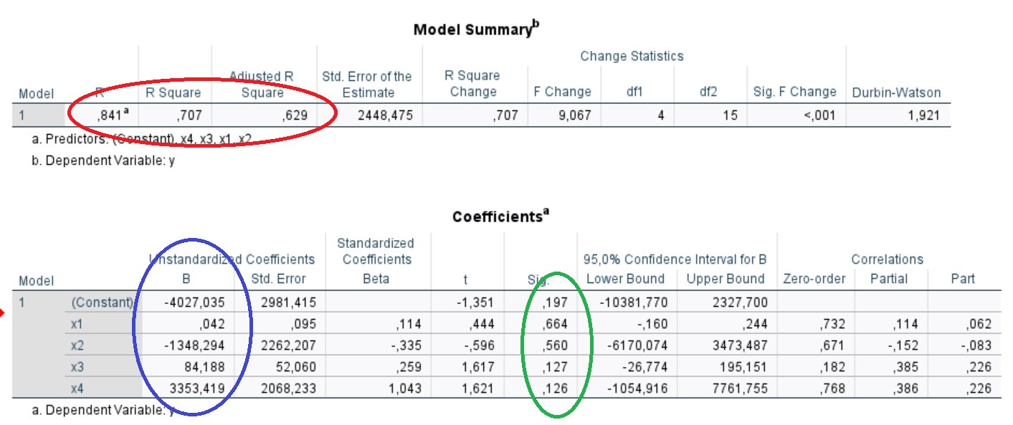
Multivariate Regression – example
y = - 4027 + 0.042063 x1 - 1348.3 x2 + 84.188 x3 + 3353.4 x4
with the adjusted coefficient of determination, which takes into account the number of independent variables, R² = 0.629 and the residual standard deviation se = 2448.5.

Slide 25
IV. Nonlinear regression - Neural net
assumptions: normality of data, homogenity of variances
(→ parametric vs. nonparametric methods)
nominal, ordinal, categorical variables cannot be combined in model
often these conditions are not met
Many inputs generate an output that is a nonlinear function of the weighted sum of these inputs.
The weights assigned to each of the inputs are obtained on the basis of a learning process, where the generated outputs are compared with the so-called target outputs.
The obtained deviations between the known values and the obtained outputs serve as feedback for the adjustment of the weights.

Slide 26
Nonlinear regression - Neural net
NN is a method in artificial intelligence
NN teaches computers to process data in a way that is inspired by the human brain.
It is a type of machine learning process, called deep learning, that uses interconnected nodes or neurons in a layered structure that resembles the human brain.
In other words, it is a very complex regression, where I have one dependent and many independent

Slide 27
Nonlinear regression - Neural net
Multilayer Perceptron (MLP): class of feed-forward neural networks
3 types of layers - the input layer, output layer and hidden layer
Activation Functions: defines how the weighted sum of the input is transformed into an output from a node or nodes in a layer of the network

Slide 28
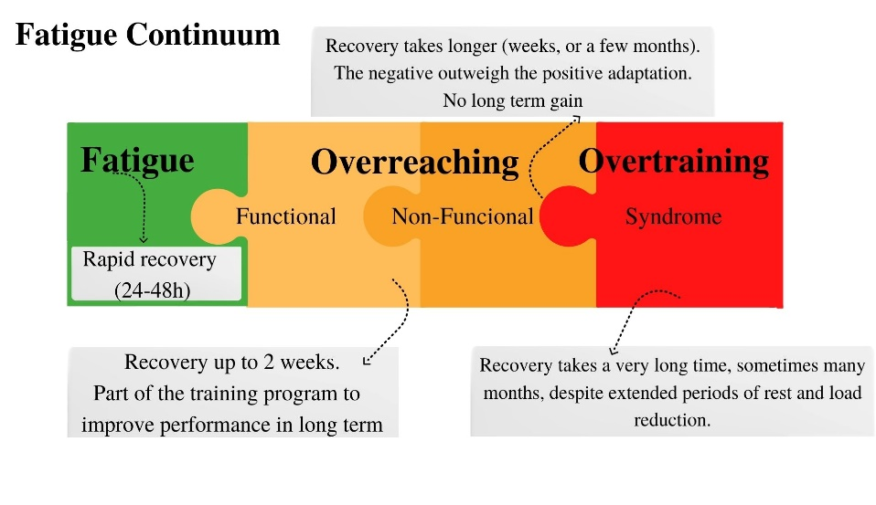
Example
Overtraining
Bernacikova, M., Kumstat, M., Buresova, I., Kapounkova, K., Struhar, I., ☺ Sebera, M., & Paludo, A. C. (2022). Preventing chronic fatigue in Czech young athletes: The features description of the “SmartTraining” mobile application. FRONTIERS IN PHYSIOLOGY, 13, 919982. https://doi.org/10.3389/fphys.2022.919982

Slide 29
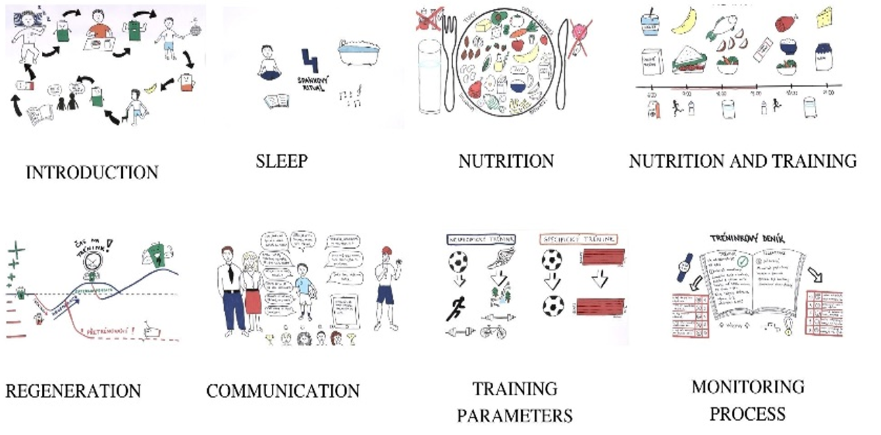

Slide 30
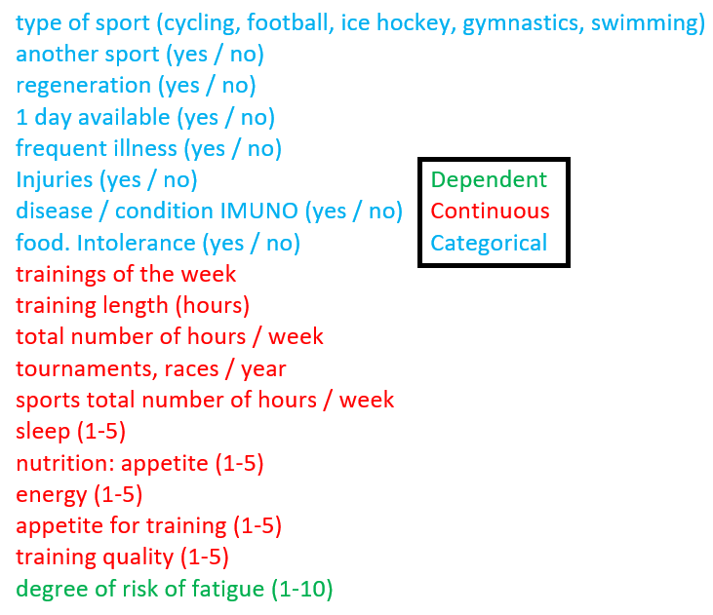
Example Overtraining
How to get variables that are numerical, categorical, nominal ordinal into one regression model?
The assumptions of data normality, homogeneity of variances, etc. are not met.

Slide 31
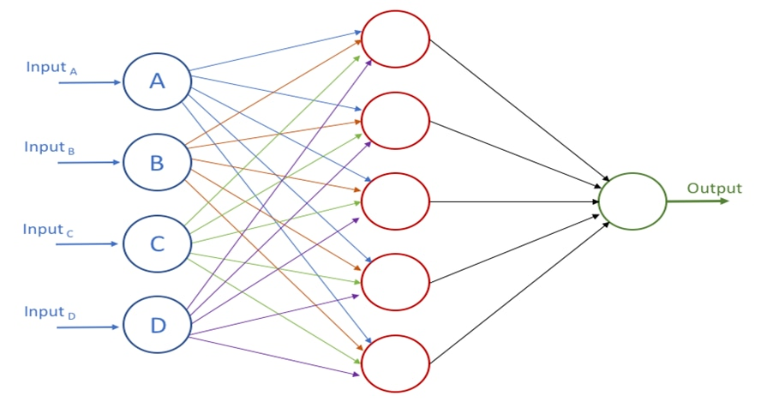
Example Overtraining
A neural network with 30 inputs, one hidden layer with 11 hidden neurons and 1 output neuron.
MLP 30-11-1

Slide 32
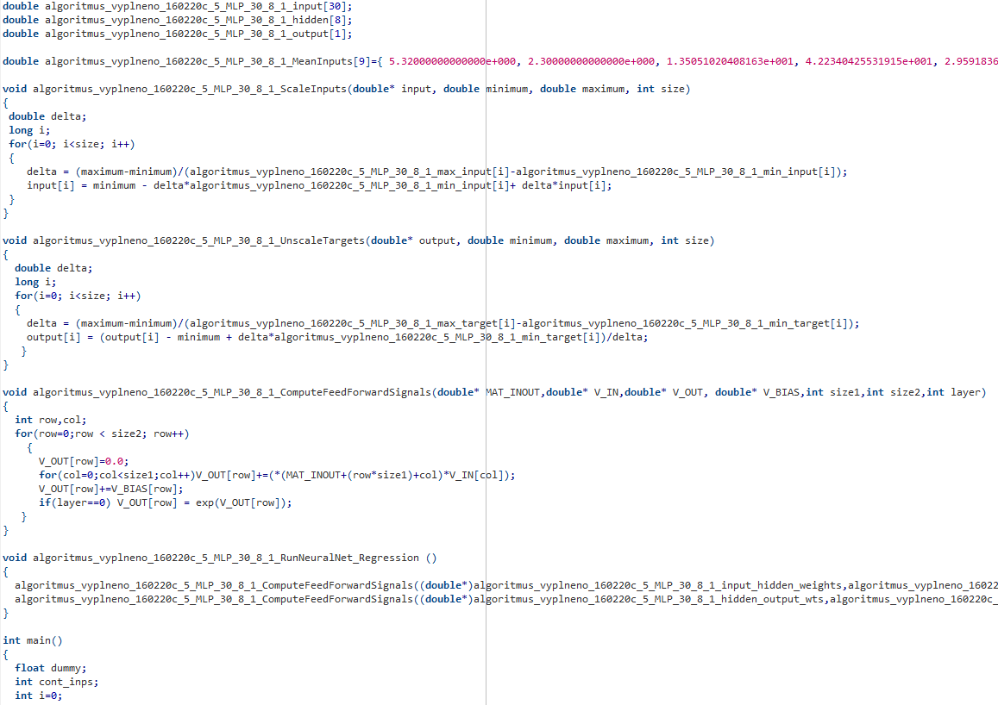

Slide 33
The most important predictors of overtraining
Amount of regeneration (active regeneration)
Sleep (pasive regeneration)
Number of tournaments/races per year
Type of sport
…

Slide 34
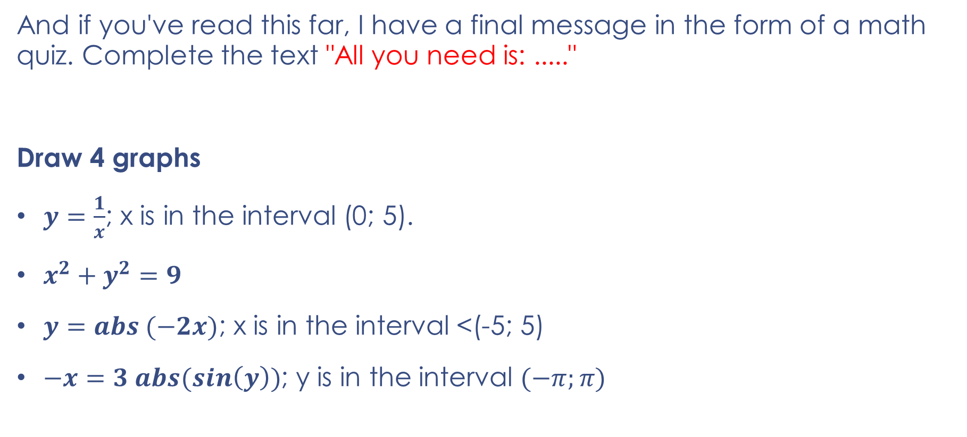
CONCLUSION
And if you've read this far, I have a final message in the form of a math quiz. Complete the text "All you need is: ....."
Draw 4 graphs
$y=\frac{1}{x}$; x is in the interval (0; 5).
$x^{2}+y^{2}=9$
$y=abs (−2x)$; x is in the interval <(-5; 5)
$−x=3 abs(sin\left(y\right))$; y is in the interval $(−π;π)$

Slide 35
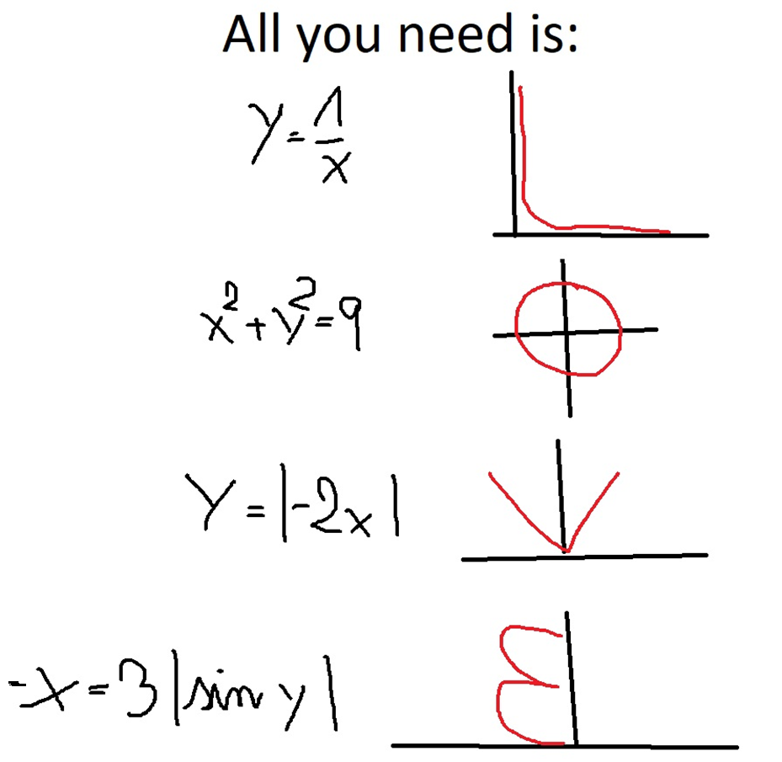

Slide 36
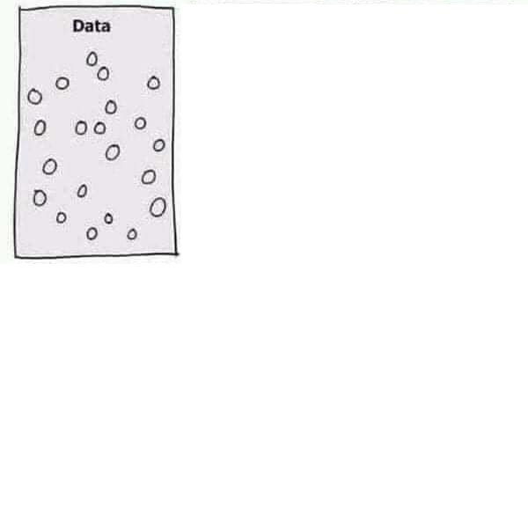
How to fight disinformation and conspiracy?

Slide 37
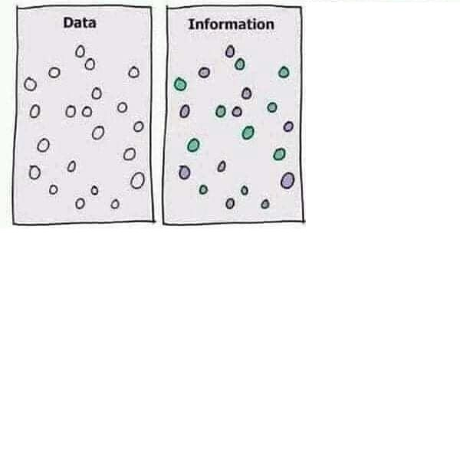
How to fight disinformation and conspiracy?

Slide 38
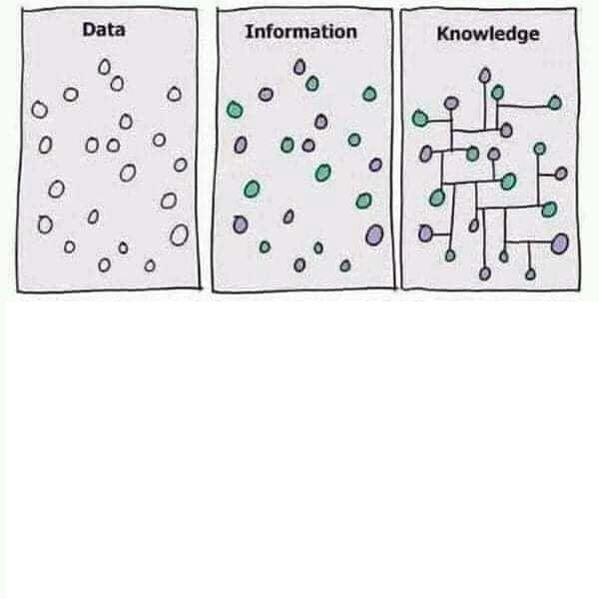
How to fight disinformation and conspiracy?

Slide 39
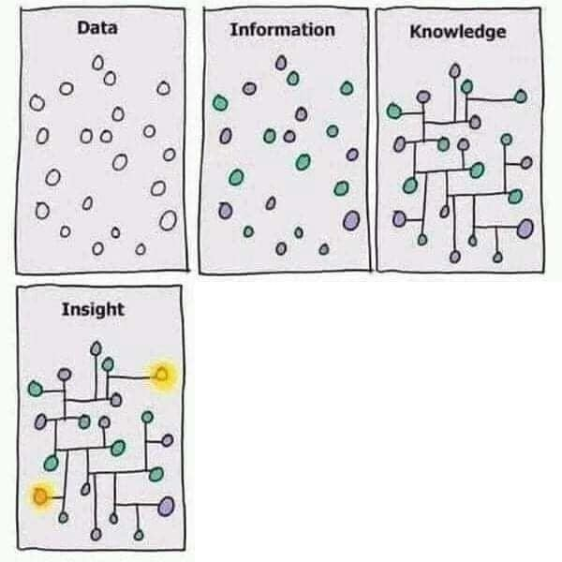
How to fight disinformation and conspiracy?

Slide 40
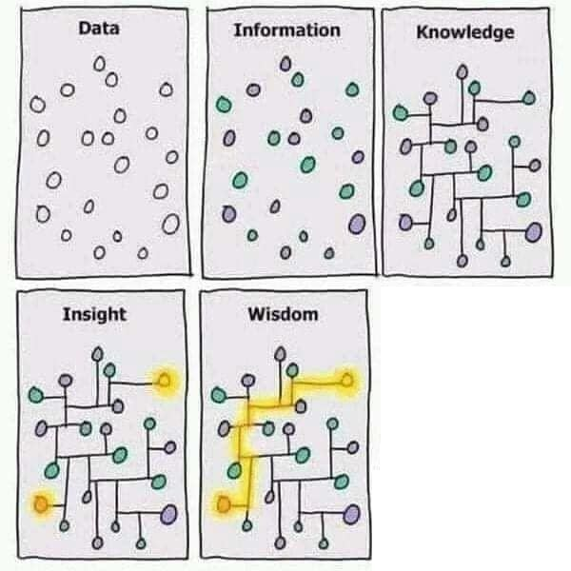
How to fight disinformation and conspiracy?

Slide 41
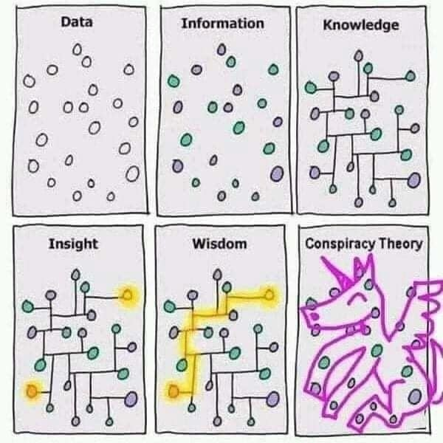
How to fight disinformation and conspiracy?

Slide 42
And that's why you need to understand statistics!
How to fight disinformation and conspiracy?
Verifying Claims and Sources:
This involves analyzing data sets that can confirm or disprove certain claims.
Recognition and detection of data manipulation:
Statistics offers tools for identifying unusual or improbable patterns in data, which may signal an attempt at disinformation.
Use of predictive regression models:
Statistical modeling and machine learning can help predict the spread of misinformation and identify potential new misinformation before it spreads.
Statistics Education Initiative:
Which teach the public how to interpret data and statistical results. This helps people better understand how data is used to support different arguments.
Promoting data transparency and openness
so that the public can verify information and conduct independent analysis.

Slide 43
1. Dezinformace o vakcínách:
Tvrzení: "Úmrtnost na očkování je mnohem vyšší než na samotný COVID-19."
• Statistická metoda: Porovnání incidence nežádoucích účinků po očkování s incidencí a mortalitou COVID-19.
• Analýza: Použití metod k výpočtu relativního rizika, odhadování intervalů spolehlivosti a kontrola zkreslení (např. nereprezentativní výběr dat).
2. Dezinformace o imigraci:
Tvrzení: "Imigranti způsobují rapidní nárůst kriminality v ČR."
• Statistická metoda: Analýza dat z kriminálních statistik, porovnání kriminality mezi migranty a místní populací po zohlednění klíčových faktorů (věk, příjem, vzdělání).
• Analýza: Použití regresní analýzy ke kontrole vlivu různých faktorů a testování statistické významnosti.
3. Dezinformace o změně klimatu:
Tvrzení: "Globální oteplování je jen přirozený cyklus a není způsobeno lidskou činností."
• Statistická metoda: Analýza dlouhodobých teplotních trendů a jejich korelace s emisemi skleníkových plynů.
• Analýza: Použití modelování časových řad a kauzálních analýz k potvrzení vztahu mezi emisemi a teplotou.
4. Dezinformace o volebních podvodech:
Tvrzení: "Ve volbách byly miliony hlasů zmanipulovány."
• Statistická metoda: Ověření volebních výsledků pomocí forenzní analýzy (analýza anomálií v distribuci hlasů).
• Analýza: Testování pravděpodobnosti vzorů, které by naznačovaly manipulaci, oproti přirozeně očekávaným trendům.
5. Dezinformace o ekonomice:
Tvrzení: "Inflace je způsobena pouze vládními výdaji."
• Statistická metoda: Analýza vlivu jednotlivých faktorů na inflaci pomocí vícerozměrné regresní analýzy (vládní výdaje, ceny energií, globální ekonomické faktory).
• Analýza: Vyvrácení zjednodušení a propojení vícero zdrojů dat.

