Slide 1
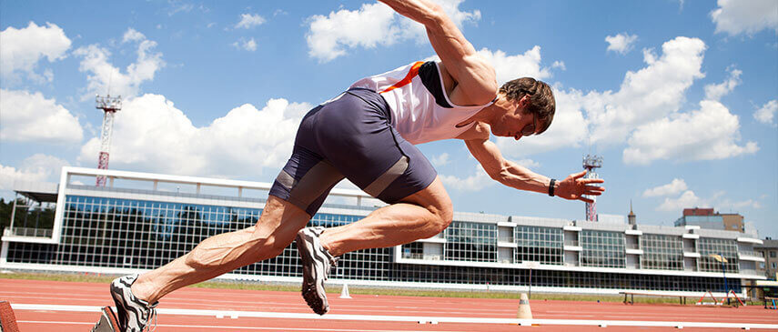
Performing under Pressure; on the Biology, Psychology and Sociology of stress in high-performance professions
I - Introduction

Slide 2
Course: Performing under Pressure
Faculty of Sports Studies
Schedule
  Tuesdays (09:00-10:40)
Lecturer
  David William Mac Gillavry
  404280@in.muni.cz
  Office hours – upon request

Slide 3
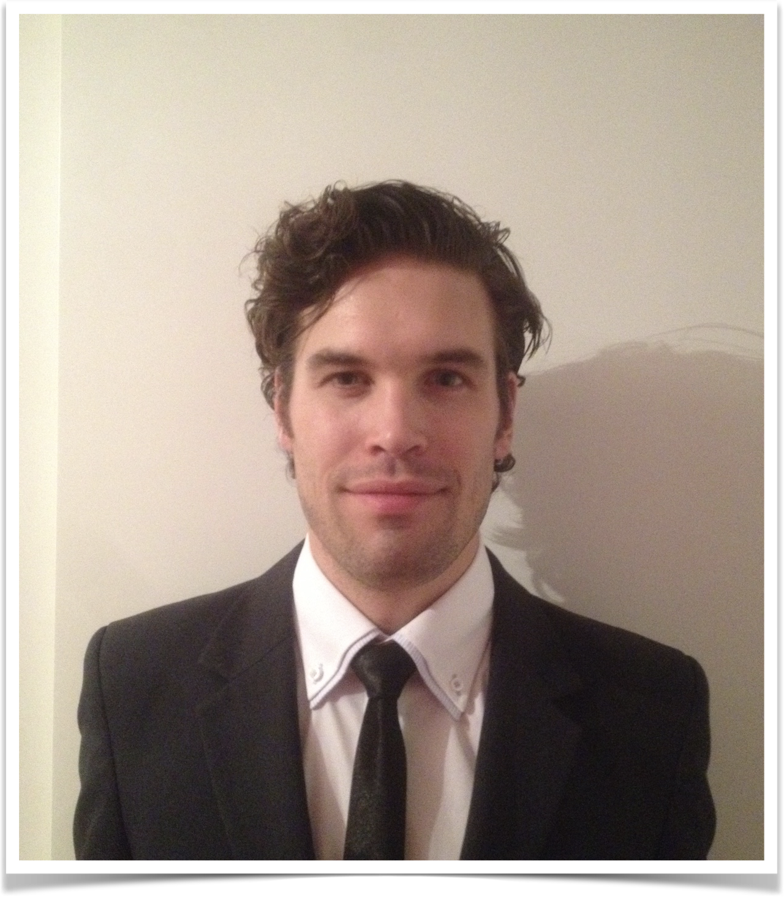
Who am I?
Religious studies (UvA / MUNI)
  Cognitive science of religion
  Western esotericism
  Secrecy dynamics
Military Management (UNOB)
  Stress & PTSD
  Leadership
  Nutrition
  Social conformity & in-group dynamics

Slide 4

My current research
University of Defence
Stress resilience under extreme conditions
Leadership & combat leadership
In-group dynamics & moral behaviour under extreme conditions
Preparation for high-stress experiences

Slide 5
Course specifics
The course aims to provide a comprehensive introduction into stress-science with a focus on high-performance professions. The course will investigate the effects of stress on the individual as well as the collective and interactions within said collective. After the course students will have a basic understanding of the function of stress under extreme conditions, how to utilise it effectively, how to manage it and how to recognise when it becomes overwhelming in both oneself and others

Slide 6
Syllabus
Lecutre | Topic | Seminar
1 | Introduction to the course and stress science | Observable measures & perception of stress
2 | On the physiology of stress
3 | On the psychology of stress
4 | On the social psychology of stress
5 | Stress related disorders and what they can teach us about performance | Stress management
6 | Stress management
7 | Performance under stress | Performance enhancement under pressure
8 | Team-performance under stress
9 | Nutrition, stress and performance | Lifestyle, stress and performance
10 | Relax, on the importance rest

Slide 7
Course requirements
Be here, be active & be prepared
A term paper
  Min 8 pages (2.0 spacing)
  Proper bibliography and referencing (preferably APA)
  Subject of your choosing as long as it relates to stress and peak performance

Slide 8
The point of this course is NOT [sic!] to eliminate stress! If you are in a situation that requires a functional, focused and quick response, you had better get stressed like any other mammal!
Peak performance and physical exercise in general depend on the stress response
  Explosive physiological output
  Heightened task related focus
Stress management and optimisation

Slide 9
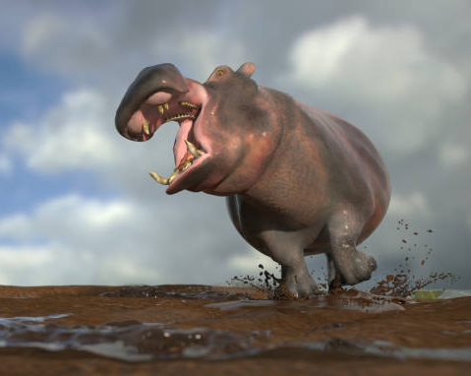
How we differ from most other animals
Anticipation
  Hyperactive Agency Detection
  Theory of Mind
Duration
Projection
Bering, J. M. (2002). The existential theory of mind. Review of General Psychology, 6(1), 3–24. https://doi.org/10.1037//1089-2680.6.1.3
Mahy, C. E. V., Moses, L. J., & Pfeifer, J. H. (2014). How and where: Theory-of-mind in the brain. Developmental Cognitive Neuroscience, 9, 68–81. https://doi.org/10.1016/j.dcn.2014.01.002
Valdesolo, P., & Graham, J. (2014). Awe , Uncertainty , and Agency Detection. https://doi.org/10.1177/0956797613501884

Slide 10
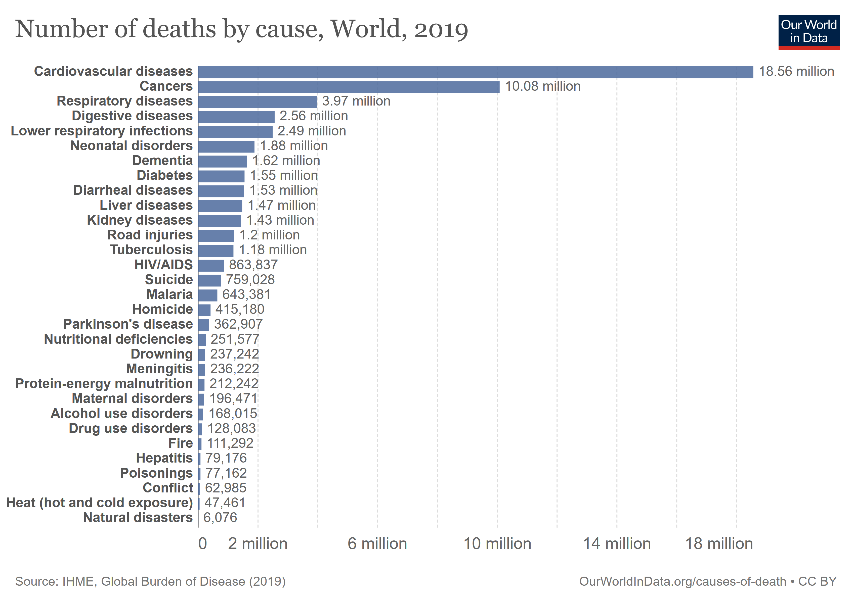
The ”luxury” of stress related illnesses
Throughout history people died of parasites, infectious diseases, violence, hunger, giving birth, etc.
The major killers today:

Slide 11
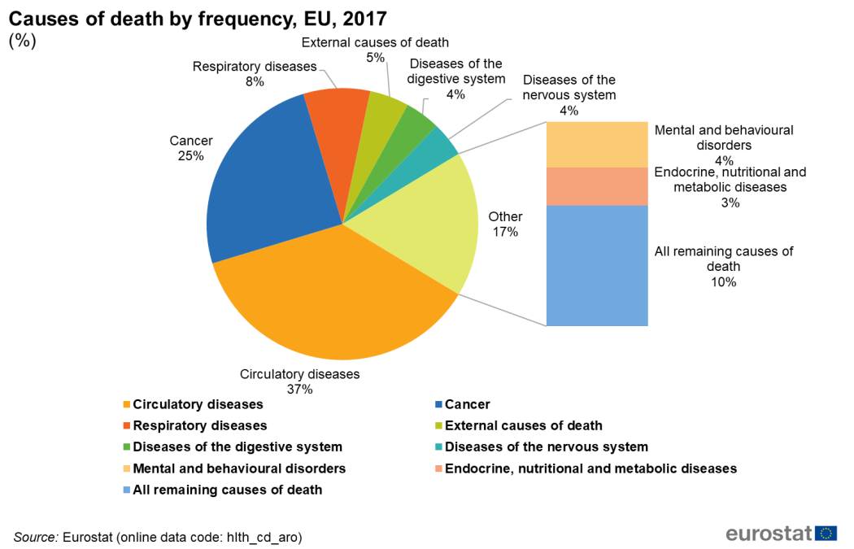
And in the EU (where few die of traditional infectious diseases)

Slide 12
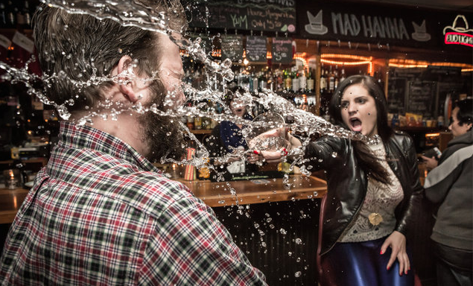
What happened here?

Slide 13
Stress is a matter of perception but its based a shared evolutionary framework and physiology

Slide 14
Perceived stressors and reality
We have a strong tendency to stress over perceived inadequacies rather than real ones
  Beauty ideals
  Happiness & success
Frank, R. H. (2016). Success and luck: good fortune and the myth of meritocracy. Princeton, Oxford: Princeton University Press.
Lin, R., & Utz, S. (2015). The emotional responses of browsing Facebook: Happiness, envy, and the role of tie strength. Computers in Human Behavior, 52, 29–38. https://doi.org/10.1016/j.chb.2015.04.064
de Lima Bastos, P. A., & Pessoa, R. R. (2019). A discussion on english language students’ body image: Beauty standards and fatness. Profile: Issues in Teachers’ Professional Development, 21(1), 13–26. https://doi.org/10.15446/profile.v21n1.69603

Slide 15

Retrospective perception: did we win?

Slide 16
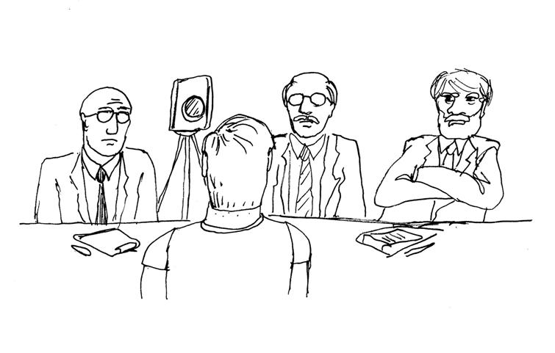
Life-threatening and social stress
Acute life threatening stress
  Fight or flight response
Social stress
  Social standing and position in the hierarchy
  Challenges to reproductive success

Slide 17
Good stress
Limited duration
Positive outcome
Not too threatening
No anticipated long term negative consequences after its over
Sapolsky, R. M. (2004). Why zebras don’t get ulcers: A guide to stress, stress related diseases, and coping. In Natural History. https://doi.org/10.1002/cir.3880060119

