Slide 1
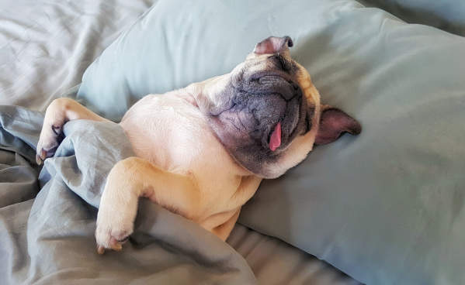
Performing under Pressure; on the Biology, Psychology and Sociology of stress in high-performance professions
X – Relax, on the importance of rest

Slide 2
Rest: one of the most important components of peak performance
Learning
We store information when we sleep
Physical performance

Slide 3
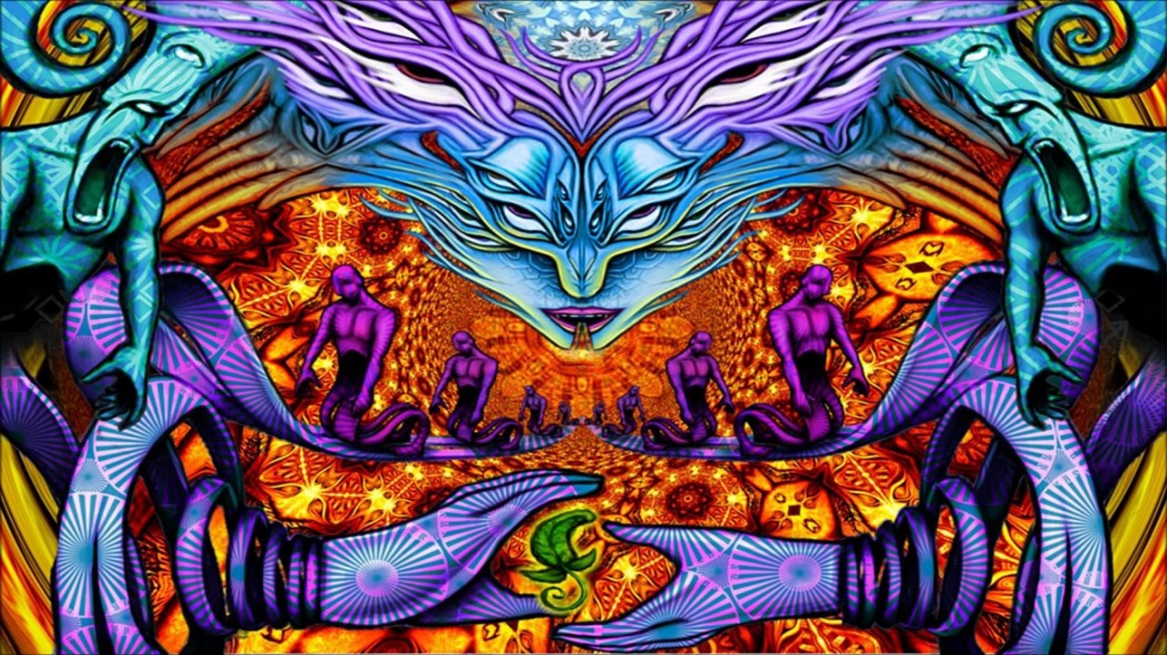
When was the last time you were delusional?

Slide 4
On the importance of sleep
Nature has not provided us with a means to store sleep. The sleep we do not get is lost.
Immune system
Endocrine system
Cognitive function
Almondes, K. M. de, Marín Agudelo, H. A., & Jiménez-Correa, U. (2021). Impact of Sleep Deprivation on Emotional Regulation and the Immune System of Healthcare Workers as a Risk Factor for COVID 19: Practical Recommendations From a Task Force of the Latin American Association of Sleep Psychology. Frontiers in Psychology, 12(May), 1–10. https://doi.org/10.3389/fpsyg.2021.564227
Garbarino, S., Lanteri, P., Bragazzi, N. L., Magnavita, N., & Scoditti, E. (2021). Role of sleep deprivation in immune-related disease risk and outcomes. Communications Biology, 4(1). https://doi.org/10.1038/s42003-021-02825-4
Lateef, O. M., & Akintubosun, M. O. (2020). Sleep and reproductive health. Journal of Circadian Rhythms, 18(1), 1–11. https://doi.org/10.5334/jcr.190
Su, L., Zhang, S. zheng, Zhu, J., Wu, J., & Jiao, Y. zheng. (2021). Effect of partial and total sleep deprivation on serum testosterone in healthy males: a systematic review and meta-analysis. Sleep Medicine, 88, 267–273. https://doi.org/10.1016/j.sleep.2021.10.031
Csipo, T., Lipecz, A., Owens, C., Mukli, P., Perry, J. W., Tarantini, S., … Yabluchanskiy, A. (2021). Sleep deprivation impairs cognitive performance, alters task-associated cerebral blood flow and decreases cortical neurovascular coupling-related hemodynamic responses. Scientific Reports, 11(1), 1–13. https://doi.org/10.1038/s41598-021-00188-8

Slide 5
Stages of sleep: and their importance
Deep sleep
Delta waves / slow waves
Memory consolidation
Rapid Eye Movement sleep
Dream state
Memory contextualization
Walker, M. (2017). Why We Sleep: Unlocking the Power of Sleep and Dreams. Retrieved from https://www.ptonline.com/articles/how-to-get-better-mfi-results

Slide 6
Why sleep is so important
Acute extreme sleep deprivation can
Be fatal
Lead to exacerbation of mental issues
Will lead to psychotic symptoms while sleep deprived
Chronic sleep deprivation
Testosterone (a few nights of 4-5 hours – drop to levels of someone 10 years older)
Blood sugar dysregulation
Immune system failure
Effect on gene-expression
1 night of 4 hours – a 70 % drop in natural killer cells
Alzheimer's
Walker, M. (2017). Why We Sleep: Unlocking the Power of Sleep and Dreams. Retrieved from https://www.ptonline.com/articles/how-to-get-better-mfi-results

Slide 7
Temperature and sleep
During sleep core body temperature drops about 1 degree
You need to get colder to get to sleep
Warm bath
Feet out
You need to get warm to wake up
Walker, M. (2017). Why We Sleep: Unlocking the Power of Sleep and Dreams. New York.

Slide 8
Light and sleep
Early morning light starts the production of adenosine
Caffeine
Late afternoon / early evening light and dark stimulate melatonin
Blue light filters
Using your mobile devices before sleep
Article, O. (2001). Circadian Time of Morning Light Administration and Therapeutic Response in Winter Depression. 58.
Choi, K., Shin, C., Kim, T., Chung, H. J., & Suk, H. (2019). Awakening effects of blue- enriched morning light exposure on university students ’ physiological and subjective responses. (November 2018), 1–8. https://doi.org/10.1038/s41598-018-36791-5
Lawrenson, J. G., Hull, C. C., & Downie, L. E. (2017). The effect of blue-light blocking spectacle lenses on visual performance , macular health and the sleep-wake cycle : a systematic review of the literature. 37, 644–654. https://doi.org/10.1111/opo.12406
Tosini, G., Ferguson, I., & Tsubota, K. (2016). Effects of blue light on the circadian system and eye physiology. (August 2015), 61–72.

Slide 9
Sleep and nutrition
Disruption of hunger hormones
Leptin
Ghrelin
Increased appetite
Especially for savory and high carbohydrate foods
Rasaei, B., Karim, N. A., Talib, R. A., Mohd Noor, I., & Karandish, M. (2019). The Effect of Simultaneous Consumption of Coffee Caffeine and Sleep Deprivation on Plasma Ghrelin and Leptin Levels. Int J Nutr Sci, 4(2), 88–96. https://doi.org/10.30476/IJNS.2019.82136.1017.Introduction
Kazemizadeh, V., & Behpour, N. (2021). The Effect of 30-Hours Sleep Deprivation on the Response of Leptin and Ghrelin Levels to an Exhaustive Activity Among Active Male Students. 28(4), 569–580.
Lin, J., Jiang, Y., Wang, G., Meng, M., Zhu, Q., Mei, H., … Jiang, F. (2020). Associations of short sleep duration with appetite-regulating hormones and adipokines: A systematic review and meta-analysis. Obesity Reviews, 21(11), 1–15. https://doi.org/10.1111/obr.13051

Slide 10
Stimulating and buffering sleepiness
Caffeine
Alcohol & sedatives
Melatonin supplementation

Slide 11
Sleep and motivation
Dopamine disruption
Attention

Slide 12
Sleep and peak performance
Lowered effect of µ-opioid receptor
Disrupted dopamine / serotonin
Increased stress sensitivity
Zant, J. C., Leenaars, C. H. C., Kostin, A., Van Someren, E. J. W., & Porkka-Heiskanen, T. (2011). Increases in extracellular serotonin and dopamine metabolite levels in the basal forebrain during sleep deprivation. Brain Research, 1399, 40–48. https://doi.org/10.1016/j.brainres.2011.05.008
Longordo, F., Kopp, C., & Lüthi, A. (2009). Consequences of sleep deprivation on neurotransmitter receptor expression and function. European Journal of Neuroscience, 29(9), 1810–1819. https://doi.org/10.1111/j.1460-9568.2009.06719.x
Benedetti, F., Barbini, B., Campori, E., Colombo, C., & Smeraldi, E. (1996). Dopamine agonist amineptine prevents the antidepressant effect of sleep deprivation. Psychiatry Research, 65(3), 179–184. https://doi.org/10.1016/S0165-1781(96)03000-4
Staffe, A. T., Bech, M. W., Clemmensen, S. L. K., Nielsen, H. T., Larsen, D. B., & Petersen, K. K. (2019). Total sleep deprivation increases pain sensitivity, impairs conditioned pain modulation and facilitates temporal summation of pain in healthy participants. PLoS ONE, 14(12), 1–14. https://doi.org/10.1371/journal.pone.0225849
Kundermann, B., Krieg, J. C., Schreiber, W., & Lautenbacher, S. (2004). The effect of sleep deprivation on pain. Pain Research and Management, 9(1), 25–32. https://doi.org/10.1155/2004/949187

