Slide 1
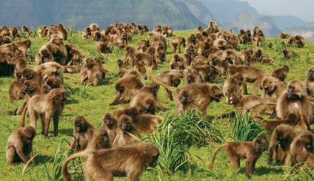
Performing under Pressure; on the Biology, Psychology and Sociology of stress in high-performance professions
IV - On the social psychology of stress

Slide 2
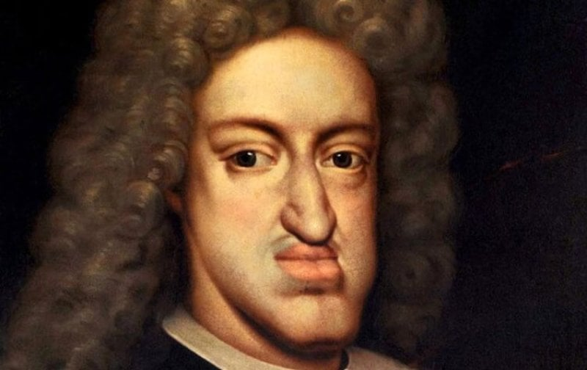
Social stress and the problem of inbreeding

Slide 3
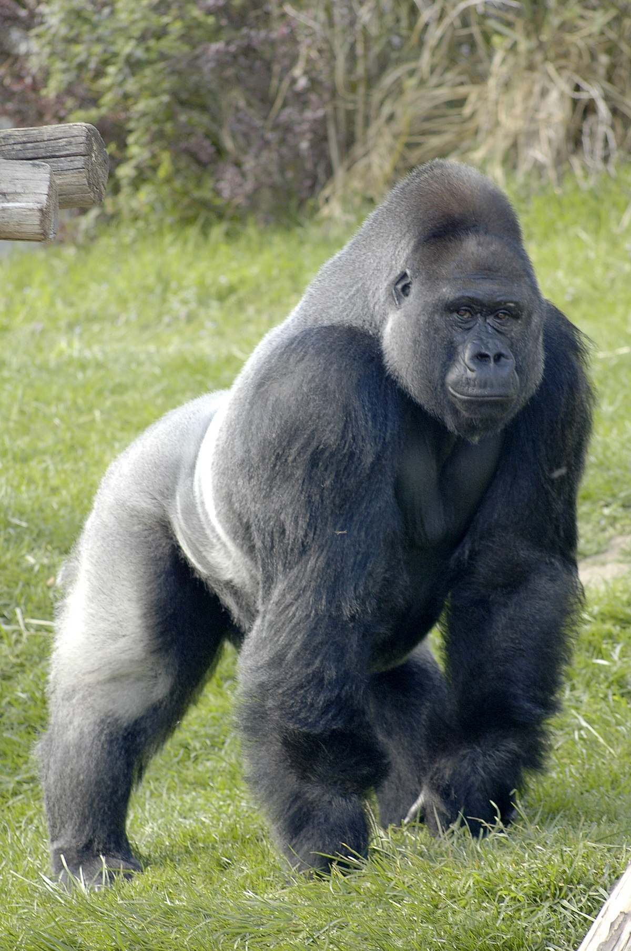
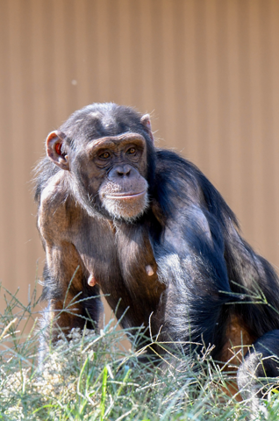
Who leaves the troop?

Slide 4
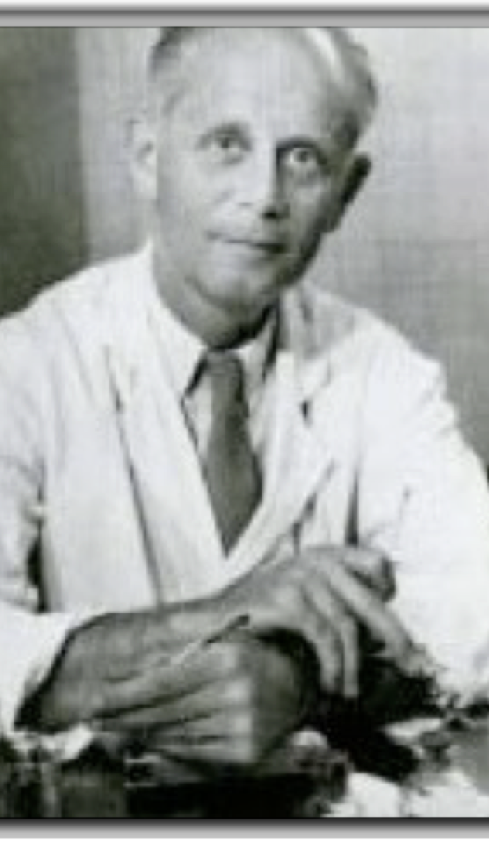
Hans Selye – The Granddaddy of stress science
Stress as a physiological reaction to general unpleasantness.
Seyle assumed that the negative effects of stress are the result of stress hormones running out. This is not the case. Rather, at a certain point we invest so much in the stress response that other processes become neglected.
Selye, H. (1936). A Syndrome Produced by Diverse Nocuous agents. Nature.
Szabo, S. (2017). “Stress” is 80 Years Old: From Hans Selye Original Paper in 1936 to Recent Advances in GI Ulceration. (December). https://doi.org/10.2174/1381612823666170622110046

Slide 5

Do you have an outlet?
Sports
Social interaction
Social care

Slide 6
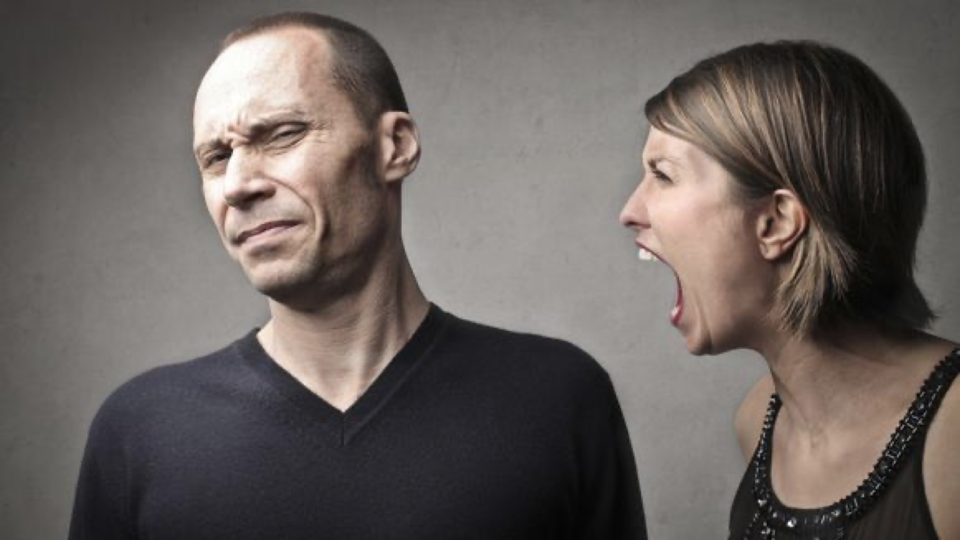
Acting out

Slide 7
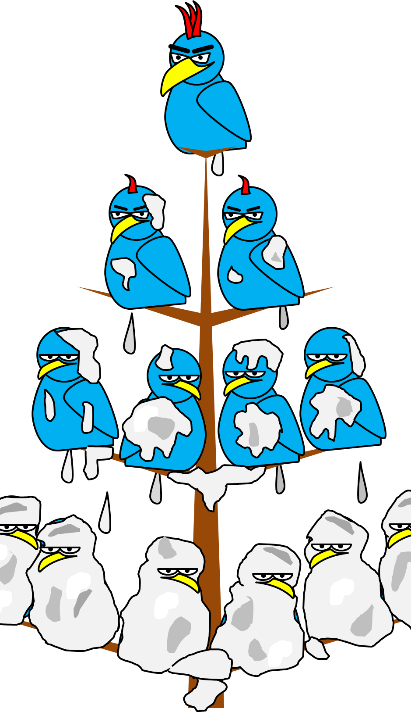
Social hierarchy and the dynamics of acting out
We mainly act out down the social hierarchy
In a stable social hierarchy, stress and its negative health outcomes accumulate at the bottom.
In an unstable social hierarchy, stress effects most members equally
Poverty, social strata and the meritocracy
Testosterone, competition and your place on the hierarchy
Sherman, G. D., & Mehta, P. H. (2020). Stress , cortisol , and social hierarchy. Current Opinion in Psychology, 33, 227–232. https://doi.org/10.1016/j.copsyc.2019.09.013
Bernal, D. R., Ho, K., Johanna, M., & Niki, A. (2022). Second ‑ class citizens ? Subjective social status , acculturative stress , and immigrant well ‑ being. SN Social Sciences, 2(7), 1–18. https://doi.org/10.1007/s43545-022-00371-2

Slide 8
Ideal human group size and its effects on performance: Dunbar’s number
The human frontal cortex can comfortably retain information on +/- 150 individuals.
  Over a 150 individuals the group has to either
    Split in two
    Develop solutions to the emerging lack of social cohesion
      Money
      Formal power structures
  Steps up from 2-5, 9-12, +/- 45, +/- 150.
    Sports teams
    Military company
Dunbar, R. (2010). How Many Friends Does One Person Need? Cambridge: Harvard University Press.

Slide 9
Your position in society and stress levels
Village elder
  Age and authority
Power and wealth as a buffer against stress
Testosterone and position
  The lower down the social ladder, the more supressed your testosterone levels will be.
Sapolsky, R. M. (2017). Behave! The biology of humans at our best and worst. In Penguin Press (1st ed.). https://doi.org/10.1111/1467-8357.00356

Slide 10
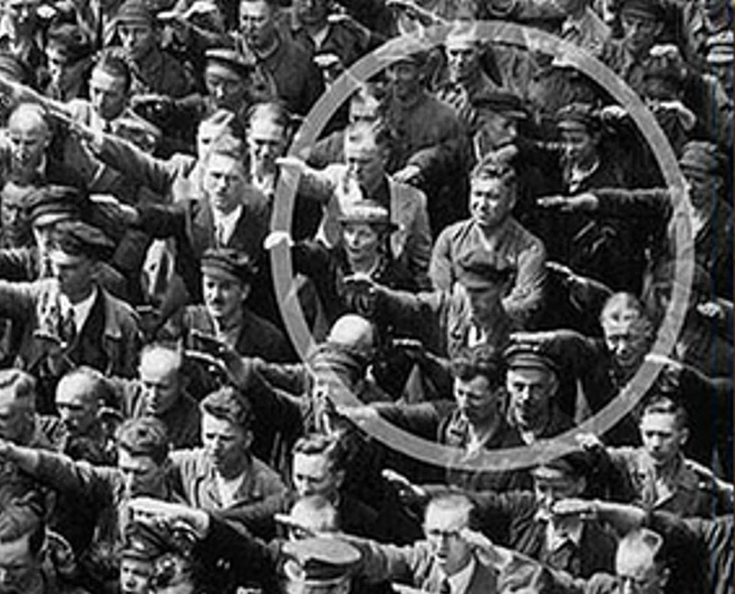
Social connection & stress modulation
Social connection has a strong effect on stress appraisal
  Β-endorphin
  Oxytocin

Slide 11
β-endorphin
µ-Opioid agonist
  Opiate drugs act upon this receptor
    Trauma in heroin addicts
    Opiate abuse among PTSD sufferers
    Morphine & PTSD susceptibility
    Social connection as a treatment option for PTSD
  µ-Opioid receptor / Galanin 1 receptor heteromers in the tail of the ventral tegmental area.
  Analgesia
  Passive coping
Serafini, R. A., & Zachariou, V. (2019). Opioid-galanin receptor heteromers differentiate the dopaminergic effects of morphine and methadone. Journal of Clinical Investigation, 129(7), 2653–2654. https://doi.org/10.1172/JCI128987
Ullrich, D., & Mac Gillavry, D. W. (2021). Mini-review : A possible role for galanin in post-traumatic stress disorder. Neuroscience Letters, 756(May), 135980. https://doi.org/10.1016/j.neulet.2021.135980

Slide 12
How to increase β-endorphin
Collective exercise and hardship
  Sports
  Struggle
Collective rituals
  Uniforms & behaviours
  Religious ritual
    Unity with God
Pain
Harber, V. J., & Sutton, J. R. (1984). Endorphins and Exercise. Sports Medicine: An International Journal of Applied Medicine and Science in Sport and Exercise, 1(2), 154–171. https://doi.org/10.2165/00007256-198401020-00004
Lang, M., Bahna, V., Shaver, J. H., Reddish, P., & Xygalatas, D. (2017). Sync to link: Endorphin-mediated synchrony effects on cooperation. Biological Psychology, 127(June), 191–197. https://doi.org/10.1016/j.biopsycho.2017.06.001
Corder, G., Castro, D. C., Bruchas, M. R., & Scherrer, G. (2018). Endogenous and Exogenous Opioids in Pain. Annual Review of Neuroscience, 41(1), 453–473. https://doi.org/10.1146/annurev-neuro-080317-061522

Slide 13
Oxytocin
Modulates PTSD susceptibility and symptom severity
Enhances ethnocentric/in-group sentiment
Proactive coping
De Dreu, C. K. W., Greer, L. L., Van Kleef, G. A., Shalvi, S., & Handgraaf, M. J. J. (2011). Oxytocin promotes human ethnocentrism. Proceedings of the National Academy of Sciences, 108(4), 1262–1266. https://doi.org/10.1073/pnas.1015316108
van Zuiden, M., Frijling, J. L., Nawijn, L., Koch, S. B. J., Goslings, J. C., Luitse, J. S., … Olff, M. (2017). Intranasal Oxytocin to Prevent Posttraumatic Stress Disorder Symptoms: A Randomized Controlled Trial in Emergency Department Patients. Biological Psychiatry, 81(12), 1030–1040. https://doi.org/10.1016/j.biopsych.2016.11.012

Slide 14
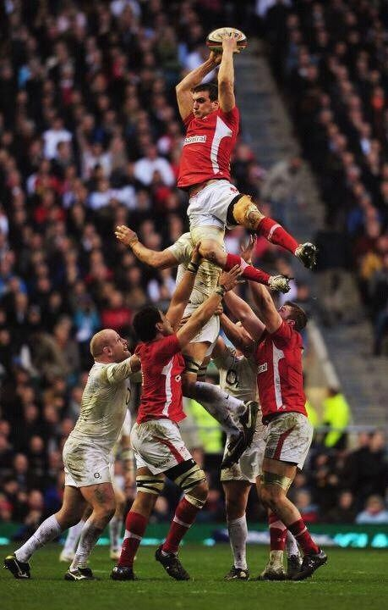
What does this mean for peak performance?
In-group cohesion
  Endorphin & oxytocin
Analgesia and resilience
Competition vs teamwork

