Slide 1
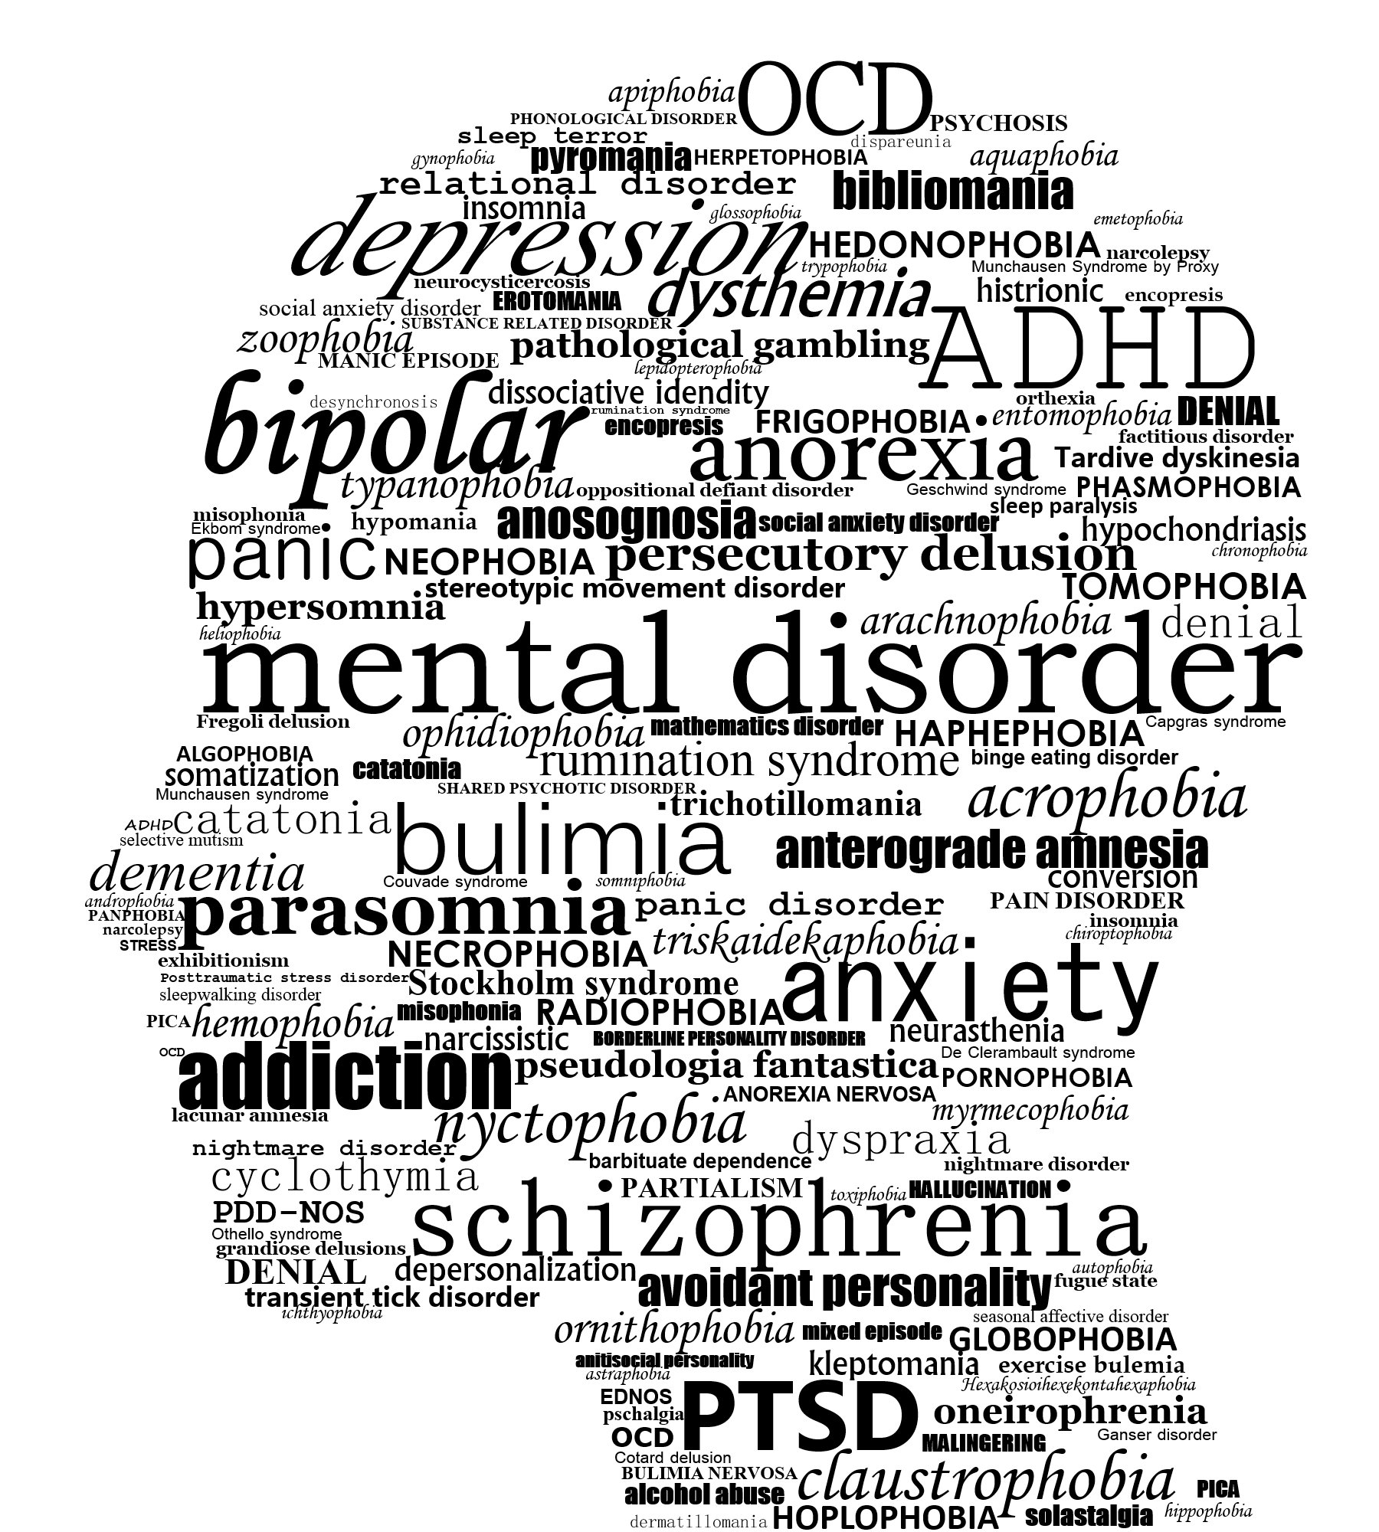
Performing under Pressure; on the Biology, Psychology and Sociology of stress in high-performance professions
V - Stress related disorders and what they can teach us about performance

Slide 2
Disclaimer I am not a psychiatrist! I am a scientist! Especially if you are experiencing mental health issues, do NOT try anything we discuss today without first consulting your specialist. Non of the information discussed today reflects individual differences and your personal physician can judge much better than I ever can, how this information may affect you.

Slide 3
Through the study of stress related disorders, we can gain knowledge of the stress system in healthy populations, that we would otherwise not be privy to.

Slide 4
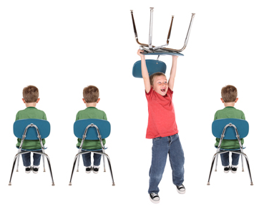
One example
Attention deficit / hyperactive disorder (ADHD)
Diminished dopamine signalling in the frontal cortex
Short bursts of hyper focus
Methylphenidate (Ritalin), a common neurotropic treatment for ADHD, also mitigates symptoms in PTSD
If we can figure out how to hyper focus works in ADHD and can be reproduced, we can potentially increase cognitive and physical output out put in non ADHD individuals
Mehta, T. R., Monegro, A., Nene, Y., Fayyaz, M., & Bollu, P. C. (2019). Neurobiology of ADHD: A Review. Current Developmental Disorders Reports, 6(4), 235–240. https://doi.org/10.1007/s40474-019-00182-w
Antshel, K. M., Biederman, J., Spencer, T. J., & Faraone, S. V. (2016). The Neuropsychological Profile of Comorbid Post-Traumatic Stress Disorder in Adult ADHD. Journal of Attention Disorders, 20(12), 1047–1055. https://doi.org/10.1177/1087054714522512
Aga-Mizrachi, S., Cymerblit-Sabba, A., Gurman, O., Balan, A., Shwam, G., Deshe, R., … Avital, A. (2014). Methylphenidate and desipramine combined treatment improves PTSD symptomatology in a rat model. Translational Psychiatry, 4(9). https://doi.org/10.1038/tp.2014.82

Slide 5
The role of stress in mental disorders
Stress plays a role in most mental disorders. Even in disorders where it does not play a causal role, it usually makes things much worse
Three levels of analysis (which are completely artificial)
Genetics
Epigenetics
Context

Slide 6
Genetic disruption of the stress system
Although there seem to be heritable components to stress sensitivity and there are specific genetic disorders in which the stress system is dysregulated, in general there is remarkably little evidence for genetic ‘determinism’. Potential exceptions:
A polymorphism on the OPRM1 (protects against PTDS but increases sensitivity to addiction)
DAT Polymorphisms in major depression
Rather many genes which code for components of the stress system express dysfunctional if, and only if, certain conditions are met (i.e. epigenetics).
Opmeer, E. M., Kortekaas, R., & Aleman, A. (2010). Depression and the role of genes involved in dopamine metabolism and signalling. Progress in Neurobiology, 92(2), 112–133. https://doi.org/10.1016/j.pneurobio.2010.06.003
Gelernter, J., & Polimanti, R. (2021). Genetics of substance use disorders in the era of big data. Nature Reviews Genetics, 22(11), 712–729. https://doi.org/10.1038/s41576-021-00377-1
Nugent, N. R., Lally, M. A., Brown, L., Knopik, V. S., & McGeary, J. E. (2012). OPRM1 and diagnosis-related posttraumatic stress disorder in binge-drinking patients living with HIV. AIDS and Behavior, 16(8), 2171–2180. https://doi.org/10.1007/s10461-011-0095-8

Slide 7
Heritability
Many mental disorders come with a certain level of heritability. However this may not necessarily derive from genetic predispositions alone.
Prenatal influences (see lecture 3)
Parental behaviour
Societal interactions

Slide 8
Contextual influences on mental disorders
Sometimes, mental disorders are mostly the result of circumstances. Of course, however, a certain susceptibility is required, so genetics and epigenetics do play a role.
Post-traumatic stress disorder
Triggered by trauma
Multiple personality disorder (nowadays dissociative Identity disorder) and the satanic panic
Mulhern, S. (2008). Satanism , Ritual Abuse , and Multiple Personality Disorder : A Sociohistorical Perspective SATANISM , RITUAL ABUSE , AND MULTIPLE PERSONALITY DISORDER : 7144. https://doi.org/10.1080/00207149408409359
Spanos, N. P. (1994). Multiple Identity Enactments and Multiple Personality Disorder : A Sociocognitive Perspective. II(1), 143–165.
Mac Gillavry, D. W., & Ullrich, D. (2020). A novel theory on the predictive value of variation in the β-endorphin system on the risk and severity of PTSD. Military Psychology, 1–14. https://doi.org/10.1080/08995605.2020.1730111

Slide 9
Stress in mental disorders I: It does not cause it, but does make everything much worse.
Schizotypal episodes
Schizophrenia
Delusions (usually auditory hallucinations) (dopaminergic component)
Disordered thought
Highly disturbing and stressful
Schizotypal experiences
Religious visions
Random, usually non-stressful, experiences
Smith, L., Riley, S., & Peters, E. R. (2009). Schizotypy, delusional ideation and well-being in an American new religious movement population. Clinical Psychology and Psychotherapy, 16(6), 479–484. https://doi.org/10.1002/cpp.645
Howes, O., McCutcheon, R., & Stone, J. (2015). Glutamate and dopamine in schizophrenia: An update for the 21st century. Journal of Psychopharmacology, 29(2), 97–115. https://doi.org/10.1177/0269881114563634

Slide 10
Stress in mental disorders II: the trigger and accelerator
Major depression
Strong evidence for a genetic predisposition
Stress triggers the disorder (3-4 episodes of severe prolonged stress)
After the first episode it becomes much easier to trigger the next one
American Psychiatric Association. (2013). Diagnostic and statistical manual of mental disorders (5th. In American Journal of Psychiatry. https://doi.org/10.1176/appi.books.9780890425596.744053

Slide 11
Symptoms and importance to stress research
The inability to get back on your feet after a period of grieving
Symptom clusters
Psychomotor retardation (noradrenergic disruption)
Anhedonia (dopaminergic disruption)
The inability to find comfort (serotonergic disruption)
Moret, C., & Briley, M. (2011). The importance of norepinephrine in depression. Neuropsychiatric Disease and Treatment, 7(SUPPL.), 9–13. https://doi.org/10.2147/NDT.S19619
Lutz, P. (2018). The opioid system and the social brain : implications for depression and suicide. (February), 1–13. https://doi.org/10.1002/jnr.24269
Weele, C. M. V., Siciliano, C. A., & Tye, K. M. (2019). Dopamine tunes prefrontal outputs to orchestrate aversive processing. Brain Research, 1713(August 2018), 16–31. https://doi.org/10.1016/j.brainres.2018.11.044
Kilpatrick, D. G., Ph, D., Koenen, K. C., Ph, D., Ruggiero, K. J., Ph, D., … Gelernter, J. (2007). The Serotonin Transporter Genotype and Social Support and Moderation of Posttraumatic Stress Disorder and Depression in Hurricane-Exposed Adults. American Journal of Psychiatry, 164(November), 1693–1699.

Slide 12
Stress induced mental disorders III: disorders in which stress is the defining feature
Post-traumatic stress disorder
Reaction to extreme stressor
Acute or repeated exposure
Hypervigilance
Flashbacks and intrusive thoughts
Nightmares
American Psychiatric Association. (2013). Diagnostic and statistical manual of mental disorders (5th. In American Journal of Psychiatry. https://doi.org/10.1176/appi.books.9780890425596.744053
World Health Organization. (1993). The ICD-10 classification of mental and behavioural disorders: Diagnostic criteria for research (pp. 155–157). pp. 155–157. https://doi.org/10.1002/1520-6505(2000)9:5<201::AID-EVAN2>3.3.CO;2-P

Slide 13
Neuromodulators involved in PTSD
Noradrenaline & the locus coeruleus
Dopamine
β-endorphin
Morphine
Post-combat delayed onset
Oxytocin
van Zuiden, M., Frijling, J. L., Nawijn, L., Koch, S. B. J., Goslings, J. C., Luitse, J. S., … Olff, M. (2017). Intranasal Oxytocin to Prevent Posttraumatic Stress Disorder Symptoms: A Randomized Controlled Trial in Emergency Department Patients. Biological Psychiatry, 81(12), 1030–1040. https://doi.org/10.1016/j.biopsych.2016.11.012
Ullrich, D., & Mac Gillavry, D. W. (2021). Mini-review : A possible role for galanin in post-traumatic stress disorder. Neuroscience Letters, 756(May), 135980. https://doi.org/10.1016/j.neulet.2021.135980
Lee, J. C., Wang, L. P., & Tsien, J. Z. (2016). Dopamine rebound-excitation theory: Putting brakes on PTSD. Frontiers in Psychiatry, 7(SEP). https://doi.org/10.3389/fpsyt.2016.00163
Pan, X., Kaminga, A. C., Wen, S. W., & Liu, A. (2018). Catecholamines in post-traumatic stress disorder: A systematic review and meta-analysis. Frontiers in Molecular Neuroscience, 11(December). https://doi.org/10.3389/fnmol.2018.00450

Slide 14
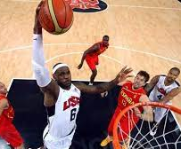
Relevance to peak performance
Most mental disorders, except perhaps under certain specific circumstances PTSD, are detrimental to peak performance.
Dopamine and noradrenaline disruption can massively affect physical and mental output.
Conversely, practices that raise reactivity or sensitivity of these neuromodulators can thus protect or even boost output
Cold exposure (see lecture 6)
Nutritional solutions (see lecture 9)
Behavioural practices
Physical exercise
Communal synchronisation
Meditation

