Slide 1

Performing under Pressure; on the Biology, Psychology and Sociology of stress in high-performance professions
VI – stress management

Slide 2
Syllabus
Lecutre | Topic
1 | Introduction to the course and stress science
2 | On the physiology of stress
3 | On the psychology of stress
4 | On the social psychology of stress
5 | Stress related disorders and what they can teach us about performance
6 | Stress management
7 | Performance under stress
8 | Team-performance under stress
9 | Nutrition, stress and performance
10 | Relax, on the importance rest

Slide 3
Final paper
Min 8 pages (2.0 spacing, times new roman)
Proper bibliography and referencing (preferably American Psychological Association, APA)
  Download a referencing tool!!
    Menedley, zotero, etc.
  At minimum 10 references. Preferably more!
Subject of your choosing as long as it relates to stress and peak performance
  Ideally, pick something from our discussions, so you have a place to start from.
  Make sure you are interested enough in your subject to see it through
  If you are not sure about your topic or need help with anything, please do not hesitate to contact me!

Slide 4

Stress management and reduction/elimination are NOT the same thing! Without stress you would quickly become bored and nothing would happen

Slide 5
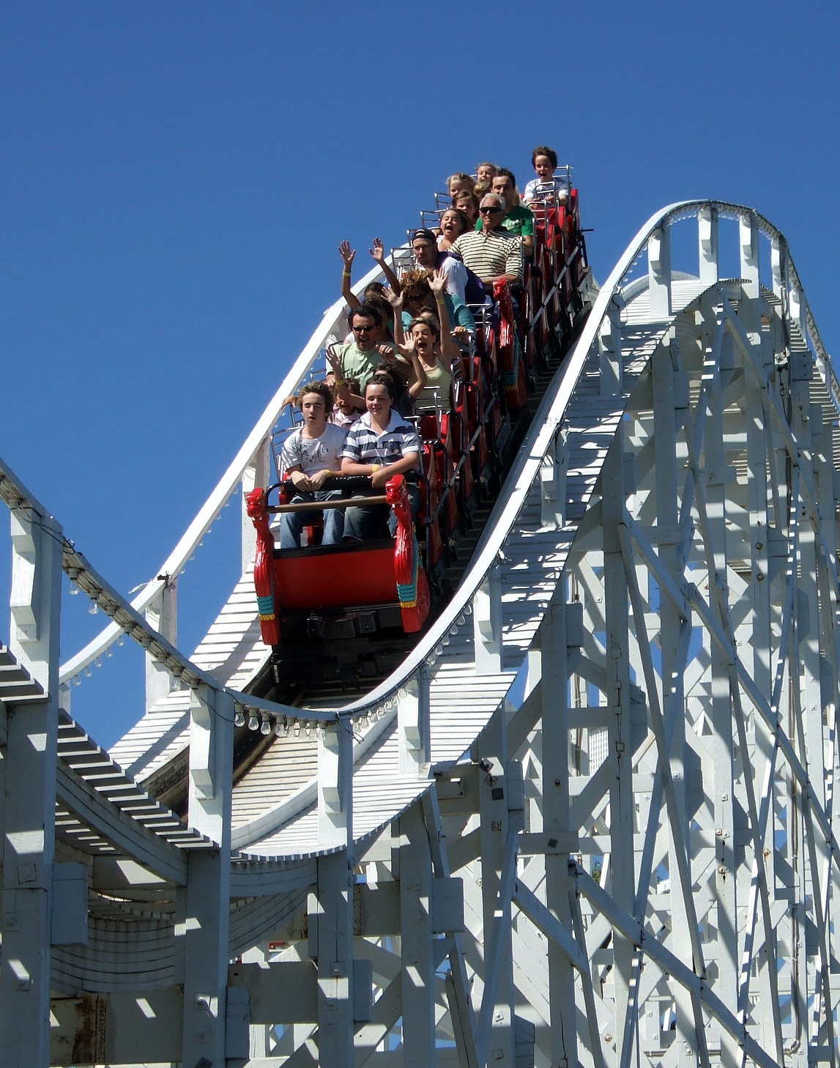
“Good” stress
Limited timespan
Predictability
Retrospective reflection
A feeling of control

Slide 6
Today’s program: preparation for stressful events
Next week: Stress and Performance
  Managing the acute stress response
  Optimising physical and cognitive output
The week after: Team-performance under stress
  Communal coping and stress management
  Manipulating the acute stress response in others

Slide 7
Social support!! (see lecture 4)

Slide 8
Sleep and rest (See lecture 10)

Slide 9
Regulated exposure to limited physiological stress
Short term exposure to mild physiological and psychological stressors
  Controlled or simulated psychological stressors
    Play & competition
    Controlled passive experience
      Fiction (horror, thriller, etc)
      Safe stressors (rollercoasters, harmless “scary stimuli”)
  Cold
  Hunger (fasting)

Slide 10
How exercise affects the stress response
Exercise enhances
  Mood
  Energy
  Memory
  Attention
A single workout can raise dopamine, noradrenaline and serotonin for at about 2 hours
Repeated exercise
  neuroplasticity
    Hippocampus (memory)
    Frontal cortex (attention)
  Brain health
Suzuki, W. (2017). The brain-changing benefits of exercise.
Basso, J. C., Shang, A., Elman, M., Karmouta, R., & Suzuki, W. A. (2015). Acute Exercise Improves Prefrontal Cortex but not Hippocampal Function in Healthy Adults. 791–801. https://doi.org/10.1017/S135561771500106X
Basso, J. C., & Suzuki, W. A. (2017). The Effects of Acute Exercise on Mood , Cognition , Neurophysiology , and Neurochemical Pathways : A Review. 2, 127–152. https://doi.org/10.3233/BPL-160040

Slide 11

Cold exposure: we evolved for uncomfortable climates
We migrated from Africa to places that were significantly colder while many places in Africa itself are not necessarily nice and warm either Evolutionary pressure for adaptation.
  Adaptations for elevated metabolic rate and blood pressure
  Adaptations related to fat storage and usage
Cardona, A., Pagani, L., Antao, T., Lawson, D. J., Eichstaedt, C. A., Yngvadottir, B., … Kivisild, T. (2014). Genome-wide analysis of cold adaptation in indigenous Siberian populations. PLoS ONE, 9(5). https://doi.org/10.1371/journal.pone.0098076
Makinen, T. M. (2010). Different types of cold adaptation in humans. Frontiers in Bioscience, 1047–1067.

Slide 12
One important note to make!!!!
The effects of climate (i.e. cold adaptation), interbreeding with other hominins (most commonly Neanderthals or Denisovans) and other evolutionary influences are often misused by bigots to argue for a qualitative evolved difference between human ethnicities.
I want to be very clear that there is no evidence of a meaningful evolved difference with regard to quality of character!!!!! Minor differences, which may affect isolated physiological functions do NOT!!! equate to identifiable differences in morality, work ethic, intellectual capacity, etc.

Slide 13

On the epigenetics
The expression of approximately 20 mammalian genes is effected by cold exposure.
  Metabolism. In fact, there is an argument to be made that the current rise in metabolic disease can be, in part, attributed to diminished metabolic rates due to a reduction in cold adaptation.
  Brown fat regulation
Makinen, T. M. (2010). Different types of cold adaptation in humans. Frontiers in Bioscience, 1047–1067.

Slide 14
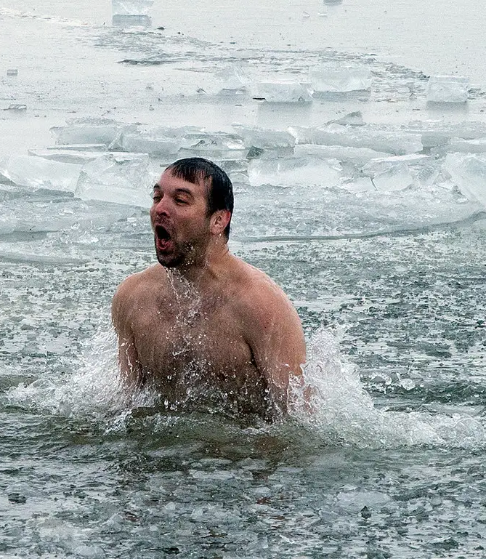
Acute response to cold
Stress response
  Vasoconstriction
  Hyperventilation
  Shivering
  Sympathetic activation
    Immune system
  Noradrenaline

Slide 15
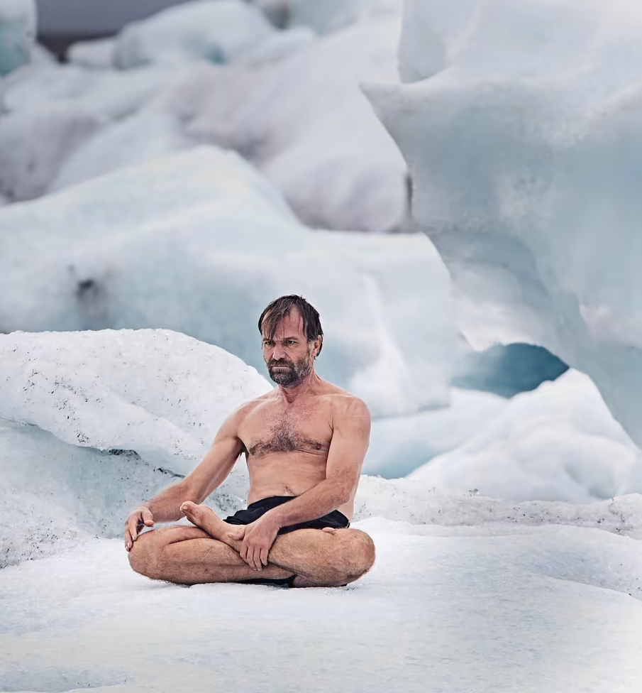
Secondary response to cold
Vasodilation
Thermogenesis (shivering)
Parasympathetic activation
Anti-inflammatory Cytokines
Mood enhancement (probably in response to dopamine outflow)

Slide 16

Repeated cold exposure
Brown fat activation and production
Non-shivering thermogenesis
Improved insulin sensitivity
Weight loss
Immune activation

Slide 17

We evolved for hunger
For most of evolutionary history we went through regular short periods of food deprivation.
  Storing excess energy
    Insulin
  Cleaning out the system

Slide 18
What happens when you stop eating?
The first 24 hours
  You burn through your glycogen stores
After 2/3 days you switch from burning glucose to fat and protein
  The more fat adapted you are the easier this transition will be
  Enhanced mood and cognitive function (due to ketone metabolism)

Slide 19
Autophagy: the medicinal qualities of consuming nothing
During hunger, the body gets a chance to burn off a lot of cells, which do not function optimally.
During refeeding these cells are reconstituted if necessary
Taylor, P., Alirezaei, M., Kemball, C. C., Flynn, C. T., Wood, M. R., Lindsay, J., … Whitton, J. L. (2014). Short-term fasting induces profound neuronal autophagy. (November), 37–41. https://doi.org/10.4161/auto.6.6.12376
Pietrocola, F., Pol, J., & Prof, G. K. (2016). Fasting improves anticancer immunosurveillance via autophagy induction in malignant cells. Cell Cycle, 15(24), 3327–3328. https://doi.org/10.1080/15384101.2016.1224797

Slide 20
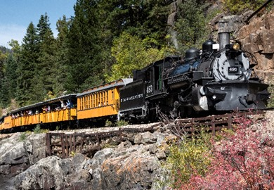

Slide 21
Health benefits
Longevity
Enhanced cognitive performance
Stress reduction
Higher efficiency
Mattson, M. P., Longo, V. D., & Harvie, M. (2017). Impact of intermittent fasting on health and disease processes. Ageing Research Reviews, 39, 46–58. https://doi.org/10.1016/j.arr.2016.10.005
Gonzalez-Estevez, C., & Flores, I. (2020). Fasting for stem cell Rejuvination. Aging, 12(5), 4048–4049.

Slide 22
Meditation (a great feedback loop?)
Breath work
Deliberate focus on slowing down mental function
Focus of the mind
  Calm
  Present
  Positive aspects of one’s life

Slide 23

Toxoplasmosis
Cat parasite
  Releases dopamine in the frontal cortex in response to stress
  In mice it reduces fear of cats
  In people it increases risk taking behaviour
Omidian, M., Asgari, Q., Bahreini, M. S., Moshki, S., Sedaghat, B., & Adnani Sadati, S. J. (2022). Acute toxoplasmosis can increase serum dopamine level. Journal of Parasitic Diseases, 46(2), 337–342. https://doi.org/10.1007/s12639-021-01447-1
Prandovszky, E., Gaskell, E., Martin, H., Dubey, J. P., Webster, J. P., & McConkey, G. A. (2011). The neurotropic parasite toxoplasma gondii increases dopamine metabolism. PLoS ONE, 6(9). https://doi.org/10.1371/journal.pone.0023866

