Slide 1

The process of preparation a systematic review
Martin Sebera
6. 5. 2024

Slide 2
Systematické review
type of literature review
uses methodologies to collect and evaluate all available scientific evidence that meets predetermined criteria in order to answer a specific research question.
The goal is to provide the most objective and comprehensive view of the topic.

Slide 3
Main steps
Question formulation – The definition of the research question that determines the objective of the review.
Protocol – Creation of a protocol that sets out the methodology of the review, including study inclusion criteria, search strategies and quality assessment methods.
Literature search – Systematic search for relevant literature in databases and other sources.
Study Selection – Selection of studies that meet predetermined criteria.
Data Extraction – Collection of data from selected studies.
Quality assessment – ​​Assessment of quality and bias in selected studies.
Data synthesis – Analysis and synthesis of the data obtained. In the case of a quantitative review, it may include a meta-analysis.
Conclusion - Evidence-based presentation of results, findings and recommendations

Slide 4
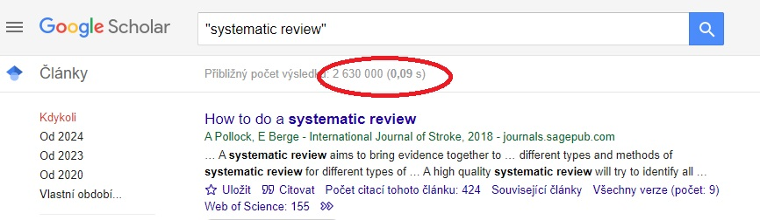
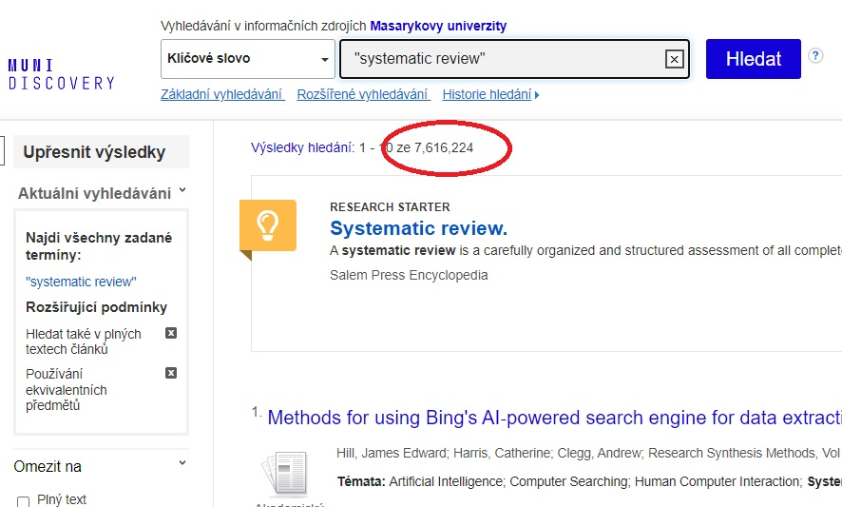

Slide 5
PRISMA
PRISMA (Preferred Reporting Items for Systematic Reviews and Meta-Analyses) is a methodological framework and set of guidelines designed to ensure transparency and quality in the processing of systematic reviews and meta-analyses.
The purpose of PRISMA is to increase transparency and facilitate the critical evaluation and reproduction of systematic reviews and meta-analyses.
PROSPERO
https://www.crd.york.ac.uk/prospero/
international database of prospectively registered systematic reviews of medical and social interventions. The goal is to provide transparency and help limit potential data selection bias that may occur if protocols and methodologies are modified during or after data collection.

Slide 6
PICO a PECO
PICO and PECO - to facilitate the structuring and formulation of research questions, especially in the field of health and ecology, which is key to the design of systematic reviews and guidelines. These criteria help define clear and specific parameters that a research study should meet.
PICO
P (Population): The population or patients that the study focuses on. It defines who the study participants are.
I (Intervention): The intervention being investigated. This can be a medical procedure, drug, diagnostic test or other medical intervention.
C (Comparison): A comparison or control group that is used to compare the effects of an intervention.
O (Outcome): The outcome or consequence that is measured and investigated in the study.
PECO
E (Exposure): Exposure or factor to which organisms are exposed.

Slide 7
Population
PICO a PECO example
Stress response of professional esports players in live stage events: a systematic review
Participants/population
Esports professional and active participants in Esports live stage competitions.
Intervention (s) exposure (s)
Studies dealing with physiological, psychological and mental stress in Esports.
Comparator (s) control
A study comparing the degree of stress in professional Esports athletes compared to another part of the population.
Outcome (s)
Main outcomes - The main directions of stress research in Esports. The effects of stress on the health of athletes in Esports.
Additional outcomes - Missing research directions
Intervention
Comparison(s)
Outcome

Slide 8
Other tools, sw, apps
https://www.rayyan.ai/
A tool for creating a systematic review, quick and effective collaboration on the selection of studies that meet predetermined criteria, and to significantly streamline the literature screening process.
https://www.zotero.org/
Citation manager, import and export of records

Slide 9
Rayyan.ai
Import references: import studies from Zotero, PubMed, Embase and others.
Deduplication: identifies and removes duplicate records.
Double screening: two independent reviewers assess the same studies without seeing each other's assessment, which helps eliminate bias.
Inclusion and exclusion of studies: Reviewers can easily mark studies as included, excluded or unclear, and add notes and comments.
Collaboration: online collaboration.
Output reports: reports and statistics about the review process.

Slide 10
Example: BENEFITS OF ESPORTS
Student: Adam Červinka
https://is.muni.cz/auth/th/rrz4j/?lang=en;setlang=en

Slide 11
Population
However, there are situations where the use of PICO or PECO criteria for systematic reviews may not be the most efficient. In our case, we did not use the PICO and PECO criteria due to the assumed diversity of topics, since we deal with esports, which is a broad and multidisciplinary topic, and the PICO/PECO criteria are limiting here. We can state that PICO and PECO are suitable for evaluating effects, especially for clinical or epidemiological studies. In our systematic review, we also focus on qualitative research and theoretical work. Additionally, we aim to explore complex or innovative research questions that cannot be easily accommodated within a traditional PICO or PECO framework. And a final reason why we did not use a typical procedure using PICO or PECO is that the criteria can lead to over-specificity, which limits the review's ability to include a wider range of relevant studies.
Intervention
Comparison(s)
Outcome

Slide 12
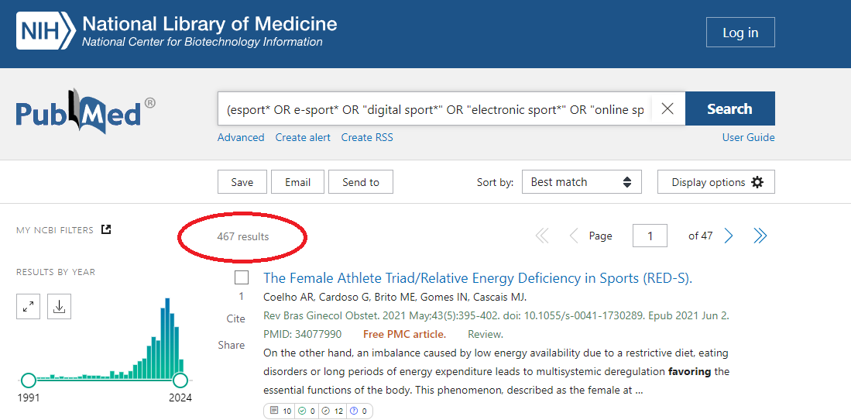
Search strategy and selection process
Database: MEDLINE (via the PubMed interface), SportDiscus, IEEE Xplore Digital Library (through EBSCOhost), and Web of Science during September 2023.
Searched record :
(esport* OR e-sport* OR "digital sport*" OR "electronic sport*" OR "online sport*" OR "virtual sport*") AND (advancements OR assets OR advantage OR benefit OR bonus OR favors OR gain OR merits OR perks OR plus OR positive OR profit OR provision OR privilege OR profits OR reward).
PubMed: MeSH terms

Slide 13
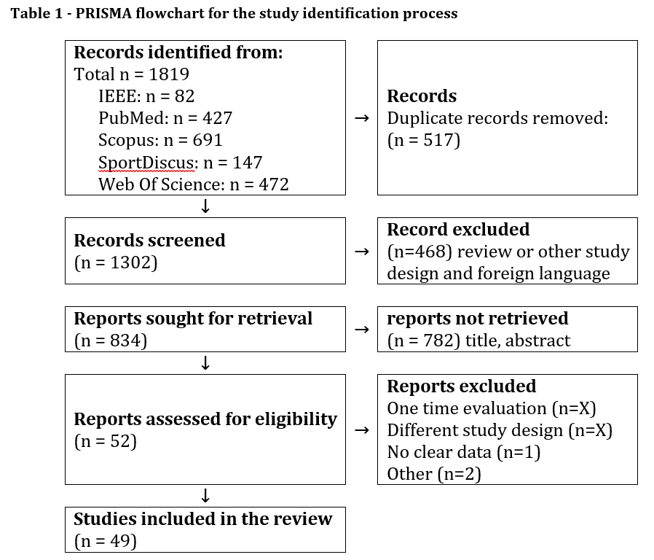






Slide 14
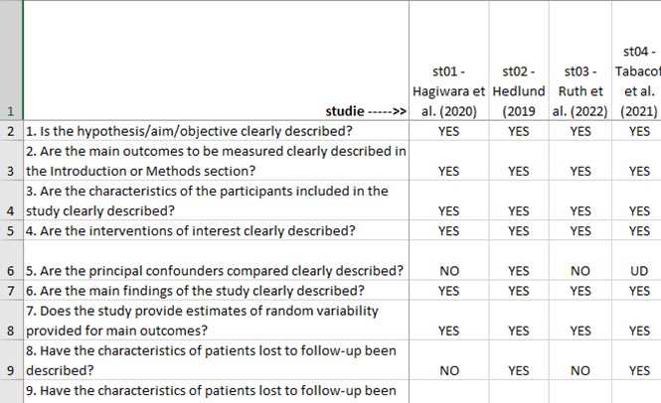
Quality of studies
Evaluation of the quality of studies according to criteria
Downs, S. H., & Black, N. (1998). The feasibility of creating a checklist for the assessment of the methodological quality both of randomised and non-randomised studies of health care interventions. Journal of Epidemiology & Community Health, 52(6), 377–384. https://doi.org/10.1136/jech.52.6.377
Final scores were converted to percentages and methodological quality was classified as follows: <45.4% “poor” methodological quality; 45.4–61.0%, “fair” methodological quality; >61.0%, “good” methodological quality (Kennelly, 2011)

Slide 15
Results – Esports benefits
Cognitive & psychological benefits
Social Benefits
Educational and career benefits
Physical Benefits

Slide 16
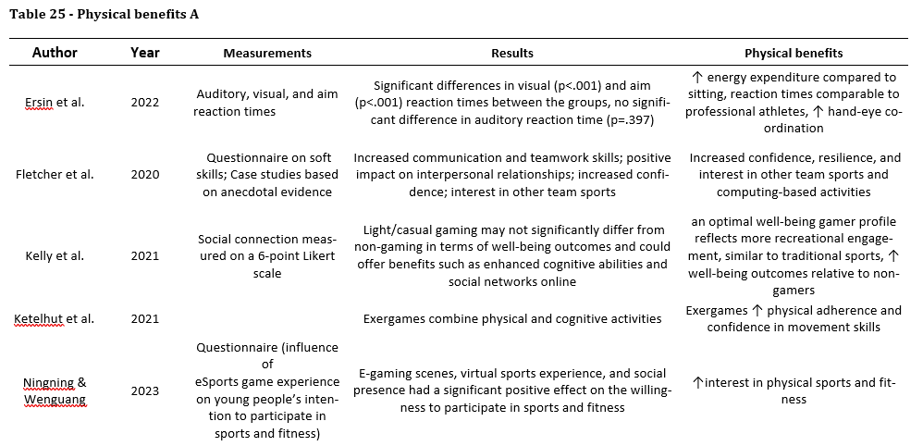
Results – Esports benefits

Slide 17
Interpretation of results
General interpretation of results in the context of other evidence
Implications for practice, the field, and future research
Limits of the studies included in the research
Limits of the systematic review procedure

