Slide 1
Lancashire Evening Post
Odpoledník
3 edice
26,000 prodej
60 novinářů
central, west and north Lancashire

Slide 2
TRÉNINK
V roce 2006 – změna
Trénink psaní pro web
Nový redakční systém
Jak pracovat s vyhledávači
AV skills

Slide 3
CHANGING NEWSROOM
Digitální šéfové
Redesign newsroomu
Změna workflow
Adaptovaný CMS

Slide 4
TECHNOLOGY
Nakoupili video camery & digitální diktafony
iMacy s Final Cut
Televizní obrazovky

Slide 5
Nový obsah
Video vysílání
Slideshows
User generated content
Cross-promotion

Slide 6
Další
CoverItLive
Live video streaming
Social networks
Mash ups

Slide 7
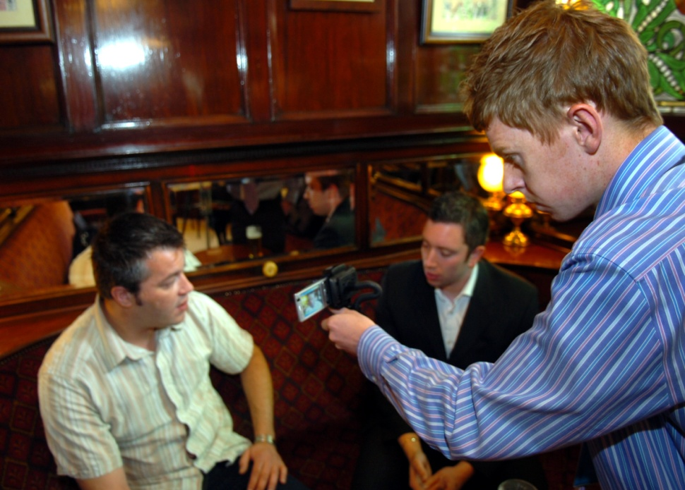
LEP Live (video streaming)
Telefon nebo laptop
Camera
Quik or Ustream websites
Real-time blog
(coveritlive)

Slide 8
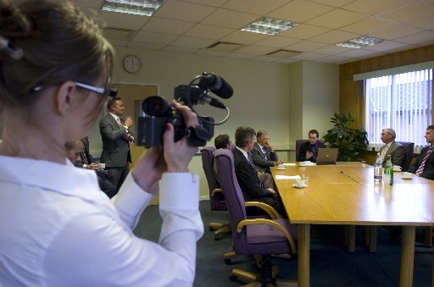
Politici a puby
Lunchtime in a typical Preston pub
Business Leaders’ Lunches
Politicians visit the LEP

Slide 9
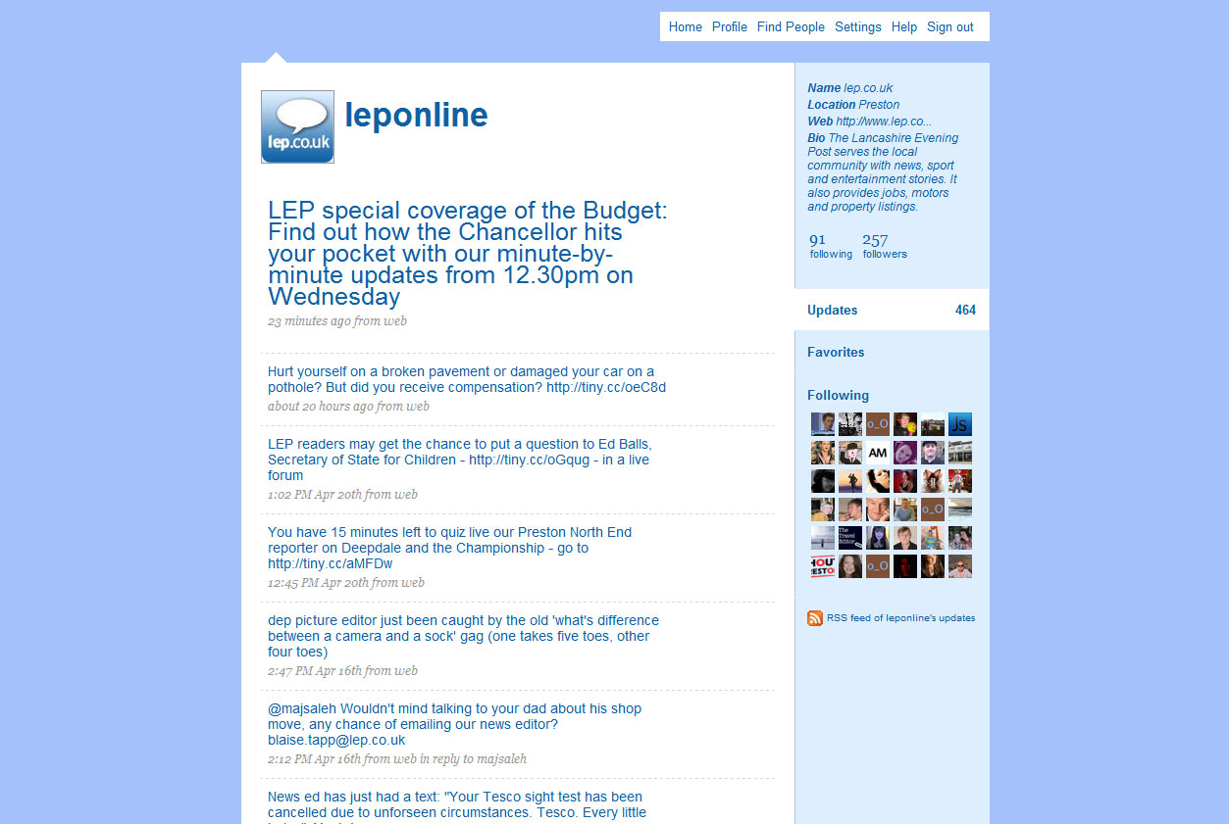
Twitter/Facebook

Slide 10
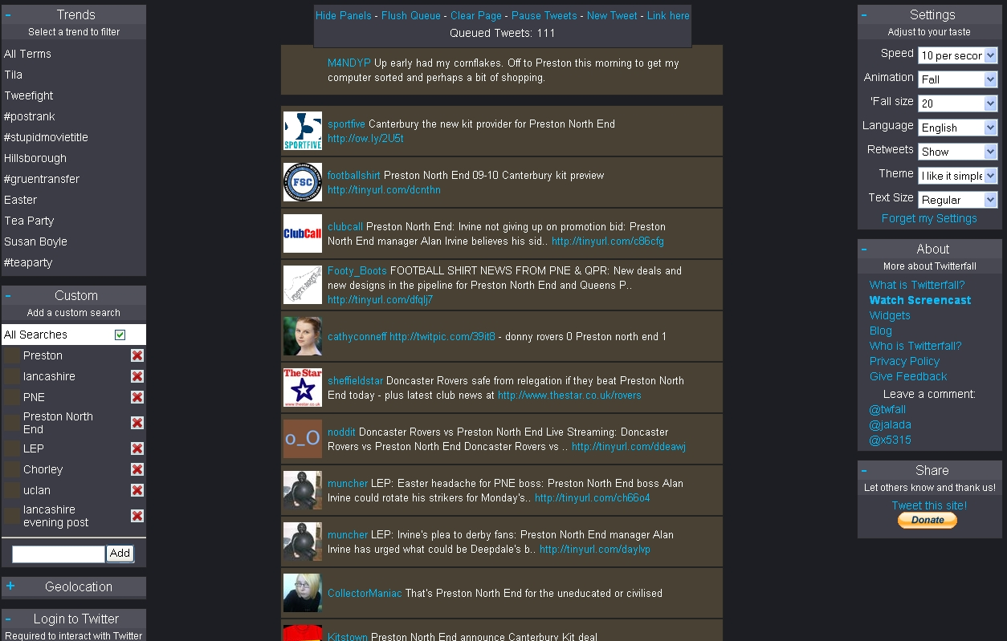
Twitterfall
Monitorují tweety 'Preston' a 'Lancashire'

Slide 11
Youtube

Slide 12
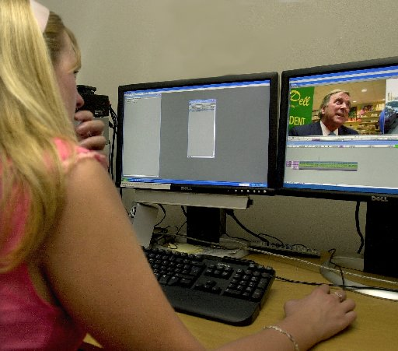
Audio and video strategy
Training pro všechny reportéry
Think print and web in every story
Breaking news for the website
AV suite and studio
UGC

Slide 13
User Generated Content in 2008
PICTURES: 4,000 (including from PR, Retro and sport)
WEB POLL VOTES: 60,000
GENERAL: 2,500 articles (sport, reviews, schools
LETTERS/EMAILS/TEXTS: 3,500 (news) and 100 (sport)
SHORT STORIES: 148 stories submitted to group-wide competition from lep.co.uk, 2,000 registered voters
AUDIO AND VIDEO: 25 videos & 60 audio files (plus school podcasts)
EDITORIAL SNAP SURVEYS: Thousands of responses (campaigns)
BLOGS: 100
FORUMS: 900 postings
STORY COMMENTS: Up to 4,000 a month
COMMUNITY CALENDAR: 500 entries
(most uploaded by users)

Slide 14
The future
More interaction (more live forums)
Encourage more UGC (poems, ultra local)
Develop podcasting (sport, business, schools)
Maintain innovation

Slide 15
Lancashire Evening Post
Odpoledník
3 edice
26,000 prodej
60 novinářů
central, west and north Lancashire

Slide 16
SUCCESS STORY
 | January 2005 | December 2008
Monthly Page Views | 422,055 | 4,406,060
Unique users per month | 50,406 | 328,158
Weekly story count online | 152 | 448
Weekly photographs | 10 | 546
Weekly video | 0 | 21
User comments | 0 | 6,379

