Slide 1

Prologue Kenya - Student Debate 3
By Francis Njoka – Kenya
njokanaam@yahoo.com
Energy Security & Environmental Studies Group
International Relations & Energy Security
Masarykova University - Brno
15-03-2012

Slide 2
Contents =>
Geography & Key Indicators
Land resource
Agricultural sector
Energy sector
Renewable Energy
Biomass Energy
Biomass & Energy security
Other advantages of biomass energy
Sustainability issues on biomass

Slide 3
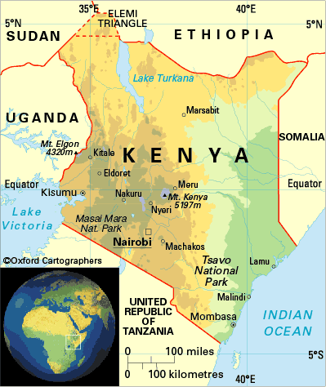
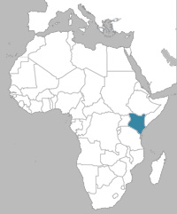

Geography & Key Indicators
Latitude - 4º35’ N – 4º42’ S
Longitude – 34º E – 41º51’ E
Time zone - +3Hrs GMT
Population – 40 million (2011 est.)
Language – English/Kiswahili
Local languages – 42
Religion – Christians (83%), Muslims (11.2%)
Literacy - 85.1% (2010)
Life expectancy – 59.5yrs (2011)
Growth rate – 2.9%
GDP (ppp) - $1,689 = €1.279 (2010)
Inflation – 18.9% (2011)
Poverty levels – 46.6% (2007)
Energy per capita – 121kWh/yr. (2008)

Slide 4
Land Resource
Element | km² | Million Ha | %
Total land area | 582,650.0 | 88.2 | 100
Water mass | 13,400.0 | 1.3 | 1.5
Landmass | 569,250.0 | 86.9 | 98.5
Arable land (16%) | 91,080.0 | 13.9 | 15.8
Farming (31%) | 28,234.8 | 4.3 | 4.9
Grazing (30%) | 27,324.0 | 4.2 | 4.7
Forests (22%) | 20,037.6 | 3.1 | *3.5
Game parks, urban centres, markets, homesteads, infrastructure (17%) | 15,483.6 | 2.4 | 2.7
ASALs (84%) | 478,170.0 | 73.0 | 82.7
Rangeland, agro-pastoralists, pastoralists, reserves ,etc
(potential for irrigation)
Irrigation potential |  | 0.54 | 0.6
Max irrigation potential (Tana & Athi basins) |  | 1 | 1.1

Slide 5

Forest
Resources
Kenya’s forest cover is less than 3% .
Main forest resources are; Mt. Kenya, Aberdares, Arabuko sokoke, Ngangao, Kakamega, Malava, Mau, Elementaita, Ol Doinyo Orok, Karura, Nairobi Arboretum etc.
Benefits; grazing, water, construction materials, energy, medicine, wild food, honey, hunting, tourism, carbon sinks and biodiversity
Pressure on forests is driven by; increasing populations, poverty, demand for agricultural land, energy demand, poor policy formulation and implementation, politics, liberalisation and worsening climate conditions
Charcoal & lumber main cause of deforestation

Slide 6
Agricultural sector
Only 16% of the total land is arable
About 8% is available for crops and feed
12% of total land is considered high potential, less than 8% medium and over 80% as Arid and Semiarid
75% of agricultural land is in the hands of small scale farmers (0.2-5ha) who lack access to technology.
Coffee, tea, sisal, wheat, pineapple and maize are some few crops mainly grown on large scale.
Over 5million people live in ASALs and are susceptible to food shortage and often need humanitarian aid.
The sector contributes 65% export, 70% informal employment, 18% formal employment, 26% GDP, 25% GDP indirectly
Key exports are tea – 23.6%, horticulture – 14.5%, coffee – 3.9%

Slide 7
The energy sector
Primary energy Biomass – 68% Petroleum – 22% Electricity* – 9% Others – 1% |  | Rural energy mix Woodfuel –89% Charcoal – 34% Kerosene – 94% Nat-gas – 1.8% Electricity – 6% Solar – 1% Biogas Candles |  | Urban energy mix Woodfuel – 7% Charcoal – 82% Kerosene - 89% Nat-gas – 23% Electricity – 51% Candles
Capacity Installed – 1,647MW Nominal – 1,433MW Peak – 1,191MW |  | Electricity Access National – 18% Urban – 51% Rural – 6% |  | Electricity Mix. Hydro – 57% Thermal – 31.7% Geothermal – 11% Wind – 0.3% Emergency – 286MW

Slide 8
Renewable energy
Commercial level
Hydro Power – 757MW
Geothermal – 165MW
Wind – 5.1MW
Biomass (sugar bagasse) – 26MW
Domestic level
Small hydro – Mini-grid installations
Solar PV – over 40 companies, over 220,000 SHS installed
-REA installing off-grid units in schools and other centres
Solar Thermal – over 140,000m² - common in upmarket residentials
Biogas – over 4,500 domestic size units installed
Improved cook-stoves – Numerous Institutional and domestic
Bio-ethanol/-diesel - stoves, lanterns, stationary engines

Slide 9
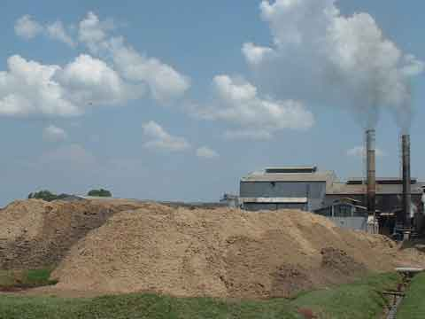
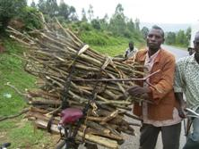
Biomass Energy
The resource base:
Waste-based
Exploited – animal manures (household biogas), molasses (ethanol), sugar bagasse* (cogeneration)
Un-used – Sisal*, coffee, tea, municipal wastes, rice husks, sugar bagasse*, horticultural wastes, wheat straws, molasses*, market wastes, saw dust, abattoir wastes,.
Plant-based
Exploited - fuelwood and charcoal extensively used
Un-used* - Prosopis Juliflora (ironwood/
mesquite), sweet sorghum, water hyacinths, cassava and other liquid biofuels.
* = marginally used currently

Slide 10
Sample biomass potentials as estimated by GIZ (GTZ) based on biogas production (2010)
Type | Solid waste (tonnes) | Liquid waste (m²) | Energy (MW_{el})
Coffee | 145,125 | 4.1m | 10
Cut flower | 27,357 |  | 0.65
Chicken wastes | 82,125 |  | 1.9
Sisal | 735,050 | 2.46m | 20
Sugar | 192,705 |  | 4.1
Milk processing |  | 1.083m | 0.55
1 Pineapple farm | 75,000 | 0.84m | 2.35
MSW (Nairobi) | 996,450 |  | 37.5
1 Distillery stillage |  | 108,000 | 1.1
1 Meat processing |  | 60.000 | 0.05
1 pig farm | 10,920 |  | 0.35
1 tea factory | 7,312 |  | 0.7

Slide 11
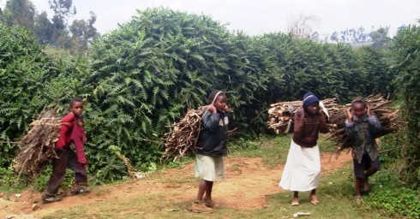
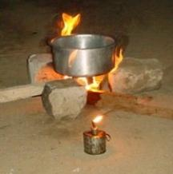
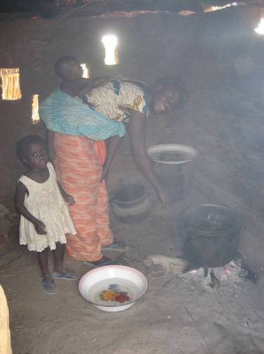
Fuelwood
A larger majority of rural population depend on firewood for fuel (89%).
In year 2000, consumption was 3,394 kg (rural) and 2,701 kg (urban) per household per annum and per capita consumption was 741 and 691 kg respectively.
Kenya experiences a deficit of over 50% of firewood per year
Over 20,000 Institutions also use firewood for catering and water heating.
Most Tea factories also use fuelwood to run their boilers
Other players working with institutions to have woodlots for fuelwood

Slide 12
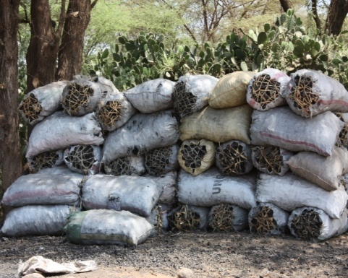
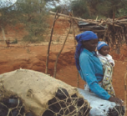
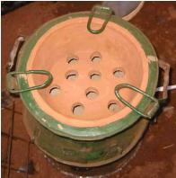
Charcoal
An important fuel source for urban dwellers (82%).
Mature trees are cut and pyrolized into high quality carbon fuel
Main cause of increased deforestation - source of income for rurals.
Per capita consumption was 156 kg (rural) and 152 kg (urban) - 2000
Sustainable projects (planting of acacia trees) being implemented in some parts of the country e.g. Bondo (Kisumu), Kitui and Kitengela (Nairobi) areas.
Energy saving stove – Kenya Ceramic Jiko (KCJ) widely distributed in E. Africa

Slide 13
Bagasse cogeneration
Annual sugar bagasse production is over 1.8million tonnes
Mumias sugar, one of the 9 sugar companies has a 35MW capacity bagasse cogeneration unit. 26MW of the generated electricity is fed to the grid
Biomass electricity
Some tea companies generate electricity from biomass for internal use
A company by the name Tower power is almost through with feasibility studies for 2No., 11.5MW thermal power plants to run on Prosopis Juliflora (mesquite / ironwood)
Vast plantations of this invasive plant, about 200,000ha are found in Baringo, Garissa and Tana river basin.

Slide 14
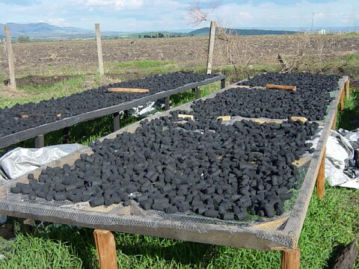
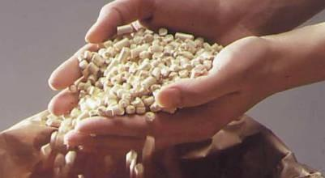
Briquettes
Kenya Planters Cooperative Union (KPCU), used to produce briquettes ‘Kahawa Coal’ from coffee husks.
In 2003, Chardust Ltd Kenya, a private Enterprise started briquetting of bagasse in conjunction with Chemelil (a sugar company) and is now producing 5 tonnes/day of Canecoal.
UNIDO recently also started briquetting projects in Prosopis Juliflora -invested areas.
A 40kVA briquette-run gasifier drives the screw press

Slide 15
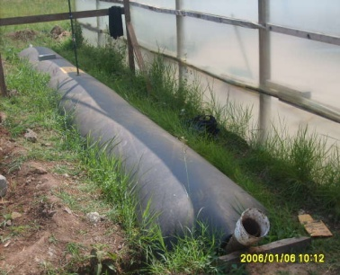
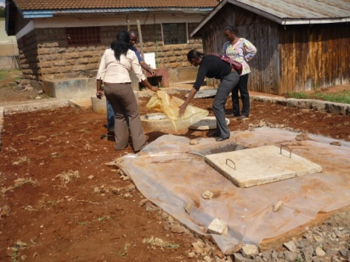
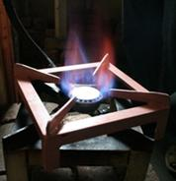

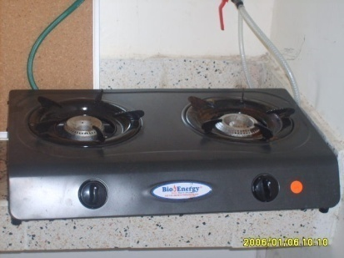
Biogas
Biogas use in Kenya is still at domestic level with units averaging from 3 to 15m³
The Ministry of Energy promotes and demonstrates biogas technology at its Energy Centres spread out throughout the country.
It has in collaboration with JKUAT constructed a 345m³ biogas digester running a 45kW generator and two more others in Maseno and Masinde Muliro Universities
The Ministry intends to pilot production of biogas from flower waste to be used to generate electricity for use by flower firms and export to the grid.

Slide 16
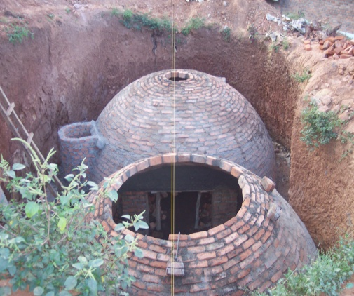
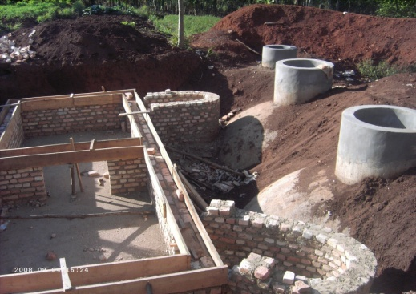
Kenya National Federation of Agricultural Producers (KENFAP) is implementing a National Domestic Biogas Programme (KENDBIP) under a the African Biogas Partnership Programme (ABPP) funded by DFIS – Netherlands.
KENDBIP is to be implemented in 4½ years between 2009 and 2013 with an aim to install 8,000 domestic biogas plants
The project gives an investment subsidy of €240. (KES. 25,000) by subsidizing construction costs.
Over 3,000 units were installed by 2011.
United Nations Industrial Development Organization (UNIDO) has implemented medium scale biogas plants using abattoir and agricultural wastes for power generation.
Kilifi plantations also runs a 150kVA biogas power plant run on sisal wastes and animal manures.
Several other projects are being undertaken by other players.

Slide 17
Liquid Biofuels - Bio-ethanol
Bioethanol in Kenya was considered an alternative energy source in 1970s.
A power alcohol factory was established in Kisumu to run on surplus molasses from sugar companies in 1978 but was not operationized.
In 2003, the state owned firm was sold to Spectre International Inc.
Today, Potable alcohol & industrial methanol is produced for beverage, medical & industrial applications.
Spectra International (SIL) and Agro-Chemical & Food Company Ltd (ACFC) are the key players producing 22millio-lts and 18million-lts respectively per year (2008)
Plans are underway to produce bioethanol from sweet sorghum and cassava.
A draft bioethanol policy is already in place and an E10 pilot is yet to start in Kisumu, Eldoret and Nakuru
A local NGO, PAC (formerly ITDG) is making field trials on stoves

Slide 18
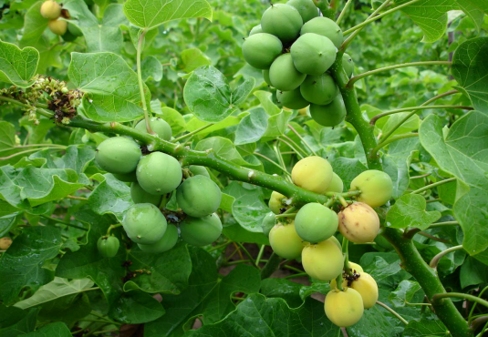
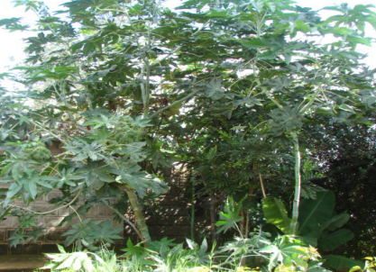
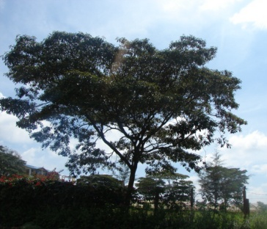
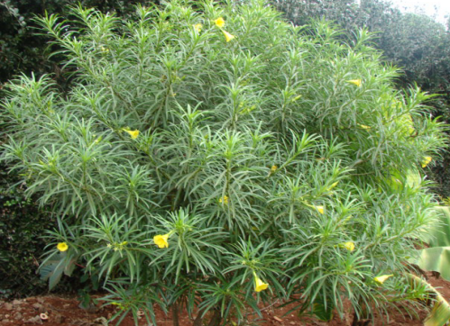
Liquid Biofuels - Biodiesel
Biodiesel is currently produced for local consumption mainly on small scale, from jatropha, castor , croton and yellow oreander
Most of the main plants existed before consideration as fuel crops and several pilot projects have been established in different areas in the country with over 4.2 million Jatropha seedlings distributed to small/large scale farmers.
Key players in jatropha include; Vanilla Development Foundation (1.19m seedlings), Green Africa Foundation (3m seedlings), Magadi Soda Company (10ha), GEF, Policy Innovation Systems for Clean Energy Security (PISCES – policy issues).
A draft biodiesel policy is already in place and a Kenya Biodiesel Association formed.

Slide 19
Biomass Energy & Energy Security
68% of population rely on biomass energy and Kenya has not developed her fossil fuel supplies yet
Biomass energy feedstock are locally available
Engenders independence from fossil sources susceptible to price fluctuations and status of multi/bilateral relations
Provides a cheap energy resource to rural communities
Value addition of agricultural produce (farm-gate quality)
Improves agricultural returns and rural economies
Contributes to national energy security by boosting local supplies

Slide 20
Other advantages
Curbs excessive use of fossil fertilizer in agriculture
Improves soil fertility
Improves management of agro-based wastes
Reduction of GHGs from fossil fuel emissions
Conservation of soils susceptible to erosion
Conservation of the forests* and environment

Slide 21
Sustainability concerns on Biomass energy
Sustainable biomass use must address 3 issues; a) ecological credibility, b) social acceptability and c) economic viability.
Use of traditional biomass energy aggravates deforestation threatening soils which leads to siltation of water bodies and eventually distorting the climate. Users of traditional biomass energy are also susceptible to diseases from in-door-air pollution.
Economically-driven new biomass promotes one sustainability pillar but threatens the other two.
Viable ventures seek fertile lands and water only available in high biodiversity areas, wetlands or forests
These same sort regions support larger populations, are designated for food production, cultural and tourism activities and hence their acquisition infringes on these socially accepted applications

Slide 22
Key issues => Floor’s open!!
Thank you!

