Slide 1
Theory of Mind in Schizophrenia
By : Victoria Mak, Cécile Delbouille, Cullen Conerly & Yvan Reynaud

Slide 2
Introduction
In 1992, Frith voiced the hypothesis in which schizophrenia would be linked with a deficit in theory of mind. He explains it with cognitive, neuropsychological, speculative and heuristic hypothesis

Slide 3
- Cognitive : anomaly of a part of information processing : the attribution of mental states to others like beliefs, thoughts, intentions.
- Neuropsychological : this cognitive anomaly is due to morbid signs and cerebral functional anomalies.
- Speculative : it could be tested experimentally
- Heuristic : permit to reinterpret the troubles of schizophrenia in a clinical way, to explain a part of those troubles, and to open to new ideas of research.

Slide 4
What is Schizophrenia?
Schizophrenia is a mental disorder with clinical signs
including:
- Positive symptoms: delusion, hallucinations,…
- Negative symptoms: social retreat, alogia (loss of speaking capacity), apragmatism (loss of capacity to begin actions),…
- Desorganization: language, behavior,…
- Cognitive troubles: memory, attention,…

Slide 5
Biological basis of ToM performance in Schizophrenia
By : Victoria Mak
Notes:
We will discuss the ………For the purpose of understanding
special considerations in testing,
the original basis in of ToM defecits and the
biological basis of deficits

Slide 6
STRUCTURAL

Slide 7
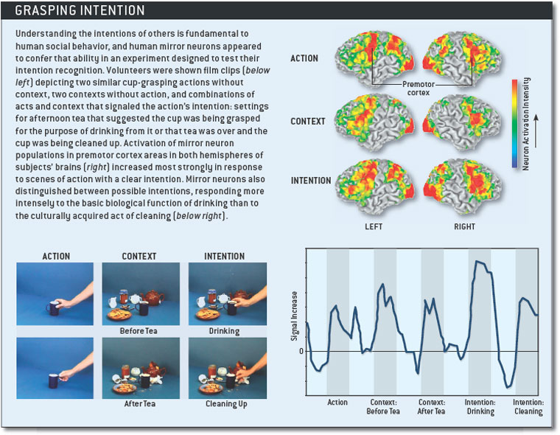
Mirror Neurons ✔
Notes:
(TMS-motor evoked potentials) –Enticott, Hoy, et al
Mirror neurons, activating corresponding action areas of viewer as if they were participating, implicated in understanding intentions-empathy.
Learned not as strong as instinctual activations.

Slide 8
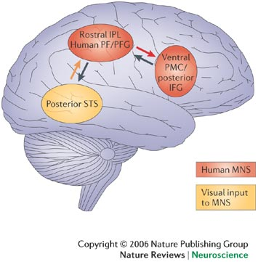
Mirror Neurons ✔
Superior Temporal Sulcus (STS)-biological motion
Inferior Parietal Lobe-perception of emotions
Inferior Frontal Gyrus- mirroring emotion/motion
Notes:
Indicates lower activation in mirror neuron system
(TMS) –Enticott, Hoy, et al

Slide 9
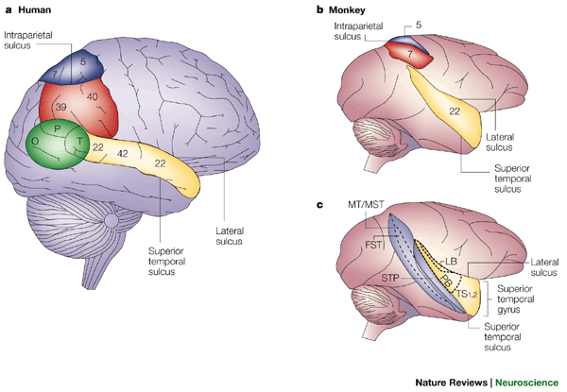
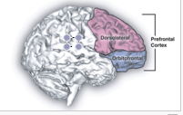
Frontal Cortex
Posterior Superior Temporal Sulcus (STS)initial sensing motion cues of animate objects ✔
Medial Prefrontal Cortex ✔ mentalizing, intentional stance
Right prefrontal cortex ✗ metacognition
Notes:
PETPosterior STS…functions in….shown in upper right-yellow. Leads to RPTJ (green)
Medial Prefrontal Cortex-weak (middle area) shown bottom right
Right Prefrontal Cortex , not activated also metacognition. In healthy, two foci in attribution of intentions
PET(blood flow)- Brunet, Sarfati et al)-nonverbal TOM task

Slide 10
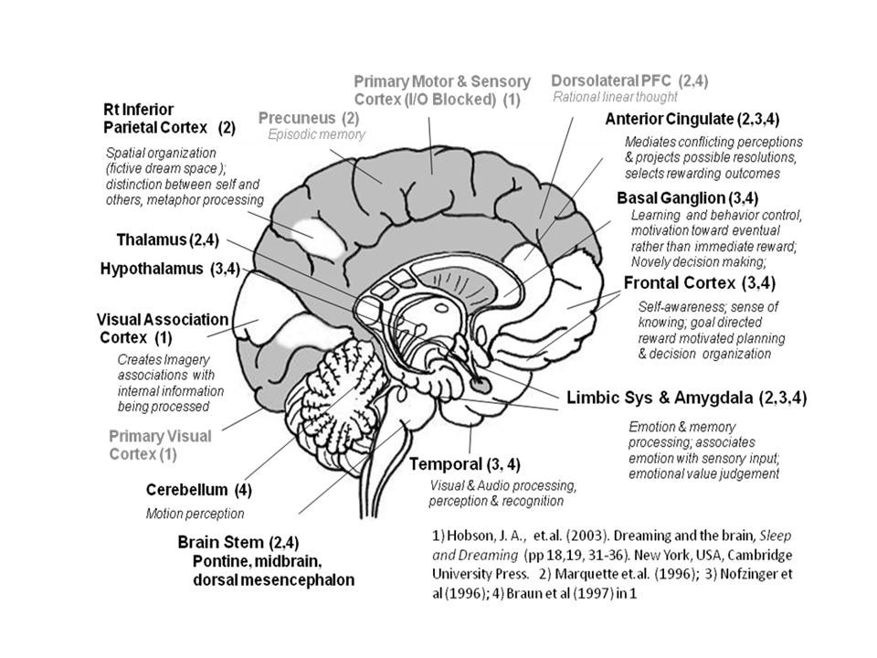
Basal Ganglia ✔
Distinguishing self from others
Monitoring intention/consequences
False-belief (self)
Notes:
Also of note-in attribution intention, poster. Orbital gyrus and medial prefrontal gyrus not pres
Instead middle occipital, L hippocampus (spatial mem) and cerebellum
(secondary brain areas activate to compensate for damage)
Basal Ganglia is also linked to metacognition ….distinguishing self/others, intention, and one’s own false beliefs
Linked to “frontal function and dopaminergic system
Limbic and motor systems

Slide 11
Chemical (Genetic)

Slide 12
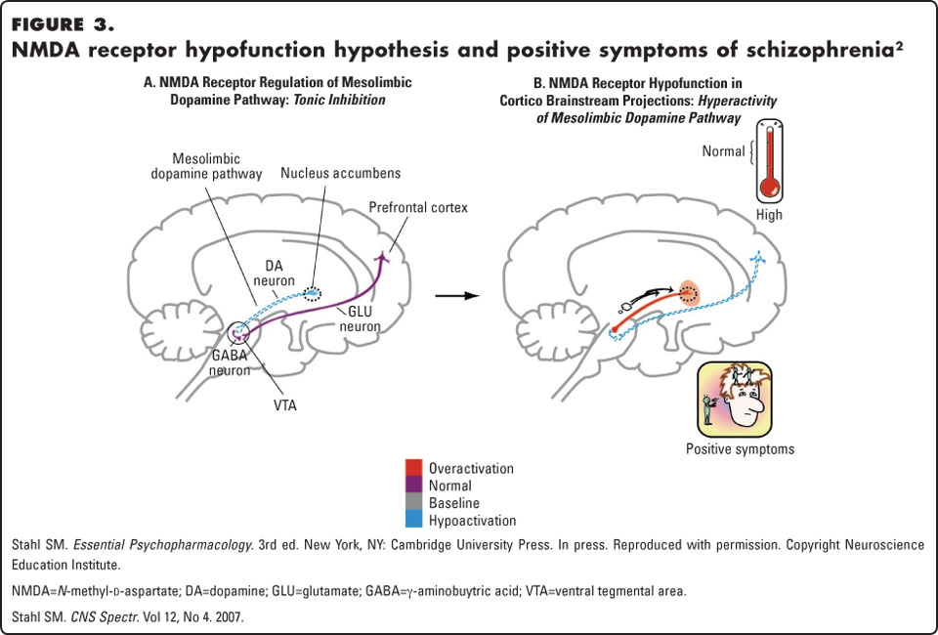
Dopamine
Dopaminergic System
D4 receptor gene (DRD4)
in ToM
D2 Schizophrenia
Notes:
Dopamine Hypothesis: disturbed and hyperactive dopaminergic signal transduction-high dopamine levels.
Long range connectivity used to explain widespread abnormalities-dopamine may be involved in modulation

Slide 13
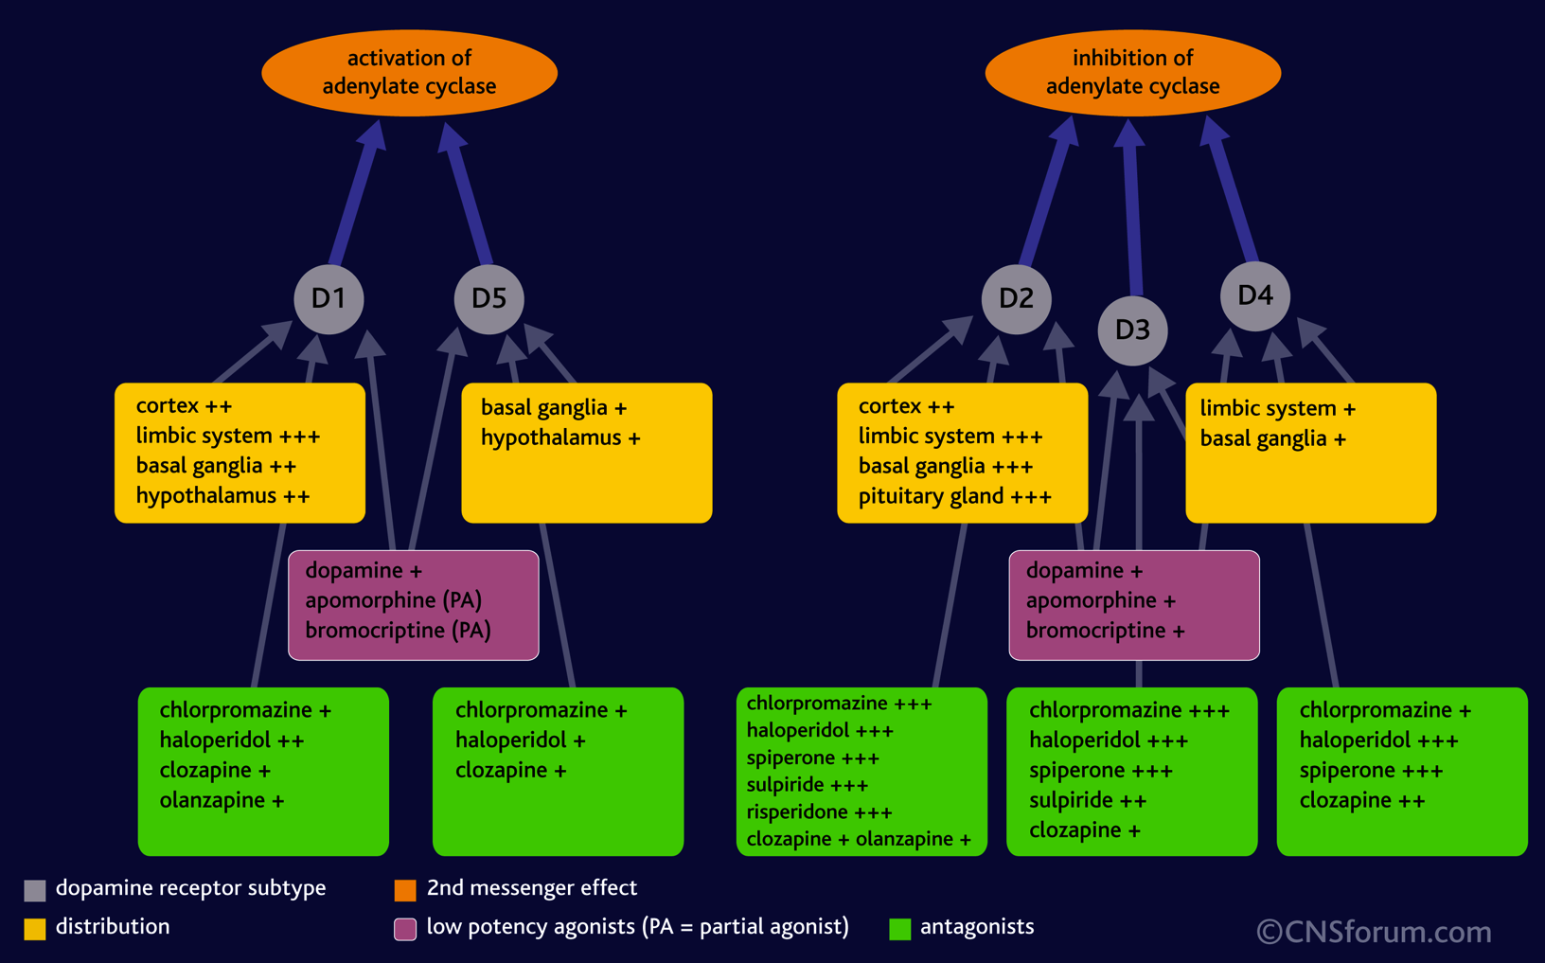
Dopamine
Notes:
D2 receptors particularly disturbed in Schizophrenia. D4 not ruled out
D4 polymorphism receptor gene (DRD4)
“shorter alleles outperformed those with one or more longer alleles” in representational ToM
Probably because of effects on frontal lobe development and functioning,

Slide 14
Tests about ToM in Schizophrenia
By Cécile Delbouille

Slide 15
Aim of research:
Understand…
How deficient ToM in schizophrenia is associated with other aspects of cognition
How the impairment fluctuates with acuity or chronicity of the schizophrenic disorder
How it affects the patients’ use of language and social behavior

Slide 16
1) Tasks involving the detection of irony (Mitchley 1998)
9 brief written scenarios including irony
18 schizophrenics
Results:
Schizophrenia didn’t understand irony in scenarios
More likely to interpret the stories literally
Lower IQ and negative (only negative) symptoms in schizophrenia.

Slide 17
2) Metaphor, or ‘‘real intentions’’ behind indirect speech (Corcoran 1995)
55 schizophrenics, 14 depressed and 30 controls
10 short stories about a social interaction between 2 characters, read aloud to subjects (‘‘hinting task’’)
Results:
Schizophrenics with negative symptoms performed worst on ToM tasks
Schizophrenics with passivity symptoms performed equally to controls
Patients with incoherence and paranoid symptoms were in between
This study suggests that performance on ToM tasks is a state rather than a trait variable

Slide 18
3) Short text passages illustrated by cartoons
(Frith and Corcoran 1996; Pickup and Frith 2001)
55 schizophrenics and 22 controls
6 stories including a ﬁrst or second order false belief with cartoon drawings
Results:
Patients with behavioral and paranoid symptoms performed more poorly on tasks than others
Easier tasks were successful!!

Slide 19
4) Visual jokes as depicted in cartoon drawings (Corcoran1997)
44 schizophrenics, 7 depressed and 40 controls
10 jokes could be understood in physical or behavioral terms
10 jokes required mental state attribution
7 involving false belief.
Results:
impaired in schizophrenic patients
Patients with behavioral symptoms performed worst, particularly if mental state attribution was involved.
Patients with passivity and paranoid symptoms also performed worse than controls

Slide 20
Main conclusion of the tests:
It is their lack of understanding of the mental states of the story characters that makes them fail in such tests. (Langdon, Pickup, Frith, Brunet)

Slide 21
Dispute:
Clinical findings of Trognon, Sperber and Wilson
impairment in social interaction
reduced capacity to effectively engage in communication
Frith’s think
ToM in schizophrenia is compromised
failure to monitor their own and other’s mental states and behavior

Slide 22
Common findings:
Many schizophrenics experience a significant loss of metacognitive capacity or previously held capacities :
Firstly, to create complex representations of the self and others
Secondly, to use that knowledge to respond to psychological challenges

Slide 23

Important notice:
During experience, researchers noticed that patients are quite aware of their loss.
Actually, They can describe it and so they fight to live with that conscious diminishment

Slide 24
II/ Cognitive deficits in Schizophrenia
By : Yvan Reynaud

Slide 25
What is cognition?
Cognition is the capacity to treat the information,
acquire new knowledge and use it.
Mental processes :
perception
attention
motors functions
memory
planning
language
learning …

Slide 26
The most severe cognitive functions touched are:
Verbal memory and learning
Semantic memory
Attention
Executive functions
Motor speed

Slide 27
Patients with Schizophrenia
Evidence has shown that patients with
Schizophrenia show impaired Systematize
ToM and cognitive abilities

Slide 28
The cognitive troubles in schizophrenia:
appear early
correspond to a general deficit but also specific
are frequent and often severe
have important functional consequences
are not simply the result of prescribed treatment or other clinical symptoms
require an assessment and specific management
can’t be stopped by a treatment

Slide 29
A central position in Schizophrenia
Cognitive difficulties are approved since a long time
For some scientists, Schizophrenia is a pathology of cognition.
But cognitive troubles are not a part of the diagnostic criteria of this trouble.

Slide 30
Zakzanis and Heinrichs (1998)
In a meta - analysis of 204 studies, they showed that:
- 61 to 78% of patients had scores below the median of control subjects on all cognitive tests
- 75% of patients had an IQ score below the median of control subjects
- A number of patients, however, retain performance "normal"
➔ This study shows the frequency and severity of cognitive impairments.

Slide 31
Research
ToM impairments have been found in
schizophrenia in :
natural communication situations
tasks assessing first and second order false beliefs
irony comprehension
hinting comprehension
picture-sequencing tasks

Slide 32
An affected way of living
10-20% of patients have a job, and only 30% of them work a significant number of hours.
They are often unable to live independently
Their have low self-esteem and quality of life

Slide 33
Functional field | Cognitive deficit correspondent
Social functioning | Declarative memory Vigilance
Professional functioning | Declarative memory Vigilance Executive functions Work memory
Independent life | Declarative memory Executive functions Work memory

Slide 34
The procedure to show the deficit in theory of mind for schizophrenic people is based on the one used for autistics. They have for common frame, the cognitive neuropsychology.

Slide 35
Affective ToM in Schizophrenia
By: Cullen Conerly

Slide 36
Affective ToM
Affective ToM (or Affective empathy) is the sub-facet of ToM that involves implicit understanding of emotions in others (Shamay-Tsoory, Shur, Harari, & Levkovitz, 2007)

Slide 37
Patients with Schizophrenia
Evidence has shown that patients with Schizophrenia show impaired Affective ToM and empathizing abilities
Thus, they struggle with basic social engagement and functioning.

Slide 38
Patients with Schizophrenia (continued)
Ziv et al. (2011) describes the two main functions of executive functions associated with ToM that would be deficient in patients with Schizophrenia as the ability to inhibit salient information so that less salient information can be considered and the ability to think hypothetically using mental representations for appropriate reactions to stimuli.

Slide 39
Empathy: Reading the Mind in the Eyes Task
Empathy was assessed through the Reading the Mind in the Eyes Task by Shimansky, David, Rössler, and Haker (2010)
Those with schizophrenia performed poorly on the mentalizing task.

Slide 40
Emotional Recognition
A study by Sparks, McDonald, Lino, O’Donnell, and Green (2010), using the Facial Expressions of Emotions: Stimuli and Tests' (FEEST), found that patients with schizophrenia did significantly worse on emotional recognition than did the healthy control group. The study also found, using self-reports on empathy, that there were higher levels of personal distress in participants with schizophrenia. Also, lower levels of perspective taking and empathic concern in those with schizophrenia.

Slide 41
Social Inference and Sarcasm
A study by Sparks et al.(2010) used The Awareness of Social Inference Test which assessed sarcasm recognition using a series of both sincere and sarcastic interactions
It was found that participants diagnosed with schizophrenia scored significantly lower in recognizing both simple sarcasm and paradoxical sarcasm

Slide 42
Links to Symptoms
SANS (Sparks et al. 2010):
Avolition/Apathy
Alogia (language connection)
Attention
Affective Blunting
SAPS (Sparks et al. 2010):
Delusions and Empathic Concern (positive relationship)

Slide 43
Conclusion
Schizophrenia is associated with a number of deficits in ToM and social cognitive functions that adversely affect the individual in his or her daily life.
Work in understanding both the biological factors and social outcomes of these outcomes is necessary for both the caring for and helping manage the lives of those with schizophrenia.

Slide 44
References :
Heinrichs, R. W. & Zakzanis, K. K. (1998) Neurocognitive deficit in schizophrenia: A quantitative review of the evidence. Neuropsychology, 12,426–445.
Frith, C. D. (1992). The Cognitive Neuropsychology of Schizophrenia. Hove, UK : Lawrence Erlbaum.
Frith, C. D., & Cocoran, R. (1996). Exploring « theory of mind » in people with schizophrenia. Psychological medicine, 26, 521-530.

Slide 45
Schimansky, J., David, N., Rössler, W., & Haker, H. (2010). Sense of agency and mentalizing: Dissociation of subdomains of social cognition in patients with schizophrenia. Psychiatry Research, 178(1), 39-45. doi:10.1016/j.psychres.2010.04.002
Shamay-Tsoory, S. G., Shur, S., Harari, H., & Levkovitz, Y. (2007). Neurocognitive basis of Impaired Empathy in Schizophrenia. Neuropsychology., 21(4), 431-438. doi: 10.1037/0894-4105.21.4.431
Sparks, A., McDonald, S., Lino, B., O'Donnell, M., & Green, M. J. (2010). Social cognition, empathy and functional outcome in schizophrenia. Schizophrenia Research, 122, 172-178. doi:10.1016/j.schres.2010.06.011
Ziv, I., Leiser, D., & Levine, J. (2011). Social cognition in schizophrenia. Cognitive Neuropsychiatry, 16, 71-91. doi:10.1080/13546805.2010.492693

Slide 46
Eric Brunet, Yves Sarfati, Marie-Christine Hardy-Baylé, Jean Decety, Abnormalities of brain function during a nonverbal theory of mind task in schizophrenia, Neuropsychologia, Volume 41, Issue 12, 2003, Pages 1574-1582, ISSN 0028-3932, 10.1016/S0028-3932(03)00119-2. (http://www.sciencedirect.com/science/article/pii/S0028393203001192)
Enticott, P. G., Hoy, K. E., Herring, S. E., Johnston, P. J., Daskalakis, Z. J., & Fitzgerald, P. B. (n.d.). Basal ganglia is also linked to metacognition ….distinguishing self/others, intention, and one’s own false beliefs . ( 2008). Schizophrenia Research, ( 102 ), 116-121. Retrieved from http://www.cogsci.ucsd.edu/~pineda/COGS260Mirroring/readings/Enticott et al 2008.pdf
Frith, C. D. (n.d.). Functional brain imaging and the neuropathology of schizophrenia. (1997). chizophrenia Bulletin , 23(3), 525-527. Retrieved from http://schizophreniabulletin.oxfordjournals.org.proxy.lib.utc.edu/content/23/3/525.short
Frith, C. D., & Frith, U. (2012). Mechanisms of social cognition. Annual review of psychology, 63, 287-313.
GRASPING THE INTENTIONS OF OTHERS WITH ONE'S OWN MIRROR NEURON SYSTEM,” BY M. IACOBONIETAL., IN PLOS BIOLOGY, VOL. 3, NO. 3; 2005; LUCY READING-IKKANDA (graph illustration)
Lackner, C., Sabbagh, M. A., Hallinan, E., Liu, X. and Holden, J. J.A. (2012), Dopamine receptor D4 gene variation predicts preschoolers’ developing theory of mind. Developmental Science, 15: 272–280. doi: 10.1111/j.1467-7687.2011.01124.x
Notes:
(Enticott, Hoy, Herring, Johnston, Daskalakis & Fitzgerald, 2008)

