Slide 1
External dimension of the EEP – IV. part
23.4.2014

Slide 2
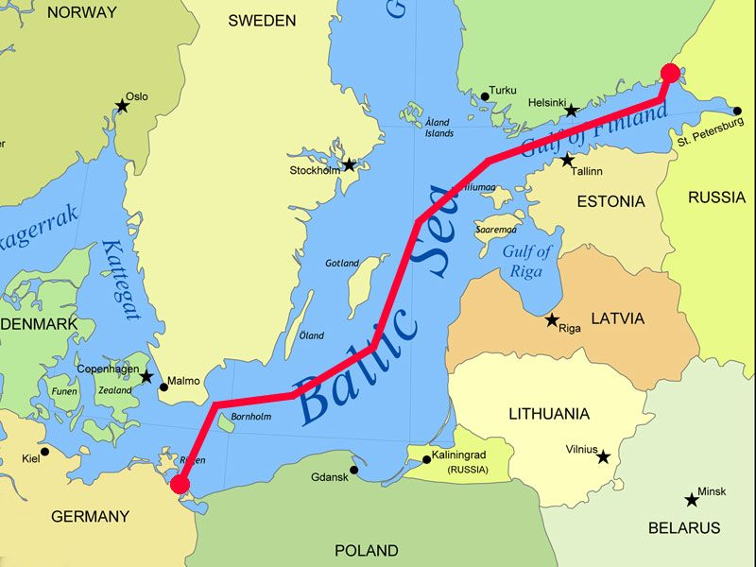
Nord Stream
https://www.youtube.com/watch?v=8urRy9200Vs

Slide 3
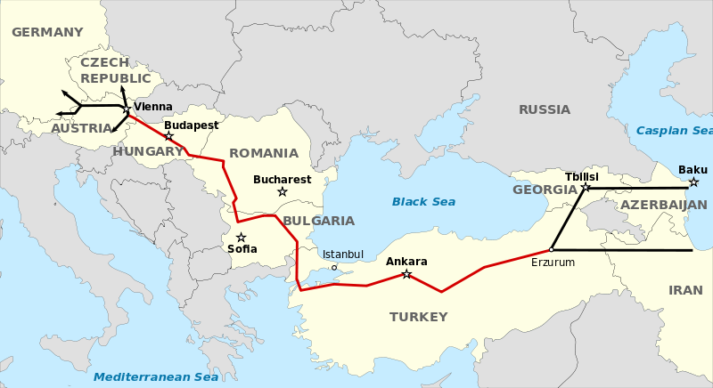
Nabucco

Slide 4
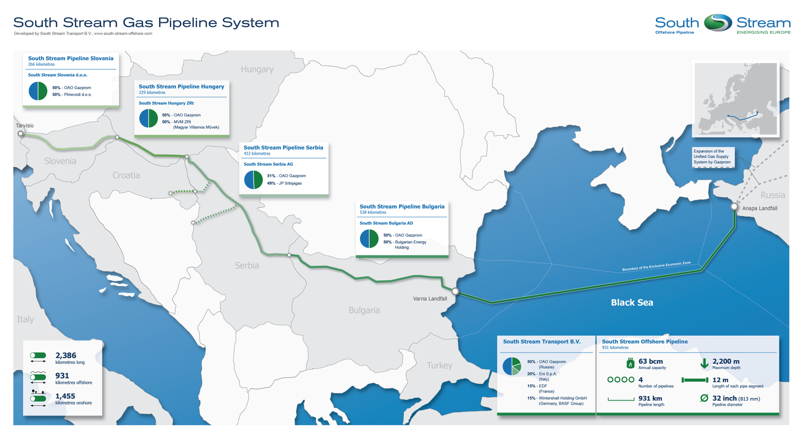
South Stream

Slide 5
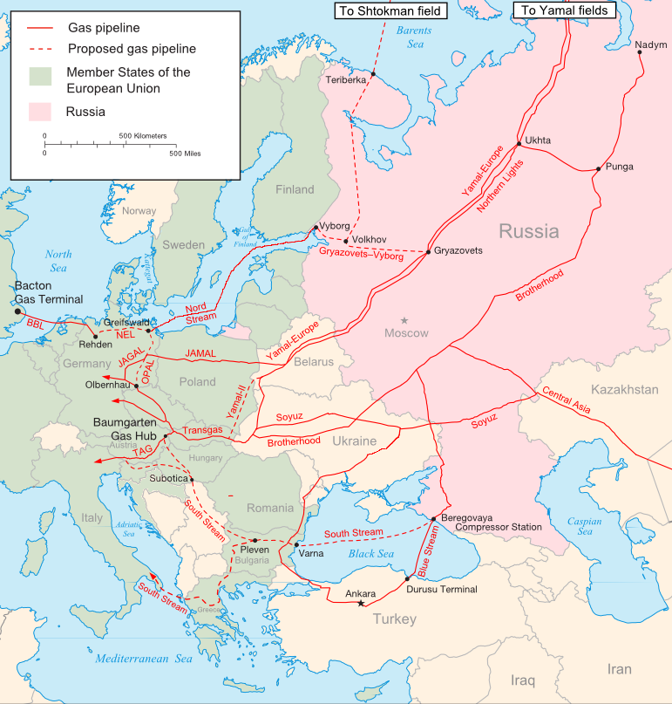
EU and the transit states
Case study – Russia – Ukraine Gas Crisis

Slide 6
Gas Wars The Russia–Ukraine Crisis of 1–22 January, 2009: major milestones
1 January: Gazprom cuts all supplies for Ukrainian consumption, while supplies to Europe continue
5 January: Gazprom alleges that 65.3 mmcm of gas has been ‘stolen’ during the first four days of the year; Ukraine responds that in the absence of a supply and transit contract it is entitled to take this ‘technical’ (fuel) gas
6 January: deliveries to Europe drastically reduced
7 January: deliveries to Europe completely cut off
11 January: EU monitors deployed
13–17 January: Gazprom cites daily attempts to resume flows ‘blocked by Ukraine’
14 January: letter from Naftogaz to Gazprom cites lack of a ‘technical agreement’ preventing resumption of flows
19 January: ten year supply and transit contracts signed
20 January: gas flows to Ukraine and Europe restart
22 January: gas flows to all European customers returning to normal levels

Slide 7
The Issue of ‘Technical’ (Fuel) Gas
Gas required to run the compressor stations is generally known in the gas industry worldwide as ‘fuel gas’. General practice is that fuel gas is provided by the transportation/transit company and included in the tariff charged to the shipper i.e. there is no separate price or tariff charge for this gas.
In the former Soviet Union it has customarily been referred to as ‘technical’ gas. During the negotiations, the Ukrainian side periodically raised the issue of a separate (discounted) price for this gas. The issue of technical gas, which would come to play an important part in the crisis, was raised from the first day.

Slide 8
Thank you for your attention
Veronika Zapletalova
zapletal@fss.muni.cz

