Slide 1
02 Measuring Energy
Václav Šebek

Slide 2
Measuring Energy
Literature:
  Bhattacharyya, S.C., 2011. Energy Economics: Concepts, Issues, Markets and Governance. Springer London, London.
  Chapters 2 and 13

Slide 3
Energy
Heat, light, motive force, chemical transformation etc.
2 thermodynamic laws
  Mass and energy cannot vanish but transform
  No 100% conversion – losses inevitable
Primary x Secondary energy
  Primary – directly from nature (oil, coal, wind, sun, nuclear…)
  Secondary – derived from Primaries (electricity, gasoline…)

Slide 4
Energy
Other divisions (boundaries change)
  Renewable x Non-Renewable
  Commerical x Non-Commercial
  Modern x Traditional
  Conventional x Non-Conventional

Slide 5
Energy System
Supply – Conversion – Consumption
Extraction → PES → Transport → Final Energy → End use app → Useful energy
Losses
Energy corporations all through the system → wide variety of companies

Slide 6
Energy Information
Broadly required data:
  Energy use by various economic activities
  E production, transformation and delivery to various users
  „Field“ technical and operating statistics
  Financial and cost information
  Macro-economic, social, political information

Slide 7
Energy Information
Transorm into information about energy…
  Pricing
  Investment
  Research & Development
  System Management
  Contingency Plan
  Long-term Planning

Slide 8
Energy Accounting Framework
Comprehensive account of energy flows including losses and any consumption
See table
  Production – transformation – consumption
Accounting units
  Commodity (physical, tonnes, barrels…)
  Overal Energy Balance (common unit, eg BTU, GJ, TOE…) – easier comparison

Slide 9
Energy Accounting Framework
Supply-side
Production (+)
Trade (import/export) (+/-)
Bunkers (transport costs, e.g. Tankers) (-)
Stock change (+/-)
Primary energy requirement (PER)
Conversion
Statistical difference (+/-)
Transformation input (-)
Energy sectors‘ own use (-)
Transmission and Distribution losses (-)
Net supply available
Net domestic consumption
Final energy consumption
Agriculture
Industry
Transport
Residential
Commercial
Non-energy uses
Total energy needed to satisfy country’s demand and transformation requirements
Primary need (shown in TPES)
Efficiency indicator
Sectorial situation may be analyzed

Slide 10
Energy Accounting Units - Example
Tab – A lignite surface mine yearly consumption decomposition
Consumer | TJ | kt | GJ/t | Share
 |  |  |  | TJ | kt | ktce | ktoe
PP Chvaletice | 16 631 | 978 | 17,00 | 32% | 33% | 567 | 397
Refinery Litvínov | 7 072 | 530 | 13,35 | 14% | 18% | 241 | 169
HP Otrokovice | 4 523 | 274 | 16,51 | 9% | 9% | 154 | 108
Paperworks Mondi Štětí | 4 358 | 180 | 16,70 | 8% | 6% | 149 | 104
HP Strakonice, a.s. | 1 754 | 112 | 15,66 | 3% | 4% | 60 | 42
HP Třinec | 1 698 | 106 | 16,00 | 3% | 4% | 58 | 41
HP Poříčí | 789 | 47 | 16,79 | 2% | 2% | 27 | 19
PP Hodonín | 446 | 27 | 16,63 | 1% | 1% | 15 | 11
Export | 6 640 | 332 | 20,00 | 13% | 11% | 227 | 159
Retail | 8 360 | 418 | 20,00 | 16% | 14% | 285 | 200
Total/mean | 52 271 | 3 004 | 17,40 | 100% | 100% | 1 784 | 1 248
All units above are scientific – commercial units (eg TCE) might be not

Slide 11
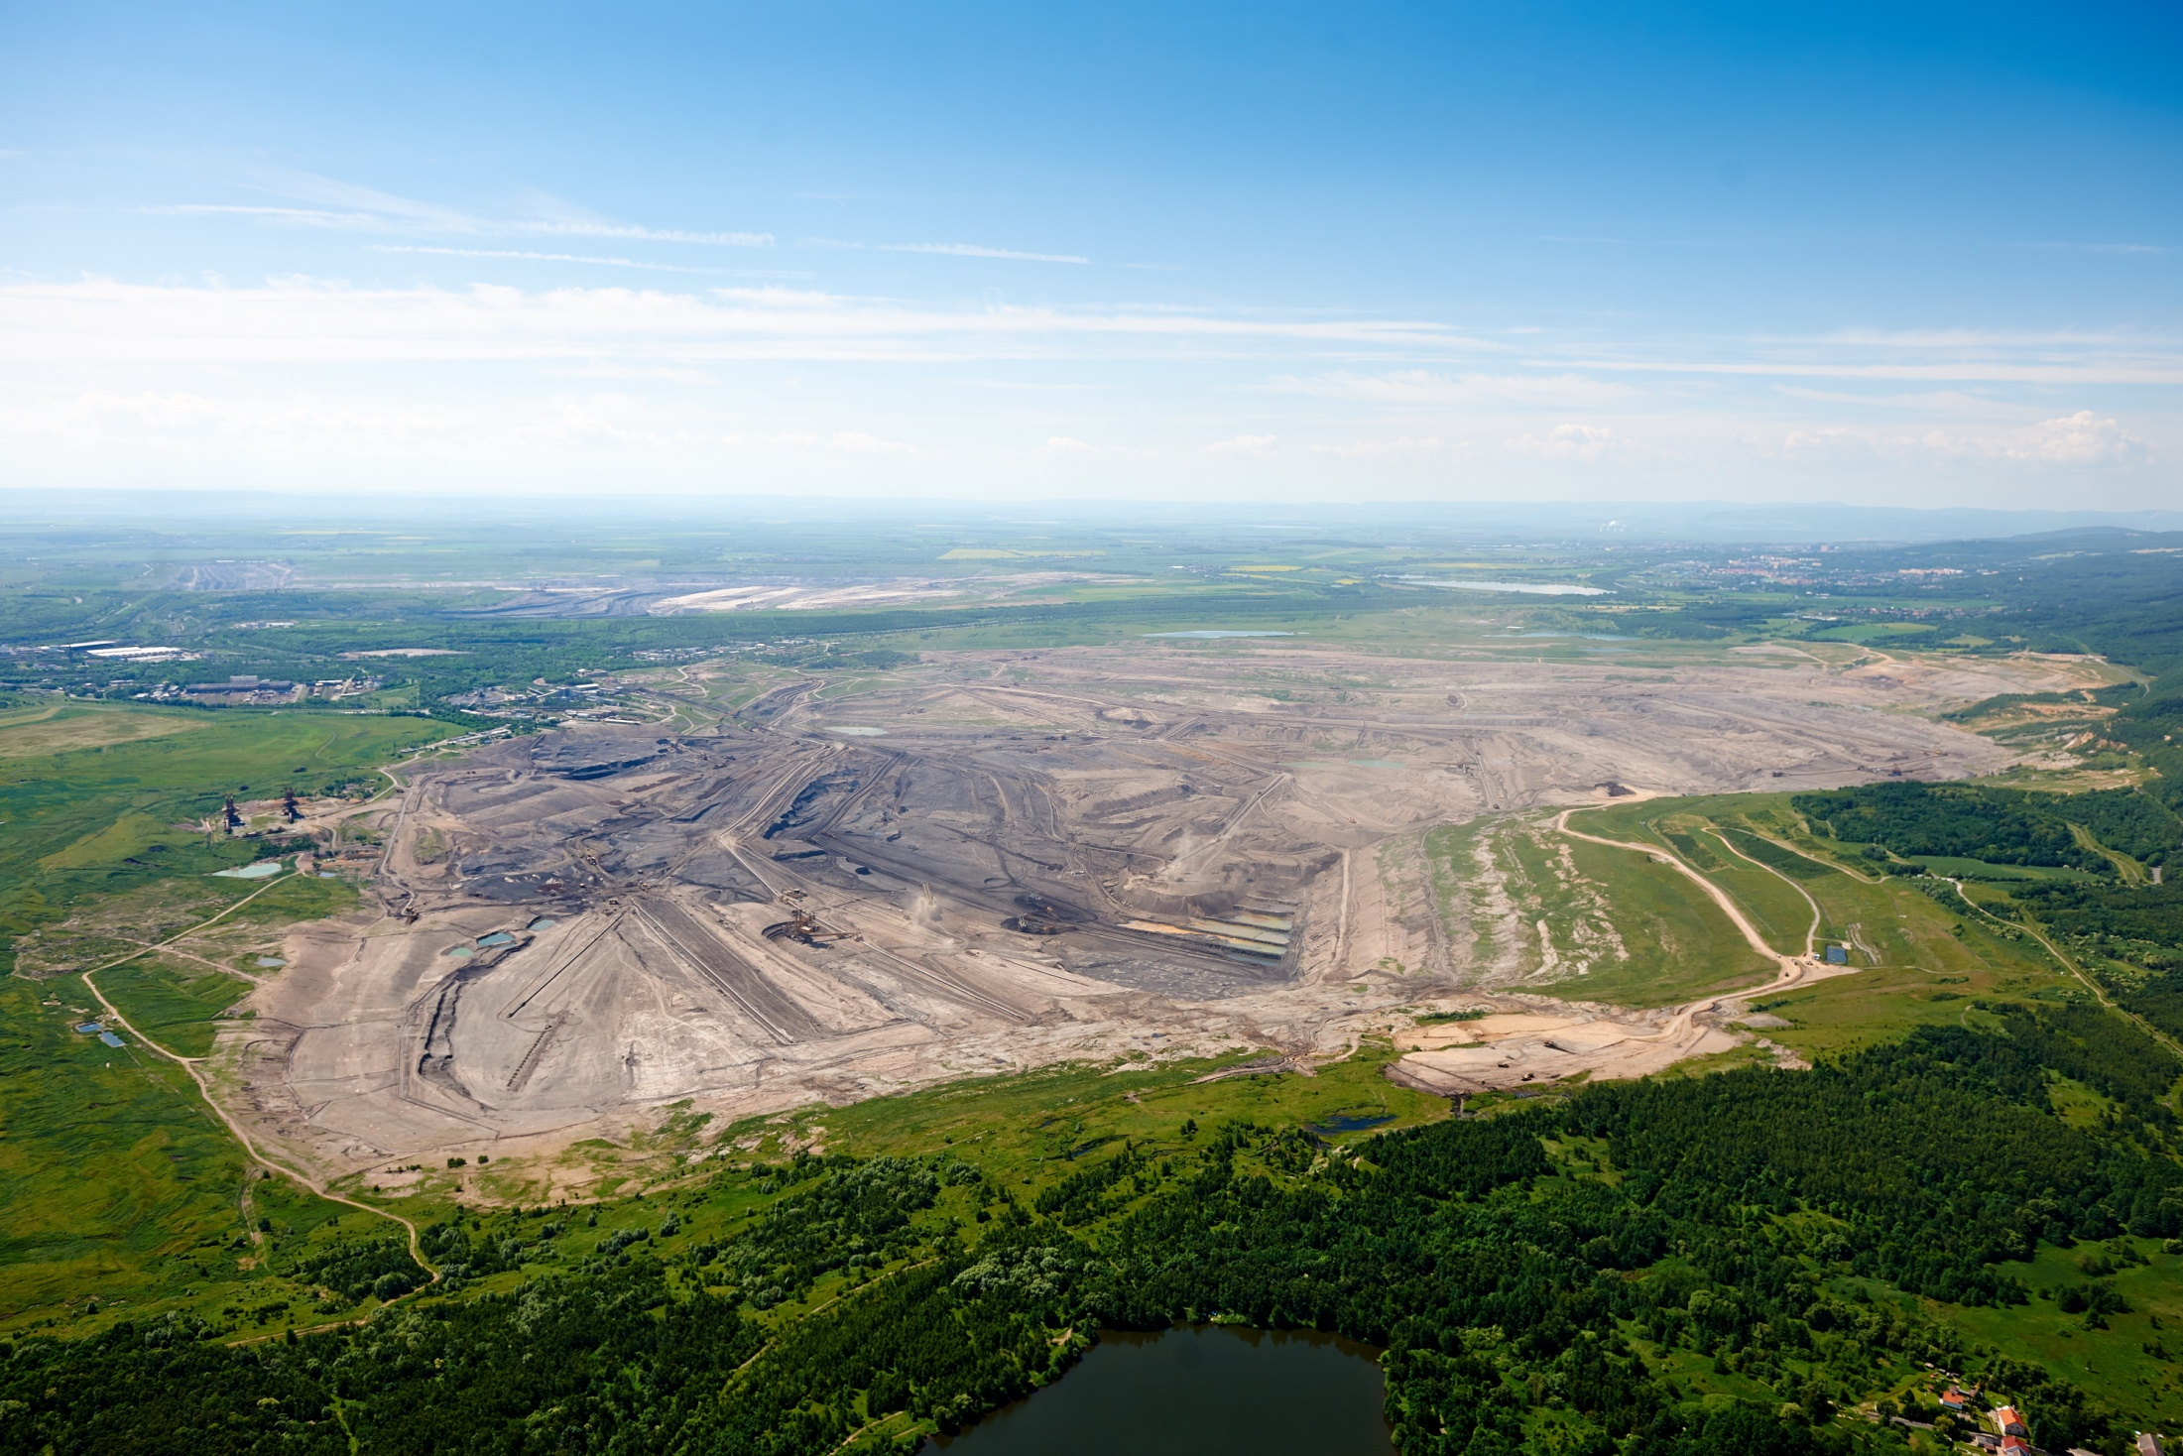
Lignite Surface Mine

Slide 12
Useful Ratios
Energy supply mix
  Share of various sources on primary supply
Self-reliance
  What portion of energy is of domestic origin
Share of renewables
Power generation mix
Efficiency
  Electricity production
  Refining
  Overall
Per capita consumption (primary and final)
Energy intensity

Slide 13
Some energy data issues
Availabilty
  lags, various sources, imprecision, confidentiality
Quality
  Different standards and methodologies, deliberate changes, trade and balance discrepancies
Cross border comparison
  Traditional fuels, terminologies, sectors definition, accounting
Common measurment
Conversion factors

Slide 14
Energy Pricing
Self-sufficient country
  Price set domestically between export and import parity price
Importing country
  Import (world) price
P
P
S
p^{m}
S
p* = p^{m}
p*
D
p^{x}
D
Realized consumption
q*
Q
q’
q*
Q
Max domestic production below world price
+
Import
= domestic consumption

Slide 15
Energy Pricing
Net exporter
  Domestic demand satisfied below world price
  Equilibrium price should be that of world price
  In reality domestic prices of oil exporters significantly lower due subsidies
P
S
D
p* = p^{x}
Q
Max domestic consumption
+
Export
= Total domestic production

Slide 16
Peak and Off-Peak Pricing
[MW]
Daytime

Slide 17
Peak and Off-Peak Pricing
[MW]
Daytime
Nuclear (yellow) – Renewables (green) – Coal (brown) – Peak gas (blue)

Slide 18
Peak and Off-Peak Pricing
[Kč/KWh]
D
Price

Slide 19
Renewables and Electricity Pricing
[Kč/KWh]
Demand
Price

Slide 20
Renewables and Electricity Pricing
[Kč/KWh]
Demand
Price

Slide 21
Renewables and Electricity Pricing
[Kč/KWh]
Poptávka
Cena

Slide 22
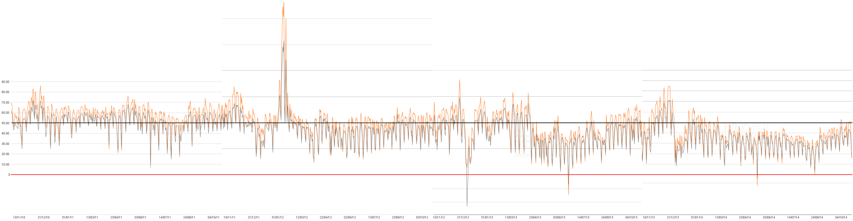
Daily electricity price at European Power Exchange Leipzig
170 € daily mean, 250 € daily max 10.2.2012
€/MWh
100
50
0
Zdroj: https://www.epexspot.com/
0 € daily mean, -450 € daily min 25.12.2012
10/2010
10/2011
10/2012
10/2013
10/2014

Slide 23
Allowances v Taxes
Government aims to decrease CO2 emissions
Two ways of achieving that:
  Tax – payment for each ton of CO2 emitted
  Tradable allowances – permission to emit particular volume of CO2
Different parameters
  Tax – maximum price for decarbonisation is set
  Allowances – maximum volume is set

Slide 24
Example 1
Two types of PP in a Country – A and B
Both emit 40t CO2 per year = total 80t/y
Different emission reduction costs per 10t
  A = $2,000; B = $4,000
Government’ objective is 60t CO2 per year
  Regulation
  Tax
  Allowances

Slide 25
Example 1
Regulation
  Each PP must decrease emissions by 10t/y
  Costs = 2,000 + 4,000 = $6,000
Allowances
  60t allowances issued, both A and B get 30t
  B buys 10t allowances from A and emits 40t
  A emit 20t … total emissions 60t
  Costs = 2 * 2,000 = $4,000
  Price of allowance between $2k and $4k
Taxation
  T < $2k … no emission reduction & C+T = $0 + $0…16k
  $2k < T < $4k … 40t of A reduced & C+T = $8k + $8k…16k
  $4k < T … all emissions reduced & C+T = $16k + $0

Slide 26
Example 2
Company | Emissions [t] | Costs reducing 1 t
A | 70 | 20
B | 80 | 25
C | 50 | 10
Total | 200
Government objective: 120 t
Method: Allowances
Who will sell at what price?
What will be final cost of reducing emissions?

Slide 27
Example 2
Company | Emissions [t] | Costs reducing 1 t
A | 70 | $20
B | 80 | $25
C | 50 | $10
Total | 200 (120 allowances issued)
C sells 40t allowances to B at price of $20
Total costs = $1,100
  A reduces 30t at $20
  B doesn’t reduce
  C reduces 50 at $10
Costs w/o trade
  $1,700
S
D

