Slide 1
Europe and the Issue of Competitiveness
Europe in International Economy
2015

Slide 2
Industrial and competitiveness policy
ICP:
  is designed to improve country’s economic performance;
  not to specify and enforce particular outcomes – rather to alter market processes by attacking the rigidities (which impede the market selection);
  private sector flexibility is encouraged and adjustment to shocks is facilitated;
Formerly:
  attempt to lead the private sector through a planning procedure (picking the winners) – predicting emergence of sunrise (and subsidizing sunset) sectors;
Modern ICP: also providing industry with appropriate resources - educated and trained labor force + an appropriate research base and infrastructure;

Slide 3
ICP in European Context
1940s–1960s orthodoxy: government to correct market failures by microeconomic intervention in specific sectors;
1970s ICP aimed to create super-firms to compete with the US giants (EoS);
since 1980s: increasing respect for market forces (neoliberal-monetarist turn);
since 1990s – EU Commission´s view:
  governments should promote adaptation to industrial change in open and competitive market;
  firms and sector specific policies are treated with suspicion Vs. approves horizontal/general policies to support market activity in general:
    specific industrial policy (by states) constrained by EU rules on state aid;
    (microeconomic) policy is often contradictory – governments tend to simultaneously support sunrise and sunset industries;
  Instruments:
  Traditional industrial policy: subsidies, tax breaks, protection from competition;
  Contemporary: deregulation; reorientation of public services (education); subsidization of infrastructure and research;

Slide 4
Industrial agglomerations
  Information/ideas circulate informally within an agglomeration:
    speeding up the process of product development;
    technology spillovers are concentrated locally;
  Pull factors :
    reducing costs for members of agglomeration = positive externalities based on production of specialized inputs (specialized labor, specialized services, shared consumers, shared infrastructure – e.g. universities, information flow);
  Agglomeration:
    reduces cost by allowing firms to contract out all but their core activities – only efficient if the specialized suppliers can themselves operate on a large enough scale;
    while agglomeration is large – most firms will be small (extremely specialized and operating on sufficient scale);
  EoS -> oligopolistic competition (non-price comp.), rents -> AGLO – NI (GOV role)!
    Centripetal and centrifugal tendencies.

Slide 5
Research and development
  Innovation as a good – production proces driven by profit but unique characteristics;
      Firms invest heavily in R&D only if they can appropriate the knowledge for themselves (vs. leak -> positive extern. - social value);
        Inovation by firm:
          positive externalities for other firms (better and cheaper products + new scientific/non-patented information);
          as well as ensuring firm’s own survival through the patented knowledge (competitive advantage);
      Innovations are non-rival (easily to be copied) – lower incentive to innovate (than social optimum) (FR);
      Suggested policy: patent system and public funding of basic research;
  Government indirectly promote innovative industries by sponsoring R&D:
      less risky than picking the winners;
      spillovers (loops, linkages, feedbacks) – helps to translate scientific knowledge into commercially useful innovations:
  Countries strong in R&D:
      Acquire a comparative advantage in the form of human capital endowments that may persist for some time;
  Rule : the further away from the marketplace and the more general the type of research, the more appropriate it is for public funding…

Slide 6
Rank | Country/Region | Exp.(bill. US$, PPP) | % of GDP | Exp. per capita
18 | Israel | 9.4 | 4.2% | 1,153.90
5 | South Korea | 55.8 | 3.7% | 1,111.12
3 | Japan | 160.3 | 3.7% | 1,260.42
16 | Sweden | 11.9 | 3.3% | 1,232.97
25 | Finland | 6.3 | 3.1% | 1,155.37
1 | United States | 405.3 | 2.7% | 1,275.64
19 | Austria | 8.3 | 2.5% | 975.91
27 | Denmark | 5.1 | 2.4% | 906.31
4 | Germany | 69.5 | 2.3% | 861.04
20 | Switzerland | 7.5 | 2.3% | 924.53
2 | China | 296.8 | 2.0% | 217.69
6 | France | 42.2 | 1.9% | 640.91
9 | Canada | 24.3 | 1.8% | 688.47
7 | United Kingdom | 38.4 | 1.7% | 602.78
15 | Australia | 15.9 | 1.7% | 978.97
21 | Belgium | 6.9 | 1.7% | 619.82
17 | Netherlands | 10.8 | 1.6% | 641.23
28 | Norway | 4.2 | 1.6% | 822.07
29 | Czech Republic | 3.8 | 1.4% | 361.43
36 | Ireland | 2.6 | 1.4% | 566.07
14 | Spain | 17.2 | 1.3% | 369.02
32 | Portugal | 2.8 | 1.2% | 266.99
12 | Italy | 19.0 | 1.1% | 316.70
10 | Russia | 23.8 | 1.0% | 165.62

Slide 7
General observations
ICP should not target specific firms or sectors, but aim at improving the general functioning of markets;
  difference between offering incentives to specific investor to invest into country and to make the country more likely to attract investment;
It is not enough to demonstrate existence of market failure:
  government action is costly and quickly becomes politicized and selective;
  once supported by industrial policy (public) funds – sector grows beyond their market - determined size;
    exercising political influence - enjoying political support (employment, GDP share);
    industrial policies become path-dependent and self-perpetuating;

Slide 8
Oligopolistic Competition in High-tech
(150+ passengers airplane – example of natural monopoly)
Boeign having head start
 | Airbus: producing | Airbus: not producing
Boeing: producing | B: -5 A: - 5 | B: 100 A: 0
Boeing: not producing | B: 0 A: 100 | B: 0 A: 0
Industrial policy of EU – subsidy 25
 | Airbus: producing | Airbus: not producing
Boeing: producing | B: -5 A: 20 | B: 100 A: 0
Boeing: not producing | B: 0 A: 125 | B: 0 A: 0

Slide 9
Weaknesses of Europe (Eichengreen)
R&D spending + limited cooperation between industry and academia;
Small, new firms (tend to pioneer new niches, e.g. IT) – greater difficulties to cope with the complexity of European regulation;
Europe: immigration-unfriendly policies (less attractive for H-T specialist form Asia);
Lower hiring and firing costs make it easier for US entrepreneurs to experiment with unproven technologies (…of great promise but uncertain commercial potential);
European financial system – well suited to mobilizing saving and deploying it for investment by incumbent firms - does not go to the start-ups and small firms (engines of output and productivity growth);
IT producing sector is where US excels – but only 6% GDP – cannot explain differences in productivity trends:
  US productivity advantage since 1990s centered in retail trade, wholesale trade, financial services – ICT using activities;
Europe has faster productivity growth in telecommunications (privatization and uniform product standards);
Higher cost etc. computer hardware in Europe (localizing costs) – itself a barrier;

Slide 10
Employment (%)
 | 1970 | 1980 | 1990 | 2003
EU 15
Overall employment | 59 | 60 | 62 | 64
Employment male | 80 | 78 | 74 | 73
Employment female | 39 | 43 | 49 | 56
Employment 15–24 | 51 | 45 | 45 | 40
Employment 25–54 | 65 | 70 | 73 | 77
Employment 55–64 | 47 | 44 | 39 | 42
US
Overall employment | 64 | 67 | 72 | 71
Employment male | 83 | 80 | 81 | 77
Employment female | 46 | 55 | 64 | 66
Employment 15–24 | 53 | 59 | 60 | 54
Employment 25–54 | 70 | 74 | 80 | 79
Employment 55–64 | 60 | 54 | 54 | 60

Slide 11
Strengths of Europe
Europeans have vastly grater amounts of leisure time (Vs. US);
Higher level of earnings equality - more people with health insurance, infant mortality rates are lower, poverty rates are lower, rates of violent crime are lower;
  Number of prisoners is only 128/100k vs. 716 in US (2013, 22% of world total); homicide (per 100k) 2,7 vs. 5,9;
Rigidities have not stood in the way of rapid export growth;
  European exporters dominate in quality HVA, H-T; premium goods; precision manufactures;
Moving into H-T and premium goods is potential source of insulation from high competition of EM:
Europe has not been subject to the kind of great financial scandals;

Slide 12
Output per head and hour of work (%)
 | 1913 | 1929 | 1938 | 1950 | 1973 | 2003
Product per worker as a % of US level
France | 66 | 68 | 73 | 55 | 79 | 73
Germany | 69 | 59 | 82 | 41 | 72 | 64
Italy | 48 | 45 | 54 | 37 | 64 | 66
Britain | 93 | 80 | 102 | 73 | 72 | 72
EU15 (aver.) | 57 | 55 | 66 | 47 | 65 | 72
Product per hour as a % of US level
France | 56 | - | - | 46 | 74 | 111
Germany | 59 | - | - | 32 | 79 | 98
Italy | 42 | - | - | 35 | 78 | 100
Britain | 84 | - | - | 63 | 60 | 83
EU15 (aver.) | 61 | - | - | 44 | 71 | 94

Slide 13
Worked hours per head
(hours/year)
 | 1950 | 1973 | 1998
Britain | 871 | 753 | 682
France | 905 | 728 | 580
Germany | 974 | 811 | 670
Italy | 800 | 669 | 637
Spain | 921 | 805 | 648
US | 756 | 704 | 791

Slide 14
Lisbon Agenda
Lisbon European Council 2000: new strategic goal till 2010 – to become the most competitive and dynamic knowledge-based economy in the world capable of sustainable economic growth with more and better jobs and greater social cohesion;
Strategy aimed to:
  transition to a knowledge-based economy by better policies for the information society and R&D;
  structural reform for competitiveness and innovation and by completing the internal market;
  modernize the European social model, investing in people and combating social exclusion;
All-embracing - result of bargaining process + disagreement how economic performance should be improved;
Open method of coordination:
  Council agreeing guidelines that contain targets and recommendations which are adopted at the discretion of member states (intergovernmental process);
  policy operates via reports – containing the policy, objectives and progress;
  „enforcement“ is by recommendation, peer pressure and benchmarking;
  no penalties – government implement policies in line with their own priorities;

Slide 15
EU is continuing to lag behind – also in amount of inputs used: slower population growth and rigid labor markets (late from school, less hours, early retirement + higher benefits and less part-time jobs);
Lisbon is about everything and thus nothing (Kok’s Report 2004);
  ccommitmentss are rhetorical (agreed at the height of the Dotcom boom);
  states are committed only to parts of agenda;
Mid-term review (2005): Barroso’s Commission’s plans – three priorities for the policy concentrating on growth and jobs (Revised Lisbon Agenda) :
  more attractive place to invest and work – completing the Single Market and business-friendly regulation;
  knowledge and innovation for growth: raising expenditure on R&D to 3% of GDP;
  creating more and better jobs – increase employment by making the labor force more adaptable through raising the level of education and skills;
Concerns that slimmer agenda downgraded the environmental and social aspects of agenda;

Slide 16
Strategy Europe 2020
  Global crisis destroyed progress reached in last years (20 years of attempts for fiscal consolidation – in 2009 average fiscal deficit 7% and public debt 70%) + there have to be careful management of exit fiscal stimulus's;
  Goals:
    intelligent growth –> economy based on knowledge and innovations;
    sustainable growth –> support for more competitive and ecological economy less energy intensive;
    growth supporting social inclusion;
  Targets - 2020:
    Higher employment for 20-64 year old (from 69% to 75%);
    Increase investment into RD up to 3% GDP EU (US 2,9% vs. EU 1,7%);
    In energetic policy reach the goal 20-20-20 (less greenhouse gases, more renewable, more energy efficiency);
    Share of tertiary educated from 31% to 40%;
    25% less people living in poverty (from 20 mil.);

Slide 17
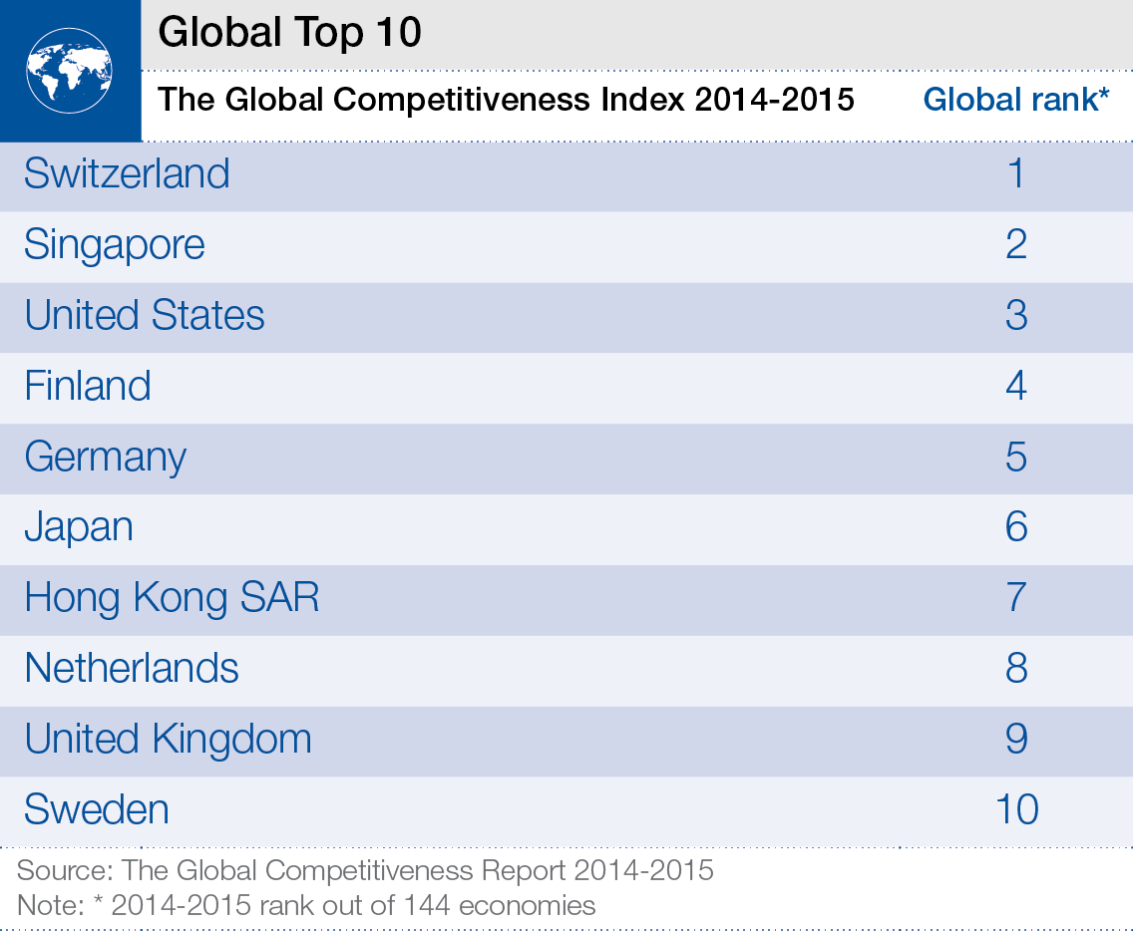

Slide 18
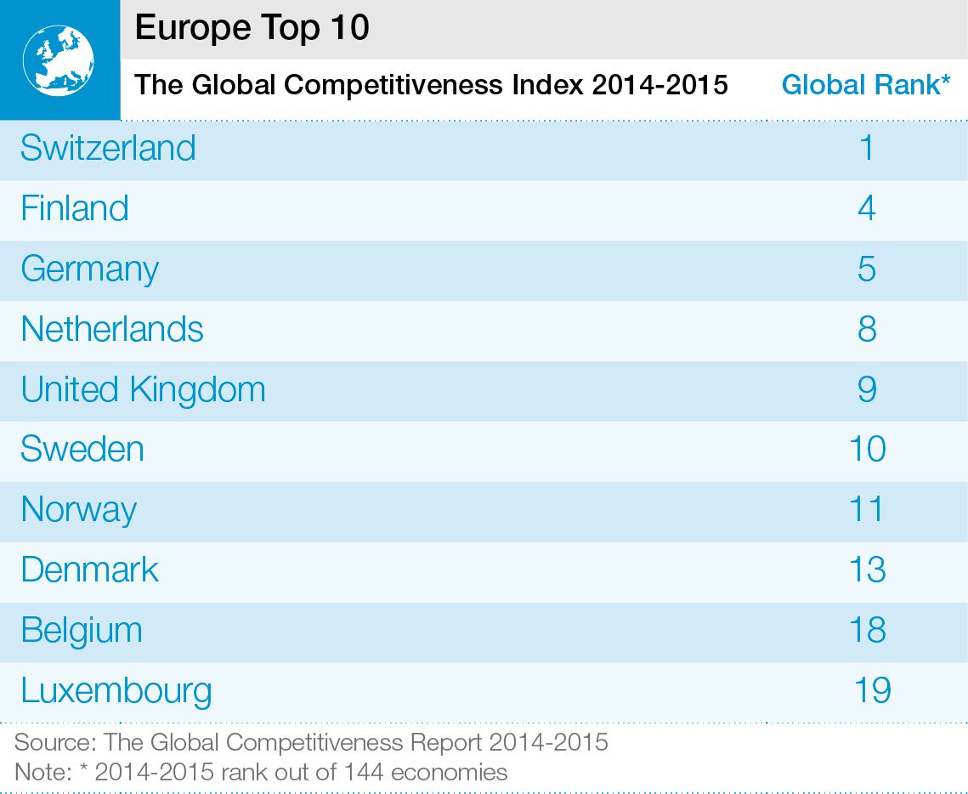

Slide 19
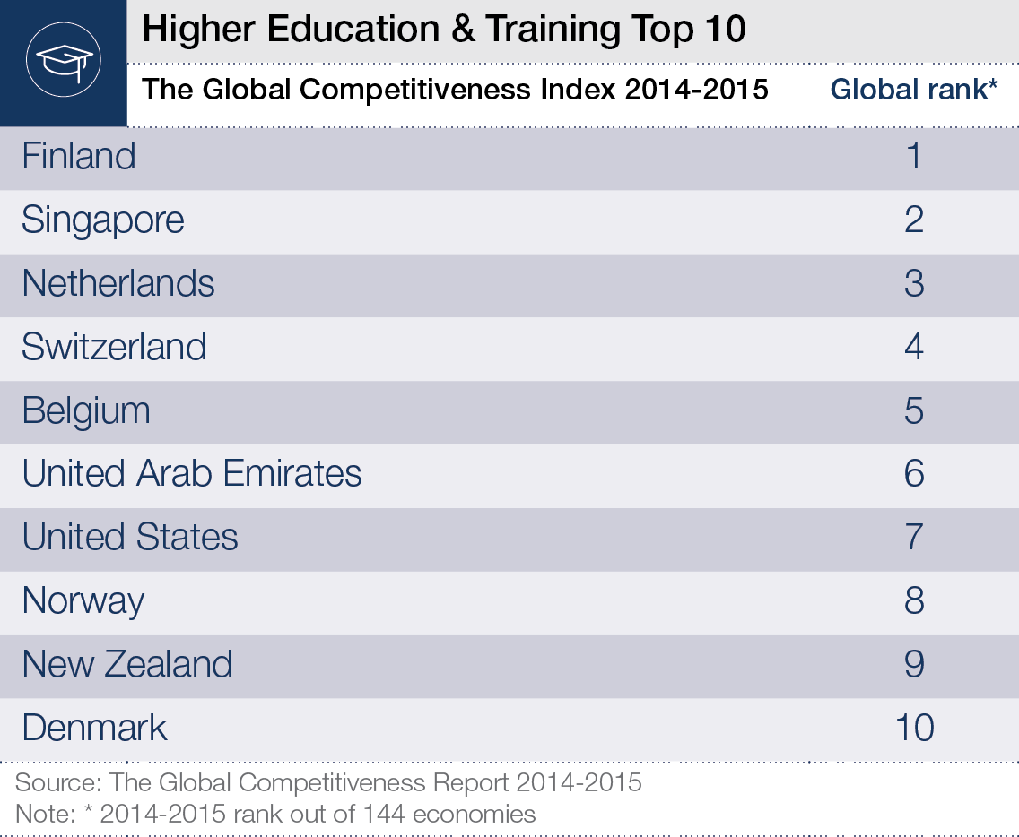

Slide 20
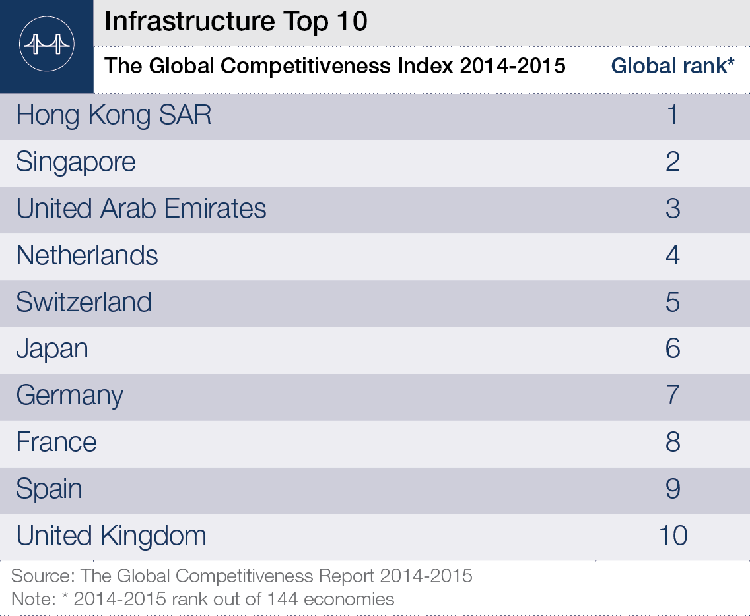

Slide 21
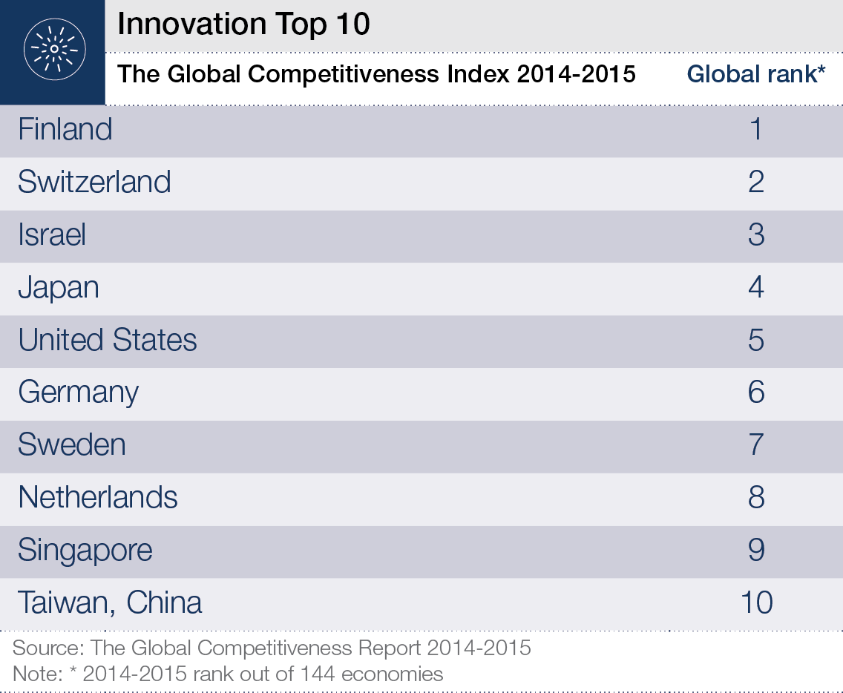

Slide 22
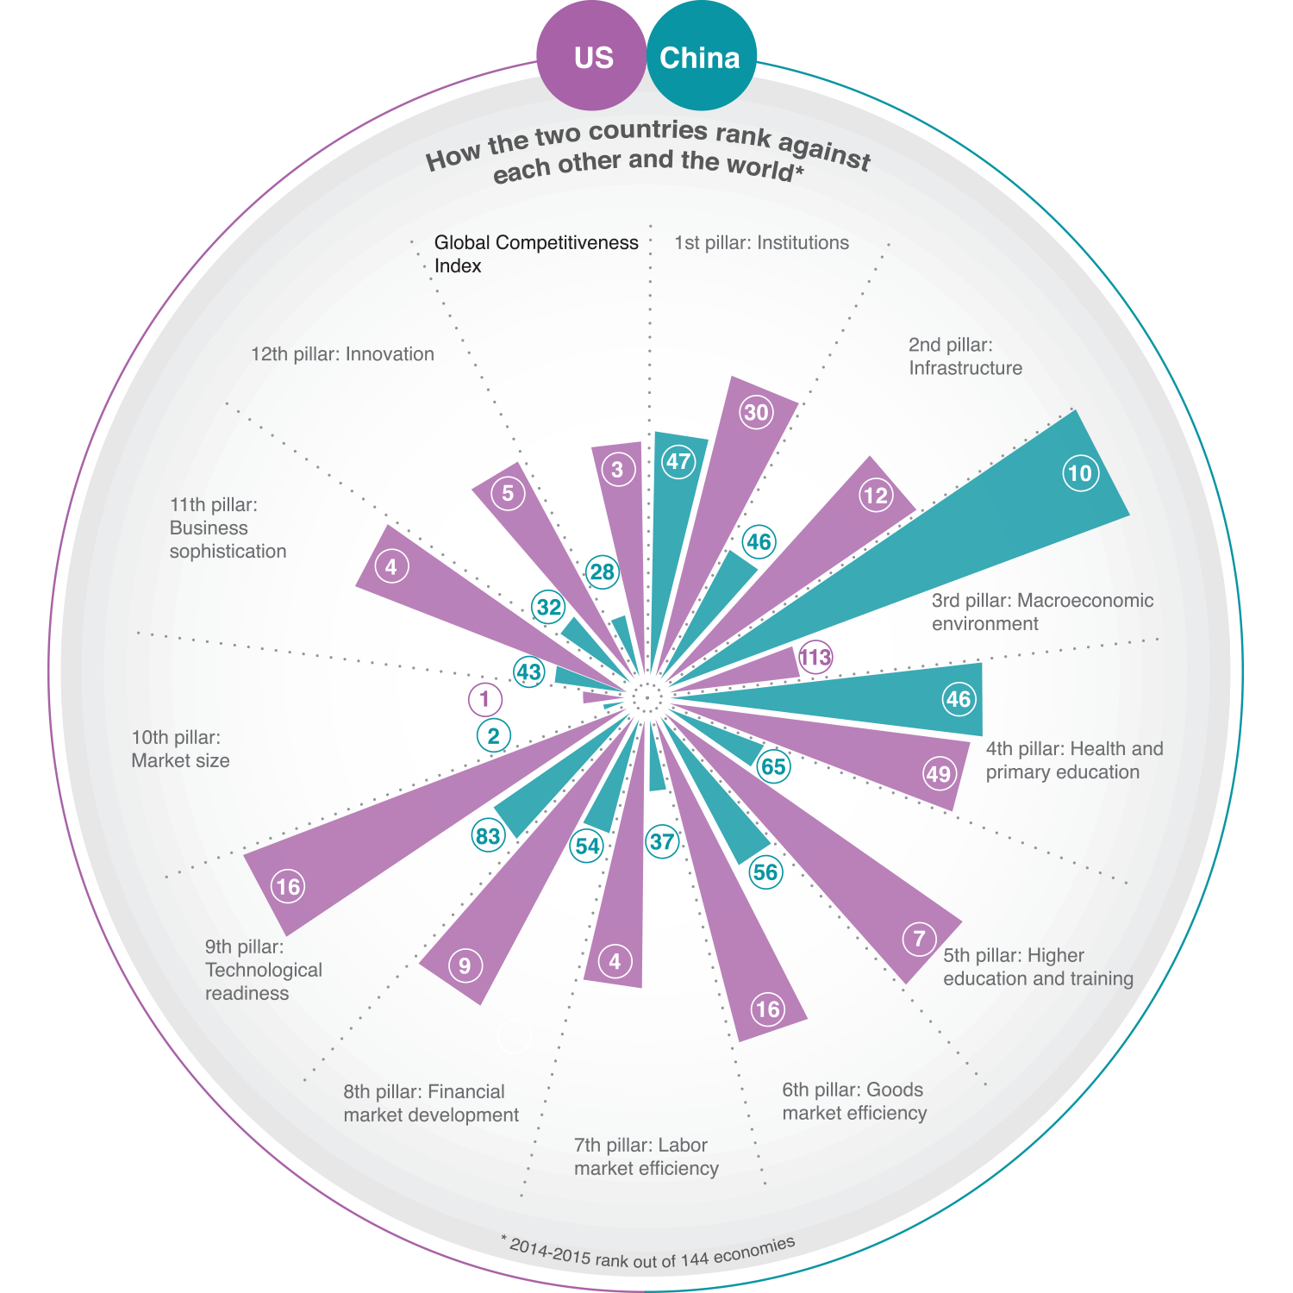

Slide 23

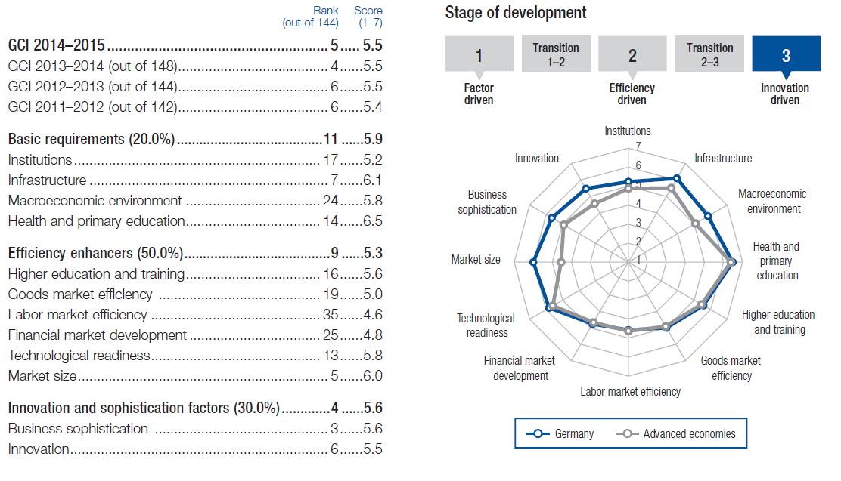

Slide 24

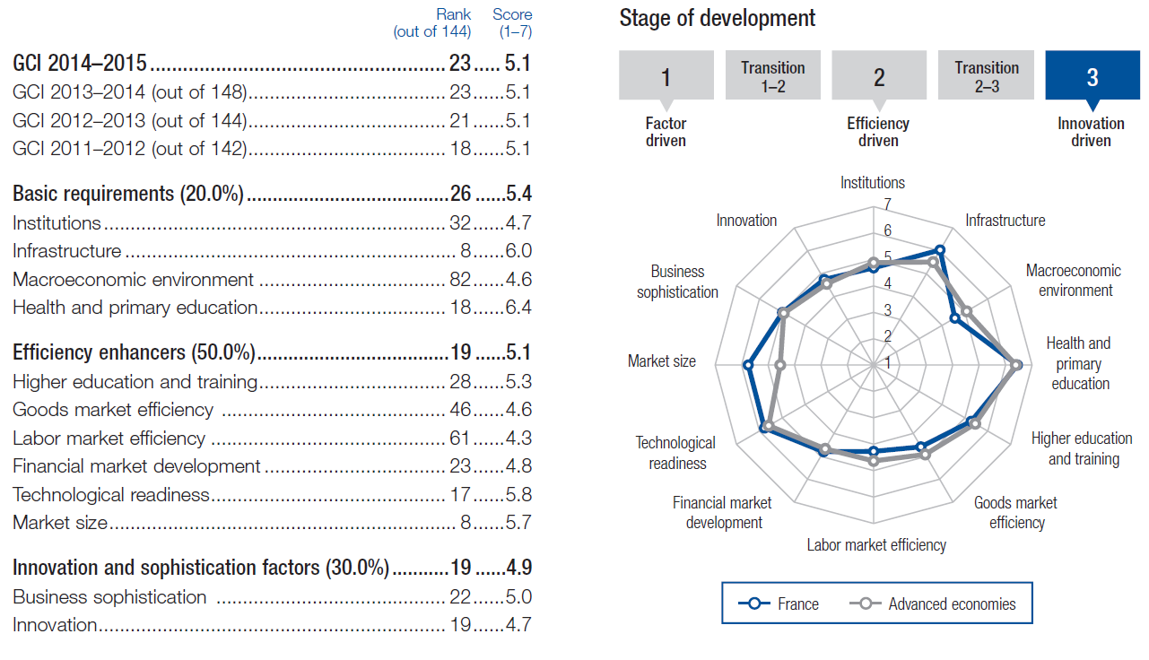

Slide 25

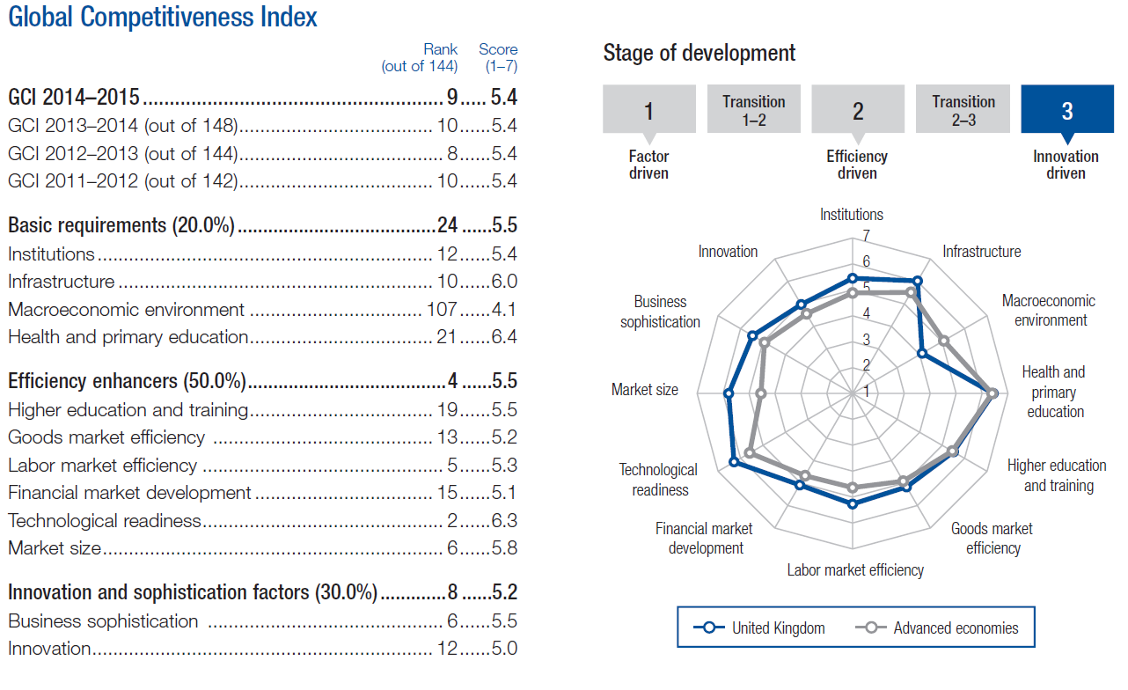

Slide 26
