Slide 1
Eurozone Crisis
Europe in World Economy 2015
Vladan Hodulák

Slide 2
Current position in the IMS
One of the reasons for the euro creation was to challenge the dominance of the US dollar
Euro in the world
  24% of world reserves (dollar 61%; 2013)
  33% of all international transactions (dollar 87%; 2013)
  32% of all debts (dollar 45%; 2009)
  27 countries have their currency fixed to Euro (66 to dollar; 2009
  less than 40% eurozone exports invoiced in euros ( around 95% in dollars)

Slide 3
Balance of payments
  Accounting accord of all monetary transactions between a country and the rest of the world
  The sum of all accounts has to be equal 0 by definition
Composition
  Current account – exports, imports, income of factors of production
  Capital account – usually negligible
  Financial account – change in ownership in assets (investment, loans)
  Change in reserves – reserves of the central bank
Balancing mechanisms
  Exchange rate adjustment
  Internal prices adjustment
  Various others (debt forgiving, war, emigration)
International investment position
Relationship to government deficits and debts

Slide 4
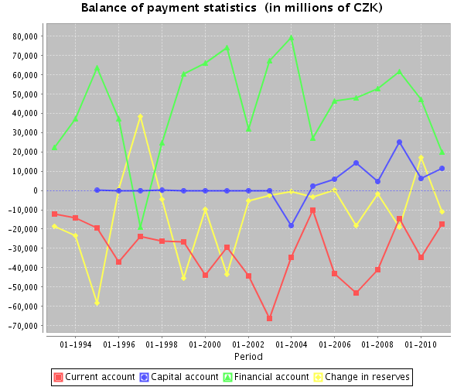

Slide 5
What is money?
Neoclassical economics has almost no place for money
  defined by functions
  medium of exchange
  lowers transaction costs
Common story – evolution of medium of exchange from barter exchange (Menger)
Money is supposed to be the most readily exchangeable commodity
Current money developed from commodity money – notes were originally promises to pay gold to the bearer
But history has some counterfactual evidence – money matters and is more than medium of exchange

Slide 6
A way of coordinating intergroup relations (esp. production) – rose out of obligation (means of payment)
Money is a social relation (institutionalized)
First „sort of money“ – unit of account in Sumer
  temple economy
  value assignment
  obligations became quantifiable – first debts
  rationalization of cooperation
It is an artificial product of human conduct, can be redesigned or „renegotiated“
Almost anything can be a „money thing“

Slide 7
Money creation implies power, therefore money is inherently political
Money and taxes are closely linked
  money obtains some of its value through taxation
  channeling of resources for a public purpose
  redistribution maintains intergroup stability
Government does not have to go bankrupt in its own currency – money creation as an emergency tool during crisis (war, political turmoil)
Real constraints of government spending
  inflation
  international economic relations
„Voluntary“ financial constraints of government (budgetary process, CB independence, fixed exchange rate etc.)

Slide 8
Eurozone Crisis
In 2010 Greece announced problems with financing its debt
Later affected – Portugal, Ireland, Spain
Reasons
  Excessive budget deficits
  Inefficient financial regulation
  Intra-European imbalances
Eurozone response
  Euro plus pact – ex-ante coordination and surveillance
  European Semester – timetable of coordination
  Six Pack – semiautomatic sanctions
  Fiscal compact – strengthened Stability and Growth Pact
  European Stability Mechanism (ESM) – emergency fund
  Banking union – surveillance of financial markets

Slide 9
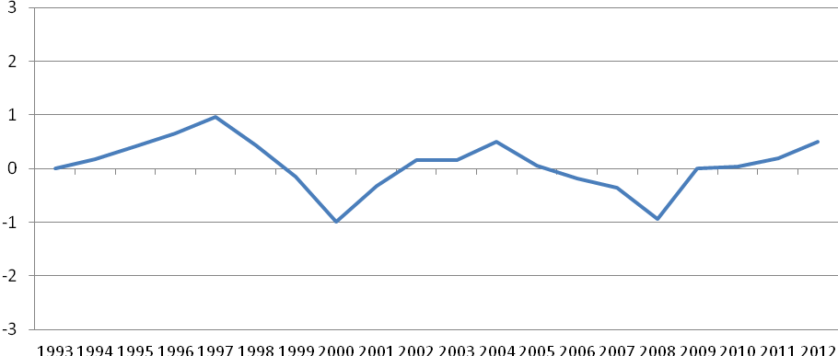
Development of the EU Current Account to GDP between the Years 1992 -2011 (%)

Slide 10
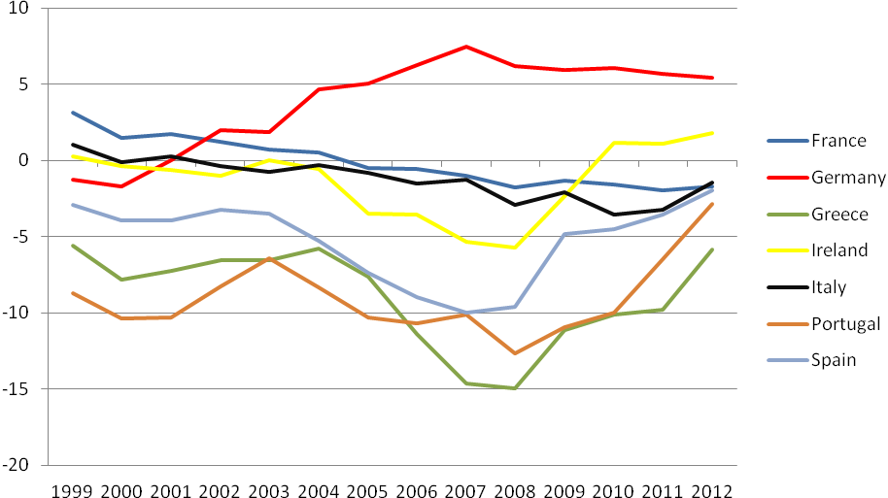
Current Account to GDP in the Years 1999-2012 (%)

Slide 11
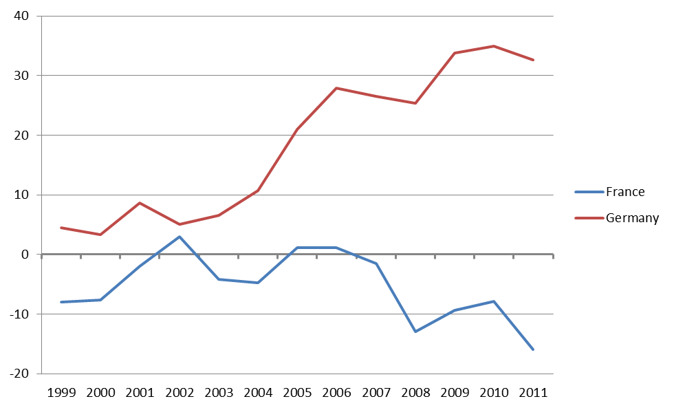
Net International Investment Position (in % of GDP)

Slide 12
Central Bank Balance Sheets within TARGET2 System (Millions of EURO)

