Slide 1
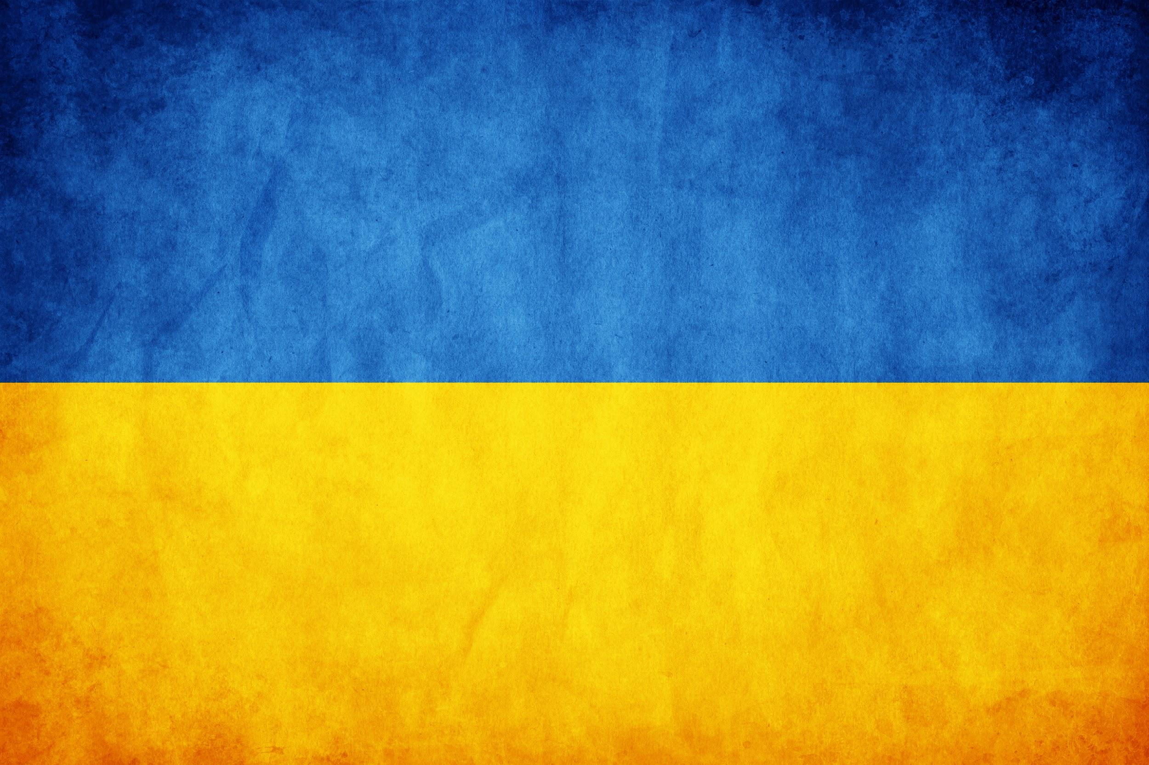
Religion in Ukraine
Natálie Müllerová, Lukáš Hájek

Slide 2
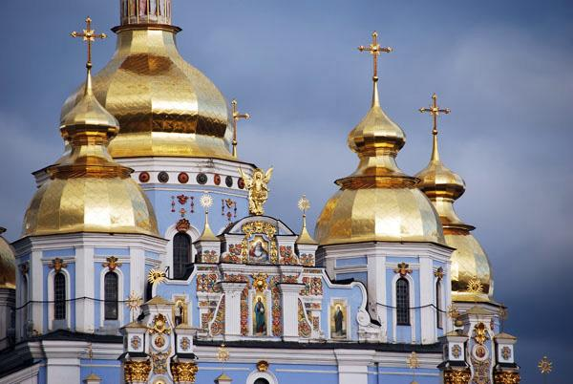
Content
Historical and societal background
Moscow vs. Kyivan patriarchate
Religion in present Ukraine
Importance of autonomy

Slide 3
Religion in Ukraine:
Modern History
Religious communities outlasted the USSR
Conflicts arose among Orthodox Christians
1990 Ukrainian Autocephalous Orthodox Church is established - not very successful
1992 Ukrainian Orthodox Church of the Kyiv Patriarchate is established
Strong competition
3 Orthodox Churches: UAOC, UOC-MP, UOC-KP
Notes:
Despite the restrictions of religious freedom, great number of religious communities - mainly the orthodox ones - outlasted the communist regime
At the end of the 80’s reports from Ukraine described rising interest in religion, churches were being reopened and so on.
But immediately after the decay of USSR the conflict between the Orthodox Christians who wanted their own autocephalous Church independent of the Moscow and those who didn’t want to break the ties with Moscow emerged and it proved very acute, developing into the real threat to the civic peace.
In 1990 the Ukrainian Autocephalous Orthodox Church was established in the west of the country, but only small number of parishes claimed it’s allegiance to it.
The Ukrainian Orthodox Church which was still accounted as a branch of ROC tried to demand from the Moscow Patriarchate greater independence and it actually did. It acquired an independent administration giving it near autonomous status within the framework of ROC.
But there were still some members headed by metropolitan Filaret, who wanted the autocephaly. Because the ROC refused, they declared the autocephaly themselves. Thus the Ukrainian Orthodox Church of Kyiv Patriarchate was established. It’s leader - Filaret was excommunicated by the ROC.
Therefore in the 1992 there were three Orthodox Churches - UAOC, UOC-MP, UOC-KP - there was really strong competition among them.

Slide 4
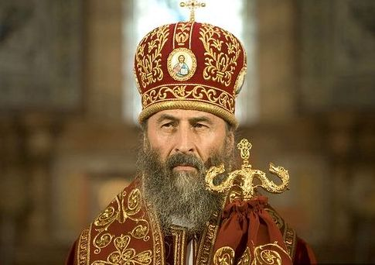
Ukrainian Orthodox Church - Moscow Patriarchate
No autocephaly (under ROC), but autonomy
Canonical status recognized by the whole Eastern Orthodox communion
More members in the East of Ukraine
Metropolitan Onuphrius
Notes:
Under the ecclesiastic jurisdiction of the
Russian Orthodox Church, but financial and administrative autonomy
Has its canonical status recognized by the whole Eastern Orthodox communion
More members in the East of Ukraine

Slide 5
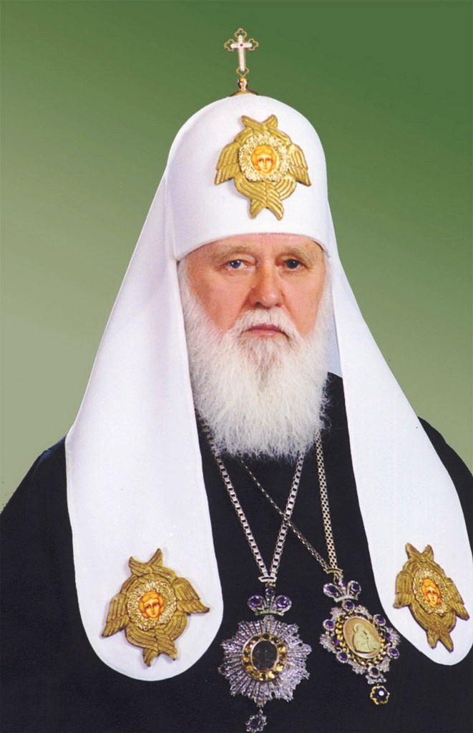
Ukrainian Orthodox Church - Kyivan Patriarchate
Unrecognized by other canonical Eastern Orthodox Churches
Charismatic leader Patriarch Filaret - emphasis on nationalism, active in politics
more members in the western part of the country
Patriarch Filaret
Notes:
Originated in 1992
Unrecognized by other canonical Eastern Orthodox Churches
Charismatic leader Patriarch Filaret - emphasis on nationalism, active in politics
more members in the western part of the country

Slide 6
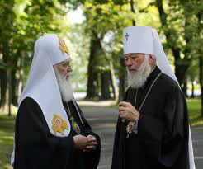
Moscow vs. Kyivan Patriarchate
Hardly any difference in account of religious practices
It’s about national identity
According to some surveys the number of UOC-KP members increases

Slide 7
Church-State Relationship
No changes of the law since adoption in 1990
Liberal approach
Right of religious organizations to exists by virtue of the mere fact of its creation
Equal status for all Churches
Separation of the Church from the state and of the schools from the Church
All politicians declare their respect for the Church X money strives to control even dioceses
Notes:
The law which regulates the Church-state relation was adopted even before the disintegration of the USSR - it undergone no fundamental changes since then
One of the most liberal approaches in the post-Soviet region
The proof can be the right of religious organizations to exists by virtue of the mere fact of its creation
Equal status for the Churches of the majority and small religious organizations
It stipulates the separation of the Church from the state and of the schools from the Church
All politicians declare their respect for the Church, they built churches in their home districts, they willingly use religious symbols in their rhetoric, it’s almost impossible to find a public figure, who would display his atheism openly
Money strives to control not only parishes, but even the whole dioceses. Recent example of that was, when in 2011 one of the wealthiest people in Ukraine - Victor Nusenkis tried to replace the patriarch of the UOC-MP

Slide 8
Religion in Ukrainian Society
End of 1990s: equilibrium established among Churches
Strong positions traditionally held by religious communities of indigenous people and by ethnic minorities
Very high trust in “the Church in general”
All public figures declare their respect for the Church
Religion connected to nationalism
Notes:
By the end of 1990s equilibrium was established among chief actors on the country’s religious scene - besides the Orthodox Churches there were mainly Greek Catholics
None of the Churches can claim the allegiance of over a quarter of the country’s adult population - they can’t overturn the equilibrium, so they had to establish a system of communication
In addition sttrong positions traditionally held by religious communities of indigenous people (above all the Crimean Tatars) and by ethnic minorities (Jews, Poles, Hungarians)
Very high trust in “the Church in general”
All public figures, all pop stars and athletes declare their respect for the Church
What is important is, that religion here always was and still is connected to nationalism and the allegiance to one Church can be part of one’s national identity, which is very important in the Rusian-Ukraine conflict

Slide 9
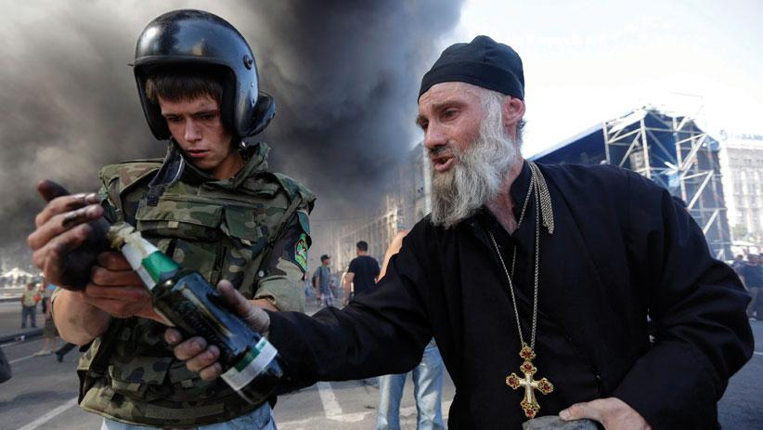
Religion in Contemporary Ukraine
Notes:
Now, I would like to tell you something about a role of religion in the contemporary Ukraine.
You all know, that these days, months and years are undoubtedly historical for all the Ukrainian people.
We are targeted by all media every day with the news from Ukraine about the conflict in Ukraine.
Furthermore, the propaganda is very powerful on both sides and it is very hard for us to create an objective picture of the situation.
Moreover, it is very strange for me that we hear about economy, politics and war in Ukraine but there are very few or no messages at all about the religion in present Ukraine.
This is the state we would like to change for you and to give you some information about the relationship of the present struggle in Ukraine with its religious background.
In final, you will see, that this image is quite symbolic.

Slide 10
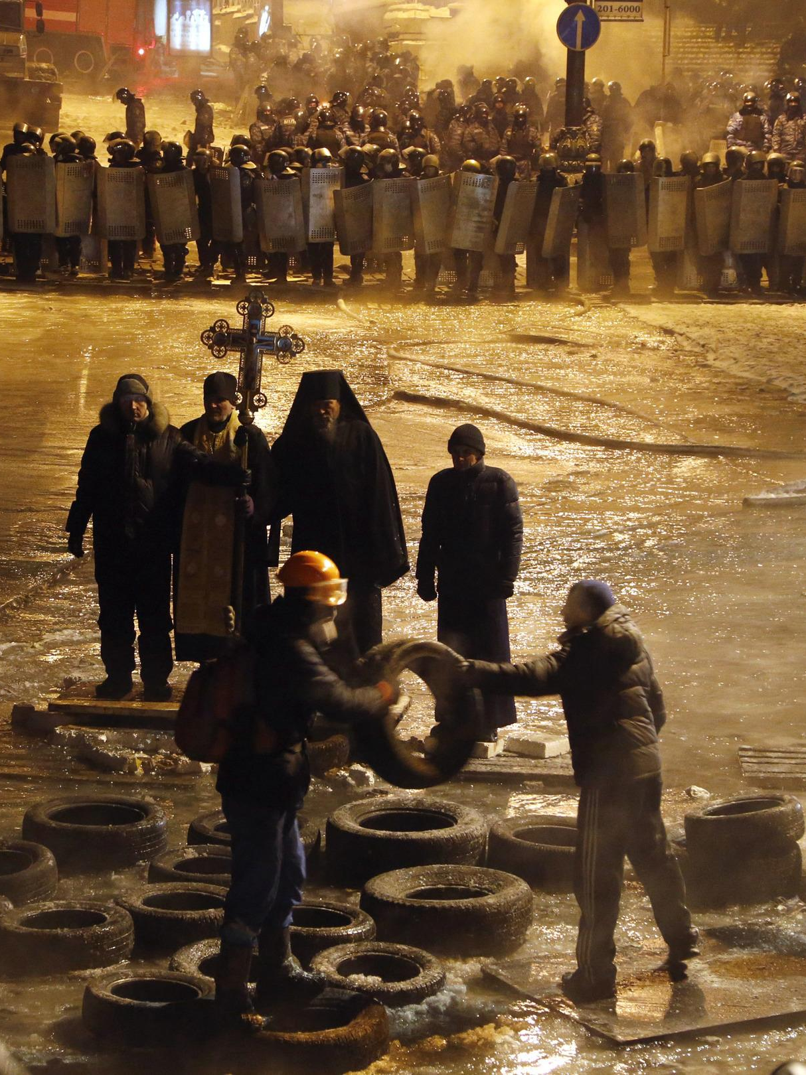
Euromaidan
Ukrainian revolution 11/2013 - 02/2014
Occupied buildings, barricades
Role of priests
Everyday group prayers
Important religious event
Violent finale
Notes:
Euromaidan is the name of the ukrainian revolution which started on November 2013. It was the reaction to the foreign policy of the former president Viktor Janukovyc who refused to sign an association agreement with the European Union.
Thousands of people started with the protests against these steps of the president, the centre of the protest was the square of independence in Kiev.
Several governmental buildings were occupied and the barricades were built in the square. It was a long struggle during the freezy Ukrainian winter.
It was a role of the priest to backup morality and determination of the people in Maidan. The priests saw the public movement and they felt their duty to work for the people in there.
It was very important and even interesting, that during the protests, all of the churches with a different pace realigned with the new agenda.
Prayer became an integral part of the protests, which also became, in effect, ecumenical meeting grounds.
There were prayers said every day in the morning and at night. It was a religious phenomenon apart from being a political and social phenomenon.
Maidan, apart from being an important civil event appeared to be an important religious event.
It was also an ecumenical phenomenon because Maidan actually facilitated many churches, many church leaders who had never really conversed publicly with each other. In those days they stayed on the stage next to each other and spoke to the people in one group voice.
In Ukraine, where people are so religious, it was very important for them to feel the backup of their churches.
When the protest were violently attacked by the military forces, there were group funerals of the deceased.

Slide 11
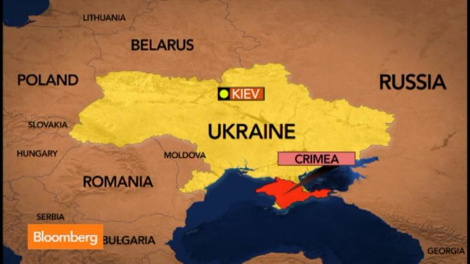
Annexation of Crimea
02/2014 - 03/2014
Russian framing as a religious struggle
Crimean Tatars forming Sunni Islam minority
Religious groups oppressed
Notes:
Just after several weeks from the end of the main period of Euromaidan, the protest of local people in Crimean Peninsula began.
Then the army forces with no signs annected Crimea and even in that time it was obvious, that the army was the Russian one. Putin confirmed that several times.
Putin claimed Crimea was the equivalent of “the Temple Mount in Jerusalem” for Russians.
Putin’s speech in the Russian duma just after the annexation: Everything in Crimea speaks of our shared history and pride. This is the location of ancient Khersones, where Prince Vladimir was baptized. His spiritual feat of adopting Orthodoxy predetermined the overall basis of the culture, civilization and human values that unite the peoples of Russia, Ukraine and Belarus.
There are several ethnic and religious groups in Crimea. You probably know about the group of Crimean Tatars and their complicated history. Human rights groups are warning that the persecution of Crimean Tatars, who make up around 13% of the population, is worsening, with an alarming increase in police raids, interrogations and arrests, sparking fear and unrest amongst the community.
Human rights groups have also expressed concern over a crackdown on the freedom of media in Crimea. As with other outlets, Tatar-language media have been forced to apply self-censorship, and prevented from using words like ‘annexation’, ‘occupation’, or ‘terrorists’ in reference to the pro-Russian rebels in eastern Ukraine.
There are fears that ATR, the only Crimean Tatar TV channel, and the only independent mass media left in Crimea, will be shut down, after raids last week on their Simferopol office. Some of the channel’s staff were detained and their equipment confiscated. It has been accused by the de facto authorities of spreading extremism.
Non-Moscow religious groups in Crimea are increasingly subjected to the provisions of Russia’s menacing “anti-extremism law”, which has long been criticized by human rights groups. The 2002 law imposes sanctions on religious extremism, which it defines as promoting the “exclusivity, superiority, or inferiority of citizens” based on religion. The law is routinely used to ban religious material and restrict the right of peaceful assembly. It is incited as a justification for frequent detentions, raids, confiscation of religious literature and other property, rejection of official registration with the Ministry of Justice, denial of official building registration, and refusal of visas to religious workers.
Crimean Tatars have not been the only targets of official harassment. Jews, Catholics, and Greek and Ukrainian Orthodox faithful have also faced harassment and the confiscation of property. Refusal to renew religious leaders’ visas, requirements to re-register established religious groups without reasonable instruction on how to do so, and rent increases on churches have been among the legal and administrative burdens imposed by Russian authorities.

Slide 12
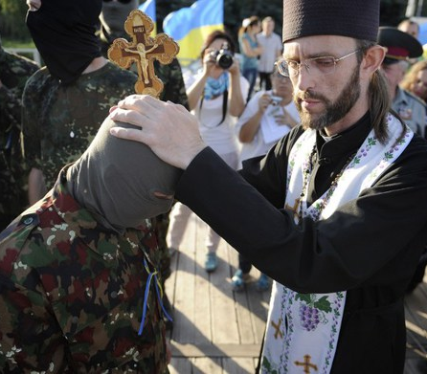
Russian-Ukrainian Conflict
Eastern Ukraine 03/2014 - present
Clergy helping the rebels
Ban of church services
Chaplain priests
Notes:
In the time when Crimea was annexed the protests also began in the Eastern part of the Ukraine. The local people were unsatisfied with the political revolution made in Kiev and they called for the protection of Russia.
In several weeks and months the Russian troops appeared in there as well. The conflict has started and continues until this time. Nowadays there is hopeful situation after the Minsk peace agreement but there are still several fights every day even now.
There are evidence of Russian Orthodox clergy helping the rebels in the Eastern Ukraine.
Patriarch Filaret: The religious situation in Donbas is difficult. The regions that have been captured by separatists and terrorists have a ban on church services by the Kyiv Patriarchate, Greek Catholics, Roman Catholics, all Protestant churches. The only priests who are able to hold services are the priests of the Moscow Patriarchate. In addition, the priests of the Moscow Patriarchate not only make available its buildings for terrorists, they are storing weapons. The “Russian Orthodox Army” formation is also there. Of course it's not made up of priests, it's made up of laity, but they are supposedly defending Orthodoxy against the “Banderists” and “fascists.” [Derisive names given Ukrainian nationalists – ed.] (But) if you have any army, then it belongs to a state, the Church cannot have its own army. That's why calling it an “Orthodox army” is at the very least incorrect.
Ukrainian Orthodox church backup the Ukrainian army forces with their prayers and helping in the field by holding their morality.
Patriarch Filaret: Our church supports the people. We also support the government, as long as the government is not lawless. If it is lawless, the Church tells it the truth about what it must do and what it must not do. That's what happened with [former] President [Viktor] Yanukovych. … The [current] president has a normal attitude toward us, because our church supports the battalions. We send chaplain priests there, we give humanitarian aid in the form of clothes, we bought them night vision goggles, we've given them transport, we collect money for this. So our relationships with the president, and with the parliament, and with the cabinet, are normal.

Slide 13
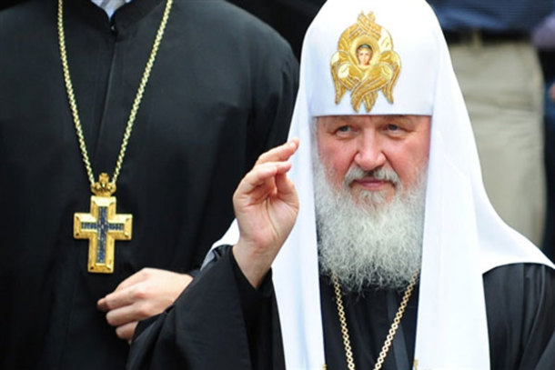
Ukraine Seeking Religious Autonomy
Patriarch Filaret: “Putin is like Cain ...”.
Separation from the Moscow Patriarchate
Relationship of the government and the church
Notes:
It is obvious that the situation in the contemporary Ukraine is deeply connected with the religious struggle between Moscow and Kiev wing of the Orthodox Church.
Therefore Kiev Orthodox priests are seeking their own religious autonomy. It is the direction of all of the present Ukraine - to gain freedom from Russia.
Patriarch Filaret: I called him a “new Cain.” Because Cain, the son of Adam, killed his brother, Abel. And when God asked him, where is your brother, Abel? Cain answered with a lie: “Am I my brother's keeper?” So Putin is like Cain because he kills his brothers, the Ukrainians. And in addition to that he tells the whole world that he is not at war in Ukraine: that there is no war, that there are no Russian troops there. But that's not true. Smerch launchers, Grad, “hurricanes,” tanks, mortars – you cannot buy these things in a store in Ukraine.
EurasiaNet: Do you still see a possibility for a united Ukrainian church separate from the Moscow Patriarchate?
Patriarch Filaret: It's here already. We have this church, the Kyiv Patriarchate, an autocephalous church that is supported by the people. And military events have confirmed that Ukraine should have the kind of church that the Kyiv Patriarchate is. In Ukraine there are a lot of people in the leadership, in the clergy [of the Moscow Patriarchate] who want to unite with us into one church. But [they hesitate because] they are worried that Moscow will punish them as anathema, denying them the ranks of clergy, of bishops. They worry. But the people, whom you cannot excommunicate, they are more decisive. They decide to leave the roster of the Moscow Patriarchate, and they just do it.
There are very close relationships between the Ukrainian government and the local church. They need each other to backup their position in the eyes of the people.
Maybe we can see the new form of desecularization in the meaning of state and religion getting closer to each other.
After all it is obvious that if we want to understand the conflict in the Ukraine we have to look at the role of the churches and the religion as well.

Slide 14
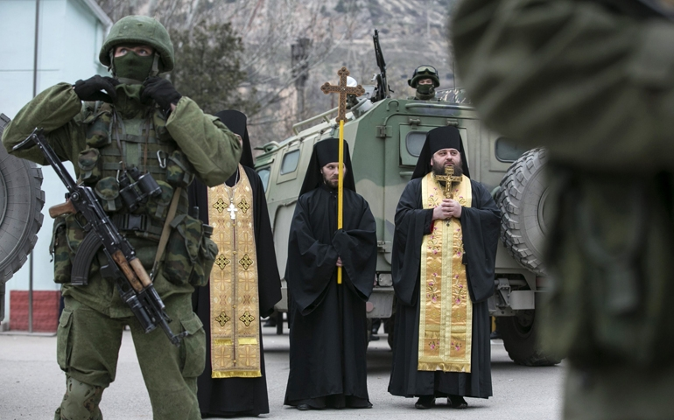
Summary
Moscow-Kyivan religious struggle
Role of religion in the present Ukraine
Ukraine building up own autonomy

Slide 15
Thank you for the attention

Slide 16
References
DRUZENKO, Gennadiy. Redrafting of the Ukrainian Law on Religious Freedom: Ukrainian Churches vs. Ukraine's Obligation to the Council of Europe. Brigham Young University Law Review [online]. 2012, roč. 2012, s. 811.
ELENSKII, Viktor. Ukrainian Orthodoxy and the Ukrainian Project. Russian Politics and Law [online]. 2014-7-1, vol. 52, issue 4, s. 7-33.
GEE, Gretchen Knudson. Geography, Nationality, and Religion in Ukraine: A Research Note. Journal for the Scientific Study of Religion [online]. 1995, roč. 34, č. 3, s. 383-390 [cit. 2015-04-07]. : http://eds.a.ebscohost.com/eds/pdfviewer/pdfviewer?vid=6&sid=9e80d482-d127-4c9e-a271-fcc2185492a3%40sessionmgr4005&hid=4113
http://www.huffingtonpost.com/2014/03/15/ukraine-russian-orthodox-church_n_4971097.html
http://www.nytimes.com/2014/09/07/world/europe/evidence-grows-of-russian-orthodox-clergys-aiding-ukraine-rebels.html?_r=0
http://www.usnews.com/opinion/blogs/world-report/2015/03/04/ukraine-crisis-threatens-to-further-fracture-orthodox-faithful
http://www.osce.org/odihr/124742?download=true
http://www.newsweek.com/crimean-tatars-fear-increasing-persecution-313111
KOZELSKY, Mara. Religion and the crisis in Ukraine. International journal for the Study of the Christian Church [online]. 2014-09-05, vol. 14, issue 3, s. 219-241.
YELENSKY, Victor. Religion, Church, and State in the Post-Communist Era: The Case of Ukraine (with Special References to Orthodoxy and Human Rights Issues). Brigham Young University Law Review [online]. 2002, roč. 2002, s. 453.

