Slide 1
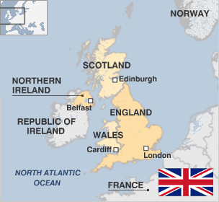
Religion in the United Kingdom
Kateřina Němečková (357822) & Vojtěch Kadrnka (349208)

Slide 2
Structure
Church of England
Royal Family
Relation – Ceremony
Public Sphere
Funding - Activity
Other religion in UK
Secularization
Results
Literature

Slide 3
Church of England
History – 1534 Act of Supremacy followed by Suppresion of the Monasteries
catholic episcopical structure (108 bishops, 2 archbishops) and protestant liturgy (Book of Common Prayer)
controversial theme: female and homosexual priests (1994) and female bishops (2014): first 2014 Libby Lane
Supreme Governor or Defensor Fidei = Monarch
2 main provinces led by archbishops
Archbishop of Canterburry – South – Primate of All England
Archbishop of York – North – Primate of England
dioceses (41) and further parishes (cca 13 000)
Source: [1], [2]

Slide 4
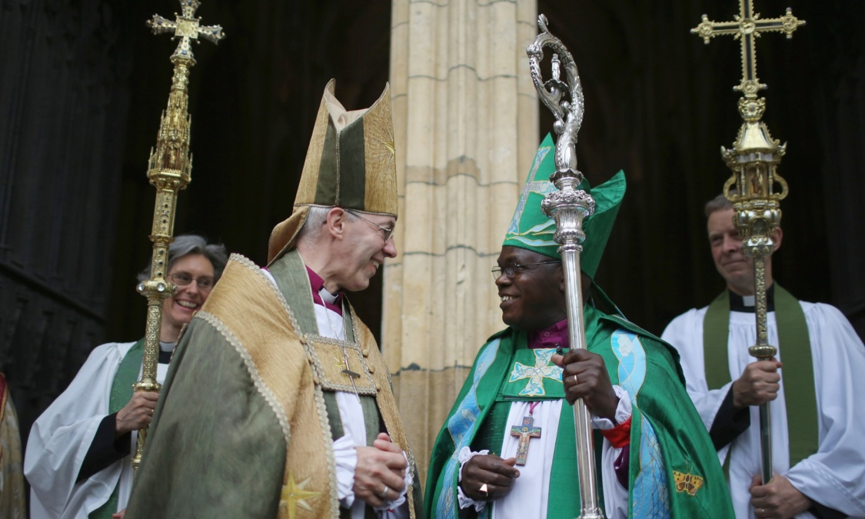
The Anglican Communion
international association of Anglican churches
there is mutual agreement on essential doctrines
Symbolic head: Archbishop of Canterburry
Ch. in Wales, Ch. of Ireland and Scotish Episcopal Ch.
X Church of Scotland (the Kirk) – presbyterian, calvinist
Source: [3], [4]
Notes:
High church – closer to catholic, low or evangelical church – closer to protestant

Slide 5
Royal Family and the Church of England
Head of the Church
In the Church of England Queen appoints archbishops, bishops and deans of cathedrals on the advice of the Prime Minister.
Royal ceremonies usually take a place in churches with the presence of the Archbishop of Canterburry and other clergy
the Sovereign reads a declaration and takes the oath to preserve the Church of Scotland and than an oath to maintain the established Protestant succession (accession declaration).
Source: [5]

Slide 6
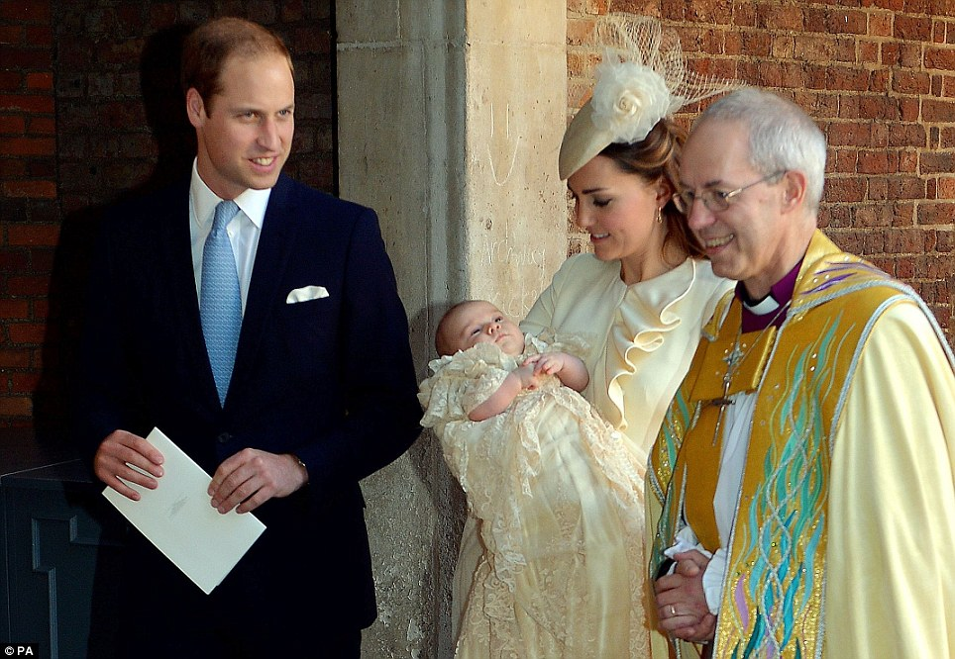
Royals
Birth – Baptism
Source: [6]

Slide 7
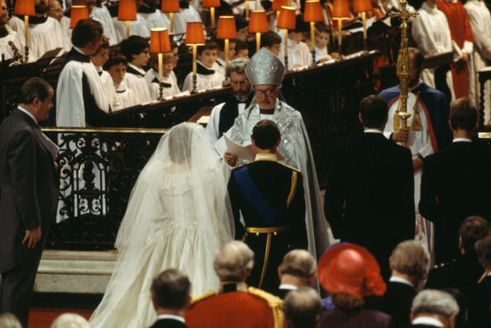
Royals
Wedding
Source: [7]

Slide 8
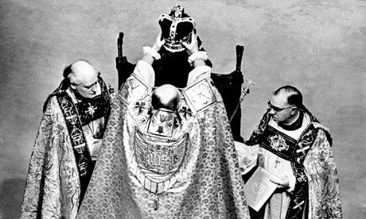
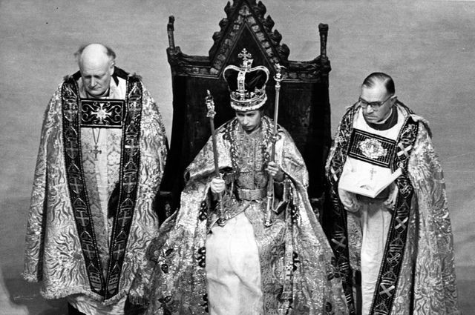
Royals
Coronation
Source: [8]

Slide 9
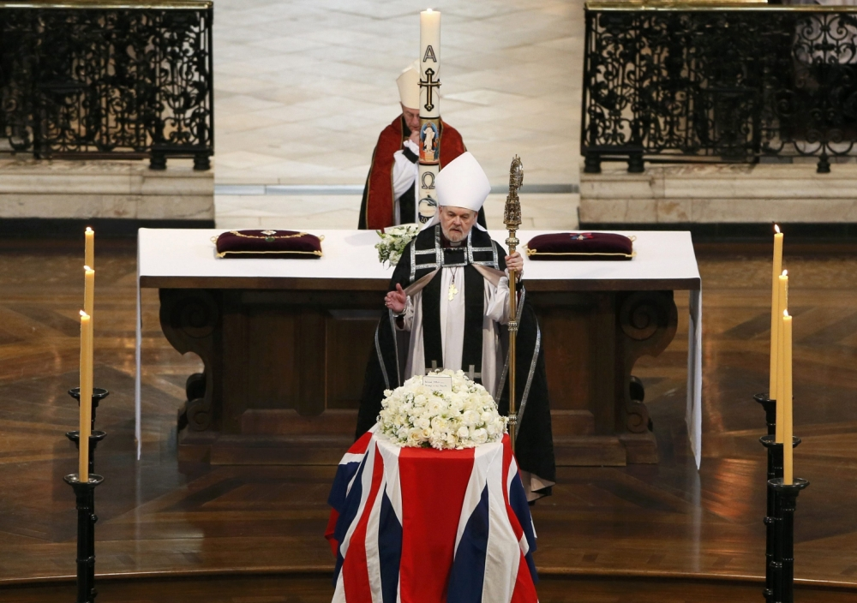
Royals
State vs. Ceremonial Funeral
Source: [9]

Slide 10
Funding of the Church
Total income and spending almost £1,4 billion/year.
Most spendings are made by parishes on paychecks, pensions, and maintenance of church buildings.
No direct government funding
FUNDED BY:
Worshippers in parishes - over £900 million (2/3)
Church Commissioners – almost £300 million. Assets of over £4 billion.
Cathedrals – over £112 million
Source: [1]

Slide 11
Public sphere
HOUSE OF LORDS
„The Lords Spirituals“ - two archbishops and 24 senior bishops (since 1847) – 26 out of 783 members.
Between their duties belong every day prayer.
Should they have right to override opinion of elected MPs?
CHARITY
About 160,000 Charities (54 % are very small)
Religious charities: Church Urban Fund (CHoE), Christian Aid, The Salvation Army, Islamic Relief Worldwide…
Source: [10], [1], [11], [12]

Slide 12
Public sphere
EDUCATION
Religious Education is compulsory subject, but schools are permitted to teach RE from their point of view.
Faith schools (state funded)
Christian, Islamic and Jewish schools
Debate about religious symbols in schools – muslim, sikh.
Religious freedom vs school uniforms.
Source: [13], [14], [15]

Slide 13
Religious affiliation
Source: [16]

Slide 14
SECULARISATION
Society is secular – moderate inclusive secularism.
Nearly all church growth is due to immigrants.
Church attendance is decreasing – in 2007 59 % of people said that thay never or practically never go to church.
Between 1998 ad 2005 – 500,000 people stopped attending church on Sunday. (English Church Census 2005)
2014 - 37 % regard themselves as Christians, 50 % no religious affiliation. 77 % not religious.
2013 YouGov study (18-24 years old):
14 % say religion is a cause for good (41 % bad)
25 % believe in God, 19 % spiritual power, 38 % no
Most represented: CoE 13 %, R-C 9 %, Islam 4 %
Source: [17], [18], [19], [20], [21], [22],

Slide 15
RESULTS
Specific position of Church of England – important tradition, but of little importance for most people
Britain is largely non-religious society
Increasing numbers of irreligious people
Multiculturalism – immigrants boost numbers of non-Christian religions

Slide 16
Sources
Church of England [online]. 2015. https://www.churchofengland.org/
Libby Lane: First female Church of England bishop consecrated. BBC News [online]. 2014. http://www.bbc.com/news/uk-politics-30974547
Anglican Communion [online]. 2015. http://www.anglicancommunion.org/
Should the church be a radical voice in politics? The Guardian [online] 2015. http://www.theguardian.com/world/2015/apr/05/church-radical-voice-politics-christianity-justin-welby
Royal events and ceremonies - The British Monarchy [online]. 2015. http://www.royal.gov.uk/RoyalEventsandCeremonies/
George can be budhist. Daily Mail [online]. 2013. http://www.dailymail.co.uk/news/article-2475972/Prince-George-Buddhist-wants-says-Archbishop-royal-christening.html
Royal Wedding Robert Runcie. Getty Images [online]. 2015. http://www.gettyimages.com/detail/news-photo/robert-runcie-the-archbishop-of-canterbury-officiates-at-news-photo/109326196
The diamond jubilee of Queen Elisabeth II. Bloomberg [online]. 2012. http://www.bloomberg.com/slideshow/2012-06-01/the-diamond-jubilee-of-queen-elizabeth-ii.html#slide8
Queen leads mourners at Margaret Thatcher’s funeral after London procession. Metro [online]. 2013. http://metro.co.uk/2013/04/17/margaret-thatcher-funeral-nation-prepares-to-pay-final-respects-amid-tight-security-3618988/

Slide 17
Sources
What is the role of bishops in UK politics. BBC News [online]. 2014 . http://www.bbc.co.uk/news/uk-politics-16702806
Britain's top 1,000 charities ranked by donations. Who raises the most money? . Guardians [online]. 2012 . http://www.theguardian.com/news/datablog/2012/apr/24/top-1000-charities-donations-britain
Church of Englandcharity set toreceive 5 mimlion from Government. Telegraph [online]. 2010 . http://www.telegraph.co.uk/news/religion/7930875/Church-of-England-charity-set-to-receive-5million-from-Government.html
Secularism [online]. 2015. http://www.secularism.org.uk/
Kindlmannová, J. Náboženská výchova v Británii. RVP [online]. 2007. http://clanky.rvp.cz/clanek/c/GO/1562/NABOZENSKA-VYCHOVA-VE-VELKE-BRITANII.html/
MOLKOVÁ, Michaela. Právo na veřejné užívání náboženských symbolů [online]. 2013 [cit. 2015-04-08]. Diplomová práce. Masarykova univerzita. http://is.muni.cz/th/257528/pravf_m/
Office for National Statistics (ONS) "Religion in England", analysis of the 2011 National Census data, covering England and Wales. [online]. 2012. http://www.ons.gov.uk/ons/dcp171776_290510.pdf
CRABTREE, V. Religion in the United Kingdom. Vexen. [online]. 2012. http://www.vexen.co.uk/UK/religion.html

Slide 18
Sources
Perspectives: Should Britain become a secular state? BBC [online]. 2013. http://www.bbc.co.uk/religion/0/21883918
How Many Catholics are in Britain. BBC News [online]. 2010 . http://www.bbc.co.uk/news/11297461
Religion and belief: some surveys and statistics. British humanist organization [online]. 2012 https://humanism.org.uk/campaigns/religion-and-belief-some-surveys-and-statistics/
Voters were not religious. YouGov [online]. 2014. https://yougov.co.uk/news/2014/04/23/voters-were-not-religious-britain-christian-countr/
British Youth reject religion. YouGov [online]. 2013 https://yougov.co.uk/news/2013/06/24/british-youth-reject-religion/

