Slide 1
Sustainable food and food security
Session 3 – Community Supported Agriculture
Masaryk University, Brno, 22nd April 2015
Dan Keech, CCRI
University of Gloucestershire
dkeech@glos.ac.uk
Notes:
1

Slide 2
Session 3
In this session we will:
Review the emergence of local food initiatives (as a response to national food security concerns)
Explore some CSA models

Slide 3
Alternative and community-led projects as responses to concerns about food security
In this session we will begin looking at food security from a UK and ideological perspective.
What is the historical backdrop to food security (with reference to the UK)?
Why did food security concerns spur alternative responses?
How is local/community food perceived as improving food security?

Slide 4
Emergence of alternatives
In session 2 we heard how some of the consequences of the modern food system stimulate concern among citizens:
about the disconnection between consumers and producers
about who controls the food chain
about health and environment linked to the industrial food system (‘externalities’ – Lang & Pretty 2004)
the idea that some of these challenges are ‘locked in’ to the places and the ways that we live and work
In this session and s 4 we will hear about a two civil society responses to these concerns – CSA and Farmers’ Markets.
Notes:
4

Slide 5
Food security policy in the UK
Increasing reliance on imports since Industrial Revolution
Colonial, later Commonwealth trading networks
Interruptions of food supply during Second World War
Consequently policy of state intervention in agriculture
Reduction in local diversity (standardisation)
Increase in output productivity (‘green revolution’)
Increased dependence on imported agricultural resources (oil and fertilisers) – 1973 oil supply crisis
From 1970s EEC/EC/EU membership – 90% self-sufficient
Global trade liberalisation during 1980s – we can buy/trade our way out of trouble
New interest in national food security in 2000s as input costs rise dramatically and food price spikes occur.

Slide 6
UK balance of trade for food, drink and feed at 2011 prices in £s (source: Defra 2012)
Year | Imports (£ million) | Exports (£ million) | Balance of trade (£ million) | Self-sufficiency in indigenous foods
1943 | 21,705 | 660 | -21,045 | n/a
1953 | 31,131 | 3,515 | -27,616 | n/a
1963 | 27,847 | 4,276 | -23,571 | 54%
1973 | 30,736 | 7,728 | -23,009 | 62%
1983 | 22,086 | 10,281 | -11,805 | 76%
1993 | 22,991 | 13,652 | -9,340 | 74%
2003 | 27,170 | 12,819 | -14,351 | 64%
2011 | 36,715 | 18,159 | -18,556 | 62%
1986
78%

Slide 7
CZ in EU
54% of the land in CZ is agricultural and 30% is forest. The balance is tipping from agriculture towards forestry (15,000 ha. from ag ➔forest since mid 1990s).
Arable land has declined and permanent pasture has increased, partly with support from with LFA grants.
Agriculture represents about 3% of CZ jobs.
(Source: Embassy of the Czech Republic http://www.mzv.cz/telaviv/en/economy_and_trade/agriculture_in_the_czech_republic/index.html)
In 1989, 500,000+ agricultural workers, in 2013 100,000.
Gap between agri and national average income widening.
CZ exports more high-value food than ever, but imports food traditionally grown domestically.
Source: http://www.freshplaza.com/article/131722/Czech-self-sufficiency-threatened
CZ 80% self-sufficient in cereals, maize, oilseed. Potatoes increasingly imported (Kotyza and Slaboch 2014)

Slide 8
Local food movement emerges in UK from the Third Sector
Soil Association Food Futures programme
Sustain and food links federation
Foot and mouth/Curry Commission – local and regional food as different forms of rural development
Lottery support:
Food for Life
Making Local Food Work
Local Food programme (largely urban – remember Deverre and Traversac in s 2)
Negligible contribution in terms of food output but social innovation and new enterprise models.
www.localfoodgrants.org/foodetube ‘more than just the veg’.

Slide 9
Local food projects presented as:
Innovative (try and solve entrenched problems?)
Convivial (social, labour intensive, inclusive?)
Educational (about learning and sharing skills)
Therapeutic (mental well-being and physical exercise)
Green/healthy (Low-input, fresh, veg, ‘primary foods’)
Building relationships (networks of organisers, regular)
Successful (they work)
Alternatives (different)
Etc… (Not just about food)

Slide 10
1. CSA - What is it?
CSA has a number of characteristics which may include:
Shared risk between farmer and consumer (member)
Advanced, or regular payment for food
Co-operative/democratic management
Contribution by members to labour
Access to the farm for education, relaxation… etc.
Essentially, it is a way of planning cash-flow and cropping; and may renegotiate the distinction between farmer, landholder, customer – this is a political/conceptual challenge in the EU.

Slide 11
Current models include:
Share in the harvest (a proportion of the harvest)
Committed market (a minimum, or informal commitment)
Support group around a farm (events, festivals, markets)
Rent a tree (for fruit – can be non-local)
Do the work yourself (labour for food)
Shares or gifts in the farm capital
Community owned enterprise (see shares above and later)
We’ll discus some of these. Main point is to think about breadth – one size will not fit all, all schemes are different.

Slide 12
North American and European divergence
In its modern form, CSA emerged in the US, under Trauger Groh. In general, the literature suggests the US and Europe have slightly different approaches:
North America | Europe
Peri-urban horticultural model prevails – access to markets | More mixed produce and locations (dairy, meat etc)
May be oppositional and linked to the construction of communities (cf. Lyson) | Some opposition; city self-provision; also supporting producers and connecting to the land (rural development and social solidarity)
Soil Association (2007) Cultivating Communities – Reconnecting food and farming. SA, Bristol.
Henderson, E. & Van En, R. (2007) Sharing the Harvest – A citizen’s guide to Community Supported Agriculture. Chelsea Green Publishing Co, White River Jct.
Notes:
12

Slide 13
CSA No 1 Stroud Community Agriculture
- Community Owned Enterprise
Operates solely to further a set
of principles (mission-led)
2 farmers paid wage c.£20k
46-acre organic mixed farm, 2 locations
A rich community life around the farm
IPS members represent 200 households
£80,000 turnover (2009)*
*Ave. farm household income 2011: £63,000 (Defra, FBS 2011/12)

Slide 14
What is it for? What are their principles?
To support organic and biodynamic agriculture.
To pioneer new economic model and ensure the farmers have a decent livelihood.
Low income shall not exclude anyone. Practical involvement on all levels encouraged.
To be transparent in all affairs and make decisions on the basis of consensus.
To offer opportunities for learning, therapy and re-connecting with the earth.
To network with others to promote CSA to other communities and farms.
To encourage members, in co-operation with the farmers, to use the farm for their individual and social activities and celebrations.

Slide 15
How does it work?
Members pay £2 subscription, plus £8 per week for a vegetable share, which they collect.
Members can buy meat from freezer, and eggs – honesty box and swap box.
Members decide all matters, delegated to a core group, many volunteers.
Farmers have delegated responsibility for farming.
No compulsion for members to be active.
Open access to the farm.
Two rented sites, one very close to Stroud.

Slide 16
No 2: Tablehurst & Plaw Hatch CSA
Tablehurst (125 ha.) is arable and stock, Plaw Hatch (50 ha. acres) is dairy and horticulture
Both are biodynamic. T’hurst was a loss-making college farm put up for sale in 1994. Local people raised capital to buy it.
A co-op (IPS) owns both farms, with shares held by local members. Membership does not give entitlement to food.
Together employ 20 f/t and 40 p/t and voluntary staff – inefficient or rural job creation? Several staff live on the farm – community inside the farm & links to social care.
Annual turnover £1.3 million

Slide 17
Tablehurst members’ meeting

Slide 18
The community
Tablehurst
and
Plaw Hatch
structure
Co-op
Tablehurst farm
Plaw Hatch farm
Farm
enterprise
Farm
enterprise
Land &
buildings
Land &
buildings
St Anthony’s Trust
(Steiner)

Slide 19
Tablehurst & Plaw Hatch - Farming for farmers?
Shares cost £100 and there are 600 members. No yield or trade.
1,000 customers a week in farm shop and bakery.
Occasionally members are asked to provide loan capital – for buildings (incl. homes) or loans equipment (over 5 years)
Total capital stock is c.£250k
In exchange for that capital and that goodwill, farmers undertake to farm well. They do.
Farmers appreciate the strong sense of community, faith in their professionalism and freedom from burden of inheritance. They farm for the future, not for their own wealth (it’s fixed) or for their children.

Slide 20
Short film
http://www.youtube.com/watch?v=dqLUasaHLuA
Growing Communities in London

Slide 21
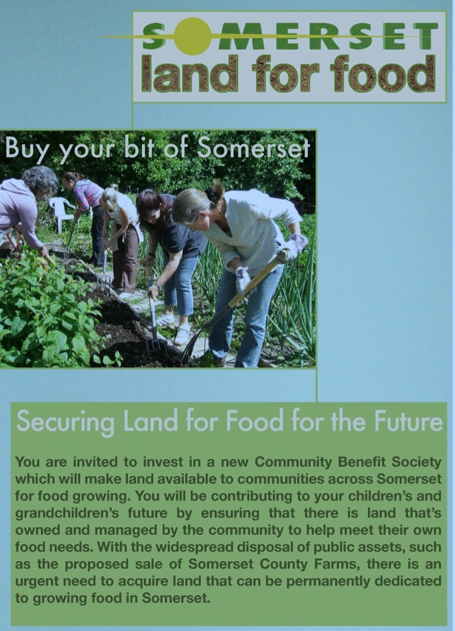
Community development finance instruments
Somerset Land for Food community share issue
People buy shares in CBS
That investment provides capital for groups to buy land
Land is rented by growers
Rental income pays dividends (2%) and secures more land purchase
Option for growers to buy after 5 years
More info: www.communitylandtrusts.org.uk
Notes:
21

Slide 22
Group exercise: CSA critique
Divide into 2 groups. Think about the CSA story.
Group 1 – Consider general strengths of the CSA models we have described as you see them. What main benefits do they offer?
Group 2 – CSAs seem a good idea but they are not the mainstream of farming. Please provide 3-5 critical points about associated difficulties or weaknesses of CSA.
10 mins and 5 mins feedback per group.

Slide 23
Some critiques of CSA
CSAs are marginal do not really change the food ‘landscape’
Their pricing policies may be exclusive for some citizens – often educated and wealthy
They can be complex and hard work – relies on high degree of farmer and business skills
Land is very expensive if you want to start up
Farmers may appreciate the support of their communities but find the limited/fluctuating sales volumes hard to accommodate
Potentially risky; have to eat what grows – choice?
Notes:
23

Slide 24
Summary
CSA takes many forms but most expect consumers to share production risks with farmers
CSAs may be ideologically led but are businesses
CSAs have made successful links with other alternative food projects – farmers’ markets, organic box schemes and have produced innovative methods and financial models
Potentially transferable? – housing and energy generation
Community supported agriculture or agriculture supporting the community?

Slide 25
Some further reading
Butler Flora, C. and Bregendahl, C. (2012) Collaborative Community-supported Agriculture: Balancing Community Capitals for Producers and Consumers. International Journal of Sociology of Agriculture and Food Vol 19 No 3 pp. 329-346.
DeLind, M. (1999) Is This a Women’s Movement? The Relationship to Gender of Community Supported Agriculture in Michigan. Human Organisation Vol 58 No 2 pp. 190-200
Franklin, A., Newton, J., and McEntee, J. (2011) Moving beyond the alternative: sustainable communities, rural resilience and the maintreaming of local food. Local Environment, Vol. 16, No. 8, pp. 771-788.
Guthman, J., Morris, A. and Allen, P (2006) Squaring Farm Security in Two Types of Alternative Food Institutions. Rural Sociology Vol 71, No 4, pp. 662-684
Keech, D., Alldred, S. and Snow, R (2009) An analysis of seven CSA enterprises. Making Local Food Work Discussion Paper. Soil Association, Bristol.
Schnell, S (2007) Food with a farmer’s face: CSA in the United States. Geographical Review Vol 97 Iss 4, pp.550-564.
Notes:
25

