Slide 1

Framing
Frame = schema of interpretation (based on beliefs, values, attitudes, mental models, etc.)

Slide 2
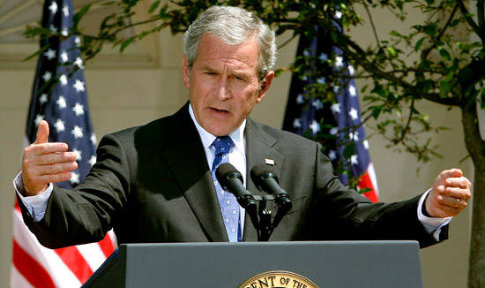
Framing in politics
A frame is the central organizing idea for making sense of relevant events and suggesting what is important. By framing an issue in one way rather than another, candidate make certain aspects of an issue more salient.
Death tax
instead of
Estate tax
Notes:
Republicans –
Tax relief instead of tax cuts
Death tax instead of estate tax

Slide 3
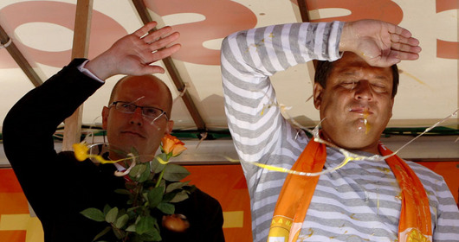
Framing in media
the media focuses attention on certain events and then presenting them in certain meaning.

Slide 4

Framing (Kahneman & Tversky)
If Program A is adopted, 200 people will be saved
If Program B is adopted, there is a one-third probability that 600 people will be saved and two-thirds probability that no people will be saved
72% chose Program A
If Program A is adopted, 400 people will die
If Program B is adopted, there is a one-third probability that nobody will die and two-thirds probability that 600 people will die
78% chose Program B
People dislike losses and seek to avoid them.
The first policy decision was worded so that Program B looked like the bigger loss; the second version was phrased so that Program A looked like sure loss. Defining the issue as “losing something” was more persuasive than stating it in terms of gain.

Slide 5
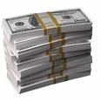
Framing (Kahneman & Tversky)
A: A sure gain of $240
B: A 25% chance to gain $1000 and 75% chance of getting nothing.
C: A sure loss of 750
D: A 75% chance of losing $1000 and a 25% chance to lose nothing.
84% of people chose A
73% of people chose D

Slide 6

Applications
Risk aversion behavior – presentation of options as sure gains
We prefer sure gains to gambling for more
Riskier behavior – presentation as the relative likelihood of looses. We are willing to gamble in order to avoid losses.
We prefer gambling than sure losses.
PEOPLE WANT TO AVOID LOSSES

Slide 7
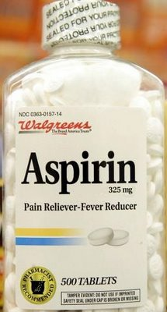
Framing
“No other pain reliever is stronger and more effective”

Slide 8
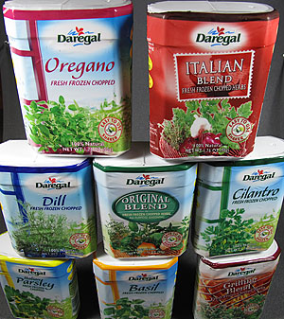

Slide 9
Doublespeak (euphemism)
Pass away = die
Fatal injury = death
Active defending = attacking
Associate = low-level employee
Efficient = profitable
Enhanced interrogation = torture
Executive assistant = secretary
Job flexibility = lack of job security
Pre-owned = used
Operátor výroby = práce u pásu

Slide 10
What sounds better?
Free guide to Brno clubs
or
Advertising material sponsored by several Brno clubs
Support our freedom fighters
or
Support the army
Cordless device
or
Runs on two AA batteries

Slide 11

Framing the price of whiskey
89,- CZK
1490,- CZK

Slide 12
Cvičenie:
Vytvorte družstvá po troch
Vytvorte zoznam čo najhorších vecí, ktoré sa môžu stať
Vymyslite čo najviac označení toho istého, no však v pozitívnom svetle
Minimálne 3 pre každé a buďte čo najkreatívnejší!

Slide 13
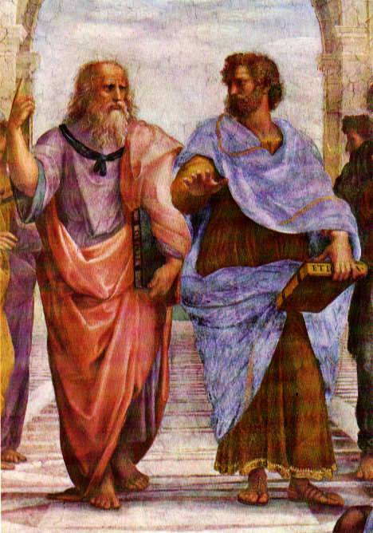
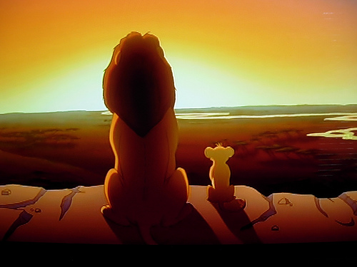
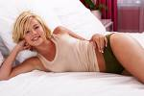

Emotion & Cognition

Slide 14

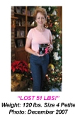

Evidence
Facts
Quantitative information
Eyewitness statements
Testimonials
Credible source’s opinion
The use of evidence is effective
Evidence is especially persuasive when attributed to highly credible source

Slide 15
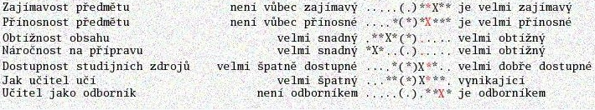
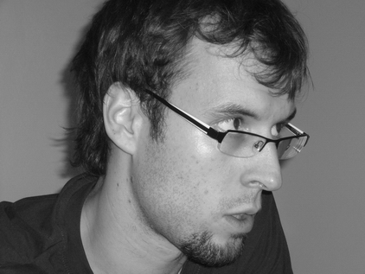
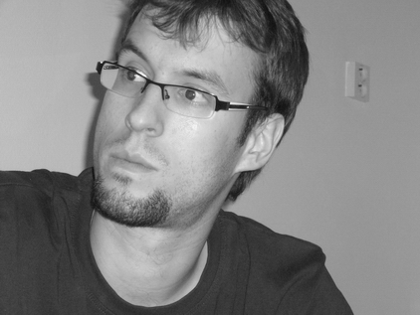
Graphic narratives vs. Statistics
GRAPHIC NARATIVES are
more compelling than STATISTICS
Hm… He must be right!
That class really sucks!
I had it!

Slide 16
http://www.youtube.com/watch?v=otgH6sFECoM
http://www.ceskatelevize.cz/ivysilani/207562230410003-stop/
http://www.youtube.com/watch?v=qpYq9CBZoKQ

