Slide 1
MEDLINE
Carlos A. Almenara, PhD
Online and Offline Resources In Psychological Assessment PSY494P122 (April 22nd, 2015)

Slide 2
WHAT’S PubMed?

Slide 3


PubMed
PubMed Health is a service provided by the National Center for Biotechnology Information (NCBI) at the U.S. National Library of Medicine (NLM).
The U.S. National Library of Medicine (NLM) is the world's largest medical library. It has millions of records of books and journals about all aspects of medicine and health care on its shelves.

Slide 4
WHAT’S MEDLINE?

Slide 5
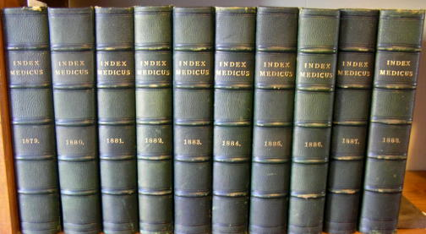
MEDLINE
NLM has been indexing the biomedical literature since 1879.
What was once a printed index to articles, the Index Medicus, became a database now known as MEDLINE.

Slide 6
MEDLINE
So, MEDLINE is the U.S. NLM premier bibliographic database and primary content of PubMed
Contains over 20 million references to journal articles in life sciences dating back to 1946.
Primary concentration is on biomedicine.

Slide 7
MEDLINE
Coverage is 5600 worldwide journals, but most records (about 93%) are from English-language sources or have English abstracts.
Approximately 84% of citations added in the last five years include a published abstract.
Since 1996, free access to MEDLINE has been available to the public online via PubMed.

Slide 8

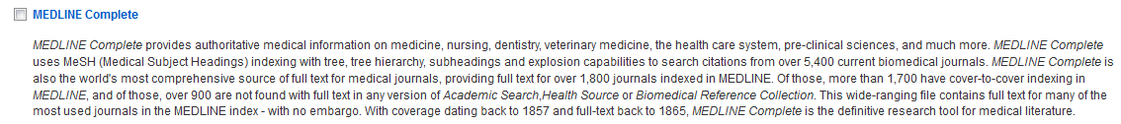
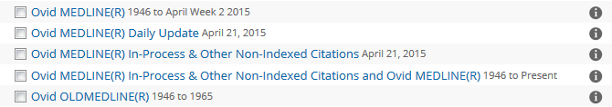



MEDLINE
MEDLINE is also available through major Databases suppliers, being OVID the most used.

Slide 9
How journals are selected?

Slide 10
MEDLINE
The Literature Selection Technical Review Committee (LSTRC) meets three times a year and considers approximately 180 titles for MEDLINE at each meeting.
Final approval is made by the Director of the NLM.
Titles are considered for scope and coverage, quality of content, quality of editorial work, production quality, audience, and type of content.

Slide 11
What is in a bibliographic record?

Slide 12
MEDLINE
The MEDLINE® Basic Bibliographic Citation contains:
  Title of the journal article
  Names of the Authors
  Abstract published with the article
  Controlled Vocabulary search terms (Medical Subject Headings, MeSH)
  Journal Source Information
  First Author Affiliation
  Language in which the article was published
  Publication Type (description of the type of article, e.g., Review, Letter, etc.)

Slide 13
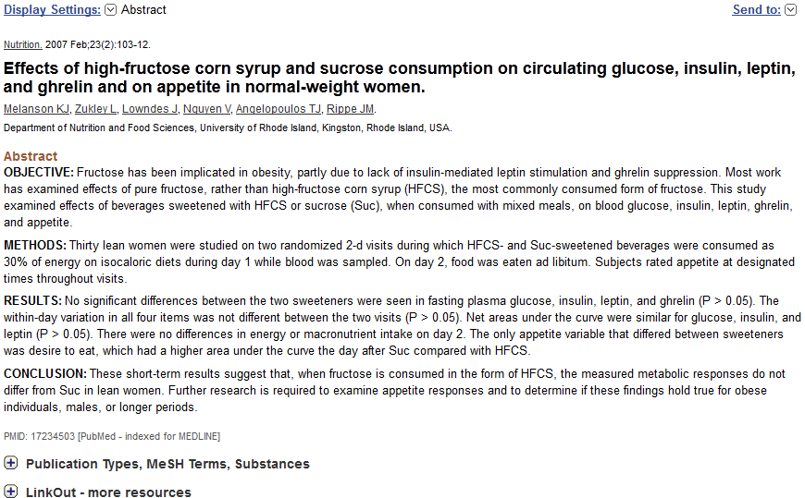
MEDLINE

Slide 14
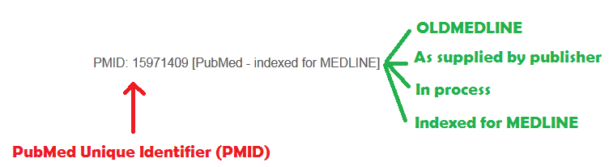
MEDLINE
“Indexed for MEDLINE” Are complete records (when MeSH terms and other indexing terms are added)

Slide 15
MEDLINE
Some articles may never become MEDLINE citations and won’t have MeSH terms:
  Out-of-scope articles from selectively indexed MEDLINE journals
  Articles from issues of journals published prior to selection for MEDLINE indexing (OldMedline, <1946).
  Articles from non-MEDLINE journals, including author manuscripts in PubMed Central (PMC) that would not normally be in PubMed.

Slide 16
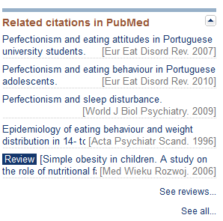
PubMed
Records can display Related citations, which are computed with an algorithm.
See reviews to see the review articles that are related to this citation.

Slide 17
PMID

Slide 18
MEDLINE
The PMID might be used in Mendeley

Slide 19
MEDLINE
The PMID might be used in your institutional link resolver

Slide 20
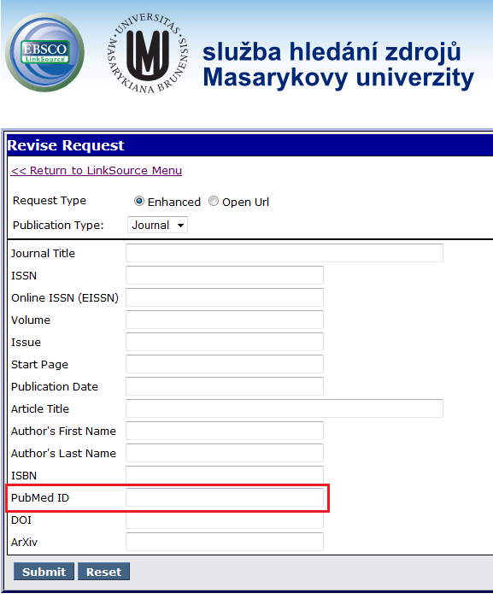
MEDLINE
The PMID might be used in your institutional link resolver

Slide 21
BASICS

Slide 22
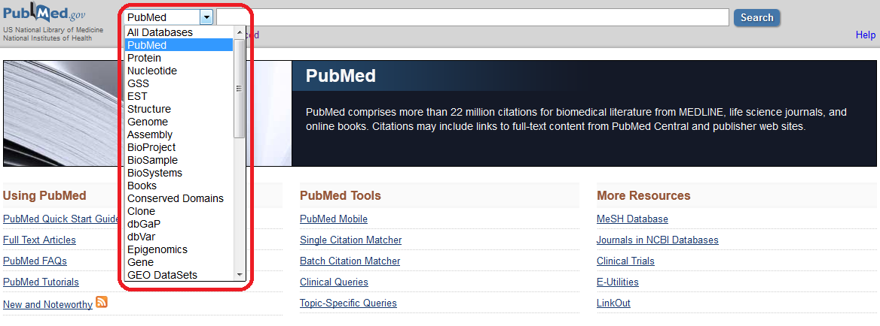
PubMed
PubMed is one of the NCBI databases

Slide 23
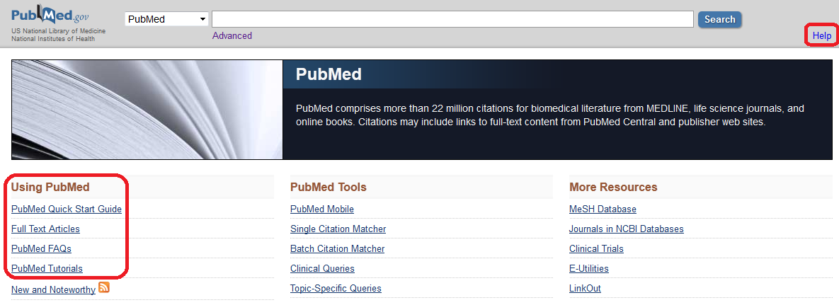
PubMed
Help and tutorials.

Slide 24
PubMed
A free tutorial is available online.
  Understand PubMed's scope and content.
  Understand how the MeSH vocabulary is used to describe and retrieve citations.
  Build a search using MeSH and PubMed search tools (Details, Filters, History, Search Builder, etc.)
  Manage your results using display, sort, the Clipboard, save, print, e-mail and order features and My NCBI filters.
  Save your search strategies.
  Link to full-text articles and other resources.
  Use special queries and other PubMed/NCBI tools.

Slide 25
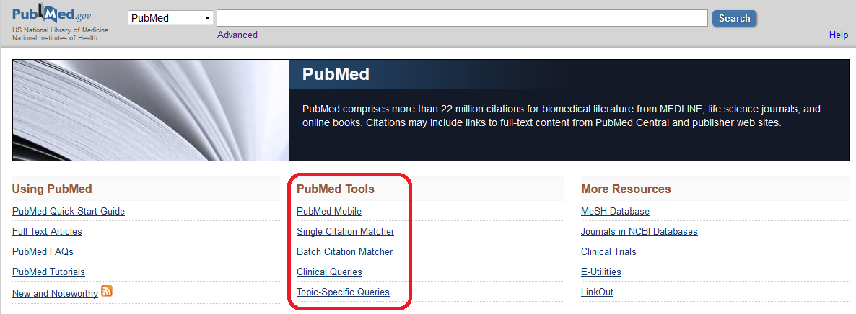
PubMed
PubMed Tools

Slide 26
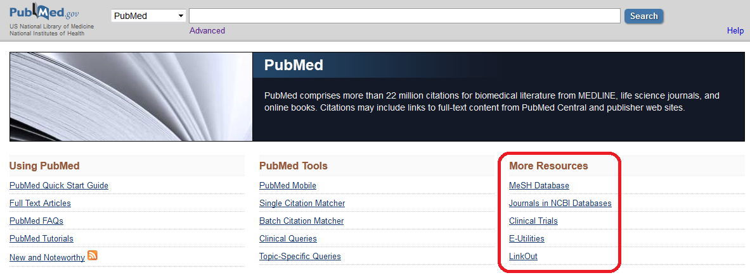
PubMed
More resources.

Slide 27
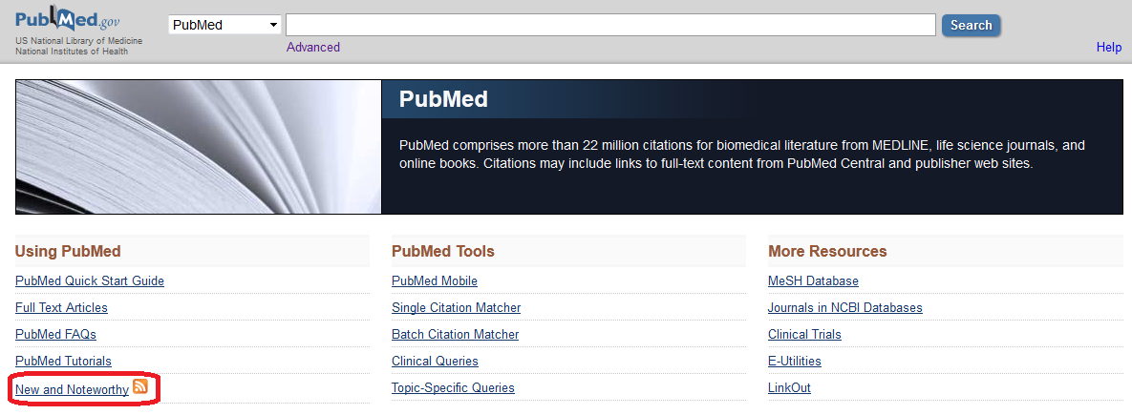
PubMed
News.

Slide 28
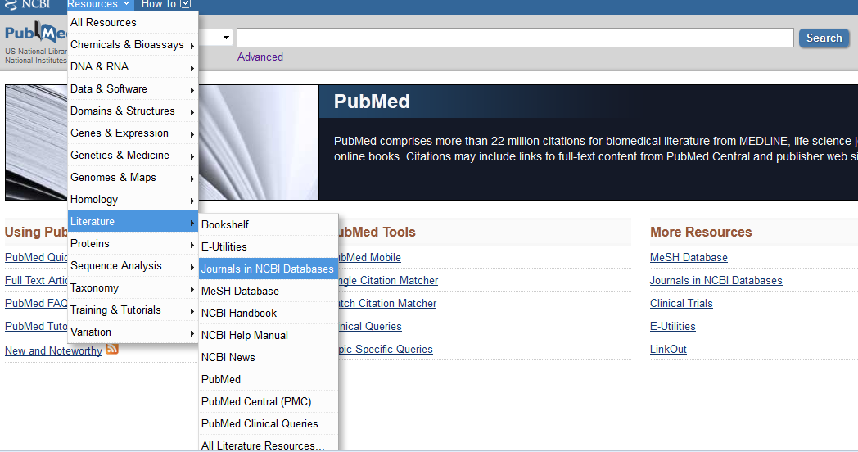
PubMed
You may also use the tab “Resources” on the top

Slide 29
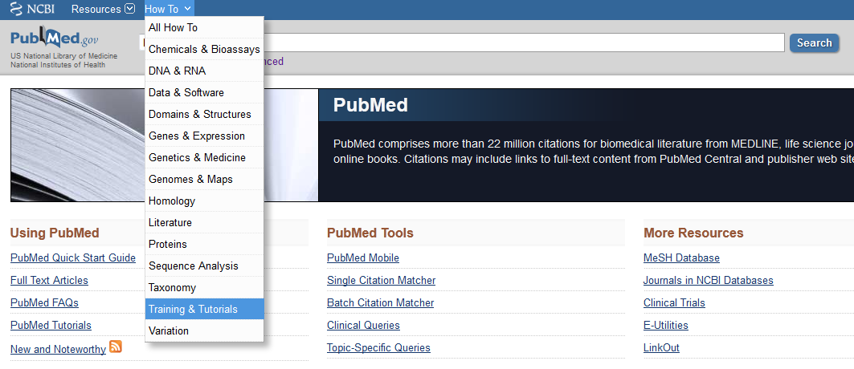
PubMed
You may also use the tab “How to” on the top

Slide 30
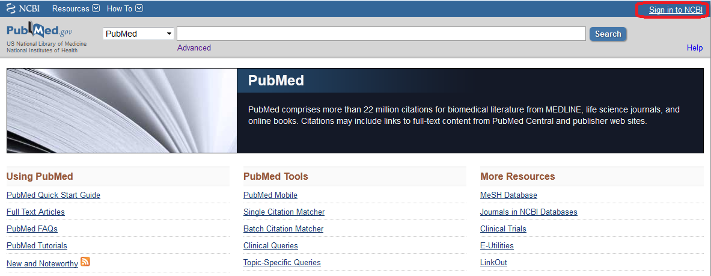
PubMed
Sign in to NCBI (customization).

Slide 31

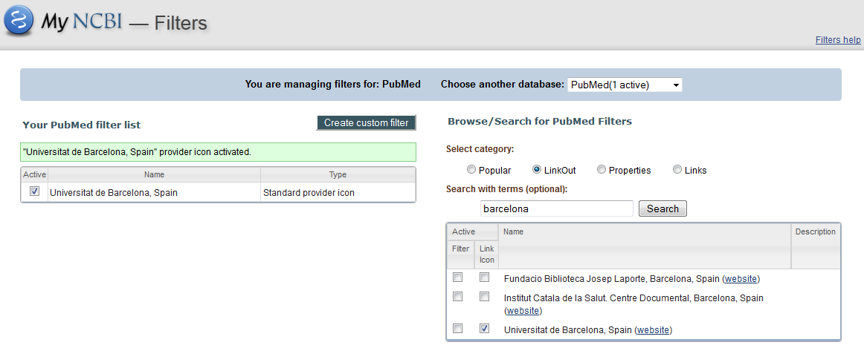
PubMed
CREATE YOUR ACCOUNT

Slide 32
MeSH
  (Controlled Vocabulary)

Slide 33
PubMed
MEDLINE uses a controlled vocabulary, meaning that there is a specific set of terms used to describe each article.
Familiarity with this vocabulary will make you a better PubMed searcher.

Slide 34
PubMed
The Medical Subject Headings (MeSH®)
  Used for subject analysis
  Used for indexing journal articles for MEDLINE, and also cataloging books, audiovisuals
  MeSH terms are arranged in a hierarchical categorized manner called MeSH Tree Structures and are updated annually.

Slide 35


PubMed
MeSH vocabulary is organized by 16 main branches:

Slide 36
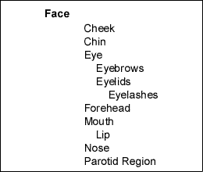
PubMed
When PubMed searches a MeSH term, it will automatically include narrower terms in the search, if applicable. This is also called "automatic explosion”.

Slide 37

PubMed
NLM indexers examine articles and assign the most specific MeSH heading(s) (also Subheadings) that appropriately describes the concept(s) discussed.

Slide 38
PubMed
In addition to assigning MeSH terms that describe the topic of the article, the indexer provides terms that reflect:
  Characteristics of the group being studied (e.g., the age group, human or other animal, male or female)
  The material represented (Publication Types) e.g., Clinical Trials, Editorial, Review

Slide 39
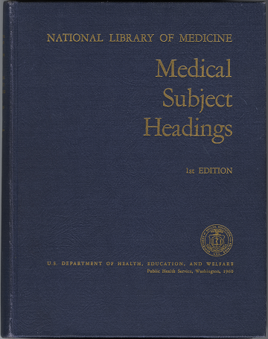
PubMed
The Medical Subject Headings (MeSH®), 1st edition catalog is freely available online:

Slide 40
SEARCHING

Slide 41
PubMed
Create your search strategy with:
  A predefined search strategy¹
  Key concepts
  Alternative terms (if needed)
  Refine your search, as appropriate
  Practice

Slide 42

SPENDING TIME ELABORATING A SEARCH STRATEGY IS A GOOD INVESTMENT

Slide 43
“PARTIAL MATCH” SEARCH

Slide 44

PubMed

Slide 45
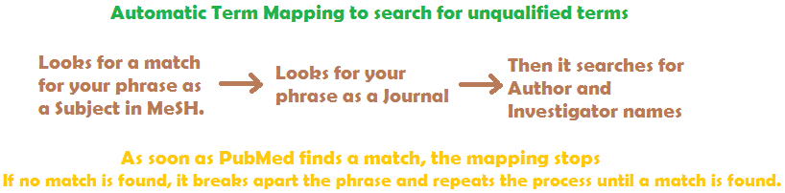
PubMed
Automatic Term Mapping
The phrases and individual terms are also searched in All Fields

Slide 46
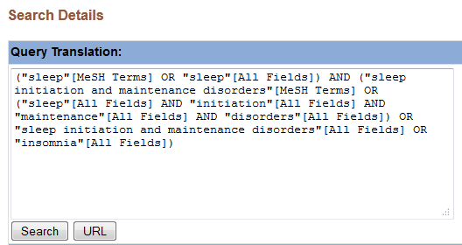
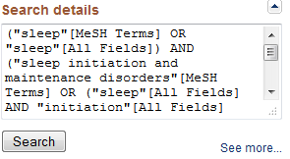
PubMed
You can see how your search was translated by PubMed in the Search details box.
However, the Search Details box does NOT show MeSH terms included by automatic explosion.

Slide 47
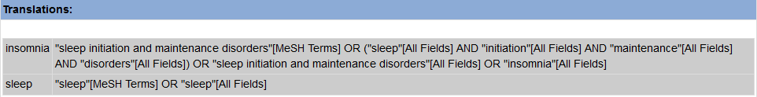
PubMed

Slide 48
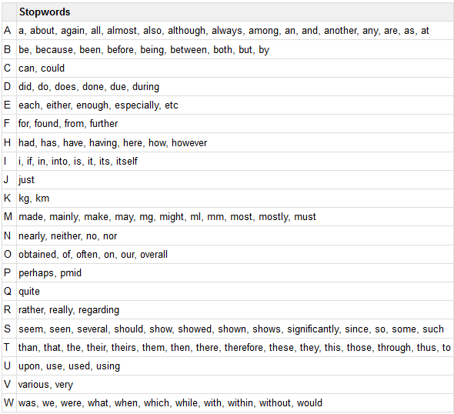
PubMed
Stopwords
(ignored words)

Slide 49
FILTERS, LIMITS, OPTIONS

Slide 50
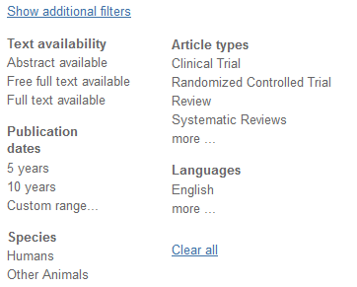
PubMed
Only filters valid for your search results will appear.
Some Filters, including many publication types, age groups, species and sex, restrict your search to indexed records.

Slide 51
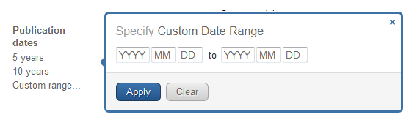
PubMed
DATE: PubMed will search both electronic and print publication dates when range searching.
If using a single date, PubMed will search only the earliest publication date (since 1946).

Slide 52
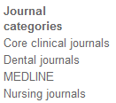
PubMed
JOURNALS
  Approximately forty languages are indexed.
  Core Clinical Journals: 120 English language clinical journals formerly published as the Abridged Index Medicus (AIM).
  MEDLINE: Limits to records that are fully indexed. This subset can also be used in a search as medline [sb].

Slide 53
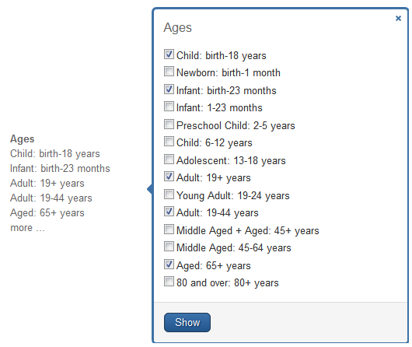
PubMed
AGE

Slide 54
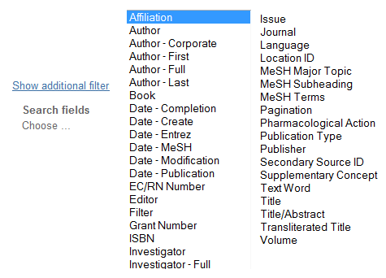
PubMed
Search Fields

Slide 55
PubMed
REMEMBER!
  Unless you remove these filters, or your session times out, any search in PubMed will be limited by applied filters.

Slide 56
BOOLEAN
SEARCH

Slide 57
PubMed
The Boolean operators AND, OR, NOT can be used to combine search terms in PubMed.
In PubMed, Boolean operators must be entered in UPPERCASE letters.
When using multiple Boolean operators in PubMed, they are processed left to right.
You can also combine previous searches (using Advanced Search).

Slide 58
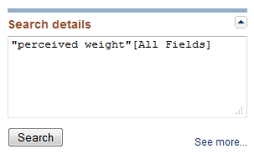

PubMed
EXACT MATCH: PubMed automatically searches for phrases during Automatic Term Mapping.
  Enclosing the phrase in double quotes without search tag indicates the search should be conducted in All Fields.

Slide 59
PubMed
EXACT MATCH: You may also try:
  Entering the phrase with a search tag:
    Perceived weight [tw]
  Truncating
    Perceived weight*

Slide 60
PubMed
Truncation (*) turns off automatic term mapping and the automatic explosion of MeSH terms.
Try your search with and without quotes, hyphenation and truncation and compare your results.

Slide 61
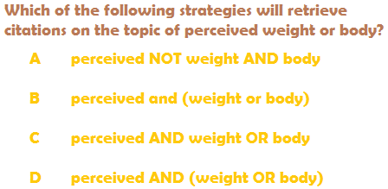
PubMed
Notes:
The answer is D (because it’s read from left to right) (See below the translation)
("perception"[MeSH Terms] OR "perception"[All Fields] OR "perceived"[All Fields]) AND (("weights and measures"[MeSH Terms] OR ("weights"[All Fields] AND "measures"[All Fields]) OR "weights and measures"[All Fields] OR "weight"[All Fields] OR "body weight"[MeSH Terms] OR ("body"[All Fields] AND "weight"[All Fields]) OR "body weight"[All Fields]) OR ("human body"[MeSH Terms] OR ("human"[All Fields] AND "body"[All Fields]) OR "human body"[All Fields] OR "body"[All Fields]))

Slide 62
MeSH
DATABASE

Slide 63
PubMed
The MeSH Database allows you to:
  Locate and select MeSH terms, (Headings, Subheadings, & Publication Types).
  See the definition and other helpful information for a MeSH term.
  Build a PubMed search strategy.
  Display MeSH terms in the hierarchy.
  Limit MeSH terms to a major concept for a search.
  Attach subheadings for a search.
  Link to the NLM MeSH Section's MeSH Browser.

Slide 64
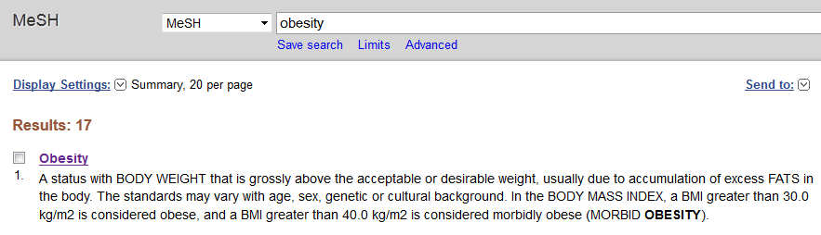
PubMed
MeSH heading: The summary may include a definition of the concept.

Slide 65
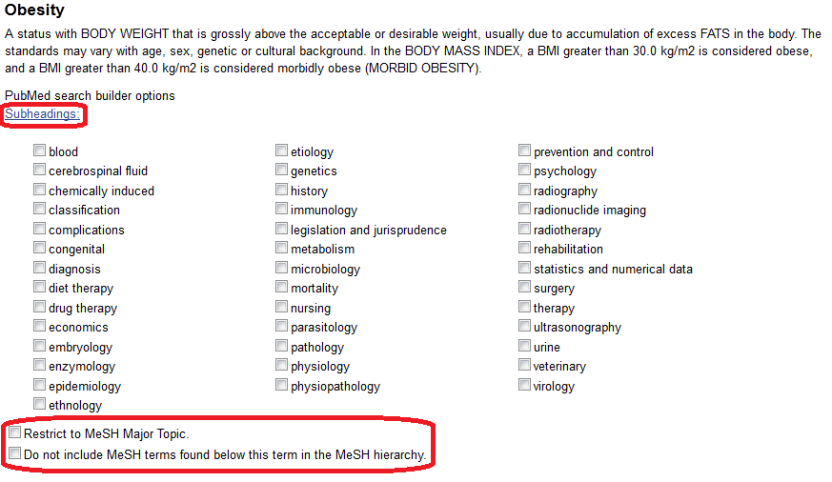
PubMed
Subheadings and limiters are available.

Slide 66
EXERCISE

Slide 67
PubMed
Let's search for treatment failure in diet therapy of obesity
1st step:
  Search treatment failure as MeSH term.
  Click Add to search builder

Slide 68
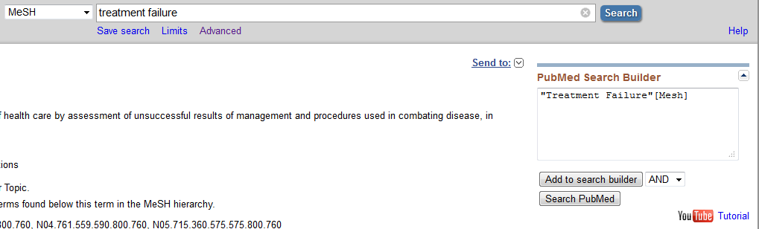
PubMed

Slide 69
PubMed
Let's search for treatment failure in diet therapy of obesity
2nd step:
  Search Obesity as MeSH term, click on it, and select diet therapy subheading.
  Before add this term to the strategy, let's restrict to citations where the major focus of the article is diet therapy. So, keep selected the option: Restrict to MeSH Major Topic.
  Click Add to search builder

Slide 70
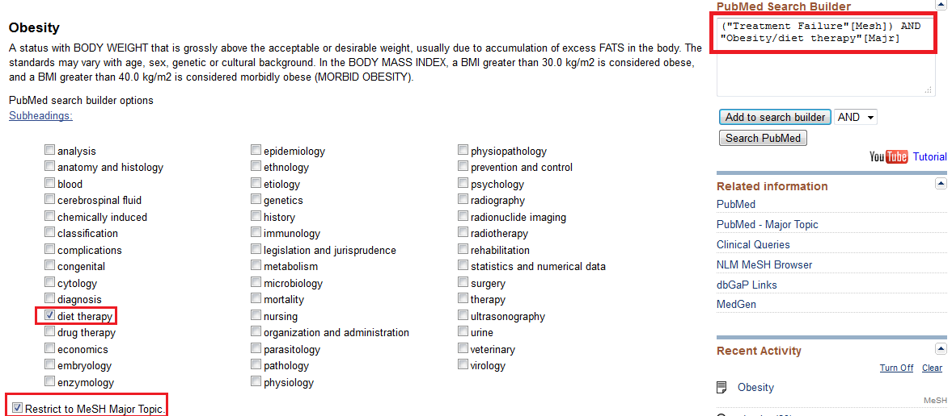
PubMed

Slide 71
JOURNALS

Slide 72
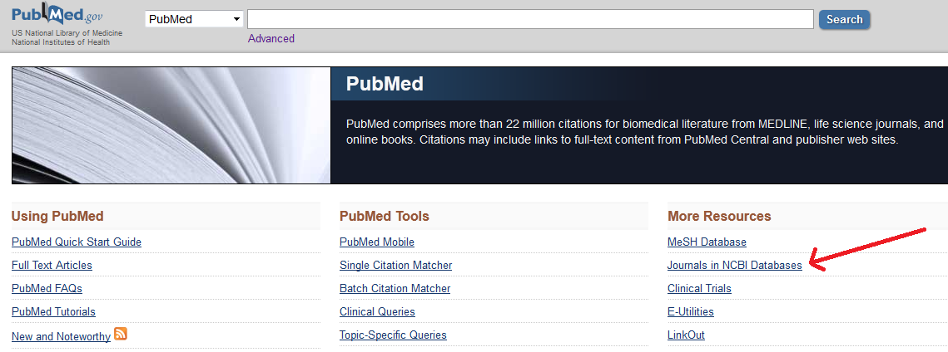
PubMed
JOURNALS

Slide 73
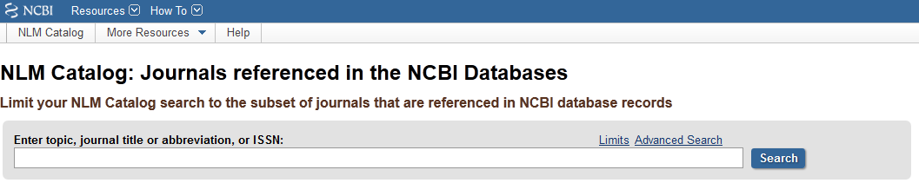
PubMed
JOURNALS:
  Search by title, abbreviation, ISSN, or topic.

Slide 74
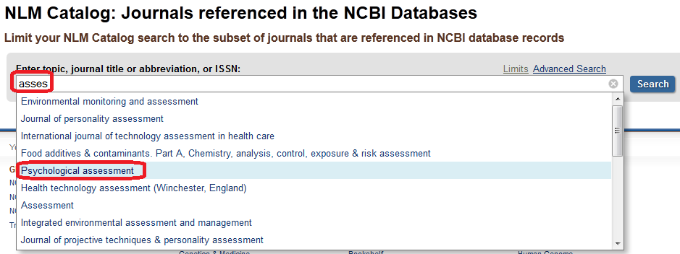
PubMed
Searching Journals (autocomplete)

Slide 75
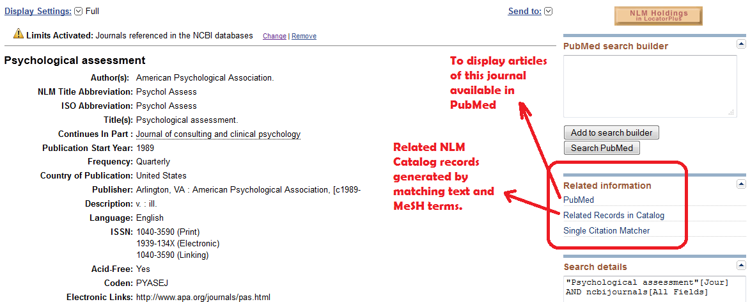
PubMed
Journal information

Slide 76
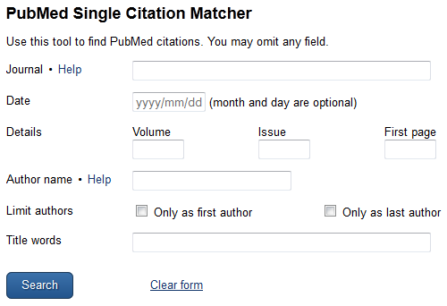
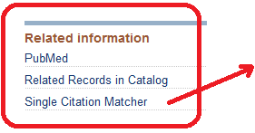
PubMed
Limiting your search into a specific journal

Slide 77
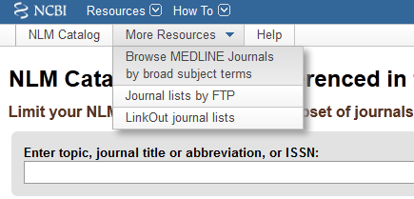
PubMed
JOURNALS:
  Browse by broad subject terms, or lists.

Slide 78
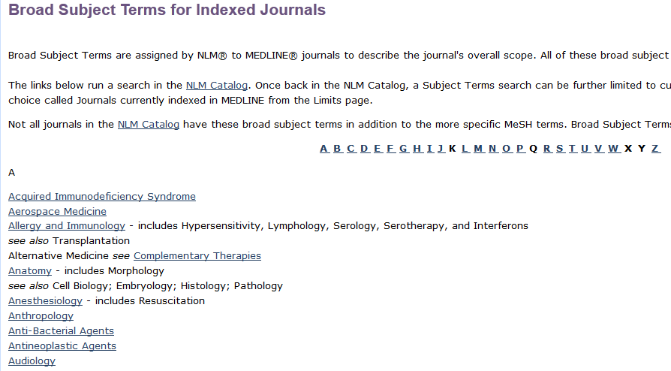
PubMed
JOURNALS:
  Browse by broad subject terms.

Slide 79
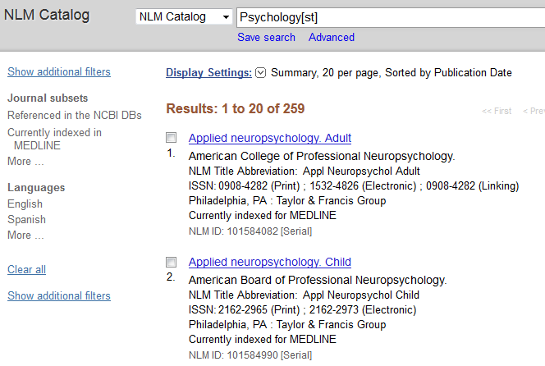
PubMed
JOURNALS:
  Browsing by broad subject terms: Psychology

Slide 80
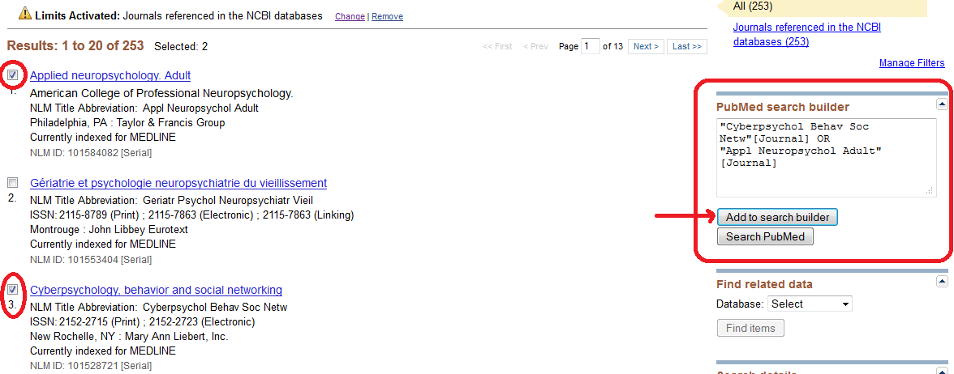
PubMed
JOURNALS:
  You can add specific journals to your search.

Slide 81
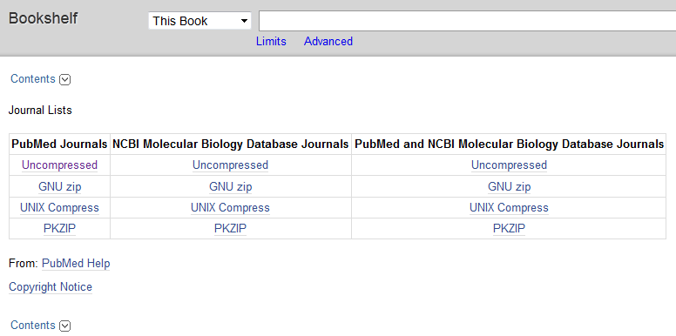
PubMed
JOURNALS:
  Browse Journal lists by FTP (available for download).

Slide 82
CLINICAL QUERIES

Slide 83
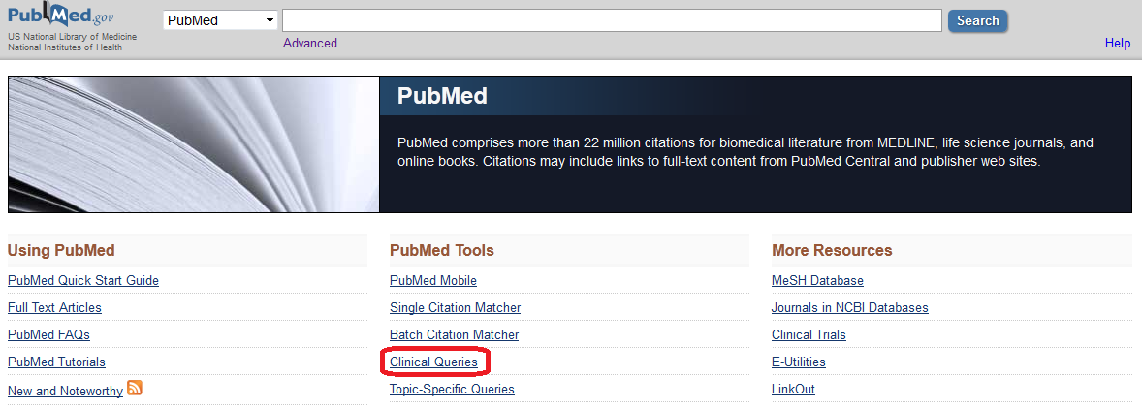
PubMed
Clinical queries is part of PubMed Tools

Slide 84
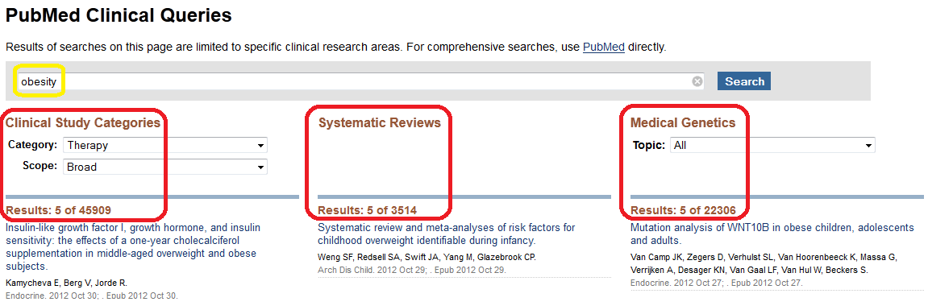
PubMed
Clinical queries is available for specific clinical research areas. 3 search filters are available

Slide 85
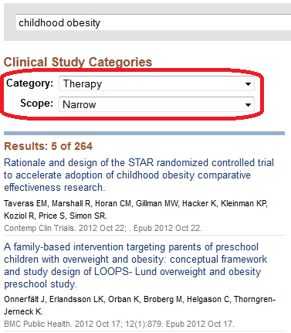
PubMed
Clinical Study Categories is intended for clinicians and has 2 filters: 5 study categories and two scope filters.

Slide 86
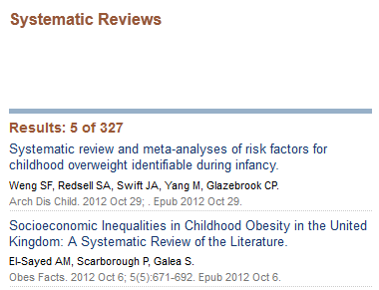
PubMed
Systematic Reviews: It retrieves systematic reviews, meta-analyses, reviews of clinical trials, evidence-based medicine, consensus development conferences, and guidelines.
Citations from journals specializing in clinical review studies are also included.

Slide 87
ADVANCED
SEARCH

Slide 88
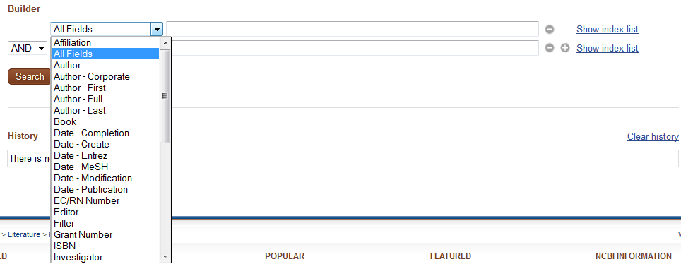
PubMed
Author, Journal and MeSH fields include an autocomplete feature.

Slide 89
PubMed
To see and select from a list of all values in the database in a specific field, use the
In parentheses are the number of records that include that term.
You may select multiple values from a single index by holding your <ctrl> key.

Slide 90

PubMed
Selecting terms from the Index List

Slide 91

PubMed
Use tags to specify fields.

Slide 92


PubMed
Use tags to specify fields.
Uppercase, lowercase or combined are the same.

Slide 93
PubMed
Using MeSH tags.
  MeSH Major Topic [MAJR]
    sleep[Majr]: automatically includes automatic explosion.
    sleep[majr:noexp]: turn off automatic explosion.
  MeSH Headings [MH]
    sleep[mh]: automatically includes automatic explosion.
    sleep[mh:noexp]: turn off automatic explosion.
Remember: “In process”, “publisher supplied”, and OldMedline citations are excluded (they aren’t indexed).

Slide 94
PubMed
Using MeSH heading/subheading combination.
  MeSH Major Topic [MAJR]
    Sleep/psychology[majr]
    Sleep/psychology[majr:noexp]
  MeSH Headings [MH]
    Obesity/prevention and control[mh]
    Obesity/prevention and control [mh:noexp]

Slide 95
PubMed
Using MeSH heading/subheading combination.
  To search the subheading attached to any MeSH heading ("free-floating"). Only one subheading at one time
    obesity[mh] AND genetics[sh]
    obesity[mh] AND mortality[sh:noexp]

Slide 96

PubMed
Use the MeSH subheadings and abbreviations list:
depression[mh] AND PD[sh]

Slide 97

PubMed
A list of subheading explosions is also available.

Slide 98
PubMed
Using Text Words [TW] tag.
  Terms tagged will be searched in:
    Title
    Abstract
    MeSH headings and Subheadings (includes single words and phrases)
    Other Terms field
    Chemical Names of Substances
    Secondary Source Identifier, which identifies a secondary source that supplies information
    Personal Name as Subject

Slide 99
PubMed
Affiliation [AD] tag.
  The institutional affiliation (address) of the first author is taken from the article.
    american[ad] AND psychological[ad] AND association[ad]
Corporate Author [CN] tag.
  Search for corporate authorship of an article.
    american psychological association [cn]
    american [cn] AND psychological [cn] AND association [cn]
    american psychological association [cn] OR american psychological association [ti]

Slide 100
PubMed
Place of Publication [PL] tag.
  This field indicates the cited journal's country of publication.
    obesity AND czech republic [pl]
Personal Name as Subject [PS] tag.
  Search citations about a named individual.
    smith j [ps]

Slide 101
PubMed
Grant Number [GR] tag.
  For Public Health Services agencies, the number is followed by the Institute acronym; the agency’s hierarchical structure from lower to higher entity, when known; and by the country name.
    LM05545/LM/NLM NIH HHS/United States
  For other funding organizations, the number is followed by the name of the organization; the country name.
    066866/Wellcome Trust/United Kingdom

Slide 102
PubMed
Secondary Source Identifier [SI] tag.
  Identifies a secondary source that supplies information (e.g. ClinicalTrials.gov – beginning in July 2005)
    obesity[mh] AND clinicaltrials.gov [si]

Slide 103
QUESTIONS?

Slide 104
NEXT CLASS
READINGS:
  Principles, standards, and guidelines that impact test development (Leach, Stevens, Lindsay, Ferrero, & Korkut, 2012)
  Concluding thoughts on the internationalization of test reviews (Bartram, 2012)
  Standards (American Educational Research Association, American Psychological Association, & National Council on Measurement in Education, 1999)
  OPTIONAL: The internationalization of test reviewing (Evers, 2012)

