Slide 1
BEING UP-TO-DATE
Carlos A. Almenara, PhD
Online and Offline Resources In Psychological Assessment PSY494P122 May 6, 2015

Slide 2
Being up-to-date
SOME REASONS:
  New research emerge everyday.
  Shortening the lag between: information release and knowledge acquisition.
  Build expertise.
  Challenges of competitiveness.
Notes:
The idea of shortening the lag comes from this book: Keeping Current: Advanced Internet Strategies to Meet Librarian and Patron Needs (by Cohen).

Slide 3

http://www.uptodate.com/

Slide 4
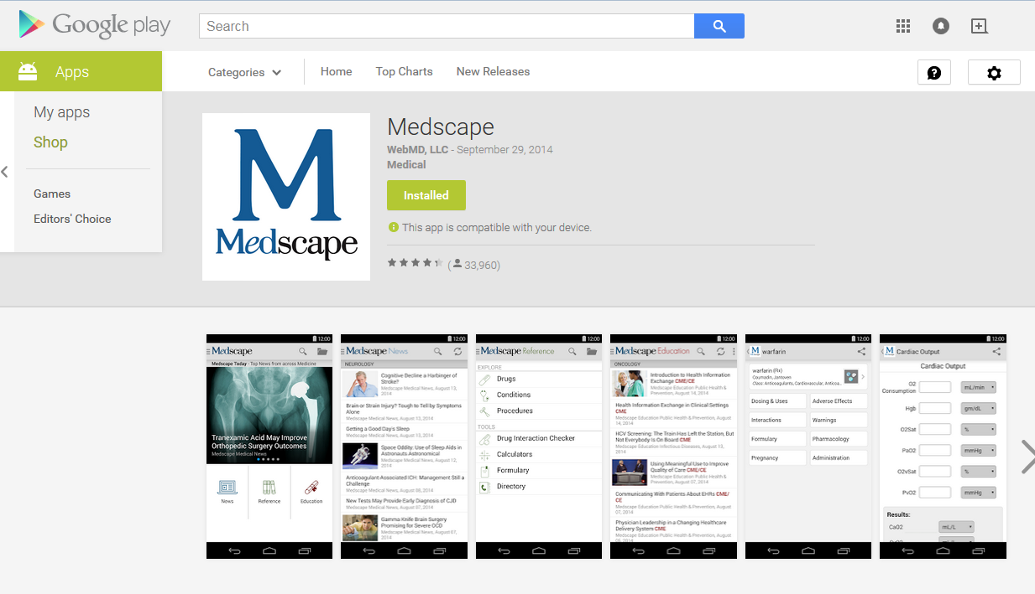
https://play.google.com

Slide 5
NEW ARTICLES
(e-mail Alerts)

Slide 6
JOURNALS
(e-mail Alerts)

Slide 7
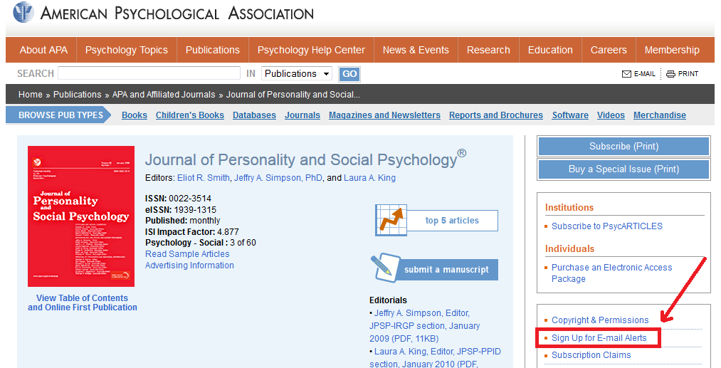
New Articles (Email Alerts)
Signing up for E-mail alerts in a Journal
http://www.apa.org/pubs/journals/psp/index.aspx

Slide 8
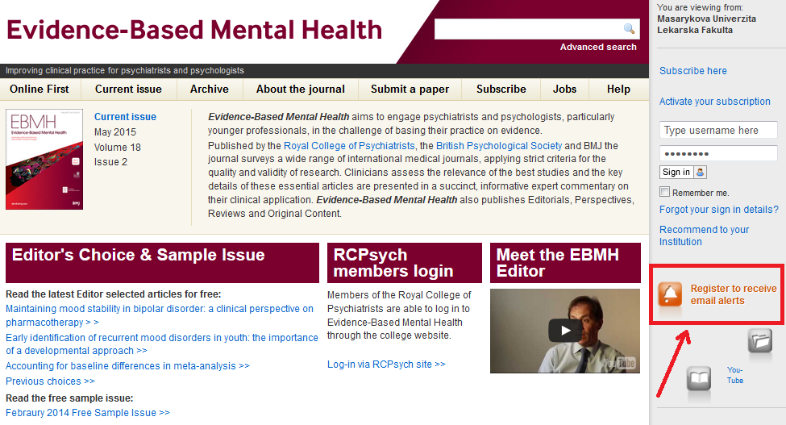
New Articles (Email Alerts)
Sign up for E-mail alerts in a Journal
http://ebmh.bmj.com/

Slide 9
EVIDENCE
(e-mail Alerts)

Slide 10
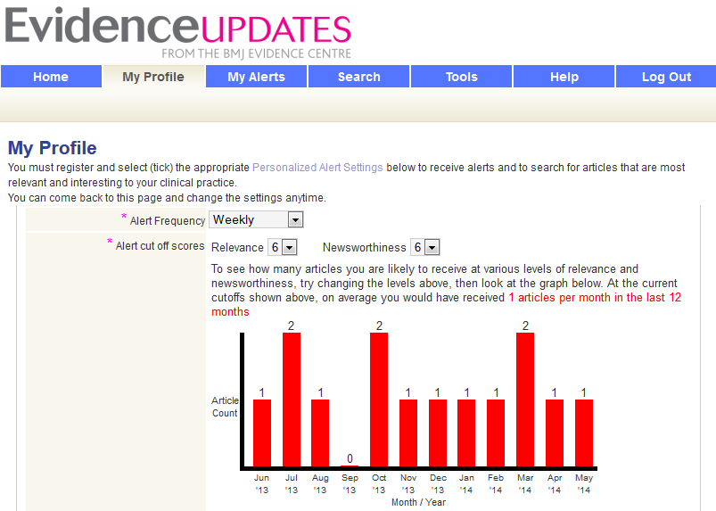
New Articles (Email Alerts)
Sign up for e-mail alerts in a Website/Database
http://plus.mcmaster.ca/EvidenceUpdates/

Slide 11
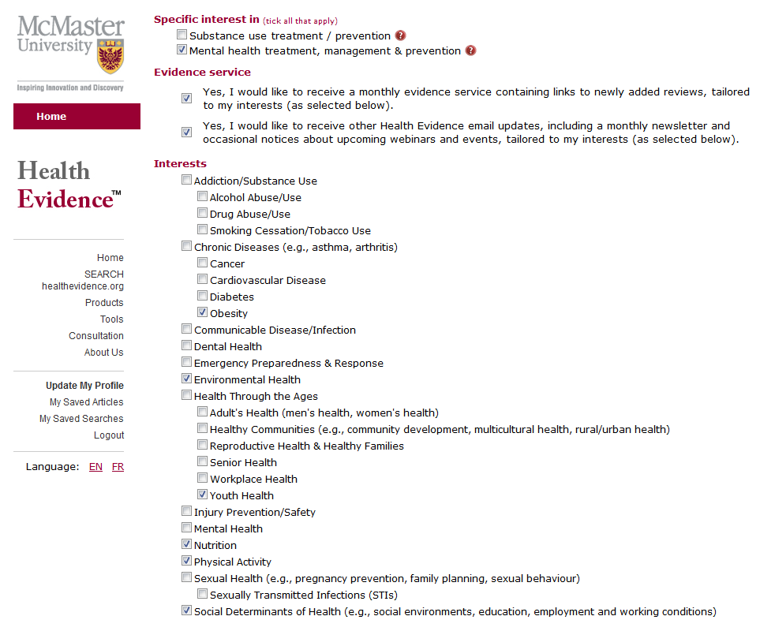
New Articles (Email Alerts)
Sign up for e-mail alerts in a Website/Database
http://www.healthevidence.org

Slide 12
New Articles (Email Alerts)
EXERCISE:
  Sign-up for email alerts.
    NOTE: For Journals’ email alerts don’t choose table of contents alerts! Instead, choose “online first” articles (also named “in press”, “ahead of print”, “press ahead”, etc.)

Slide 13
(MATCHING)
SEARCH RESULTS
(E-mail Alerts)

Slide 14
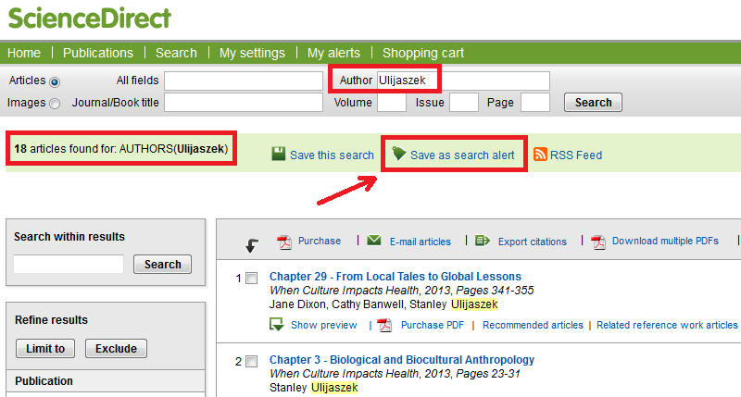
ScienceDirect
Create an alert of results matching your search query
http://www.sciencedirect.com

Slide 15
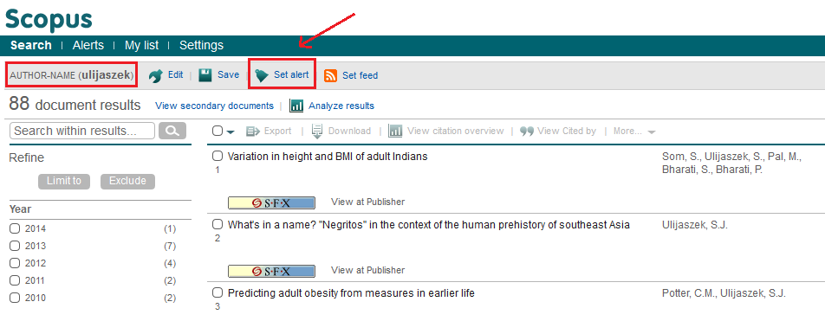
Scopus
Create an alert of results matching your search query
http://www.scopus.com/

Slide 16
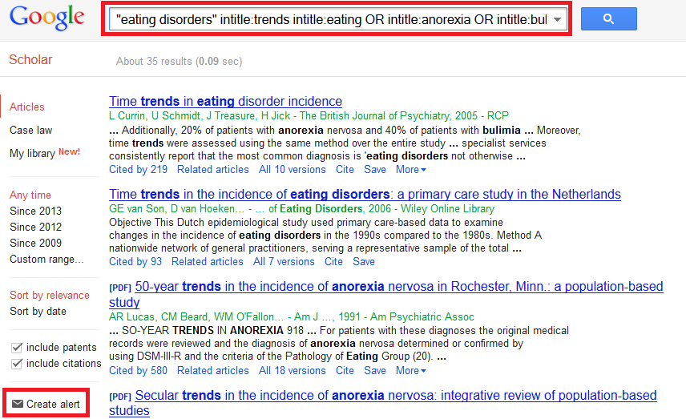
Google Scholar
Create an alert of results matching your search query
http://scholar.google.com

Slide 17
New Articles Matching your Search Query (Email Alerts)
EXERCISE:
  Create 2 email alerts:
    1 for a search on Scopus
    1 for a search on Google Scholar

Slide 18
CITATIONS
(E-mail Alerts)

Slide 19

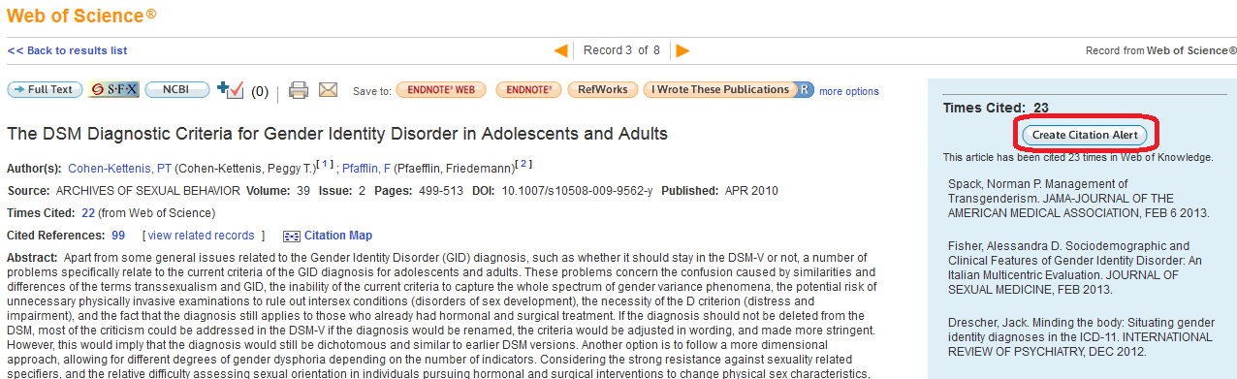
ISI Web of Knowledge
Citation Alert
http://isiknowledge.com/

Slide 20
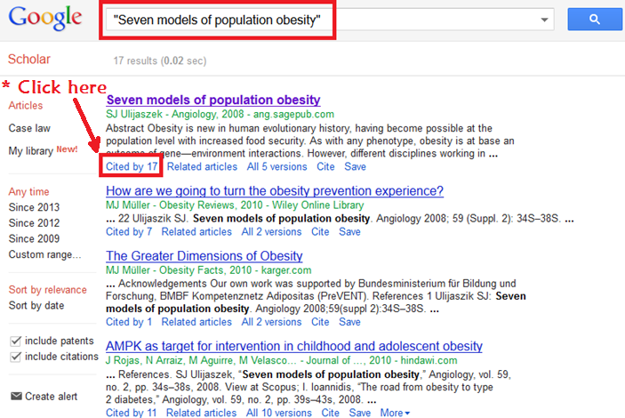
Google Scholar – Step 1
Citation alert
http://scholar.google.com

Slide 21
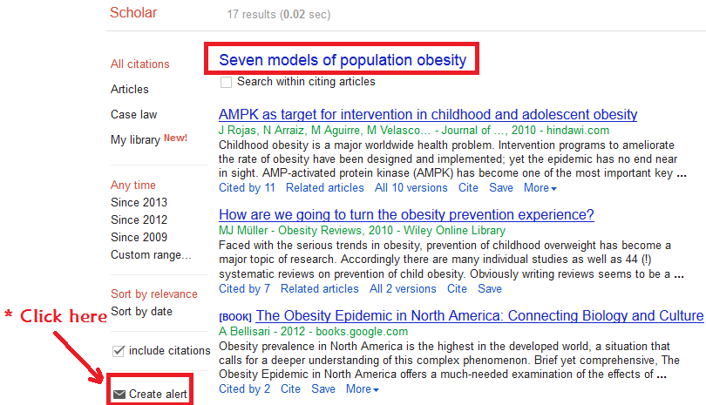
Google Scholar – Step 2
Citation alert
http://scholar.google.com

Slide 22
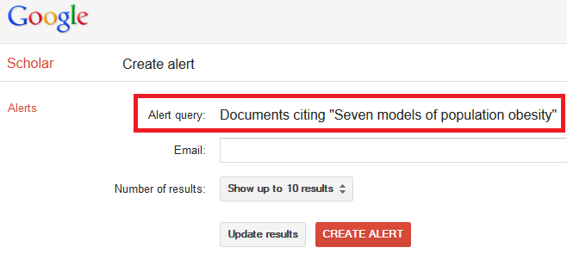
Google Scholar
Citation alert
http://scholar.google.com

Slide 23
New Citations (Email Alerts)
EXERCISE:
  Create 2 citation alerts:
    1 from ISI Web of Knowledge
    1 from Google Scholar

Slide 24

RSS

Slide 25

RSS
RSS (Rich Site Summary; often dubbed Really Simple Syndication)
  RSS feeds enable publishers to syndicate data automatically.
  If you subscribe to a website RSS, then you don't need to manually check for new information.
  Instead, your RSS reader or web browser will provides you any updates.
http://en.wikipedia.org/wiki/RSS
Notes:
Dupped: apodado (nickname)

Slide 26
RSS
(Web Browser)

Slide 27
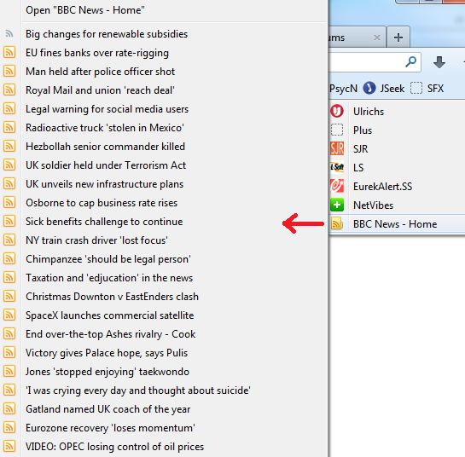
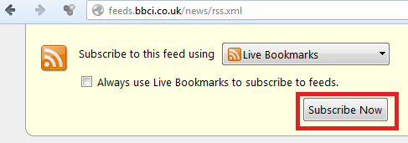
RSS
EXAMPLE: BBC News – Using FIREFOX
http://www.bbc.co.uk/news/10628494

Slide 28
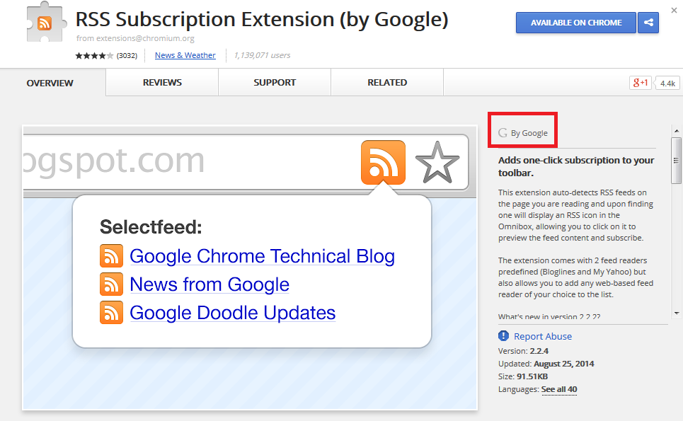
RSS
Google Chrome users can use this App developed by Google
https://chrome.google.com/webstore/detail/rss-subscription-extensio/nlbjncdgjeocebhnmkbbbdekmmmcbfjd?hl=en

Slide 29
RSS
(RSS Feed)

Slide 30
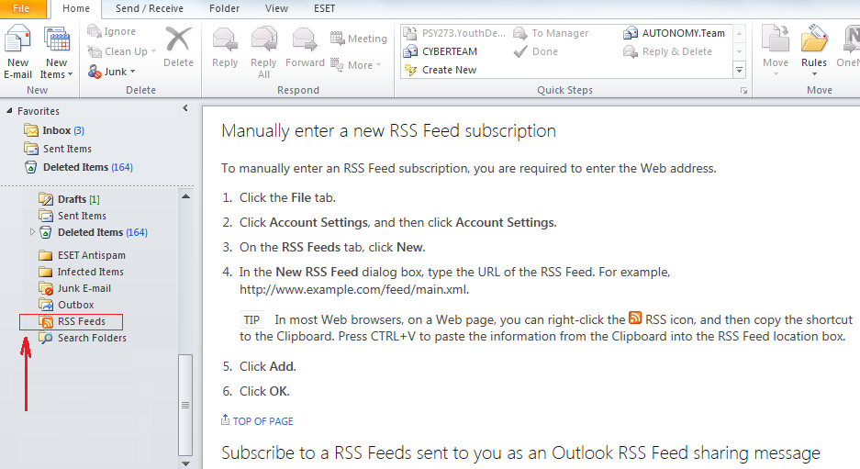
RSS
RSS Reader: Microsoft Outlook

Slide 31
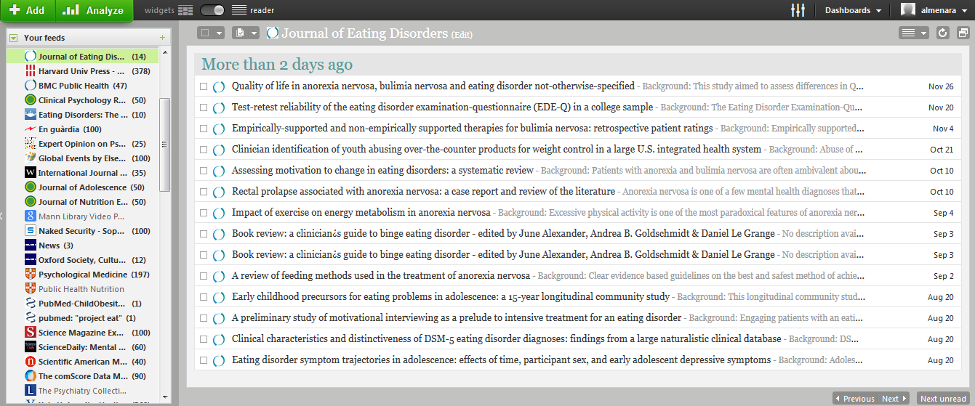
RSS
RSS Reader: NetVibes
http://www.netvibes.com/

Slide 32
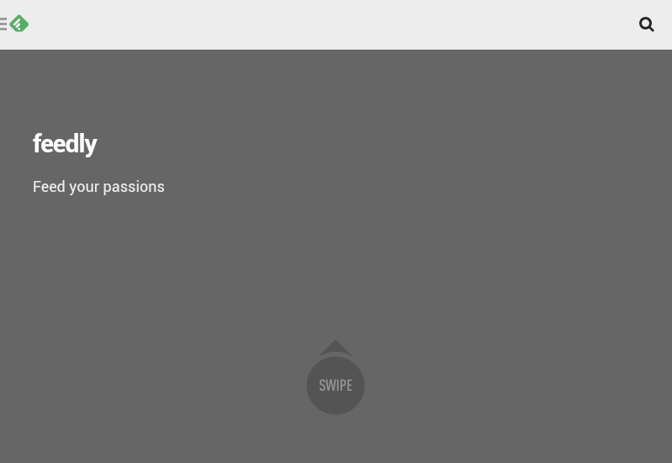
RSS
RSS Reader: Feedly
http://www.feedly.com/

Slide 33
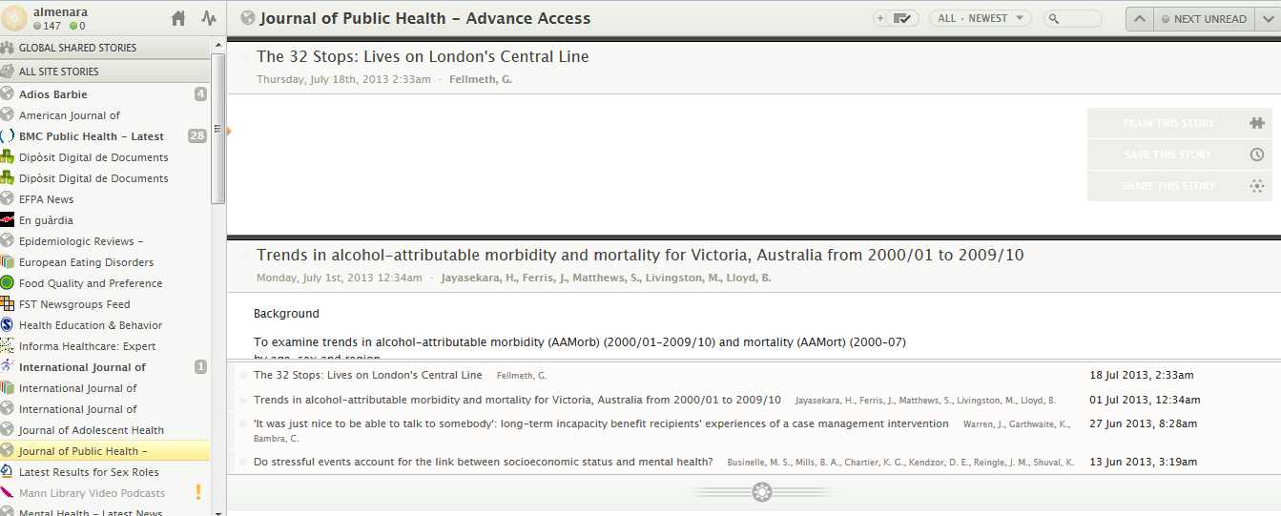
RSS
RSS Reader: NewsBlur
http://www.newsblur.com/

Slide 34
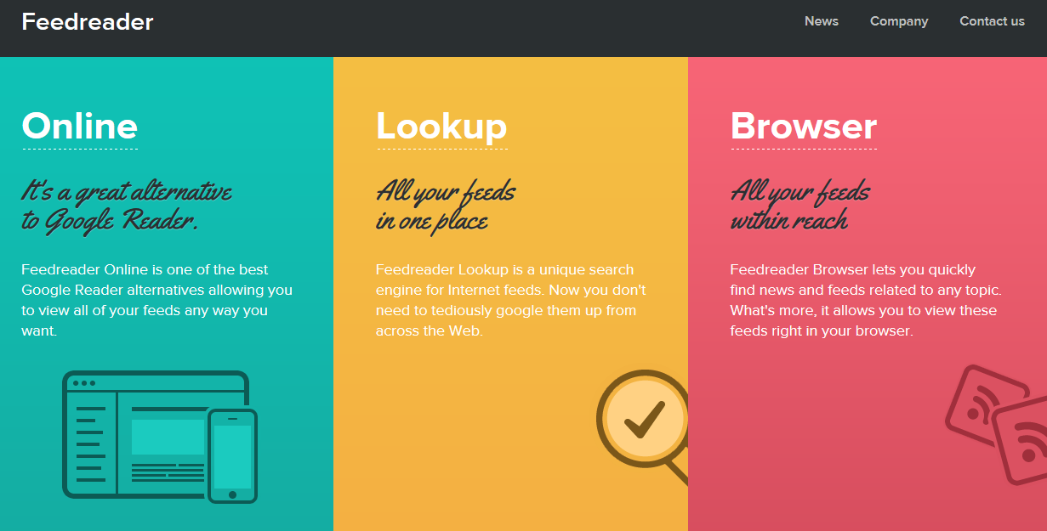
RSS
RSS Reader: FeedReader
http://www.feedreader.com/

Slide 35
RSS
(News)

Slide 36

RSS
EXAMPLE: Psychology Today
https://www.psychologytoday.com/articles/index.rss

Slide 37
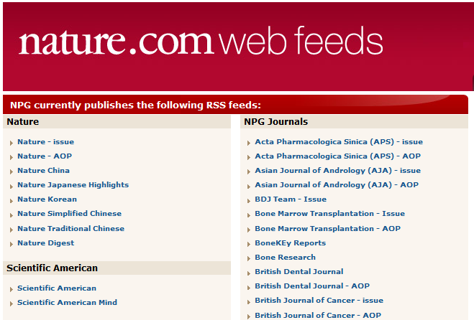
RSS
EXAMPLE: Nature Publishing Group
http://www.nature.com/webfeeds/index.html

Slide 38
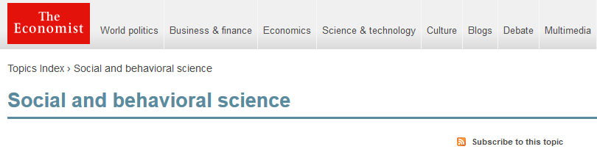
RSS
EXAMPLE: The Economist – Social & Behavioral Science
http://www.economist.com/topics/social-and-behavioral-science

Slide 39
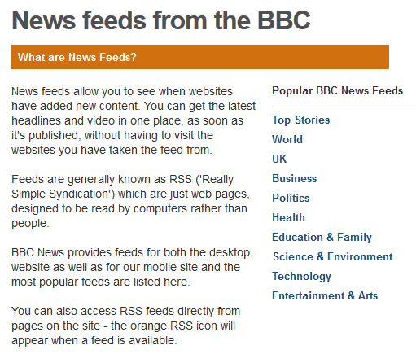
RSS
EXAMPLE: BBC News
http://www.bbc.co.uk/news/10628494

Slide 40




RSS
And many more:

Slide 41
RSS
(Searches)

Slide 42
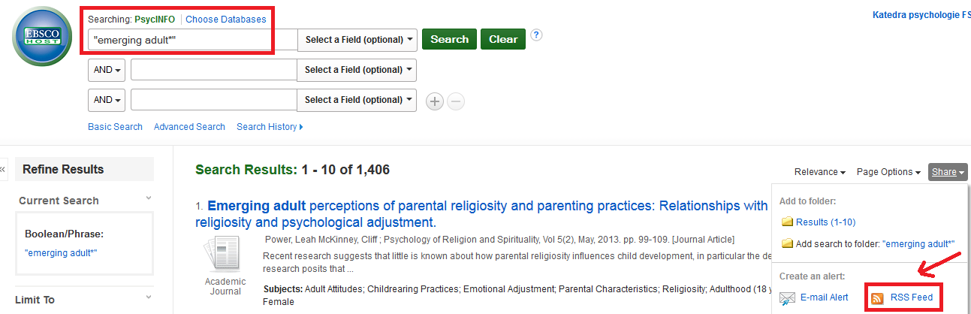
RSS
EXAMPLE: PsycINFO search
http://search.ebscohost.com/

Slide 43
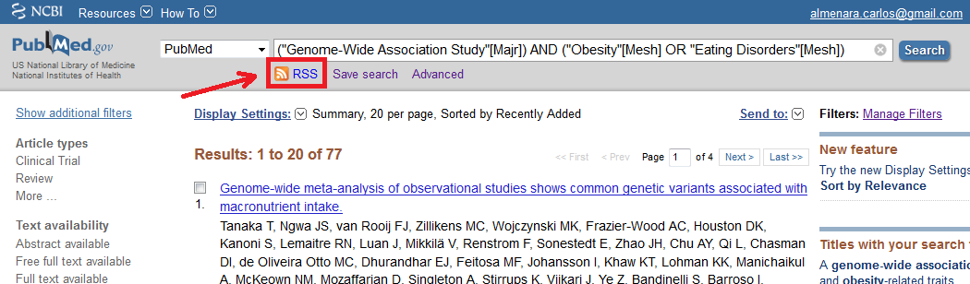
RSS
EXAMPLE: PubMed search
http://www.ncbi.nlm.nih.gov/pubmed/

Slide 44
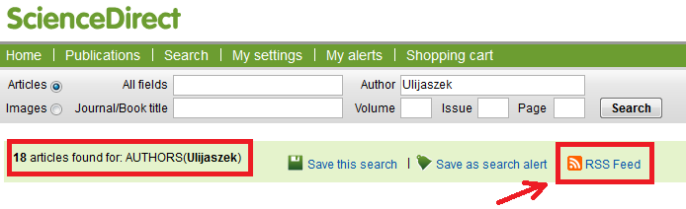
RSS
EXAMPLE: ScienceDirect search
http://www.sciencedirect.com

Slide 45
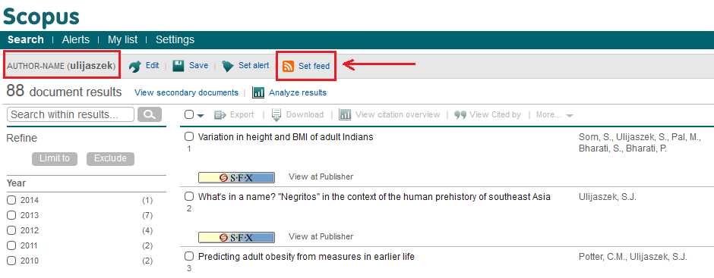
RSS
EXAMPLE: Scopus search
http://www.scopus.com

Slide 46
RSS Feed
EXERCISE:
  Sign up for a RSS feed reader (e.g. Netvibes) and subscribe to at least 2 RSS

Slide 47
LISTSERV

Slide 48
LISTSERV
The term refers to electronic mailing list software.
People subscribed to these mailing lists may participate in the discussion of different topics.
See: Willis, J., Inman, D., & Valenti, R. (2010). Sources of knowledge and perspectives. In J. Willis, D. Inman, & R. Valenti (Eds.), Completing a professional practice dissertation: A guide for doctoral students and faculty (pp. 123–175). Charlotte, NC: IAP.

Slide 49
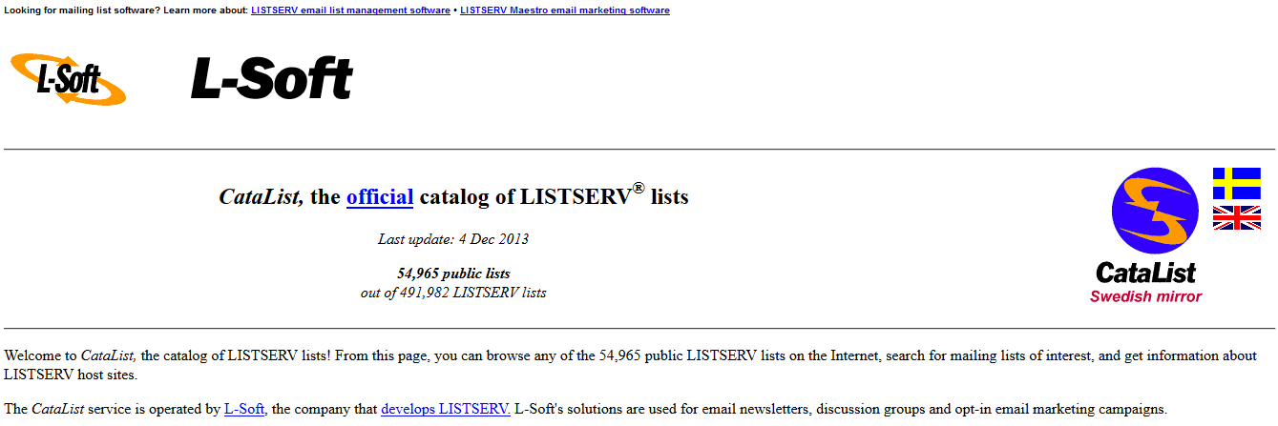
LISTSERV: Search lists with CataList
http://www.lsoft.com/catalist.html

Slide 50
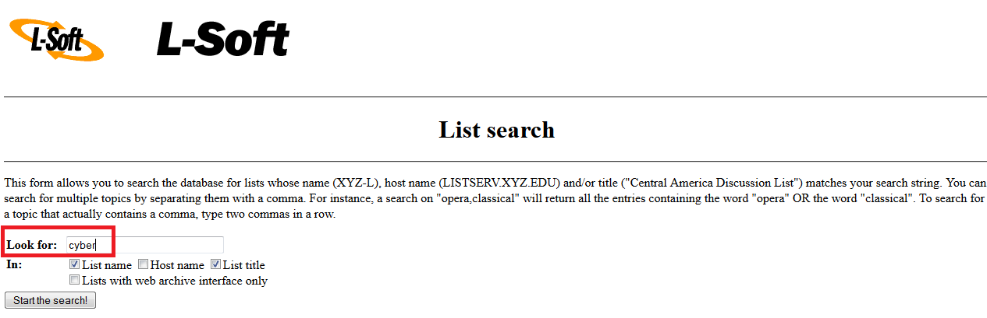
LISTSERV: Search lists with CataList
Example:
http://www.lsoft.com/catalist.html

Slide 51
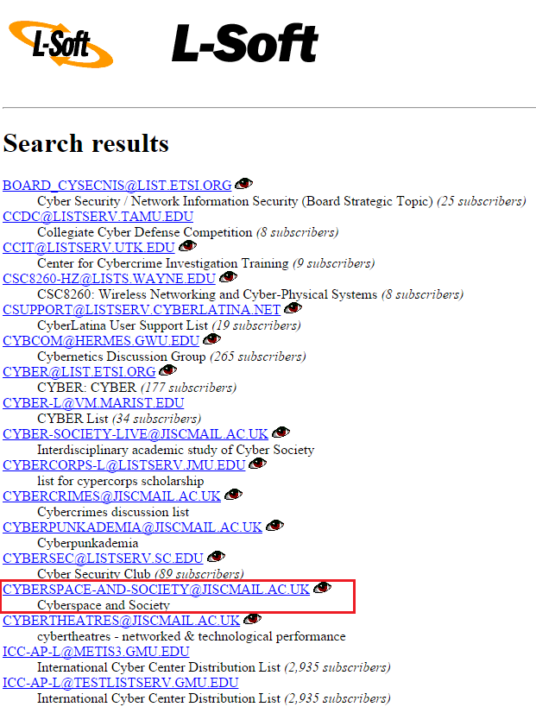
Choose among the results
http://www.lsoft.com/catalist.html

Slide 52
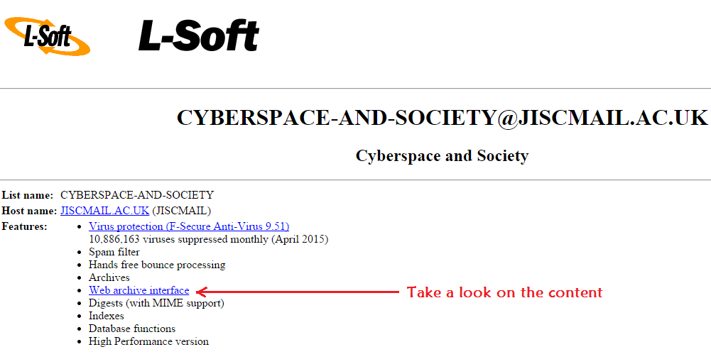
LISTSERV: Search lists with CataList
http://www.lsoft.com/catalist.html

Slide 53
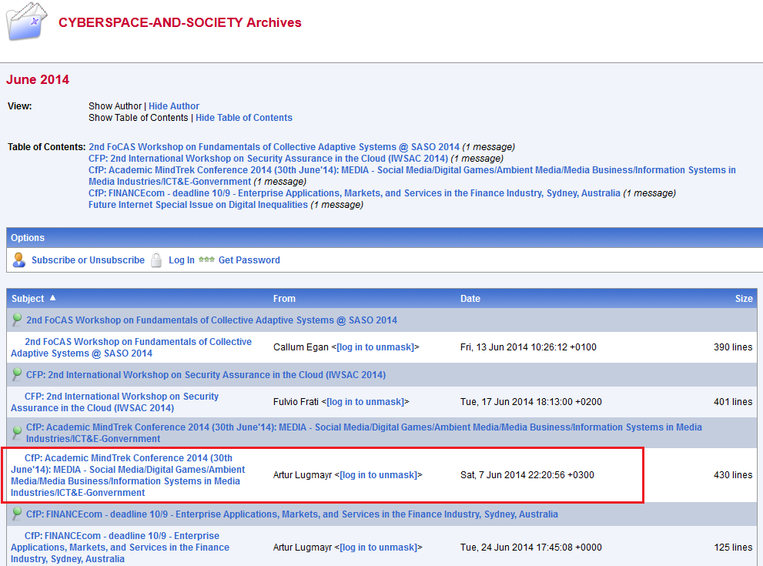
http://www.lsoft.com/catalist.html

Slide 54
TRACKING
AUTHORS

Slide 55
Tracking Authors’ new publications
IMPORTANT:
"...[consider that it] can result in a biased sample of references, perhaps reflecting only one line of argument" (Booth, Papaioannou, & Sutton, 2012; p. 79)
Booth, A., Papaioannou, D., & Sutton, A. (2012). Systematic approaches to a successful literature review. Thousand Oaks, CA: Sage.

Slide 56

Authors’ new publications
Author’s academic web page

Slide 57
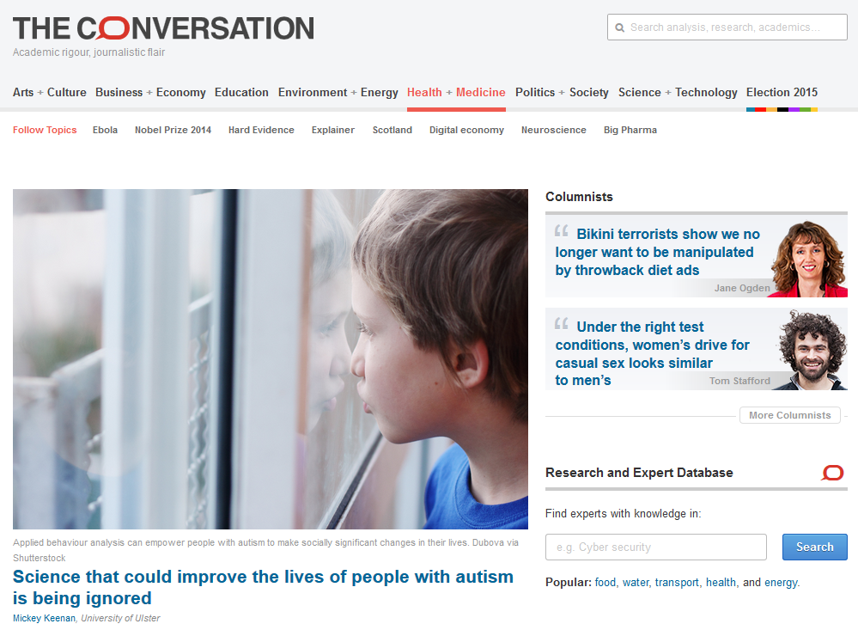
Authors divulging science
https://theconversation.com/uk/health

Slide 58
BUILDING AND EXPANDING YOUR ACADEMIC SOCIAL
NETWORKS

Slide 59
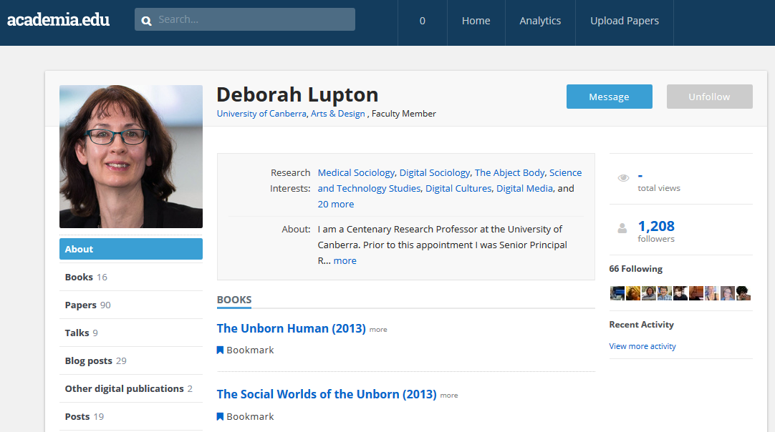
FOLLOW - Authors’ new publications
https://www.academia.edu/

Slide 60
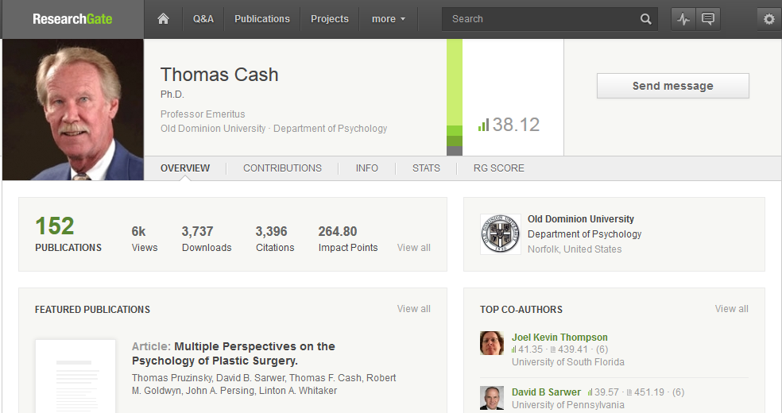
Follow - Authors’ new publications
https://www.researchgate.net/

Slide 61
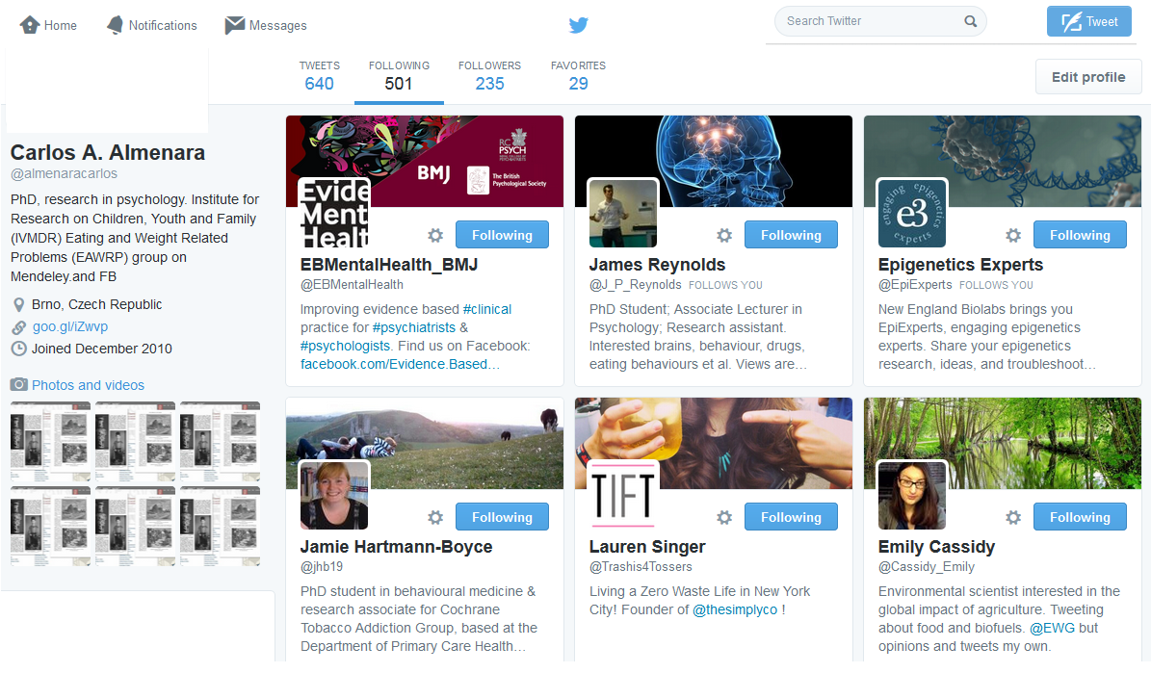
FOLLOW - Academic social networks
In Twitter you can follow your preferred authors, institutions, etc.
https://www.twitter.com

Slide 62
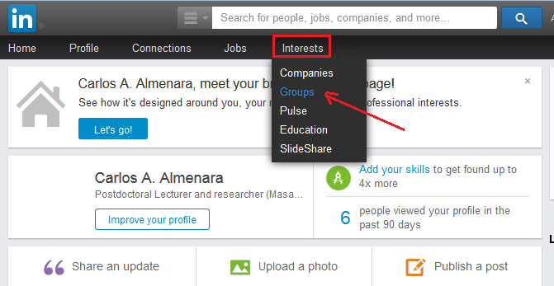
JOIN - Academic social networks
Joining a group in Linkedin
https://www.mendeley.com/

Slide 63
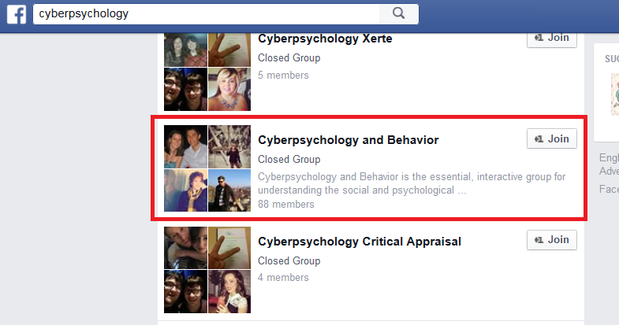
JOIN - Academic social networks
Joining a group in Facebook
https://www.facebook.com/

Slide 64

PARTICIPATE - Academic congresses
Participate in congresses and other academic events
http://http://www.globaleventslist.elsevier.com

Slide 65
EXAM

