Slide 1
ORGANIZING THE INFORMATION with MENDELEY
Carlos A. Almenara, PhD
Online and Offline Resources In Psychological Assessment PSY494P122 (March 11th, 2015)

Slide 2
REFERENCE
MANAGEMENT

Slide 3
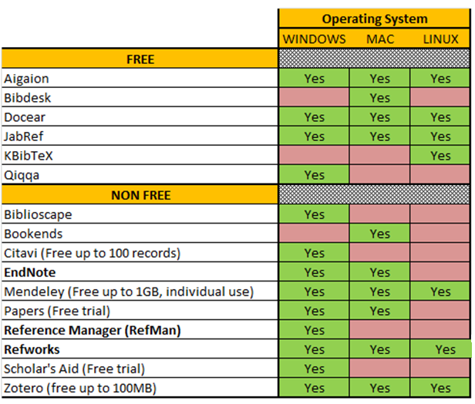
Comparison of Reference Management Software: Operating System

Slide 4
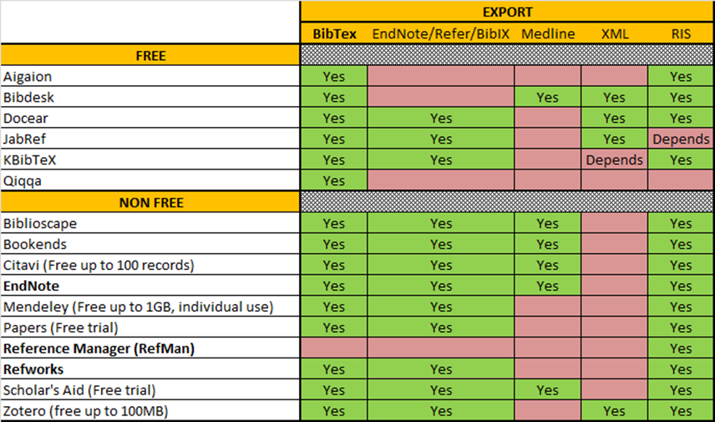
Comparison of Reference Management Software: Exporting Options

Slide 5
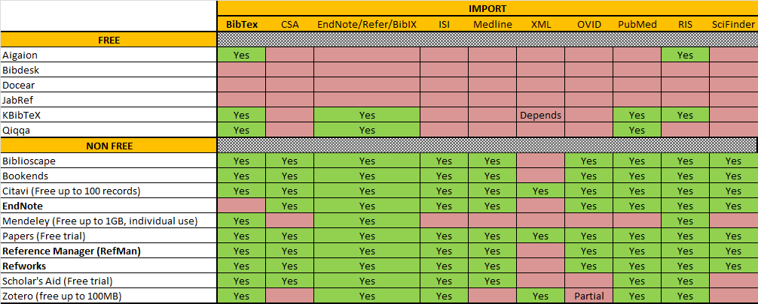
Comparison of Reference Management Software: Importing Options

Slide 6
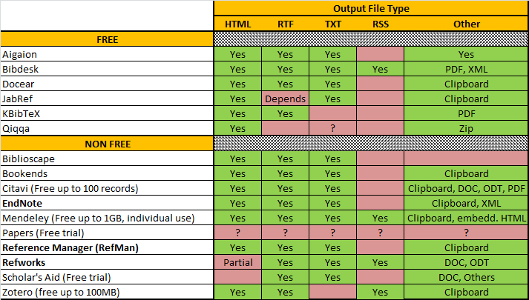
Comparison of Reference Management Software: Output File Format

Slide 7
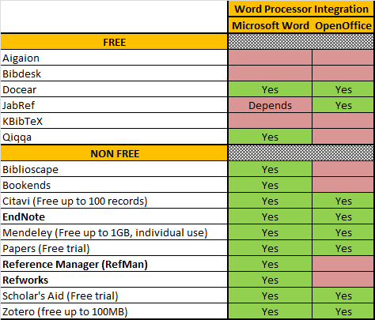
Comparison of Reference Management Software: Word Processor Integration

Slide 8
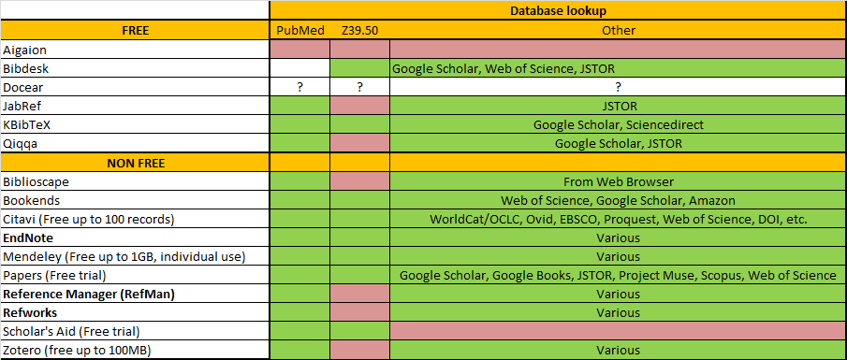
Comparison of Reference Management Software: Database Lookup

Slide 9


Slide 10
MENDELEY (Reference Manager)
Mendeley has two synchronized interfaces:
  Desktop software: Software and documents manager.
  Web Application: Incl. also an academic social network

Slide 11
MENDELEY (Reference Manager)
Key characteristics of Mendeley:
  Content discovery & access
  Knowledge management & collaboration
  Publication & dissemination

Slide 12
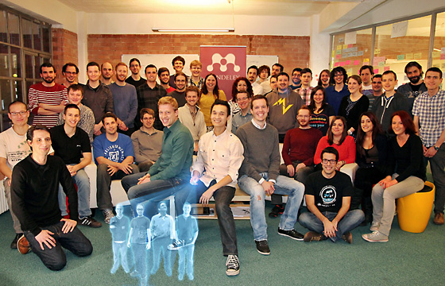
MENDELEY (Reference Manager)
On April 9th 2013, Elsevier acquired Mendeley

Slide 13
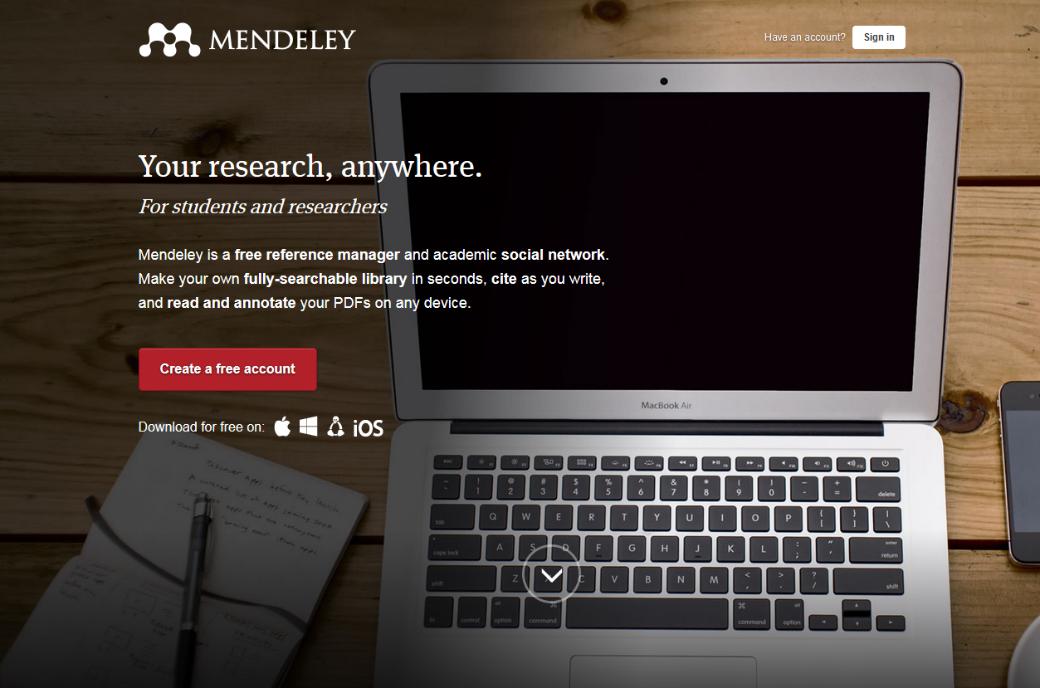
MENDELEY: Create your account

Slide 14
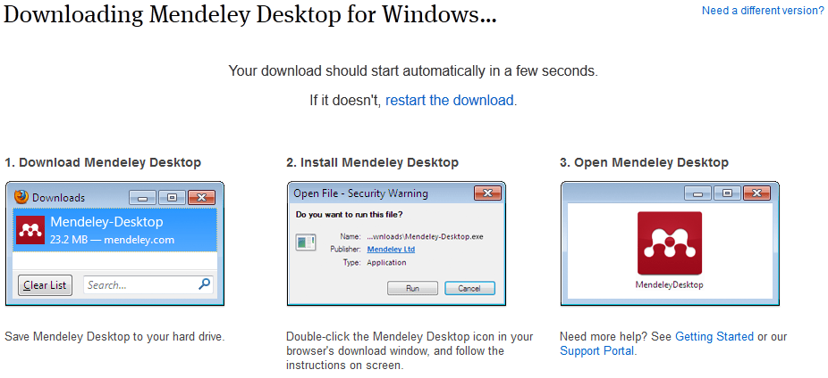
MENDELEY: Download

Slide 15
MENU BAR:
FILE

Slide 16
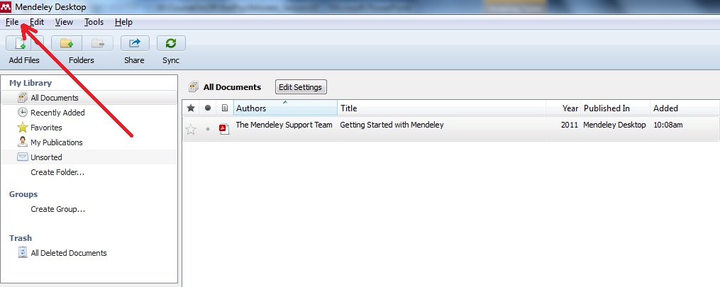
MENDELEY: File (Menu bar)

Slide 17
ADDING
FILES INTO YOUR DATABASE

Slide 18

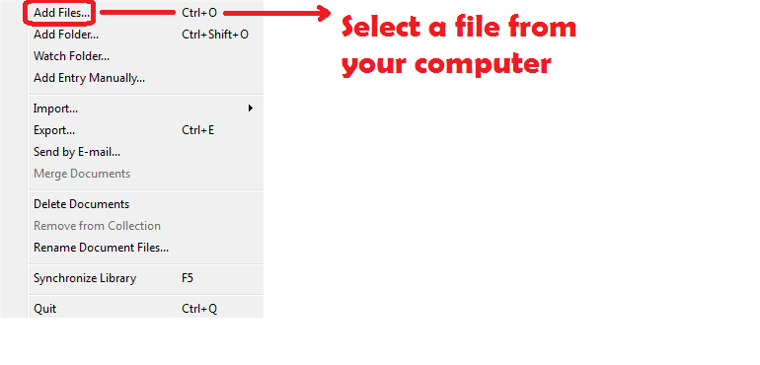
MENDELEY: File (Menu bar)

Slide 19
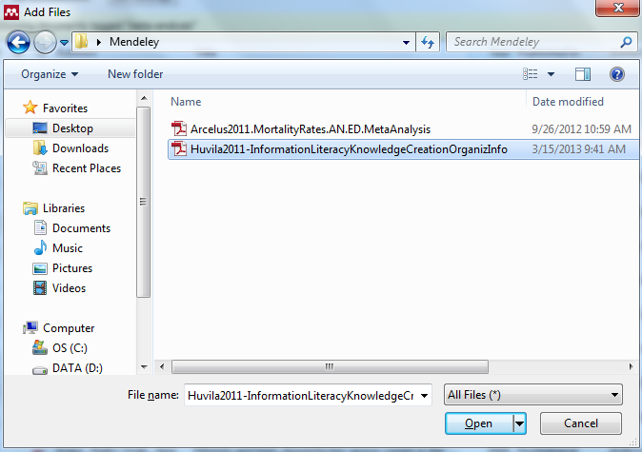
MENDELEY: File (Menu bar)

Slide 20
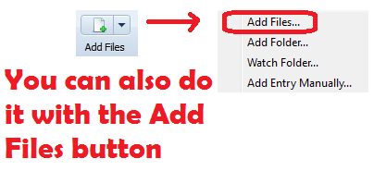
MENDELEY: File (Menu bar)

Slide 21
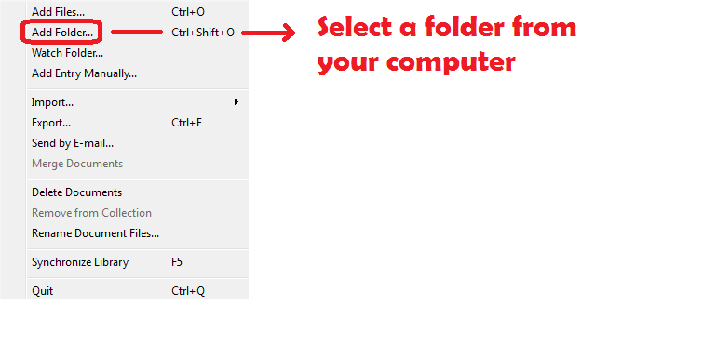
MENDELEY: File (Menu bar)

Slide 22
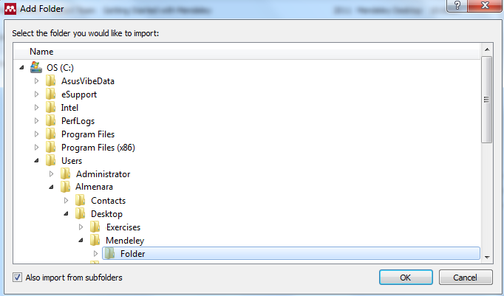
MENDELEY: File (Menu bar)

Slide 23
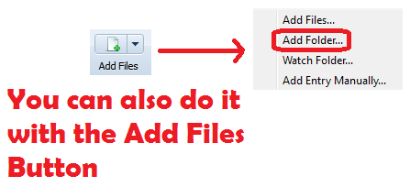
MENDELEY: File (Menu bar)

Slide 24
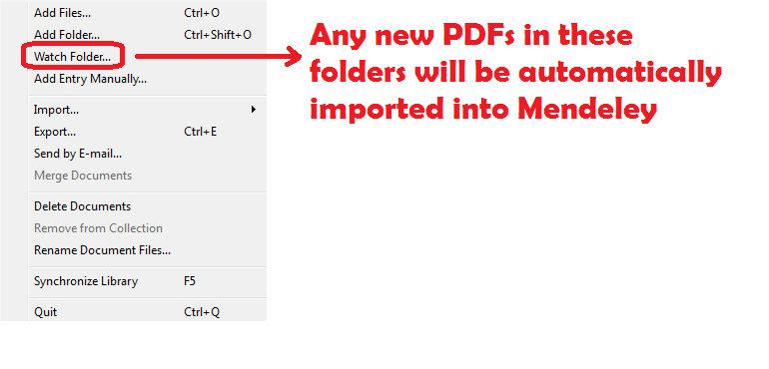
MENDELEY: File (Menu bar)

Slide 25
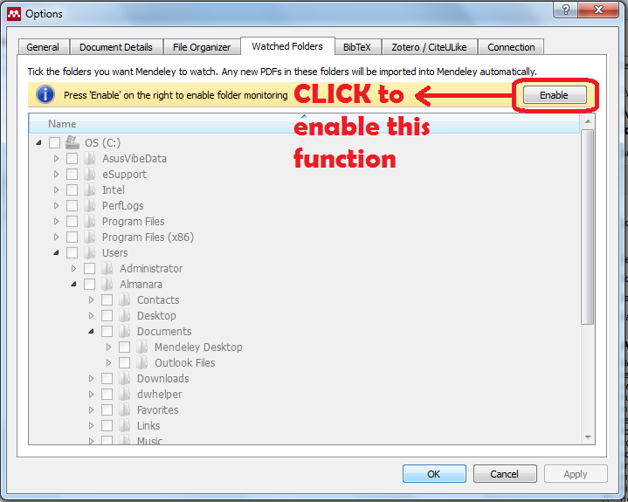
MENDELEY: File (Menu bar)

Slide 26
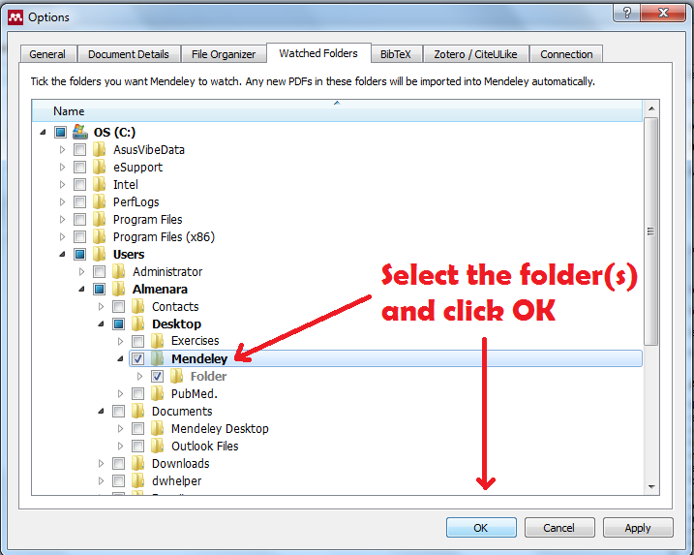
MENDELEY: File (Menu bar)

Slide 27
ADDING
REFERENCES MANUALLY

Slide 28
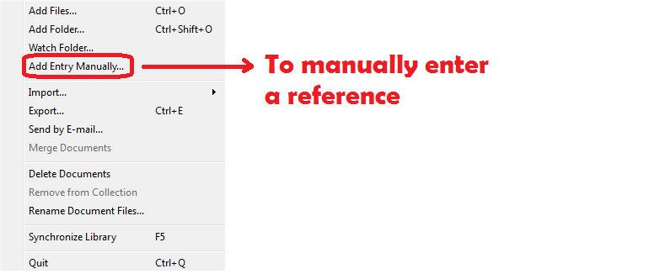
MENDELEY: File (Menu bar)

Slide 29
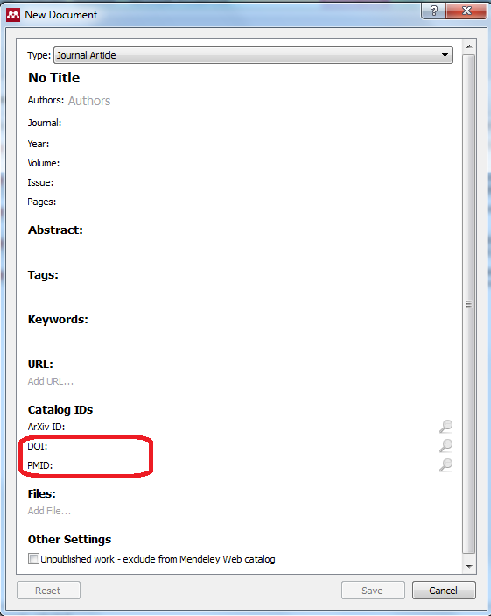
Manual mode
The easiest and recommended way to manually introduce an article’s reference is using the DOI * or PMID **

Slide 30
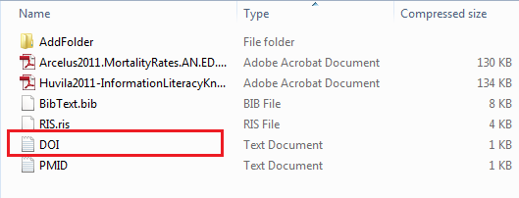
MENDELEY: File (Menu bar)

Slide 31
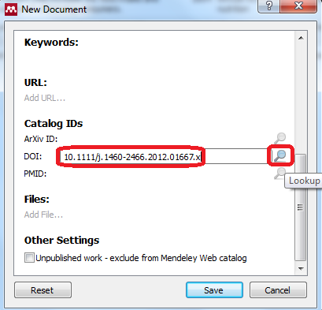
MENDELEY: File (Menu bar)

Slide 32
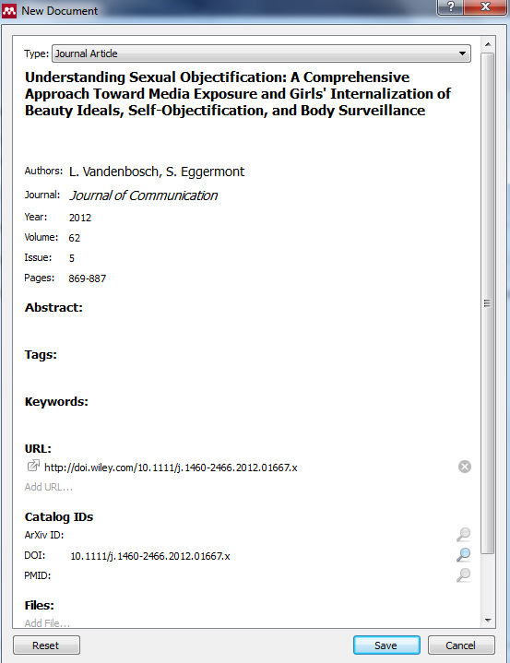
Manual mode
As you can see, there is missing information.
In the case of this journal, Keywords are not available.
The Abstract is retrieved from PubMed, but the PMID is still pending.

Slide 33
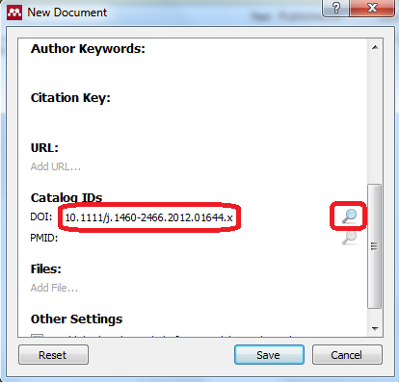
MENDELEY: File (Menu bar)

Slide 34
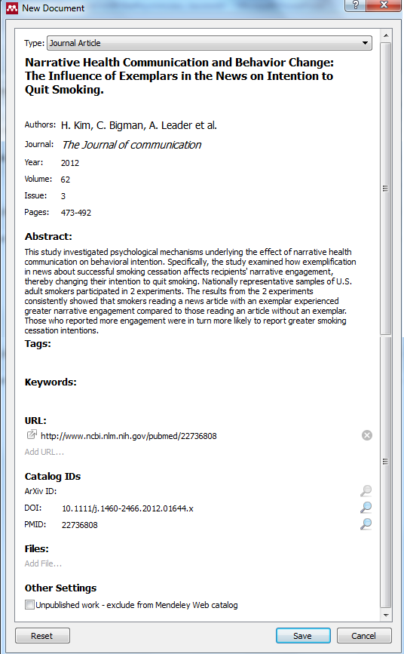
Manual mode
In the case of this other article from the same journal, the Abstract was retrieved (PMID is already available).

Slide 35
MENDELEY: Modifying references
This is how the reference would looks like:
  Kim, H. S., Bigman, C. A., Leader, A. E., Lerman, C., & Cappella, J. N. (2012). Narrative Health Communication and Behavior Change: The Influence of Exemplars in the News on Intention to Quit Smoking. The Journal of communication, 62(3), 473–492. doi:10.1111/j.1460-2466.2012.01644.x
This is the correct reference (APA style, 6th edition):
  Kim, H. S., Bigman, C. A., Leader, A. E., Lerman, C., & Cappella, J. N. (2012). Narrative health communication and behavior change: The influence of exemplars in the news on intention to quit smoking. The Journal of Communication, 62(3), 473–492. doi:10.1111/j.1460-2466.2012.01644.x

Slide 36
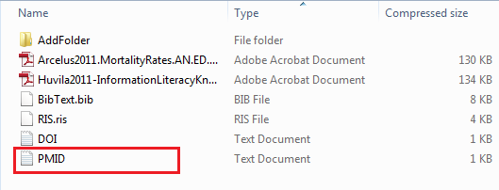
MENDELEY: File (Menu bar)

Slide 37
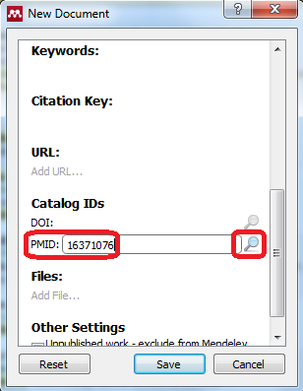
MENDELEY: File (Menu bar)

Slide 38
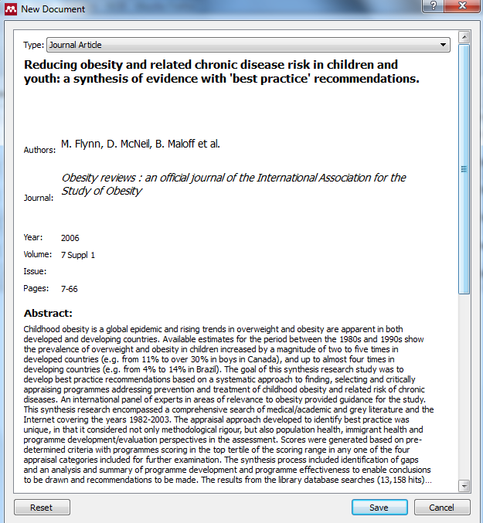
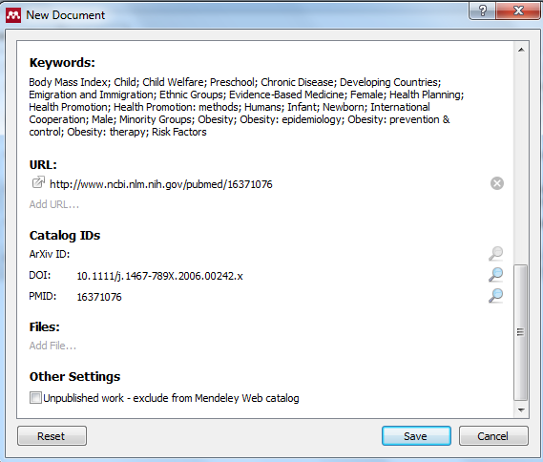
MENDELEY: File (Menu bar)

Slide 39
IMPORTING
A LIST OF REFERENCES

Slide 40
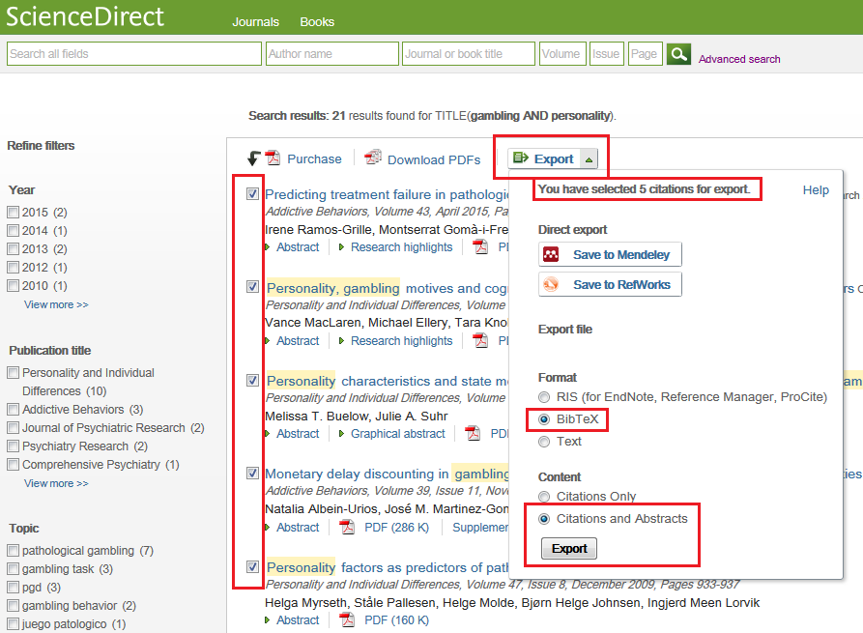

Slide 41
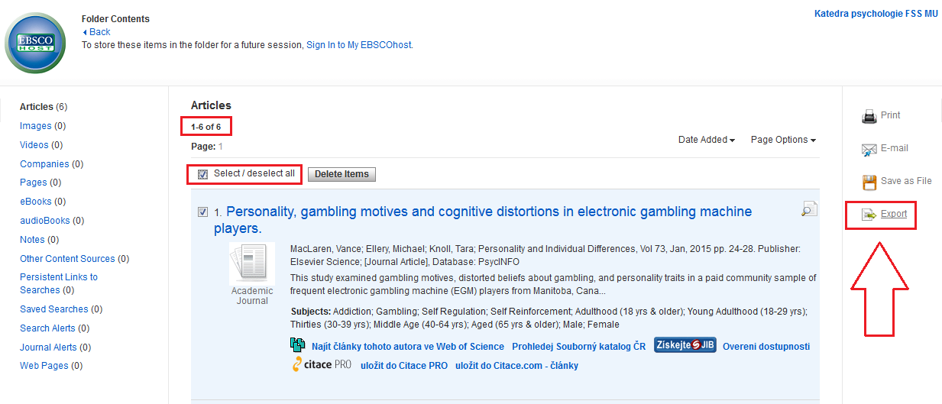
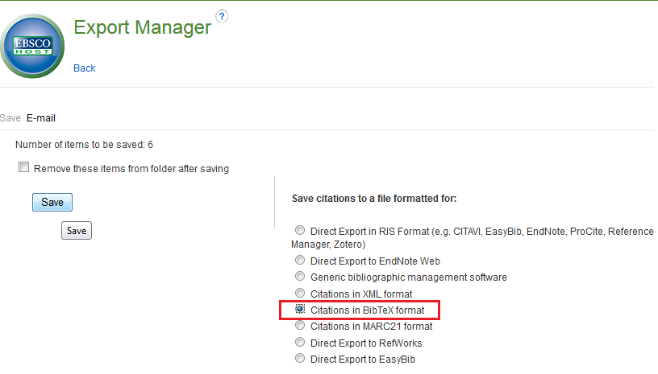

Slide 42
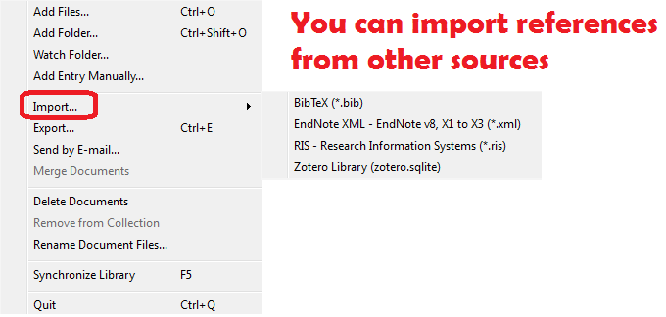
MENDELEY: File (Menu bar)

Slide 43
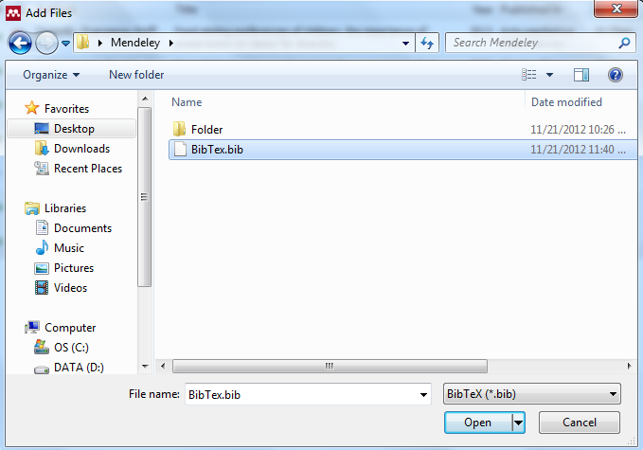
MENDELEY: File (Menu bar)

Slide 44
EXPORTING
A LIST OF REFERENCES

Slide 45
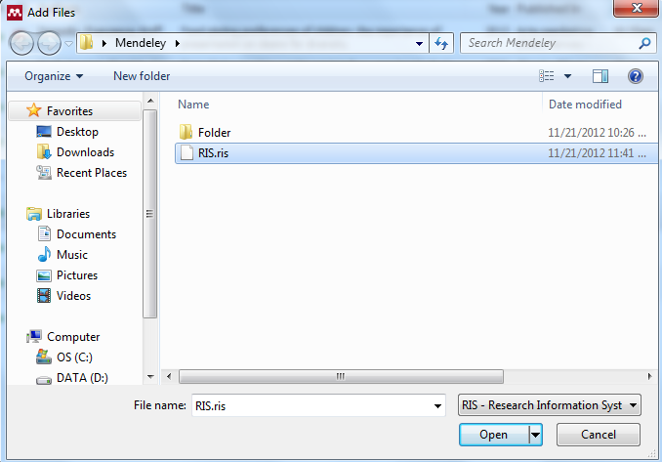
MENDELEY: File (Menu bar)

Slide 46
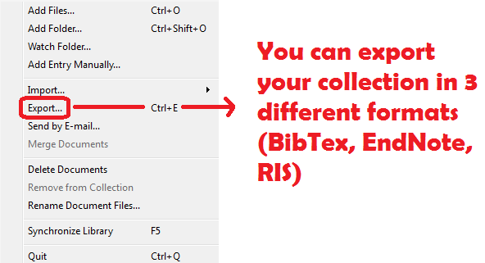
MENDELEY: File (Menu bar)

Slide 47
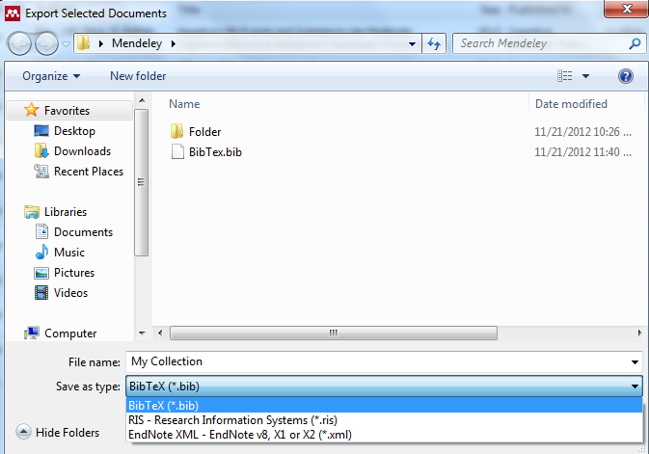
MENDELEY: File (Menu bar)

Slide 48
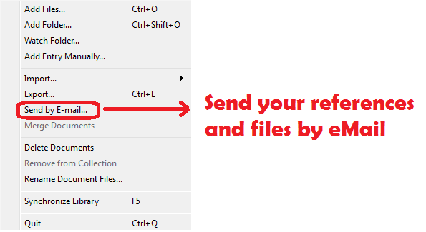
MENDELEY: File (Menu bar)

Slide 49
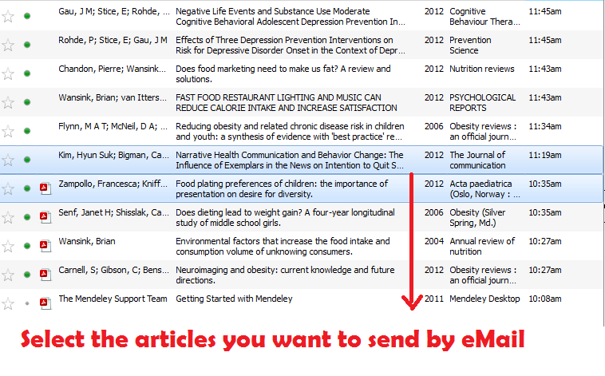
MENDELEY: File (Menu bar)

Slide 50
MENDELEY: File (Menu bar)

Slide 51
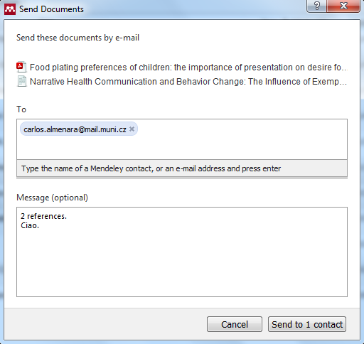
MENDELEY: File (Menu bar)

Slide 52
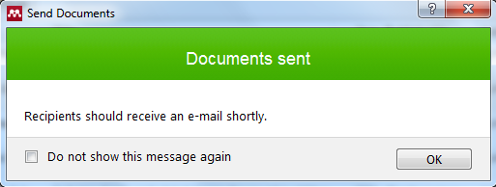
MENDELEY: File (Menu bar)

Slide 53
DUPLICATED
REFERENCES

Slide 54
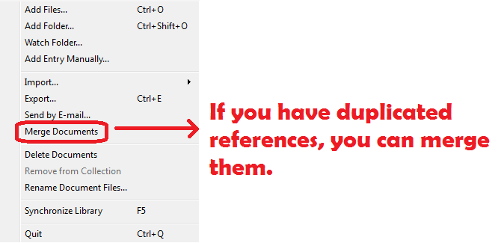
MENDELEY: File (Menu bar)

Slide 55
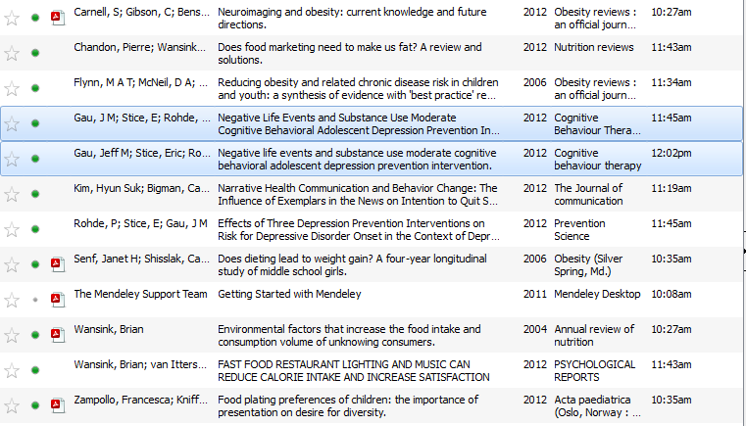
MENDELEY: File (Menu bar)

Slide 56
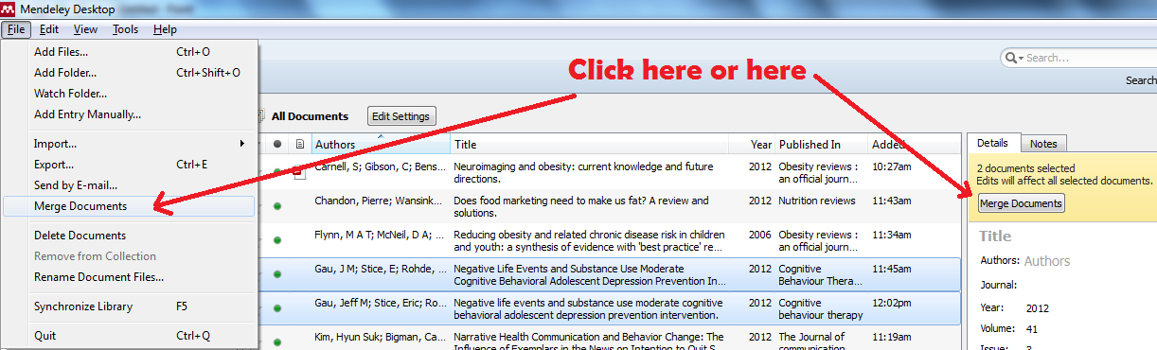
MENDELEY: File (Menu bar)

Slide 57
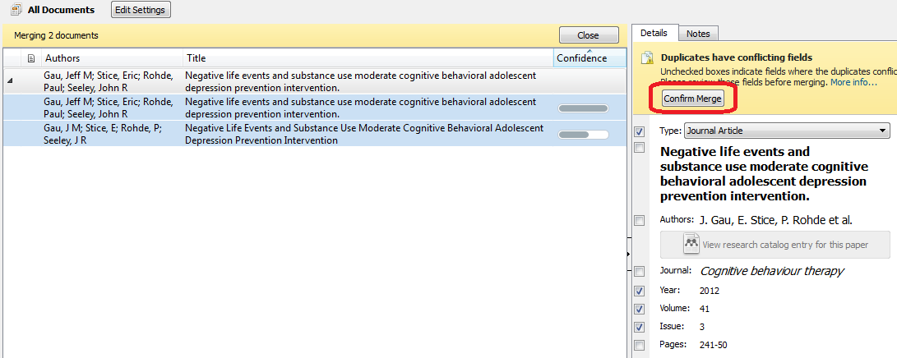
MENDELEY: File (Menu bar)

Slide 58
DELETING
REFERENCES

Slide 59
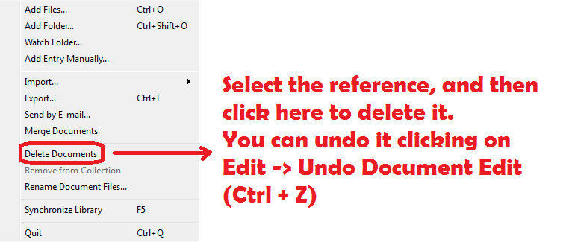
MENDELEY: File (Menu bar)

Slide 60
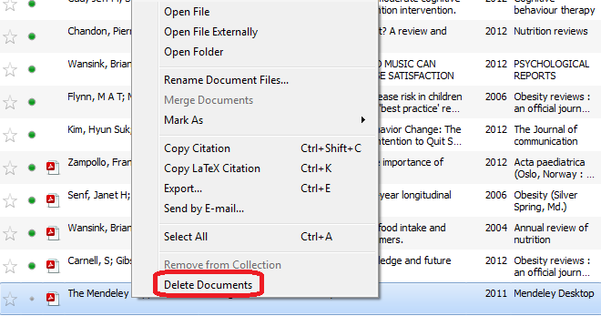
MENDELEY: File (Menu bar)
The Delete Documents option (and other options) is also available using right click.

Slide 61
THE NAME OF YOUR FILES

Slide 62
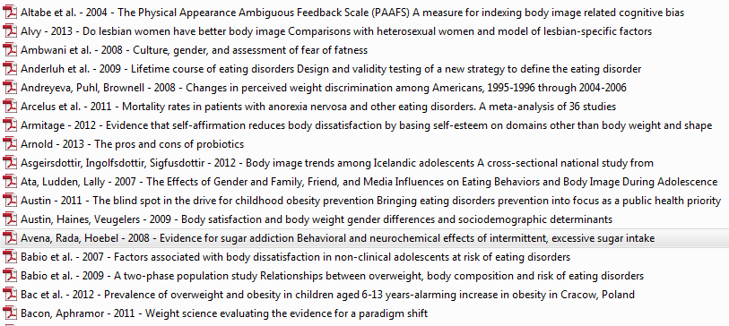
MENDELEY: File (Menu bar)

Slide 63
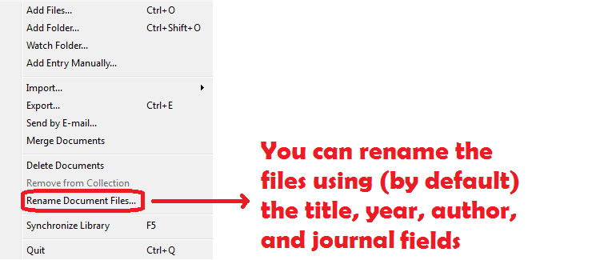
MENDELEY: File (Menu bar)

Slide 64

MENDELEY: File (Menu bar)
Click and drag the bubbles to edit the way the files are named.

Slide 65
SYNCHRONIZING YOUR DATABASE

Slide 66

MENDELEY: File (Menu bar)
Synchronize your library to be used by you on the Mendeley’s website or to retrieve your records and files in another device.

Slide 67

MENDELEY: File (Menu bar)
During the synchronization process, your files, records, annotations are uploaded/downloaded

Slide 68
MENU BAR:
EDIT

Slide 69
SEARCHING
YOUR
DATABASE

Slide 70


MENDELEY: Edit (Menu bar)
Searching

Slide 71


MENDELEY: Edit (Menu bar)
Searching:

Slide 72


MENDELEY: Edit (Menu bar)
Searching: You may use truncation (*)

Slide 73


MENDELEY: Edit (Menu bar)
Searching: You may use Boolean operators (AND, OR, NOT)

Slide 74

Advanced Search: Improve your search using the filters on the left panel.

Slide 75


Slide 76
COPY/PASTE
REFERENCES

Slide 77

MENDELEY: Edit (Menu bar)
Copy citation

Slide 78
CREATE FOLDERS FOR YOUR
REFERENCES

Slide 79

MENDELEY: Edit (Menu bar)
Create a folder

Slide 80

MENDELEY: Edit (Menu bar)
Drag and drop into the new folder

Slide 81

MENDELEY: Edit (Menu bar)
The records appear now also in the folder.

Slide 82
CREATE A GROUP!

Slide 83

MENDELEY: Edit (Menu bar)
Create a Group

Slide 84

MENDELEY: Edit (Menu bar)

Slide 85

MENDELEY: Edit (Menu bar)
Invite people to join your group:

Slide 86

MENDELEY: Edit (Menu bar)
Edit the characteristics of your group:

Slide 87

MENDELEY: Edit (Menu bar)
Give this group more details:

Slide 88

MENDELEY: Edit (Menu bar)
Give this group more details:

Slide 89

MENDELEY: Edit (Menu bar)
Give this group more details:

Slide 90

MENDELEY: Edit (Menu bar)
Delete the group:

Slide 91

MENDELEY: Edit (Menu bar)
Delete the group:

Slide 92

MENDELEY: Edit (Menu bar)
The number of groups is growing everyday

Slide 93
MENU BAR:
VIEW

Slide 94

MENDELEY: View (Menu bar)

Slide 95

MENDELEY: View (Menu bar)
View Mode: Library as Citations

Slide 96

MENDELEY: View (Menu bar)
Citation Style

Slide 97

MENDELEY: View (Menu bar)
Details box

Slide 98

MENDELEY: View (Menu bar)
Mendeley Suggests

Slide 99

MENDELEY: View (Menu bar)
Mendeley Suggests

Slide 100
MENU BAR:
TOOLS

Slide 101

MENDELEY: Tools (Menu bar)
Invite people

Slide 102

MENDELEY: Tools (Menu bar)
Invite people

Slide 103
WEB BROWSER
BUTTON

Slide 104

MENDELEY: Tools (Menu bar)
Bookmarklet

Slide 105


Slide 106


Slide 107
MS WORD
BUTTON

Slide 108

MENDELEY: Tools (Menu bar)
MS Word plugin

Slide 109

MENDELEY: Tools (Menu bar)
MS Word plugin

Slide 110


MENDELEY: Tools (Menu bar)
MS Word plugin

Slide 111

MENDELEY: Tools (Menu bar)
This is how it appears in your text

Slide 112

MENDELEY: Tools (Menu bar)
Click Insert Bibliography

Slide 113


MENDELEY: Tools (Menu bar)
Insert Bibliography

Slide 114


MENDELEY: Tools (Menu bar)
Insert Bibliography

Slide 115
AUTOMATICALLY CHECK
FOR DUPLICATES

Slide 116

MENDELEY: Tools (Menu bar)
Duplicates

Slide 117
CUSTOMIZE

Slide 118

MENDELEY: Tools (Menu bar)
Options

Slide 119

MENDELEY: Tools, Options
General

Slide 120

MENDELEY: Tools, Options
General

Slide 121

MENDELEY: Tools, Options
Document Details

Slide 122

MENDELEY: Tools, Options
File Organizer

Slide 123
MENDELEY: Tools, Options
Watched (Indexed) Folders

Slide 124

MENDELEY: Tools, Options
BibTex File

Slide 125

MENDELEY: Tools, Options
Integrate

Slide 126

MENDELEY: Tools, Options
Proxy

Slide 127
MENU BAR:
HELP

Slide 128

MENDELEY: Help

Slide 129
EXTRA
BUTTONS

Slide 130

MENDELEY: Extra Buttons

Slide 131

MENDELEY: Extra Buttons

Slide 132

MENDELEY: Extra Buttons

Slide 133
APA Citation Style
EXERCISES

Slide 134

EXERCISE
Insert a book chapter (manually)

Slide 135
NEXT CLASS
READINGS:
Finding sources by subject: Psychology (Lenburg, 2010)
Evaluating and selecting psychological measures for research purposes (Constantine & Ponterotto, 2006)
Finding search words (Ercegovac, 2008; Chapter 2)
Finding sources of information: archives, CD-ROM collections, general references (Lenburg, 2010) (optional)

