Slide 1
Offline resources
Carlos A. Almenara, PhD
Online and Offline Resources In Psychological Assessment PSY494P122 (March 18th, 2015)

Slide 2
MENTAL MEASUREMENTS YEARBOOK

Slide 3
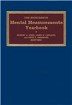
Mental Measurements Yearbook
The series (now 19th, 2014), initiated in 1938, provides factual information, critical reviews, and comprehensive bibliographic references on the construction, use, and validity of all tests published in English.
Reviews are written by highly qualified professionals with expertise in a range of disciplines.
An updated directory of test publishers is also included.

Slide 4
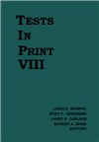
Tests in Print VIII (2011)
Complement the Mental Measurements Yearbooks.
Information on available tests and specific test bibliographies.
Contains descriptive information on approximately 3,000 testing instruments, including specific data on its purpose, target population, scoring, and pricing.

Slide 5
Directory of Special Libraries and Information Centers

Slide 6
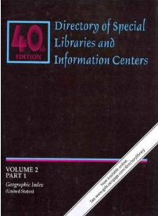
Directory of Special Libraries and Information Centers
This 40th edition has 2 Volumes:
  Volume 1 (6 parts): provides detailed contact and descriptive information on subject-specific resource collections maintained by various government agencies, businesses, publishers, educational and nonprofit organizations, and associations around the world.
  Volume 2 Geographic and Personnel Indexes (3 parts): provides access to profiled libraries by geographic region, as well as by the professional staff that are cited in each listing.

Slide 7
WORLD GUIDE
TO
SPECIAL LIBRARIES

Slide 8
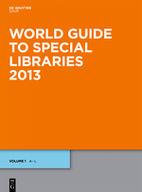
World Guide to Special Libraries
This 9th edition lists over 35,000 libraries under approx. 80 subject headings.
Includes special libraries from the National Library of Medicine (Bethesda, USA), to ‘classic’ special libraries such as the Bibliothèque artistique de la ville de Bruxelles.
It provides complete details of the libraries and their holdings, and alphabetical indexes of subjects and institutions.

Slide 9
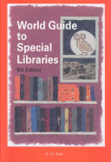
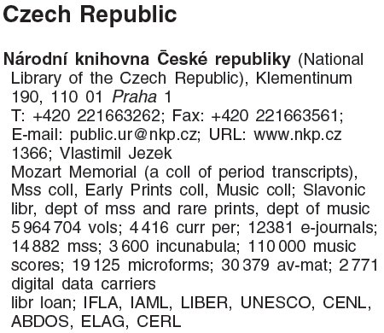
World Guide to Special Libraries
Record example: Czech Republic’s national library

Slide 10
Social Science Reference Sources:
A Practical Guide

Slide 11
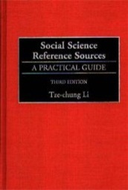
Social Science Reference Sources:
A Practical Guide (2000)
Provides entries for roughly 1,600 reference sources in the social sciences, including anthropology, business, economics, education, geography, history, law, political science, psychology, and sociology.
Most titles published before 1980, which are listed in the second edition, have been excluded, while the present volume gives special attention to electronic resources, including more than 200 web sites.

Slide 12
Directory of Unpublished Experimental Mental Measures

Slide 13
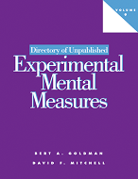
Directory of Unpublished Experimental Mental Measures
Identifies and describes noncommercial psychological measures from the fields of psychology, sociology, and education that have been devised by researchers and published in 36 top journals.
The instruments are not evaluated, but provides useful information about tests.
Served as inspiration for the PsycTESTS database.

Slide 14
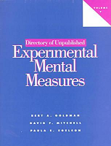
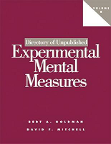
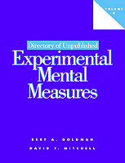
Directory of Unpublished Experimental Mental Measures
Volume 7: Published in 1997
  Covers noncommercial psychological measures between 1970 and 1985.
Volume 8: Published in 2002
  Covers noncommercial psychological measures between 1996 and 2000.
Volume 9: Published in 2007
  Covers noncommercial psychological measures between 2001 and 2005.

Slide 15
DOODY’S
CORE TITLES

Slide 16

DOODY’S CORE TITLES
Provides expert recommendations of must-have titles in 121 specialties.

Slide 17
SELECTED BOOKS

Slide 18
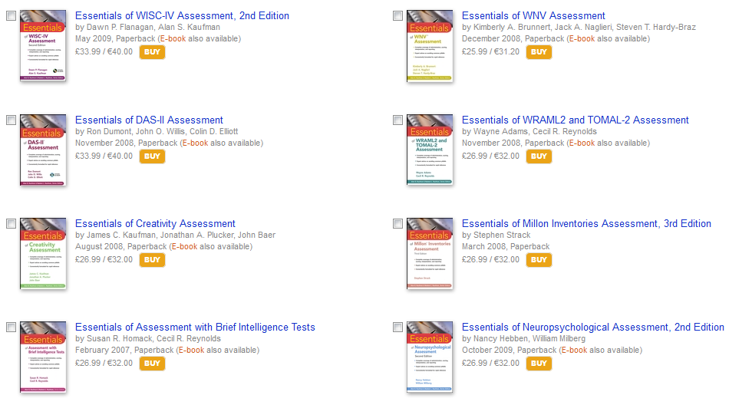
Wiley’s Essentials of Psychological Assessment
To quickly acquire the knowledge and skills needed to make optimal use of the major psychological assessment tests.

Slide 19

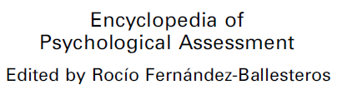
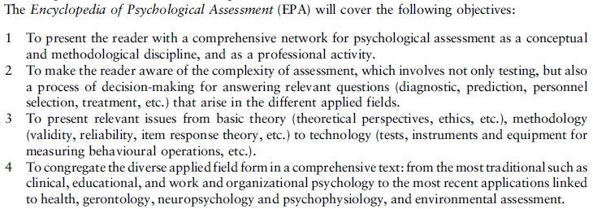
Encyclopedia of Psychological Assessment
Notes:
gender identity disorder; impulse control disorders (i.e., kleptomania, trichotillomania, intermittent explosive disorder); selective mutism; Munchausen by proxy; childhood schizophrenia; gang involvement; sexual offending; self-injurious behavior; and feral children.

Slide 20
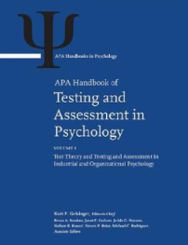
APA Handbook of Testing and Assessment in Psychology
This 3-volume handbook is a comprehensive presentation of the theory and application of tests in psychology and education.
Probably the most comprehensive reviews on the use of testing and assessment.
MUNI Library (Book Number): 4240767206

Slide 21
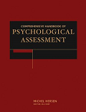
Comprehensive Handbook of Psychological Assessment (Hersen, 2004)
4-volume set presenting essential information on the 4 major classes of psychological assessment instruments:
  Comprehensive Handbook of Psychological Assessment
  Intelligence/neuropsychological
  Personality
  Behavioral
  Industrial/organizational
MUNI Library (Book Number): 4240748762

Slide 22
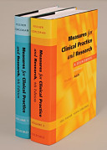
Measures for Clinical Practice and Research: A Sourcebook (4th ed)
The 4th edition (Corcoran & Fischer, 2007) of this 2-volume classic sourcebook has dozens of new scales as well as updated information for existing instruments.
Each instrument is reproduced in its entirety and critiqued by the editors.
MUNI Library (Book Number): 4240767408

Slide 23
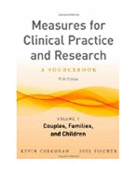
Measures for Clinical Practice and Research: A Sourcebook (5th ed)
This seminal 2 volume 5th edition (2013) contains hundreds of the most useful measurement tools for use in clinical practice and in research.
All measures are critiqued by the editors, who provide guidance on how to select and score them and the actual measures are wholly reproduced.
MUNI Library (Book Number): 000880275

Slide 24
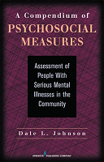
A Compendium of Psychosocial Measures
(Dale L. Johnson, 2010) Presents the purpose of each measurement tool, the description, psychometric properties, reliability, validity, and usage guidelines in template format
Includes measurement tools for functional assessment, community living, social problem solving and coping, agency performance evaluation, and more
http://books.google.com/books?id=k_ukS4wz1dEC
Notes:
Assessment of People with Serious Mental Illness in the Community

Slide 25
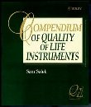
Compendium of Quality of Life Instruments
(Sam Salek, 1999) 5-volume set covering approximately 200 instruments, all validated by key references, used by researchers to measure the quality of life.
Reliability, validity and strengths and weaknesses of the instruments are presented, enabling researchers to decide their use.
http://www.wiley.com/legacy/products/subject/reference/salek_index.html

Slide 26
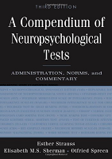
A Compendium Of Neuropsychological Tests
Strauss et al. (2006)
1216 pages covering every aspect of neuropsychological assessment.
Critical review of tests.
A complete chapter about norms selection, and access to normative data.

Slide 27
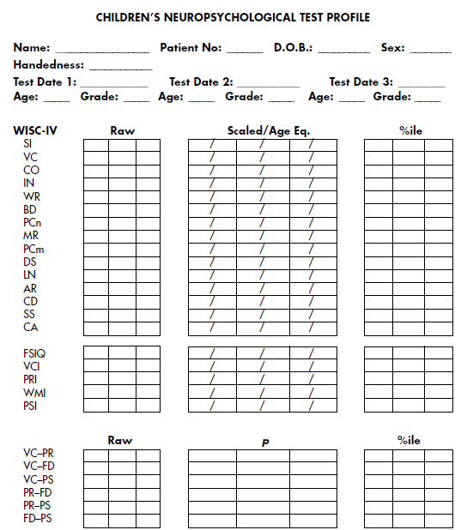
A Compendium Of Neuropsychological Tests
Children’s Neuropsychological Test Profile

Slide 28
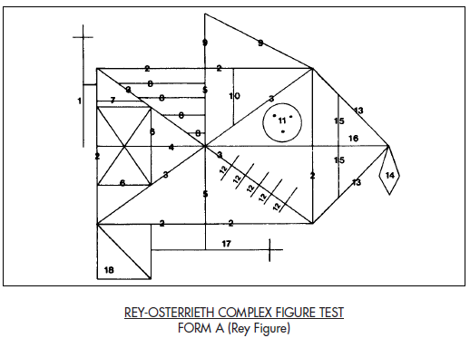
A Compendium Of Neuropsychological Tests
Complete tests are available.

Slide 29
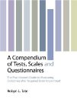
A Compendium of Tests, Scales and Questionnaires (Tate, 2010)
Contains an extensive selection of instruments developed to measure signs and symptoms commonly encountered in neurological conditions.
Provides a repository of established instruments, as well as newly-developed scales, and covers all aspects of the functional consequences of acquired brain impairment.

Slide 30
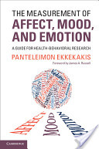
The measurement of affect, mood, and emotion:
A guide for health-behavioral research
Ekkekakis (2013)
Proposes a sound system for selecting measures for these constructs (affect, mood and emotion) in an accessible guidebook.

Slide 31
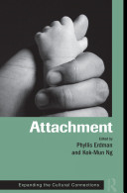
Attachment: Expanding the Cultural Connections (Erdman et al., 2010)
Explores the latest trends in the theory and application of attachment within cross-cultural settings.
Provides an insightful analysis, remarkable case studies, and groundbreaking research make it essential reading for any clinician or scholar interested in perceptions of love and attachment.

Slide 32
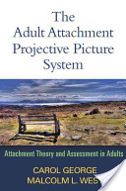
The adult attachment projective picture system: Attachment theory and assessment in adults
George & West (2012)
Presents cutting-edge research on adult attachment together with a complete overview of the Adult Attachment Projective Picture System (AAP), the authors' validated developmental assessment.

Slide 33

Assessing common mental health and addiction issues with free-access instruments
Sandberg et al. (2013)
Identifies the most efficient free access instruments and provides summary information about administration, scoring, interpretation, psychometric integrity, and strengths and weaknesses.

Slide 34
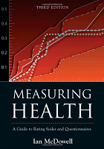
Measuring health: A guide to rating scales and questionnaires (McDowell, 2006)
This 3rd edition provides in-depth reviews of over 100 of the leading health measurement tools and serves as a guide for choosing among them.
Each chapter presents a tabular comparison of the quality of the instruments reviewed, followed by reliability and validity and, where possible, shows a copy of the actual scale.

Slide 35

Health measurement scales: A practical guide to their development and use
Streiner & Norman (2008)
This 4rd edition is a practical guide for clinicians who are developing tools to measure subjective states, attitudes, or non-tangible outcomes.
  Attitudes
  Feelings
  Quality of life
  Educational achievement and aptitude
  Learning style

Slide 36

Measurement in health behavior: Methods for research and evaluation (Di Lorio, 2006)
Offers information needed to improve the knowledge of instrument development and testing and the understanding of reliability and validity testing discussed in articles and reports.

Slide 37

Measuring health and wellbeing
Harvey & Taylor (2013)
It is concerned with assessing and describing the needs, health and wellbeing of specific populations, communities and groups.
Case studies, activities and research summaries are used throughout the book to help the reader understand how to apply theory to practice.

Slide 38
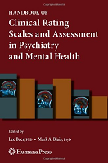
Handbook of clinical rating scales and assessment in psychiatry and mental health
Baer & Blais (2010)
Covered chapters:
  Depression
  Anxiety Disorders
  Bipolar Disorder
  Eating Disorders
  Addictions (alcohol, nicotine)
  Personality Disoders
  Outcomes in Mental Health
  Adult ADHD
  Schizophrenia
  Cognitive and Neuropsychological Status
  Psychotherapy Practice
  Terrorism impact

Slide 39
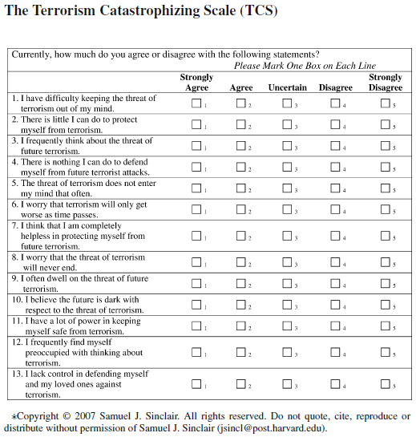
Handbook of clinical rating scales and assessment in psychiatry and mental health
The Terrorism Catastrophizing Scale (TCS)

Slide 40
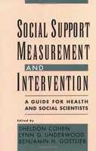
Social Support Measurement and Intervention
Cohen et al. (2000)
Provides a solid theoretical background for the measurement of social support.
Includes different theoretical perspectives.
Includes related constructs.

Slide 41
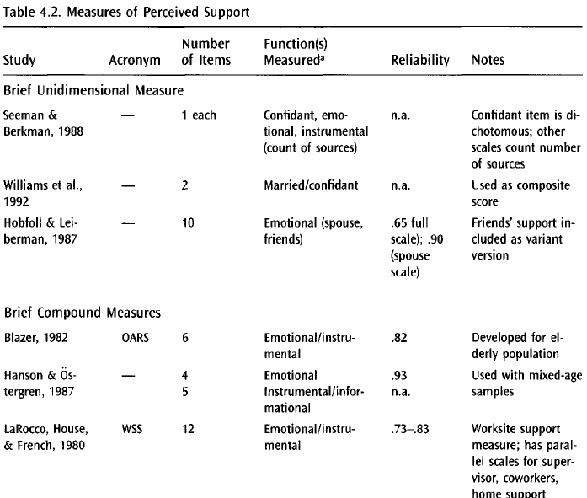
Social Support Measurement and Intervention

Slide 42
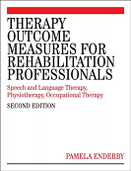
Therapy outcome measures for rehabilitation professionals (Enderby et al., 2006)
Concise 152 pages book covering the use of the TOM Core Scale in 26 different diseases.
  Impairment
  Activity
  Participation
  Well-being/Distress

Slide 43
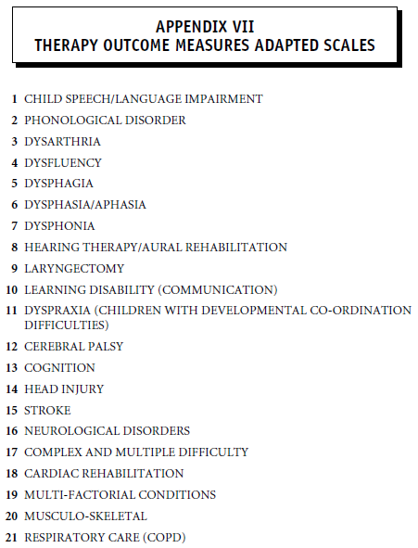
Therapy outcome measures for rehabilitation professionals

Slide 44
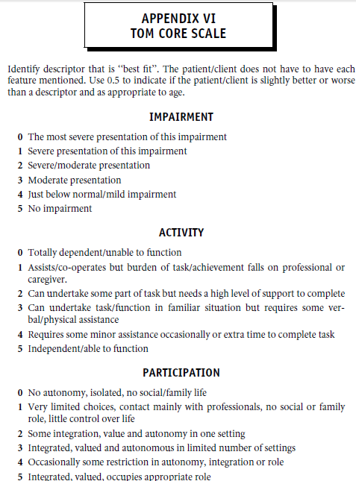
Therapy outcome measures for rehabilitation professionals

Slide 45
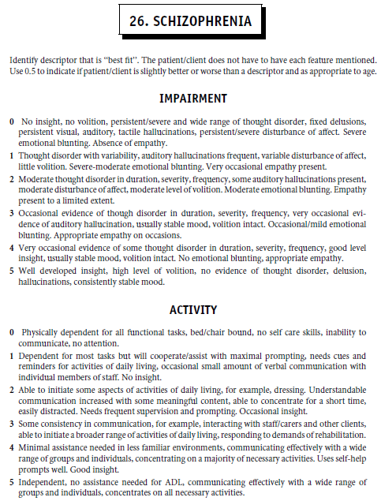
Therapy outcome measures for rehabilitation professionals

Slide 46
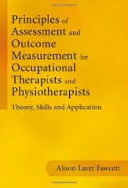
Principles of assessment and outcome measurement for occupational therapists and physiotherapists
Fawcett (2013). Wide coverage of the different aspects of measurement:
  Importance of accurate assessment
  Methods and sources of assessment
  Purposes of assessment
  Levels of measurement
  Standardization and test development
  Validity, reliability
  Test administration, reporting

Slide 47
Principles of assessment and outcome measurement for occupational therapists and physiotherapists
This book provides worksheets to:
  Evaluate your evidence-based practice
  Reflect on data-collection methods
  Reflect on the purposes of assessment
  Reflect on levels of measurement
  Reflect on the adequacy of standardisation (checklist)
  Prepare for an assessment (checklist)
  others

Slide 48
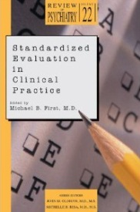
Standardized evaluation in clinical practice
First (2003)
Focused in the integration and standardization of assessment methods for the diagnosis in clinical settings.
Specially interesting: an entire chapter to evaluate Suicide History (includes appendix)

Slide 49
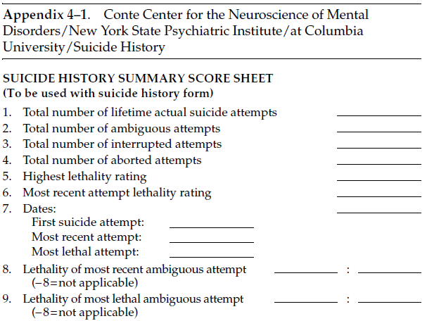
Standardized evaluation in clinical practice

Slide 50
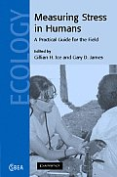
Measuring stress in humans
Ice & James (2007)
Covers the emotional, behavioral, and physiological measurement of stress.
Review and basic information of measures.
Although doesn’t provides the tests, provides web links to them (when available).

Slide 51
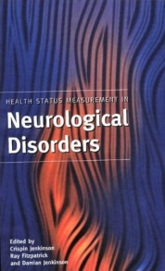
Health status measurement in neurological disorders (Jenkinson et al., 2000)
Covers the health status assessment in:
  Headache
  Parkinson’s disease
  Multiple sclerosis
  Stroke
  Epilepsy
  Alzheimer’s disease
  Amyotrophic Lateral Sclerosis
Includes an entire chapter on the translation and cross-cultural adaptation of quality of life measures.

Slide 52

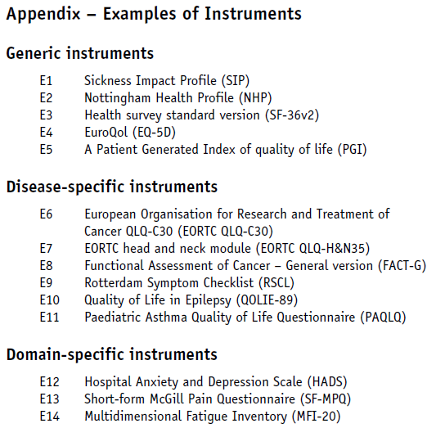
Quality of Life: The Assessment, Analysis and Interpretation of Patient-reported Outcomes
Provides guidelines on assessing, analyzing and interpreting quality of life data

Slide 53
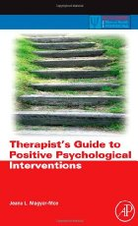
Therapist’s guide to positive psychological interventions (Magyar-Moe, 2009)
Evaluates the psychometric properties of some important instruments.
Emphasize in the role of culture.
Includes complete tests.

Slide 54
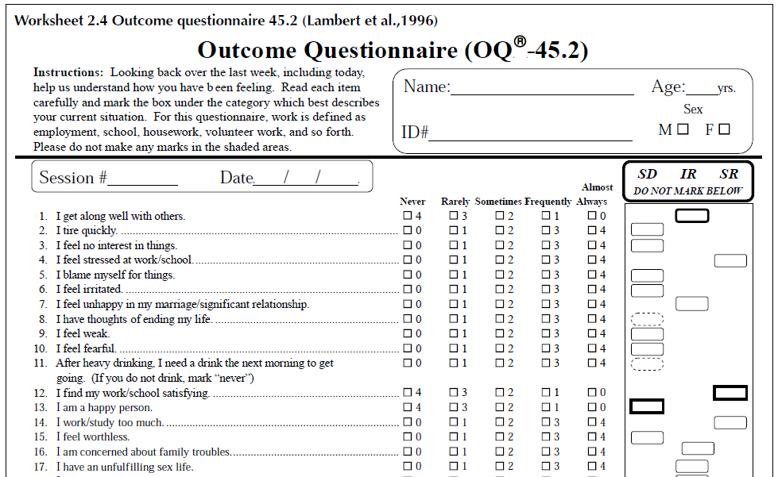
Therapist’s guide to positive psychological interventions

Slide 55
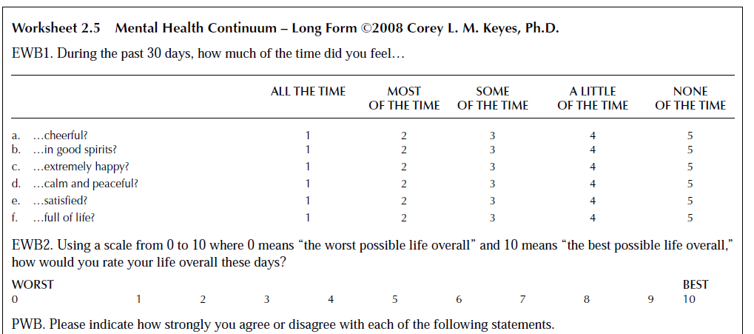
Therapist’s guide to positive psychological interventions

Slide 56

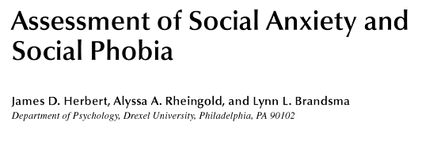
Social Anxiety: Clinical, developmental, and social perspectives
Hofmann & DiBartolo (2014)
An entire chapter covering different dimensions of social anxiety and phobia assessment.

Slide 57

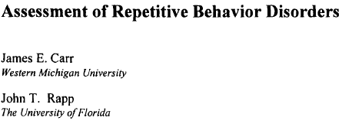
Tic Disorders, Trichotillomania, and Other Repetitive Behavior Disorders
Woods & Miltenberger (2001)
This book, the most comprehensive guide to behavioral treatment of repetitive behavior disorders, includes a chapter on assessment.

Slide 58

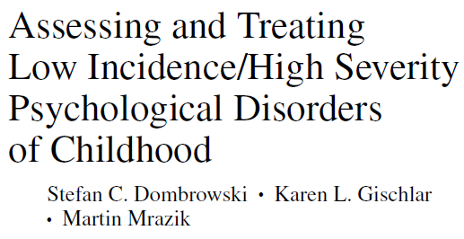
Assessing and Treating Low Incidence/High Severity Psychological Disorders of Childhood
Dombrowski et al. (2011)
This book deserves attention, it’s focused on less-known disorders in children.
Notes:
gender identity disorder; impulse control disorders (i.e., kleptomania, trichotillomania, intermittent explosive disorder); selective mutism; Munchausen by proxy; childhood schizophrenia; gang involvement; sexual offending; self-injurious behavior; and feral children.

Slide 59

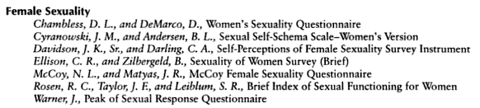
Handbook of Sexuality-Related Measures
Fisher et al. (2011)
Reproduces more than 200 instruments, accompanied by essential information for their use in research, educational and clinical settings.
Notes:
gender identity disorder; impulse control disorders (i.e., kleptomania, trichotillomania, intermittent explosive disorder); selective mutism; Munchausen by proxy; childhood schizophrenia; gang involvement; sexual offending; self-injurious behavior; and feral children.

Slide 60

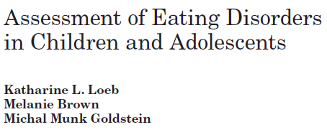
Eating Disorders in Children and Adolescents
Le Grange & Lock (2011)
Chapter 10 provides information to accurately assess the cardinal features of eating disorders.
Notes:
gender identity disorder; impulse control disorders (i.e., kleptomania, trichotillomania, intermittent explosive disorder); selective mutism; Munchausen by proxy; childhood schizophrenia; gang involvement; sexual offending; self-injurious behavior; and feral children.

Slide 61


Handbook of assessment methods for eating behaviors and weight-related problems
The most comprehensive collection of measures and assessment tools related to eating behaviors.
Notes:
gender identity disorder; impulse control disorders (i.e., kleptomania, trichotillomania, intermittent explosive disorder); selective mutism; Munchausen by proxy; childhood schizophrenia; gang involvement; sexual offending; self-injurious behavior; and feral children.

Slide 62


Psychological assessment in clinical practice: A pragmatic guide (Hersen, 2004)
16 chapters covering the assessment of most common mental disorders.
Notes:
gender identity disorder; impulse control disorders (i.e., kleptomania, trichotillomania, intermittent explosive disorder); selective mutism; Munchausen by proxy; childhood schizophrenia; gang involvement; sexual offending; self-injurious behavior; and feral children.

Slide 63

Towards personal excellence: Psychometric tests and self-improvement techniques for managers
This 2nd edition contains 6 pilot-tested modules each with a cluster of skills and a self-assessment questionnaire (with response sheets)
Enables the reader/user to record individual strengths and weaknesses to keep track of the process of learning.
Notes:
gender identity disorder; impulse control disorders (i.e., kleptomania, trichotillomania, intermittent explosive disorder); selective mutism; Munchausen by proxy; childhood schizophrenia; gang involvement; sexual offending; self-injurious behavior; and feral children.

Slide 64

Management Skills: Assessment and Development
Offers a comprehensive, real world approach to mastering the skills needed for a career in management. It contains:
    Assessing Your Skills (pre-assessment scales);
    Learning About the Skills (concept portion of the text);
    Practicing Your Skills (exercises);
    Using Your Skills (case analysis);
    Extending Your Skills (group and individual exercises);
    Visualizing the Skills (video exercises);
    Your Skills Now (assessing skills after working through the chapter);
    Interpretations (scoring keys and comparison data).
Notes:
gender identity disorder; impulse control disorders (i.e., kleptomania, trichotillomania, intermittent explosive disorder); selective mutism; Munchausen by proxy; childhood schizophrenia; gang involvement; sexual offending; self-injurious behavior; and feral children.

Slide 65

Oxford Handbook of Personnel Assessment and Selection
Comprehensive review of:
  (1) historical and social context of the field of assessment and selection
  (2) research strategies
  (3) individual difference constructs that underlie effective performance
  (4) measures of predictor constructs
  (5) employee performance and outcome assessment
  (6) societal and organizational constraints on selection practice
  (7) implementation and sustainability of selection systems
Notes:
gender identity disorder; impulse control disorders (i.e., kleptomania, trichotillomania, intermittent explosive disorder); selective mutism; Munchausen by proxy; childhood schizophrenia; gang involvement; sexual offending; self-injurious behavior; and feral children.

Slide 66

Multiple Perspectives on the Effects of Evaluation on Performance
This book integrates thinking from five different research traditions:
  Achievement Goals
  Intrinsic vs. Extrinsic Motivation
  Goal Setting
  Social Loafing
  Social Facilitation
Notes:
gender identity disorder; impulse control disorders (i.e., kleptomania, trichotillomania, intermittent explosive disorder); selective mutism; Munchausen by proxy; childhood schizophrenia; gang involvement; sexual offending; self-injurious behavior; and feral children.

Slide 67
TESTS AVAILABLE
IN
MASARYK UNIVERSITY

Slide 68


Psychological instruments available in MUNI FSS
An inventory of tests is available for download.

Slide 69
QUESTIONS?

Slide 70
NEXT CLASS
READINGS:
  Publishers of psychological and psychoeducational tests (Koocher, Norcross, & Hill III, 2005)
  Where to go for authoritative information: Reference sources (Cohen & Swerdlik, 2009)
  Sourcing materials and measures for psychological research (Evans, 2007).

