Slide 1
databases oF psychological tests
Carlos A. Almenara, PhD
Online and Offline Resources In Psychological Assessment PSY494P122 (March 25th, 2015)

Slide 2
EDUCATIONAL TESTING SERVICE
(ETS)

Slide 3


Educational Testing Service
The ETS Test Collection is a database of more than 25,000 tests and other measurement devices.
Contains information about tests from the early 1900s to the present, and is considered the largest compilation of such materials in the world.
Downloadable tests have a cost.

Slide 4
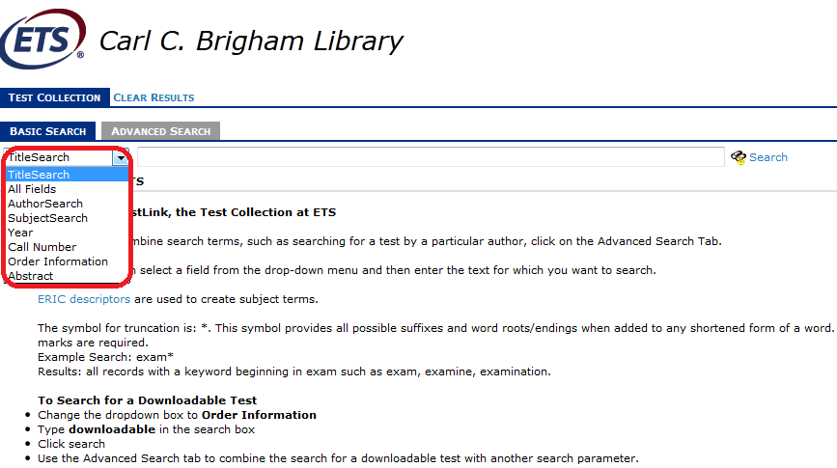
Educational Testing Service
Field codes

Slide 5
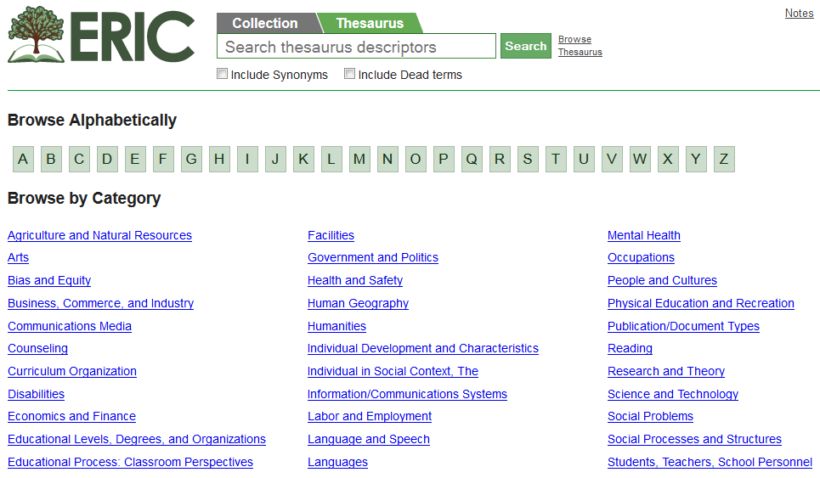
Educational Testing Service
You may use ERIC descriptors (Thesaurus)

Slide 6
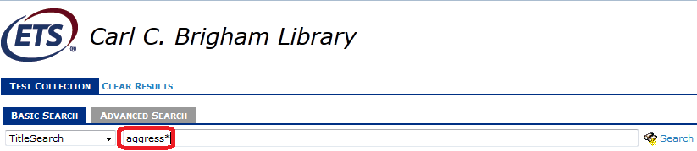
Educational Testing Service
Truncation (* wildcard)

Slide 7
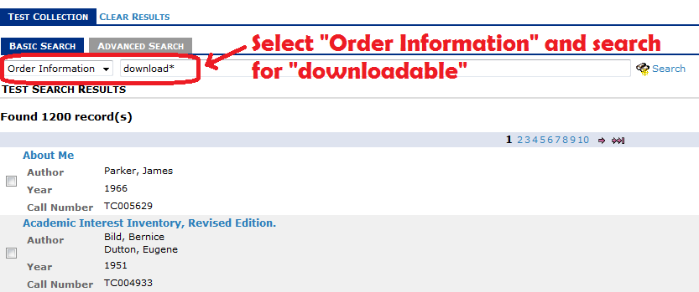
Educational Testing Service
Searching a downloadable test

Slide 8
Educational Testing Service
EXERCISE 1:
  Using the Advanced Search, use the SubjectSearch field and try searching on your research topic (you could use ERIC descriptors or truncation: *)
  Identify the newest measurement tool in your topic using the Year field.

Slide 9
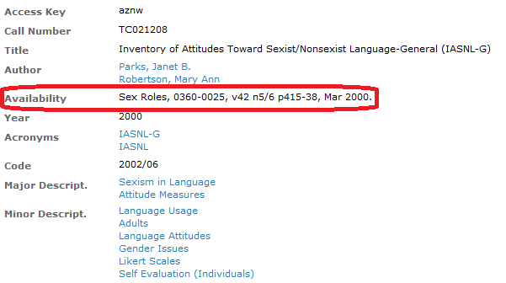
Educational Testing Service
EXERCISE 2:
  Use the AVAILABILITY section of the test record to find a test.

Slide 10
TESTS AND MEASURES
IN THE
SOCIAL SCIENCES

Slide 11

Tests and Measures in SS
This database contains information on about 14,000 measures available in 139 compilation volumes.
http://libraries.uta.edu/TMdb
There is a database version in RefShare*.

Slide 12
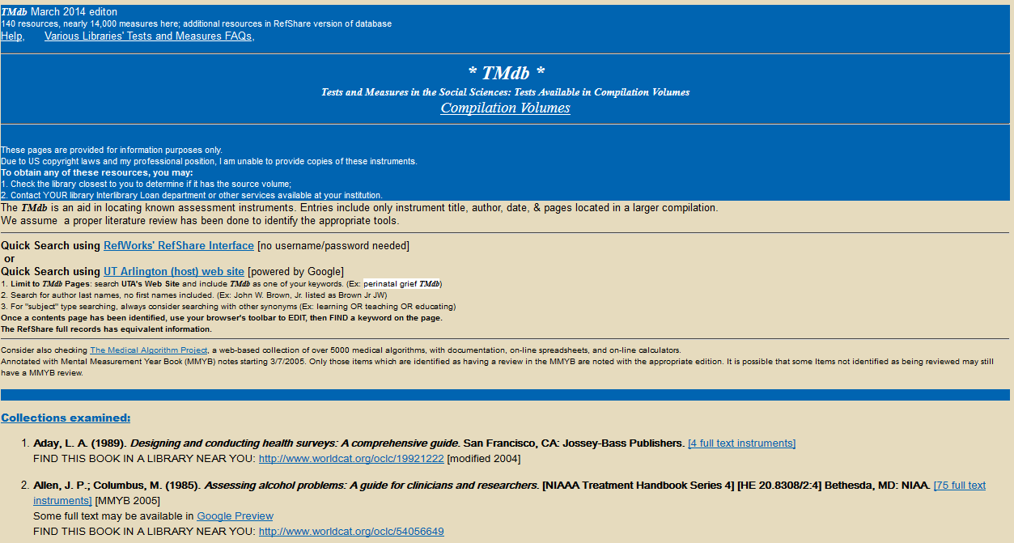
Tests and Measures in SS

Slide 13
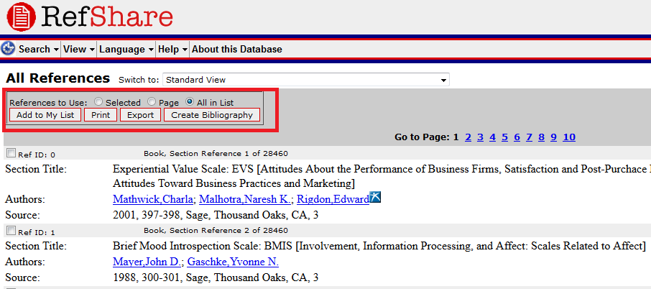
Tests and Measures in SS
Export all the database

Slide 14
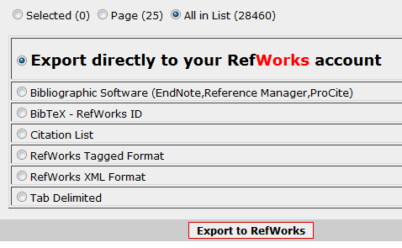
Tests and Measures in SS
Export all the database (28985 records)

Slide 15
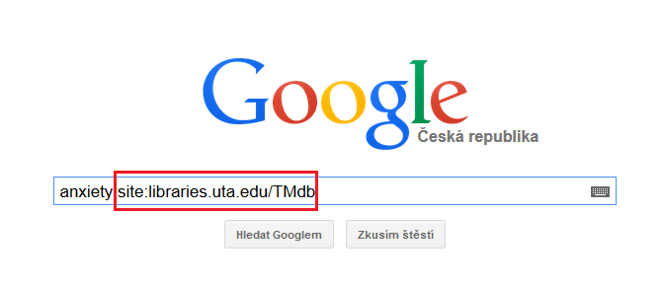
Tests and Measures in SS
Searching through Google

Slide 16
Tests and Measures in SS
EXERCISE 1:
  Using the exact match search strategy in Google, find and list all the books where the Overt Aggression Scale is available in full text.

Slide 17
Tests and Measures in SS
EXERCISE 2:
  Identify an instrument related to your topic.
  Save the name of the instrument.
  Save the source (reference) in Mendeley.

Slide 18
MENTAL MEASUREMENTS YEARBOOK

Slide 19

Mental Measurements Yearbook
FREE: Find free information on over 3500 commercially available tests.
PAY-PER-VIEW: Get access to the test reviews online, as they appear in the Mental Measurements Yearbook series (fee: USD$15.00 per test review)

Slide 20
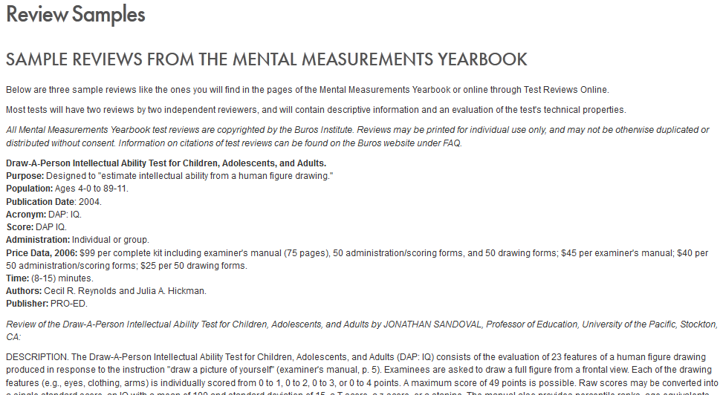
Mental Measurements Yearbook
Search interface

Slide 21
Mental Measurements Yearbook
SEARCH:
  Alphabetic Search: Alphabetical listing of test titles
  Category Search: Category listing of test titles
  Keywords search: Search for keywords on test titles, acronym, author, publisher, purpose, scores.

Slide 22
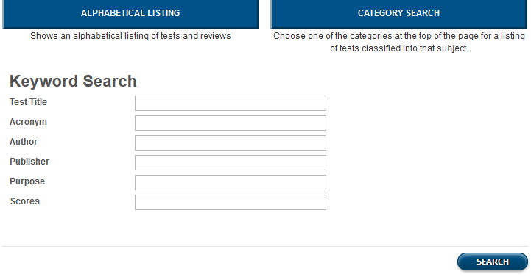
Mental Measurements Yearbook
Search interface

Slide 23
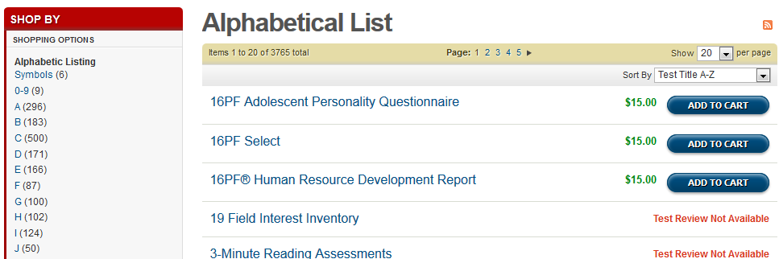
Mental Measurements Yearbook
Alphabetical Listing

Slide 24
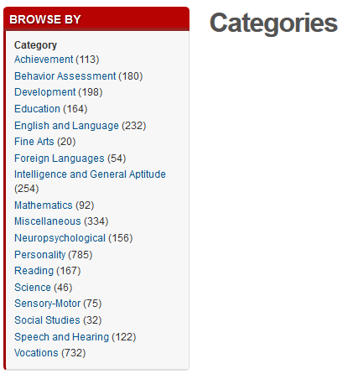
Mental Measurements Yearbook
Category Listing

Slide 25
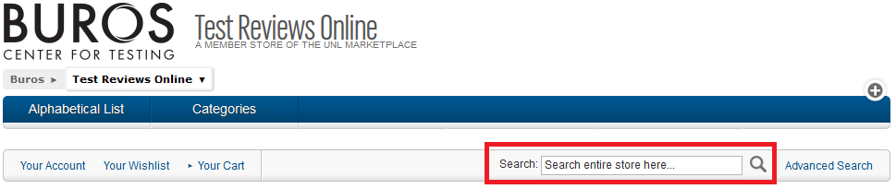
Mental Measurements Yearbook
Open search

Slide 26
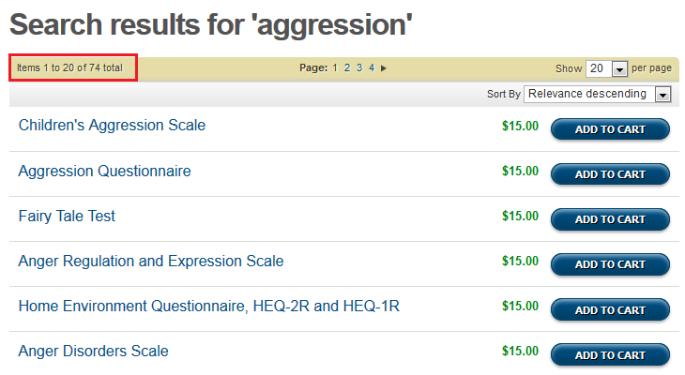
Mental Measurements Yearbook
Open search (results)

Slide 27
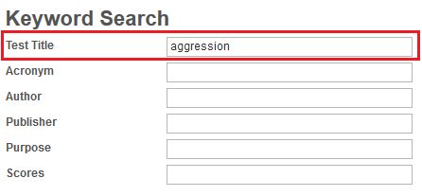
Mental Measurements Yearbook
Limited search

Slide 28
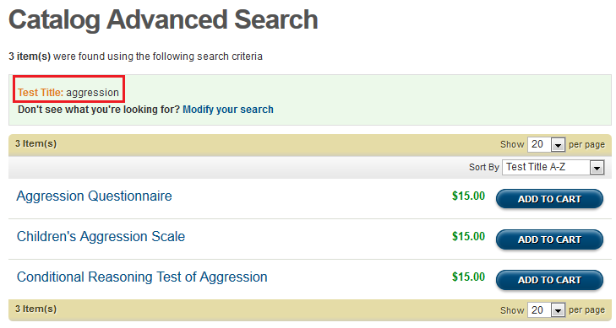
Mental Measurements Yearbook
Limited search (results)

Slide 29
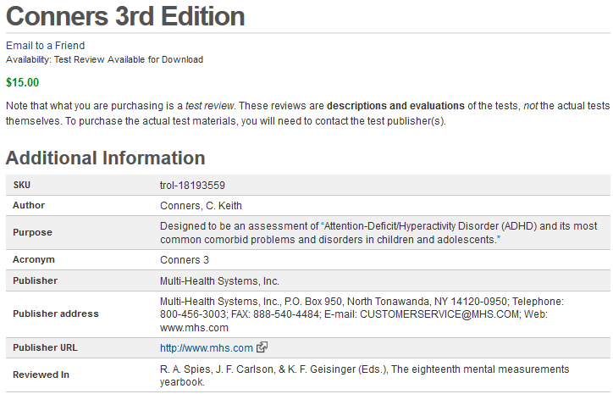
Mental Measurements Yearbook
Record preview

Slide 30
Mental Measurements Yearbook
EXERCISE:
  Try to identify the most suitable instrument for your research.
  If there is a review available, open the record and look for the section Reviewed In.

Slide 31


Slide 32

Health and Psychosocial Instruments
(HaPI)
Provides access to information on approximately 15,000 measurement instruments in the fields of health and psychosocial sciences:
  Medicine, nursing, public health, psychology, social work, communication, sociology, and organizational behavior/human resources.
Approximately 145,000 records.
The full-text of the instruments is not included.

Slide 33
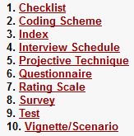
Health and Psychosocial Instruments
(HaPI)
Types of instruments covered by HaPI:
Coverage: Since 1985

Slide 34
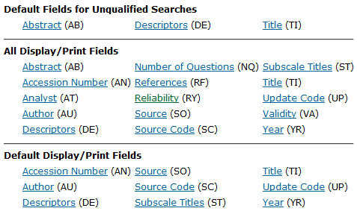
Health and Psychosocial Instruments
(HaPI)
Field codes available through OVID

Slide 35
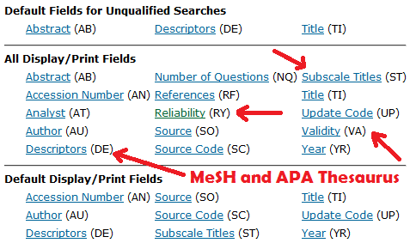
Health and Psychosocial Instruments
(HaPI)
Field codes available through OVID

Slide 36
PSYNDEX

Slide 37
PSYNDEXplus with TestFinder
The most comprehensive abstract (not full text) database of psychological literature, audiovisual media, intervention programs, and tests from the German-speaking countries (30% translated in english)
Records of psychological publications from authors in the German-speaking countries, audiovisual media, and descriptions of intervention programs

Slide 38
PSYNDEXplus with TestFinder
Published by Zentrum fur Psychologische Information und Dokumentation (ZPID) at the University of Trier.
Coverage:
  Literature: 1977 – Present (~215,000 records)
  Audiovisual media: 1932 – Present (~2,000 records)
  TESTS: 1945 – Present (~5,800 tests)

Slide 39

PSYNDEX via PubPsych
39
http://www.pubpsych.eu/

Slide 40
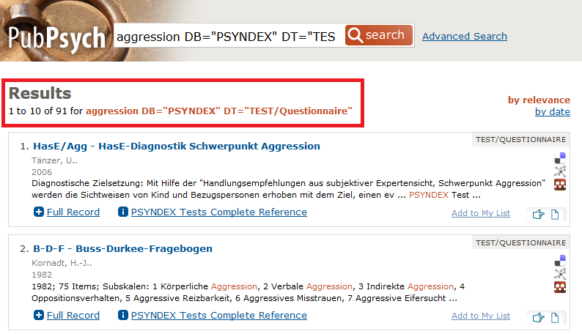
PSYNDEX via PubPsych
40
aggression DB="PSYNDEX" DT="TEST/Questionnaire"
http://www.pubpsych.eu/

Slide 41
QUESTIONS?

Slide 42
EXERCISE

Slide 43
UTA Database & BUROS Database
EXERCISE:
  You found tests in UTA Database & BUROS Database.
  Now, use Google Scholar to find recent articles related to your topic, and that have used any of those instruments.

Slide 44
NEXT CLASS
READINGS:
  Publication and citation analysis as a tool for information retrieval (Goh & Foo, 2008)
  Citation pearl searching (De Brún & Pearce-Smith, 2014; Chapter 11)

