Slide 1
Online and Offline Resources In Psychological Assessment PSY494P122 – Spring 2015
APA Databases
April 15th, 2015

Slide 3
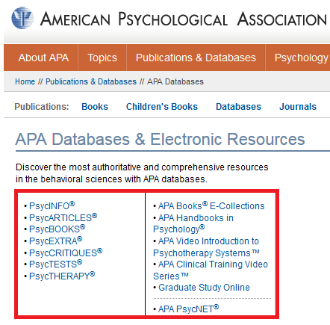
APA Databases
http://www.apa.org/pubs/databases/

Slide 4
PsycINFO

Slide 5
PsycINFO ®
First, go to EBSCO:
Direct access from On Campus computers: http://search.ebscohost.com/

Slide 6
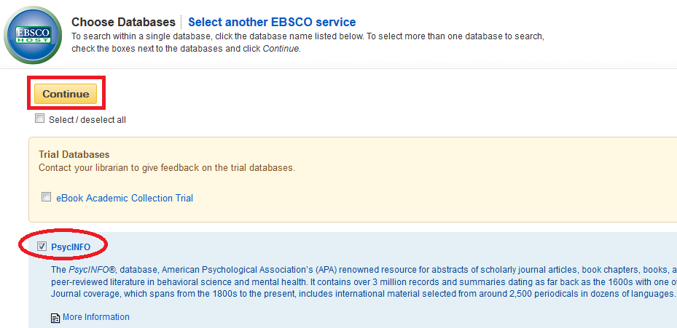
PsycINFO ®
Select PsycINFO and click Continue
http://search.ebscohost.com/

Slide 7
EXAMPLE

Slide 8
RESEARCH PROBLEM:
Is there any relationship between:
videogames and personality traits?
http://search.ebscohost.com/

Slide 9
RESEARCH PROBLEM:
After reading several articles (you did a literature review), you are interested in ANY OF these personality traits:
Aggressiveness
Self-Control
http://search.ebscohost.com/

Slide 10
SEARCH STRATEGY:
videogames
and
(aggressiveness OR self-control)
http://search.ebscohost.com/

Slide 11
TERM 1: Videogames

Slide 12
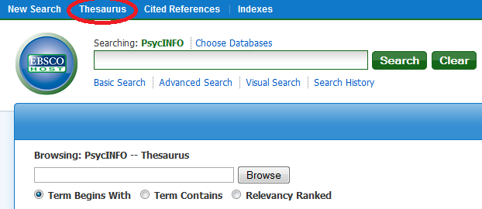
PsycINFO ®
Click on Thesaurus
http://search.ebscohost.com/

Slide 13
PsycINFO ®
Look up for the first term of your search strategy (videogames).
Try with different terms using the operator “OR”.
http://search.ebscohost.com/

Slide 14
PsycINFO ®
Click on the term “Games”.
Because it’s a broad term, it has the “explode” box which means there are narrower terms.
http://search.ebscohost.com/

Slide 15
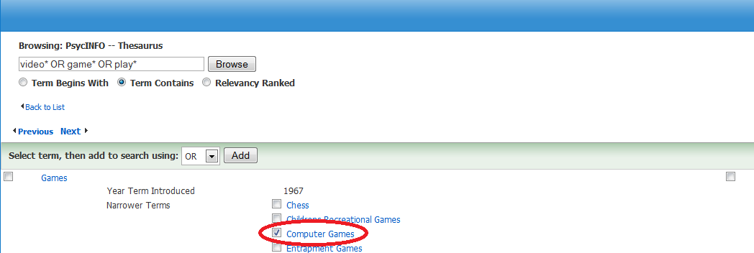
PsycINFO ®
Select the term “Computer Games” because is the term most related for my search.
http://search.ebscohost.com/

Slide 16
TERM 2: Personality Traits (aggressiveness or self-control) Part 1: Aggressiveness

Slide 17
PsycINFO ®
Click on Thesaurus
http://search.ebscohost.com/

Slide 18
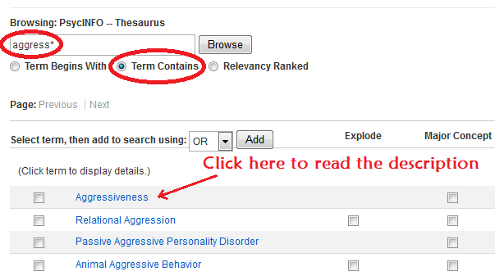
PsycINFO ®
Now, look up for the second keyword (try using a broad term and/or truncation).
Select “Term Contains”. Click on Browse.

Slide 19
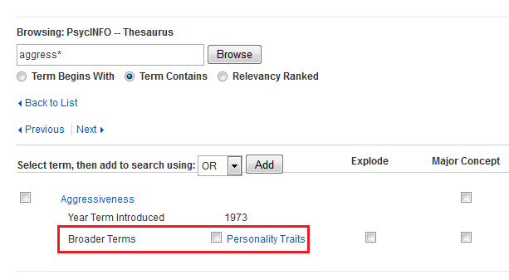
PsycINFO ®
As you can see, the term “aggressiveness” was introduced in 1973, and it’s included inside the broader term “Personality Traits”

Slide 20
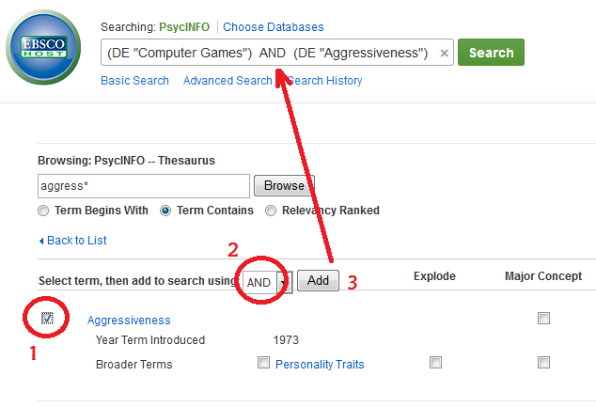
PsycINFO ®
Since this is exactly what we are looking for, we select the term “aggressiveness” and add it in the search box.

Slide 21
TERM 2: Personality Traits (aggressiveness or self-control) Part 2: Self-control

Slide 22
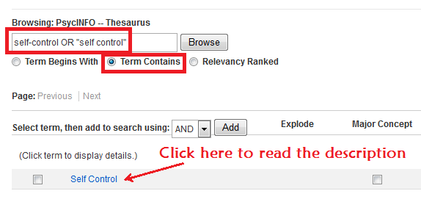
PsycINFO ®
Now, look up for the second keyword (try using a broad term and/or truncation).
Select “Term Contains”. Click on Browse.

Slide 23
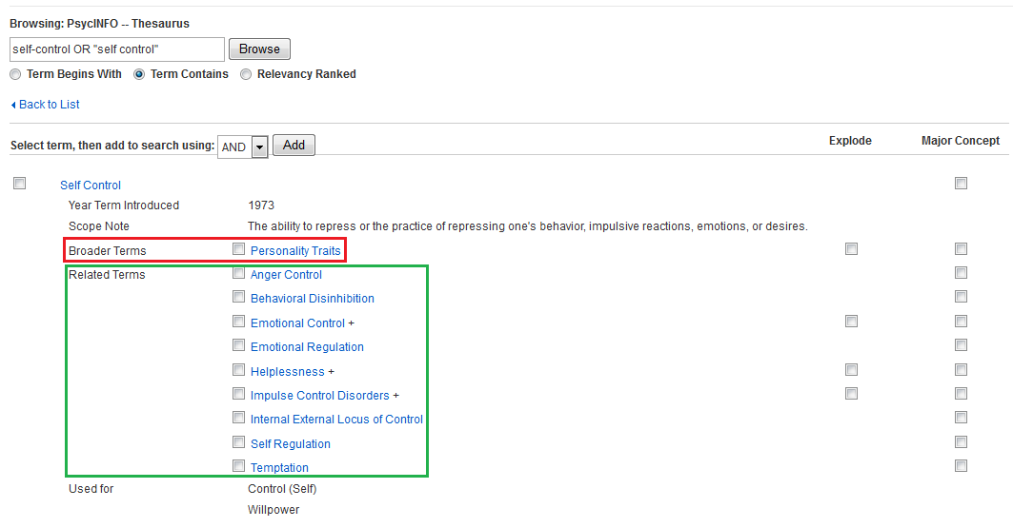
PsycINFO ®
As you can see, the term “self control” was introduced in 1973, it’s included inside the broader term “Personality Traits”, and there are related terms

Slide 24
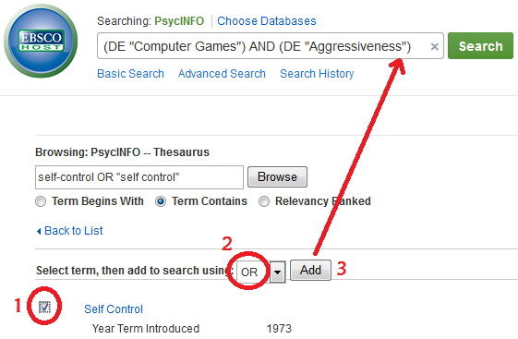
PsycINFO ®
Since, for this example, this is exactly what we are looking for, we select the term “self control” and add it in the search box.

Slide 25
DOUBLE CHECKING OUR SEARCH STRATEGY

Slide 26
SEARCH STRATEGY:
videogames
and
(aggressiveness OR self-control)
http://search.ebscohost.com/

Slide 27
SEARCH STRATEGY:
Which one is the correct one?
1
2
http://search.ebscohost.com/

Slide 28
RESULTS

Slide 29
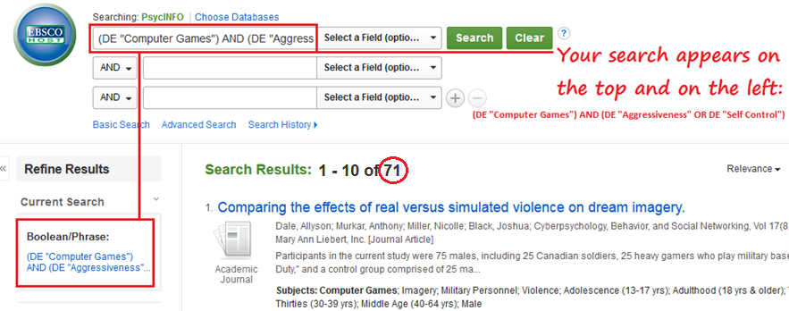
PsycINFO ®
You should have > 70 results.
(DE "Computer Games”) AND (DE "Aggressiveness" OR DE "Self Control")
http://search.ebscohost.com/

Slide 30
APPLYING LIMITS
(PsycINFO – THESAURUS)

Slide 31
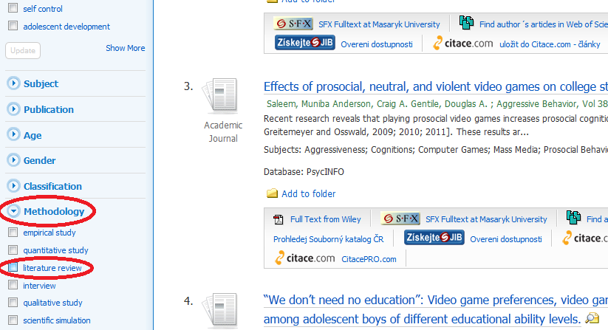
PsycINFO ®
If we want a review study.
Methodology -> Show More -> “literature review”.
http://search.ebscohost.com/

Slide 32
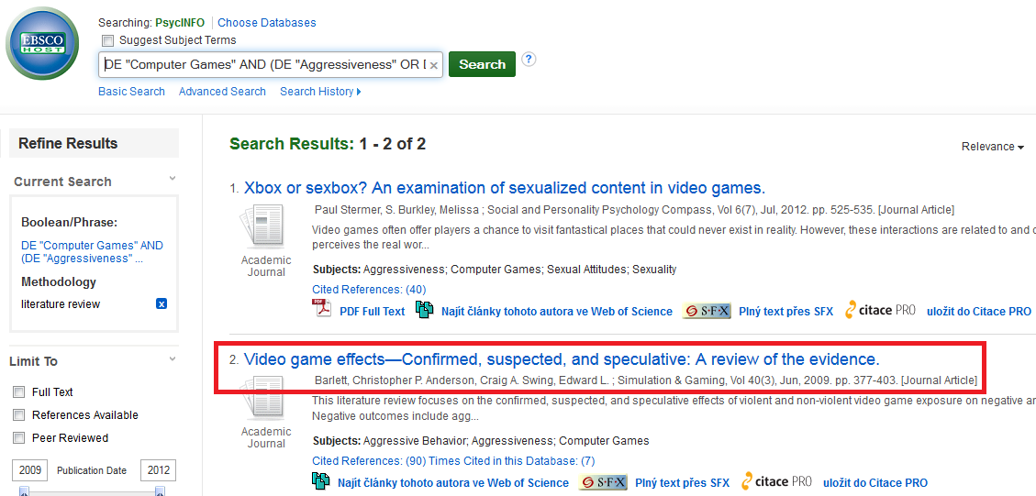
PsycINFO ®
As you can see, there are now only 2 results, and the second one seems to be important.
http://search.ebscohost.com/

Slide 33
SEARCH OPTIONS
USING PsycINFO

Slide 34
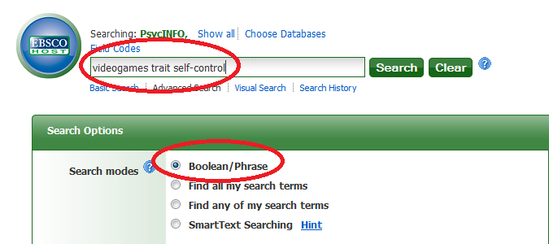
PsycINFO ®
This is the simplest search (Partial Match) and the Boolean/Phrase search is used by default.
http://search.ebscohost.com/

Slide 35
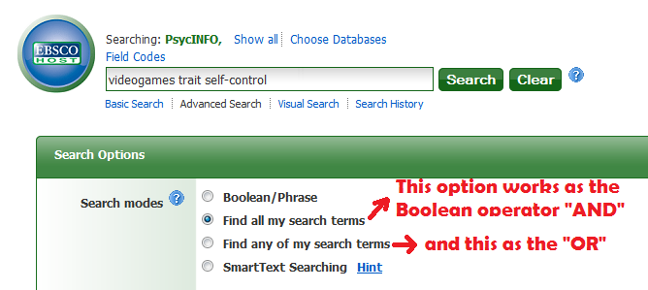
PsycINFO ®
Options working as Boolean operators (“AND”, “OR”).
http://search.ebscohost.com/

Slide 36
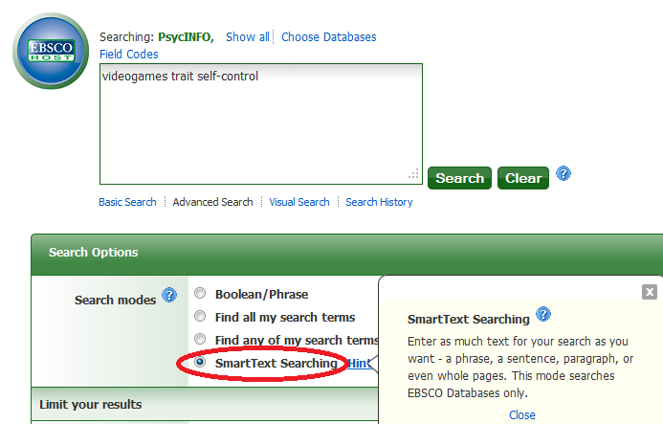
PsycINFO ®
SmartText Searching is a natural language search strategy that allows you to enter as much text for their search as you want – a phrase, a sentence, paragraph, or even whole pages. The final results are based on the Boolean operator “OR”.
http://support.ebsco.com/knowledge_base/detail.php?id=3736

Slide 37
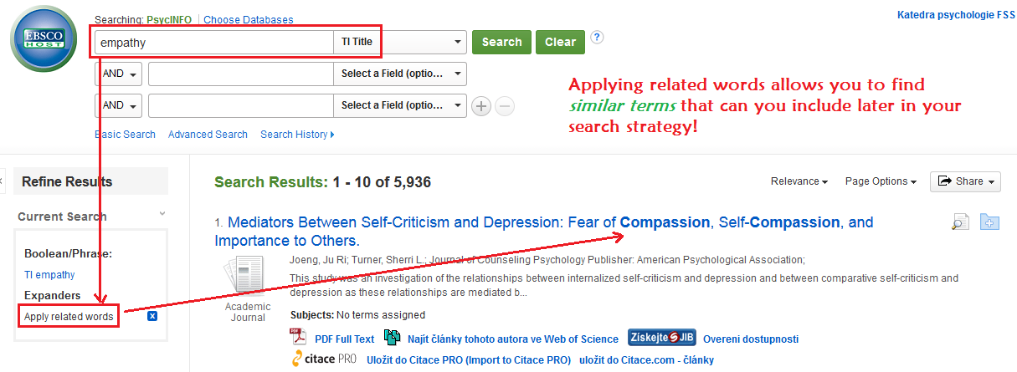
PsycINFO ®
http://search.ebscohost.com/

Slide 38
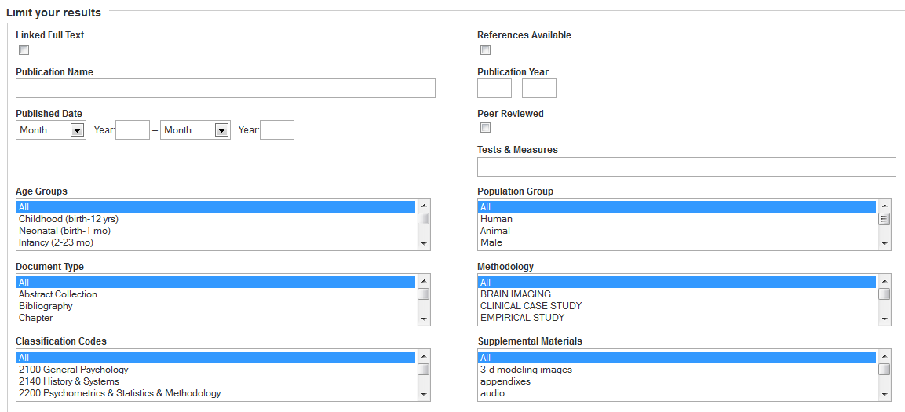
PsycINFO ®
You may limit your results.
http://search.ebscohost.com/

Slide 39
PsycINFO ®
PsyARTICLES additionally has other limit options.
http://search.ebscohost.com/

Slide 40
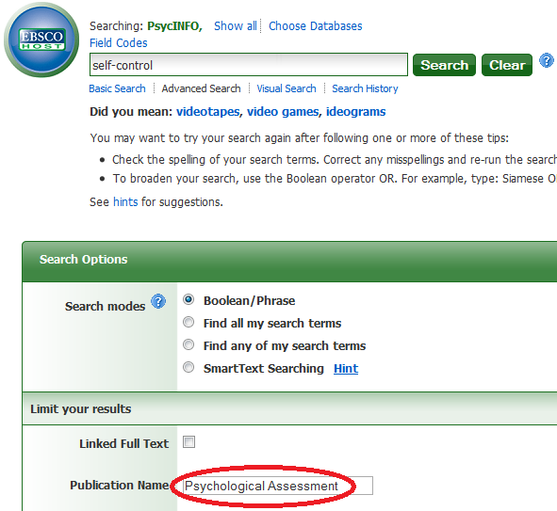
PsycINFO ®
You can limit by Publication Name.
http://search.ebscohost.com/

Slide 41
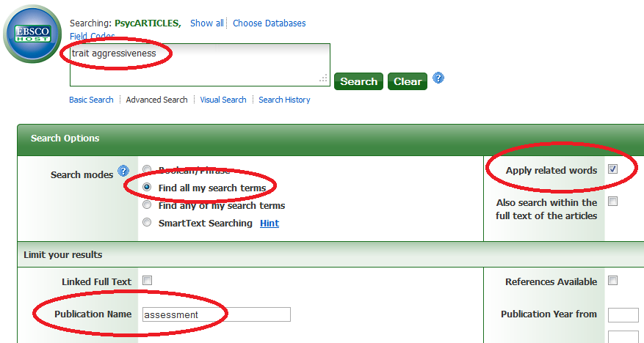
PsycINFO ®
This is one of the different ways to find an instrument on a specific topic. TRANSLATE THIS SEARCH!
http://search.ebscohost.com/

Slide 42
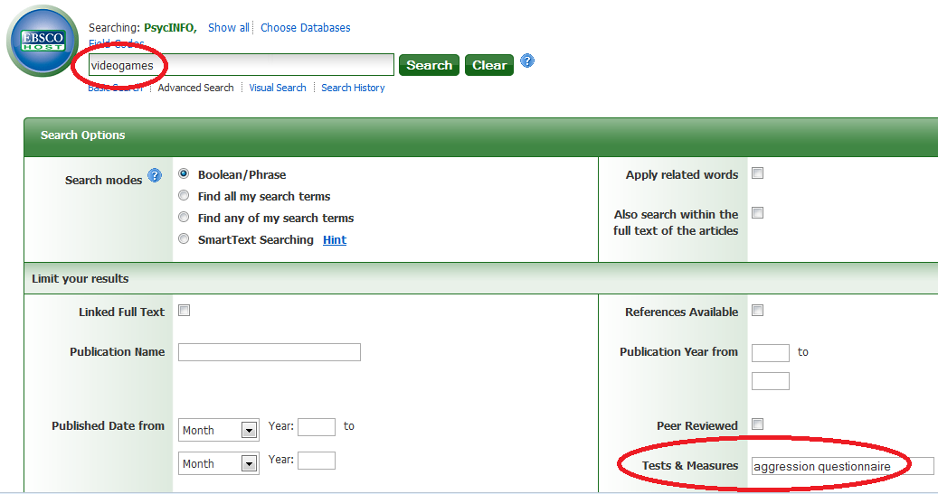
PsycINFO ®
If you are going to use a specific instrument in your research, you may include it in your search strategy.
http://search.ebscohost.com/

Slide 43
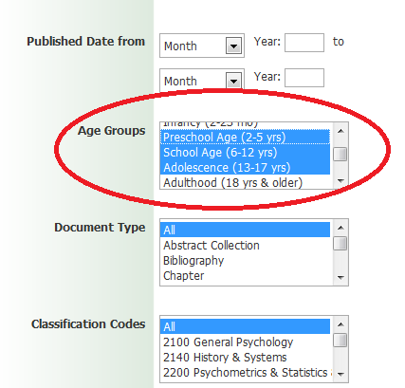
PsycINFO ®
If you are interested in children and adolescents, use the Age Groups limit.
However, you should consider the limitations (e.g. results couldn’t include a longitudinal study with adolescents that became young adults).
http://search.ebscohost.com/

Slide 44
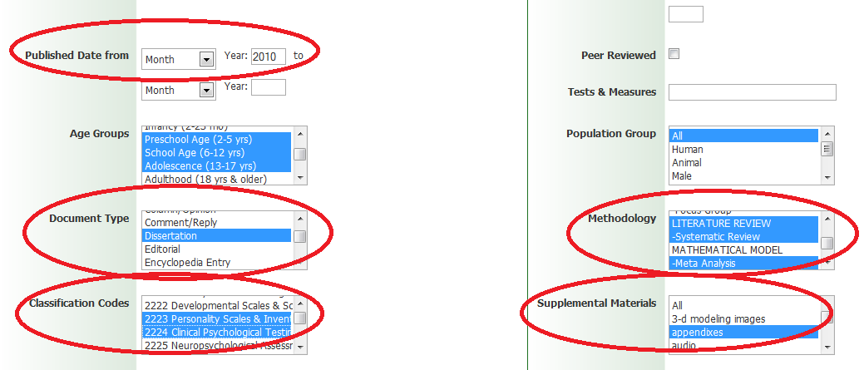
PsycINFO ®
You can select several limits. But remember:
more limits = less results
http://search.ebscohost.com/

Slide 45
SEARCH OPERATORS
USING PsycINFO

Slide 46
PsycINFO ®
Remember the use of:
Truncation (*) and Wildcards (?, #)
psy* = psychology, psychiatry, psychosis, etc.
nurs?? = nurses, nursed (not nurse)
Internali?ation = internalization, internalisation
behavio#r = behavior, behaviour (not plural)
colo#r# = color, colour (incl. plural)

Slide 47
PsycINFO ®
Remember the use of:
Proximity (N or W)
NOT respecting the order:
tax N5 reform = tax reform, reform of income tax, etc.
Respecting the order:
tax W8 reform = tax reform, tax and the European reform, etc.

Slide 48
FIELD CODES
IN PsycINFO

Slide 49
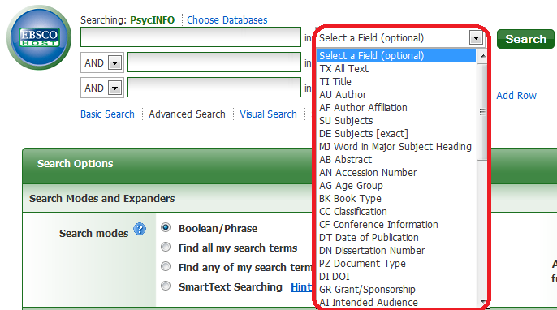
PsycINFO ®
FIELD CODES: PsycINFO has several field codes.

Slide 50
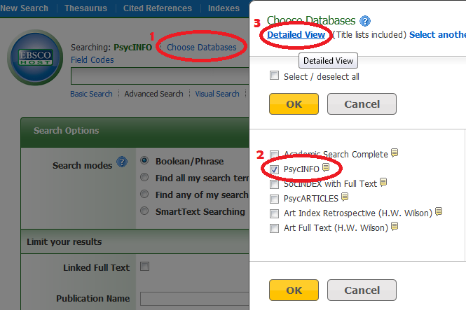
PsycINFO
For a detailed view of the field codes, click on Choose Databases, select PsycINFO and click on Detailed View

Slide 51
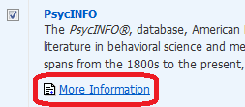
PsycINFO
Then, click on More Information.

Slide 52
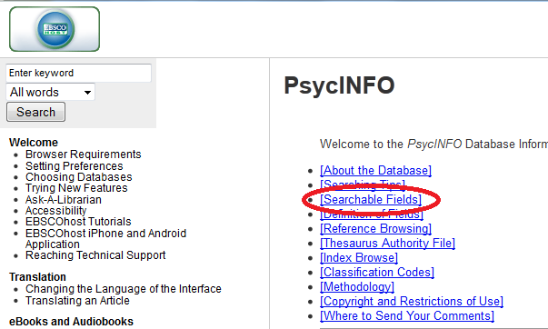
PsycINFO
Click on Searchable Fields.

Slide 53
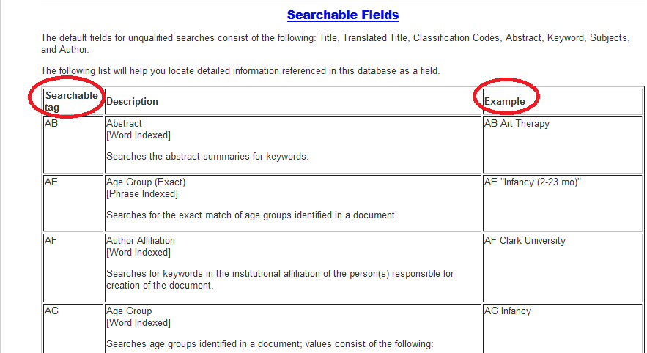
PsycINFO
Here you will see all the field codes and examples about how to use them.

Slide 54
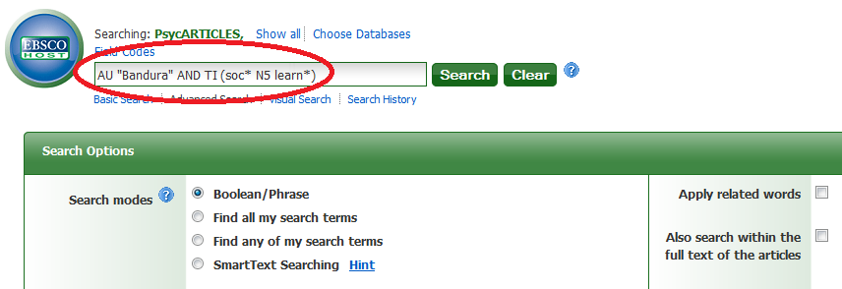
PsycINFO ®
In this example we’ll use 2 field codes (AU, TI), 1 Boolean operator (AND), truncation (*) and proximity (N5). TRANSLATE THIS SEARCH!

Slide 55
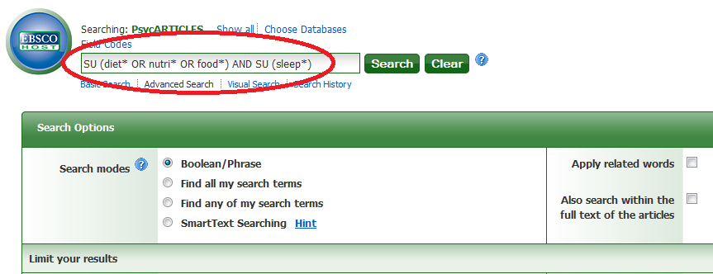
PsycINFO ®
This is another example using field codes (SU), and Boolean operators (OR, AND). TRANSLATE IT!

Slide 56
EXERCISES

Slide 57
PsycINFO ®
EXERCISE:
Boolean operator OR
+
Truncation *

Slide 58
PsycINFO ®
Two keywords with:
Truncation *
separated by:
Proximity W or N

Slide 59
PsycINFO ®
EXERCISE:
Boolean operator OR or AND
+
Field Code TI
+
Proximity W

Slide 60
PsycTESTS

Slide 61
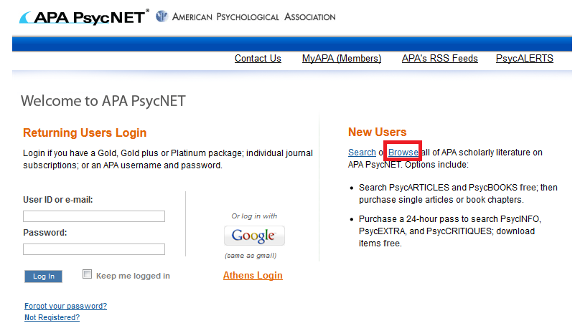
PsycTESTS®
Go to PsycNET and click on Browse.
Database: http://psycnet.apa.org
Presentation: http://www.apa.org/flash/pubs/databases/tutorials/psycnet-psyctests-browse/index.aspx

Slide 62
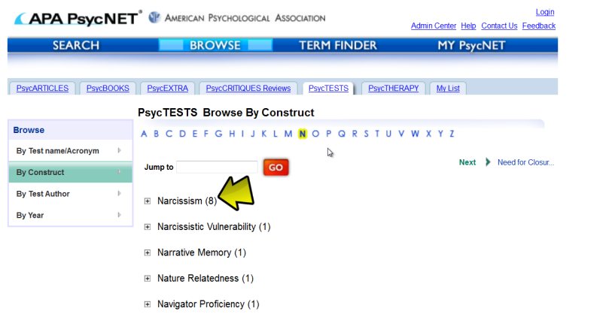
PsycTESTS®
You can browse the tests by construct.
Database: http://psycnet.apa.org
Presentation: http://www.apa.org/flash/pubs/databases/tutorials/psycnet-psyctests-browse/index.aspx

Slide 63
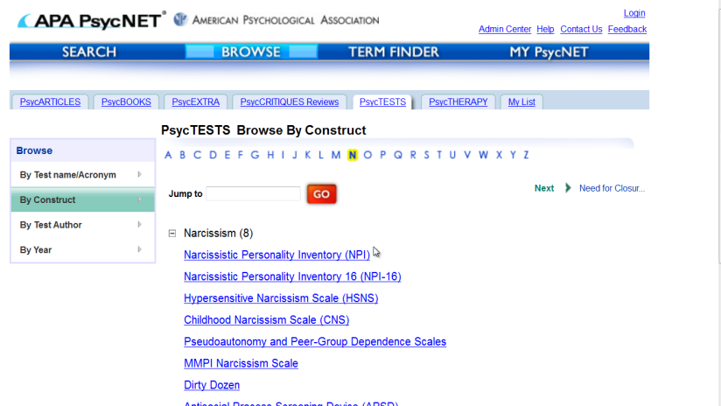
PsycTESTS®
After clicking on the construct you will see the tests available on that construct.
http://www.apa.org/flash/pubs/databases/tutorials/psycnet-psyctests-browse/index.aspx

Slide 64
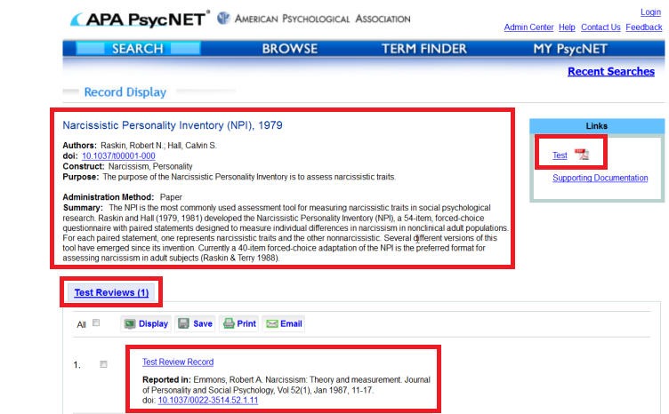
PsycTESTS®
You have detailed information and access to the test in PDF and also a review (if available).
http://www.apa.org/flash/pubs/databases/tutorials/psycnet-psyctests-browse/index.aspx

Slide 65
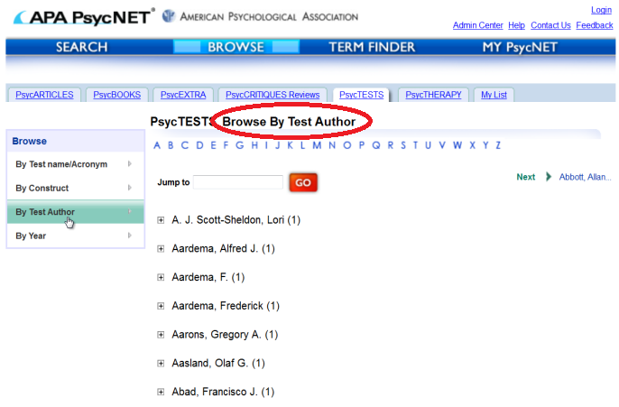
PsycTESTS®
You can also browse by test author.
http://www.apa.org/flash/pubs/databases/tutorials/psycnet-psyctests-browse/index.aspx

Slide 66
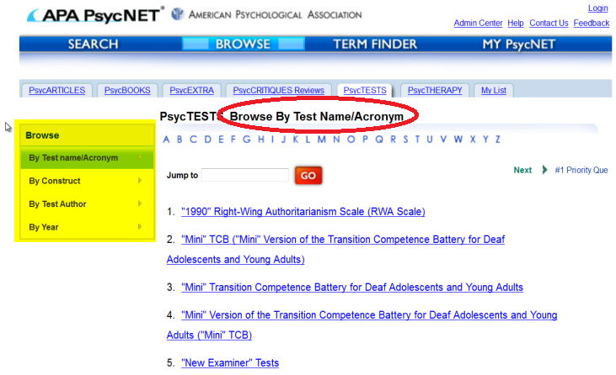
PsycTESTS®
You can also browse by test name / acronym.
http://www.apa.org/flash/pubs/databases/tutorials/psycnet-psyctests-browse/index.aspx

Slide 67
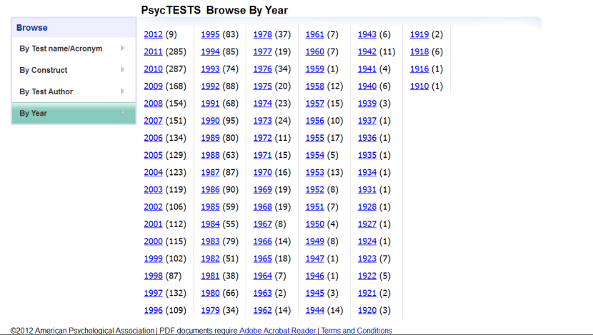
PsycTESTS®
Browse tests by year.
http://www.apa.org/flash/pubs/databases/tutorials/psycnet-psyctests-browse/index.aspx

Slide 68
USING TEST DOI

Slide 69
PsycTESTS®
You can search PsycINFO using tests’ DOI instead of the instrument’s name
State-Trait Anxiety Inventory for Children DOI: 10.1037/t06497-000
Internalizing Symptoms Scale for Children DOI: 10.1037/t07249-000
Multidimensional Anxiety Scale for Children DOI: 10.1037/t05050-000
Revised Children's Manifest Anxiety Scale DOI: 10.1037/t00514-000
Beck Depression Inventory DOI: 10.1037/t00741-000
Beck Depression Inventory–II DOI: 10.1037/t00742-000
Rosenberg Self Esteem Scale DOI: 10.1037/t01038-000
Aggression Scale DOI: 10.1037/t06861-000
Children's Negative Cognitive Error Questionnaire DOI: 10.1037/t04358-000
Self-Concept Scale DOI: 10.1037/t09910-000
Drug Abuse Screening Test DOI: 10.1037/t09815-000
Eating Disorder Examination Questionnaire DOI: 10.1037/t03974-000
Massachusetts Gambling Screen DOI: 10.1037/t04676-000
http://www.apa.org/flash/pubs/databases/tutorials/psycnet-psyctests-browse/index.aspx

Slide 70
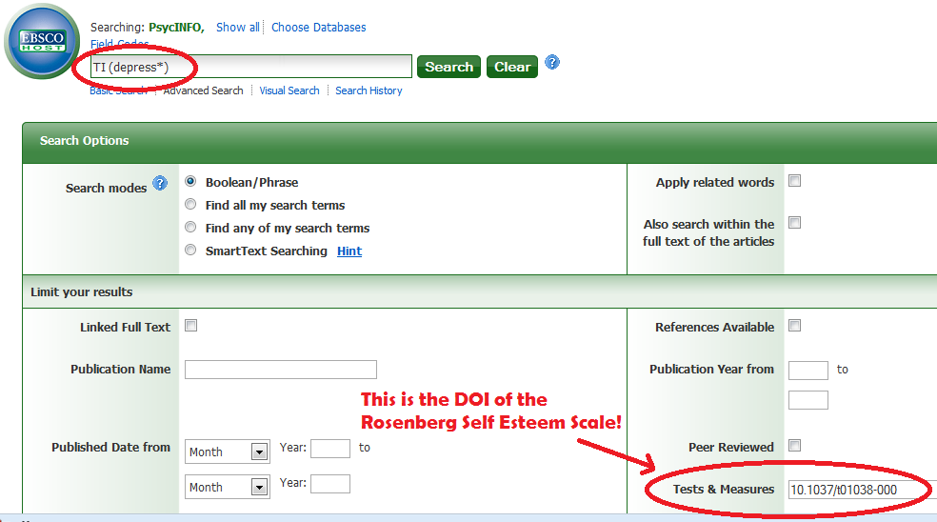
PsycINFO ®
Using an instrument’s DOI instead of its name

Slide 71
PsycINFO ®
EXERCISE:
In only one search, find an article using either:
State-Trait Anger Expression Inventory
DOI: 10.1037/t02657-000
or
Modified Aggression Scale
DOI: 10.1037/t10654-000

Slide 72
PsycBOOKS

Slide 73
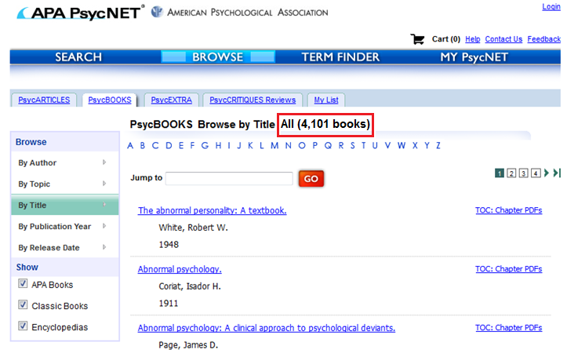
PsycBOOKS®
Right now there are 4,101 books available.
http://psycnet.apa.org/index.cfm?fa=browsePB.home

Slide 74
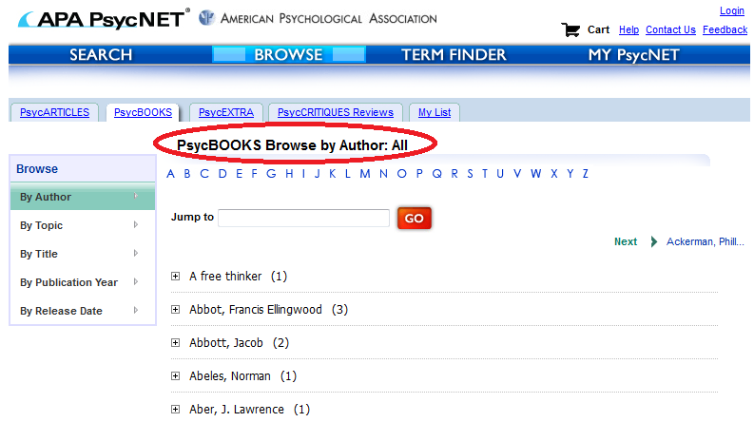
PsycBOOKS®
You can browse them by author.
http://psycnet.apa.org/index.cfm?fa=browsePB.home

Slide 75
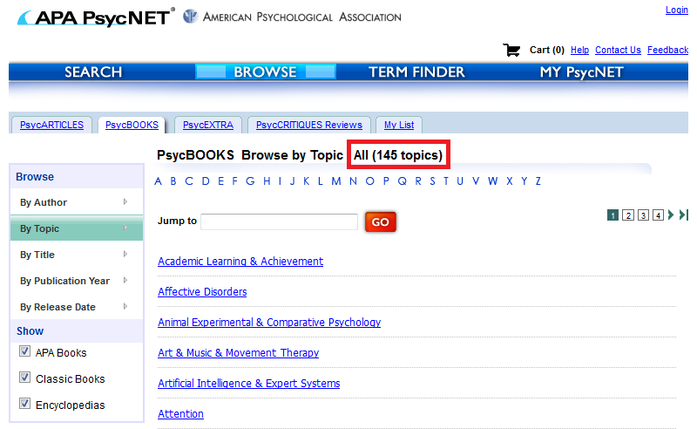
PsycBOOKS®
You can browse them by topic.
http://psycnet.apa.org/index.cfm?fa=browsePB.home

Slide 76
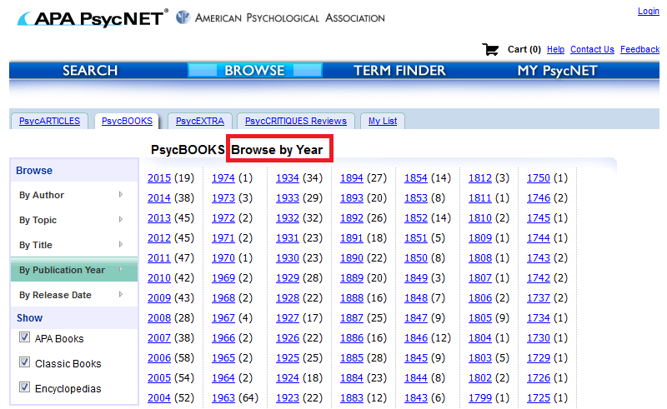
PsycBOOKS®
You can browse them by publication year.
http://psycnet.apa.org/index.cfm?fa=browsePB.home

Slide 77
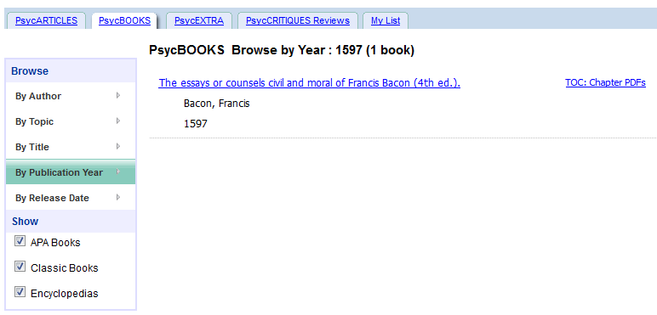
PsycBOOKS®
The oldest book available right now is dated back to 1597.
http://psycnet.apa.org/index.cfm?fa=browsePB.home

Slide 78
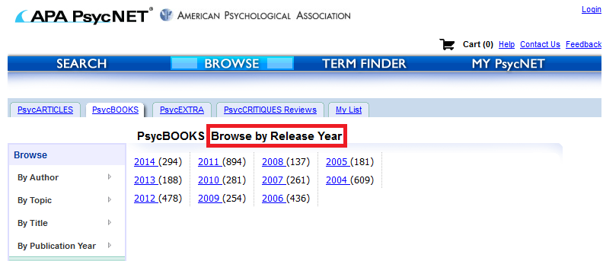
PsycBOOKS®
Finally, you can browse by release date.
http://psycnet.apa.org/index.cfm?fa=browsePB.home

Slide 79
PsycTHERAPY

Slide 80
PsycTHERAPY®
Is a video demonstrations database.
http://psycnet.apa.org/index.cfm?fa=browsePT.home

Slide 81
PsycTHERAPY®
Example: Searching for anxiety.
http://psycnet.apa.org/index.cfm?fa=browsePT.home

Slide 82
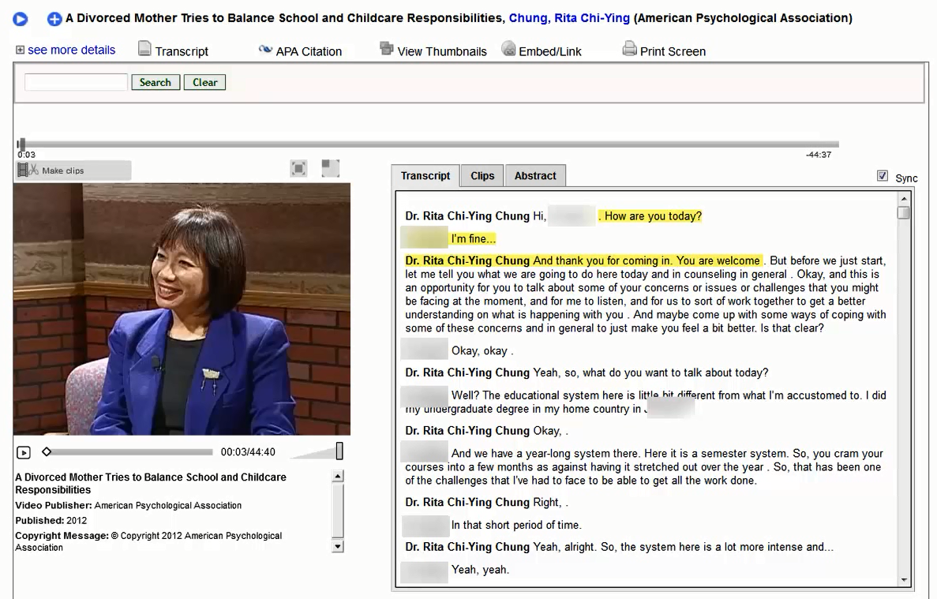
http://psycnet.apa.org/index.cfm?fa=browsePT.home

Slide 83
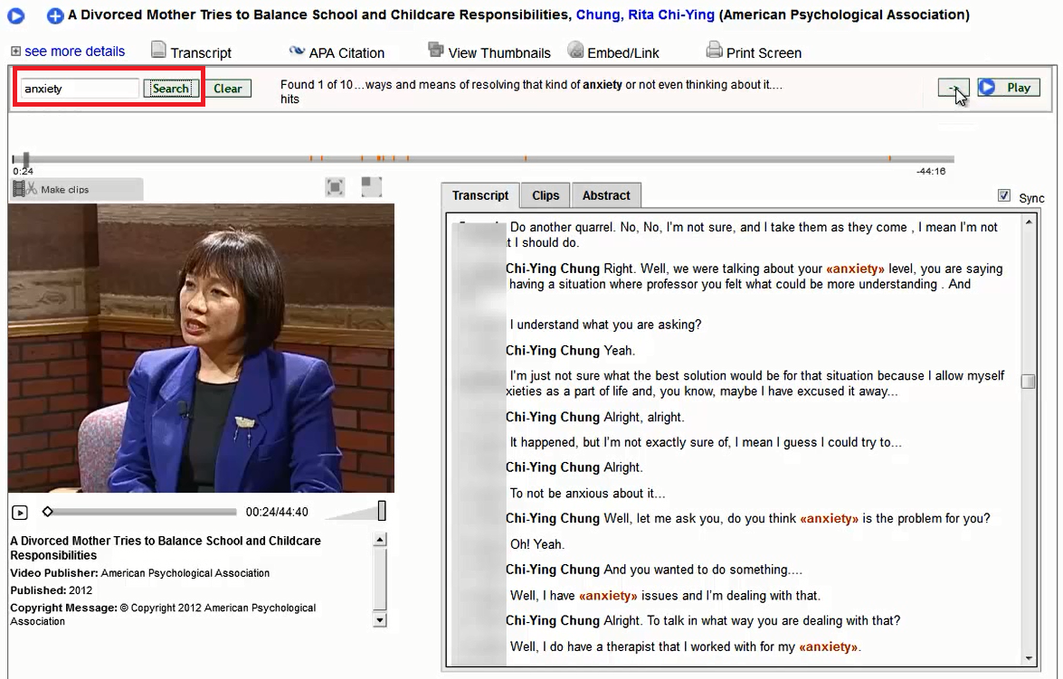
http://psycnet.apa.org/index.cfm?fa=browsePT.home

Slide 84
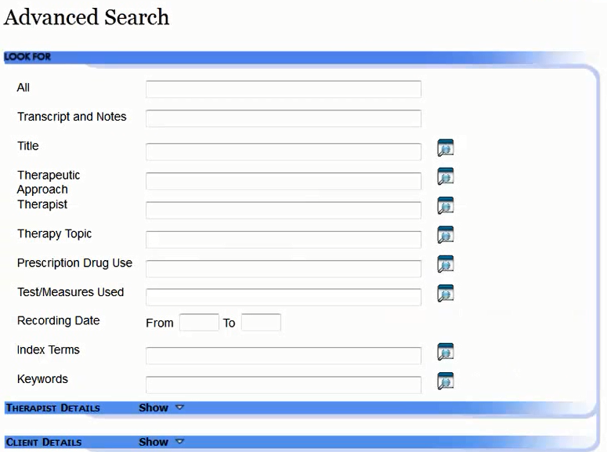
PsycTHERAPY®
Advanced Search
http://psycnet.apa.org/index.cfm?fa=browsePT.home

Slide 85
PsycTHERAPY®
Advanced Search: Therapist
http://psycnet.apa.org/index.cfm?fa=browsePT.home

Slide 86
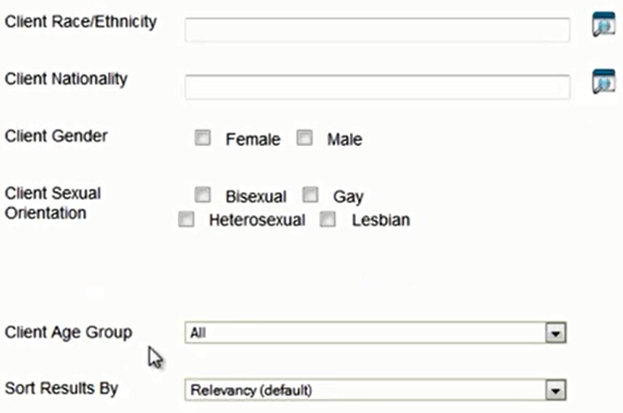
PsycTHERAPY®
Advanced Search: Client
http://psycnet.apa.org/index.cfm?fa=browsePT.home

Slide 87
PsycTHERAPY®
Browse
http://psycnet.apa.org/index.cfm?fa=browsePT.home

Slide 88
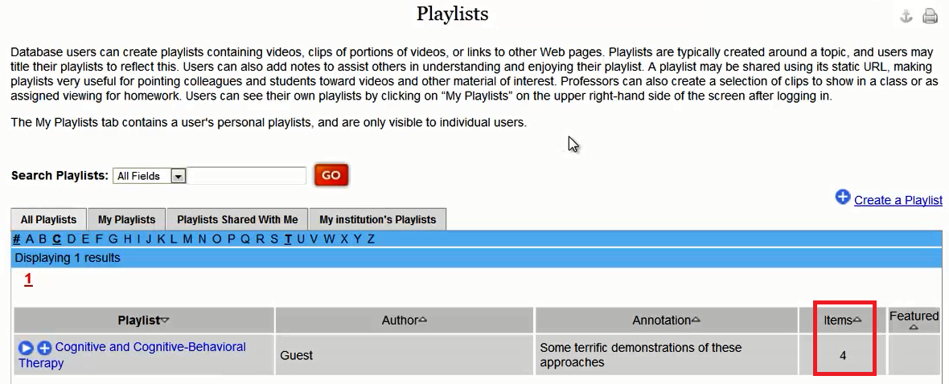
PsycTHERAPY®
Create your own playlist of videos
http://psycnet.apa.org/index.cfm?fa=browsePT.home

Slide 89
NEXT CLASS
MEDLINE Introductory Video Tutorials
http://www.nlm.nih.gov/bsd/disted/pubmed.html

