Slide 1
WITH/OUT NUCLEAR WEAPON
WORLD IS TO BE MORE SECURE
???

Slide 2
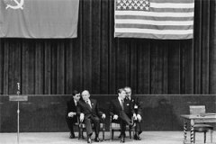
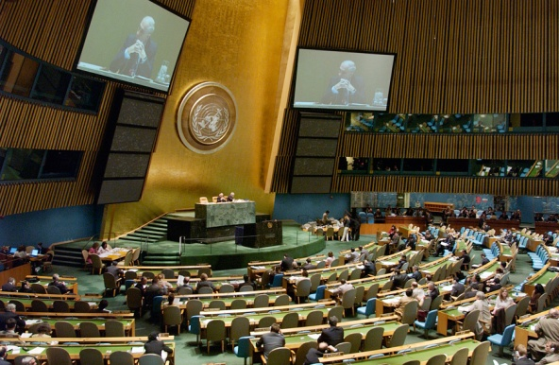
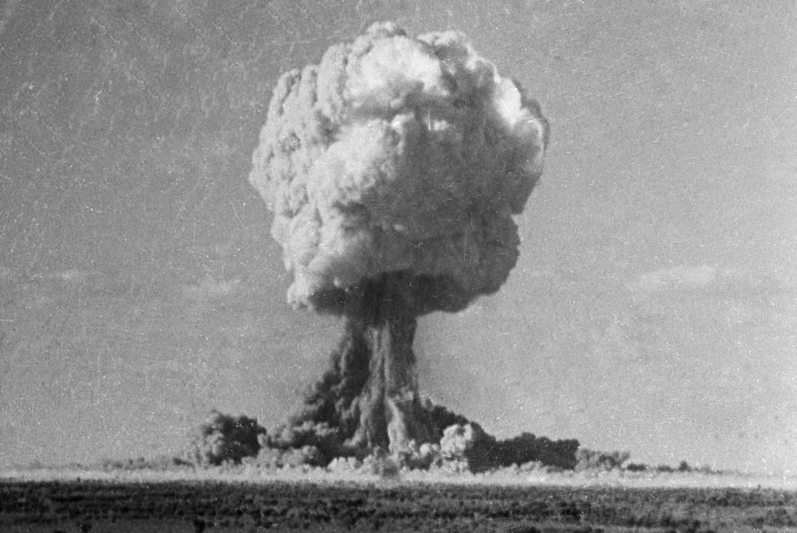
??? More secure ???
dialogue
deterrence
абсолютное зло

Slide 3
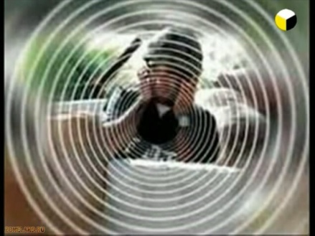
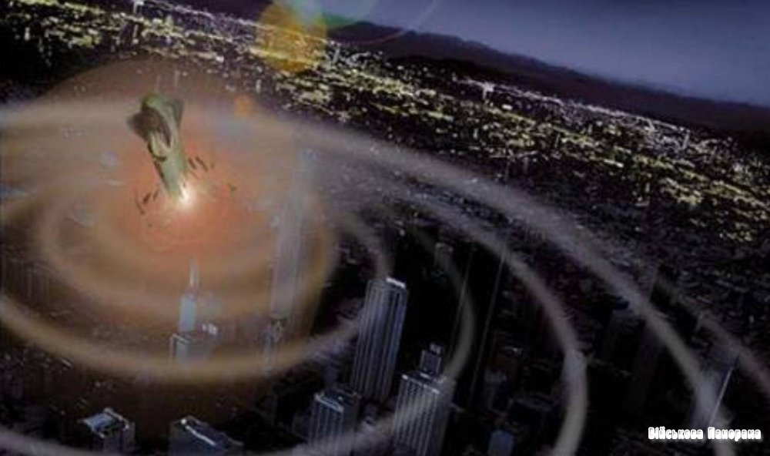
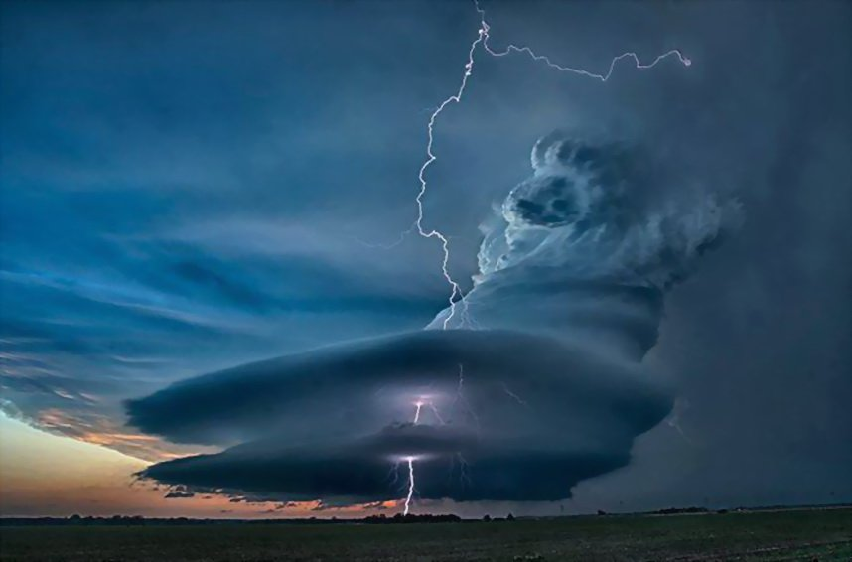
??? ДОВЕРИЕ ???
"the effect of remembering“
all and everything?
the ability to reproduce
New types of WMDs
Radiation
Laser
RF
Radiological
Infrasound
geophysical

Slide 4
the cycle zeroing
no deterrence
no "eternal" themes of dialogue
no trust
no unfair order
the growing number of local conflicts
Any local can become global
Confrontation
the arms race
chaos

