Slide 1
Political Campaigns Around the Globe: Selected Case Studies
France
Michal Pink
12. 4. 2016

Slide 2
Presidential election
1962 – referendum, direct vote
1965 – first election, seven years
TV become the „member of home“
Development of quantitative research, survey
Journal L´Express introduce first reports of preference every month before 1958
Philippe Jean Maarek identify year „0“ in to the presidential election 1965
Not very famous candidate hired own adviser for campaign: Jean Lecanuet and Michel Bongrand

Slide 3
Campaign in France
14 days before the first round of election
Long time without any regulation and law restiction
UK, Germany, Italy earlier, first regulation in France 1988
In 1990. 1993, 1995 and 1996 laws regulating presidential, national, regional, EP, local elections

Slide 4
Regulation of electoral campaign
Restriction of of all private TV media source during the three months before elections
During 90 days before election it is strictly forbidden any presentation in private media include phone marketing
Restriction of large bilboards (reality?)
The rule of three third (president/government/ oposition)
Since 2000 two half government/opossition
But since 1881 written newspapers with „open political opinion are out of this regulation and can inform all the time until the end of campaign

Slide 5
French newspapers
Newspaper | Frequency | Political alignment | Circulation | Website
L'Express | weekly | centre-right to right-wing | 437,800 | http://www.lexpress.fr
L'Humanité | daily | communist/far-left | 52,800 | http://www.humanite.presse.fr/
La Croix | daily | centre/Catholic | 104,901 | http://www.la-croix.com/
La Tribune Internationale | daily | Centrist | 87,800 | http://www.inttribune.com/fr
Le Figaro | daily | right-wing | 321,500 | http://www.lefigaro.fr/
Le Monde | daily | centre-left to left-wing | 314,000 | http://www.lemonde.fr
Libération | daily | center-left | 134,800 | http://www.liberation.fr/

Slide 6
1965
Candidate | I. Round | II. Round
Ch. De Gaulle | 44,65% | 55,20%
F. Mitterrand | 31,72% | 44,80%
Jean Lecanuet | 15,57%
J.L. Tixier Vignancourt | 5,20%
P. Marcilhacy | 1,71%
Marcel Barbu | 1,15%

Slide 7
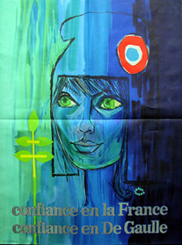

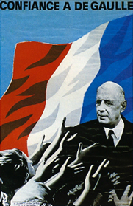
De Gaulle 1965

Slide 8
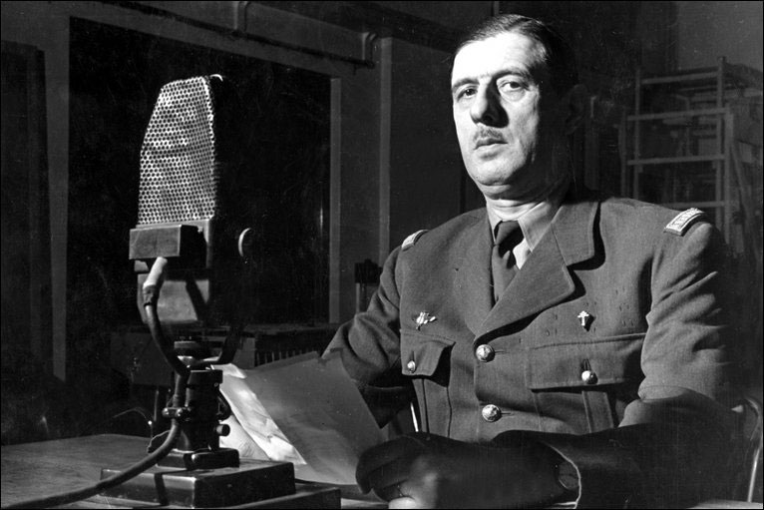
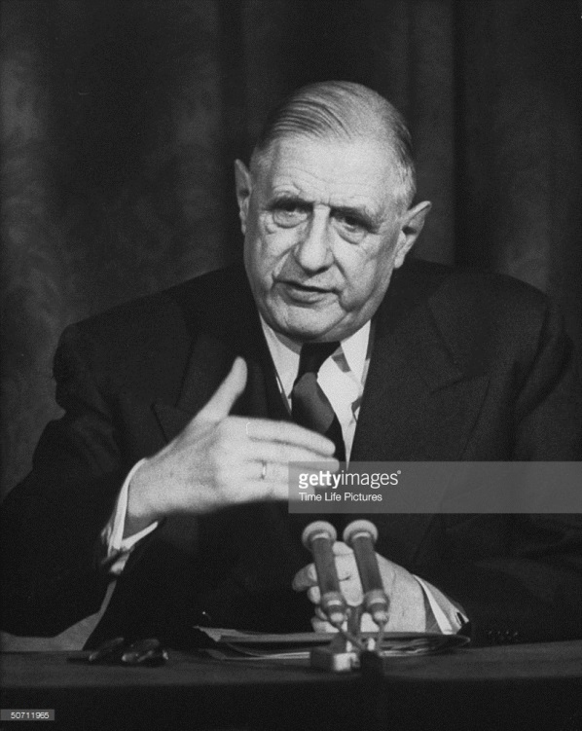
De Gaulle and media

Slide 9
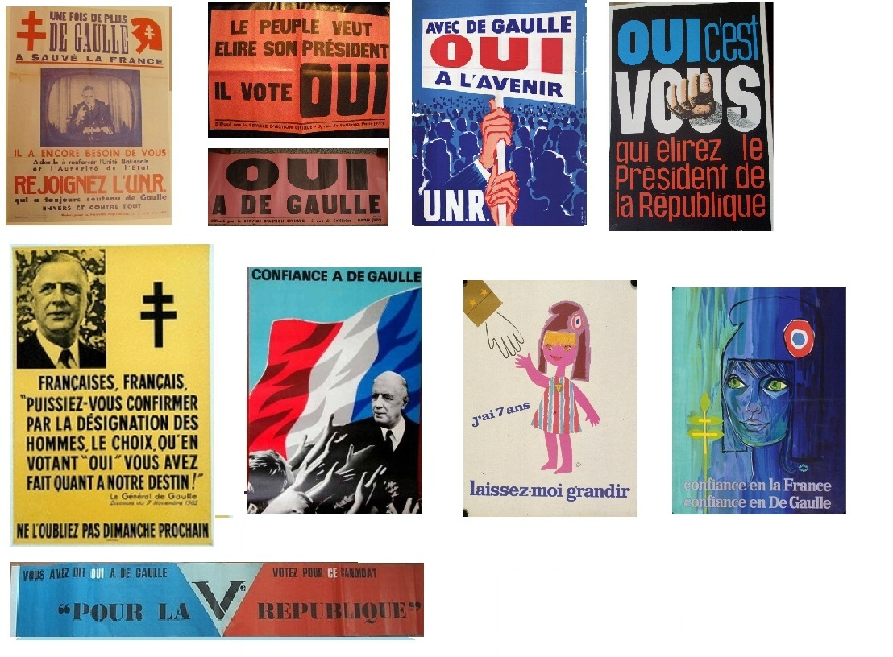
1965

Slide 10
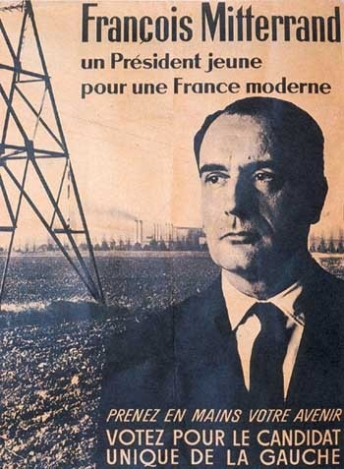
Francois Mitterand 1965

Slide 11

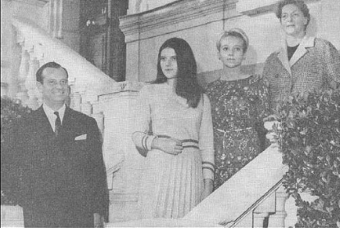
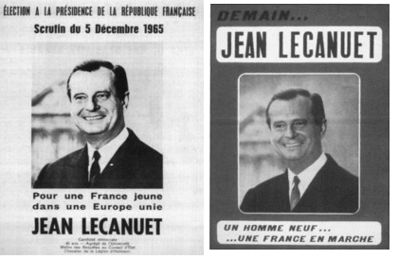
Jean Lecanuet 1965

Slide 12
Jean Lecanuet
Candidate – no name
Agency „Service et Méthodes24“ Michel Bongrand
During the campaign increase the popularity
First large introduction of bilboards
General campaign was for the first time base on image and not at the program
83 % voters knows him in the day of elections

Slide 13
1969
Candidate | I. Round | II. Round
G. Pompidou | 44,47 % | 58,21 %
Alain Poher | 23,31 % | 41,79 %
Jacques Duclos | 21,27 %
Gaston Deffere | 5,01 %
Michel Rocard | 3,61 %
Louis Ducatel | 1,27 %
Alain Krivine | 1,06 %

Slide 14

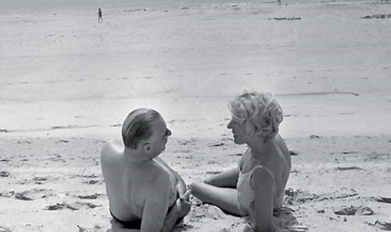

1969 – Pompidou

Slide 15
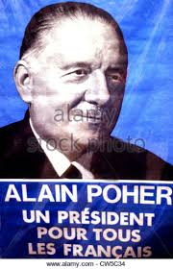
1969 – Poher

Slide 16
1974
Candidate | I. Round | II. Round
François Mitterrand | 43,25 % | 49,19 %
Valéry Giscard d'Estaing | 32,60 % | 50,81 %
Jacques Chaban-Delmas | 15,11 %
Jean Royer | 3,17 %
Arlette Laguiller | 2,33 %
René Dumont | 1,32 %
Jean Maria Le Pen | 0,75 %

Slide 17
1974
Short time for campaign, same 1969
Announce of candidat in the time of „state sadnes“
First was FM, folowed by JCHD and VGD
New TV programs and colour TV at the home!
„Face à face“, first TV program about politics
February 1970 „À armes égales“ (At the same swords)
Two politician with different opinions
„La voix de la France“ (Voice of France)
„Cartes sur table“ (Cards on the table)
VGD – ministr of finance from last decade, married, four childrens
VGD won the elections - 420 000 votes (1,82%)

Slide 18
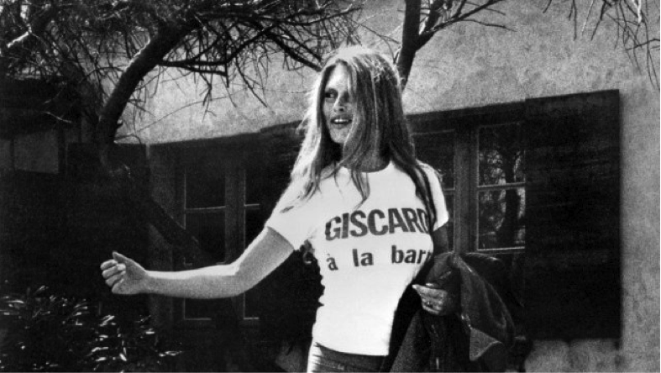
1974 VGD
Michel Poniatowsky „special personal assistant“
Activ participation of whole family
National committee of young generation, actvities (Sunday afternnon run, bicycle race, etc.)
Valérie-Anne Giscard d´Estaing daughter of VGD
„Conduisez votre avenir – Votez Giscard“

Slide 19
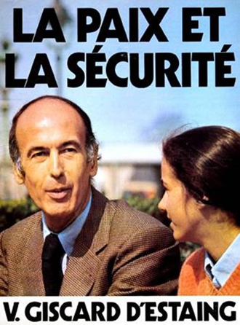
V. G. D´Estaign 1974

Slide 20
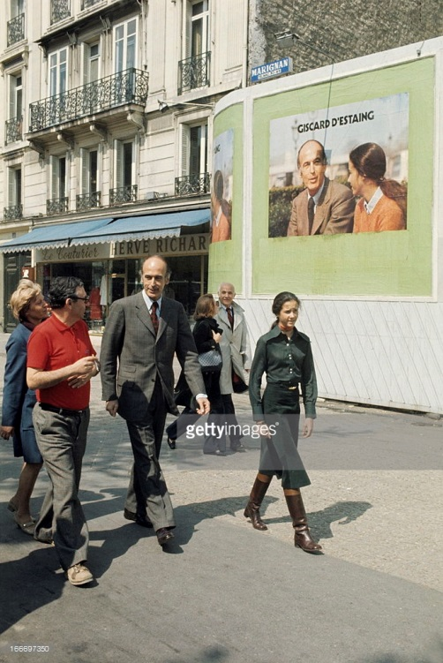
VGD 1974

Slide 21
1974 newspapers
Each newspaper has own „candidate“
Journal L´Aurore - Valéry Giscard d´Estainga
Le Figaro a Les Echos, - J. Chabana-Delmas,
second round Valéry Giscard d´Estainga
Valéry Giscard d´Estainga – TV and first „image of candidate“
Journal L´Unité (PS) and Le Mond - FM
Vous n'avez pas le monopole du cœur
„(You have not the monopol for heart)“
10.5. 1974 TV http://www.ina.fr/video/I00017840

Slide 22
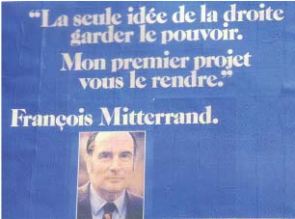
1974 FM

Slide 23
1974 François Mitterrand
Mitterand: less cultivated, less dynamic, less honest
His week competencies: foreign affaires, internatinal politics, economy, limit in solving the problems of the country
Best assesment – get on well with people
Candidate with best ability of understanding of every day problems
Social and family politics
Ex- minister before 1958, but without any personal experience with TV and modern media
VGD: more comunication skills for TV

Slide 24
1981
Candidate | I. Round | II. Round
Valéry Giscard d'Estaing | 28,32 % | 48,24 %
François Mitterrand | 25,85 % | 51,76 %
Jacques Chirac | 18,00 %
Georges Marchais | 15,35 %
Brice Lalonde | 3,88 %
Arlette Laguiller | 2,30 %
Michel Crépeau | 2,21 %

Slide 25
1981
Increasing number of research
Who is better neighbour ?“ VGD or FM? Etc.
First round – VGD winner
One of the explication: VGD obtain good results in first round but…
FM: candidate without PCF support before first round of the election and long time before elections was very often in TV

Slide 26
1981 VGD
President since 1974
TV show: „Les voeux présidentiels“„Elysée Portes Ouvertes: Visages d´un Président
„La France a l´Elysée“ 1977, group of 60 people, asking direct to president and he is ready to explain and describe it
In to the campaign was introduce much more wife of VGD Anne Aymone, born in to the aristocratic family, since 1974 togehter with VGD represent country

Slide 27
VGD Incumbent president 1981
Economic „crise“ and inflation
Unification of Europe and cooperation with Germany (EP elections)
Liberalisation (abortion)
Decease of activ voting age 18 - 21
1977, first steps in campaign regulation
FM: problematic partnership with PCF, election 1978 and bipolar quadrille
VGD: candidat Jacques Chirac (RPR)
Elections in real time and date

Slide 28
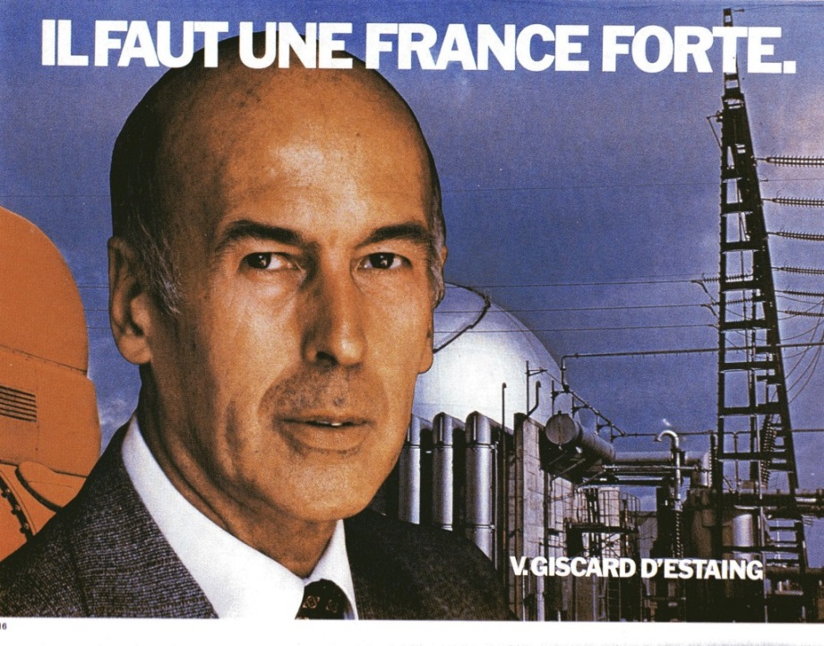
1981 VGD
„candidate of hope“ and “ citizen candidate“
VGD during the offical campaign use in formal speach „YOU“
FM use in formal speach „we“
Key point was II. round and overtaking of voters of J. Ch. and G.M.

Slide 29
1981 VGD

Slide 30
Negativ campaign 1981

Slide 31
VGD II. Kolo

Slide 32

J. Chirac - RPR 1981

Slide 33
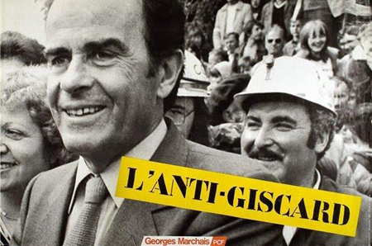
G. Marchaise – PCF 1981

Slide 34
1981 FM
Strategy of „ordinary citizen“
In the TV discusion FM cooperate with „ordinary people“ together with academics (ecolo, enemployment, housing etc).
Between first and second round of presidential elections movie about the campaign – describtion of „Tour de France of FM“
Role of Danielle Mitterrand, oposition of „madame VGD“
10.5. 1981 pilgrimage around small village together with journalist

Slide 35
1981
Bernard Cathelet, sociologist with own concept of „sociostyle“ – lifestyle in french society
Comunication strategy - „cultural change“
La force tranquille – change but not modern
„L´Autre chemin. Une autre politice, un autre president“
„Other way, other politics other president“

Slide 36
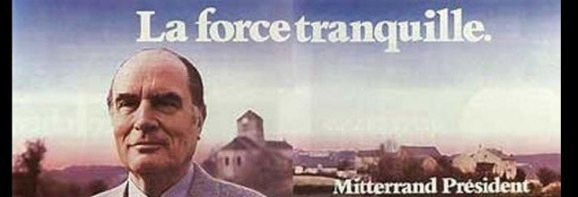
1981 „La force tranquille“

Slide 37
1981 - 1995
New TV program „Ca nous interesse monsieur le Président“ - „It is of interest to us, Mister President“
Bilateral talk show for „people“
1995 J. Pilhan long time FM adviser and later join J. Chirac team

Slide 38

1988 – Géneration Mitterrand

Slide 39
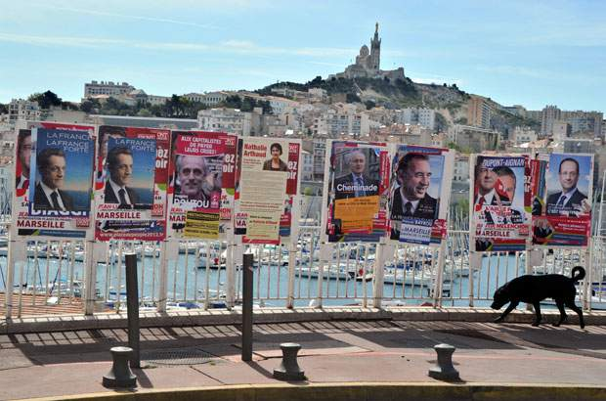
Election campaign - 2012

Slide 40

2007 Nicolas Sarkozy

Slide 41
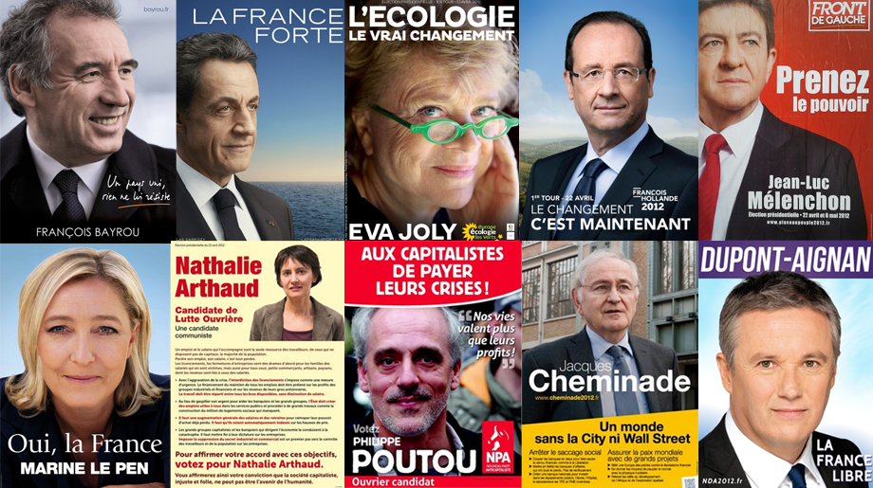
2012

Slide 42
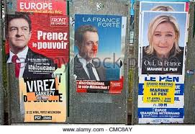
2012

Slide 43

NPA – Far left

Slide 44
PS – Jospin, Royal, Hollande
https://www.youtube.com/watch?v=sgLCqFmzzpQ
https://www.youtube.com/watch?v=hVtpufFN95E&nohtml5=False
https://www.youtube.com/watch?v=Iy5yc6-E6gM&nohtml5=False

Slide 45
UMP – Chirac, Sarkozy
https://www.youtube.com/watch?v=_xsLo9zWJh4&nohtml5=False
https://www.youtube.com/watch?v=HpttGntCPZM&nohtml5=False
https://www.youtube.com/watch?v=EkuPdIK_6IE&nohtml5=False

Slide 46
Jean M. Le Pen
https://www.youtube.com/watch?v=RP6Fr5GRmjg
https://www.youtube.com/watch?v=JFRlkxwnHdg
https://www.youtube.com/watch?v=CwnXx5Jv2c0
https://www.youtube.com/watch?v=94GBLvwLWY4
https://www.youtube.com/watch?v=loatjnSZtCk

Slide 47
Source
Institut national audivisuel, INA
La Politique.net
La Documentation Francaise
Christian Delport
Philippa Jeana Maarek
R. - G. Schwartzenberg
Jeana Stoetzel

