Slide 1
GOOD LUCK for SPRING 2016!
INTRODUCTION
You self
Your motives
Your expectations
WHY ARE YOU HERE???

Slide 2
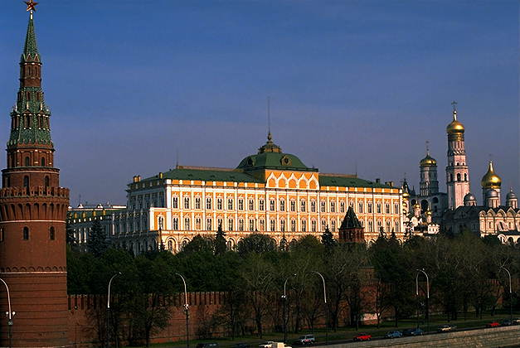
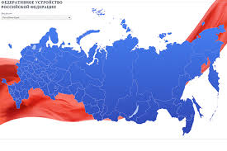
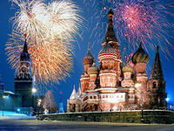
NATIONAL SECURITY in regional perspective
Case study of RUSSIA
Prof. Lidiia Kuliabina
Department of Political Science and Political Governance
UDMURT STATE UNIVERSITY
lidiiakuliabina@gmail.com
Masaryk University Brno
Spring 2016

Slide 3
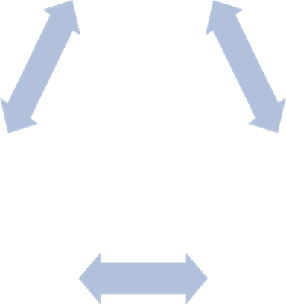
Theory. Definitions
National security: case of Russia
National S
State S
Civil S

Slide 4
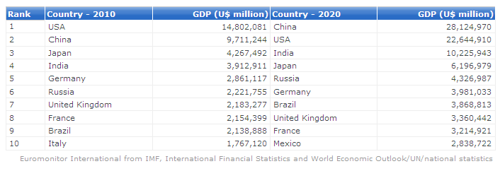
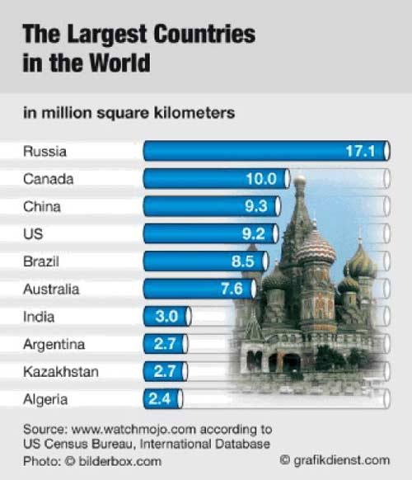
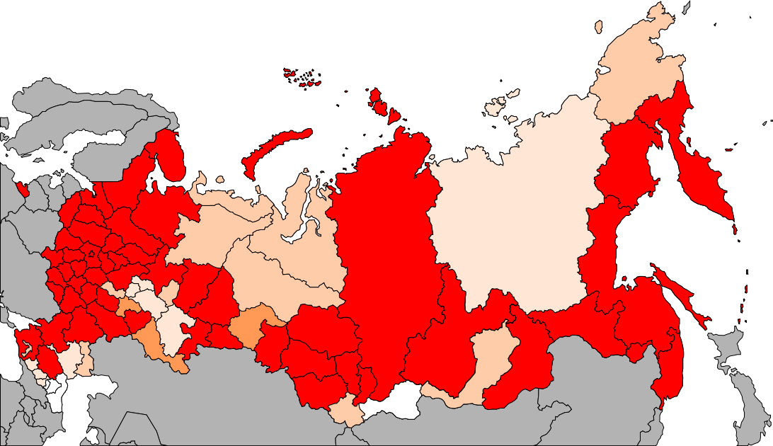
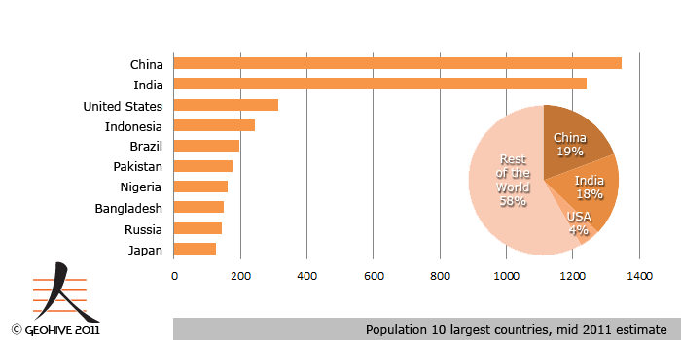
Population: 144 millions people
Languages: Russian is official throughout the country;
27 other languages - co-official in various regions, 100 nationalities
11 time zones
Cities: 1000 cities and towns, 13 cities with population over 1 million
Percentage of ethnic Russians by region in 2010 >80% 70—79% 50—69%

Slide 5
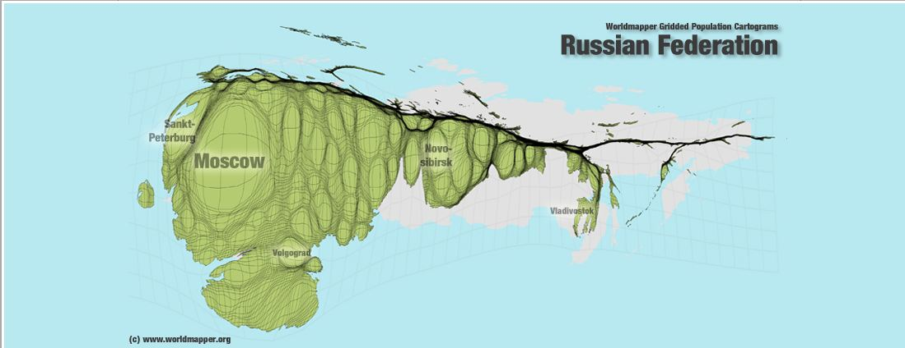
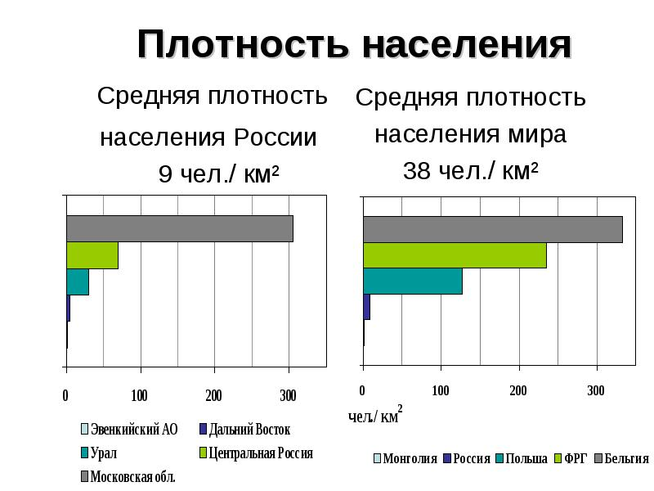
National security: case of Russia

Slide 6
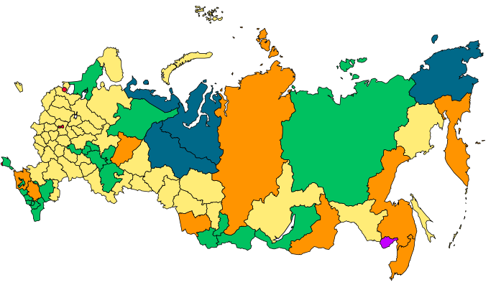

Slide 7




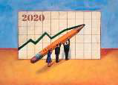
RUSSIAN STRATEGIC PLANNING
2014-2020
РОССИЙСКОЕ СТРАТЕГИЧЕСКОЕ ПЛАНИРОВАНИЕ
➢ 2014 Зимние Олимпийские
Игры в Сочи
➢2020 Результаты реализации
Стратегии развития России
Выборы: 2016 Государственная Дума
2018 Президент
В.А. Орлов
➢ 2014-2015
Председательство
России в ШОС
➢ 2015
Председательство
России в БРИКС
➢ 2018 ЧМ по
футболу
➢

Slide 8
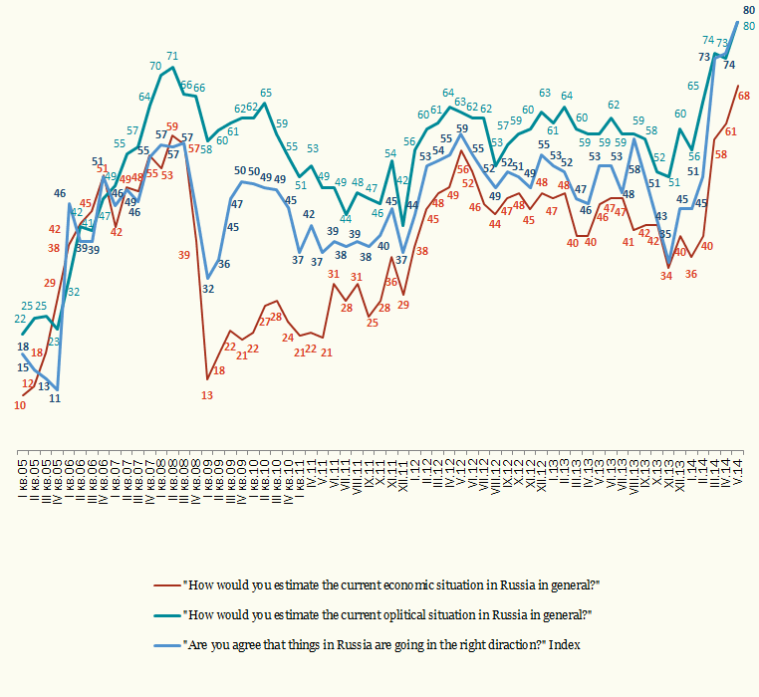
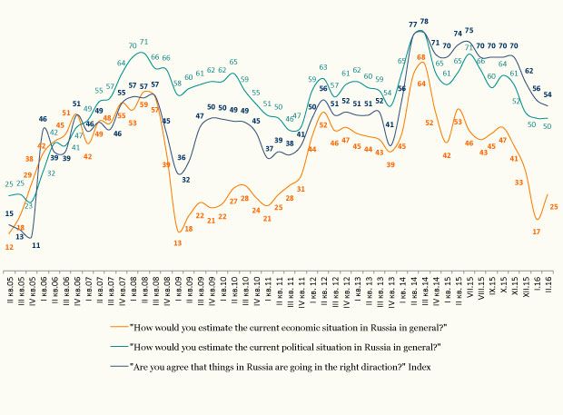
Index of social moods http://www.wciom.com/index.php?id=126
National security: case of Russia
October, 2014
Economic situation
in the country 59
Political situation 71
General vector
of development 78

Slide 9
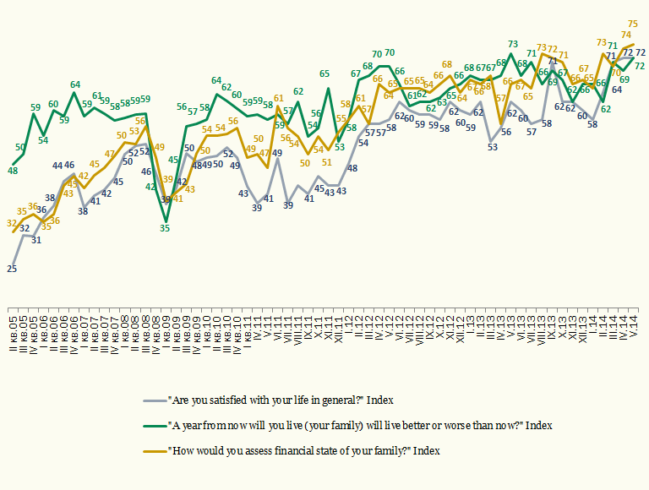
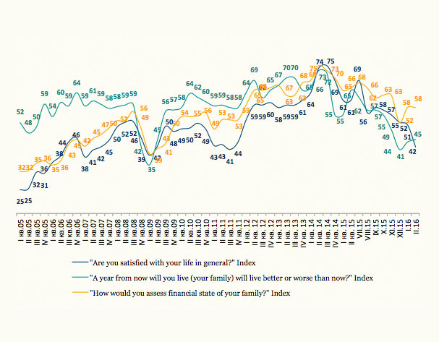
Index of Social wellbeing http://www.wciom.com/index.php?id=126
National security: case of Russia
October, 2014
Satisfaction
with life 69
Social optimism
63
Financial state 72

Slide 10
Terms and definitions
National security: case of Russia
Khan network
Nuclear sharing
Third positional district
Anti-ballistic missile defense system
National values
National interests
National-state-civil security
Sustainable development
Global governance
Failed state
Balance of forces
Cockeyed lens in NS
Danger in Security theories
Threat in Security theories
Challenge in Security theories
Weapons of Mass Destruction (WMD)
Strategic offensive weapons
International Documents
Treaty on the Non-Proliferation of Nuclear Weapons (NPT, 1968)
Chemical Weapon Convention (CWC, 1997)
Biological Weapon Convention (BWC, 1975)
Comprehensive Nuclear-Test-Ban Treaty (CTBT, 1996)
Pan-European security treaty (proposal, 2009)
Strategic Arms Reduction Treaty (START I, 1992, START II, 1996, New START III, 2010)
Intermediate-Range Nuclear Forces Treaty (INF , 1987)
International and regional organizations
International Atomic Energy Agency (IAEA, 1957)
Commonwealth of Independent States (CIS, 1991)
Eurasian Economic Community (EurAsEC, 2000-2014)
Eurasian Economic Union (EAEU or EEU, 2015)
Collective Security Treaty Organization (CSTO, 2002)
Shanghai Cooperation Organization (ShCO, 1996)
Organization for Security and Co-operation in Europe (OSCE, 1975)
BRICS (2009)
Russia-NATO Council (2002)
Programs
Cooperative Threat Reduction Program (Cooperative Threat Reduction (Nunn-Lugar, CTR, 1991))
Partnership for Peace (PfP, 1994)
Russian Documents
National Security Strategy 2015
National Security Strategy to 2020
National Security Concept 1997/2000
Military Doctrine of Russian Federation 2010
Food Security Doctrine 2010
Energy Security Doctrine 2012
Energy Security Strategy to 2030
Information Security Doctrine 2000
Russia’s NS Structures
Security Council of RF
Presidential Executive Office
Federal Security Service
Ministry for Foreign Affairs
Ministry for Domestic Affairs
Defense Ministry Federal Custom Service
Armed Forces
Federal Intelligent Service
Federal Drug Control Service
Ministry of Civil Defense, Emergencies and Natural Disasters Relief

Slide 11
1. MARCH 7
Idea and content overview.
Skills and assessments.
Definition list (10 min)
Current event methodology (45 min)
Theory and definitions.
Levels of security
NS in globalized world, post-security.
Soft and hard
Security components (foreign policy, military, intelligence, etc).
Correlation of internal and external security(80 min).
Work in groups: threats list (45 min).
Assessment:
Currents news.
Position paper/short speech (1-3 pages/2-3 min) about one of the threats or challenges for Russian NS (what exactly means, dynamic of growth/reducing, variants of symmetrical / asymmetrical answer).
Reading.
Looking at SC faces
Watch a film http://www.nucleartippingpoint.org/film/film.html

Slide 12
2. March 14
Assessment: 1. Currents news. 2. Reading. 3. Work on paper Russia’s Security Strategies Comparative Analyze.
Warming up: current news discussing (20 min).
Discussion: treats and challenges (20 min)
Reports on reading (20 min)
Lecture:
Security structure, institutes
faces in contemporary Russia (80 min).
Algorithm of official security documents analyzing (40 min).
Assessment:
Currents news.
Reading.
Work on paper comparative analyze of (by choice)
A) Russia’s NS Strategy to 2020 and Russia’s NS Strategy 2015
B) Russia’s NS Strategy 2015 and Security Strategy of the Czech Republic 2015 (or national state of your’s citizenship)
C) Russia’s NS Strategy 2015 and US National Security Strategy 2015
Use a scheme!!!
4. Choose a personality!

Slide 13
3. April 4
Warming up: current news discussing (20 min)
Reports on reading (20 min)
Lecture: Regional and global agenda for Russia’s NS. Main streams (Ukraine, ISIS, Syria, Iran, Afghanistan etc.), membership in regional organizations(G8, G20, Russia-NATO Council). Russia and EU in security context. Russia and former soviet members (CIS, CSTO, Customs Union). Internal security agenda for Russia. Economic development (natural resources/high technologies), political “stabilization” (United Russia party, Putin’s personality, opposition), human dimension (migration, brain drain, ethnic confrontations), etc. (120 min)
Explanations on Simulation process (20 min)
Assessment:
Currents news.
Reading for cyberday.
Simulation preparations

Slide 14
4. April 11
Warming up: current news discussing (20 min).
Reports on reading (20 min)
Lecture:
Cyber Security day.
Definitions, main approaches.
Global internet governance
Freedom, privacy, intelligence (110 min)
Assessment:
Currents news.
Reading.
Simulation preparations

Slide 15
5. April 18
Warming up: current news discussing (20 min).
Reports on reading (20 min)
Simulation: Weekly Russian Security Council meeting (90 min). Discussion on results (30 min)
Discussion on student’s papers. Recommendations for feather experience (20 min)
Assessment:
EXAM!!!
Currents news.
Test on terms and definitions.

Slide 16
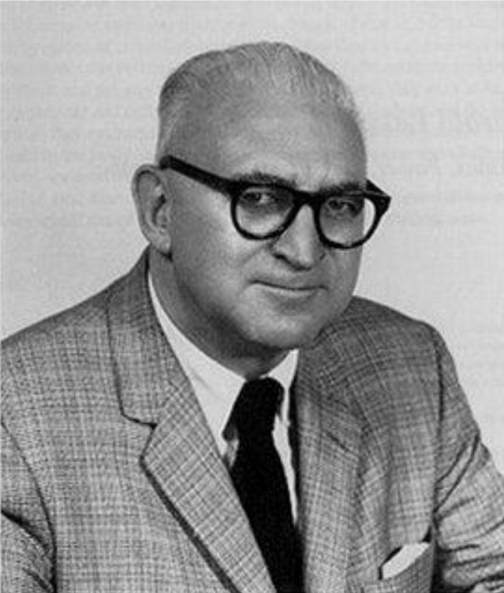
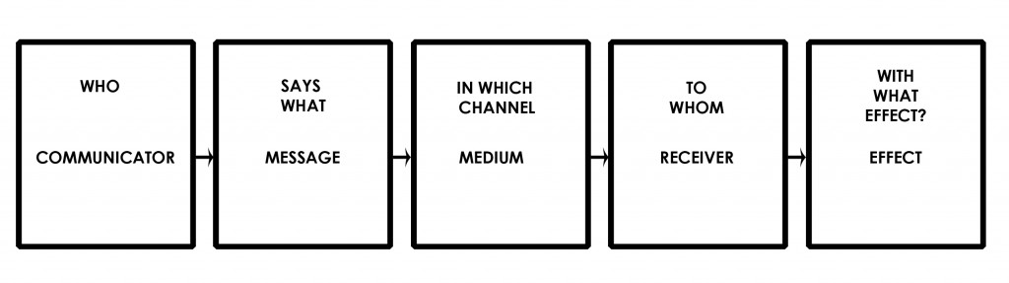
NEWS
Harold D. Lasswell

Slide 17
NEWS
+ pre-story
details
evidences
expert’s comments
Prognoses
compare the sources
try to weed out the propaganda
formulate ??? for the shortfall of information
when happened?
where?
what happened?
Who tells?
Whom tells?
What about?
What channel is used?
With what effects?

Slide 18
‘Make-up…military-style’: Russian servicewomen compete in speed and strength
6 Mar, 2016 22:54 https://www.rt.com/news/334746-make-women-military-russia/

Slide 19
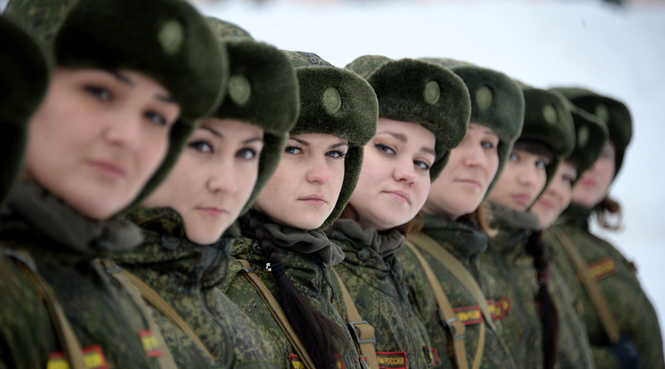
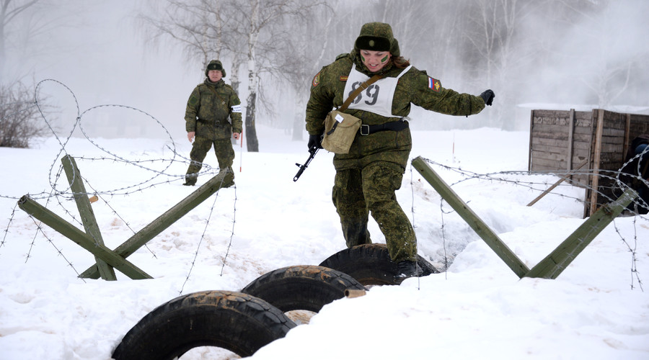
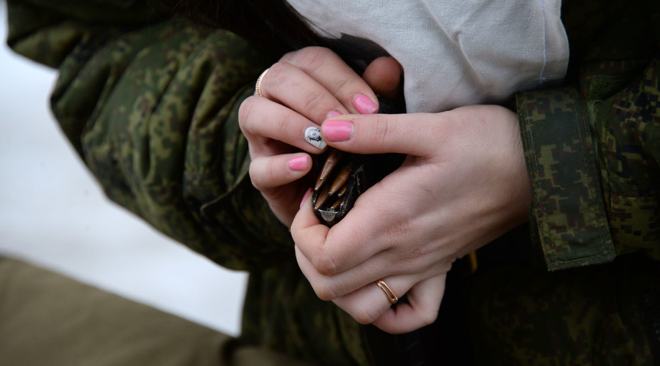
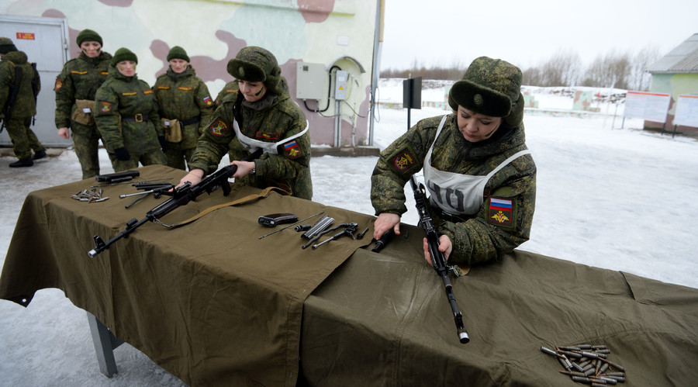

Slide 20
READING for March14
PRIMAKOV, Yevgeny. Perception of Russia in the World, Russia in global affairs, 2013 http://eng.globalaffairs.ru/number/Perception-of-Russia-in-the-World-15926 (3
Ryabkov S. Nonproliferation as number one priority, Security Index, №1, Winter 2014. P. 17-25
Iran in the Regional and Global Perspective. Moscow, 2015

Slide 21
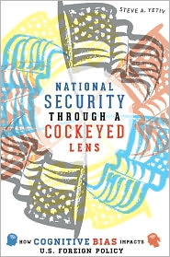
National security: case of Russia
Steve A. Yetiv
National Security through a Cockeyed Lens:
How Cognitive Bias Impacts U.S. Foreign Policy
(Johns Hopkins University Press, November 2013).
Agenda
For what
For whom
Who
Theoretical points
Documents
Structures

Slide 22
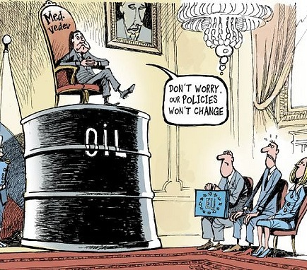
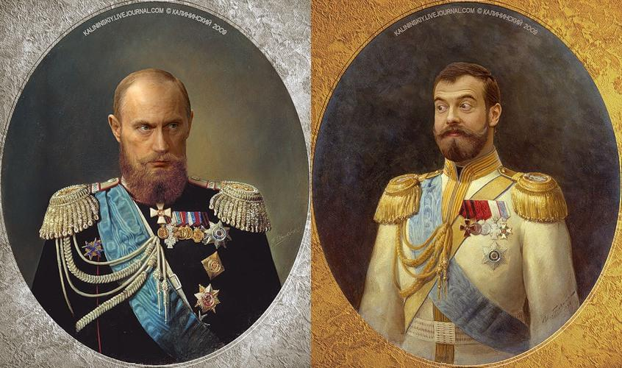
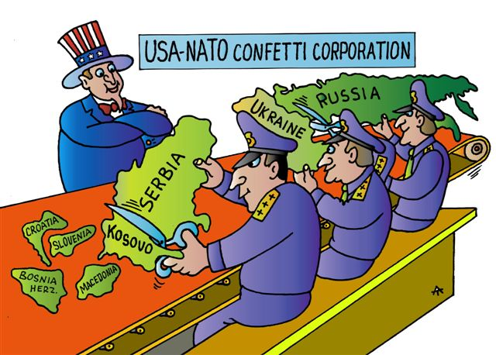
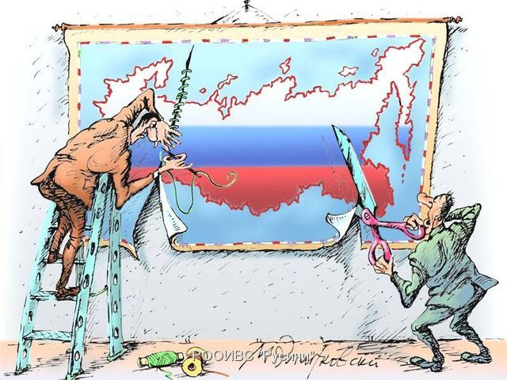
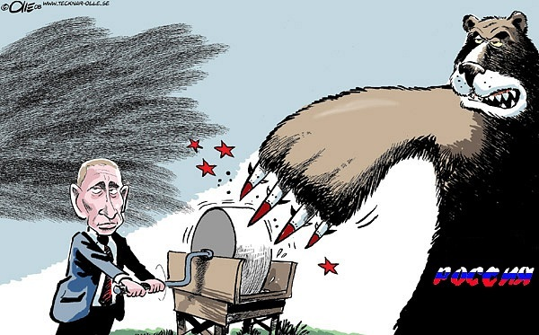
National security: case of Russia

Slide 23
«Please name 5-6 politicians, whom you trust most» (open-ended question) http://www.wciom.com/index.php?id=120
Question: «Please name 5-6 politicians, whom you trust most» (open-ended question).
 | February 7, 16 | February 14, 16 | February 21, 16 | February 28, 16
Putin V. | 62 | 58 | 57 | 58
Lavrov S. | 9 | 10 | 8 | 8
Shoygu S. | 6 | 7 | 5 | 8
Medvedev D. | 8 | 8 | 6 | 8
Zhirinovsiky V. | 5 | 6 | 6 | 6
Zyuganov G. | 3 | 4 | 4 | 5
Mironov S. | 1 | 1 | 1 | 1
Prokhorov M. | 0 | 0 | 0 | 0

Slide 24
THEORETIC POINTS
National security: case of Russia
GLOBAL
INTERNATIONAL
REGIONAL
NATIONAL
LOCAL
PERSONAL
DANGER
THREAT
CHALLENGE
HARD
SOFT

Slide 25
Cockeyed lens
National security: case of Russia
NATO near the border
Terrorizm
Reducing oil prices
Dependence from row energy export
Collaborationists and foreign agents of influence
Illegal migration
uneven distribution of the population across the country
Disproportions in region’s development
Conflicts on the border
environmental degradation
Humanitarian expansion
Interethnic tensions
Title nation discrimination
Losing of national identity
Social deceases
Alcoholism
Drug addiction
Corruption
Education and medical service system degradation
Law nihilism

Slide 26
Theory. Definitions.
National security: case of Russia
S
O
Person
Nature
Technogenic
Social group
Society
State
Group of states
Person
Nature
Technogenic
Social group
Society
State
Group of states
___________________
___________________
___________________
___________________
__________________
___________________
___________________
___________________
___________________
___________________
______________

Slide 27
Theory. Definitions
National security: case of Russia
National Security
State Security
The indicator of the state of the nation,
meaning that
the cumulative impact of internal and external factors
Does not create threats to its existence
may not significantly reduce the quality of the life
The indicator of the situation with state and its institutions,
meaning that
they are able to perform its functions in relation to society.
The state needs:
Protection from other States
From civil society
From the destructive activities of officials

Slide 28
Theory. Definitions
National security: case of Russia
abilities
implementation
The national strategy
programs that are not associated explicitly with a total document
To anticipate
To prevent
Transfer
To recover from
ADVERSE EFFECTS

Slide 29
Criteria of NS providing
National security: case of Russia
High quality operational and strategic management, the availability of reserve capacity management
The ability to develop concepts and technologies
the ability to evacuate population and values
Protection of the built environment and population from external factors and destructive actions
The availability of supplies,
power reserve
the dominance of common interests
even if there are internal conflicts

Slide 30

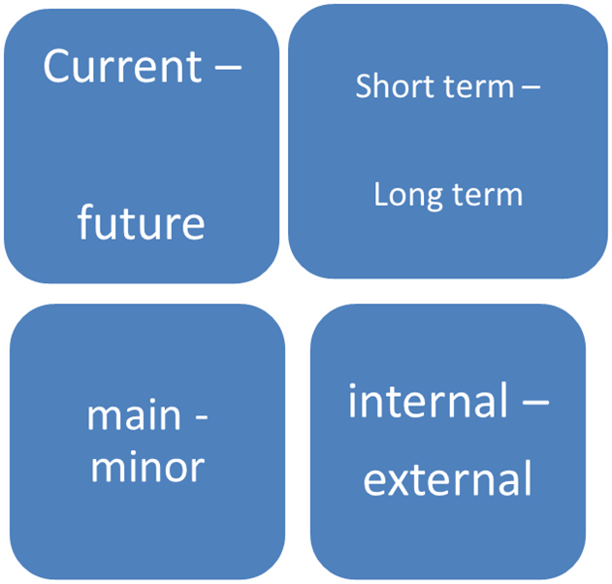
National interests
National security: case of Russia
conscious
goals and values
Arena of providing NI
External
Internal
Borders

Slide 31
Functioning regimes
National security: case of Russia
O
C
M
O
C
M
O
C
M
O
C
M
O
C
M
O - ordinary
M - military
C- catastrophe

Slide 32
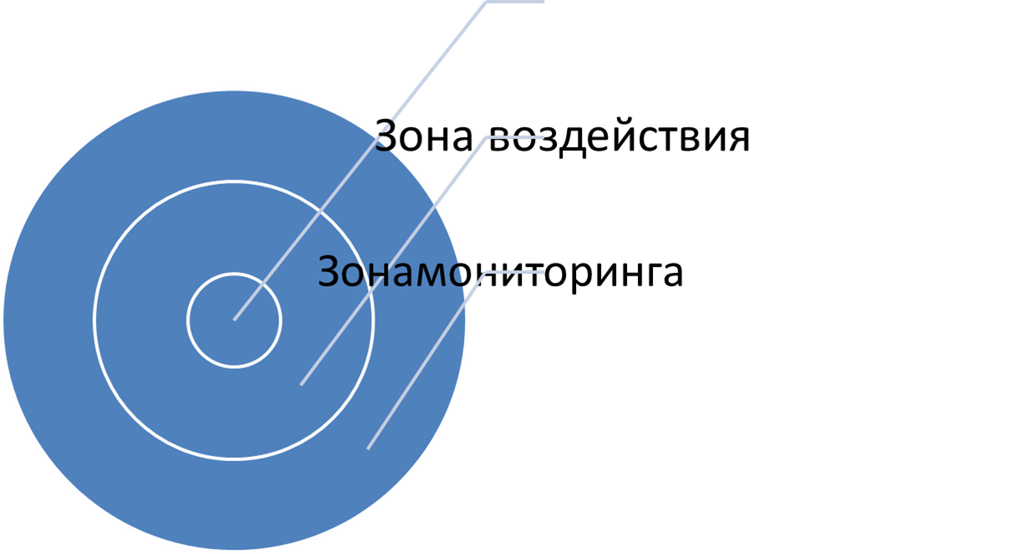



Zones of S providing
National security: case of Russia
The impact zone is the area within which the security system can greatly affect the circumstances.
The impact zone is wider then responsibility zone and may be wider than the monitoring zone.

Slide 33
Documents
National security: case of Russia
1992 Federal Law “About Security”
1996 President's annual address to the Federal Assembly (!first NS!)
NS Consept
1997 1st edition
10.01.2000 edition
NS Strategy 2020
NS Strategy 2015

Slide 34
