Slide 1
2. March 14
Assessment: 1. Currents news. 2. Reading. 3. Work on paper Russia’s Security Strategies Comparative Analyze.
Warming up: current news discussing (20 min).
Discussion: threats and challenges (20 min)
Reports on reading (20 min)
Lecture:
Security structure, institutes
faces in contemporary Russia (80 min).
Algorithm of official security documents analyzing (40 min).
Assessment:
Currents news.
Reading.
Work on paper comparative analyze of (by choice)
A) Russia’s NS Strategy to 2020 and Russia’s NS Strategy 2015
B) Russia’s NS Strategy 2015 and Security Strategy of the Czech Republic 2015 (or national state of your’s citizenship)
C) Russia’s NS Strategy 2015 and US National Security Strategy 2015
Use a scheme!!!
4. Choose a personality!

Slide 2
NEWS
+ pre-story
details
evidences
expert’s comments
Prognoses
compare the sources
try to weed out the propaganda
formulate ??? for the shortfall of information
when happened?
where?
what happened?
Who tells?
Whom tells?
What about?
What channel is used?
With what effects?

Slide 3
THEORETIC POINTS
National security: case of Russia
GLOBAL
INTERNATIONAL
REGIONAL
NATIONAL
LOCAL
PERSONAL
DANGER
THREAT
CHALLENGE
HARD
SOFT

Slide 4
Cockeyed lens
National security: case of Russia
NATO near the border
Terrorizm
Reducing oil prices
Dependence from row energy export
Collaborationists and foreign agents of influence
Illegal migration
uneven distribution of the population across the country
Disproportions in region’s development
Conflicts on the border
environmental degradation
Humanitarian expansion
Interethnic tensions
Title nation discrimination
Losing of national identity
Social deceases
Alcoholism
Drug addiction
Corruption
Education and medical service system degradation
Law nihilism

Slide 5
READING for March14
PRIMAKOV, Yevgeny. Perception of Russia in the World, Russia in global affairs, 2013 http://eng.globalaffairs.ru/number/Perception-of-Russia-in-the-World-15926 (3
Ryabkov S. Nonproliferation as number one priority, Security Index, №1, Winter 2014. P. 17-25
Iran in the Regional and Global Perspective. Moscow, 2015

Slide 6
Theory. Definitions.
National security: case of Russia
S
O
Person
Nature
Technogenic
Social group
Society
State
Group of states
Person
Nature
Technogenic
Social group
Society
State
Group of states
___________________
___________________
___________________
___________________
__________________
___________________
___________________
___________________
___________________
___________________
______________

Slide 7
Theory. Definitions
National security: case of Russia
National Security
State Security
The indicator of the state of the nation,
meaning that
the cumulative impact of internal and external factors
Does not create threats to its existence
may not significantly reduce the quality of the life
The indicator of the situation with state and its institutions,
meaning that
they are able to perform its functions in relation to society.
The state needs:
Protection from other States
From civil society
From the destructive activities of officials

Slide 8
Theory. Definitions
National security: case of Russia
abilities
implementation
The national strategy
programs that are not associated explicitly with a total document
To anticipate
To prevent
Transfer
To recover from
ADVERSE EFFECTS

Slide 9
PRINCIPLES OF NS ENSURING
National security: case of Russia
The preservation of diversity (the adaptation factor)
The accumulation of reserves, creation of reserve capacity, industrial capacity
The growth potential manageability
The growth of intelligence of society
Maintaining optimum level of consumption
To teach the society to fight with difficulties
Providing attractive prospects, the General "bright future"

Slide 10
Criteria of NS providing
National security: case of Russia
High quality operational and strategic management, the availability of reserve capacity management
The ability to develop concepts and technologies
the ability to evacuate population and values
Protection of the built environment and population from external factors and destructive actions
The availability of supplies,
power reserve
the dominance of common interests
even if there are internal conflicts

Slide 11

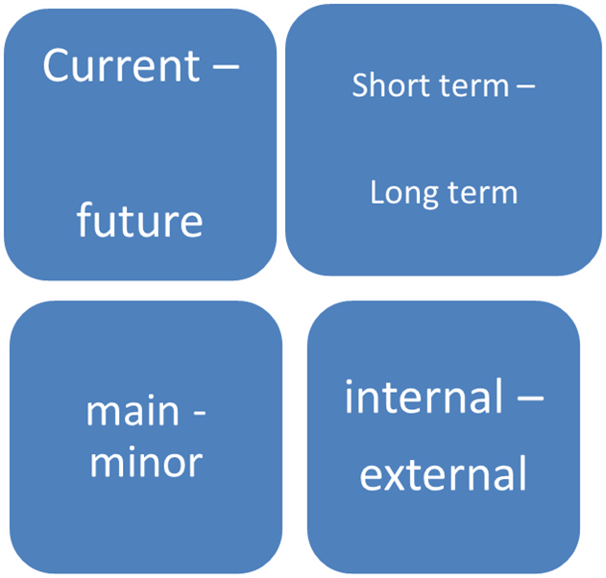
National interests
National security: case of Russia
conscious
goals and values
Arena of providing NI
External
Internal
Borders

Slide 12
Functioning regimes
National security: case of Russia
O
C
M
O
C
M
O
C
M
O
C
M
O
C
M
O - ordinary
M - military
C- catastrophe

Slide 13
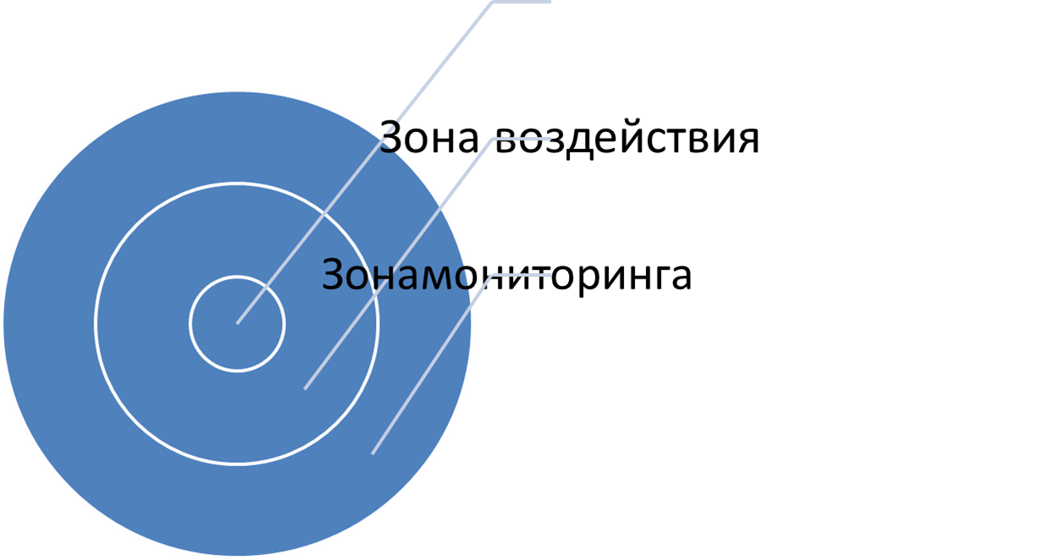



Zones of S providing
National security: case of Russia
The impact zone is the area within which the security system can greatly affect the circumstances.
The impact zone is wider then responsibility zone and may be wider than the monitoring zone.

Slide 14
Documents
National security: case of Russia
1992 Federal Law “On Security”
1996 President's annual address to the Federal Assembly (!first NS!)
NS Consept
1997 1st edition
10.01.2000 edition
NS Strategy to 2020
NS Strategy 2015

Slide 15

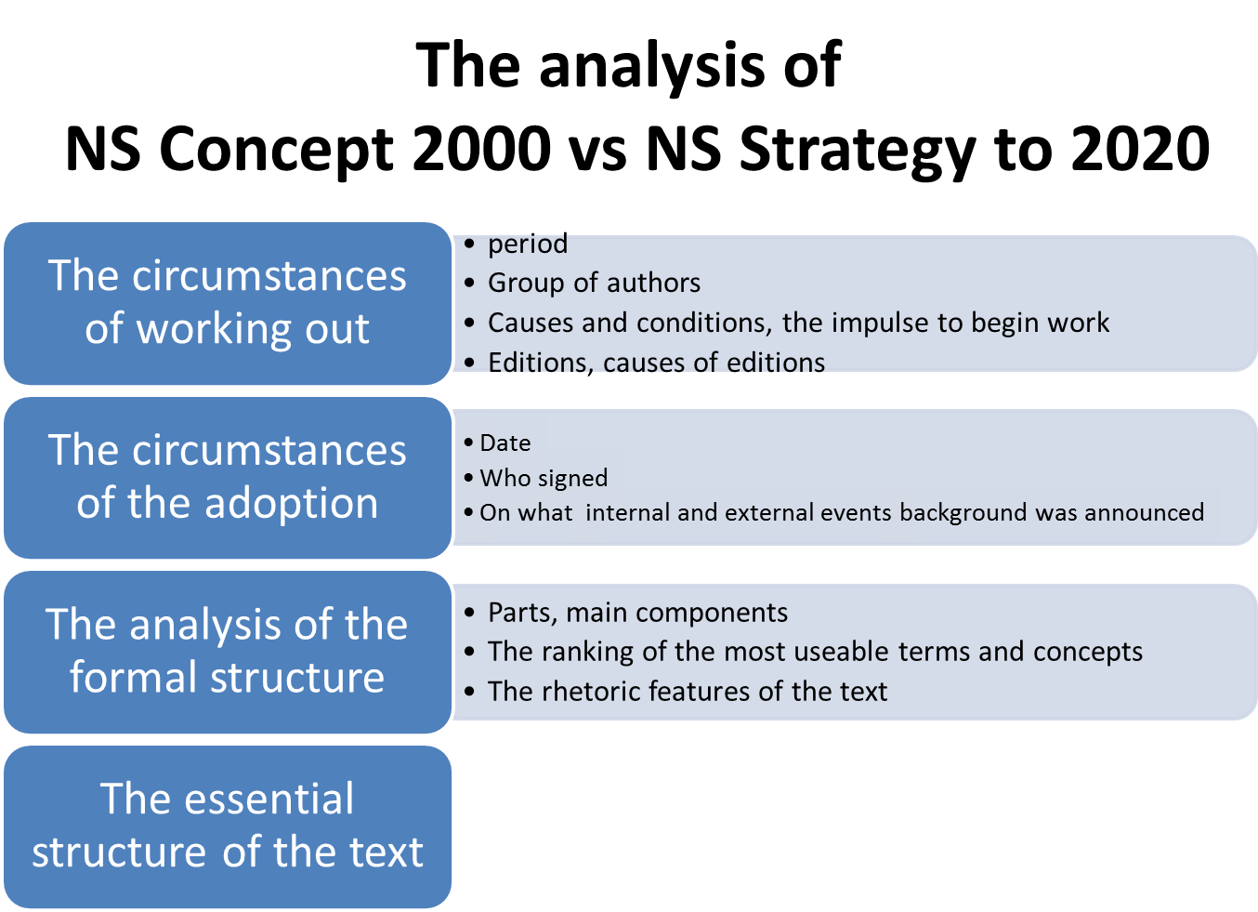

Slide 16
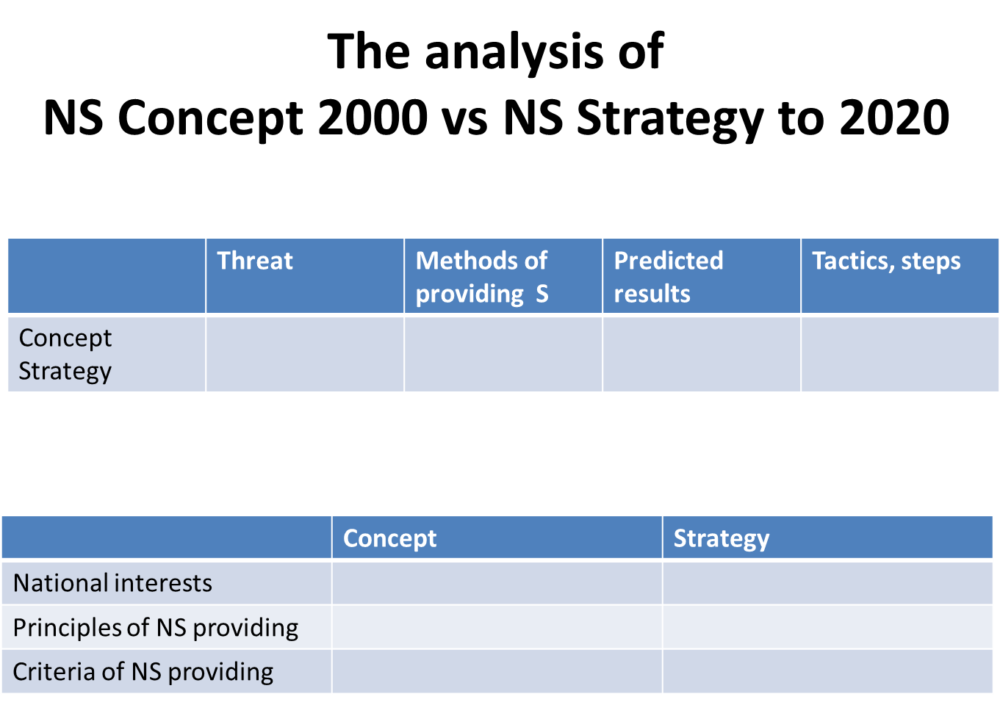
Conclusions: common and special,
Assumptions of Russian political system’s evolution based on docs
Research program (questions, hypothesis)

Slide 17
National security: case of Russia

