Slide 1
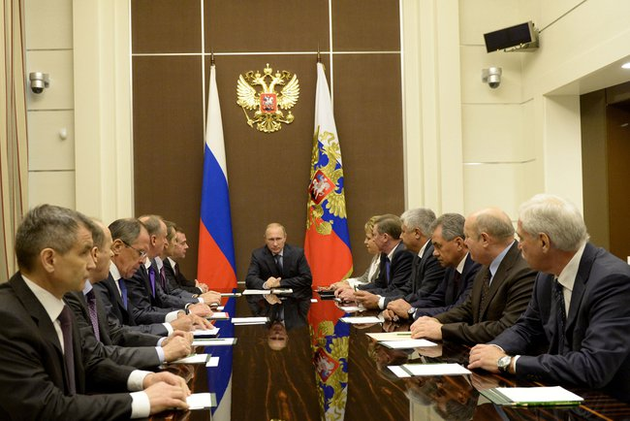

Slide 2
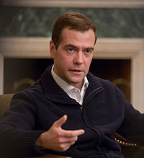
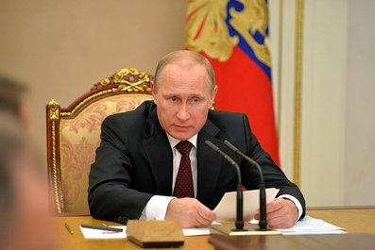
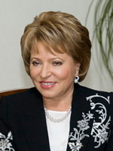
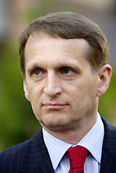
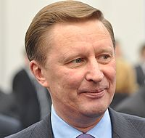
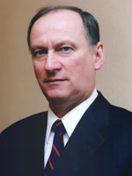
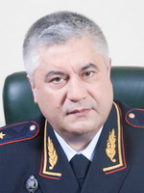
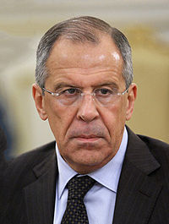
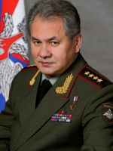
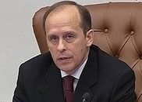
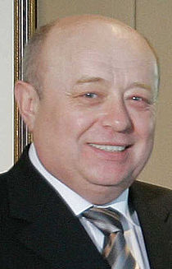
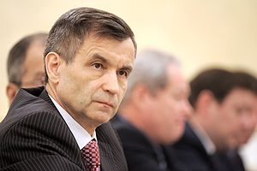
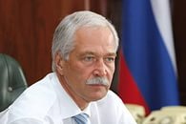

Slide 3
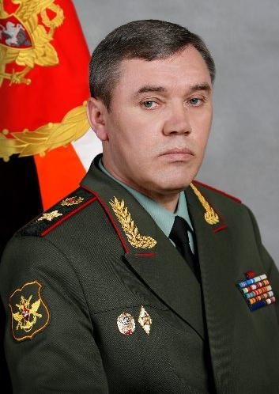
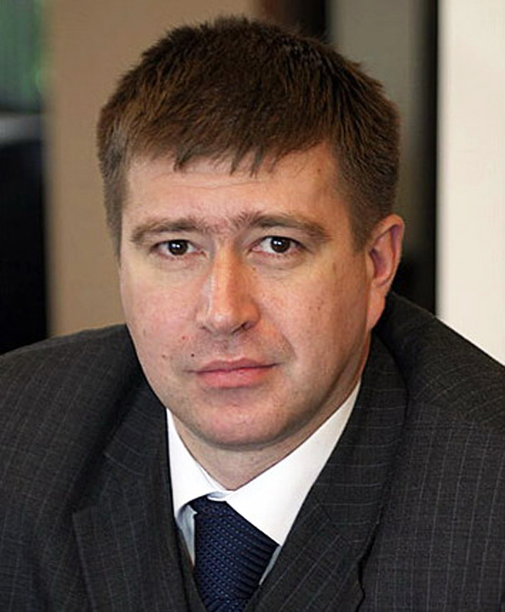
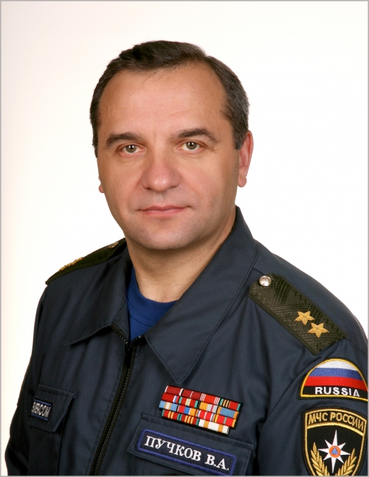
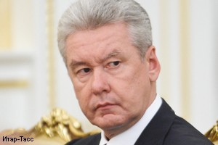
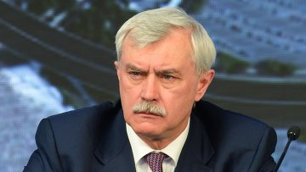
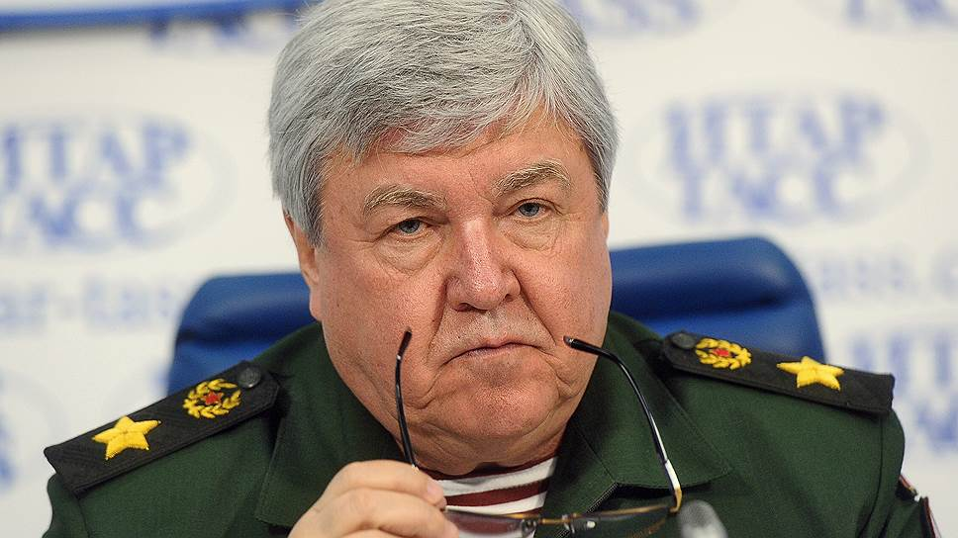

Slide 4
Putin Vladimir
Head of the SC of the RF
Dmitry Medvedev - Prime Minister
Sergei Naryshkin - State Duma Speaker
Nikolai Patrushev - Secretary of the SC
Sergei Lavrov – Foreign Minister
Alexander Bortnikov - Federal Security Service (FSB) Director
Rashid Nurgaliyev - Deputy Secretary of the SC
Valentina Matviyenko - Federal Council Speaker
Sergei Ivanov - Chief of Staff of the Presidential Executive Office
Vladimir Kolokoltsev – Interior Minister
Sergei Shoigu - Defence Minister
Mikhail Fradkov - Director of the Foreign Intelligence Service
Boris Gryzlov - permanent SC member

Slide 5
Non-permanent members
Presidential Plenipotentiary Envoys in Federal Districts
Yury Chaika - Prosecutor General of the RF
Valery Gerasimov -Chief of the General Staff of the Armed Forces of the RF- First Deputy Minister of Defense
Anton Siluanov- Finance Minister
Alexander Konovalov - Justice Minister
Vladimir Puchkov - Minister of Civil Defence, Emergencies and Natural Disasters Relief
Viktor Ivanov - Director of the Federal Drug Control Service
Sergei Sobyanin - Mayor of Moscow
Georgy Poltavchenko - Governor of St Petersburg
Viktor Tolokonskii - Governor of the Krasnoyarsk Territory
Vladimir Bulavin - Northwestern FD
Alexandr Beglov – Central FD
Mikhail Babich - Volga FD
Igor Kholmanskikh - Urals FD
Vladimir Ustinov -
Southern FD
Nikolai Rogozhkin - Siberian FD
Sergey Melikov - North Caucasian FD
Yurii Trutnev – Far Eastern FD
Oleg Belaventsev -Crimean FD

Slide 6
The interdepartmental Commissions:
on security in the economic and social sphere
on military security
information security
civil security
on problems of the Commonwealth of Independent States
on strategic planning
on environmental security
Scientific Council

Slide 7
SC simulation AGENDA
10 minute speech:
-introduce yourself and your service
-role in SC providing
- proposal for agenda
Moderator decision – shaping agenda
Discussion
Results: decisions (assignments, projects of decrees, instructions, orders, drafts of Federal Laws)
http://www.scrf.gov.ru/

Slide 8
http://www.scrf.gov.ru/
http://en.kremlin.ru/structure/security-council/members
http://www.minchenko.ru/en/
http://www.minchenko.ru/netcat_files/File/Politburo%202015%20ENG%2026_12_15.pdf

Slide 9
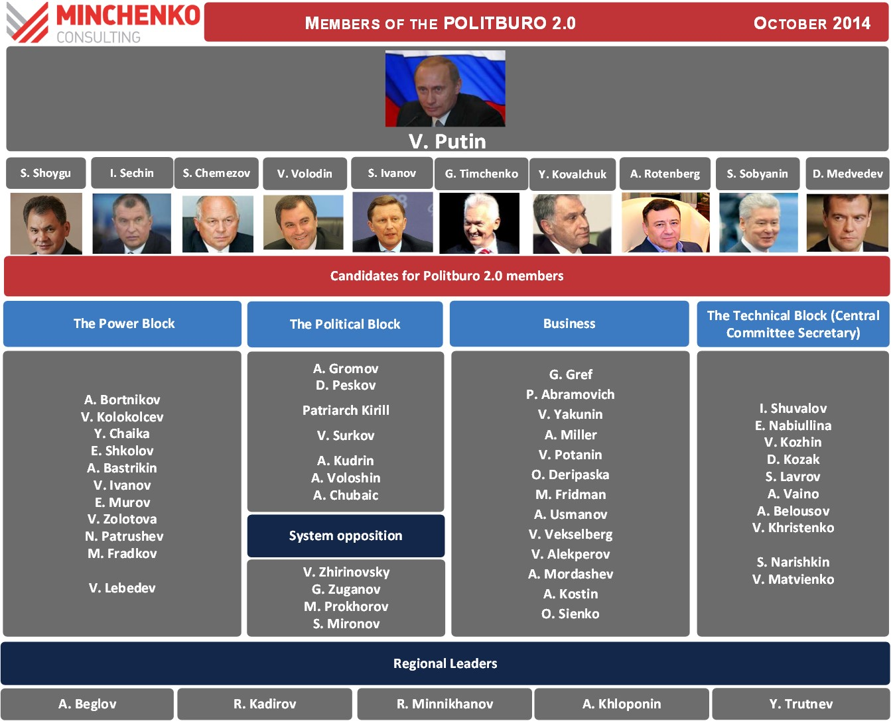

Slide 10
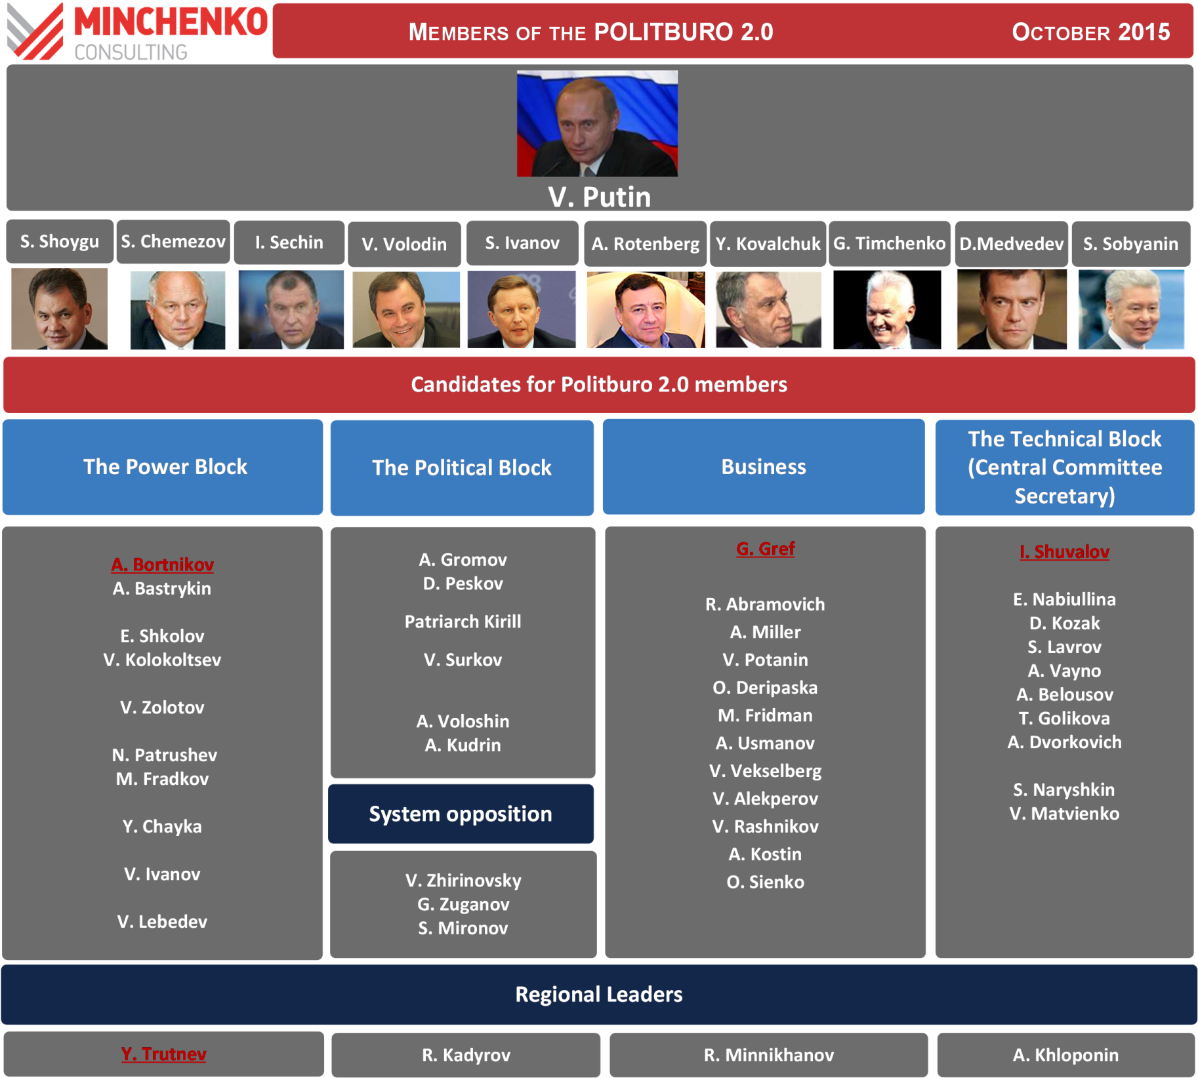

Slide 11
