Slide 1
Receiver factors

Slide 2
Personality characteristics and persuasion
Need for cognition
Self-monitoring

Slide 3
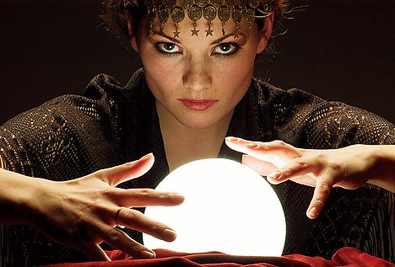
Self-fulfilling prophecy
Sebanaplňujúce sa proroctvo je fenomén, kde očakávania budúcich udalostí vedú k správaniu, ktoré zapríčiní, že sa daná udalosť skutočne stane.
Realizácia je známa jako Pygmalion efekt

Slide 4
Pygmalion effect
Rosenthal & Jacobson (1968/1992)
PROCEDURE:
  Intelligence test was given to elementary school pupils
  20% of those pupils were randomly selected.
  The teachers were told that these pupils have "unusual potential for intellectual growth“
  8 months later, the researchers came to re-test the pupils
RESULTS: - Those labeled as "intelligent" children showed significantly greater increase in the new tests than the other children.
- These kids were also rated by teachers as more intellectually curious and happier.
EXPLANATION: The change in the teachers' expectations (consequently also in behavior) regarding the intellectual performance of these 'special' children had led to an actual change in the intellectual performance of these randomly selected children.
Notes:
Rosenthal and Jacobson borrowed the term 'Pygmalion effect' from a play by George Bernard Shaw ('Pygmalion') in which a professor's high expectations radically transformed the educational performance of a lower-class girl.

Slide 5
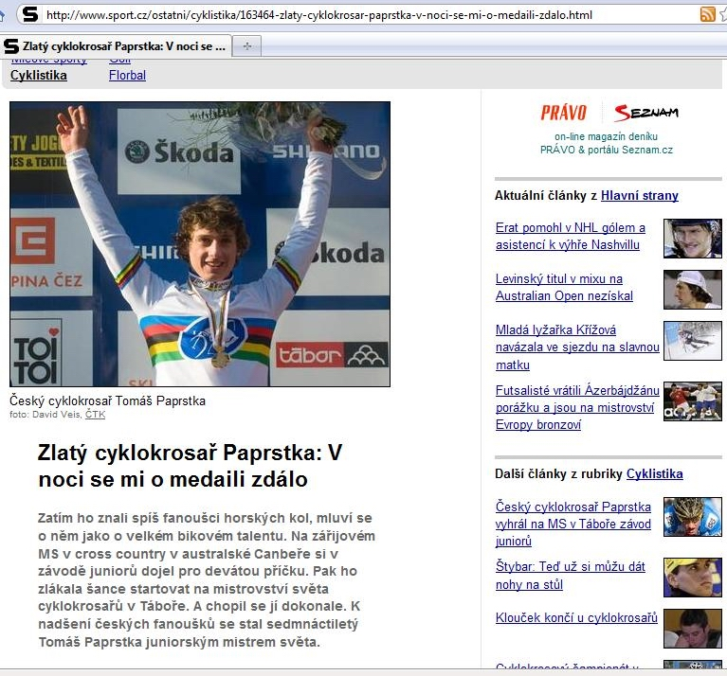

Slide 6
Confirmation bias
Tendency to search for information that confirms our decision or hypothesis
How to use it?
After having persuaded a person of something, help them feel good by letting them find examples that confirm their good judgment

Slide 7

Halo effect
= concluding from a perceived single trait a general assessment

Slide 8
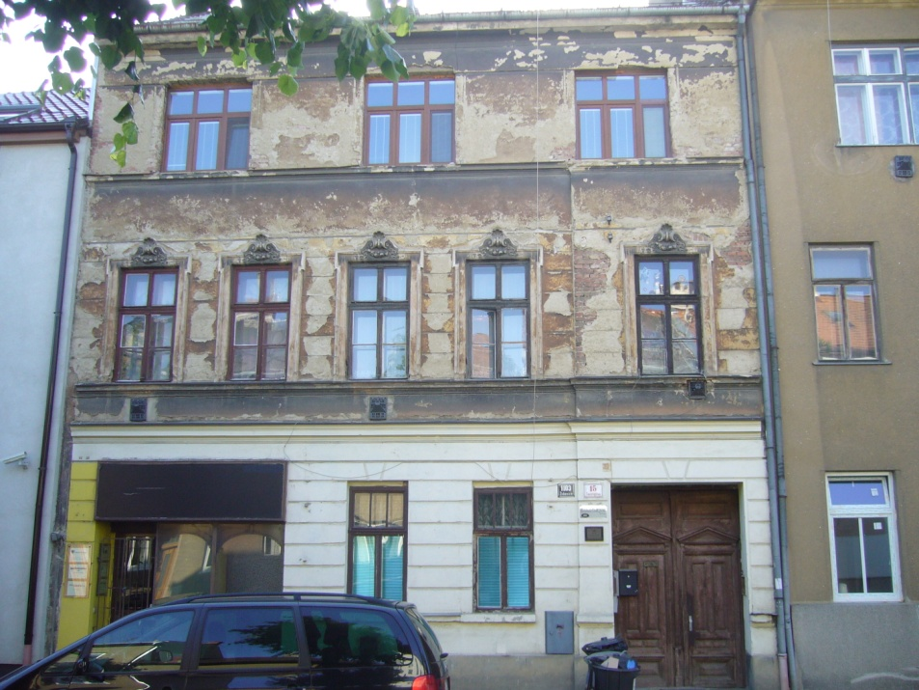

Halo effect

Slide 9

Halo effect
Notes:
Wow!!! The pool right next to the see! (But what about the additional fees for the activities you want and are free in all the other hotels. And what about the free bar they are offering in the other hotel)

Slide 10
Halo effect - Conclusion
Don’t get swayed by the “halo”

