Slide 1
Faktory správy

Slide 2
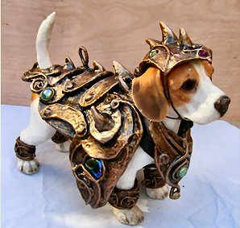
Forewarned is forearmed
One-sided or Two-sided messages?

Slide 3
Conclusion
– to provide or not to provide?
O’Keefe (1997) found that messages explicitly articulating an overall conclusion are more persuasive than those that omit a conclusion
Making the conclusion explicit minimizes the chances that individuals will be confused about where the communicator stands. It also helps people comprehend the message.

Slide 4

Language
Faster speech suggest that the communicator is credible, knowledgeable, intelligent, and confident.
Slower pace brings calm and reassurance

Slide 5


Powerful vs. Powerless language
Uh…, Well, you know…
Sort of…, Kinda…, I guess….
I’m no expert, of course, but…
Vivid, specific, graphic language
Obama’s speech on victory
http://www.youtube.com/watch?v=otA7tjinFX4&feature=fvst

Slide 6

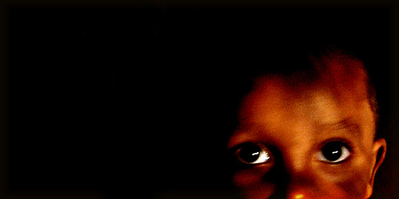

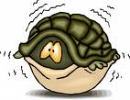




FEAR

Slide 7

Fear appeal

Slide 8

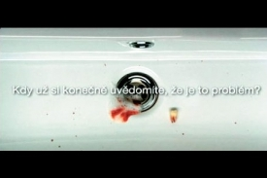
Fear appeal
Fear appeal is a persuasive communication that tries to scare people into changing their attitudes by conjuring up negative consequences that will occur if they do not comply with the message recommendations

Slide 9
Fear Appeal
Extended parallel process model (K. Witte)
Fear appeal message contains two information: threat & efficacy information (problem & solution)

Slide 10
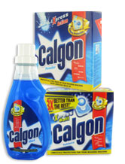
Creating a fear appeal
T
H
R
E
A
T
  SEVERITY (seriousness or magnitude of the threat)
    Consumption of junk food can lead to heart disease
  SUSCEPTIBILITY (likelihood that the threatening outcome will occur)
    People who eat junk food have 80% higher chance of having a heart disease
  RESPONSE EFFICACY (effectiveness of the recommendation)
    Healthy diet decrease the chance of heart disease.
  SELF-EFFICACY (arguments that the individual is able to perform the recommended action)
    You can change your diet. Millions have!
E
F
F
I
C
A
C
Y

Slide 11

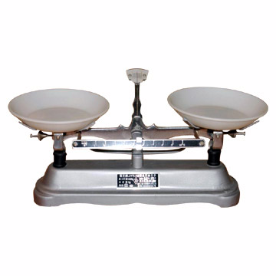
Response to fear appeal
Danger control
Fear control
When people perceive that they are able of averting the threat by undertaking recommended action
When people focus on the fear rather than the problem. They try to deal with the fear.
<
>
Perceived efficacy =
response efficacy x self-efficacy
Perceived threat =
severity x susceptibility

Slide 12
How to create the best fear appeal
Scare the heck out of recipients
  High fear appeals are more effective than low-fear appeals
Provide solutions
  After you scare someone, tell them explicitly how to prevent it
Emphasize costs of not taking the action, as well as benefits of undertaking the action
  People are more motivated by the threat of losing than by the
  chance of gaining
Threats and recommendations should be relevant to the target group
  Message has to be targeted. Anti-obesity campaign should
  have different message when focused on children and on adults.

Slide 13

What if the fear is to large?
BOOMERANG EFFECT
*
change
fear
* Boomerang effect is a general term describing the situation when we make too strong attempt to change prospect’s attitude and the prospect will end up with even stronger attitude of the original valence.

