Slide 1
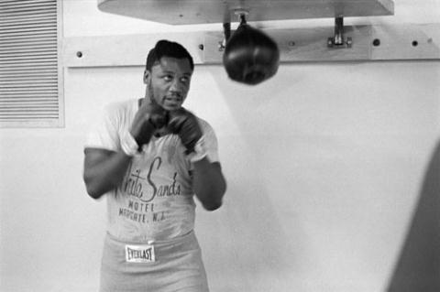
Boxing and Urban Cultures
‘When the Smoke Clears:’
SOC280: Lecture II
2016 Czech Fulbright Mid-year Conference
Olomouc, Czech Republic
27-30 January 2016

Slide 2
Authentic Boxing Club
Kansas City, USA
http://www.authenticboxing.com

Slide 3
Authentic Boxing Club
Kansas City, USA
https://www.facebook.com/pages/Authentic-Boxing-Club/182229248485793

Slide 4
Structural Violence and the Damaged Urban Life
Kanye West: ‘All falls down’ College Dropout
https://www.youtube.com/watch?v=8kyWDhB_QeI

Slide 5
Structural Violence and the Damaged Urban Life
It seems we livin’ the American dream, but the people highest up got the lowest self-esteem.
The prettiest people do the ugliest things, for the road to riches and diamond rings.
We shine because they hate us, floss cause’ they degrade us.
We tryin’ to buy back our 40 acres. And for that paper,
Look how low we a’ stoop.
Even if you in a Benz, you still a nigga in a coupe.

Slide 6
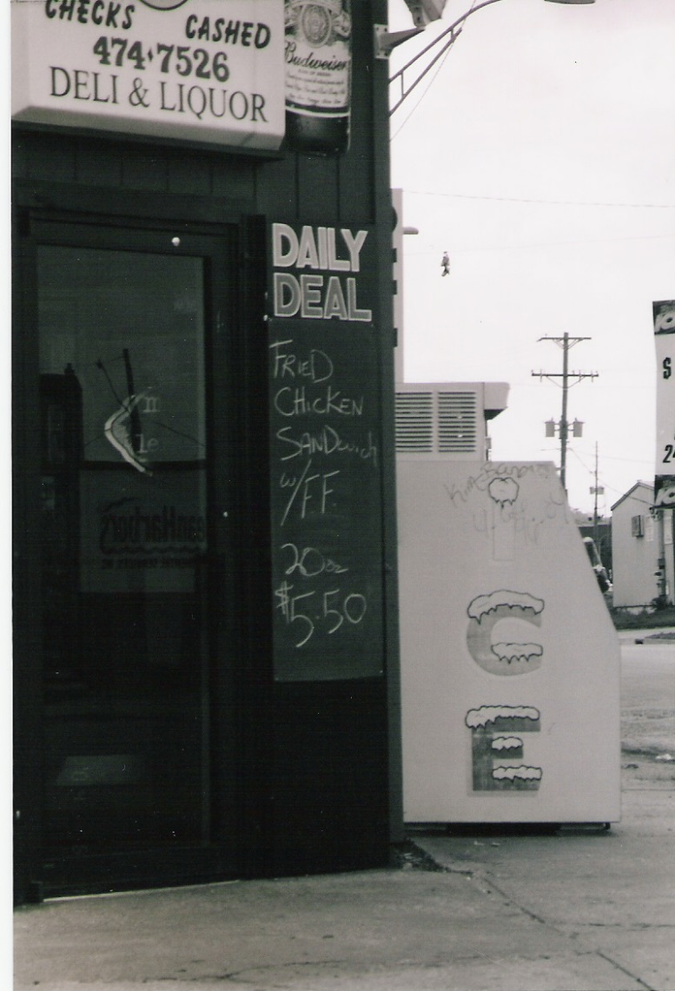
Happy Gilmore’s
Kansas City, USA

Slide 7
Joe Frazier’s Gym
Philadelphia, PA
Located in North Philadelphia (The ‘Badlands’)
Century-old, 30,000 square feet former lumber warehouse (address: 2917 North Broad Street )
Opened in 1968 as the ‘Cloverlay Gym’
Frazier trains there for his entire career, retiring and living in the upstairs flat in 1976
Neighborhood to ‘the hood’
Recently designated as a US historical landmark

Slide 8
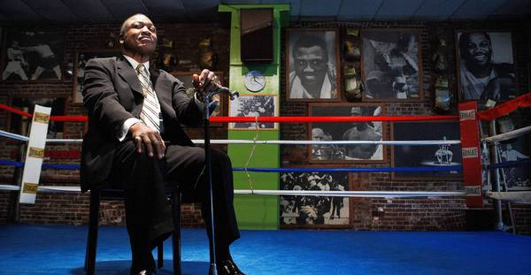
Joe Frazier’s Gym
Philadelphia, PA

Slide 9
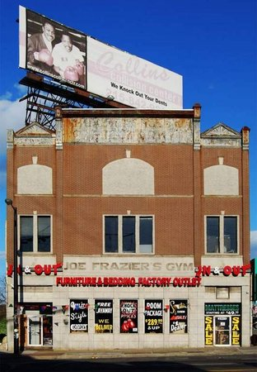
Joe Frazier’s Gym
Philadelphia, PA

Slide 10
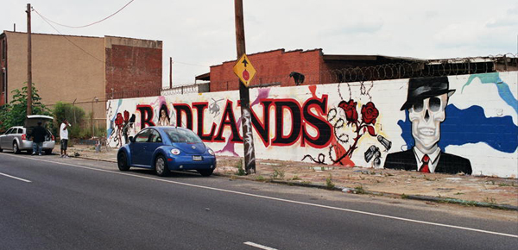
The Badlands

Slide 11
The Badlands
36, 268 residents
94% African-American
52% of residents are unemployed
18777USD: median household income for a family of four (Pennsylvania household median for a family of four is 40106USD)

Slide 12
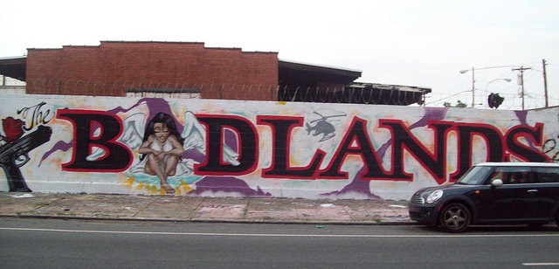
The Badlands

Slide 13
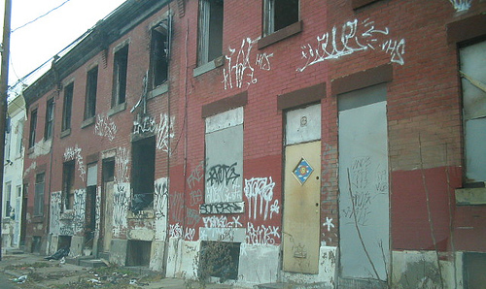
The Badlands

Slide 14
The Badlands
25000USD: average house value in area
25%: housing unit vacancy rate
36%: number of Badlands residents with high school diplomas

Slide 15
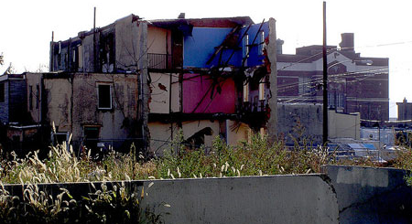
The Badlands

Slide 16
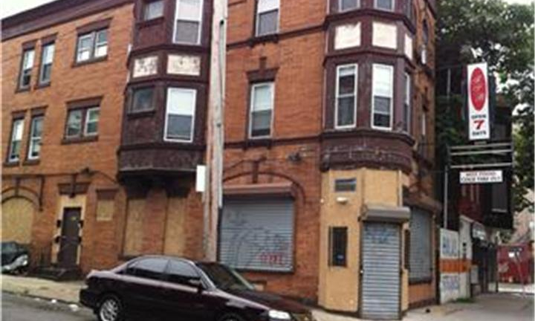
The Badlands

Slide 17
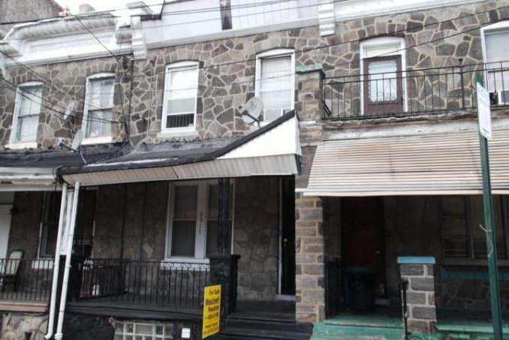
The Badlands

Slide 18
The Badlands
George Clymer Elementary School
28%: number of 8th grade students that perform at grade level in mathematics
14%: number of 8th grade students that perform at grade level in science
42%: number of 8th grade students that are able to read and write at grade level

Slide 19
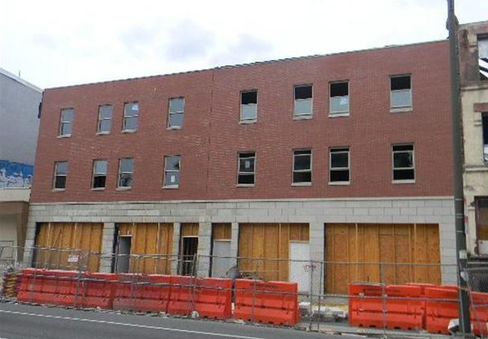
The Badlands

Slide 20
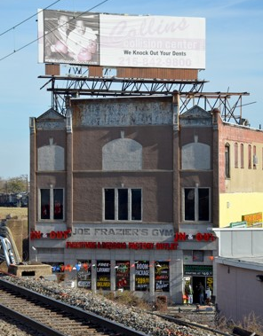
The Badlands

