Slide 1
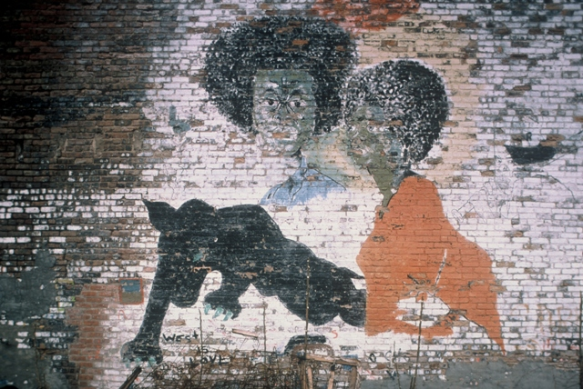
(White) Police and Black Males
SOC604: Lecture II
Joseph D. Lewandowski

Slide 2
(White) Police and Black Males
American urban police forces as the face of the State/Dominant
Possess enormous discretionary power to enforce—or not to enforce—existing laws
Often have military backgrounds
Receive working-class salaries
Serve as agents of social control in contexts of profound anomie

Slide 3
(White) Police and Black Males
Cycles of oppression
* Black males stopped by police for being black (commonly referred to as ‘color-coding’ or ‘racial profiling’)
* Black males then arrested and receive a police record for minor/non-violent offences (loitering, curfew violations, possession of small amounts of marijuana, speeding—‘doin 55 in a 54, as Jay Z says)
* Cycle continues when they are stopped a subsequent time and are now ‘criminals’ with a ‘police record’

Slide 4
(White) Police and Black Males
Key interview excerpt:
‘At 8:30 on a Thursday evening…’ (p.185)

Slide 5
(White) Police and Black Males
Reflexivity vis-à-vis ‘the Man’: Negotiating Police Encounters in the Urban Milieu
* ‘Street’ versus ‘Decent’ (or ‘square’)
* Code-switching
* Camouflaging
* Alternate ‘pose’ vis-à-vis ‘the Man’
* Dialog and dialectic switching
* Urban agents/street cultures as objects/practices in need of social control

Slide 6
(White) Police and Black Males
The Identification Card
* Symbolic weapon of identity within an existing legitimate institution—such cards say, ‘I am not just Black, but also a university student or a business employee.’
* Way to establish identity beyond ‘the hood’
* Badge/emblem of status in the dominant society
* Identifies urban actors as agents already ‘under control’

Slide 7
(White) Police and Black Males
Key interview excerpt:
‘I know how I used to feel when I enrolled in college last year, when I had an ID card…(p.188)

Slide 8
(White) Police and Black Males
Militarization of American Police Forces
* Federal surplus of military vehicles and weapons
* Discounted pricing to State and local police forces
* Military grade outfitting of urban police with army assault rifles, body armor, night vision and advanced surveillance technology, tanks, helicopters, etc.
* Creation of ‘special’ assault units
* Dialog and dialectic switching
* Urban agents/street cultures as an object in need of social control

Slide 9
(White) Police and Black Males
Baghdad by the Bay? Syria, or St. Louis?
* http://www.huffingtonpost.com/rebecca-gordon/san-francisco-police-mario-woods_b_9298196.html
* http://mashable.com/2014/08/14/5-things-police-militarization-america-ferguson-mike-brown

