Slide 1
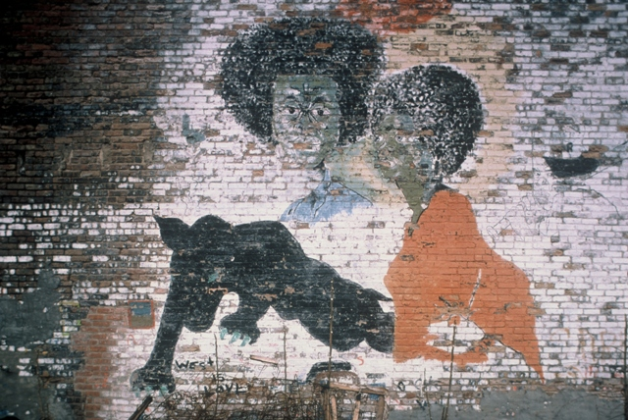
Street Codes, Violence, and Status Struggles
SOC604: Lecture III
Joseph D. Lewandowski

Slide 2
Street Codes, Violence, and Status Struggles
Street codes as effects of structural violence
Street codes as ‘deviant, anti-social attitudes’ that are apparently related to violent behavior
Synopsis of street code argument(p.1-3)

Slide 3
Street Codes, Violence, and Status Struggles
Respect and Disrespect in the Urban Milieu
* In sites of profound scarcity, struggles over status and respect are acute
* Young people who experience racial discrimination are more likely to engage in violent behavior

Slide 4
Street Codes, Violence, and Status Struggles
Key causal factors in the adoption of street codes:
* Neighborhood versus ‘the hood’ (embeddedness within an institutionalized ghetto)
* Ethno-racial discrimination (including repeated encounters with police)
* Family socialization: street versus decent

Slide 5
Street Codes, Violence, and Status Struggles
Reflexivity and street code adoption?
* Complex entwinement of reflexive choices and actions (code-selecting and switching); and durable constraints/structural violence in which such choices and actions are embedded
* Dialectic of actions (violent or otherwise) and structures (violent or otherwise)

Slide 6
Street Codes, Violence, and Status Struggles
Conclusions
* Being raised in a “decent” family appears to lower the risk of being involved in violence
* Street families use the threat of violence (the ‘code’)as a form of deterrence
* Experience with ethno-racial discrimination significantly predicted self-reported violent behavior

