Slide 1
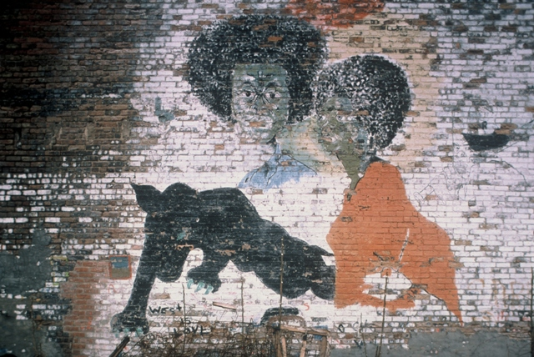
The Dialectic of Urbanism: Rethinking Street Cultures
SOC604: Lecture IV
Joseph D. Lewandowski

Slide 2
Dialectic of Urbanism
On the one hand, urban actors and their individual and collective actions are very much (pre)structured by the systems, structures, and built milieu in which they are embedded.
On the other hand, such actors are always already agents, in the sense of reflexive actors engaged in making explicit, innovating, and transforming such a milieu from within.

Slide 3
Dialectic of Urbanism
Thus we must construe urbanism dialectically, as the interpenetration of actions and structures in complex and non-deterministic ways.
Thus we must think of urbanism and the street cultures that embody that way of life as a habitus for homo urbanus.

Slide 4
Conceptual Origins of the Dialectic of Urbanism: Engels and Simmel
Engels’ pioneering 1844 study of the working-class in England
* Describes firsthand the daily degradations wrought by the intersection of modern capitalism and urbanization.
* Repeatedly emphasizes the direct connection between capitalism and modern urban planning: capitalist cities administratively designed to make invisible the conditions of the working-class in Manchester.
* In capitalist urban planning, we witness ‘the dissolution of
mankind into monads’.

Slide 5
Conceptual Origins of the Dialectic of Urbanism: Engels and Simmel
On Haussmannization:
‘By ‘Haussmann’ I mean the practice which has now become general of
making breaches in the working class quarters of our big towns, and
particularly in those which are centrally situated, quite apart from whether
this is done from consideration of public health and for beautifying the
town, or owing to the demand for big centrally situated business premises,
or owing to traffic requirements, such as the laying down of railways,
streets, etc. No matter how different the reasons may be, the result is everywhere
the same: the scandalous alleys and lanes disappear . . . but they
reappear again immediately somewhere else.’

Slide 6
Conceptual Origins of the Dialectic of Urbanism: Engels and Simmel
On Haussmannization:
‘The growth of the big modern cities gives the land in certain areas . . . an
artificial and often colossally increasing value; the buildings erected on
these areas depress this value, instead of increasing it, because they no
longer correspond to the changed circumstances. They are pulled down and
replaced by others. This takes place above all with workers’ houses which
are situated centrally and whose rents, even with the greatest overcrowding,
can never, or only very slowly, increase above a certain maximum. They
are pulled down and in their stead shops, warehouses and public buildings
are erected. Through its Haussmann in Paris, Bonapartism exploited this
tendency tremendously….The result is that the workers are forced out of
the center of the towns towards the outskirts…’

Slide 7
Conceptual Origins of the Dialectic of Urbanism: Engels and Simmel
Simmel’s 1903 work on metropolis and ‘spiritual’ or mental life
* Modern cities generate dissociated individuals.
* ‘Dissociation’ is the general processes through which individuals become both psychically hardened to harsh urban environments and uncoupled from one another as an adaptive response to the colonization of human interaction by the impersonal rationality of capitalistic existence in the city.

Slide 8
Conceptual Origins of the Dialectic of Urbanism: Engels and Simmel
Yet such dissociation enables a new kind of individual freedom and self-constitution.
Simmel says: ‘What appears here [in the capitalist metropolis] as dissociation is in reality only one of the elementary forms of socialization...It assures the individual of a type and degree of personal freedom to which there is no analogy in other circumstances.’
Strong ties (community, tradition, etc.) become frayed in the urban milieu, and weak or ‘secondary’ ties come to replace them in emancipatory ways.

Slide 9
Conceptual Origins of the Dialectic of Urbanism: Engels and Simmel
Simmel’s argument, which serves as a kind of an early articulation of the dialectic of urbanism, is that:
While the structures and routines of city life are profoundly dissociating, such dissociating features make possible a flexible scheme of perceptions – an urban habitus, as it were – of creative individualism and loose secondary ties that enable new forms of association and action outside of rigid non-urban cultural norms.

Slide 10
The Dialectic of Urbanism today:
Camilo Vergara’s Invincible Cities
Invincible Cities website: http://invinciblecities.camden.rutgers.edu/intro.html
The ‘New’ American Ghetto:
http://www.josephlewandowski.com/wp-content/uploads/2014/05/Rescuing_Critique.pdf

