Slide 1
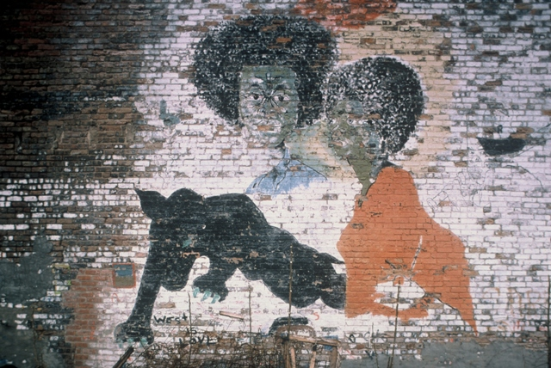
Urbanism and Social Capital
SOC604: Lecture V
Joseph D. Lewandowski

Slide 2
What is Social Capital?
Capital is value accumulated or stored in physical objects—timber, coal, screwdrivers, etc.
Human capital is value accumulated or stored in individual human beings—skills, training, knowledge, education, etc.
Social capital is value accumulated or stored between and among individual human beings—social connections, norms, ties and networks of trust that facilitate individual and collective action in a given context or structure

Slide 3
Dominant Threads in Contemporary Social Capital Studies
Economic thread: rational choice model found in Gary Becker and James Coleman and central to policy-oriented theories of growth and economic development such as those pursued at the World Bank
Marxist thread: critical sociology exemplified by the work of Pierre Bourdieu, in which theories of social groups, stratification and conflict are applied in the empirical study of sociocultural practices
Democratic thread: first intimated by Alexis de Tocqueville and popularized by Robert Putnam, in which civil associations—including sport associations—are considered crucial to making democracy work

Slide 4
City Life & Social Capital
Core Research Questions:
How are social norms, networks, connections and ties created, deployed—and often frayed—in the context of processes of urbanization?
What effects do core features of city life, such as human density, social complexity, inequality, cultural pluralism, ethnoracial diversity and division have on communities, associations, groups and networks that typically constitute urban civil society?

Slide 5
Cities & Urbanization
Today half the globe’s population lives in cities
Nearly seventy percent of the populations of Latin America, Europe, and the US reside in urban centers
The once primarily rural populations of Asia and India continue to urbanize
Even some of the most conservative estimates and models suggest that the percentage of urban dwellers world-wide will increase to two thirds by the middle of this century

Slide 6
Global Cities of Today & Tomorrow
City | Current Population | Projected growth (2010-2025) in people per hour
Berlin | 3.5 million | 1
Bogota | 6.8 million | 22
Hong Kong | 7.0 million | 8
Istanbul | 13.6 million | 30
London | 8.2 million | 10
Mumbai | 12.5 million | 54
New York | 8.2 million | 26
Sao Paulo | 11.3 million | 27
Singapore | 5.3 million | 5
Stockholm | 0.8 million | 3

Slide 7
What is urban social capital?
Social connections, norms, ties and networks of trust that facilitate individual and collective action in urban contexts

Slide 8
Two kinds of urban social capital
Horizontal urban social capital: resources (connections, norms, ties and networks) that are accessible and appropriable within a specific socio-economic or cultural stratum in the urban milieu
Vertical urban social capital: resources (connections, norms, ties and networks) that are accessible and appropriable between and among various socio-economic and cultural strata in the urban milieu

Slide 9
Urban Social Poverty in Sao Paulo, Baltimore, & Prague
Urban social poverty is an absence or scarcity of vertical social capital. It is a lack or shortage of the kinds of social trust and connections that link individuals and enable freedom of movement and associational interactions up and down the socioeconomic and cultural ladder
Examples of the challenges posed by urban social poverty include the walled communities of Sao Paulo, the problem of ‘black social capital’ in Baltimore, and the Roma of Prague
  Sao Paulo: social poverty, class, and the built environment
  Baltimore: social poverty, ethnicity, and public policy
  Prague: social poverty, sport, and advanced marginality

