Slide 1

The euro crisis, labour markets and the analytical future of the European integration
17th May 2017
Masaryk University
Oddělení strategií a trendů EU, Úřad vlády ČR
Aleš Chmelař, M.Sc.

Slide 2

Content
Euro a critical element of the crisis
The consensus narrative of the crisis
Consequences for the labour market
How to make the euro viable and robust?

Slide 3
The situation before 1999
Everything was different
  Different inflation expectations
  Different perceived interest rates
  Different wage setting mechanisms
  Different nominal interest rates
  Floating exchange rates

Slide 4
What happens when imbalance?
if money stock too high => inflation => real value of money lower
if money stock too high (due to external debt) => devaluation
if inflation too high => nominal interest rates high => real interest rates stable
if wages rise faster than productivity => higher inflation => lower exchange rate

Slide 5
The situation before 1999?
Some nations got used to higher inflation
  Their „inflation expectation“ rose
Inflation expectations influences real perceived interest rates
  But in borrowing there is nothing but perceived real interest rates
Some nations had perceived the same nominal interest rates differently

Slide 6
With the euro, everything is different

Slide 7
With the euro, everything is different
Because some things are the same...

Slide 8
The situation after 1999
Everything was different, but...
  Different inflation expectations
  Different perceived interest rates
  Different wage setting mechanisms
  Same nominal interest rates
  No exchange rates

Slide 9
Explanation 1: Wages

Slide 10
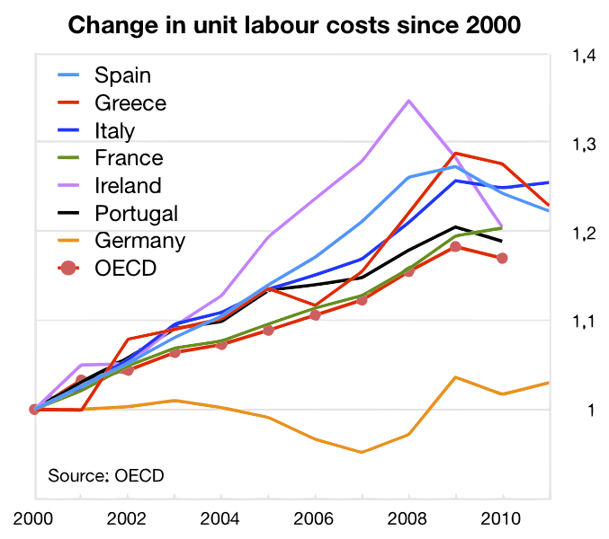
Explanation 2: Wages!

Slide 11
Wages and public debt as a motor of the crisis?
South was used to higher inflation
Therefore (or because?) wages rise more quickly
  Faster than productivity
The price competitiveness decreases
Imports rise faster than exports
Trade deficit is created
People/companies/government borrow to finance this

Slide 12
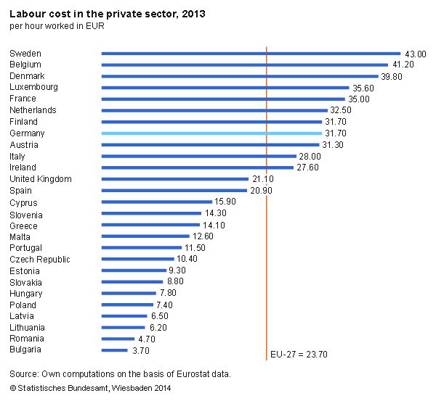
But what about those nominal numbers?

Slide 13
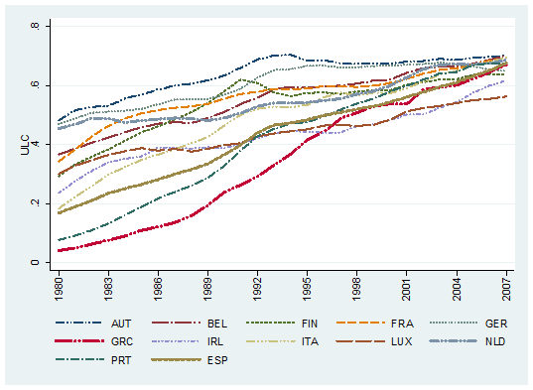
Wage rise

Slide 14
Wage rise

Slide 15
Wage rise

Slide 16
And the cost of capital rise!

Slide 17
And the cost of capital rise!

Slide 18
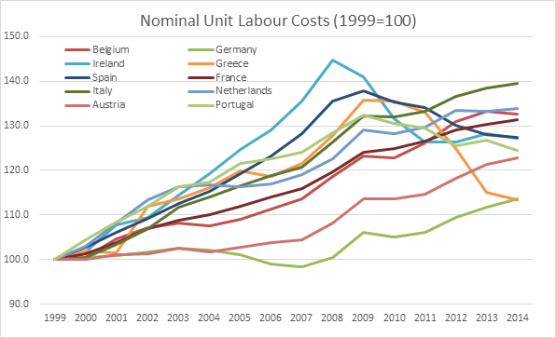
Those damn wages

Slide 19
ULC drive prices

Slide 20
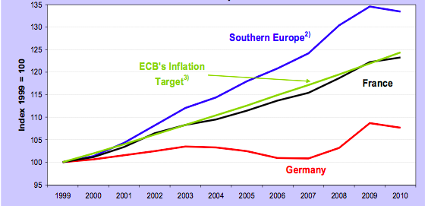
One-size-fits-all monetary policy
One size fits France

Slide 21
You need more than wages
But how can you rise wages if you don‘t get pay for it?
  By borrowing to sustain them?
There is a need for deliberate debt accumulation (public debt)
Or an investment bubble...
In reality the real exchange rates can‘t do the trick if interest rate and investment overhang doesn‘t follow

Slide 22
The consensus narrative
Sudden stop of cross-border lending when the crisis came
  Due to rising risk premiums
  Banks and governements were cut off the capital flows they got used to
Weak growth produced higher budget deficits
Monetary union enabled the build-up of the imbalances unnoticed
Incomplete architecture enabled a sudden loss of trust in deficit countries

Slide 23
The consensus narrative
Too much public and private debt
Big capital flows from the core (DE, FR, NL) to EA periphery (IE, PT, ES, EL)
Not a problem solely of public debt
  Just EL had one of the highest public debt in EA
  IT and BE had over 100% debt yet did not need bailout, IE and ES with under 40% needed one
Current account deficits of crisis countries
  No country with surpluses was hit

Slide 24
The consensus narrative
EA govs did not have a lender of last resort (LoLR)
  Without a LoLR: the deficits and higher risk premiums lead to insolvency
Devaluation impossible
=> a sudden stop crisis (developing countries)
Close link between banks and govs
  Vicious cycle – doom loop
Slowing economy
  i.a. due to lower bank funding in bank-oriented economies (basically all EU)
  also lower gov spending, lower overall investment

Slide 25
The consensus narrative
Rigidity of product and service markets makes restoring competitiveness slow and painful
  High loss of output
Mistakes were made in crisis management (“Greece is solvent!“)
But mainly: no institutional infrastructure to deal with the crisis on this scale
You cannot deal with a financial/economic crisis together with a constitutional crisis

Slide 26
The consensus narrative
Crisis management made mistakes (but mostly for objective reasons)
  Because we were simultaneously fire-fighting + institution building
  Interests of debtors and creditors hugely divergent
  Economic crisis craved stimulus, while fiscal crisis craved consolidation
  European citizens closely watching
Extreme dead-weight losses both due to the crisis and to its management

Slide 27
Implications
Structural weaknesses of the EMU:
  A tendency to develop imbalances as a feature of the systém, “not a bug“
  Inherent deflationary bias
The EMU architecture as an “assymetric shock“ by itself
The signalling function of exchange rates lost
Markets cannot correct imbalances
Different business cycles and inflation expectations led to one-way capital flows
Demand shock – different ULCs

Slide 28
The story of the DE current account

Slide 29
Implications
Positive and stat.significant correlation with DE bank exposure and current account (bilateral one)
Relatively lower investment activity in DE
The correlation continues
The crisis caused by demand shocks and investment inflow
Vendor-financing operation

Slide 30
The story of the DE current account

Slide 31
Implications
Positive and stat.significant correlation with DE bank exposure and current account (bilateral one)
Relatively lower investment activity in Germany
The relationship continues
The crisis caused by demand shocks and investment inflow
Vendor-financing operation

Slide 32
Implications
Imbalances decreased by deacreasing demand of deficit-countries, but the causes remain
Investment and demand not restored in surplus countries so to stimulate imports
No common instruments for demand management
  If only national level and if only adjustment through internal devaluation (= in most cases deflation)
Deflationary bias
Lower growth in good times, longer stagnations in bad times

Slide 33
Two possibilities for the eurozone
Growth with imbalances
Stagnation without imbalances

Slide 36
Explanation 2:
Capital flows

Slide 37
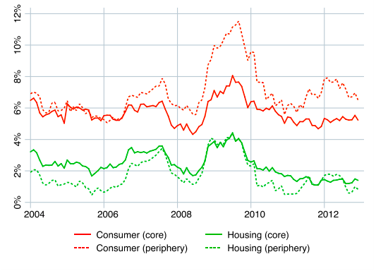
Low, zero and negative interest rates

Slide 38
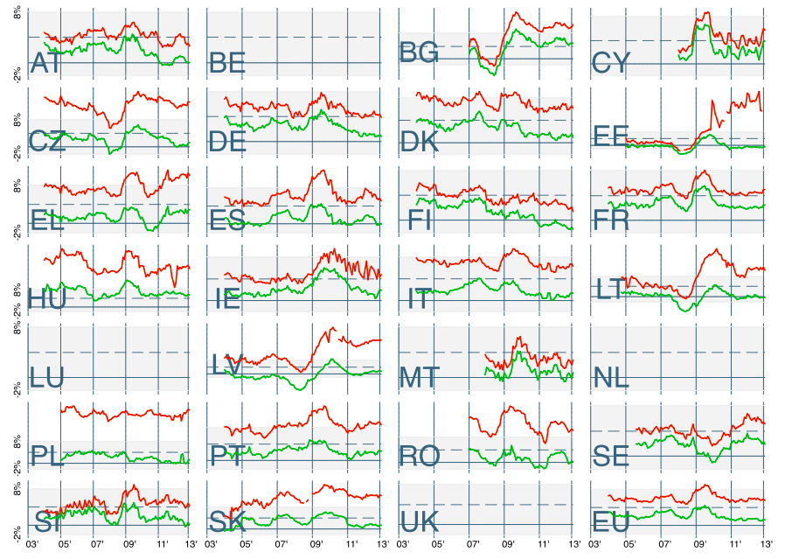
Explanation 1:
Low, zero and negative interest rates

Slide 39
Interest rate and investment
Nominal convergence of interest rates
If you have high inflation expectations, the interest rates you „see“ are low
Nominal interest rate reacts to the same monetary policy of the whole EA
  And banks were not able to discriminate properly within the EA (one of the largest market failures in human history)
Too cheap money + economy booming => unproductive investments

Slide 40
10yr bond yields

Slide 41
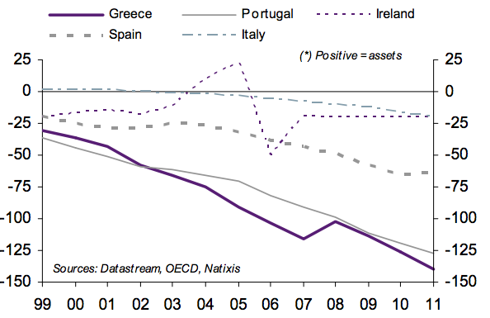
External debt

Slide 42
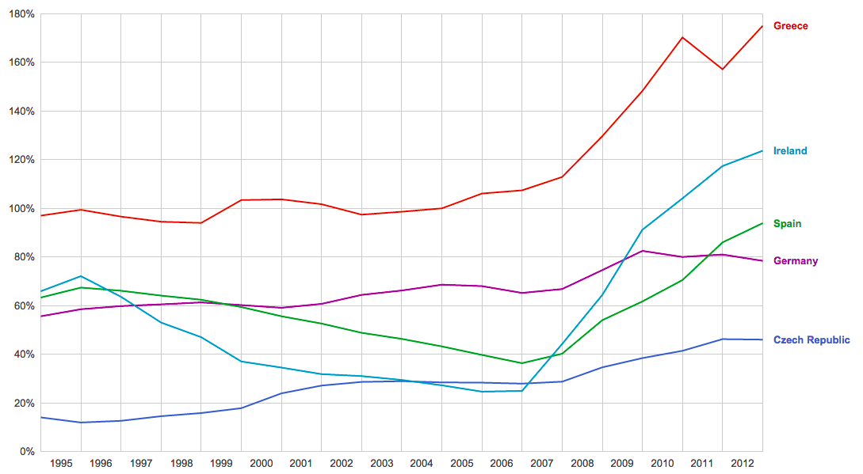
Not just public

Slide 43
You need more

Slide 44
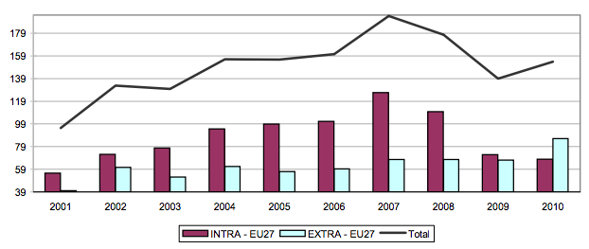
Trade balance of which country?

Slide 45
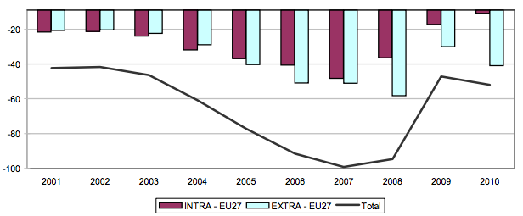
And this one is just the other way around

Slide 46
Share in exports by complexity
 | Top 10 | Top 100 | 1 | 2 | 3 | 4 | 5 | 6
Austria | 1.73 | 1.62 | 1.58 | 1.49 | 1.10 | 1.23 | 0.85 | 0.23
Belgium | 3.76 | 2.26 | 3.21 | 2.89 | 2.01 | 2.05 | 2.60 | 1.85
China | 1.22 | 1.28 | 2.72 | 8.08 | 10.78 | 13.97 | 12.96 | 13.35
Finland | 0.50 | 1.09 | 1.05 | 1.38 | 0.59 | 0.72 | 0.29 | 0.22
France | 5.11 | 3.57 | 5.78 | 6.08 | 5.43 | 5.58 | 3.08 | 1.59
Germany | 12.24 | 17.99 | 17.73 | 13.50 | 8.01 | 7.64 | 4.65 | 1.89
Greece | 0.01 | 0.02 | 0.03 | 0.16 | 0.13 | 0.24 | 0.31 | 0.37
Ireland | 1.25 | 0.80 | 2.71 | 2.26 | 1.21 | 1.50 | 0.51 | 0.11
Italy | 1.40 | 3.07 | 4.04 | 4.30 | 3.15 | 3.87 | 4.69 | 2.56
Luxembourg | 0.81 | 0.15 | 0.14 | 0.30 | 0.15 | 0.20 | 0.11 | 0.03
Netherlands | 5.11 | 3.50 | 2.93 | 3.51 | 3.17 | 2.76 | 3.50 | 2.73
Portugal | 0.05 | 0.04 | 0.30 | 0.23 | 0.48 | 0.48 | 0.56 | 0.52
Spain | 0.23 | 0.88 | 2.23 | 2.36 | 1.70 | 1.85 | 2.46 | 1.28

Slide 47
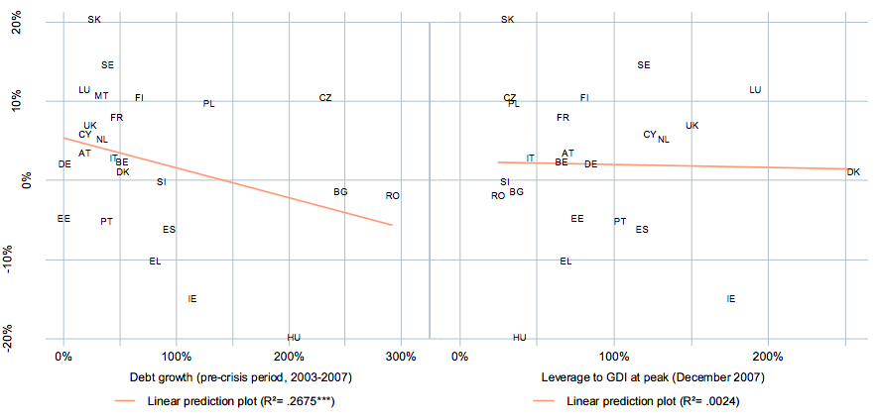
Deleveraging – the quick and the stable debt

Slide 48
What happened during the crisis?
Some sectors went bust (e.g. construction)
Unemployment in some sectors rises
The output of the economy goes down
Monetary policy cannot react if those shocks are localised unevenly and if you have just one
Fiscal policy is national and it was ultimately prevented from borrowing
Notes:
After the start of the fi nancial crisis in 2008, almost 4 million jobs were initially lost in euro area labour markets, with employment decreasing by 2.5% from its peak, in the fi rst quarter of 2008, to its trough, in the fi rst quarter of 2010.
Differences in recent labour market developments can only be partially explained by differences in the extent of the slowdown in economic activity across countries.
Expectations about the length of the crisis
might have infl uenced the extent to which
fi rms in some countries shed (or hoarded)
labour during the crisis. Using investment
expectations as a proxy for the perceived
length of the crisis
Regressing the elasticity of unemployment to output during the present crisis on the variables
mentioned provides some evidence that positive investment expectations, the existence of a
tripartite council and the extent to which fi rms engage in “on–the-job training” may mitigate the
impact of the crisis on unemployment

Slide 49
Asymmetric crisis
Assymetric impacts of the crisis on different countries, especially on labour markets
  Huge increase of unemployment (by 4 pp.)
  Muted response of employment (large heterogeneity)
  Young and low-skilled workers hit most heavily
Explaining heterogeneity
  Presence of imbalances before crisis (such as previous booms in the construction sector or accumulated competitiveness losses)
  Export oriented countries hit less (related to the role of expectations if the shock is only temporary)
Notes:
After the start of the fi nancial crisis in 2008, almost 4 million jobs were initially lost in euro area labour markets, with employment decreasing by 2.5% from its peak, in the fi rst quarter of 2008, to its trough, in the fi rst quarter of 2010.
Differences in recent labour market developments can only be partially explained by differences in the extent of the slowdown in economic activity across countries.
Expectations about the length of the crisis
might have infl uenced the extent to which
fi rms in some countries shed (or hoarded)
labour during the crisis. Using investment
expectations as a proxy for the perceived
length of the crisis
Regressing the elasticity of unemployment to output during the present crisis on the variables
mentioned provides some evidence that positive investment expectations, the existence of a
tripartite council and the extent to which fi rms engage in “on–the-job training” may mitigate the
impact of the crisis on unemployment

Slide 50
Dead-weight loss in the job market

Slide 51
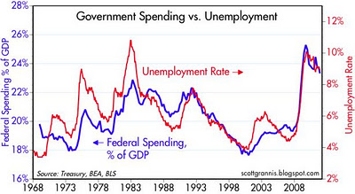
The case of US

Slide 52
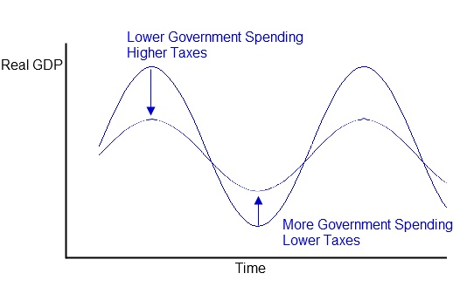
Automatic fiscal stabiliser

Slide 53
Automatic fiscal stabiliser
Shock absorber
How should it help?
  Transfers from less severely hit to those in the worst situation
  Risk sharing
  Avoidance of fiscal policy constraints
  Gains for everybody – lower impacts of crisis, reduced public debt, confidence effects
Drawbacks
  Moral hazard problem
  Need for consensus on a more harmonised social model
Avenue for further harmonisation of labour markets?

Slide 54
Social pillar
Drawbacks of schock absorbers
  Moral hazard problem
  Need for consensus on one social model
Reminiscent of something? Banking union
  Harmonise, reduce risks
  Then share risks (most difficult)
Social pillar is to the shock absorber what is stage 1 of the BU to SRF/EDIS

Slide 55
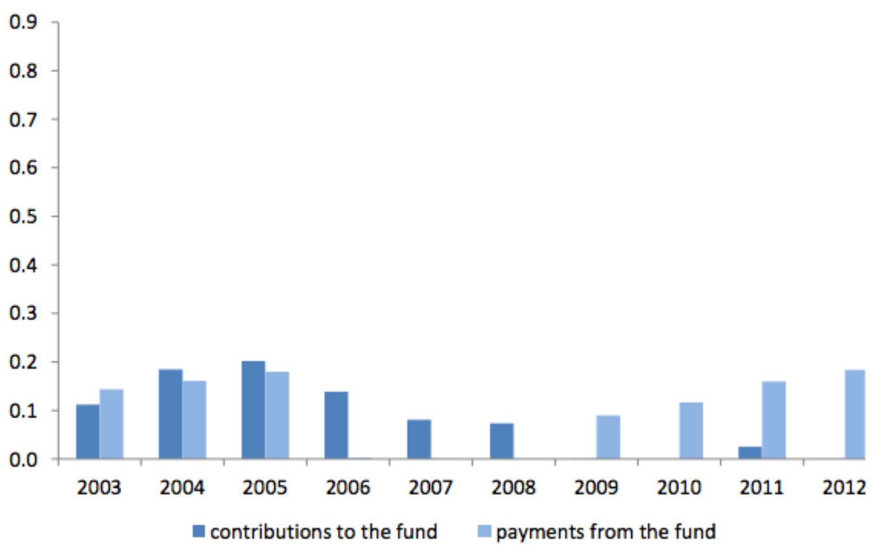
Fiskální pojišťovací mechanismus
Zdroj: Andor (2014)

Slide 56
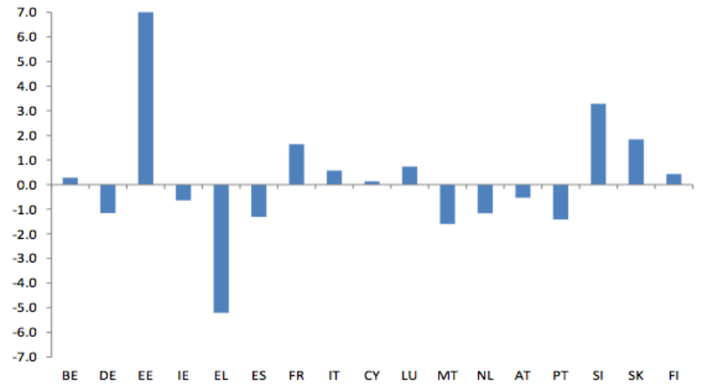
Fiskální pojišťovací mechanismus
Zdroj: Andor (2014)

Slide 57
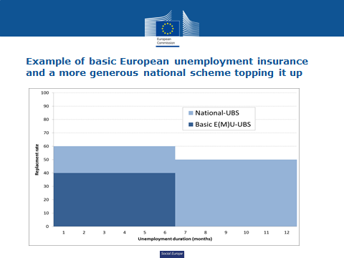
European Unemployment Insurance Scheme
Size of insurance
Length and eligibility
Permanent or crisis transfers
Some countries with negative balance or negative system?
Euro-area or EU?
Basic features of EUI
Zdroj: Andor (2014)

Slide 58
How to prepare for the next crisis?
Impacts on Czech Republic in billions of CZK
Varianta | 2004 | 2005 | 2006 | 2007 | 2008 | 2009 | 2010 | 2011 | 2012 | 2013 | Total
Basic | 0,00 | 0,00 | -3,51 | -7,66 | -8,03 | 0,00 | 0,00 | -4,02 | -8,10 | -8,17 | -44,86
Catastrophic, 60% | -1,53 | -1,95 | -2,81 | -3,07 | -3,21 | 20,79 | 14,63 | 10,86 | -11,74 | -13,89 | 7,52
One rate, 80% | 0,00 | 0,00 | -3,51 | -7,66 | -12,05 | 0,00 | 0,00 | -4,02 | -8,10 | -12,26 | -55,33
Differentiated, 60% | 0,00 | 3,26 | 0,00 | -3,83 | -4,02 | 7,84 | 7,91 | 4,02 | 0,00 | 0,00 | 22,49
Differentiated, 80% | 3,06 | 3,26 | 0,00 | -3,83 | -4,02 | 11,77 | 7,91 | 4,02 | 0,00 | 0,00 | 32,15
Zdroj: Modelace a Bruegel

Slide 59
chmelar.ales@vlada.cz

Slide 60
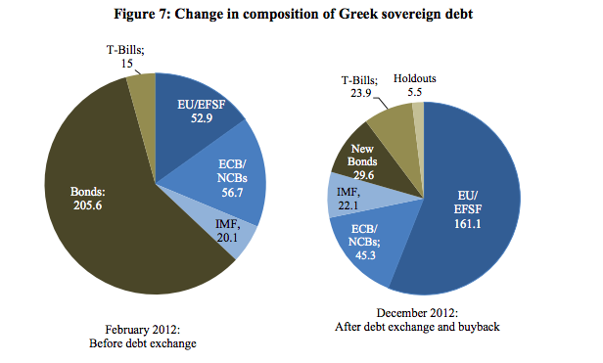
Change in Greek debt holders

Slide 61
Harmonization vs. Competing social models?
What has happened in last few years?
  Harmonization in market of services
  Not a single social model and no convergence
  Social dumping?
Minimum wage and united rules for the whole EU?
Social (tripartite) dialogue on EU level?
  National Competitiveness Councils
Notes:
Země bez minimální mzdy - Cyprus, Austria, Denmark, Finland, Italy and Sweden
€1,200 gross. In the southern countries, it varies between €600 and €800, whereas in Eastern Europe, the figure is closer to €400.
Lucembursko - €1,923, Bulharsko – 184 euro; ČR – 332, 4. nejnižší
The minimum wage has been a hot topic in the EU over the past years, especially in 2014, when Germany introduced a minimum wage, and when the issue was being debated as part of the European Parliament and Commission President candidate elections.
Commission's President Jean-Claude Juncker has stated on many occasions that he would work towards introducing a minimum social wage in each member state. Addressing the Parliament in July, before a vote to confirm his appointment, Juncker announced, "For all countries in the European Union, we set in place a minimum social wage, a minimum income, a guaranteed minimum income."
Austria, Cyprus, Denmark, Finland, Italy and Sweden are the only EU member states which have not introduced a minimum wage.
http://www.euractiv.com/sections/social-europe-jobs/minimum-wage-lives-its-name-many-eu-member-states-survey-312455
Debata oživla i kvůli Německu
which measures the minimum wage as a percentage of the national median wage – mimochodem ČR s Estonskem nejnižší minimální mzdu vzhledem k mediánu – 36%
Minimální mzda a zaměstnanost – původní neoliberální pohled jasný. Ovšem empirická literatura vliv na zaměstnanost nepotvrzuje, a to z několika důvodů – vyšší minimální mzda zvedne celkovou úroveň mezd v ekonomice a podpoří tak poptávku; a zadruhé vyšší mzda zvyšuje produktivitu. Jednodušše řečeno, když zaměstnance zaplatíte víc, tak se bude i více snažit.
Technické problémy

Slide 62
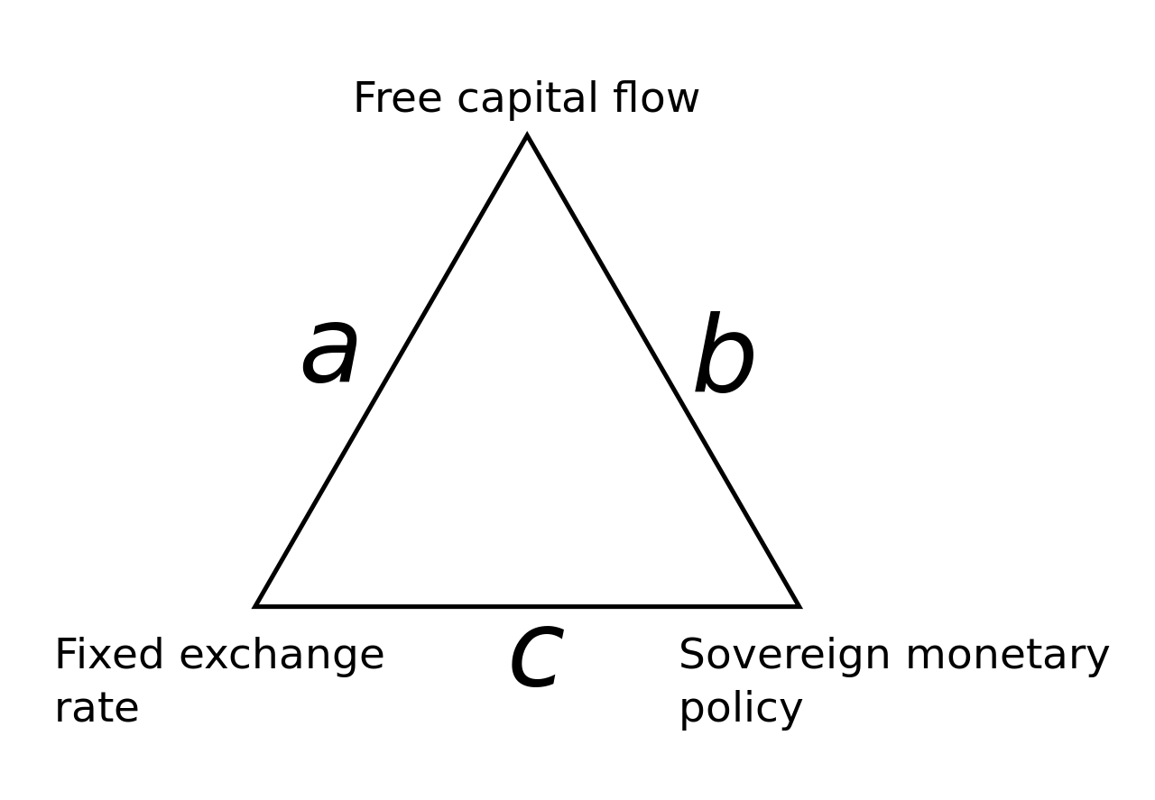
Impossible trinity

Slide 63
Impossibility of creating a common currency
Werner report
  Brettonwood context
Snake in a tunnel
European monetary system
  European currency unit
It did not work (?)
  Internal and external devaluation
  Drop-offs from EMS

Slide 64
What enabled the euro?
Monetarist revolution
  Monetary policy can be technocratically created
  How many states had an independent central bank?
Reunification of Germany
Mundell II

Slide 65
History of the EU – History of Rules
ECSC and Euratom
European Economic Communities
Single market
Euro
  Maastricht criteria
  Stability and Growth Pact
Banking and fiscal crisis
  Fiscal compact – Fiscal union
  Aid programmes
  Banking union
Notes:
Common regulation and supervision

Slide 66
The Rules
One set of rules that we can all agree on
There is one best solution for everybody
No discretion on the supranational level
European commission is a rule processor
Democratically elected EP merely controls

Slide 67
The rules
Perfect – no discretion necessary
Amovible – otherwise moral hazard
Consensual – everybody agrees

Slide 68
The Rules of the Euro
One perfect monetary (monetarist) policy
  Targeted inflation and nothing else
  No direct financing of government liabilities
  Rigid mandate
  No political meddling
But what if the rules stop working?
Crisis management: Unconceavable
Notes:
CCTB

Slide 69
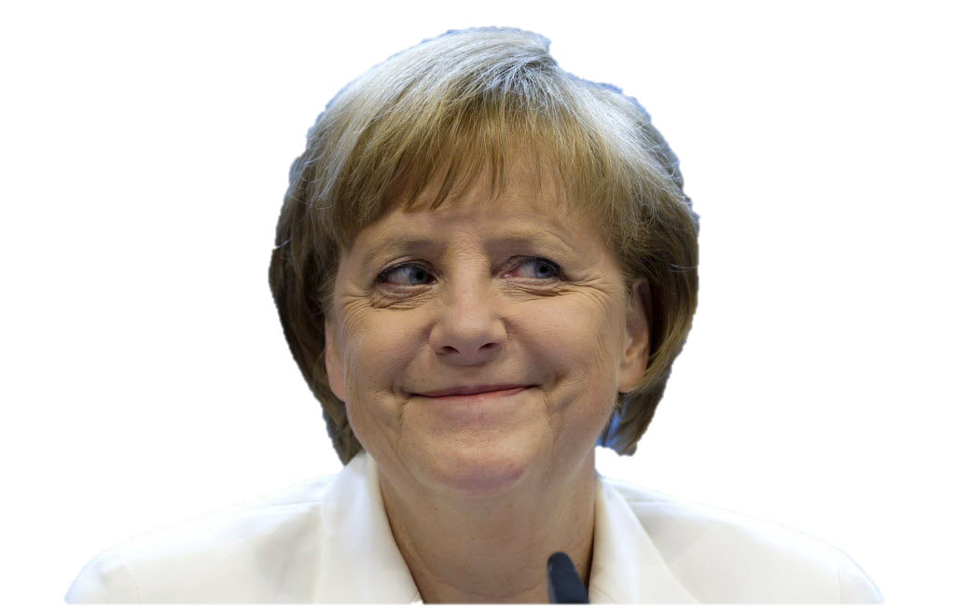
“Stability and Growth Pact didn’t work…
let’s make it more binding”

Slide 70
Economic vs. Political
  Mismatch of economic and political
  Need for a (more) political union to balance
Rules more binding? Or more political topics?
  Already political functions
    Security
    Judicial cooperation
    Common foreign policy
What is political?
  Democratic

Slide 71
Technocracy
No margin for policy flexibility
  Incapacity of crisis management
Constitutional changes to cope with crises
If discretion needed then illegitimacy
  Troika, aid packages
People’s despair
  Elections don’t change policies
  No hope for change

Slide 72
 | Technocracy | Democracy
Legitimacy | Output | Input
Decision-making | Consensus (lowest common denominator) | Majority
Executive power | Pre-determined (bureaucracy) | Flexible
Democratic power | Controls the functioning | Determines the functioning

Slide 73
Democratic Union
Political mandate for the supranational sovereign
Flexibility
Operational executive
  the Commission, not the Council
Ministers should not legislate

Slide 74
Towards a Democratic Union
1. The Commission accountable to the EP
  More control, more responsibility, more power and legitimacy
  2. Mandated officials to the Council
  Transparent positions – publishing minutes
  “Ministers should not legislate”

Slide 75
Can it happen?
Maybe not
  But then the EU will never go beyond the “bureaucratic, illegitimate, over-paid foreigners”
Unfeasible! But what’s the impediment?
  People fearing loss of sovereignty?
  Or the governments fearing loss of power?

