Slide 1
Introduction.
Democratic Transition and Transformation
EUP406 Czech Politics

Slide 2
Outline
A short overview of the history of Czech Politics
The fall of communism
Democratic transition and transformation
The end of Czechoslovakia

Slide 3
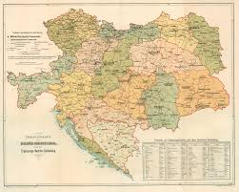
A short political history of the Czech Lands
Czech nationalism in the 19th century Habsburg empire – Czech National Renescence
Politics of „passive resistence“
The National Theatre, Czech language (Josef Dobrovský, František Palacký, Božena Němcová, …)
Unsuccessful fight for autonomy in a quite liberal multinational monarchy
Establishment of the first political parties (Young Czechs,

Slide 4
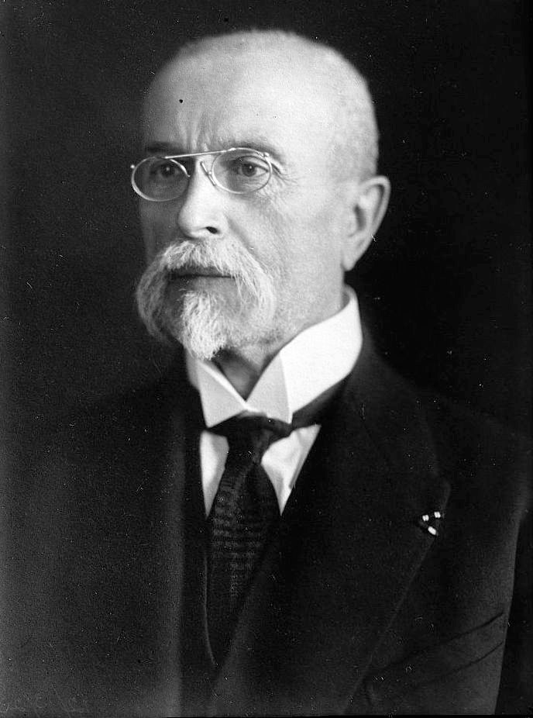
The First Republic (1918 – 1938)
One of the newly-born states after WWI (Pittsburgh
Declaration)
October 28 – Declaration of Czechoslovak Independence
The „Czechoslovak nation“
Multiethnic state
Presidents of Czechoslovakia
A democratic and economically successful exception of the interwar Central and Eastern Europe
Democratic backslide since the second half of the 1930s – the Second Republic (1938 – 1939) and the Protectorate of Bohemia and Moravia (1939 – 1945)

Slide 5
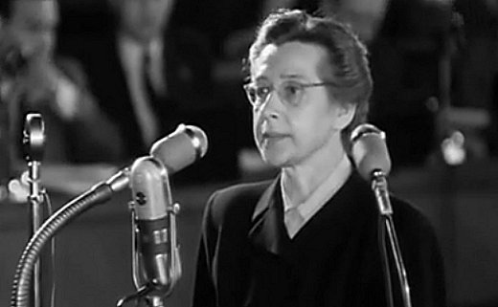
Czechoslovak Communism
Third Republic (1945 – 1948) and the
„Victorious February“
Totalitatian regime – the leading ideology, political monism, control of security forces, terror
The position of the President preserved
Gradual liberalization in the 1960 (Prague Spring of 1968) led to „normalization“
Frozen postotalitarian regime based on the tacit „social contract“

Slide 6
Roots of the transition

Slide 7
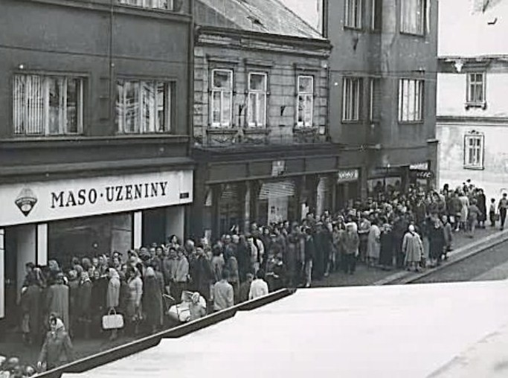
The change of the 1980s
The economy:
Worsening of economic conditions
(supply of even basic things)
Breaking of the social contract
International context:
Perestroika and glasnost in the USSR
Emergence of opposition in the neighbouring countries (Solidarnosć)
Internal opposition
Strenghtening of the opposition and transformation of its goals
Catholic demonstration in Velehrad in 1985 (200.000 people), the candle demonstration in Bratislava

Slide 8
The trigger

Slide 9
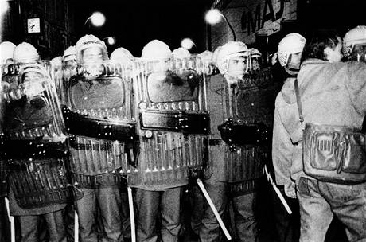
The 17th November 1989
A student demonstration on the 50th anniversary of students' oppresion during the Nazi occupation – approved by the regime
Turned into an anti-regime rally
A violent conflict between the students and the riot police
Rumours about a death of a student
(conspiracy theories) escalated the situation
Public unrest and new demonstration
The drama of Velvet Revolution started

Slide 10
Actors

Slide 11
The Party
The unreformed party – intraparty gerontocracy
Milouš Jakeš - as "the sole picket in a fence" (Jako kůl v plotě)
The lack of "liberal" reformers willing and able to take over power
Completely suprised by the situation
Unable to react (the People's Militia)
Quick disintegration of the National Front (Christian Democrats, the Czechoslovak Socialist Party)

Slide 12

The opposition
Student demonstrations activated the dissent
Joined by artists, philosophers
The leading role of the Charta 77 with Václav Havel as the leader
November 19 – the Civic Forum established
  Broad anti-regime movement – Charta 77, catholic dissent, neoliberal economists, reform communists
  Grassroot movement – hundreds of branches
  Turned into the main opposition platform
  Careful attitude, lack of experience
Roundtable talks

Slide 13
While it took 1000 days in Poland, 100 days in Hungary, it took 10 days in Czechoslovakia. T. G. Ash

Slide 14
The process of transition
Quick resignation of the old cadres (Jakeš, Lenárt, Biľak, Štěpán, ...)
KSČ pulled by the situation, ready to relinquish power
OF – aim to "controll" the government, not to take over it
Party – opposition talks: 15 + 5 government rejected by the public
A change of the strategy of OF + the emergence of M. Čalfa as the new leader-in-talks of KSČ
A new government led by Čalfa appointed – resignation of President Husák
December 29 – Václav Havel elected unianimously the President of the Country by the Federal Assembly – the first period of transition completed

Slide 15
Political changes
Renewal of political pluralism (small and big laws political parties) – acknowledgment of the existence of several political parties including KSČ (see also later)
Constitutional changes – free mandate instead of the imperative one, abolition of the leading role of the Communist party and the Marxist-Leninist ideology, co-option of MPs on federal, state and local levels, proportional representation introduced
Fair and free elections arranged – the referendum about the change

Slide 16
The 1990 election
Landslide victory for the Civic Forum (50 % of votes, 96 % turnout)
Other parties also succesful – Christian Democrats, Moravian regionalists and...
...the Communist Party of Czechoslovakia (13% of votes)
A new government of OF, VPN (Slovakia), Slovak Christian Democrats and the Moravian Movement formed with Čalfa as the Prime Minister

Slide 17
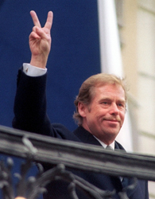
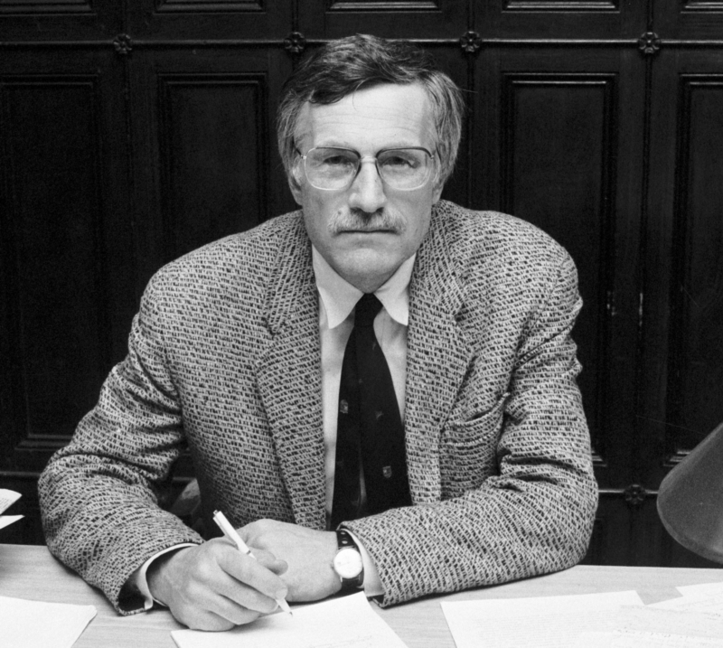
Two Václavs and two approaches to politics
Václav Havel
President (1989-1992, 1993-2003)
Plawriter and dissident during the com. rule (Charter 77)
Critical approach to politics based (solely) on political parties – „non-political politics“
Stress on civic society and human rights
Václav Klaus
Minister of Finance (1990-1992), Prime Minister (1992-1997), President (2003-2013)
Economic during the com. Rule
Indispensible role of political parties and elections
Critical perception of participatory politics
Clear liberal-conservative attitudes and economic perception of politics

Slide 18
Decommunization (and the fate of the Communist Party)

Slide 19
What to do with the communists?
Strong public demand to abolish the Party X the result
Reasons:
The history – generally leftist public (although not necessarily communist)
KSČ led by pragmaticians (a deal with Havel?)
Havel's approach – rejection of of strong punishment
The notion of the legal continuity
The transition process – legitimation of the Communist Party confirmed by the election
Contradictio ad excludendum

Slide 20
Decommunization
Law on Restitution of the Property of the Communist Party to the Czechoslovak people
Lustration laws – forbiding access of former communists and secret police members (collaborators) to positions in public administration
Law on Crimes of Communism
The Institute for the Study of Totalitarian Regimes (including the period of the communist rule)
But also continuity (justice system, administration, economy,…)
Anti-communism and evolution of the party system

Slide 21
The economic transformation
Conflict of paradigms (gradualists vs radicals)
The Czech Republic vs Slovakia
The radicals won (Václav Klaus) – introduction of reforms inspired by neoliberalism including widespread privatization and liberalization of the economy
The breeding ground of the later conflict between the losers and the winners of transition + conflict of Czechs and Slovaks

Slide 22
The end of Czechoslovakia
Historical experience (A-H monarchy, First Republic, Communist rule)
the lack of strong Czechoslovak identity
separated party systems
Religious differences
economy
Hyphen – war, several rounds of negotiations
non-functional federal polity
August 1992 – Declaration of Independence
1993 – the emergence of the independent Czech R. And Slovakia – one of the most peaceful ends of multiethnic states in the history

Slide 23
Discussion
Rich history of democracy and undemocratic backclashes
History and context matters
Czech exceptionalism (Roberts)
Smooth transition to liberal democracy after the fall of communism

Slide 24
Czech Parliamentarism

Slide 25
Political system of the new state
Passed in December 1992 (intensive discussions)
Unitary state (Moravist movement)
Inspiration by the First Republic but also by USA, France…
Basic principles:
  Democracy
  Republicanism
  Stress on human rights (the Charter of Basic Rights and Freedoms)
  Parliamentary democracy
  Key role of political parties
Duality of institutions (dynamic vs stable ones)

Slide 26
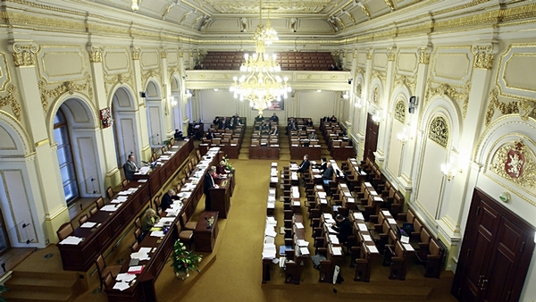
Bicameralism
The Chamber of Deputies and
the Senate
Inspiration by the First Republic
Senate as a stabilization institution
Dominant role of the Chamber of Deputies
  Legislation procedure (state budget)
  Relationship towards the government
  (election of the President)

Slide 27
Chamber of Deputies
200 MPs elected for a 4-year term using the „principle of proportional representation“
Established in 1993 by transformation of the Czech National Council
Organized by resort-oriented commitees
Party groups (at least 10 MPs)
Can be dissolved under strictly defined circumstances
Control power via the government (investiture vote, vote of no-confidence, questioning…)

Slide 28
Senate
81 senators elected for 6 years (1/3 each two years) by a majoritarian system
At least 40 years – „the chamber of wise men“
Established not earlier than in 1996
Struggling with legitimacy (electoral turnout around 15 %)
Not a clear position in the political system
Important competencies – legislature, approval of constitutional judges, involved in the process of impeachment of the President
Cannot be dissolved

Slide 29
Legislation procedure
Legislative initiative
3 readings in the Chamber of Deputies
Senate – approval, rejection, amendments, neglection (30 days)
Chamber of Deputies (majority of all MPs)
President – 15 days for signature, veto – Chamber of Deputies (majority of all MPs)
Special position of Constitutional Laws, elections laws, state budget

Slide 30
Other competencies
Approval of the government (more later)
Approval of judges of the Constitutional Court (Senate)
Election (ChoD) and nomination of the Ombudsman and her deputy

Slide 31
Executive

Slide 32
The President
Directly elected for five years (two consecutive terms allowed)
Formally rather weak but strong informal authority (history, Prague Castle, Presidents elected)
Head of the State with representative function
Appoints and dismiss members of the cabinet (see also later), members of the National Bank and of the Constitutional Court, judges
Foreign policy
Rather limited role in the legislative process, suspensive veto of ordinary bills
Dissolves the ChoD
Has the right to issue amnesty

Slide 33
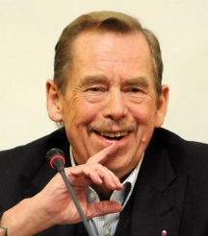
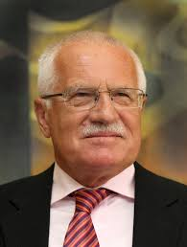
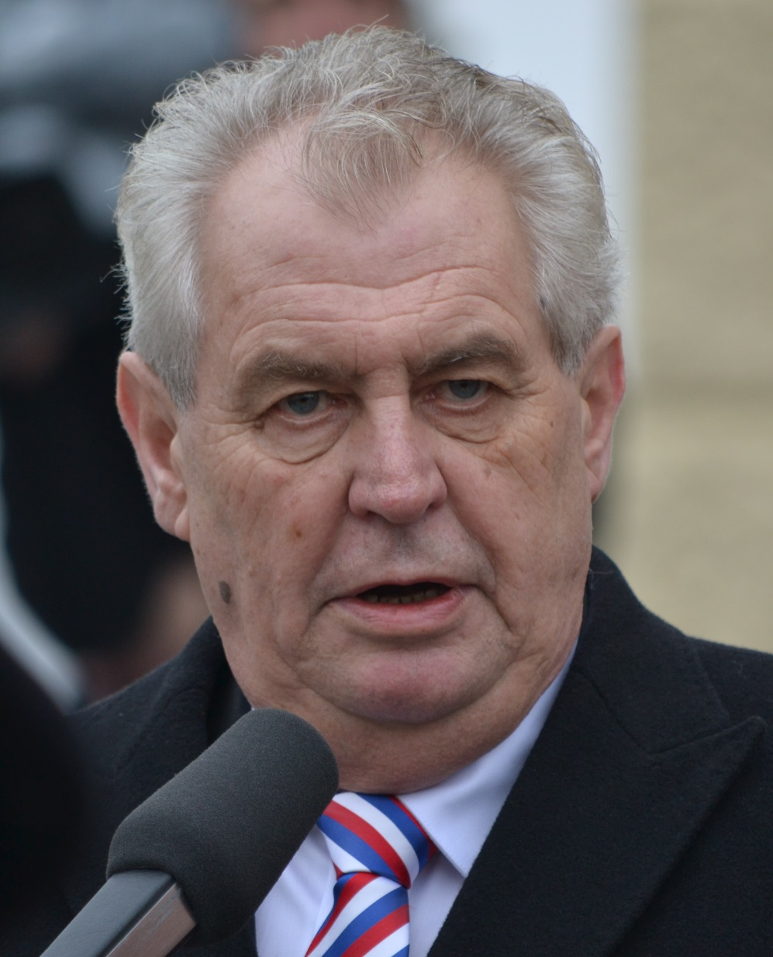

Slide 34
CR towards semi-presidentialism?
Direct election as a stronger source of legitimacy
Historical legacy
Strong persons willing to go beyond written constitution (ministerial appointments and dismissals, cabinet formation)
The case of Rusnok cabinet
Mixture of institutional setting + willingness to get power + context of the party system

Slide 35
The government
Collective body appointed by the President but responsible to the Chamber of Deputies
investiture vote X vote of confidence
Headed by the Prime Minister (Primus inter Pares)
Crucial role of political parties
Low stability (694 days on average), often minority cabinets: reasons (anti-system parties, electoral system, personal animosities, intra-party cohesion)

Slide 36
Judiciary
Four levels of the system of courts (counties, regions, 2 Upper Courts and the Supreme Court)
Supreme Administrative Court
Constitutional Court
Protection of constitutional rights
Can repeal laws
15 judges proposed by the President and approved by the Senate (10 years, 1 renewable term)

Slide 37
Conclusion
The Czech Republic as a parliamentary democracy
Assembly parliamentarism (Sartori)
Asymmetrical bicameralism
Real functioning strongly influenced by the party system (weak governments – more in lectures on executive and party politics)
Concurrent locus of power in the Prague Castle
Discussions over reforms (the Senate, number of MPs, electoral system…)
Strong position of the Constitutional Court

