Slide 1
Political parties and party system

Slide 2
Two main goals
Produce a narrative of the development of the Czech Party system
Lessons learned from the Czech case? What has been done and what could (should) be done.

Slide 3
Structure of the presentation
1. Let me introduce…A brief description of the evolution of the party system in the Czech Republic
2. The stability of the party system I: Individual actors and volatility
3. The stability of the party system II: A systemic approach
4. Party system in the Czech Republic: Problems, challenges, possibilities

Slide 4
Who are they? Political parties in the Czech Republic
Civic Forum (OF, 1989) – umbrella democratization movement, broke up in 1991
Communist Party of Bohemia and Moravia (KSČM, 1921) – radical-left, an untransformed communist party
Czech Social Democratic Party (ČSSD, 1878) – moderate centre-left party
Christian Democratic Union – Czechoslovak People`s Party (KDU-ČSL, 1919)
Civic Democratic Party (ODS, 1991) – the major centre-right (liberal-conservative) party, a result of breaking up of OF
Civic Democratic Alliance (ODA,1989) – a minor conservative party

Slide 5
Who are they? Political parties in the Czech Republic
Association for the Republic – Republican Party of Czechoslovakia (SPR-RSČ, 1990) – radical-right wing, populist party
Movement for Self-Governing Democracy – Association for Moravia and Silesia (HSD-SMS, 1990) – a regional party
Liberal Social Union (LSU, 1992) – an electoral alliance of agrarians, socialists and the Green Party
The Green Party (SZ, 1990) – an ecologist, rather right-centre party
Freedom Union (US, 1998) – a minor liberal party, splinter from ODS
TOP 09 (2009) – splinter from KDU-ČSL, a liberal-conservative party
Public Affairs (2002) – an „exclusively populist“ political party

Slide 6
Development of political parties in a nutshell
November 1989 – the Civic Forum founded (together with other political parties), recognition of the „old parties“ (KSČ, ČSL, ČSS)
1990 election – victory of OF, parl. representation of KDU(-ČSL), KSČ(M) and HSD-SMS
1991 – breakup of OF and emergence/independence of ODS, ODA and other small parties
1992 election won by ODS-KDS and formation of the centre-right cabinet (V. Klaus)
Fragmentation of the parliament (LSU, HSD-SMS, ČSSD, SPR-RSČ, KSČ)
1996 – the electoral success of ČSSD; formation of the centre-right minority cabinet (V. Klaus)

Slide 7
Development of political parties in a nutshell
1997/8 – splitting of ODS and the emergence of Freedom Union (US)
1998-2002: reduction of the number of parliamentary parties, „opposition agreement“ (Coalition of Four project)
2002-2006: left-centre cabinets (ČSSD, KDU-ČSL, US-DEU)
2006 – parliamentary dissapearence of US-DEU, entry of the Green Party (SZ), centre-right-green cabinet
2009 – fall of the cabinet (a caretaker cabinet till 2010)
2010 – the rise of (quasi-)new parties TOP 09 and Public Affairs (VV), weakening of the two major parties, parliamentary departure of SZ and KDU-ČSL, centre-right cabinet

Slide 8
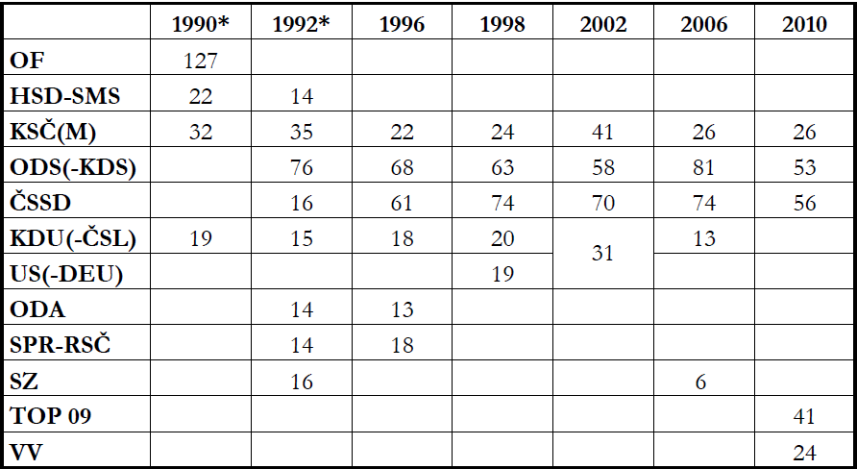
Electoral results (1990-2010, number of seats)
Data source: volby.cz, *Czech National Council election

Slide 9
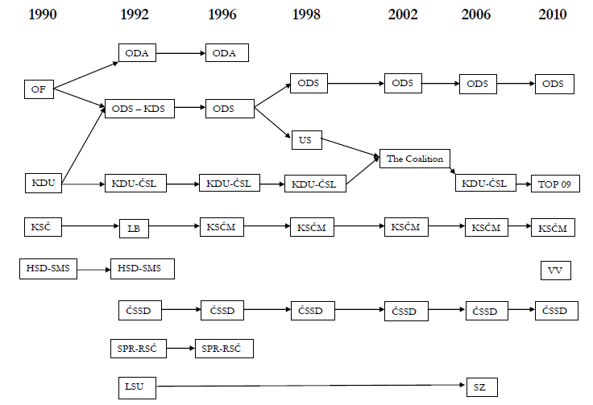

Slide 10
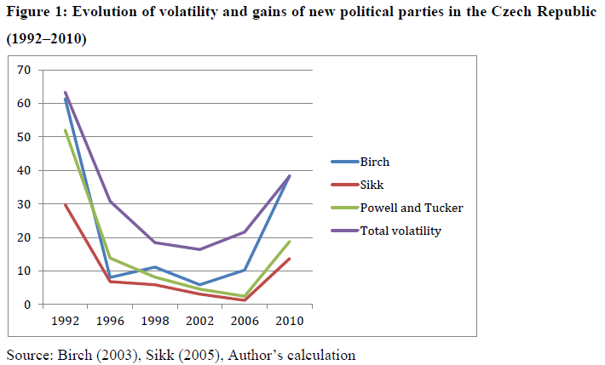
Volatility and the success of new political parties

Slide 11
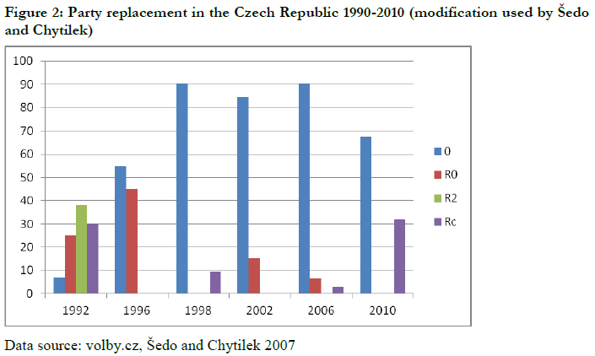
Parliamentary party replacement

Slide 12
Party system stability in CZE – a systemic approach
„the system of interactions resulting from inter-party competition“ (Sartori 1976)
A party system change occurs „when a party system is transformed from one class or type of party system into another“ (Mair 1997: 51-52)
A stable party system = stable and predictable patterns of party competition
How to measure these patterns?
Cabinets composition? Polarity? Polarization?

Slide 13
Cabinets formation and patterns of party competition in the Czech Republic
Since 1998 – the absence of clear, predictable government alternatives:
The position of KSČM – very limited coalition potential, unprobable but not impossible cooperation of left political parties, determinates interactions among the rest of the parties
Pivotal position of KDU-ČSL (participation in both right-centre and left-centre cabinets)
„Opposition agreement“ and after 2006 elections bargaining – (possible) cooperation of the two major rival parties
Uncertainty related to (quasi)new political parties – SZ (2006) and VV (2010) – presence of new actors contributes to uncertainty and unpredictability of the patterns of competition
Variability of (possible) real coalition options - instability of the Czech party system

Slide 14
Conclusion
Stable parties and unstable party system in the Czech Republic – necessary to distinguish between parties stability and party system stability
Unstable parties due to the recent electoral earthquakes
Dominant unidimensional competition (supplemented by some other relevant issues)
Unstable party system – lack of well-established patterns of conflicts and cooperation
Roots of low stability:
Character of parties (mostly top-down institutions)
Atmosphere in society
Economic turbulence
Quality of political representation

