Slide 1
Political parties and the party system

Slide 2
The end of communism
Renescence of political pluralismu
„Small Bill on Political Parties“ – recognition of some political parties
Number of new political parties:
Already existing (OF, KSČ, ČSL)
Renewned (ČSSD)
Genuinely new (SZ, ODA, SPR-RSČ,…)

Slide 3
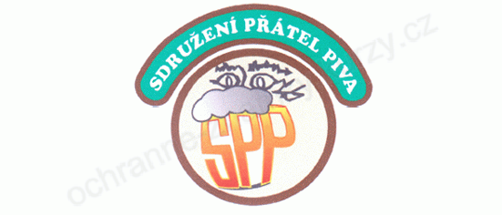

Joke parties
Friends of Beer Party
Independent Erotic Initiative

Slide 4
The 1990 general election
Struggle over the character of the régime
Clear victory of OF
Legitimity of KSČ confirmed
Number of new parties elected

Slide 5
Development of political parties in a nutshell
1991 – breakup of OF and emergence of ODS, OH and ODA
1992 election won by ODS-KDS and formation of the centre-right cabinet (V. Klaus)
  Fragmentation of the parliament (LSU, HSD-SMS, ČSSD, SPR-RSČ, KSČ)
1996 – the electoral success of ČSSD; formation of the centre-right minority cabinet (V. Klaus)
Tendency to a bipolar pattern of competition BUT not repeated patterns of alteration (see later)
Four main parties established

Slide 6
OF and its effects on party system formation
Initially a very broad (anti-communist) movement
Conflict over the character of the movement (and politics)
Social-liberal Civic Movement
Conservative-liberal Civic Democratic Party
The role of political parties, civic society, attitude to economy…

Slide 7
The „Big Four“
Civic Democratic Party (ODS)
Conservative (values) liberal (economy), soft-Euroscepticism
Czech Social Democratic Party (ČSSD)
Left-centre in economic terms, split in value dimension, pro-European
Communist Party of Bohemia and Moravia (KSČM)
Unreformed, anti-capitalist, Eurosceptic, the issue of the past
Christian and Democratic Union – Czechoslovak People`s Party (KDU-ČSL)
Social-conservative party, religious values, economically in the centre, existence of internal disputes

Slide 8
Development of political parties in a nutshell
1997/8 – splitting of ODS and the emergence of Freedom Union (US)
1998-2002: reduction of the number of parliamentary parties, „opposition agreement“ (Coalition of Four project)
2002-2006: left-centre cabinets (ČSSD, KDU-ČSL, US-DEU)
2006 – parliamentary dissapearence of US-DEU, entry of the Green Party (SZ), centre-right-green cabinet
2009 – fall of the cabinet (a caretaker cabinet till 2010)
2010 – the rise of (quasi-)new parties TOP 09 and Public Affairs (VV), weakening of the two major parties, parliamentary departure of SZ and KDU-ČSL, centre-right cabinet

Slide 9
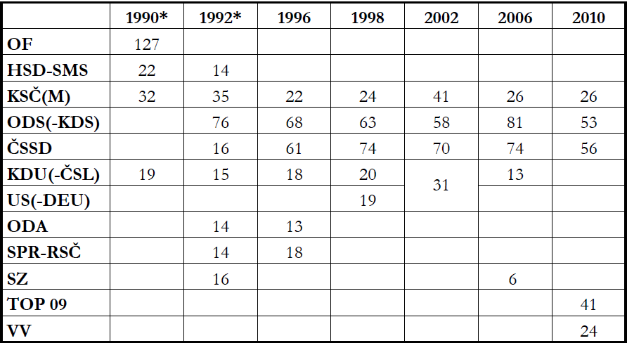
Electoral results (1990-2010, number of seats)
Data source: volby.cz, *Czech National Council election

Slide 10
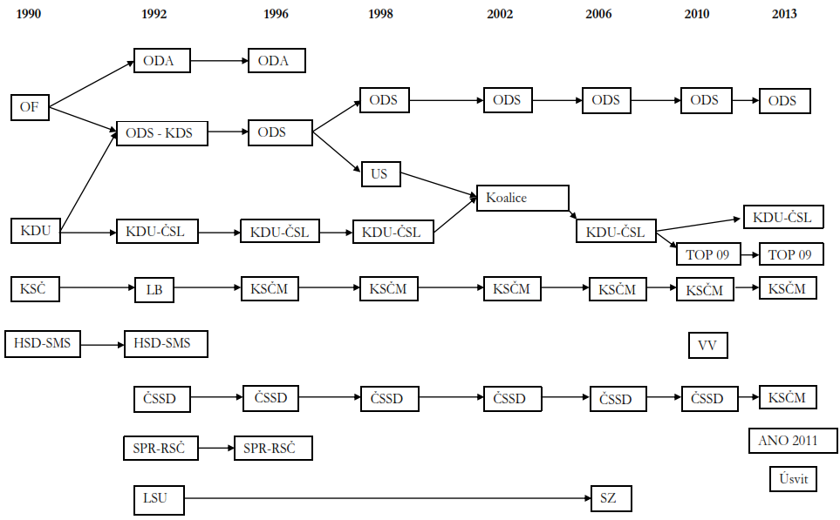

Slide 11
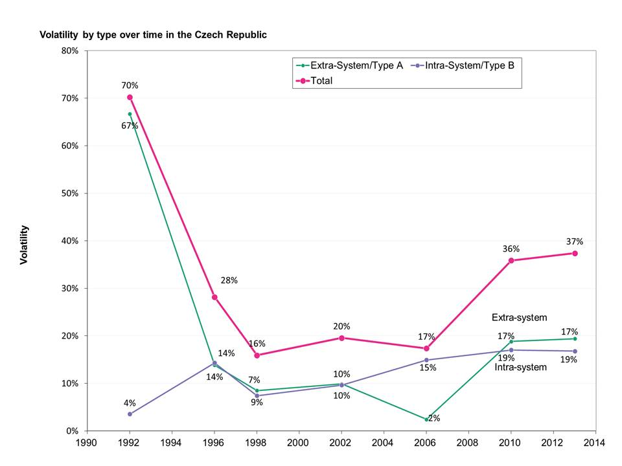
Zdroj: Haughton, Novotná, Deegan-Krause 2013

Slide 12
Party system stability in CZE – a systemic approach
„the system of interactions resulting from inter-party competition“ (Sartori 1976)
A party system change occurs „when a party system is transformed from one class or type of party system into another“ (Mair 1997: 51-52)
A stable party system = stable and predictable patterns of party competition
How to measure these patterns?
Cabinets composition? Polarity? Polarization?

Slide 13
Cabinets formation and patterns of party competition in the Czech Republic
Since 1998 – the absence of clear, predictable government alternatives:
The position of KSČM – very limited coalition potential, unprobable but not impossible cooperation of left political parties, determinates interactions among the rest of the parties
Pivotal position of KDU-ČSL (participation in both right-centre and left-centre cabinets)
„Opposition agreement“ and after 2006 elections bargaining – (possible) cooperation of the two major rival parties
Uncertainty related to (quasi)new political parties – SZ (2006) and VV, ANO, Úsvit (2010) – presence of new actors contributes to uncertainty and unpredictability of the patterns of competition
Variability of (possible) real coalition options - instability of the Czech party system

Slide 14
Conclusion
Stable parties and unstable party system in the Czech Republic – necessary to distinguish between parties stability and party system stability
Unstable parties due to the recent electoral earthquakes
Dominant unidimensional competition (supplemented by some other relevant issues)
Unstable party system – lack of well-established patterns of conflicts and cooperation
Roots of low stability:
  Character of parties (mostly top-down institutions)
  Atmosphere in society
  Economic turbulence
  Quality of political representation

