Slide 1
Party system in the Czech Republic II.
Voters and transformation of party politics

Slide 2
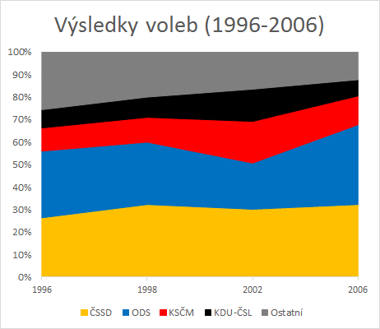
Electoral results (1996-2006)
Others

Slide 3
Stable cleavage structure
 | ČSSD |  |  |  |  |  |  | KSČM
 | 1996 | 1998 | 2002 | 2006 | 2010 | 2013 |  | 1996 | 1998 | 2002 | 2006 | 2010 | 2013
pensioners | 0.08 | 0.1 | 0.18 | 0.16 | 0.26 | 0.25 | pensioners | 0.19 | 0.16 | 0.19 | 0.14 | 0.11 | 0.11
high education | -0.11 | -0.17 | 0.07 | 0.03 | 0.02 | 0.05 | high education | -0.21 | -0.23 | -0.32 | -0.23 | -0.19 | -0.22
industry | 0.08 | 0.05 | -0.01 | 0.03 | 0.02 | 0.03 | industry | -0.03 | -0.04 | -0.05 | -0.04 | -0.02 | -0.03
unemployment | 0.33 | 0.24 | -0.07 | 0.07 | 0.06 | -0.05 | unemployment | -0.03 | 0.01 | 0.08 | 0 | 0.01 | 0.04
bussinesmen | -0.33 | -0.33 | -0.29 | -0.43 | -0.28 | -0.27 | bussinesmen | -0.18 | -0.19 | -0.19 | -0.16 | -0.07 | -0.12
catholics | 0 | 0 | 0.04 | 0.06 | 0.03 | 0.04 | catholics | -0.04 | -0.02 | -0.03 | -0.02 | 0 | -0.01
R² | 0.44 | 0.44 | 0.16 | 0.38 | 0.43 | 0.4 | R² | 0.25 | 0.31 | 0.43 | 0.38 | 0.37 | 0.45
 | ODS |  |  |  |  |  |  | KDU-ČSL
 | 1996 | 1998 | 2002 | 2006 | 2010 | 2013 |  | 1996 | 1998 | 2002 | 2006 | 2010 | 2013
pensioners | 0.1 | 0 | 0.02 | -0.03 | -0.02 | 0.01 | pensioners | 0.01 | 0.04 | 0.04 | -0.01 | -0.01 | -0.02
high education | 0.33 | 0.36 | 0.16 | 0.26 | 0.2 | 0.09 | high education | -0.09 | -0.11 | 0.15 | -0.01 | 0.05 | 0.09
industry | 0.02 | -0.01 | 0 | -0.02 | 0.06 | -0.01 | industry | -0.01 | -0.02 | -0.01 | 0 | 0.03 | 0.03
unemployment | -0.3 | -0.38 | -0.28 | -0.41 | -0.31 | -0.18 | unemployment | -0.21 | -0.22 | -0.21 | -0.13 | -0.02 | -0.07
bussinesmen | 0.44 | 0.53 | 0.4 | 0.7 | 0.4 | 0.15 | bussinesmen | 0 | -0.01 | 0.15 | 0.02 | -0.01 | 0
catholics | -0.05 | -0.09 | -0.07 | -0.1 | -0.04 | -0.02 | catholics | 0.26 | 0.24 | 0.18 | 0.2 | 0.14 | 0.16
R² | 0.56 | 0.76 | 0.69 | 0.77 | 0.67 | 0.63 | R² | 0.7 | 0.72 | 0.62 | 0.72 | 0.65 | 0.68

Slide 4
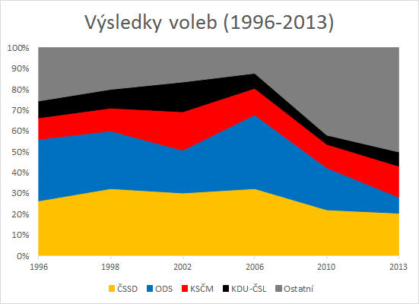
Electoral results (1996-2013)
Others

Slide 5
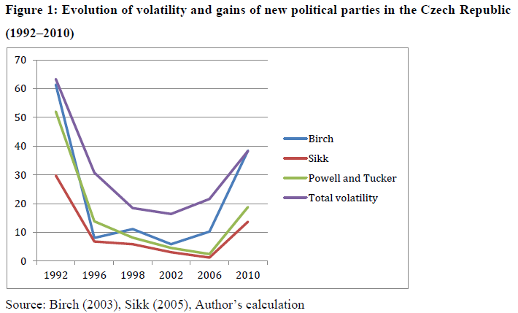
Volatility and the success of new political parties

Slide 6
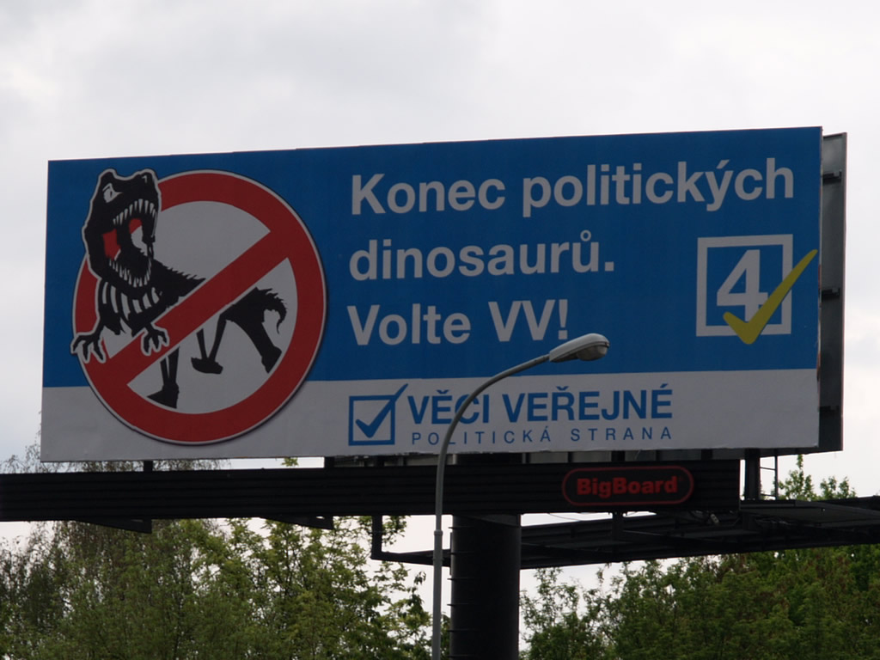
Public Affairs (VV)

Slide 7
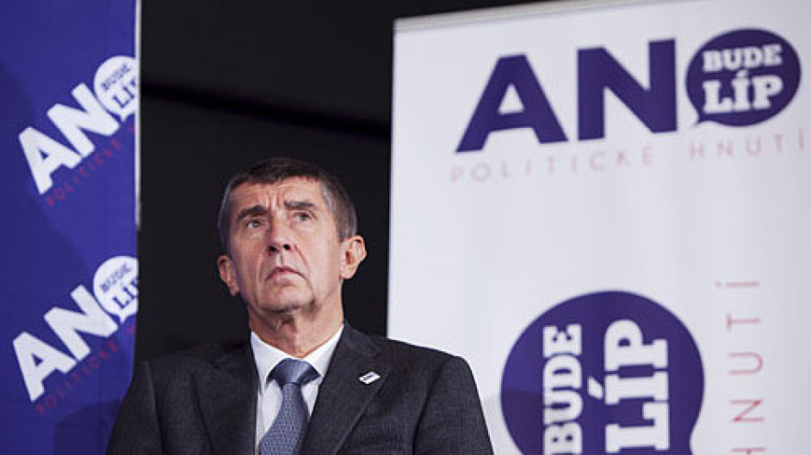
Action of Dissatisfied Citizens 2011 (ANO 2011)

Slide 8
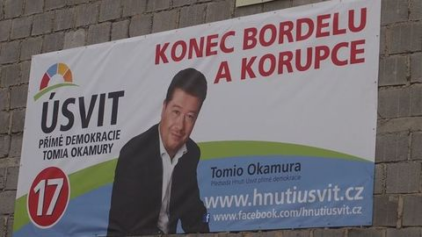
Tomio Okamura`s Dawn od Direct Democracy

Slide 9
Who are they?
Strong populist appeal
Lack of a clear host ideology
Solutions: direct democracy (VV, Dawn), managerial way of running the state (ANO 2011)
New/centrist populist parties (Pop Eleches 2010, Učeň 2008)

Slide 10
Political crisis and the rise of populist parties
Similar political context preceding both the 2010 and 2013 elections
Crises and eventually falls of weak(ened) Topolánek and Necas cabinet
Formation of „non-political“ (and popular) caretaker cabinets
2009 – cancelled early election
2013 – corruption affair of Prime Minister and head of his Office
Trust to the parliament and satisfaction with political situation falling off

Slide 11
Affiliation of voters
 | Time of electoral decision |  |  |  | Close to a party
 | 2006 | 2010 | 2013 |  | 2002 | 2006 | 2010 | 2013
Always + long time | 57.7 | 45.6 | 43.2 | Yes | 56 | 42.2 | 38.3 | 31.2
Last year - months | 18 | 21.7 | 16.5 | No | 34.7 | 53.4 | 58 | 65.8
Weeks - election day | 23.2 | 32.3 | 40.5 | DK | 9.3 | 4.4 | 3.7 | 3

Slide 12
Political cynicism
 | Voting can change something
 | 2006 | 2010 | 2013
Yes | 62.3 | 58.2 | 53.1
No | 15.6 | 19.6 | 20.3

Slide 13
Why should one vote for new parties?
H1: The effect of cleavage voting will be lower in explanation of voting for new centrist populist parties in comparison to voting for the established political parties.
H2: Voters who perceive corruption as a salient issue are more likely to vote for centrist populist parties.
H3: Voters who evaluate the state of economy negatively are more likely to vote for centrist populist parties.
H4: Voters who evaluate the future of economy negatively are more likely to vote for centrist populist parties.
H5: Voters with low satisfaction with democracy are more likely to vote for centrist populist parties.
H6: Voters who do not trust politicians are more likely to vote for centrist populist parties.
H7: Voters who position themselves in the centre of political space are more likely to vote for centrist populist parties.
H8: Voters who perceive centrist populist parties more competent to solve the most salient political issues are more likely to vote for them in comparison to other political parties.

Slide 14
Results I.
Cartograms and correlations:
  TOP 09: concentrated electoral support similar to ODS and SZ
  VV: dispersed, weak positive correlation with ODS
  ANO: dispersed, medium positive correlation with ODS, TOP 09 and VV
  The Dawn: dispersed, very limited similarity to the established parties
Pearson | ČSSD 2006 | KDU-ČSL 2006 | KSČM 2006 | ODS 2006 | SZ 2006
TOP 09 2010 | -0,2 | 0 | -0,33 | 0,6 | 0,3
VV 2010 | 0 | -0,01 | -0,19 | 0,21 | 0,15
 | ČSSD 2010 | ODS 2010 | TOP 09 2010 | KSČM 2010 | KDU-ČSL 2010 | VV 2010
ANO 2013 | -0,12 | 0,32 | 0,32 | -0,19 | -0,14 | 0,27
The Dawn 2013 | 0 | -0,03 | -0,03 | -0,05 | 0,07 | 0,18

Slide 15
Results I.
Cartograms and correlations:
  TOP 09: concentrated electoral support similar to ODS and SZ
  VV: dispersed, weak positive correlation with ODS
  ANO: dispersed, medium positive correlation with ODS, TOP 09 and VV
  The Dawn: dispersed, very limited similarity to the established parties
Pearson | ČSSD 2006 | KDU-ČSL 2006 | KSČM 2006 | ODS 2006 | SZ 2006
TOP 09 2010 | -0,2 | 0 | -0,33 | 0,6 | 0,3
VV 2010 | 0 | -0,01 | -0,19 | 0,21 | 0,15
 | ČSSD 2010 | ODS 2010 | TOP 09 2010 | KSČM 2010 | KDU-ČSL 2010 | VV 2010
ANO 2013 | -0,12 | 0,32 | 0,32 | -0,19 | -0,14 | 0,27
The Dawn 2013 | 0 | -0,03 | -0,03 | -0,05 | 0,07 | 0,18

Slide 19
Results – model fit
 | 2006 | 2010 | 2013 | evolution
class | 0.41 | 0.34 | 0.36 | ↓
values | 0.56 | 0.47 | 0.43 | ↓
position | 0.14 | 0.11 | 0.15
satisfaction | 0.44 | 0.35 |  | ↓
cynism |  | 0.18 | 0.09
issue and valence | 0.12 | 0.19 | 0.32 | ↑
economic voting | 0.16 |  | 0.10 | ↓

Slide 20
H1: The effect of cleavage voting will be lower in explanation of voting for new centrist populist parties in comparison to voting for the established political parties.
  √
H6: Voters who do not trust politicians are more likely to vote for centrist populist parties.
±
H7: Voters who position themselves in the centre of political space are more likely to vote for centrist populist parties.
√
H8: Voters who perceive centrist populist parties more competent to solve the most salient political issues are more likely to vote for them in comparison to other political parties.
√

Slide 21
H2: Voters who perceive corruption as a salient issue are more likely to vote for centrist populist parties.
  X
H3: Voters who evaluate the state of economy negatively are more likely to vote for centrist populist parties.
X
H4: Voters who evaluate the future of economy negatively are more likely to vote for centrist populist parties.
X
H5: Voters with low satisfaction with democracy are more likely to vote for centrist populist parties.
X

Slide 22
Conclusion
General patterns of voting have changed
Differences between the established and the new populist parties in several ways:
Socio-structural and value based model X new populists
Political cynicism/dissatisfaction – Dawn
Valence voting
Prospective economic voting
Generally weakening of voters affiliation + cleavage voting

